Slide 2
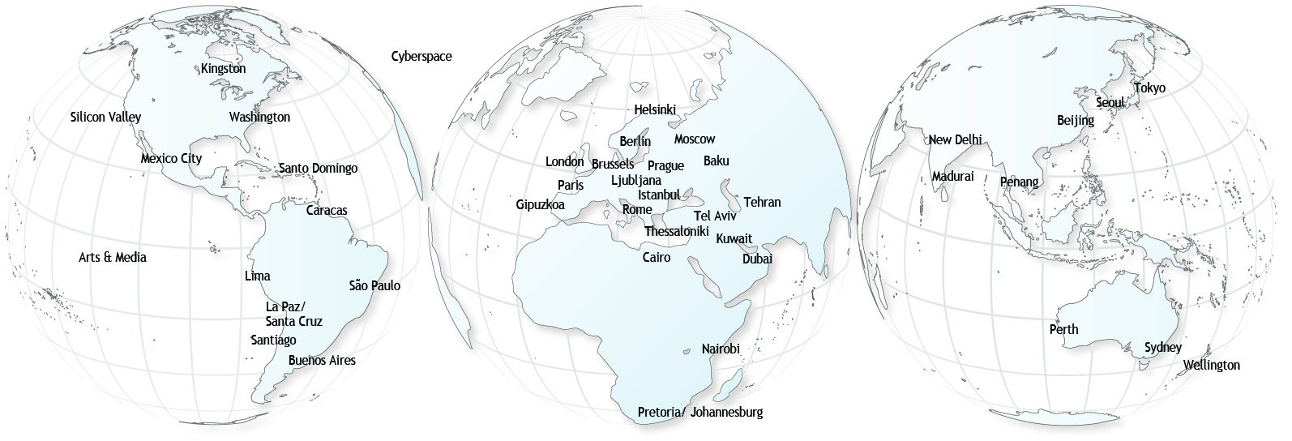
^{40 Millennium Project Nodes...} are groups of experts and institutions that connect global and local views in:
Nodes identify participants, translate questionnaires and reports, and conduct interviews, special research, workshops, symposiums, and advanced training.

Slide 3
An overview of the human condition and prospects for the future … picking 3,000 minds around the word

Slide 4
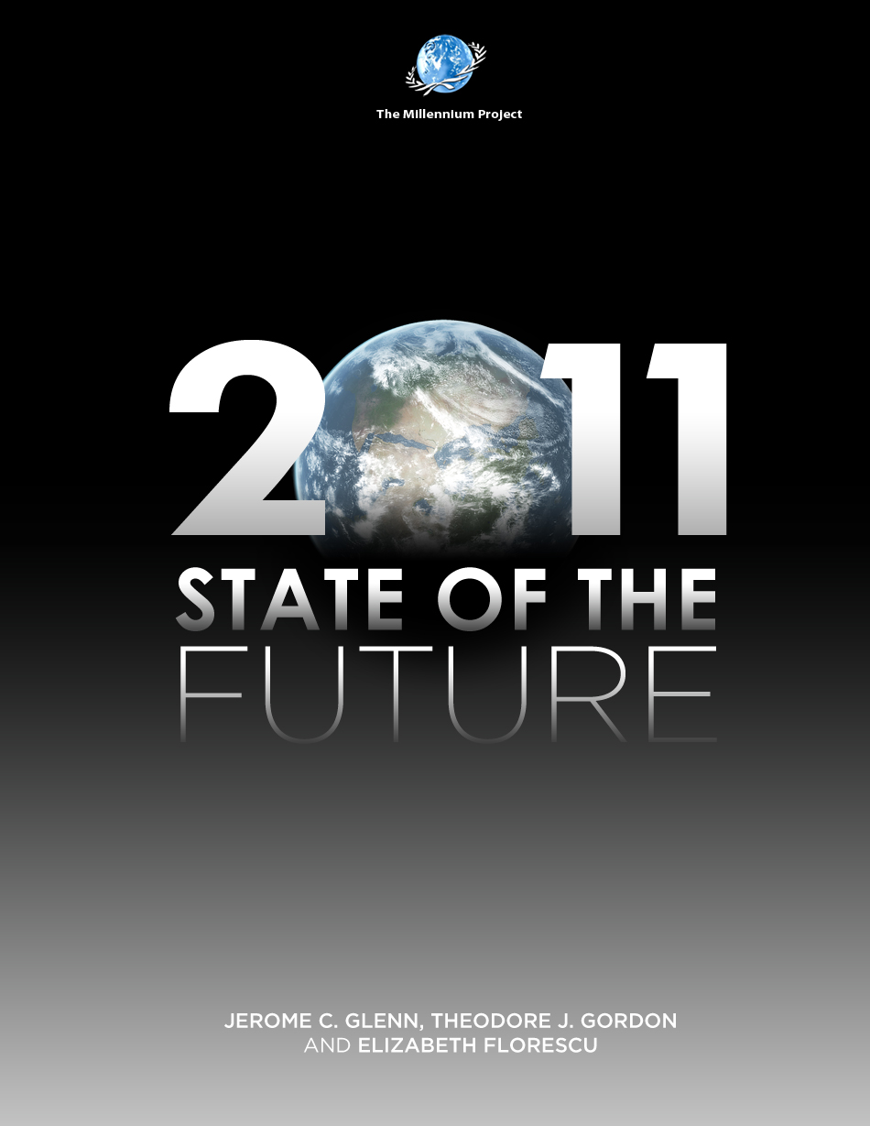
The Millennium Project’s 15th Anniversary
Annual Report Card
on the Future
Global Challenges
State of the Future Index
Egypt 2020
Future Arts/Media 2020
Latin America 2030
Environmental Security
Other Futures Research
Plus 8,000-page CD

Slide 5
World Report Card
Where we are winning
Improved water source (% of population access)
Literacy rate, adult total (% of people ages 15+
School enrollment, secondary (% gross)
Poverty headcount ratio at $1.25 a day (PPP) (% of population in least developed countries)
Population growth (annual %) (A drop is seen as good for some countries, bad for others)
GDP per capita (constant 2000 US$)
Physicians (per 1,000 people)
Internet users (per 100 people)
Mortality rate, infant (per 1,000 live births)
Life expectancy at birth, total (years)
Proportion of seats held by women in national parliaments (%)
GDP per unit of energy
Major Armed Conflicts deaths >1,000
Food availability (cal/cap)
Where there is little change
Prevalence of HIV, total (% of pop. ages 15-49)
Homicide Rate
R & D expenditure (% of GDP)
Where we are losing:
CO2 emissions (kt)
Global Surface Temperature Anomalies
People Voting in Elections (% population of voting age- 15 largest countries)
Unemployment, total (% of total labor force)
Fossil fuel energy consumption (% of total)
Levels of Corruption (15 largest countries)
People killed or injured in terrorist attacks (number)
Refugee population by country or territory of asylum
Where there is uncertainty
Countries having or thought to have plans for nuclear weapons (number)
Population in Countries that are Free (percent of total global population)
Forest area (% of land area)
Total debt service (% of GNI) low and mid income
Number of emerging and reemerging infectious diseases

Slide 6
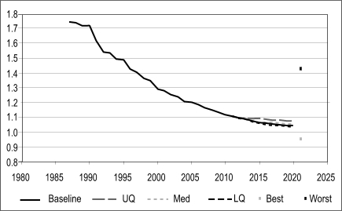
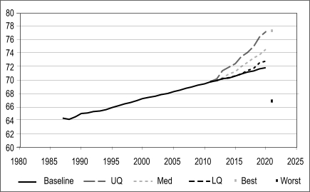
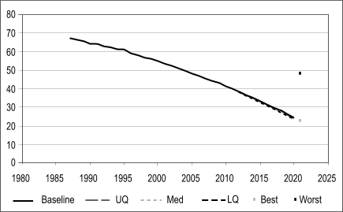
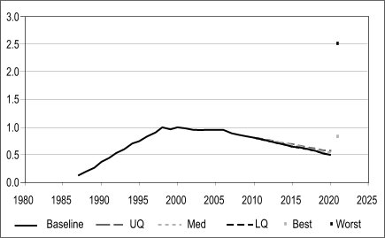
Some projections using SOFI methodology
Population growth (annual percent)
Life expectancy at birth (years)
Infant mortality (deaths per 1,000 births)
Prevalence of HIV (% of pop age 15-49)

Slide 7
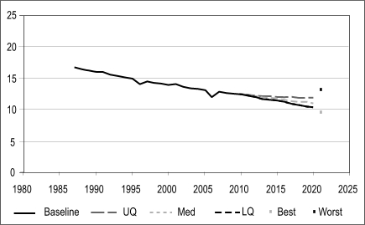
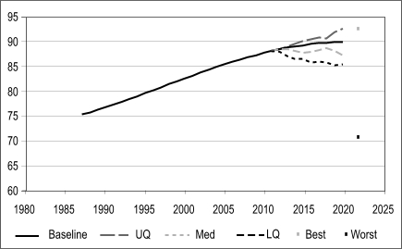
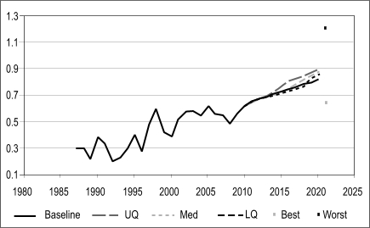
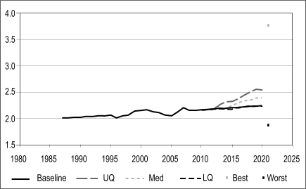
Some projections using SOFI methodology (cont.)
Undernourishment (percent of population)
Improved water source (% pop. with access)
Global surface temperature anomalies
R&D expenditures (% of national budget)

Slide 8
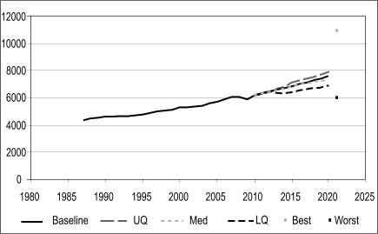
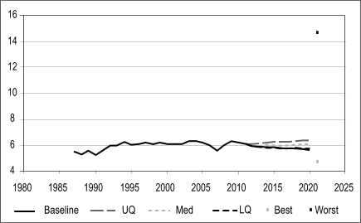
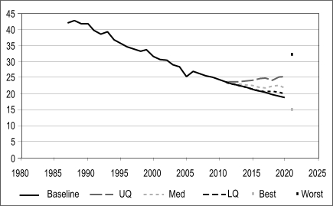
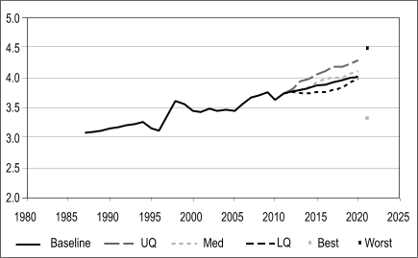
Some projections using SOFI methodology (cont.)
GDP per capita (constant 2000 US$)
Unemployment, total (% total labor force)
Poverty headcount ratio at $1.25 a day (PPP) (% of population) (low- and mid-income ctries)
Levels of corruption (15 largest countries) (larger numbers = less corruption)

Slide 9
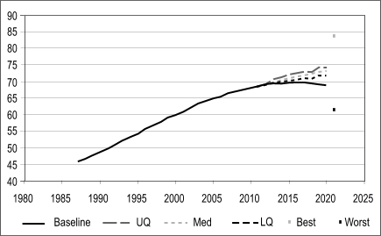
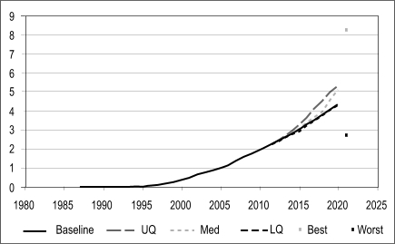
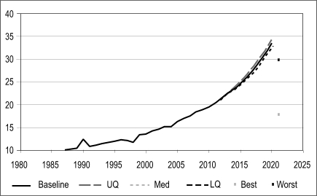
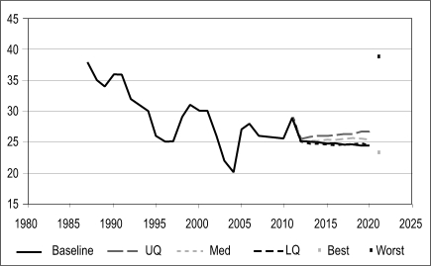
Some projections using SOFI methodology (cont.)
School enrollment, secondary (% gross)
Internet users (billion people)
Women in parliaments (% of all members)
Number of major armed conflicts (deaths >1,000)

Slide 10
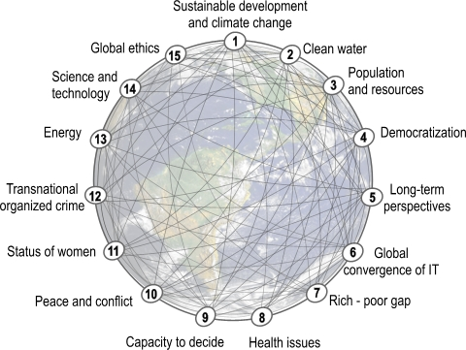
15 Global Challenges
#1 is no more important than #15. This global agenda is a system: improving any improves others; reducing any reduces the others

Slide 11
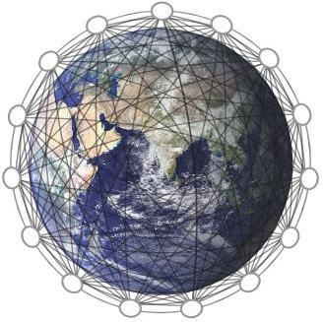
15 Global Challenges–the Agenda today
How can sustainable development be achieved for all while addressing global climate change?
1
How can sustainable development be achieved for all while addressing global climate change?
How can everyone have sufficient clean water without conflict?
2
How can everyone have sufficient clean water without conflict?
How can ethical considerations become more routinely incorporated into global decisions?
15
How can ethical considerations become more routinely incorporated into global decisions?
3
How can population growth and resources be brought into balance?
How can population growth and resources be brought into balance?
How can genuine democracy emerge from authoritarian regimes?
How can scientific and technological breakthroughs be accelerated to improve the human condition?
4
14
How can genuine democracy emerge from authoritarian regimes?
How can scientific and technological breakthroughs be accelerated to improve the human condition?
How can policymaking be made more sensitive to global long-term perspectives?
5
How can growing energy demands be met safely and efficiently?
How can policymaking be made more sensitive to global long-term perspectives?
13
How can growing energy demands be met safely and efficiently?
How can transnational organized crime networks be stopped from becoming more powerful and sophisticated global enterprises?
How can the global convergence of information and communications technologies work for everyone?
6
12
How can transnational organized crime networks be stopped from becoming more powerful and sophisticated global enterprises?
How can the global convergence of information and communications technologies work for everyone?
How can the changing status of women improve the human condition?
How can ethical market economies be encouraged to help reduce the gap between rich and poor?
11
How can the changing status of women improve the human condition?
7
How can ethical market economies be encouraged to help reduce the gap between rich and poor?
How can shared values and new security strategies reduce ethnic conflicts, terrorism, and the use of weapons of mass destruction?
10
How can shared values and new security strategies reduce ethnic conflicts, terrorism, and the use of weapons of mass destruction?
8
How can the threat of new and reemerging diseases and immune microorganisms be reduced?
How can the threat of new and reemerging diseases and immune microorganisms be reduced?
How can the capacity to decide be improved as the nature of work and institutions change?
How can the capacity to decide be improved as the nature of work and institutions change?
9
Notes:
11

Slide 12
Prices are going up…
Food
Energy
Water

Slide 13
High Food Prices – Long-Term
population growth
rising affluence especially India & China
diversion of corn for biofuels
soil erosion
aquifer depletion
the loss of cropland
falling water tables and water pollution
Increasing fertilizer costs (high oil prices)
Market speculation
diversion of water from rural to urban
Increasing meat consumption
global food reserves at 25-year lows
climate change
Increasing droughts
Increasing flooding
Melting mountain glaciers reducing water flows
And eventually saltwater invading crop lands

Slide 14
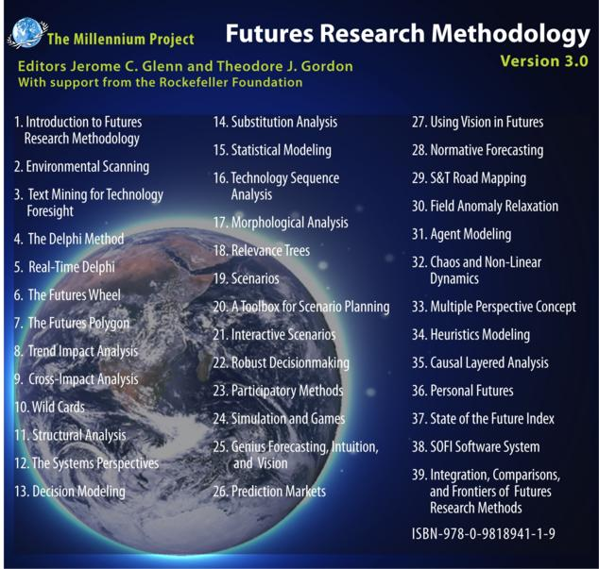
39 Chapters
1,300 pages
Largest collection of
Internationally peer-reviewed methods to explore the future ever assembled in one source

Slide 16
For further information
Jerome C. Glenn
The Millennium Project
4421 Garrison Street, NW,
Washington, D.C. 20016 USA
+1-202-686-5179 phone/fax
JGLENN@IGC.ORG
www.StateoftheFuture.org

