Slide 1
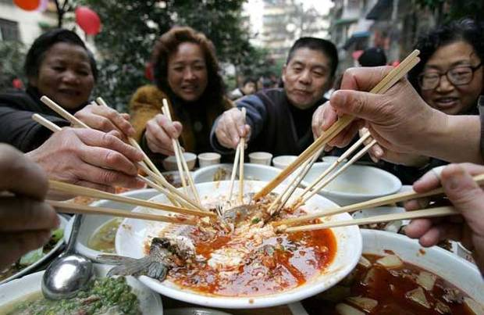
What China’s Growing Appetite Means for U.S. Agriculture
July 27, 2015
Susan Chan Shifflett
Wilson Center
Notes:
How China’s rising demand for food is transforming U.S. agriculture sector – from U.S. agribusiness, food companies – down to what it means for an individual U.S. farmer.

Slide 2
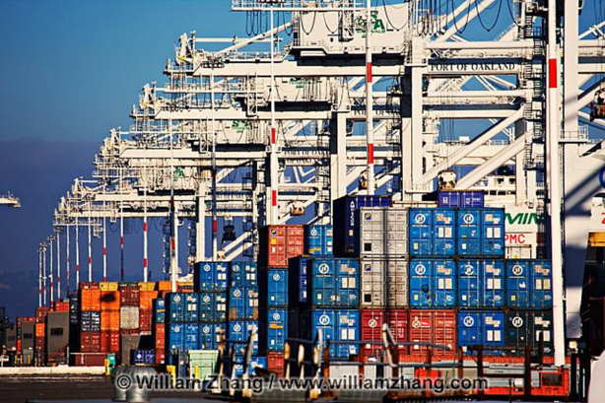
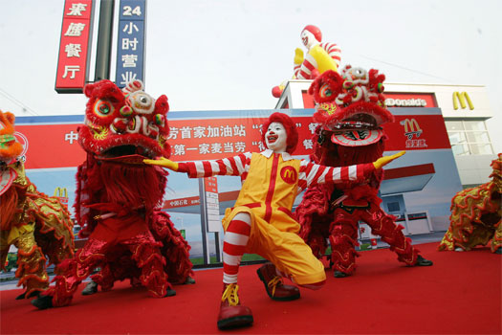
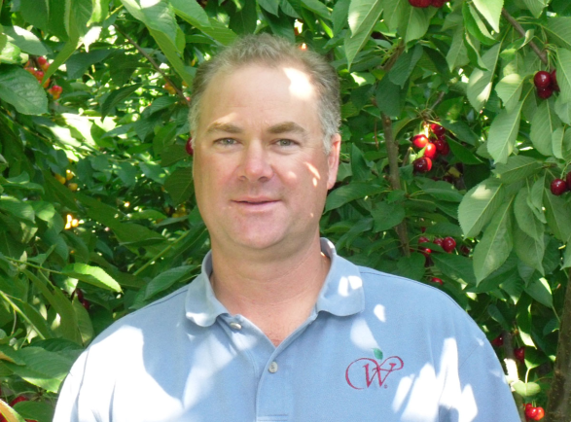
Outline
1. U.S. agriculture exports to China
2. Drivers of Chinese demand for U.S. agricultural products
3. Opportunities and Challenges for U.S. Agriculture

Slide 3
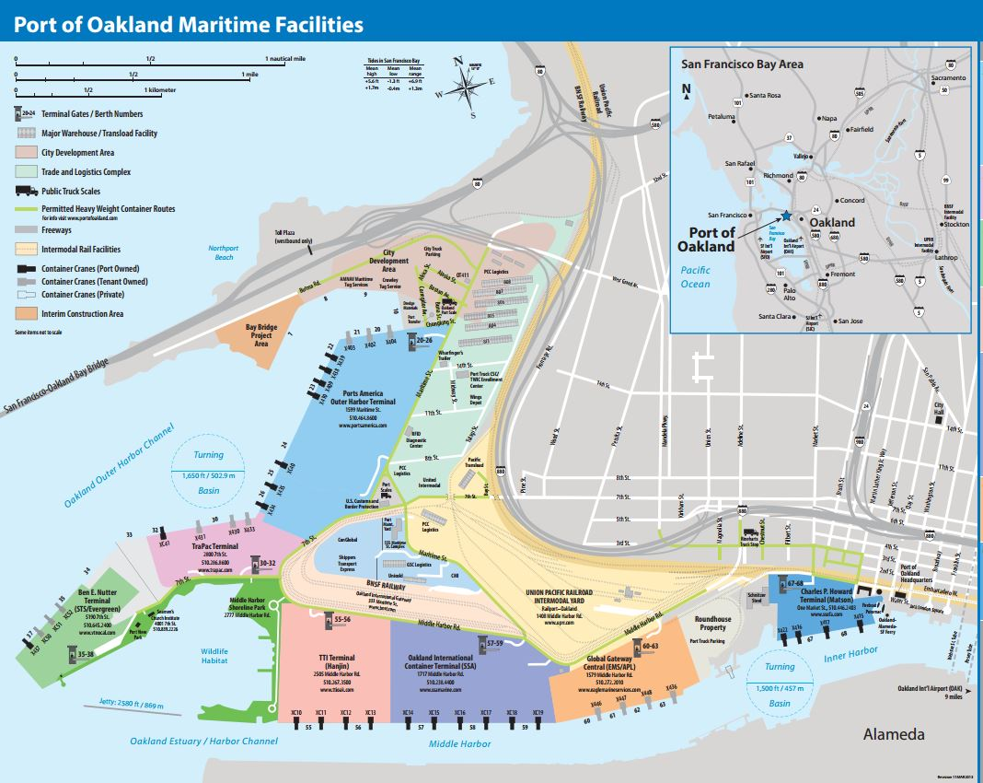

1. Cold chain storage
2. Grain transload operation
Source: Port of Oakland
Notes:
Last month I went to the Port of Oakland. How best to measure China’s rising demand for food than going to one of the key ports where the corn, the wheat, the apples, the soybeans are being shipped to China.
Capital River Group
“Massive and cannot be overstated.”

Slide 4
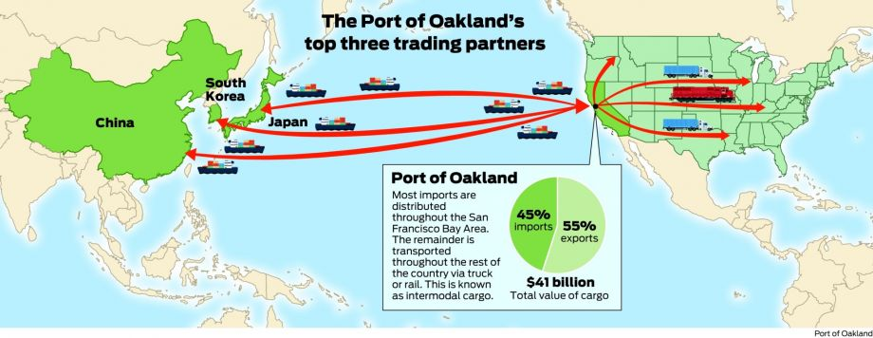
Port of Oakland’s Top 3 Trading Partners
Notes:
2 trends to look at: total and net

Slide 5
Statistics
U.S. agricultural sales to China doubled during 2004-08 and doubled again during 2008-12.
China is the largest overseas market for U.S. farm products (up from number four in 2008)
Notes:
U.S. agricultural sales to China doubled during 2004-08 and doubled again during 2008-12, reaching nearly $26 billion in annual sales – a tenfold increase from the late 1990s.
China has overtaken Japan, Mexico, and Canada to become the leading export market for U.S. agricultural products

Slide 6
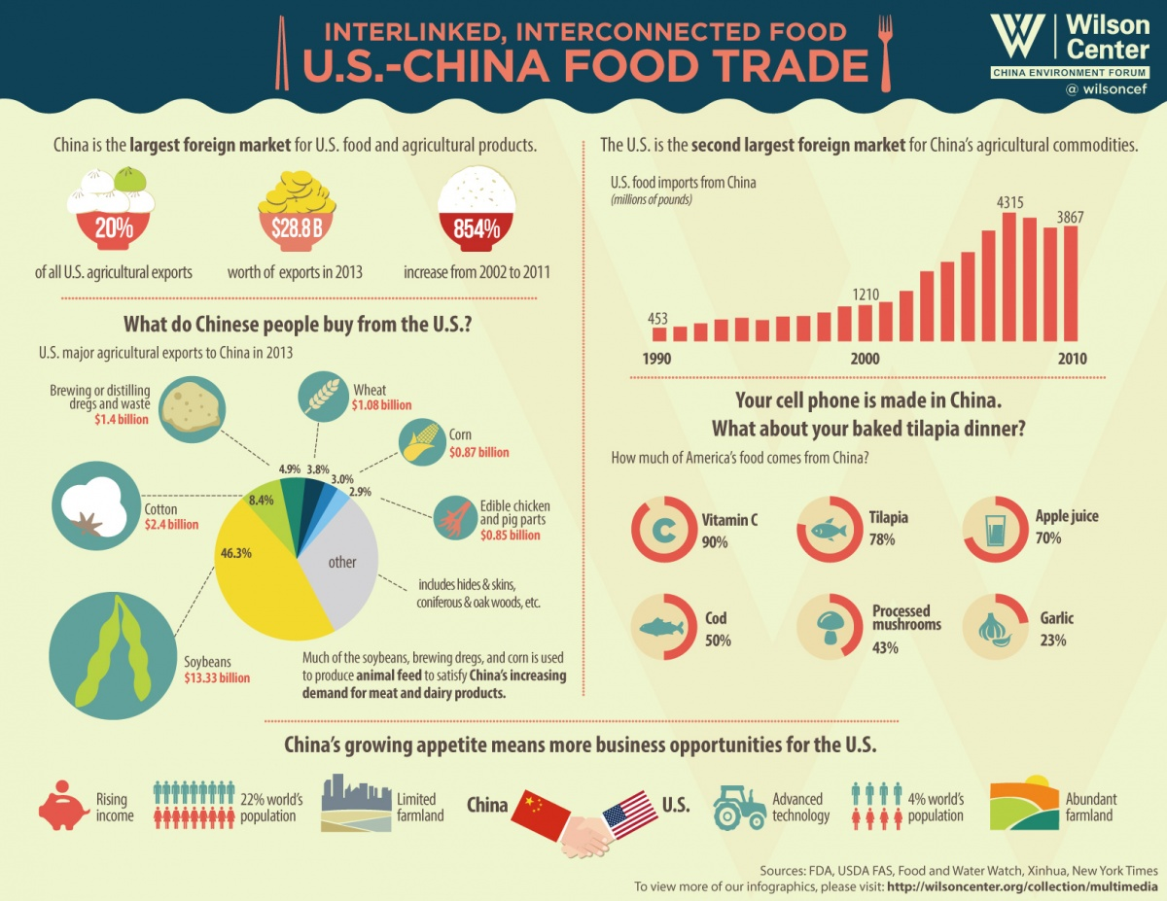
Notes:
Why soybeans so big?
Relatively land intensive
Chinese eating more meat

Slide 7
Soybeans are the largest U.S. export of any type to China
(11% of the value of all U.S. exports to China)

Slide 8
What’s Driving This?
1. Limited farmland
(China 0.08 vs. U.S. 0.49 hectares per person)
2. Rising incomes → Rising demand for meat
Direct meat imports from U.S.
Soybean
3. Western tastes
4. Safer food

Slide 9
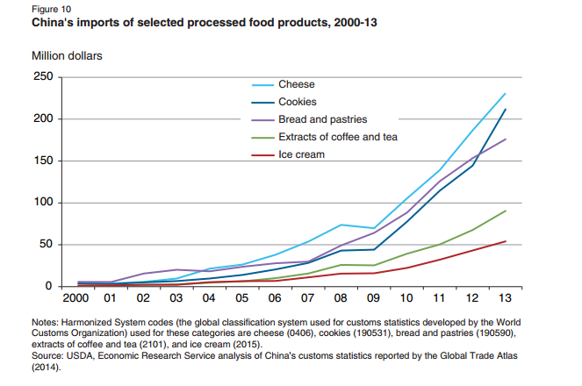
Trend: Western Tastes

Slide 10
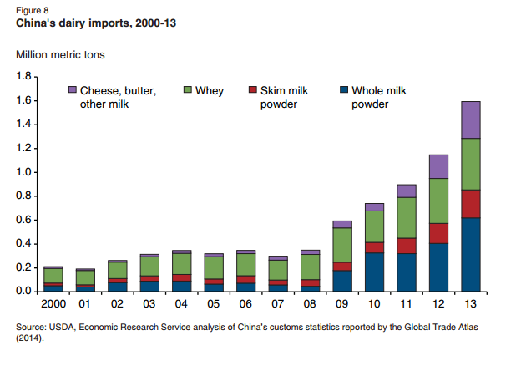
Trend: Demand for Safer Food
2008 melamine milk scandal

Slide 11
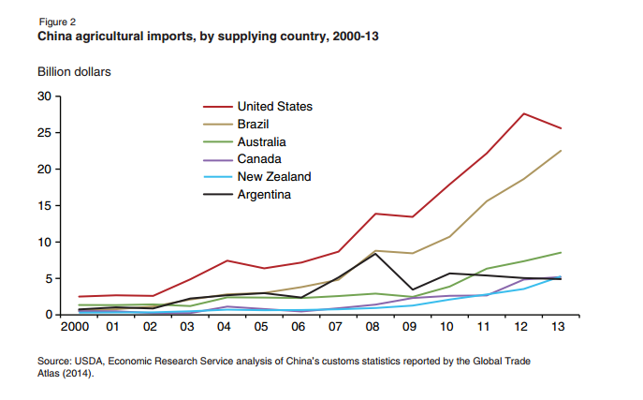
Opportunities for U.S. Agriculture

Slide 12
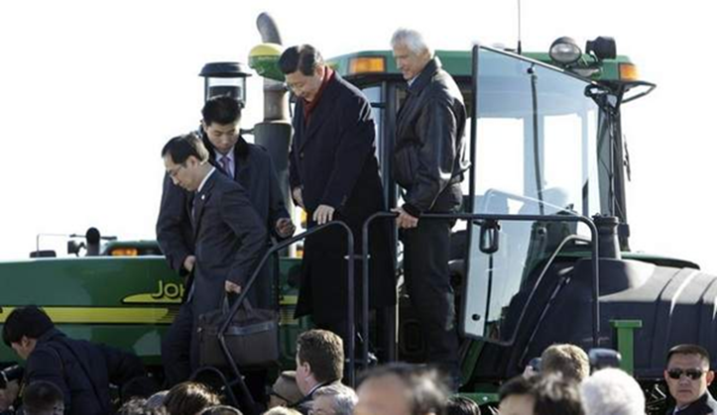
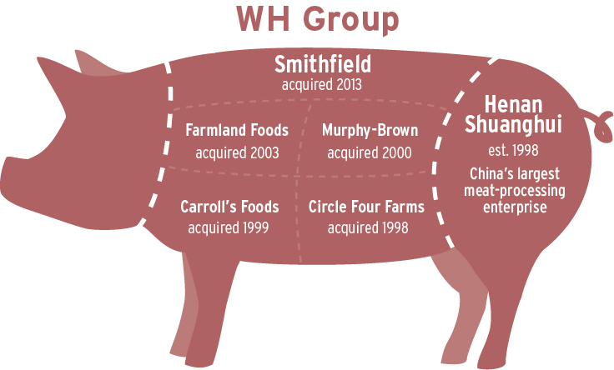
Notes:
China has the largest market for agricultural machinery in the world.

Slide 13

Challenges for U.S. Agriculture
Foreign firms audited more often, or at least that is the perception
Differing phytosanitary standards
China’s policies change based on self-sufficiency goals

Slide 14

Who is this?
Notes:
Alibaba has been likened to Amazon, it’s an e-commerce platform for business to business, consumer to consumer, business to consumer sales.
“In the middle of apple harvest.”
Peter’s family started growing in Washington State in the 1930s and he is the third generation that has worked on the family farm. He has worked on the farm his whole life, on the original land that his grandfather and his brother had purchased.

Slide 15
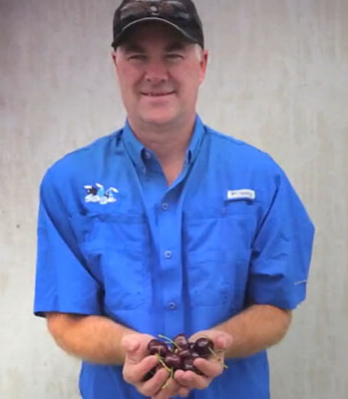
Peter Verbrugge’s Opportunities
Growing middle class to buy “our products positioned on the higher-end of retail scale over there.”
Product differentiation – Fuji apples
“The food safety component. They know they can trust U.S. products as much as you can trust any product you put in your mouth.”
Notes:
. “when I’ve tasted their fruit, it just tastes different (flavor isn’t anywhere near ours).”

Slide 16
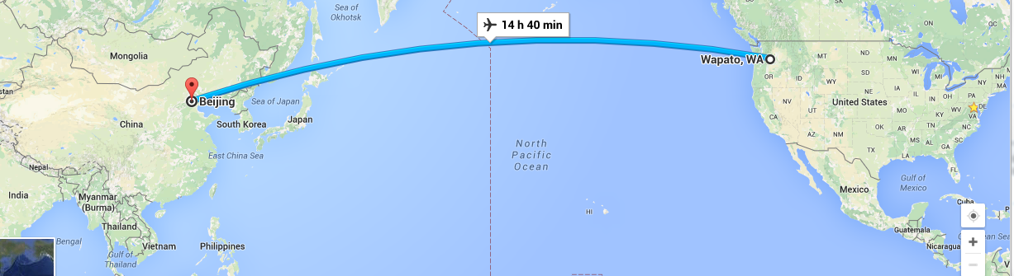
Peter Verbrugge’s Challenges
Logistics: 56-72 hours from tree to consumer
Culture and positioning: “Understanding where my product is positioned and why.”
Slowing Chinese economy - before there was “cherry bubble”
Notes:
Navigating the intricacies and blind spots is also important.

Slide 17
Thank you!
susan.shifflett@wilsoncenter.org

