Slide 1
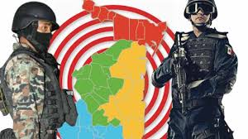
The State of Security in Mexico
The case of Tamaulipas
The New Dynamics of the once "Forgotten Border"
Guadalupe Correa-Cabrera
WWICS
Washington, DC
February 3, 2017

Slide 2
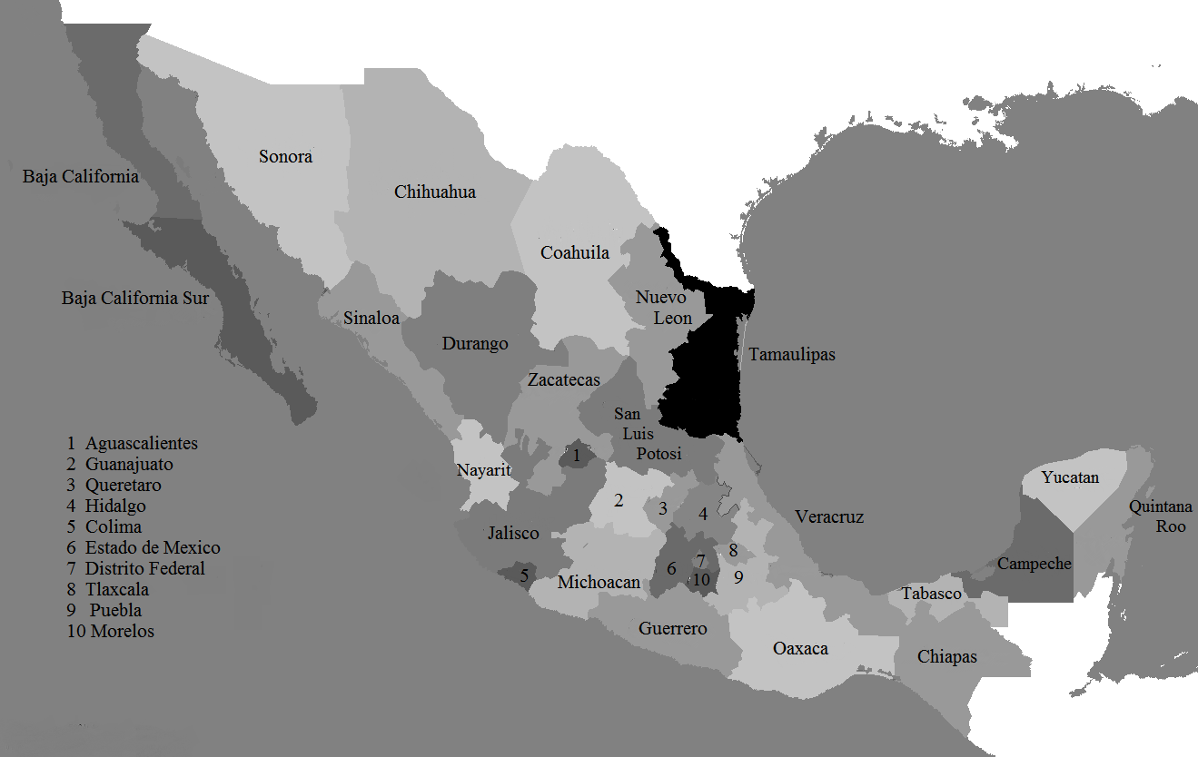
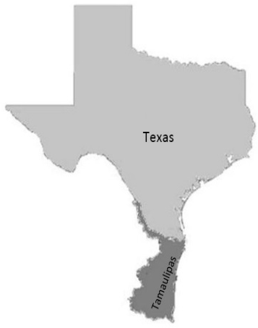
Tamaulipas-Texas: The once “Forgotten Border”

Slide 3
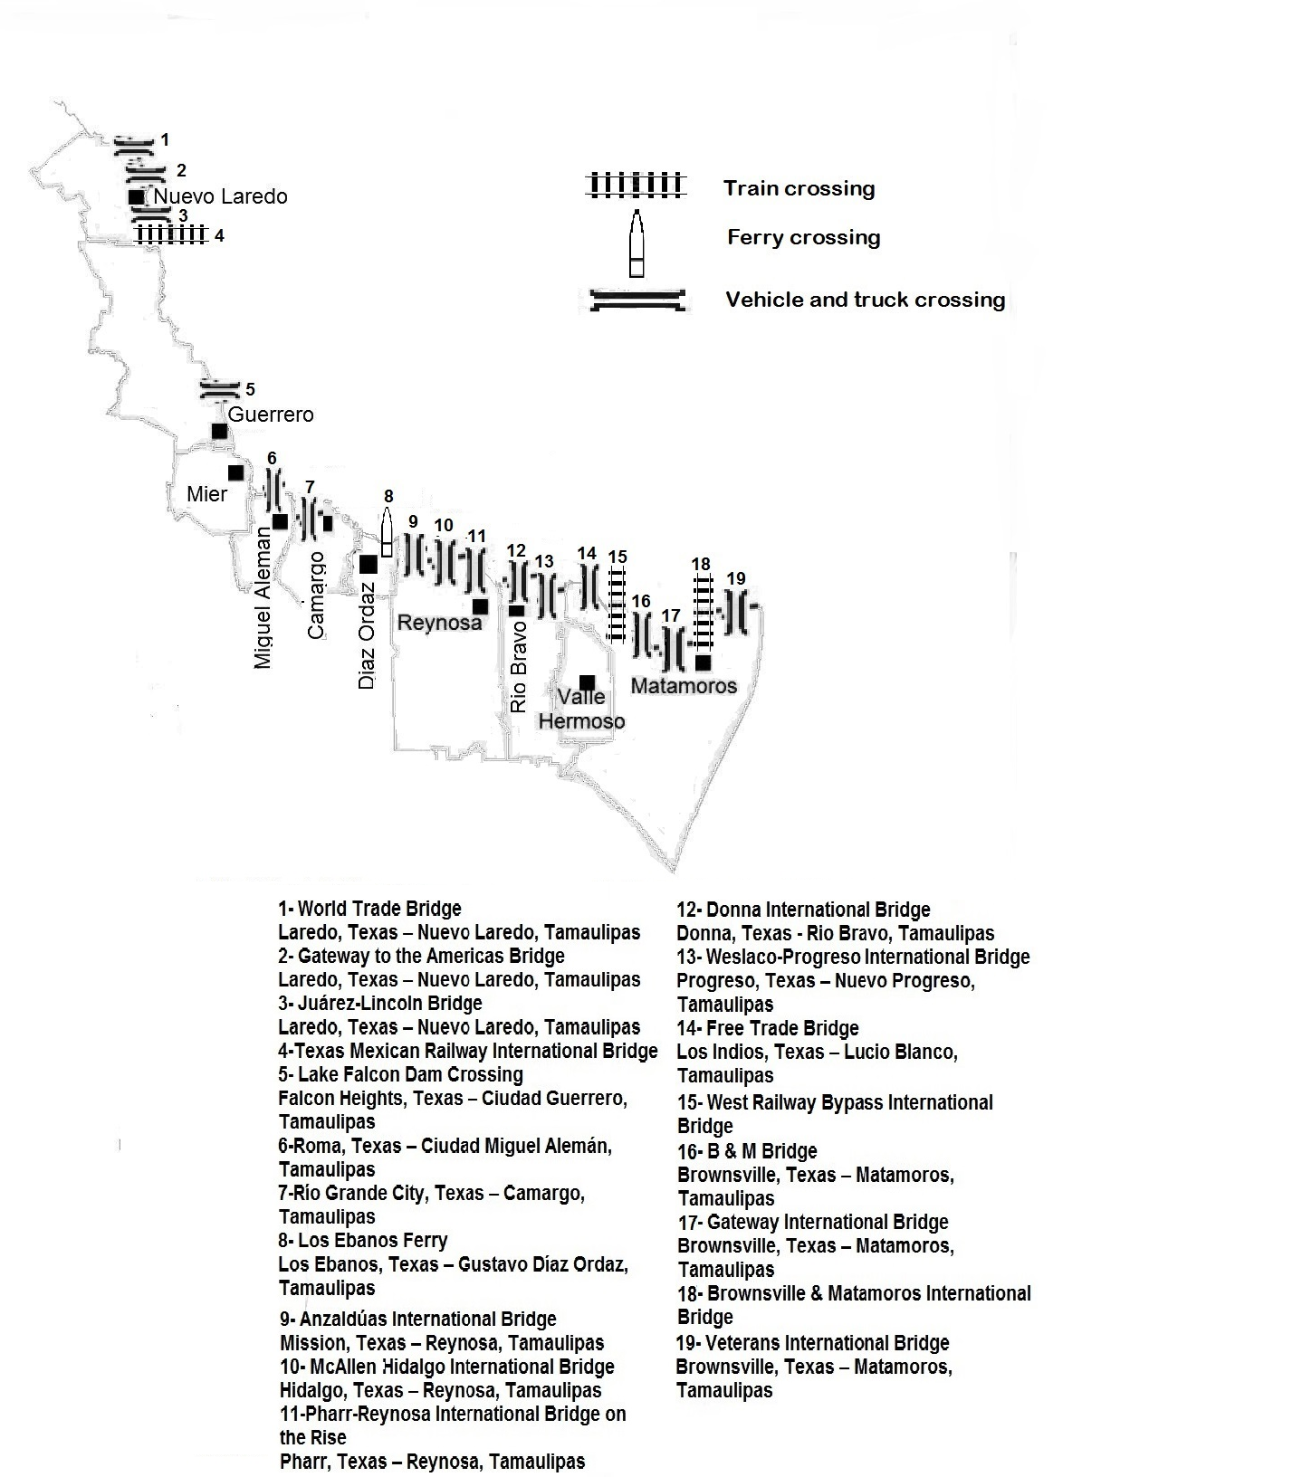

Slide 4
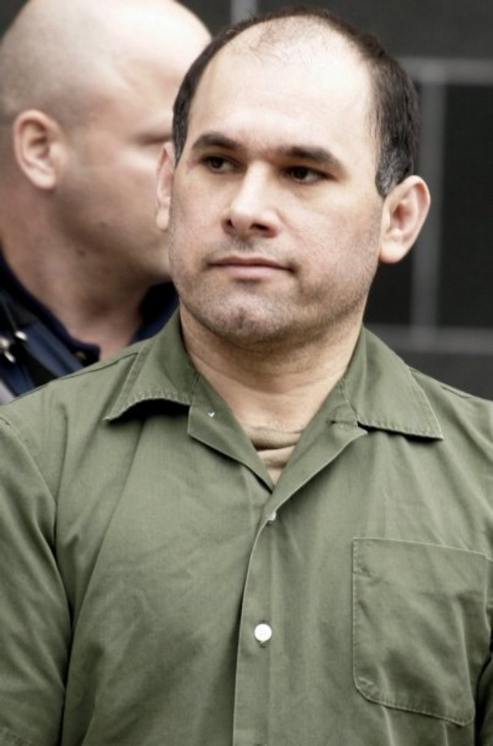


The Zetas and the new configuration of organized crime in Mexico

Slide 5
Actors and levels of conflict
CDG
Zetas
GOM
vs.
vs.
4. CDG vs. CDG & Zetas vs. Zetas
2010-2016

Slide 7
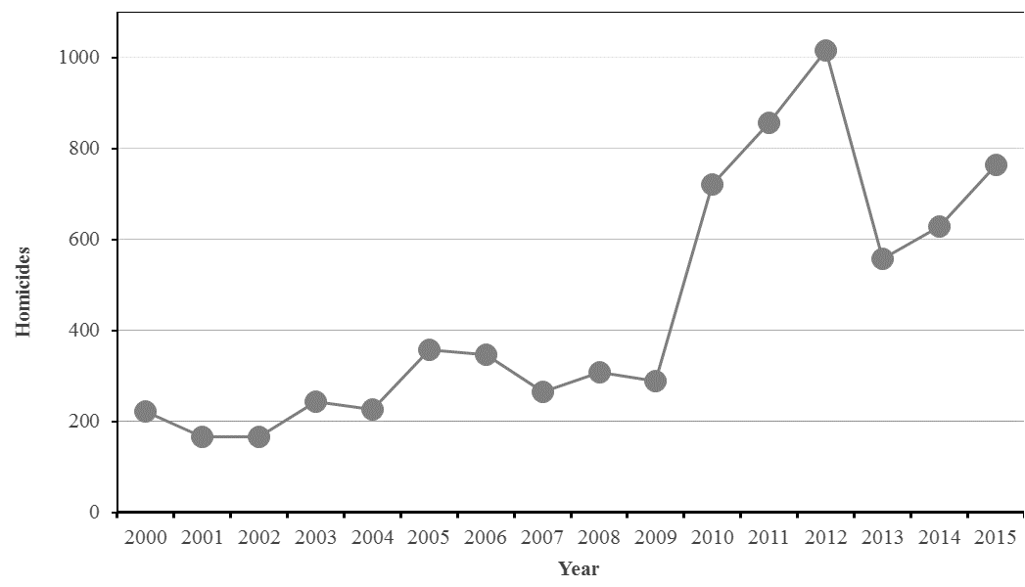
Homicides en Tamaulipas (2000-2015)

Slide 8
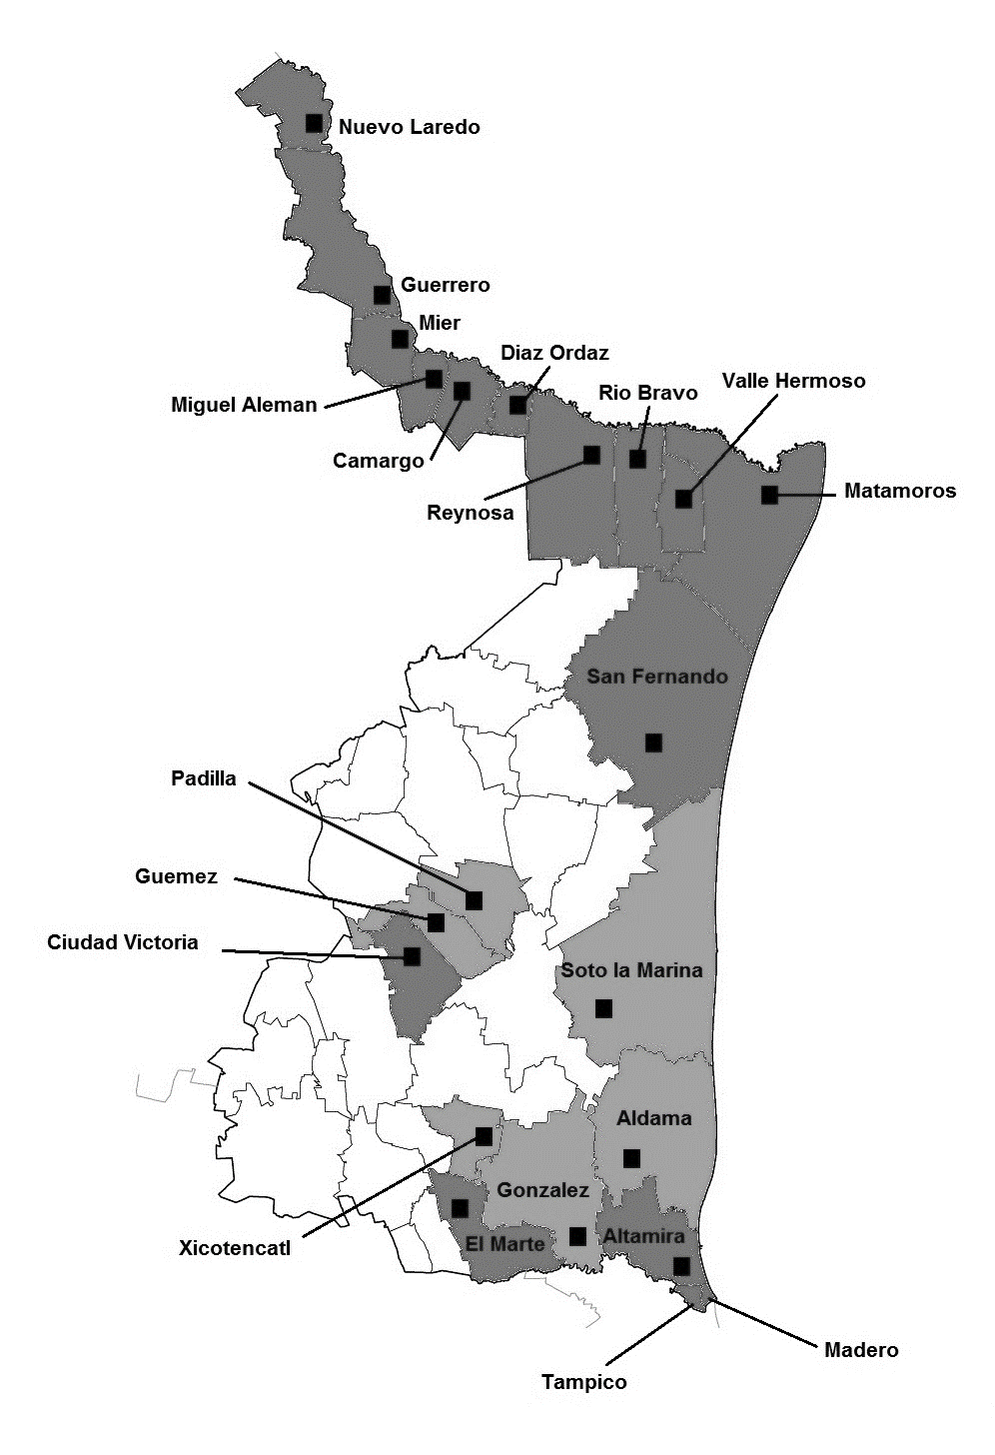
Violence in Tamaulipas

Slide 9
Tamaulipas Today
Elections June 5, 2016: Francisco Javier García Cabeza de Vaca (PAN)
Cartels’ factions
Reduction in levels of violence
Coordination between federal forces and state authorities
Pax Mafiosa
¿Vuelve la paz a Tamaulipas?

Slide 10
Cartels’ factions in Tamaulipas
CDG Matamoros Group (Matamoros, Valle Hermoso, San Fernando)
CDG Reynosa Group (Río Bravo, Reynosa and La Ribereña
CDG Tampico
Cartel del Noreste
Zetas Vieja Escuela
Los Renegados w/ Vieja Escuela
Coahuila – Cartel del Noreste

Slide 11
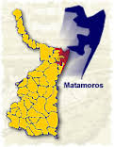

Matamoros

Slide 12
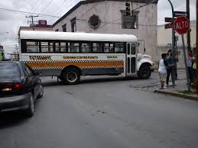
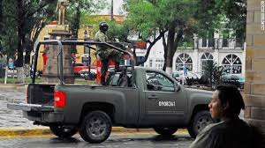
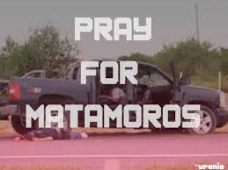
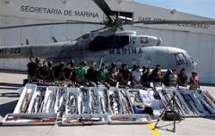
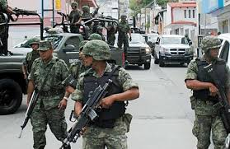
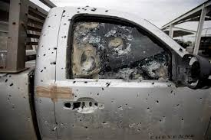
Violence in Matamoros

Slide 13
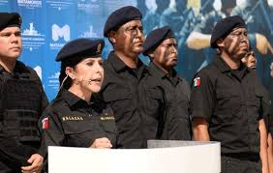
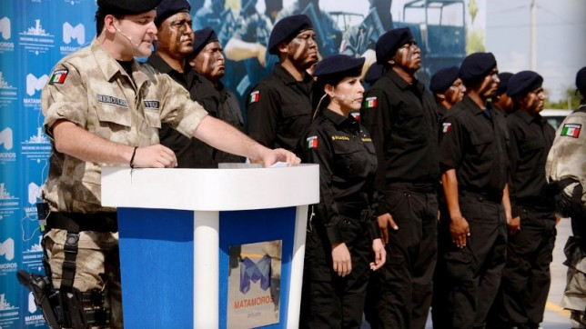
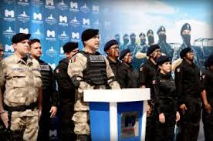
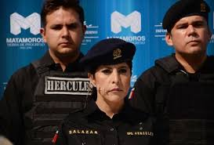
Paramilitarism in Matamoros: The “Hércules” Group

