Slide 1
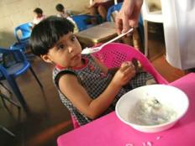
Mycotoxins as a Challenge to Agriculture and Food Security in Developing Countries Rob Bertram, Bureau for Food Security February 14 2012
Notes:
Address plant health
Build food safety into the productivity research agenda
Field-ready diagnostics is an area -

Slide 2
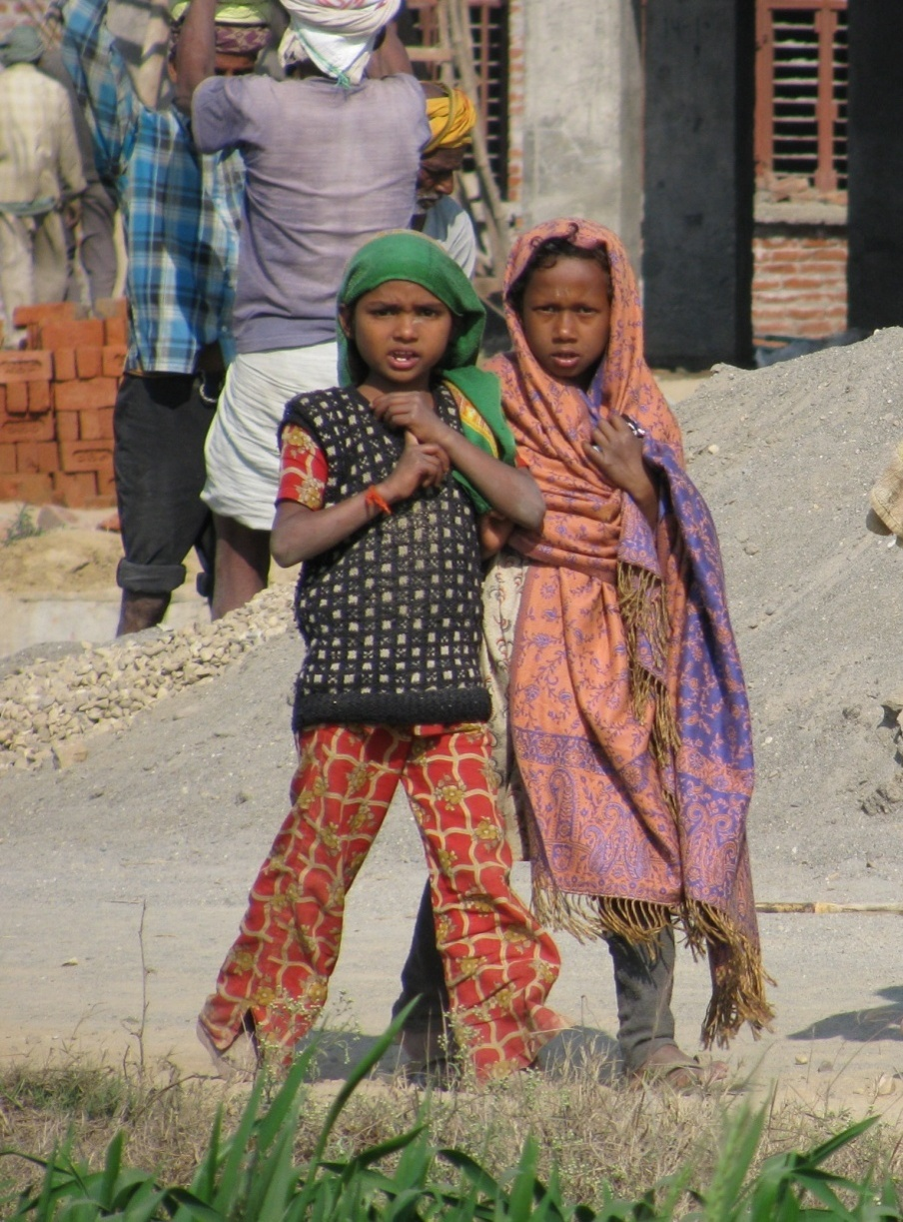
The Global Challenge
Climate change already impacting yields - drought, high temperatures and unpredictable climates
As arable land is lost to urbanization and other uses, we need to produce more food on less land
Water, energy, labor and fertilizer availability constraining production
System diversification and intensification needed to improve nutrition, incomes
Notes:
High Food Prices: Poor households in the developing world spend 60-80 percent of their incomes on food

Slide 3
Global Food Prices
Source: FAO
Notes:
High Food Prices: Poor households in the developing world spend 60-80 percent of their incomes on food

Slide 4
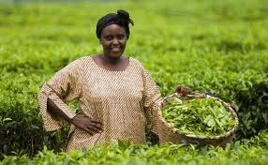
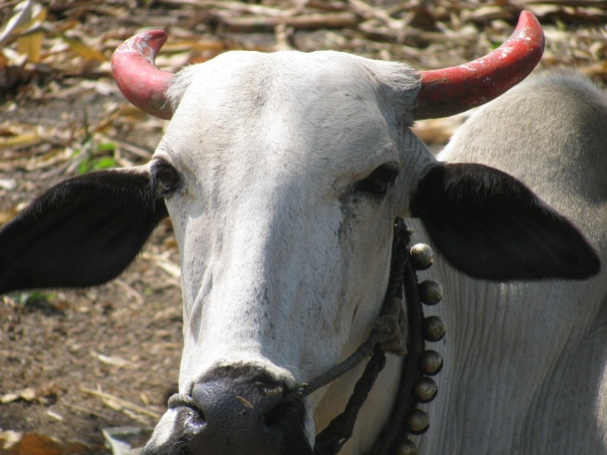
USG Response: Feed the Future
Help farmers produce more
Help farmers get more food to market
Support Research & Development to improve smallholder agriculture in a changing climate
Strengthen Regional Trade
Create a better Policy Environment
Improve Access to Nutritious Food and Nutrition Services
Notes:
OUR Response: FTF – links to value chain work at Mission level
Recognition of AR4D as integral component

Slide 5
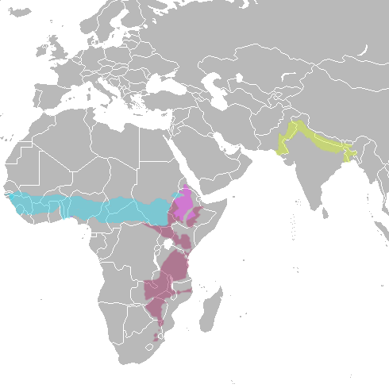
FTF Research Strategy
Overarching Goal Emerged: Sustainable Intensification
Three research themes:
Advancing the productivity frontier
Transforming key production systems
Improving nutrition and food safety
Anchored by key geographies:
Indo-gangetic plains in South Asia
Sudano-sahelien systems in West Africa
Maize-mixed systems in East and Southern Africa
Ethiopian highlands
Notes:
This process led to the identification of the overarching goal – sustainably intensifying production in key agro-ecologies.
Strategy relies on integrating component technologies – leading to Advancing the Productivity Frontier

Slide 6
Food Security Research Priorities
Longer-term Research - Major Themes
1. Heat and drought tolerant, climate adapted cereals
2. Advanced technology solutions for animal and plant diseases
3. Legume productivity for improved nutrition and incomes
South Asia Indo-Gangetic Plains
Maize-mixed East & Southern Africa
Ethiopian Highlands
Ghana
Ethiopia
Bangladesh
Tanzania
Sudano-Sahelian West Africa
Application of Advanced Research for Productivity and Resilience
- Policy, social science and nutrition research (e.g. utilization of food)
- Increased availability and access to high quality foods for improved diets (animal sourced food, horticulture, aflatoxin control)
Longer-Term Investments Near-Term Impact
Sustainable Intensification of Key Production Systems
Complement Mission investments in select value chains
Integrate component technologies, policies, social sciences, nutrition
Notes:
NOTE MIDDLE SECTION – Aflatoxin and nutrition are key themes in there.

Slide 7
Food Security Innovation Center
Leads USAID’s implementation of the FTF Research Strategy
Integrated, portfolio-based management across seven priority program themes
Encourages a multi-disciplinary approach, better linkages among related projects, cross-project learning and management efficiencies
Engages U.S. universities, international research centers, private sector, local agricultural research and educational institutions, think tanks

Slide 8
Food Security Innovation Center Program Areas
Program for Sustainable Intensification (e.g., CSISA, Africa RISING, SANREM Innovation Lab)
Program for Climate Resilient Cereals (e.g., Cereals RFA, DTMA, WEMA, CGIAR Rice, Wheat, Maize, Sorghum/Millet programs.)
Program for Advanced Research on Animal and Plant Diseases (e.g., Livestock and Climate Change Innovation Lab, Virus Resistant Cassava)
Program for Legume Productivity (e.g., Dry Grain Pulses Innovation Lab, Peanut Innovation lab, CGIAR Legumes Program)
Program for Safe & Nutritious Foods (e.g., Nutrition Innovation Labs (Africa/Asia), Aflatoxin under NBCRI, Horticulture Innovation Lab, AVRDC
Program for Policy Research & Support (e.g., Program for Biosafety Systems (PBS), Enabling Agricultural Trade, AMA Innovation Lab)
Program for Human & Institutional Capacity Development (e.g., MEAS, InnovATE, AWARD, LEAP)
Notes:
The FSIC supports seven interlinked research and capacity programs aimed at sustainably transforming agricultural production systems, ensuring access to nutritious and safe foods, creating enabling and supportive policies and addressing the emerging challenges of climate change and natural resource scarcity.

Slide 9
Program for Legume
Productivity
Program for Research on Nutritious and Safe Foods
Cross-cutting issues between two Program Areas
Peanut research in Legumes program overlaps with mycotoxin in Nutrition Program area
Aflatoxin research investments on peanuts and other commodities
Solutions:
Cross-cutting research on mycotoxin reduction on-farm
and through post-harvest technologies and approaches
Nutrition research examines interactions among
environmental conditions and food systems issues
Capitalize on strengthening private sector post harvest
handling and food safety.
Example Projects Addressing Mycotoxins
NBCRI-USDA/ARS
Peanut & Mycotoxins Innovation Lab
Venganza RNAi technology
CRP 4 – Ag for Nutrition and Health
Nutrition Innovation Lab – Uganda
Notes:
Private sector collaborations – biotech approaches to food safety (mycotoxin control) and reduced pesticide use
Additional investments through NBCRI-USDA/ARS breeding for aflatoxin resistance in maize, etc.
Nutrition Innovation Lab – Uganda: examining relationships between aflatoxin in food supply, exposure in children and mothers, and outcomes of stunting

Slide 10
Mycotoxins – Cross-cutting, complex
Requires multi-faceted solutions
Distinct challenges for implementing solutions in each national context
Productivity gains (esp. in cereals and legumes) will be diminished by mycotoxin presence (acute toxicity) and decreased nutritional performance (blockage of micronutient uptake, enteropathy, etc.)
Notes:
Challenges of known solutions to aflatoxin reduction:
Leave grain in field to dry down before harvest – concerns of theft
Poor regulatory enforcement
No price premium in the market
Difficulty distinguishing contaminated materials from clean

Slide 11
Research along the value chain Tackling multiple entry-points of mycotoxin contamination
On-farm productivity research
Breeding
Postharvest handling/Marketing research
Economics of:
Utilization research
Developing new mycotoxin reduction/elimination techniques during processing
Alternative value chains for contaminated material
Agronomy
Harvest practices
Storage
End-user market opportunities/quality requirements
Crop Protection/bio-control
Technology adoption research
Storage/drying technologies & strategies
Policy agenda:
Regulatory harmonization - tolerance levels across countries
Regulatory reform – cross-border usage of bio-control strains
Policy harmonization on contaminated stock disposal
Notes:
Both biophysical and social science research are required to understand the potential for technology adoption – to ensure solutions are realistic and viable in the local/national context
From input markets/policies to on-farm technology adoption issues.
Research along the value chain is critical to ensure technology adoption
All researchers must consider upstream and downstream research/outputs/context simultaneously to improve the utility of technology and knowledge developed
On-farm productivity research includes:
Social sciences research to understand technology adoption issues
Labor, general resource allocation considerations IN CONCERT with technology development in breeding, agronomy and crop protection
Marketing research requires understanding of the economics of:
Harvest practices (e.g. labor availability, tarps/equipment, other requirements)
Storage capacity: communal vs on-farm, duration of storage needs relative to market opportunities
End-user market opportunities – linked with utilization research to connect potential market opportunities with processing capacity
Utilization:
Development of new products or processes can help increase market demand
Addressing nutrition goals with food technology and recipe formulation = AVRDC working with recipe development for African indigenous vegetables
Hort CRSP – sweet potato complementary food recipes in Uganda to increase utilization.

Slide 12
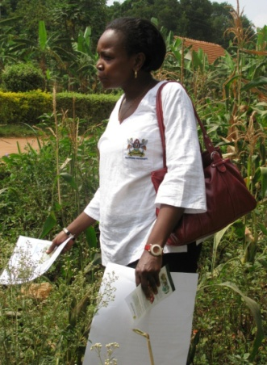
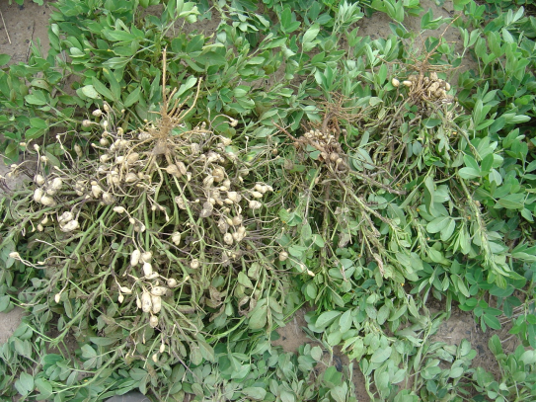
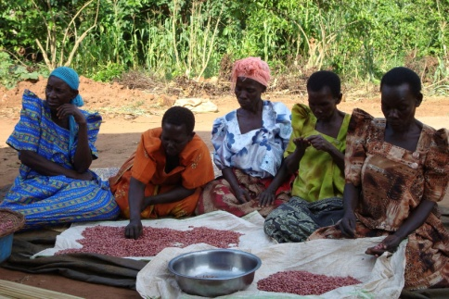
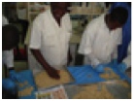
Mycotoxin Reduction Research Along the Value Chain
Crop management
Post-harvest handling
Breeding
Processing
Economics of :
Storage
Drying
Market Dynamics
Variety trials
on station/on farm
Field-level
diagnostics; use
of atoxigenic
strains
Detection/elimination technologies
Notes:
Research includes:
Genomics/breeding resistant varieties, RNAi technology, Field Diagnostics
Technology adoption research
Objectives: taking technology to scale – what are scalable solutions to this challenge?

Slide 13
Upstream research approach
Private sector partnership with public sector to move innovation approach to crops of significance to smallholder producers
RNA interference technology
Effective in vitro against A. flavus
Silences essential gene(s) expression in the fungus (not the plant)
Looking for partners to do maize transformation as test case

Slide 14
Downstream research approach
Biological Control using Atoxigenic Strains (e.g., Aflasafe)
Identify and ramp up production of regional strains which work across key agro-ecological zones
More research on multi-year efficacy (spill-over effects) and possible environmental effects
Private sector partnerships to determine value proposition of local production/sales/marketing

Slide 15
Utilization research:
Aflatoxin reduction in peanuts
Scale neutral processing technology
Dry blanching/manual sorting for aflatoxin contaminated peanuts (GP3 Team, Peanut CRSP)
Reduces aflatoxin levels to undetectable levels
Originally developed in Philippines – processor began exporting to U.S.
Transferred to processors in Ghana and Uganda under FTF
Notes:
GP3 Team at University of Georgia
Dry roast at 140 degrees Celcius for 25 minutes
Cool
Deskin the peanuts
Manually, identify discolored/dark peanuts– aflatoxin levels of the discarded peanuts up to 16,000 ppb !!!
Anyone can do this – no matter the size/scale of processing
The Philippine company ultimately increased sales so much, they purchased an automated sorter to distinguish between dark and light peanuts – and no longer had to do this with manual sorting.

Slide 16
Future Considerations
Research is key to identify commercially viable solutions – how to have a profitable business model that works for the entrepeneur as well as the small farmer client/buyer…
Policy engagement critical – need regional harmonization of policy
Understanding national context will inform solutions envisioned

