Slide 1
Mycotoxins 101 Mycotoxins: Triple Threat to African Development 14 February 2013 Washington, DC
Robert E. Brackett, Ph.D.
IIT Vice President and Director
Institute for Food Safety and Health
Illinois Institute of Technology
Notes:
45 min

Slide 2
What are mycotoxins?
Mycotoxins are toxic chemicals (secondary metabolites) produced by molds

Slide 3
What are molds?

Slide 4
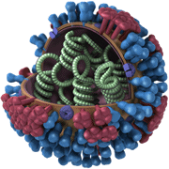
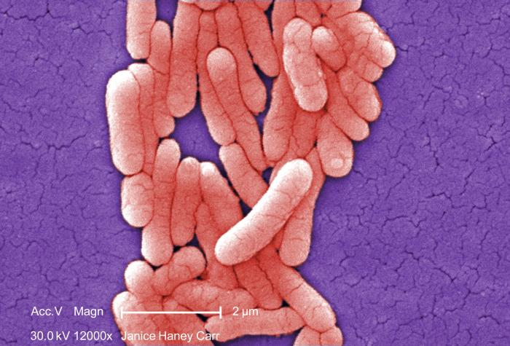
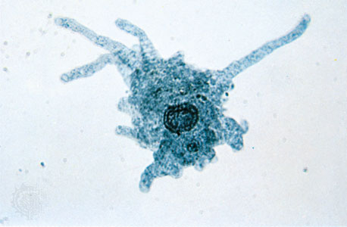
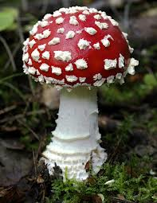
Microorganisms
Viruses
Bacteria
0.02-.2 µm
0.5 - 5 um
Fungi
Protists
2- 10 µm*
10-20+ µm

Slide 5
Microorganisms
Viruses
Bacteria
0.02-.2 µm
0.5 - 5 um
Fungi
Protists
2- 10 µm
10-20 µm

Slide 6
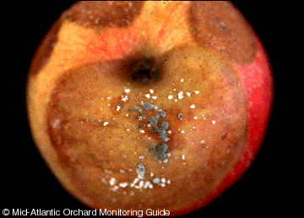
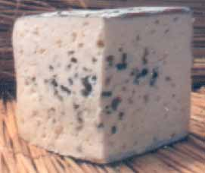
Molds
Growth
Low moisture
Wide Range of pH
Mesophilic (25~40°C; 77~104°F) and Psychrotrophic (can grow 0 ~7°C)
Most aerobic
Significance
Spoilage
Sanitation Index
Health Issues
Produce Foods
Notes:
Problem in grains
pH of 2.0 –8.5 – spoilage in acid products
Can grow at refrigeration temperatures, but low temps slow growth
Spoilage
Can grow/spoil in lower Aw/higher NaCl content foods, but do not compete well with bacteria
Mycotoxin Production
AFLATOXINS are concinogenic
Mainly produced on grain and nut products
Feeding high moisture corn to dairy cattle can cause aflatoxins to show up in milk
Aflatoxins – Aspergillus Flavis – carcinogenic
Rye – Ergot – Claviceps purpurea – neurotoxin
Toxin effects – carcinogenic, liver damage, neurotoxins, rashes, kidney damage
Mold Allergies
Sanitation Index
Yeast and molds are less resistant to sanitizers therefore if they are present, sanitizers are not working
Foods
Blue cheese, Brie, Roquefort, Sake

Slide 7
Major Mycotoxins of Concern

Slide 8
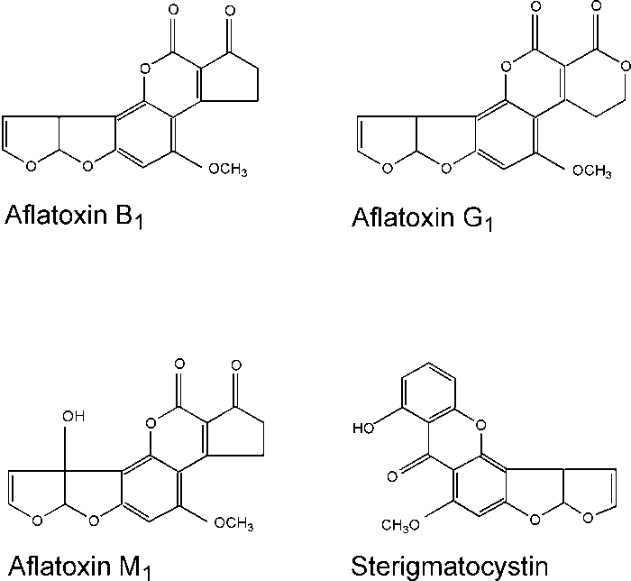
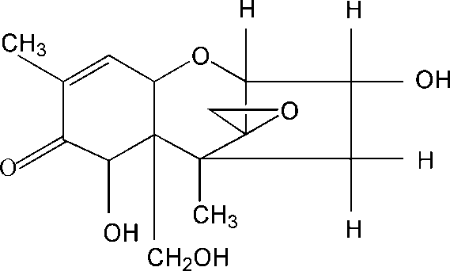
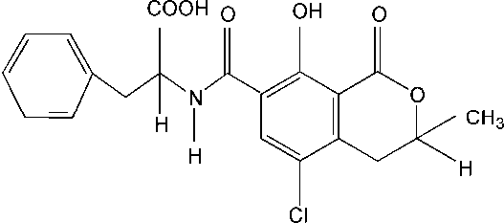
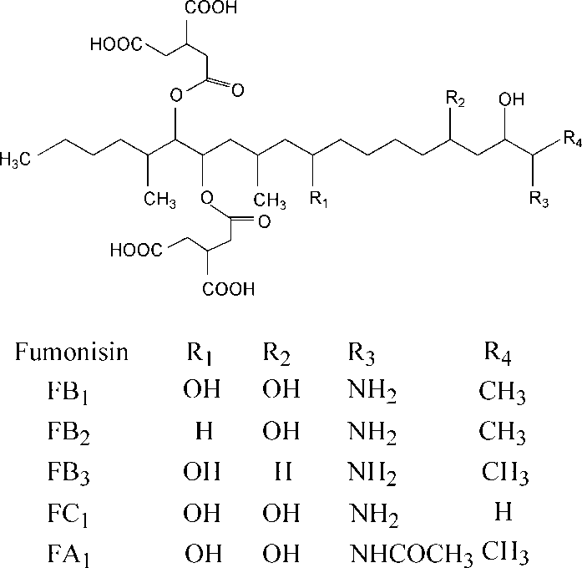
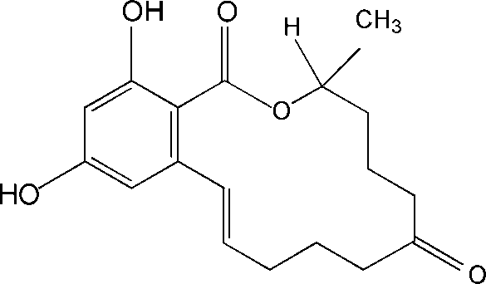
Major Mycotoxins
Ochratoxin A
Aspergillus ochraceous
Penicillium spp.
Trichothecenes [Vomitoxin (DON)]
Fusarium graminearum
Aflatoxins
Aspergillus flavus
Aspergillus parasiticus
Fumonisins
Fusarium verticillioides
Zearalenone (F-2 Toxin)
Fusarium graminearum

Slide 9
Toxicity of Major Mycotoxins
Mycotoxin | Commodities | Toxicity
Ochratoxins | Cereals, coffee beans, grapes | Nephrotoxin, immunosuppressant, teratogen, suspected carcinogen
Trichothecenes | Maize (corn) , cereals, wheat, barley, oats, rye, rice, others | Cytotoxicity, protein synthesis inhibition, emetic toxicity
Fumonisins | Maize (corn), wheat and other cereals | Hepatotoxin
Aflatoxins | Maize (corn), nuts, copra, cottonseed, milk | Hepatotoxin, synergistic toxicant, potent carcinogen, growth inhibitor
Notes:
Widespread in food commodities
Broad toxicity

Slide 11
Why be Concerned About Mycotoxins as a Global Food Safety Issue?

Slide 12
Why are mycotoxins important?
Usually ingested in contaminated foods and feeds.

Slide 13
Why are mycotoxins important?
Usually ingested in contaminated foods and feeds.
Most are not destroyed in normal cooking procedures.

Slide 14
Why are mycotoxins important?
Usually ingested in contaminated foods and feeds.
Most are not destroyed in normal cooking procedures.
They can cause cancer, birth defects, liver damage, and nervous tissue damage, etc.

Slide 15
Why are mycotoxins important?
Usually ingested in contaminated foods and feeds.
Most are not destroyed in normal cooking procedures.
They can cause cancer, birth defects, liver damage, and nervous tissue damage, etc.
Usually no treatment for mycotoxin poisoning

Slide 16
Why are mycotoxins important?
Usually ingested in contaminated foods and feeds.
Most are not destroyed in normal cooking procedures.
They can cause cancer, birth defects, liver damage, and nervous tissue damage, etc.
Usually no treatment for mycotoxin poisoning
Significant economic and trade issue.
Notes:
Annual losses in the USA and Canada, arising from the impact of mycotoxins on the feed and livestock industries, are of the order of $5 billion

Slide 17
Why are mycotoxins important?
Usually ingested in contaminated foods and feeds.
Most are not destroyed in normal cooking procedures.
They can cause cancer, birth defects, liver damage, and nervous tissue damage, etc.
Usually no treatment for mycotoxin poisoning
Significant economic and trade issue.
~25% of food crops affected by mycotoxigenic molds*
Global losses of foodstuffs due to mycotoxins are in the range of 1 billion tons per year*
*FAO
Notes:
Annual losses in the USA and Canada, arising from the impact of mycotoxins on the feed and livestock industries, are of the order of $5 billion

Slide 18
Why are mycotoxins important?
Usually ingested in contaminated foods and feeds.
Most are not destroyed in normal cooking procedures.
They can cause cancer, birth defects, liver damage, and nervous tissue damage, etc.
Usually no treatment for mycotoxin poisoning
Significant economic and trade issue.
Global public health and economic problem
Notes:
Annual losses in the USA and Canada, arising from the impact of mycotoxins on the feed and livestock industries, are of the order of $5 billion
It is estimated that 25% of the world's food crops, including many basic foods, are affected by mycotoxin producing fungi. A ccording to FAO estimates global losses of foodstuffs due to mycotoxins are in the range of 1 billion tons per year. (FAO)

Slide 19
Acknowledgements
UW Food Research Institute Staff
Jae-Hyuk Yu
Chuck Czuprynski

Slide 20
Thank you!

