Slide 1
Innovative Approaches to Dealing with the Incentive Problem
K. F. Cardwell, PhD
Senior Advisor, World Bank Agriculture & Environment Section
Mycotoxins: Triple Threat to African Development Washington, DC; 14 February 2013

Slide 2
How Social Marketers See Incentives – Just Do What?
Think in terms of customers, not converts. For our customers, a shared worldview is not a prerequisite to action.
People don’t need to know everything; they want to know what is relevant to them.
Either we can try (in vain) to get them to see the same way we do, or we can work from their perspective.
Robin Hood Marketing, Andresen, 2006

Slide 3
Re Mycotoxins, What do we want from them vs What is their perspective?
Governments;
Farmers;
Animal feeds consumers/food and beverage processers;
Urban Marketers;
Urban and Rural Consumers;
International Traders.

Slide 4
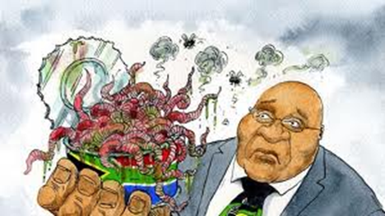
How Governments See the What
What Government Ministries want – Positive public perception: to be seen to be effective and in control of situation: agricultural competitiveness; public health; food security and safety.
For Mycotoxins the What is for Governments to
Internally regulate food safety (monitoring and control);
Balance public health, food safety and food security;
Oversee markets and trade; and
Enact policies that promote REE on mycotoxins.
Notes:
Public health – Ministries of Health (nutrition and health indicators)
Food safety – Food and Drug agencies – regulatros
Food security and trade – Ministries of Ag & Commerce

Slide 5
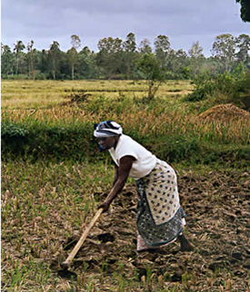
What Farmers Want
Maximized farm income;
Minimized income variation;
Minimized variable costs;
Minimized variable cost variation;
Minimized additional labor;
Maintained previous activity level (representing aversion to change); AND
Household health and well-being (esp children).
From Behaviour and motivations of farmers in responding to policy changes . Reading Univ, UK

Slide 6
How Farmers See the What
What Mycotoxin Management Calls for:
Change of management practices;
Additional labor;
Additional cost;
Income/yield neutral activities (in absence of incentive);
Potential income variability and/or liability;
How does this balance with the desire for a healthy household?
Notes:
Management practices
Table 1. Farming practices associated with high and low aflatoxin levels in stored maize
in Benin. Hell et al
Lower Aflatoxin Levels vs Higher Aflatoxin Levels
Production Practices
Crop rotation vs Maize mono cropping vs cropping with other aflatoxin sensitive crops
Local variety in South vs Improved variety in South
Improved vs Local
Diammonium phosphate fertilizer vs No fertilizer
Farmers aware of incomplete husk cover and sort vs maize is damaged in the field
Harvest Practices
Harvest at crop maturity vs Delayed harvest
Harvest of maize with the husk vs Harvest maize in heaps; cobs shelled later
Sun drying on platform vs "Field" drying on the plant
Drying of maize without the husk vs Delayed drying
Immediate removal of damaged cobs vs No sorting at harvest
Storage Practices
Cleaning of the storage structure vs No preparation of the storage structure
Maize stored for 3-5 months vs Maize stored for 8-10 months
Smoke or insecticide use vs No insect control
Maize stored in aerated stores vs Maize stored in poorly aerated stores

Slide 7
Remember How Social Marketers See Incentives
Think in terms of customers, not converts. For our customers, a shared worldview is not a prerequisite to action.
Do Farmers need to care about Public Health?
Will Farmers find food safety for their families a great enough incentive to change their production systems?
How do we see Farmers as customers?
People don’t need to know everything; they want to know what is relevant to themselves.
Robin Hood Marketing, Andresen, 2006

Slide 8
What is the strategy for farmers?
Couple mycotoxin management with increased income potential;
Couple mycotoxin management with improved productivity;
versus
Regulate and penalize;
Scare the hell out of everybody with negative health campaigns about staple foods to create a demand?
Notes:
Mycotoxin management must be a package with opportunities to improve production so the costs of doing it are offset by higher income. The M mngment alone will not be accepted by this customer without 1. more money, 2. regulatory enforcement, or 3. a turned public opinion.

Slide 9
What Urban Maize Marketers Want
Ease of purchase at farm gate or from aggregator;
Less labor requirements;
Stable transport and storage;
Profitability (buy low, sell high);
Minimized losses;
Return Customers.
Notes:
Lets talk about public opinion.

Slide 10
How Marketers see the What
What we want of them is to sell maize at a slightly higher price if it has low myco/afla-toxin.
What incentive do they have to do that?
Pull-mechanism incentives – a bonus (short term);
Market force price differential - Informed and savvy consumers – (medium term);
Regulatory – risk of penalty and public opinion (long term); and/or
Concern for their own children’s health.
Notes:
Establishing a price differential is the purpose of incentive programs. The incentive is paid per ton of treated/low-mycotoxin product.

Slide 11
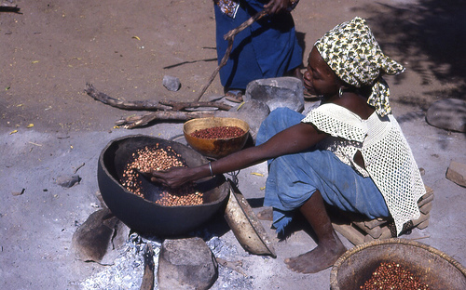
What Maize Consumers Want
Low price;
Good quality;
Convenient location for purchase;
Convenience for preparation;
Consistent taste and
Cooking characteristics.

Slide 12
What we want from the Customer
For them to purchase mycotoxin-free product for a slightly higher price and seek vendors that sell Aflasafe maize.
Why would they do that? What would social marketers say about how much information the consumer needs?
How much information is too much information?
Choosey Mothers Choose Jiff!

Slide 13
Back to What for the Farmers
Want them to manage aflatoxin (other toxins?) with
Cultural techniques of which there are about 15 that need to be used in conjunction;
Biological control – for which there is a cost and some additional labor;
What do we say to them?
Do/use this and it will be worth your while!
Meanwhile, for this to happen and be sustainable, all other elements have to align.

Slide 14
Players and Motivations
We have to get a handle on this can of worms!!
Will you pay me more?
Quality or price?
Dev Country Governments
Will I pay you more?
So much work!
Marketers
Consumers
Cheep moi? I’ll pay more!
Public Health
Farmers
Industrial consumers
Food Security

Slide 15
AFLASAFE ™ Incentivization Pilot in Nigeria
Pull Mechanism Initiative Organizational Chart
Donor’s Steering Committee
Financial Trustee
Nigerian Bank (s)?
AG-Results Secretariat (TBD)
Oversight Stakeholders
Ag-Results Evaluator (TBD)
Aflasafe Pilot
Steering Committee
Doreo Partner (Chair)
MAN
PAN
Food Safety Committee
Finance
Women traders’ rep
Program supervisor
Incentive payments
Technical Outreach, verification, Aflasafe manufacturing
Monitoring and Evaluation
Field Initiative
Program Management
Implementer 4
Babban Gona
Implementer 2
Masala and Premier Commercial Aggregators
Technical Ops Teams
Implementer 3
Kaduna CADP
Implementer 1
Women marketer

Slide 16
Strategic Plan to Drive Sustainability Leverage Strong Regulatory Enforcement to Sustain Premium Market for Aflasafe maize
1
Supply of Affordable Low- Aflatoxin Maize
CADPs and Pull Mechanism Incentives
2
Enable Market Forces to Drive Sustainability
Market Forces
3
Public Health Awareness
Health Awareness: Farmer Focus
Health Awareness: Industry Focus
Health Awareness: End Consumer
4
Policy: Build Regulators Capacity
Policy: Develop regulatory framework
Enforce Regulatory Policy
Policy: Phased in regulatory enforcement mechanism
1
2
3
4
5
Year
Doreo Partners
Notes:
What are the alternatives if the regulatory enforcement mechanism fails to kick in?
What is the alternative if the market can not bear the additional cost?
What is the alternative if governments do not allow awareness building for fear of public unrest?
Spray it on!!

Slide 17
Thank you for your comments and thoughts.
kcardwell@worldbank.org
bmasha@gmail.com
gdixie@worldbank.org
r.bandyopahdyay@iita.cgiar.org

