Slide 1
Crisis Management 3.0 Questions to Speakers
Twitter hashtag #Crisis30
Online Dialogue
http://us.resiliencesystem.org/forum
http://us.resiliencesystem.org/social-media-governance-symposium-series
Submit questions by email
Michael.D.McDonald@mac.com

Slide 2
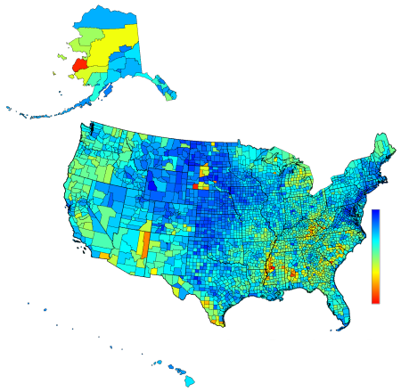
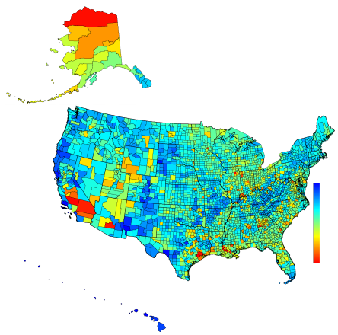
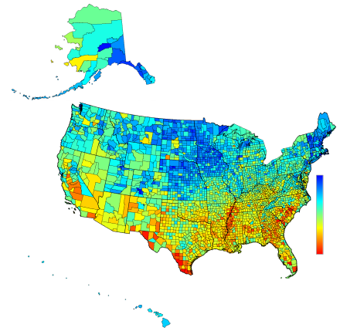
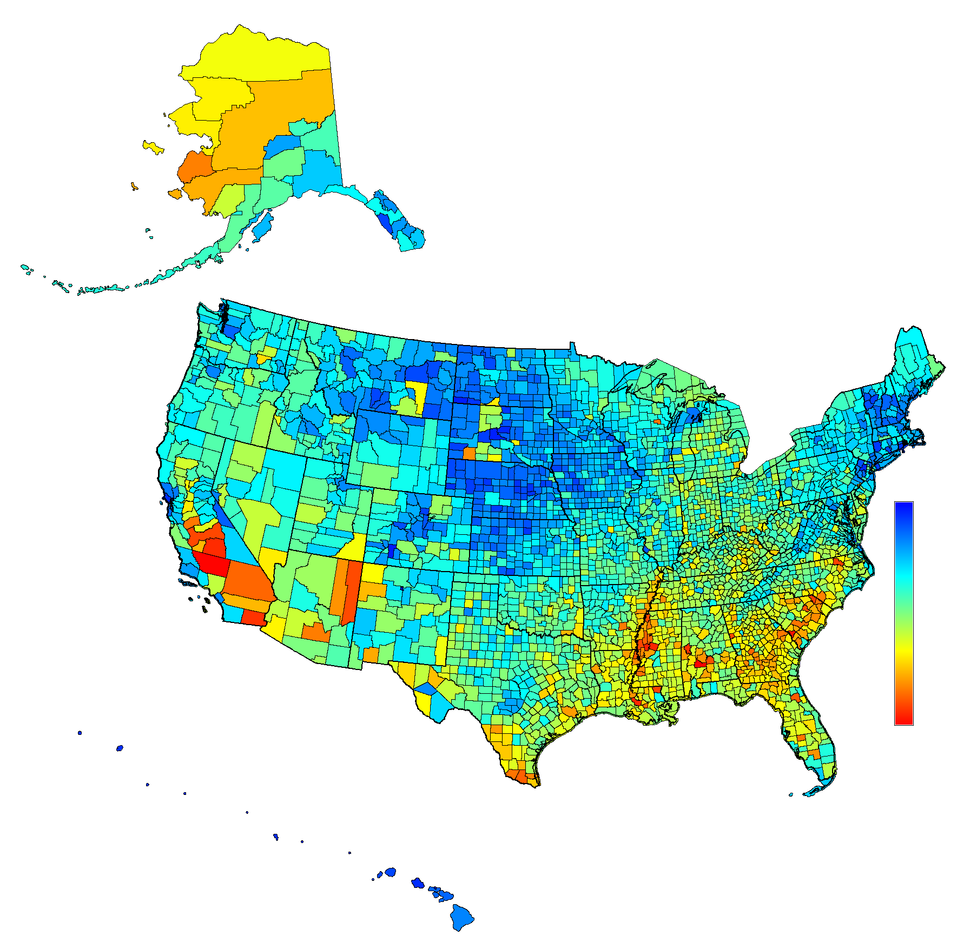
Economic Fabric Index | Environmental Fabric Index | Social Fabric Index
 |  |  | Composite HSI = unweighted mean of EconFI, EnvFI, & SocFI

Slide 3
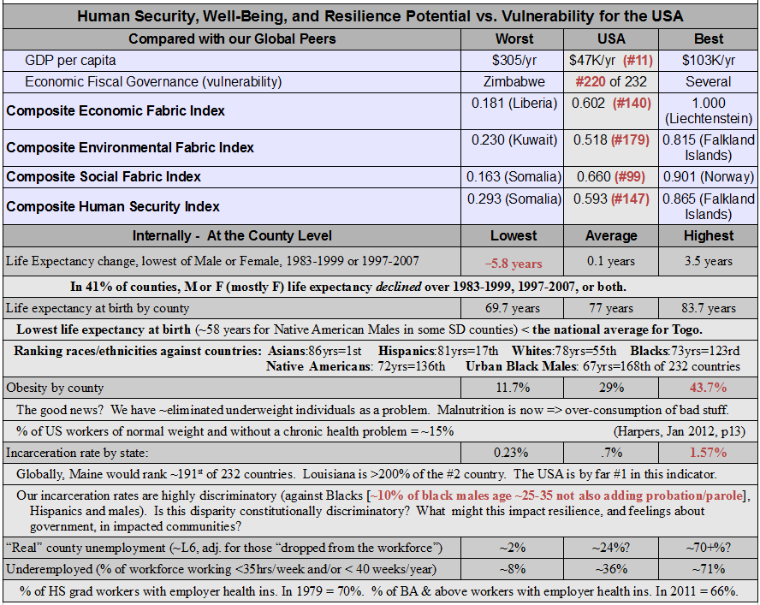

Slide 4
Levels of Severity in Crisis Management
Level 1: Local Emergency, Small Scale, Manageable By Local Incident Command Systems
Level 2: Larger Scale Disaster, Manageable By Supplementing Incident Command System
Level 3: Large and Complex Disaster, Incident Command Fail – e.g., Hurricane Katrina
Level 4: Large and Complex Crisis, Government Loses the Trust of the Public – e.g., Tohoku Region Japan, Haiti
Level 5: Large-scale Catastrophe, Social Ecology Fails, Catastrophic Drop in Population – e.g., Detroit

Slide 5
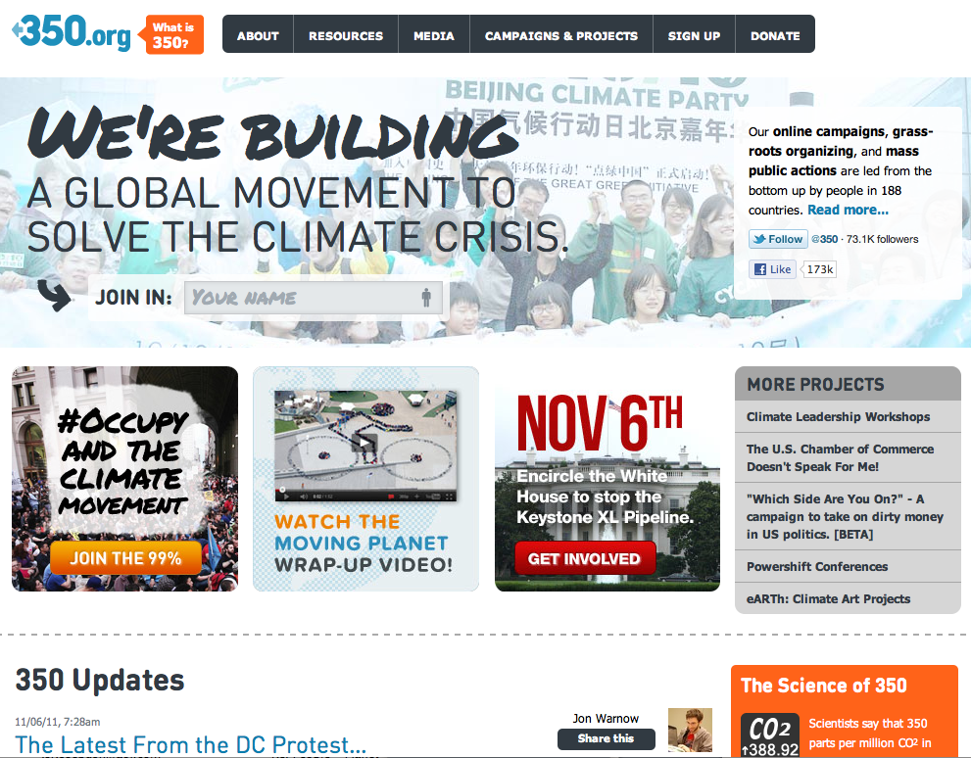
Web 2.0 Social Media & Flocking Behavior

Slide 6
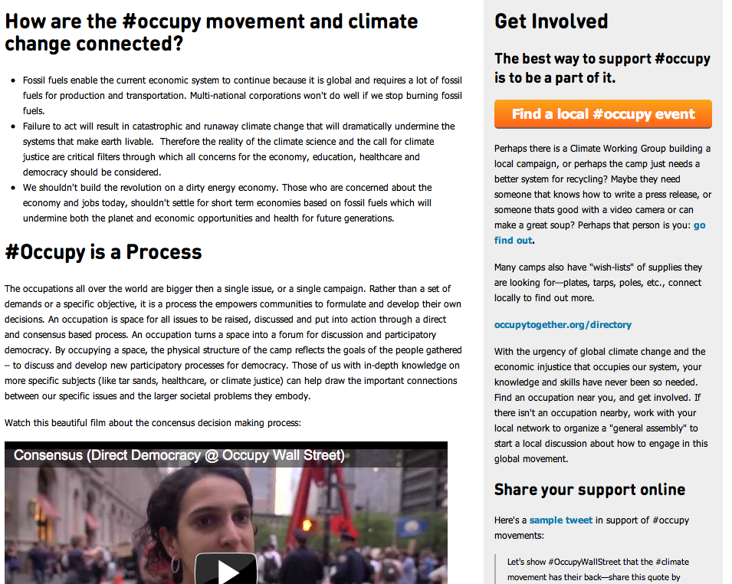
The Internet and Direct Democracy

Slide 7
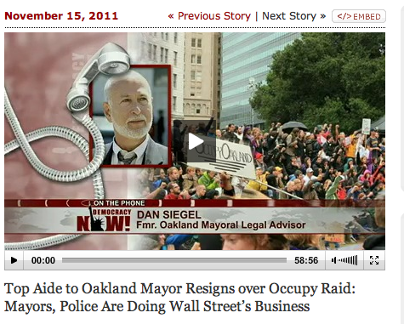
Governance In Times of Transition?

Slide 8
Industrial Revolutions Emerge when new communication modalities meet new energy systems
First Industrial Revolution
The Printing Press
Coal and Steam Engines
Second Industrial Revolution
Television and Radio
Oil, Internal Combustion Engine, and Nuclear
Third Industrial Revolution -- Distributed Smart Grids
World Wide Web 3.0
Renewable Energy: Solar, Wind, Geothermal …

Slide 9
Knowledge is Key During the Third Industrial Revolution
Simultaneous Web Linkage of Millions of
Computers
Phones / Mobile Telecognitors
Sensors
Real time Sense-making within a Societal Supercomputer
Massively Parallel Human/Machine Parallel Processing System with Millions of Nodes Within Cloud Computing
Emergence of a New Type of Collective Intelligence
Herein lies the true power of the 21st Century Knowledge Manager
Shift from Building Networks to Growing Societal Mind

Slide 10
Social Media and Governance in Times of Transition
Web 2.0 Social Networks vs. Web 3.0 Intelligent Social Networks
Knowledge Management for the General Public in High Severity Crises
The Role of Social Media, Riots, Civil Insurrections, Social Crises, and Revolutions
Smart Swarms and Fifth Generation Management and Governance

Slide 11
Web 3.0 Intelligent Social Networks
Evidence Base
Deep Science Base
Knowledge Management System
Solution Oriented
Based in Integrative Power
Enabling New Forms of Governance in Times of Transition

Slide 12
Resilience Systems as Web 3.0 Complex Adaptive Systems
Facebook & Twitter – Web 2.0 Social Networks
Good for Creating Flocking Behaviors
Simple, Uniform Behaviors
Resilience Systems and Resilience Networks
Semantically Deep and Evidence Based
Science-based, Knowledge Management Systems
Highly Customable and Localizable
Enabling Context-rich Communication and Collective Action
Use of Cloud Computing for Society-Level Parallel Processing Creating Real-time Situational Awareness

Slide 13
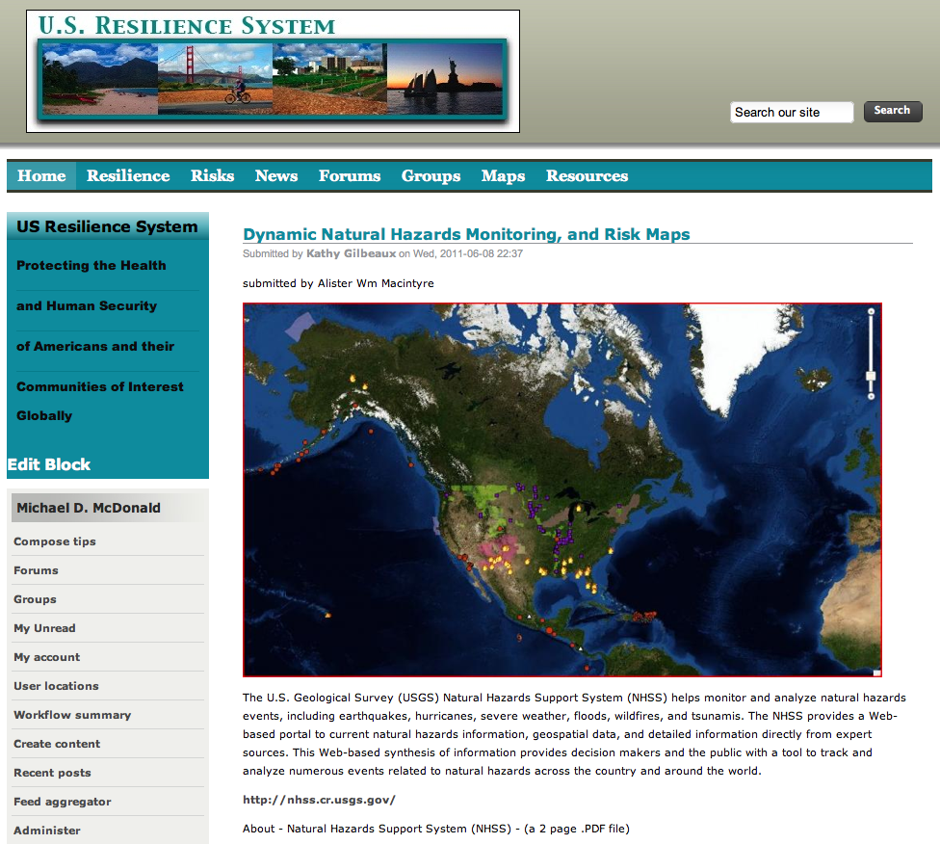

Slide 14
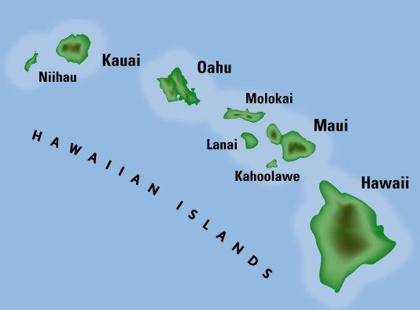
Resilience system: State, island and community networks, under the umbrella of a state-wide system, utilizing evolving and innovative technology… as well as the time-tested “coconut wireless”.
Hawaii Resilience System
Island Resilience Networks
Community Resilience Networks
coconut wireless

Slide 15
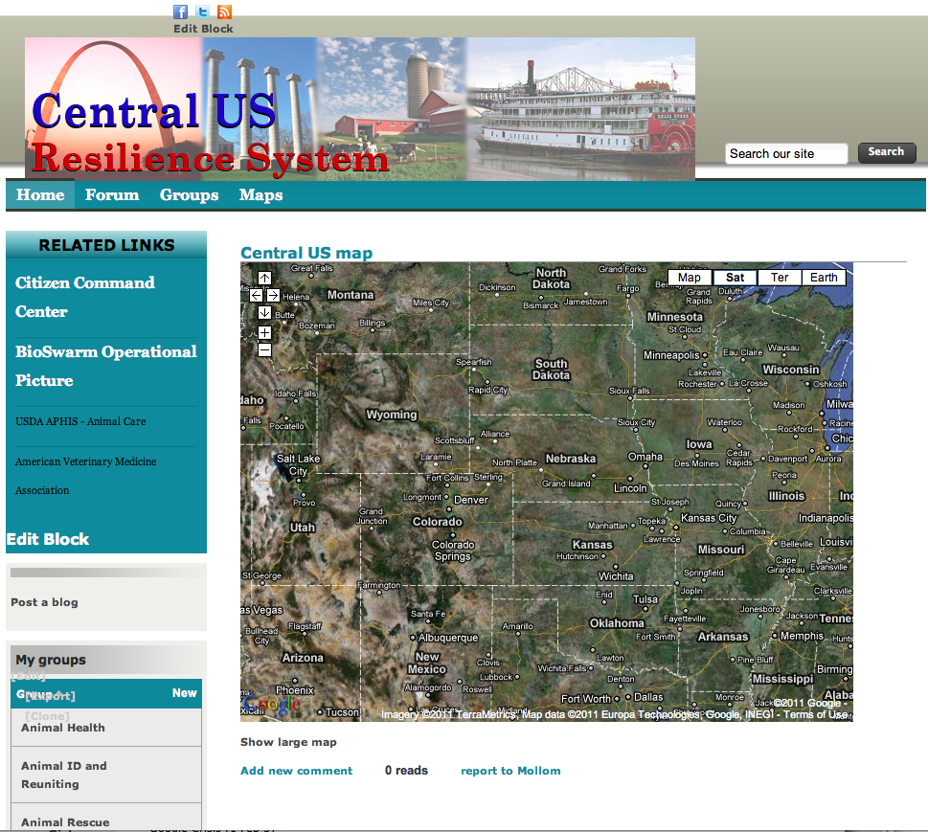

Slide 16
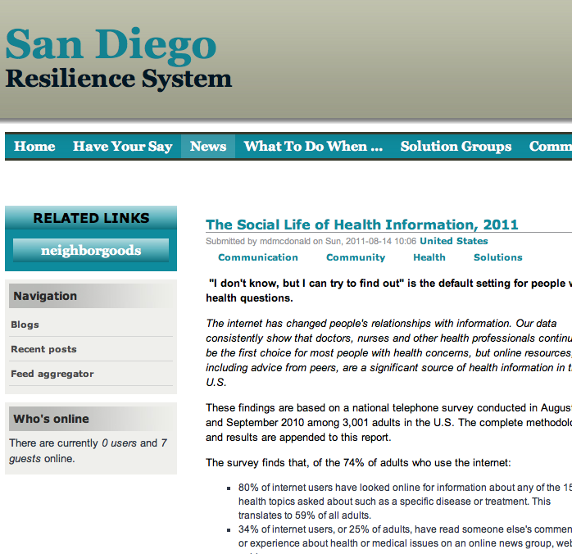

Slide 17
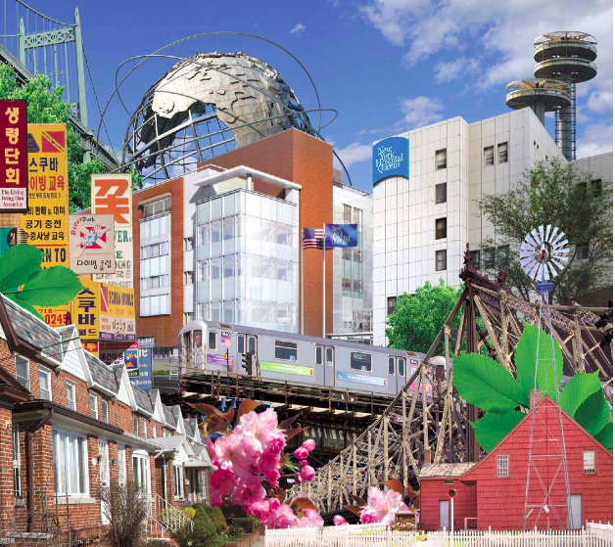
New York Hospital Queens Medical and Public Health Information Sharing Environment
NYHQ MPHISE

Slide 18
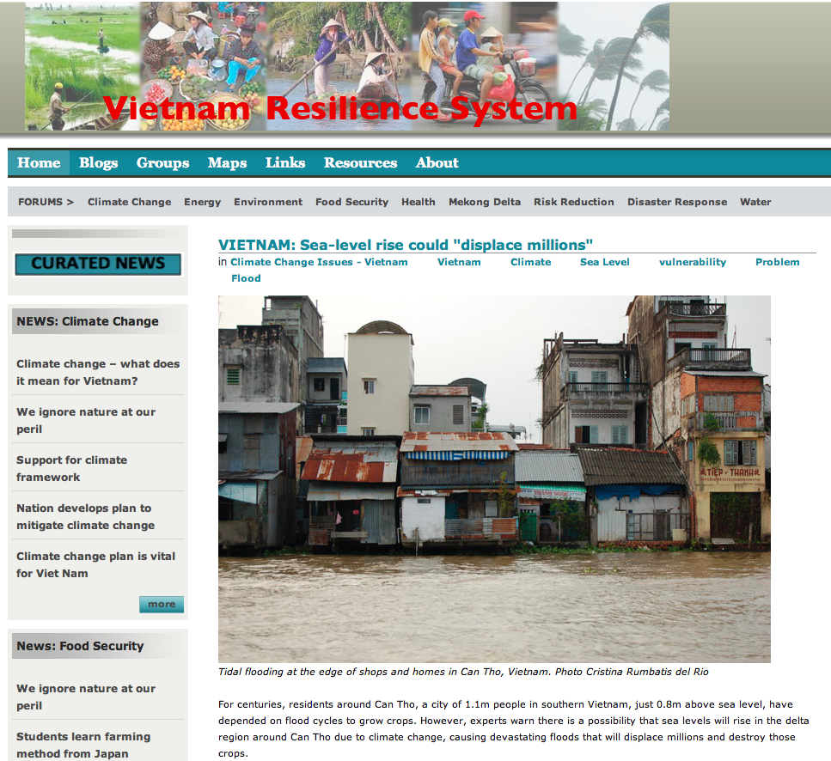

Slide 19
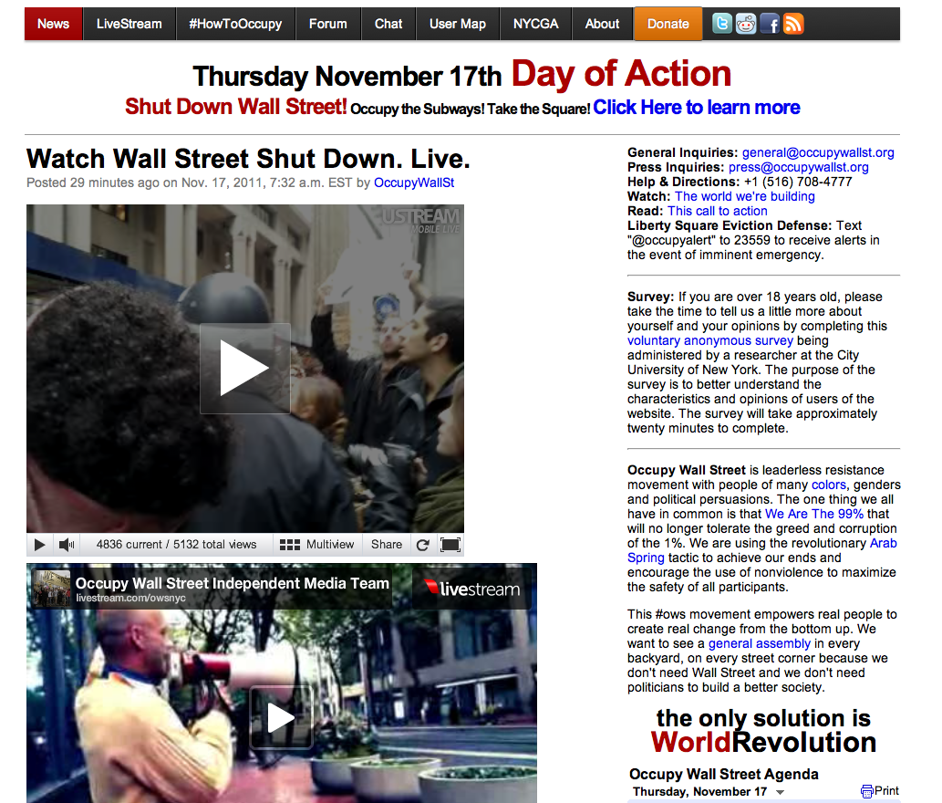
“The Revolution will not be televised.”

Slide 20
U.S. Resilience System Components
MPHISE (Medical and Public Health Sharing Environments)
FAC Teams
Resilience Networks
ALADIN (Adaptive Logistics & Distribution Intelligent Network)
Trust Networks

Slide 21
Resilience Networks as a Platform for 5th Generation Management and Governance
Anticipatory Science Base
Severity-Indexed, Trigger Point-based Prospective, Best Practices
Situational Awareness
Common Operating Picture
User Defined Operating Picture
Intelligent Social Networks
Coordinating Self-triggering Smart Swarms
Mission-Critical Gaps Focus
Task Server Management for Smart Swarms

Slide 22
Horizontalism
Leaderless
Participatory Democracy
In Opposition to Inequitable Control of Resources
Agile, Focused, Converging
Fifth Generation Management & Governance?
Horizontalism must be reintegrated with hierarchical management and governance or it will elevate the levels of social crisis

Slide 23
Integrative Power
Socially Networked
Rebalancing Vertical and Horizontal Power
Non-violent Collaboration
Speaking Truth to Power
Focused on Solving Strategic Challenges
Radical Inclusion
Solutions for the Good of All
Everyone involved in creating the solution set
Focused on creating sustainable capacity
Success measured in the health and human security of citizens

Slide 24
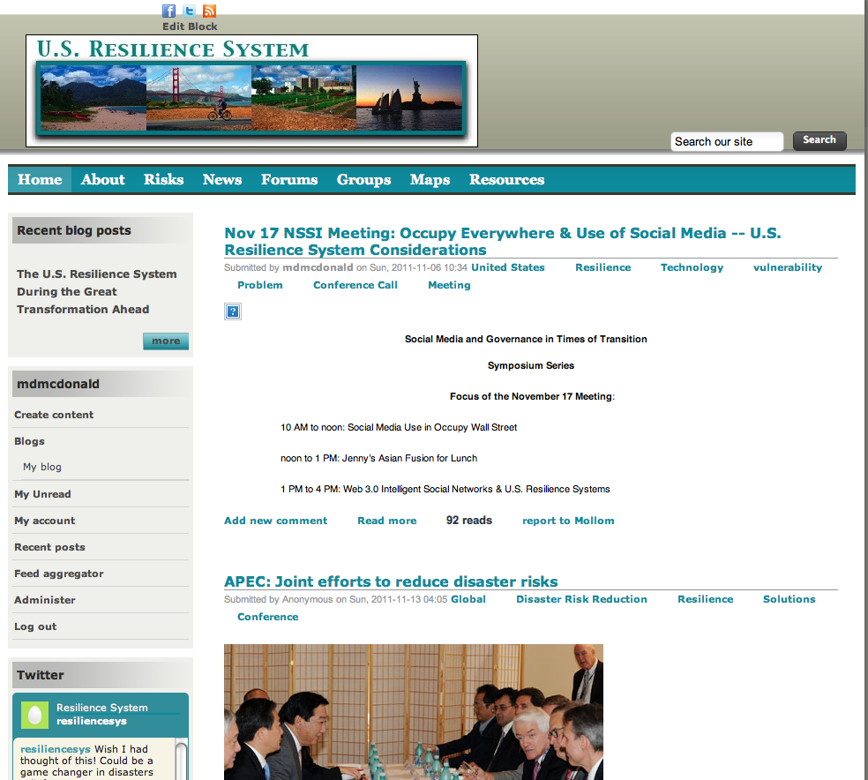

Slide 25
U.S. Resilience Summit 2012
Series: “Social Media and Governance in Times of Transition”
Symposium at the National Defense University in Spring 2012
Planning Session at NAPA in Summer 2012
Collaboratories started in the U.S. Resilience System
Serious Game Simulation of energy costs exceeding thresholds where >35% of the U.S. population are plunged into energy descent
problems affording the commute to work
problems affording heating their homes
Want to Participate?: Michael.D.McDonald@mac.com

Slide 26
Memetics and Evolutionary Psychology
Memes: Self-replicating Fragments of Culture
Informing behavior, social process, & social structure
VVH: Victim-Villain-Hero Template
If It Bleeds, It Leads
Genetically Tagged Memes
Subculturally Tagged Memes

