Slide 1
CFK2 and Foreign Investors

Slide 2
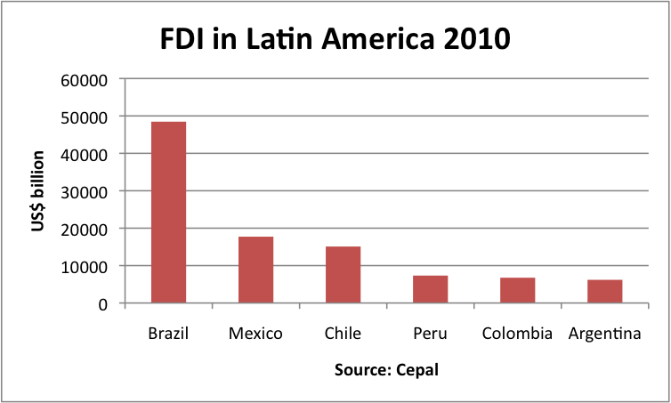
Relations with foreign investors have been difficult
Argentina is, by most measures, an economic success story
High growth, fiscal and trade surplus, manageable debt dynamics
Inflation high, but stable
And yet, investors do not like Argentina, especially since 2007
FDI remains relatively low, while spreads remain high

Slide 3
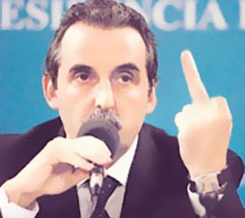
Why is that?
Inheritance: default, restructuring, pesification
Government’s tough stance vis-à-vis the private sector
Reluctance to allow utility prices to increase
Manipulation of official statistics
Unwillingness to address distortions
Increasingly arbitrary and unpredictable policy style

Slide 4
Will this change?
Main question is whether the government will become more moderate or radical
In contrast to 2007, expectations are low
Economic policy is unlikely to change, but radicalization is unlikely
Electoral victory will reinforce sense that policy direction is appropriate
Reluctance to adjust in the face of an uncertain global outlook
Government will continue to maximize short-term economic growth and avoid paying political costs

Slide 5
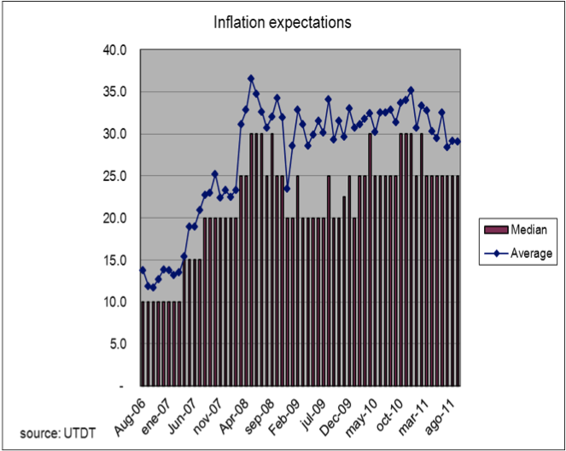
Main challenges
Inflation: stable, but high
Fiscal accounts: subsidies challenge fiscal solvency
Deteriorating external accounts; pressures on the currency are rising
Lack of investment in the energy sector

Slide 6
Time is of the essence
If the government does not make the needed adjustments, these problems will worsen
An increasingly interventionist stance would further erode confidence
Hard to tell how sustainable the “model” is, but room to maneuver is declining
But adjustments are manageable
So government could surprise investors positively

