Slide 1
Improving Creditworthiness of Subnational Authorities in Latin America: Using Peer-to-Peer Assistance David Grossman Director, International Programs ICMA

Slide 2
Regional Credit Rating Improvement Program
Funded by World Bank, Public-Private Infrastructure Advisory Facility (PPIAF)
Implemented by ICMA México-Latinoamérica
What are the essential elements of the peer-to-peer approach?
How was the peer-to-peer approach implemented in Mexico, Costa Rica, and Argentina?
What was the impact on participating subnational authorities?

Slide 3
Essential Elements of Peer Learning:
ICMA CityLinks Model
Philosophy: Cities learn best from other cities

Slide 4
CityLinks Process
Programmatic selection criteria
Intention to borrow for infrastructure
Commitment to reform
Selection of partners
Exchange visits
Diagnostic assessment
Definition of work plan
Direct technical assistance
ICMA facilitation
Documentation of experience
Regional workshops

Slide 5
RCRI Partnerships
Mexico Pilot
State of Jalisco – Phoenix, AZ
State of Guerrero – El Paso, TX
Municipality of Puebla – Burlingame, CA, and Genesee County (MI) Road Commission
Costa Rica
Municipality of Cartago and regional electric utility (JASEC) – El Paso, TX
Municipalities of San Carlos and Esparza – Burlingame and the Genesee County Road Commission
Argentina
Municipality of Mendoza and province of Salta – Santa Fe County, NM

Slide 6
Impact of RCRI Program
Established long-term capital improvement plans
Established multi-year budgets
Developed written debt and budget policies
Two Mexican entities kept their credit ratings and obtained a line of credit at a time when many ratings were being lowered

Slide 7
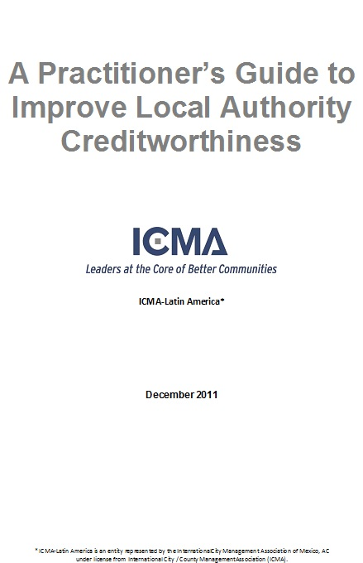
Practitioner’s Guide
Outlines the management policies
and practices that affect an entity’s
creditworthiness
Provides step-by-step guidelines
for reviewing management issues
relating to debt, liquidity, financial
controls, and other factors
Provides model financial management
policies that address areas in need of
improvement

