Slide 1
Urbanization, Infrastructure and the Financial Implications for Latin America
May 6, 2014 – Woodrow Wilson International Center for Scholars
dp david painter / development finance advisor
Notes:
The importance of infrastructure for urbanization & the financial implications for Latin America.
Cities & Economic Development in LAC
Cities LEAD the economic development of emerging and developing countries, but they are not contributing as much in LAC as they are in East Asia.
Infrastructure’s Impact on City Development in LAC
Infrastructure is essential for city development and the city economy. A city’s global competitiveness is substantially affected by the quality and quantity of its infrastructure.
LAC cities have relatively weak infrastructure compared to East Asian cities.
The Urban Infrastructure Gap in LAC
Existing infrastructure shortfalls are significant and growing. Housing and related infrastructure is a good example.
LAC countries have been underinvesting in infrastructure and the investment volumes are declining.
Closing the Gap: The Implications for Infrastructure Financing in LAC
Historically very large investments will be required. This is well beyond the resources available to International Donors and Multilateral Development Banks.
Combination of Government resources and private sector financing is essential.

Slide 2
dp Cities are Central to Economic Development in LAC
Financial Times April 25, 2014
Cities, not countries, are the key to tomorrow’s economies
Commentary by Arif Naqvi, founder and group chief executive of the Abraaj Group, a global investment firm
… cities within the Pacific Alliance nations of Mexico, Colombia, Peru and Chile contribute about two-thirds of the bloc’s combined gross domestic product. In three dozen of those cities, GDP is growing 20 per cent faster than the national averages. By investing billions in infrastructure, removing tariffs on most merchandise trade within the group and expanding their links to Asia, these countries are taking steps to expand opportunity and attracting attention from investors as a result.
Such policies not only raise the living standards of newcomers to the cities; they also create opportunities for emerging businesses. As more investors acknowledge the vital role cities play in driving economic development, they will start to see our backyards the way they see their own – and they will increasingly seek opportunities outside the developed world…

Slide 3
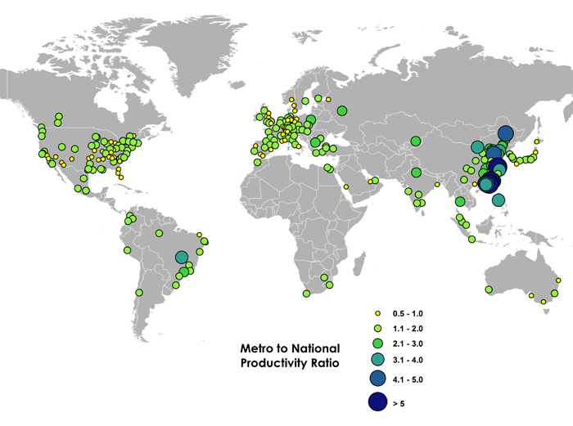
dp Cities are Central to Economic Development in LAC
The Urban Productivity Ratio.
The ratio compares the per capita economic output of metros to the per capita economic output of their nations.
Source: Richard Florida, Why Big Cities Matter in the Developing World, The Atlantic Cities. Jan 14, 2013
Charlotta Mellander of Martin Prosperity Institute calculated the urban productivity ratios for these 300 metros based on Brookings data for metros and World Bank data for nations, using data from 2012. Zara Matheson of MPI mapped the results.
Notes:
Cities & Economic Development in LAC
Cities LEAD the economic development of emerging and developing countries, but they are not contributing as much in LAC as they are in East Asia.
CAF-ADB Study
The study assesses the competitiveness of three cities in Asia — Ho Chi Minh City, Dhaka, and Seoul — and four cities in Latin America—Curitiba, Lima, Bogotá, and Guayaquil—through analysis of urban planning and institutional capacity, as well as cluster strength and value chains. All seven cities face growth related challenges. However, the Asian cities have been more successful in regional integration of production, services, and infrastructure and in the development of human capital.
Atlantic Cities
While our analysis is provisional, it suggests that many cities in emerging and developing nations have a considerable productivity advantage over their countries, and also have higher relative productivity than their counterparts in the advanced world. … 18 metros – mainly in China but also in Brazil and the Philippines – have ratios of 3 or greater; 10, all in China, have ratios of 4 or more; and 3 have ratios of 5 or more. … While this is the dominant pattern, it does not hold across the board. Mumbai, Cairo, Bogota, and Jakarta – with ratios around 1.6 – are on the high side of what are found in advanced nations. Rio, Cape Town and Abu Dhabi have ratios of 1.4, about the same as Munich; Mexico City and Santiago come in at roughly 1.2, about the same as Minneapolis; Hyderabad and Bangalore around 1.1; and Guadalajara around 1.0.

Slide 4
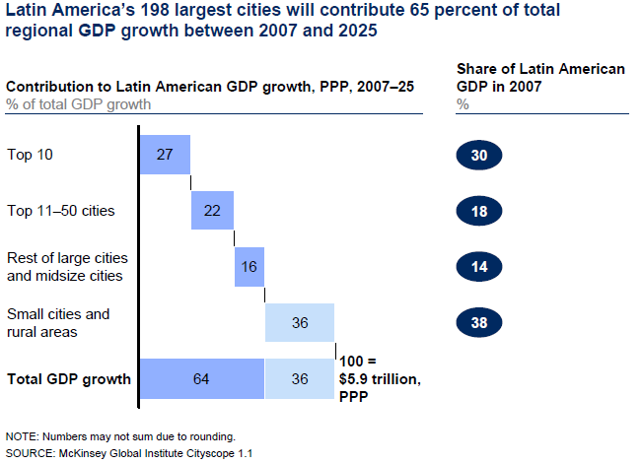
dp Cities are Central to Economic Development in LAC
Notes:
McKinsey.
Given their strong starting point, Latin America’s large cities will continue to be the principal engine of the region’s growth. Latin America’s 198 large cities are expected to generate 65 percent of the region’s growth over the next 15 years, McKinsey Global Institute estimates.
HOWEVER…(Infrastructure lags behind population growth.) In Latin America’s largest cities, signs of diseconomies of scale such as congestion and pollution have started to outweigh scale benefits, diminishing the quality of life they can offer citizens and sapping their economic dynamism.
YET…According to McKinsey Global Institute… research indicates that the cost of delivering basic services such as water, housing, and education can be 30 to 50 percent cheaper in concentrated population centers than it is in sparsely populated areas. Very large cities attract the most talent, draw the most inward investment, and are often at the center of a cluster of smaller cities, creating network effects that spur economic growth and productivity.
AND… MGI expects midsize cities to contribute a larger share of economic activity in the medium term, making them an increasingly important engine of growth in the region. However, as the midsize cities grow in size and complexity, they will inevitably begin to run into the kind of challenges that the largest Latin American cities face today.

Slide 5
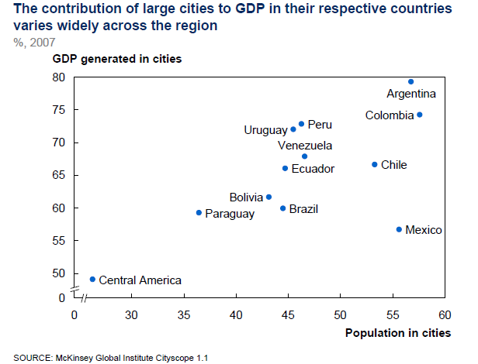
dp Cities are Central to Economic Development in LAC
Notes:
McKinsey
Countries vary in the contribution their urban centers make to their national economies (Exhibit 4). By a large margin, Argentina and Colombia are the economies for which large cities are most important. … In Peru and Uruguay, large cities also account for a major share of GDP. … Chile has eight major cities that are home to almost 55 percent of the population and account for 65 percent of the country’s economy. … In Brazil and Mexico, the two largest economies of the region, large cities contribute about 60 percent of national GDP. …
BUT …In contrast, large cities are less important in the economies of Central America and the Caribbean.

Slide 6
dp Cities are Central to Economic Development in LAC
Notes:
UN Habitat
Many major cities in the region have per capita incomes higher than their respective national figures; for the moment, they are the drivers of much of the region’s economic dynamism. The participation of these cities in the national economy may be higher than their demographic weighting, as illustrated in the graph showing Panama City (responsible for 39 per cent of the country’s total population and 61 per cent of its GDP) and Lima (29 per cent of population and 52 per cent of GDP).
HOWEVER…
CAF-ADB Study
The economic development of Latin American cities is largely fueled by expansion in the natural resources and agricultural sectors. In Asia, city growth is driven in many cases by export-oriented manufacturing and services. For the most part, Asian cities are expanding more quickly than Latin American cities. In East Asia, large and intermediate cities continue to grow at rapid rates. In Latin America, the expansion of megacities, including Sao Paulo, Mexico City and Buenos Aires, is generally happening at a slower pace than in intermediate cities.

Slide 7
  dp Infrastructure has a Major Impact on City Development in LAC
Notes:
McKinsey Global Institute
Latin American cities have fallen short of being able to provide coordinated urban planning and sufficient infrastructure and services needed for efficient and livable cities. … The inefficiencies translate into a direct drag on growth, with large monetary costs from waste in resource use and worker time spent in traffic jams.
Struggling to meet urban demand for services and infrastructure imposes significant costs on Latin America’s cities in terms of low productivity and growth and acts as a constraint on economic growth in the entire region.

Slide 8
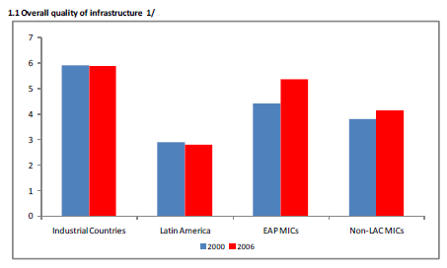
  dp Infrastructure has a Major Impact on City Development in LAC
Source: Calderon & Serven, Infrastructure in Latin America, World Bank, May 2010
Notes:
No notes

Slide 9
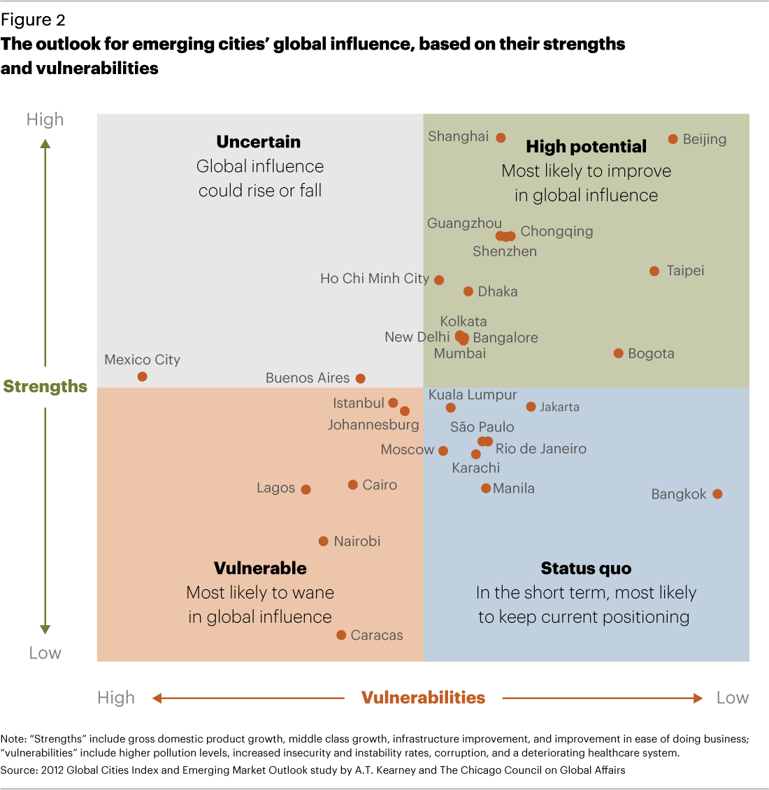
  dp Infrastructure has a Major Impact on City Development in LAC
Notes:
ATKearney - 2012 Global Cities Index
Latin America: cities in all quadrants. Thanks to improvements in infrastructure and reductions in instability and corruption, Bogota, Colombia, is the one non-Asian city in the high-potential quadrant. However, other Latin American cities seem likely to exhibit different future behaviors. For example, Brazil's Sao Paulo and Rio de Janeiro appear poised to maintain their global positioning, with balanced opportunities and risks. Caracas, Venezuela, with its economic problems, increasing instability and corruption, and deteriorating healthcare system, occupies a more vulnerable position.
(Figure 2 maps the strengths and vulnerabilities of these emerging cities: In the high-potential quadrant (upper right), a city's strength score is higher than its vulnerability score, indicating cities well poised for the future. Those in the status quo quadrant (lower right) have low strength and vulnerability scores, suggesting relative stability. By contrast, cities in the uncertain quadrant (upper left) have high scores in both, which could lead to large positive or negative changes, while the vulnerable quadrant (lower left) reflects the potential for future struggles. We analyze these results in more detail, exploring the likely rise or fall of the world's leading emerging market cities over the next decade or two.)

Slide 10
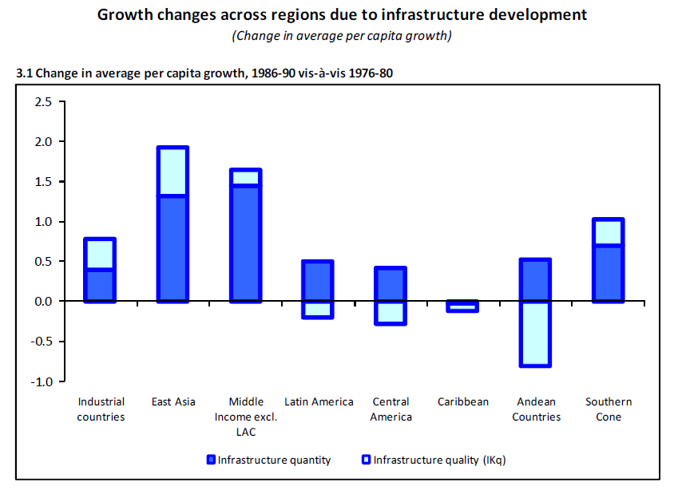
  dp Infrastructure has a Major Impact on City Development in LAC
Source: Calderon & Serven, Infrastructure in Latin America, World Bank, May 2010
Notes:
No notes

Slide 11
  dp There is an Urban Infrastructure Gap in LAC
Notes:
CAF-ADB Study
City growth and development require government promotion of infrastructure development (and regional infrastructure
integration), innovation, strategic investment, and urban planning. Initial findings of the RCC study indicate that low labor productivity, weak business dynamics, and poor interregional infrastructure especially affect the Latin American cities’ competitiveness.
All of the cities in the study face increasing vehicle traffic, rising housing costs, and decreasing quality of residential areas. Poor urban conditions have, in some cases, led companies to transfer their businesses to the city periphery or even overseas.

Slide 12
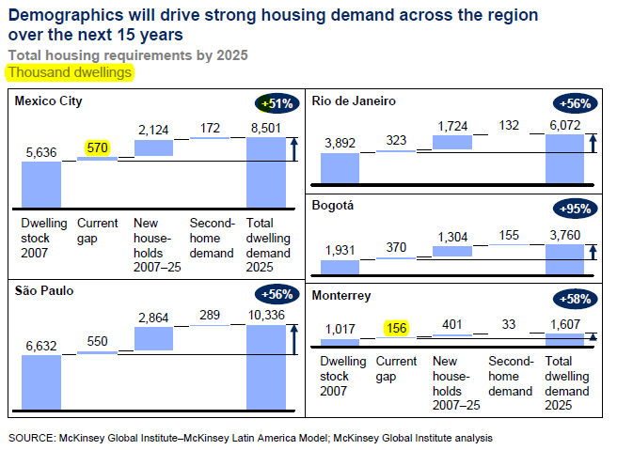
  dp There is an Urban Infrastructure Gap in LAC
Notes:
McKinsey Global Institute
Today, many of Latin America’s largest cities are grappling with traffic gridlock, housing shortages, and pollution, all symptoms of diseconomies of scale. For the region’s largest cities to sustain their growth, they need to be able to address challenges not only to their economic performance but also to the quality of life experienced by their citizens, sustainable resource use, and the strength of their finances and governance.
Many of the top ten cities in the region … Many cities have outgrown the capacity of their infrastructure, the design of their transportation systems, and their ability to deliver adequate public services, making it difficult to “get things done” efficiently and effectively. As a result, cities are not generating enough high-productivity jobs to employ an expanding labor force, boosting informal economic activity to damagingly high levels.
-- MGI would expect this to translate into an increase of more than 4 percent a year in the number of new vehicles sold—implying a very large needed increase in the urban road infrastructure.
-- Housing/Infrastructure Gap. Colombia, has a 19 percentage point gap today between housing supply and demand, implying a shortage of 620,000 dwellings. Demographic trends, including the declining size of households, suggest that without a substantial expansion in supply, the gap between supply and demand is likely to widen. We estimate that Bogotá will need to almost double its dwelling stock by 2025. In Mexico City and São Paulo, demand for housing will expand by more than 50 percent by 2025 (Exhibit 16). The task that Latin American cities face is far bigger than simply building sufficient affordable dwellings—they also need to construct the infrastructure services required by these households, namely sewage, water, gas, and electricity.

Slide 13
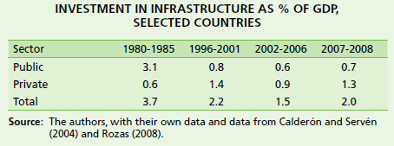
  dp There is an Urban Infrastructure Gap in LAC
From: The economic infrastructure gap in Latin America and the Caribbean, Daniel Perrotti, ECLAC Infrastructure Services Unit, 2011
Notes:
ECLAC
Investment in economic infrastructure has declined significantly throughout most of the last three decades, falling from almost 4% of gross domestic product (GDP) in 1980-1985 to 2% between 2007 and 2008.
McKinsey – MGI report on LAC Cities
At the time of this writing, most Latin American cities were in a healthy fiscal position. They are not overly indebted and are not running large deficits compared with international benchmarks. However, this fiscal “health” does not reflect sound urban financial management as much as constraints on borrowing and chronic underinvestment. In short, Latin American cities have robust fiscal positions because, compared with benchmark cities, they are underspending on critical services including housing, transportation, education, and health care. … While the investment needed varies from city to city, in general urban Latin America needs to find new, sustainable ways to finance long-term improvements to the urban infrastructure.

Slide 14
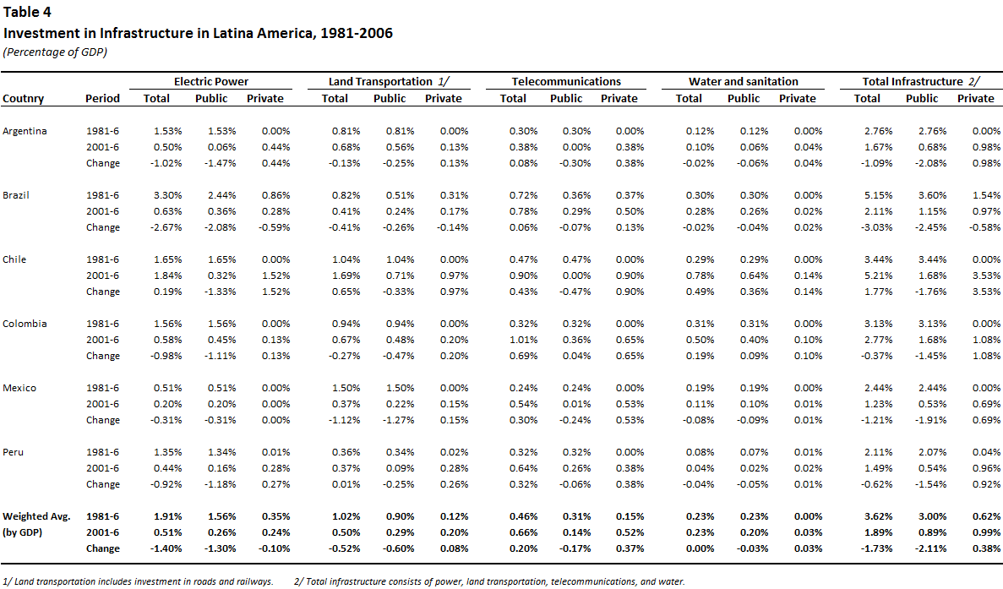
  dp There is an Urban Infrastructure Gap in LAC
Source: Infrastructure in Latin America, César Calderón and Luis Servén, World Bank Working Paper, May 2010
Notes:
No notes

Slide 15
  dp Closing the Gap has Implications for Infrastructure Financing in LAC
MGI estimates that closing the current housing & related infrastructure gap in the next 15 years and supplying future demand will require cumulative investment of nearly $400 billion in five of the major cities of the region and more than $3 trillion in the region as a whole.
Citibank estimates; The difference between existing and needed infrastructure investment in Latin America is USD$170 billion a year to 2020 .
ECLAC estimates Latin America and the Caribbean will have to invest around 5.2% of the region’s GDP annually in order to meet the needs of companies and individuals between 2006 and 2020, assuming average annual economic growth of 3.9% during this period. If, however, the intention were to close the gap with a group of East Asian countries, expenditures would have to rise to 7.9% of annual GDP.
Notes:
No notes

Slide 16
  dp Closing the Gap has Implications for Infrastructure Financing in LAC
Citibank Observes:
Pension funds are also becoming increasingly important in funding infrastructure in Latin America. Some countries there have managed to establish large pension fund industries, in both absolute terms and in relation to the size of their economies.
In December 2010, Chile’s pension funds had accumulated assets equivalent to 63% of its GDP while Peru and Brazil have asset-to-GDP ratios close to 20%. Latin American pension funds also have among the highest allocations to infrastructure projects — around 3% of total assets in countries such as Peru and Mexico.
The increasing investment flexibility of the Specialized Retirement Funds (Siefore) in Mexico is also opening up the possibility of channeling resources to infrastructure projects, especially through structured instruments.
Source: “Bridging Latin America’s Infrastructure Gap” Citibank N.A. 2013
Notes:
No notes

Slide 17
Thank you.
dp david painter / development finance advisor
Notes:
No notes

