Slide 1
Learning From Success:
Reduction of maternal mortality in Rwanda: an integrated approach
Dr. Fidele Ngabo, Maternal Child Health Director

Slide 2
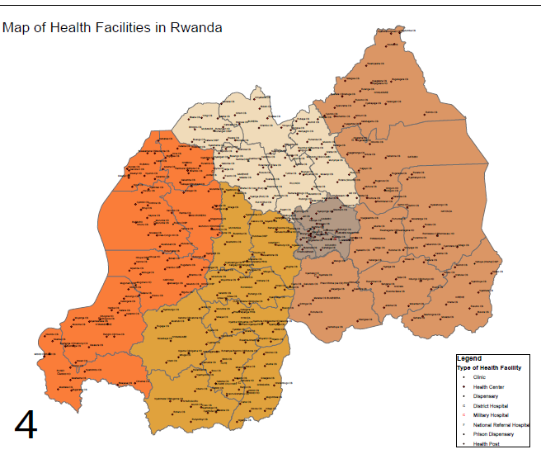
I. Introduction: Map of Health Facilities

Slide 3
I. Introduction (cont.) Administrative and Health Structures
Levels | Admin Structures | Health Infrastructure | Numbers
1. Villages / imidugudu | 14.837 | CHW | 44,511
2. Cells / akagari | 2.148 | Health Posts / FoSaCom | 44
3. Sectors / imirenge | 416 | Health Centres | 450
4. Districts | 30 | District Hospitals District Pharmacies | 40 30
5. Province (incl Kigali) | 4 | (DH to be upgraded to ProvH) | later
6. National | 1 | Nat. Referral Hospitals | 5
Referral systems |  | Ambulances / SAMU | 154
Registered Private HF |  |  | 157
Total Public + Agree HF | (= in bold, being | HC + DH + Nat Ref Hosp | 495

Slide 4
II. Achievements Maternal Mortality Trend

Slide 5
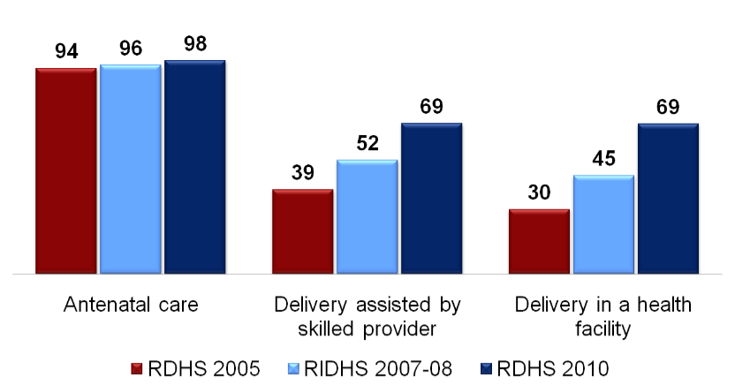
II. Achievements (cont.) Trends in Maternal Health

Slide 6
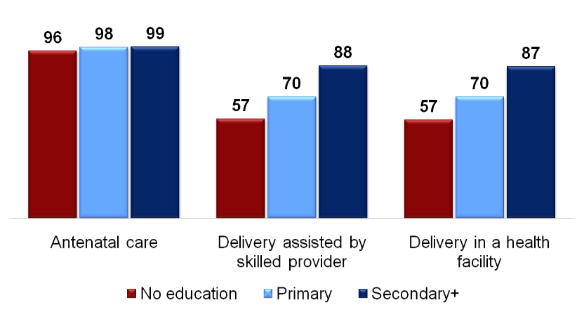
II. Achievements (cont.) Role of Education in Health Improvement

Slide 7
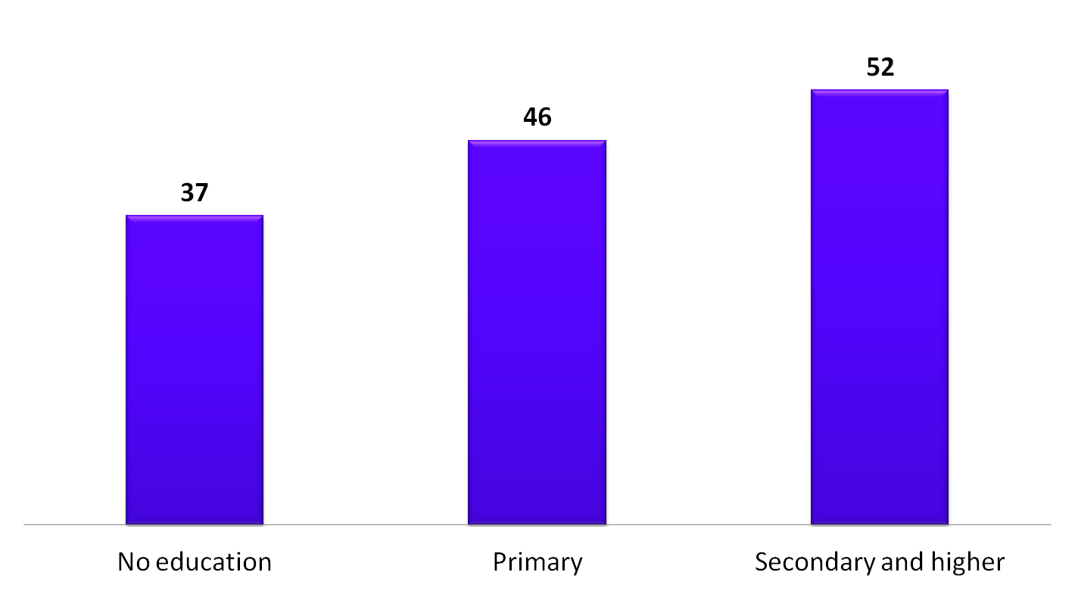
II. Achievements (cont.) Use of Modern Contraception by Education
Percent of married women using any modern method

Slide 8
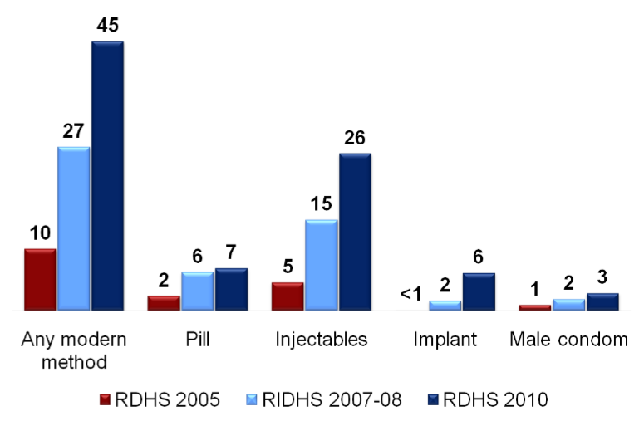
II. Achievements (cont.) Current Use of Modern Methods
Percentage of currently married women using any modern method

Slide 9
II. Achievements (cont.) Fight against Malaria
Decline in incidence, 70% between 2005 & 2010;
Decline in morbidity, 60% decline in out-patient cases between 2005 & 2010;
Decline in mortality, 54% decline in patient deaths between 2005 & 2010;
Increase in percent of pregnant women sleeping under LLINs, from 60 to 73% (2007/8 – 2010)

Slide 10
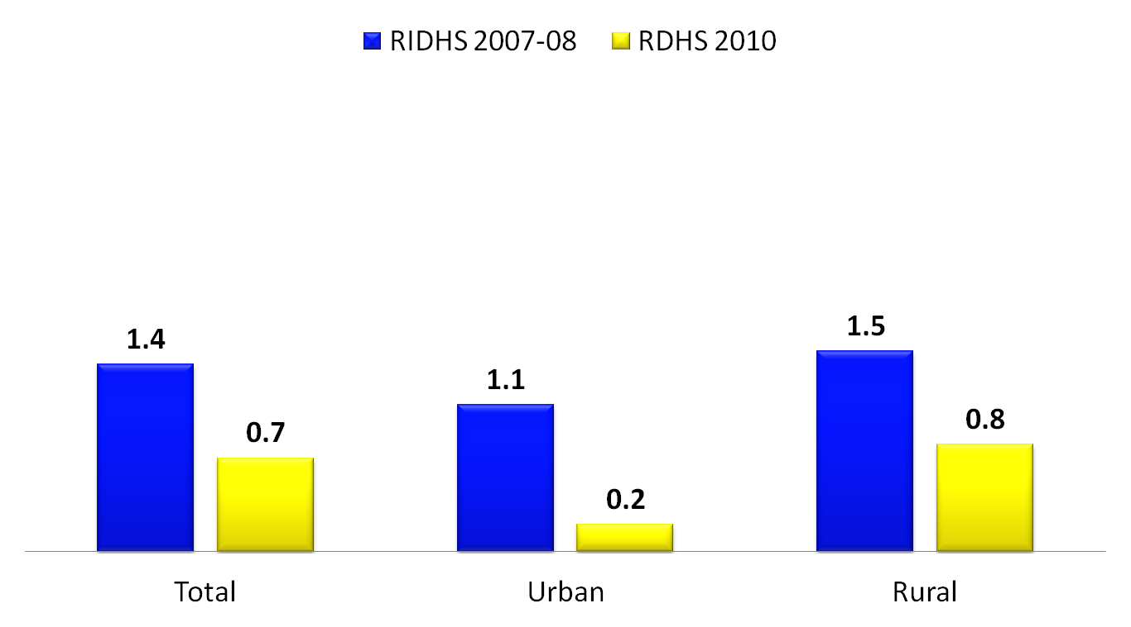
II. Achievements (cont.) Trends in malaria prevalence in women by residence
Percent woman age 15-49 classified as having malaria

Slide 11
III. Contributing Factors to Success
Conducive policy environment:
(Clear policies & strategies are developed and implemented.)
Vision 2020
Economic Development and Poverty Reduction Strategy
Health Sector Strategic Plan

Slide 12
III. Contributing Factors to Success (cont.)
2. Strong commitment from highest level to the grass roots
Performance-based contracts (imihigo) at all levels of government
Women empowerment

Slide 13
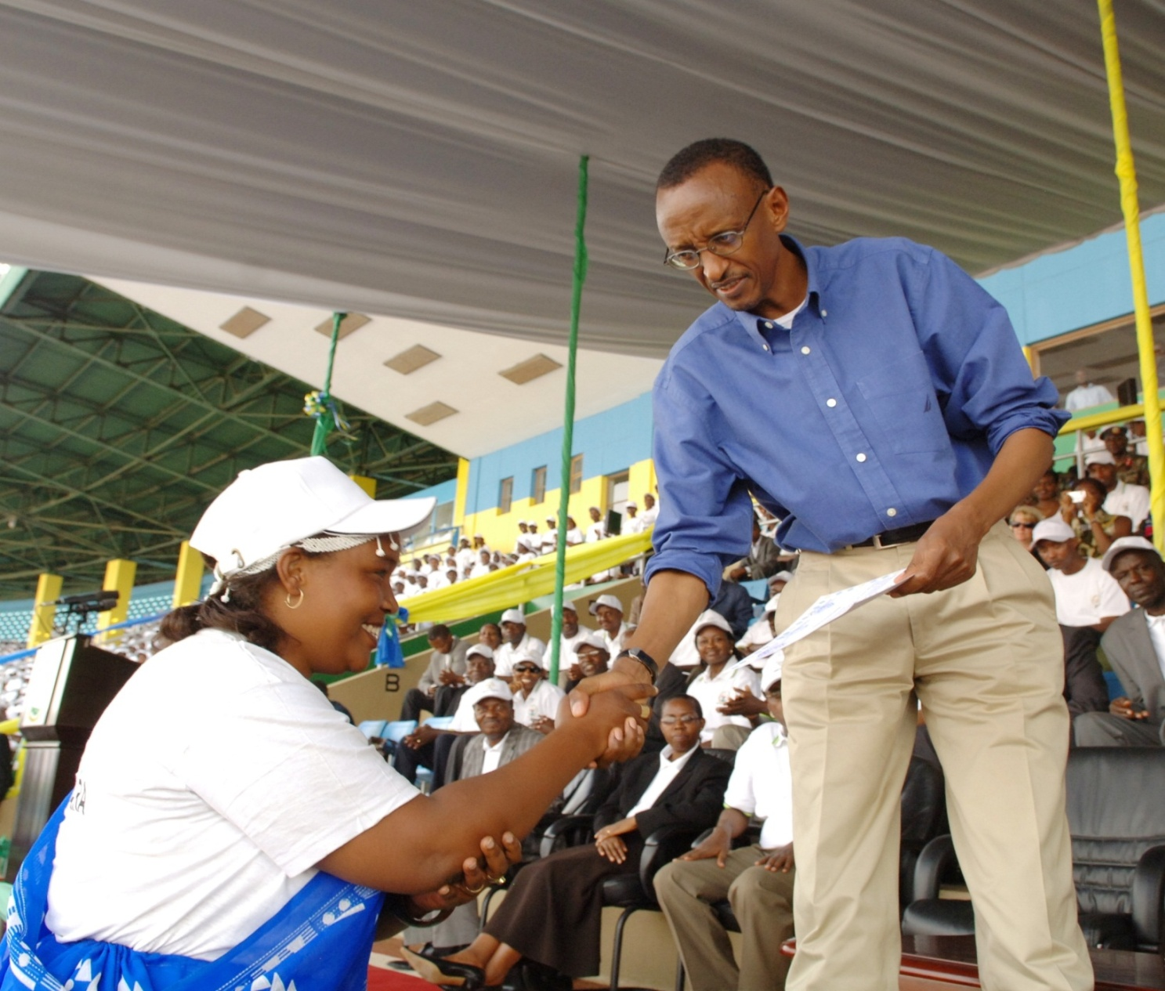
Political commitment to support health services
HE The President meeting the CHWs in 2010

Slide 14
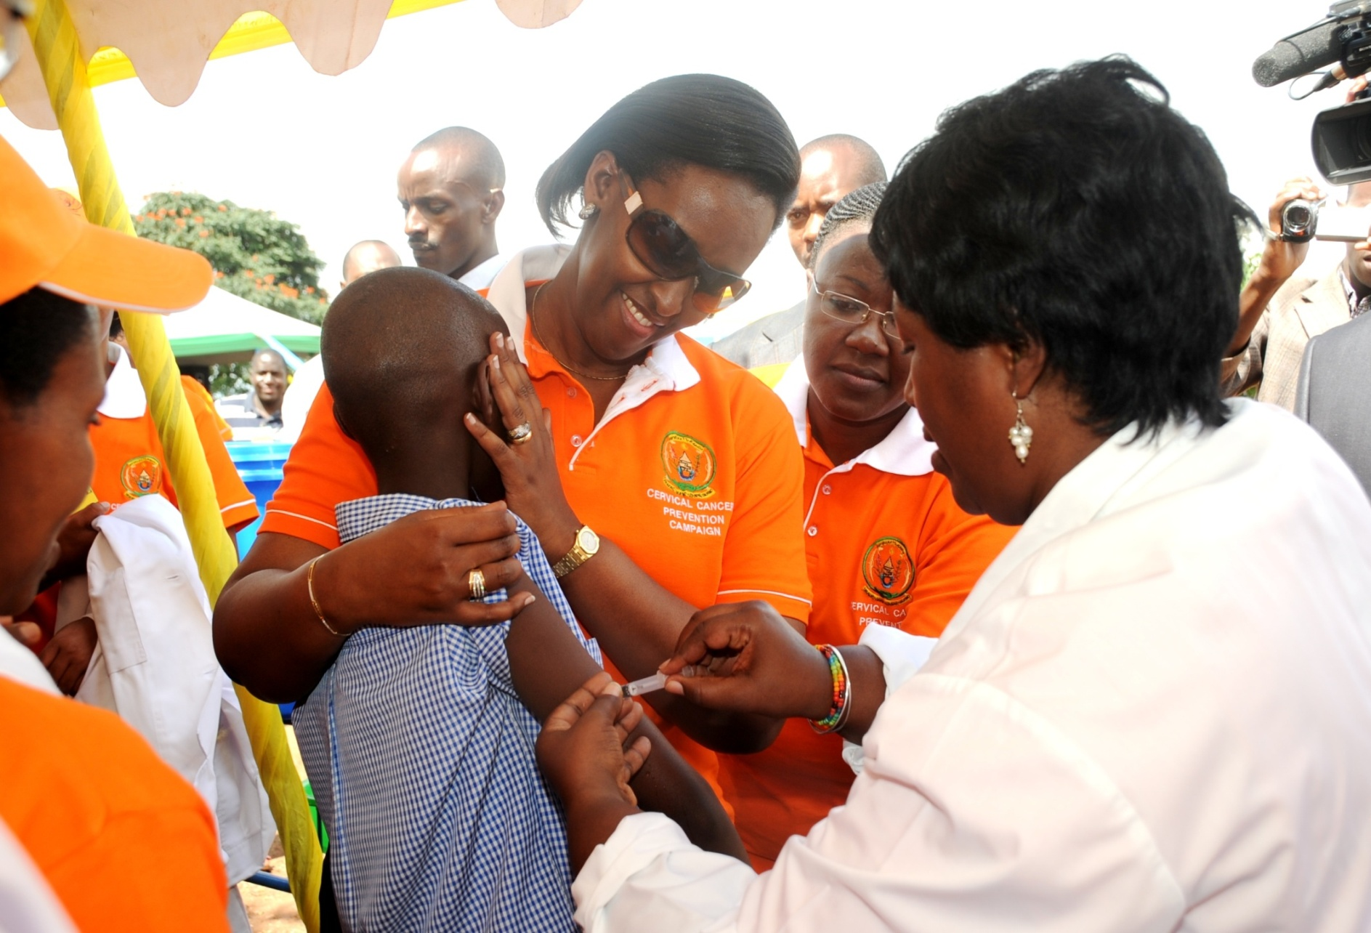
High level support to MCH
HE the First Lady leading the HPV vaccination campaign

Slide 15
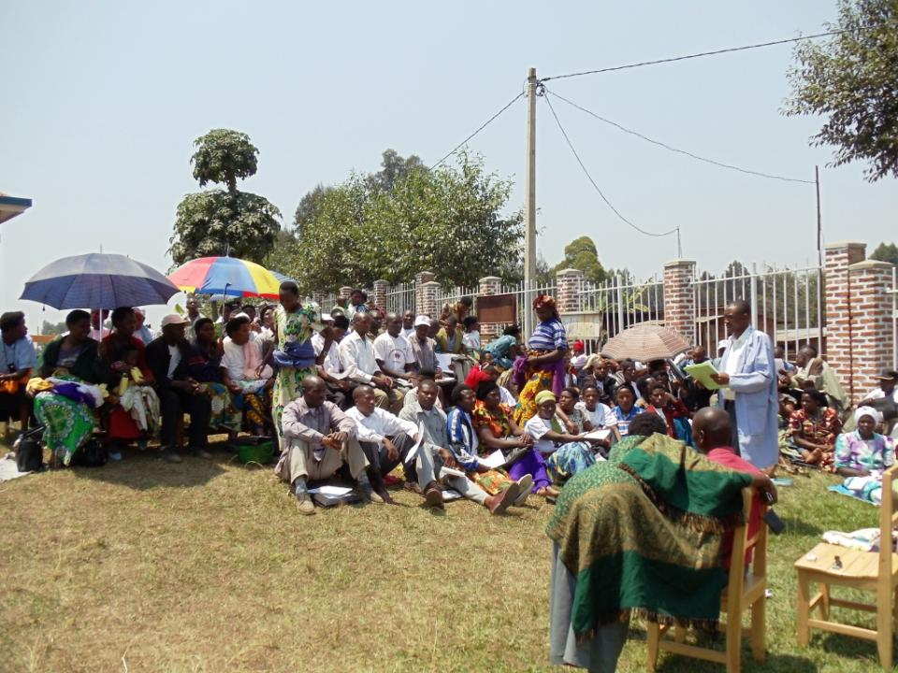
Community Participation: Community discussing health issues in the village

Slide 16
III. Contributing Factors to Success (cont.)
3. Innovative financing systems
Performance-based financing (health facilities and community health workers)
Community-based health insurance coverage (95%)
4. Strong financial support from GOR and from development partners

Slide 17
III. Contributing Factors to Success (cont.)
5. Good Health Sector Coordination:
JHSR: Joint Health Sector Review jointly done every six months by Ministry of Health (MOH) and Development Partners (DPs)
Health Sector Working Groups which include MOH and DPs: to harmonize implementation of activities and avoid duplication
MCH technical working Group

Slide 18
III. Contributing Factors to Success (cont.)
6. Accountability at All Levels
Sector-Wide Approach (SWAP): All resources are provided in the context of a defined Health Sector Strategic Plan under Government leadership and in partnership with DPs
Mid Term Review Framework: A systematic and effective use of results-focused budget planning, preparation and review approaches over a medium term; it allows an efficient and effective management of public funds and sound stewardship
Transparency in financial management with regular financial audits

Slide 19
IV. Sustaining Successes
Maintain Government commitment
Strengthen health policies, strategies and systems
Strengthen community involvement
Strengthen women empowerment
Increase male involvement in reproductive health
Strengthen partnership for knowledge sharing
Continued support from DPs to strengthen a sustainable health system

Slide 20

Murakoze! Thank you!

