Slide 1
FERTILITY, POPULATION, & EMPOWERING WOMEN
Suzanne Ehlers
President and CEO Population Action International
The World at 7 Billion: Building a Sustainable Future
George Mason University and the Woodrow Wilson Center’s Brazil Institute/ ECSP
December 5, 2012, Woodrow Wilson International Center for Scholars, Washington DC

Slide 2
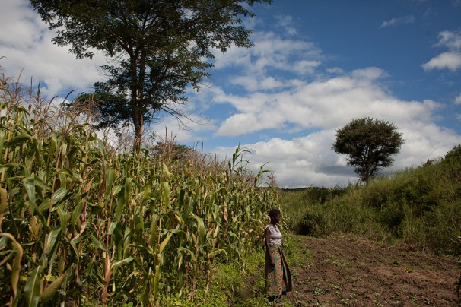
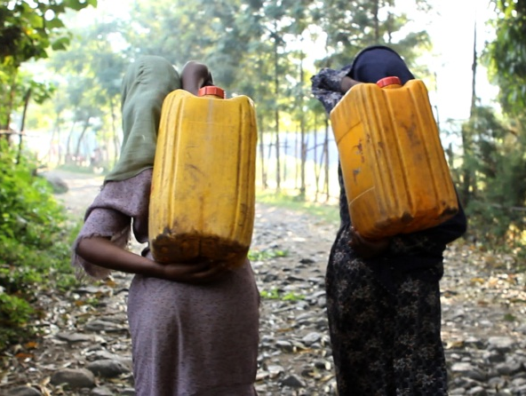
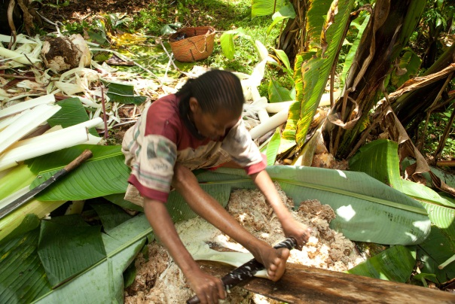
Presentation Outline
The evidence
Some solutions, both policy and program
Why these efforts fall short
-- What we’re missing --
The opportunities ahead

Slide 3
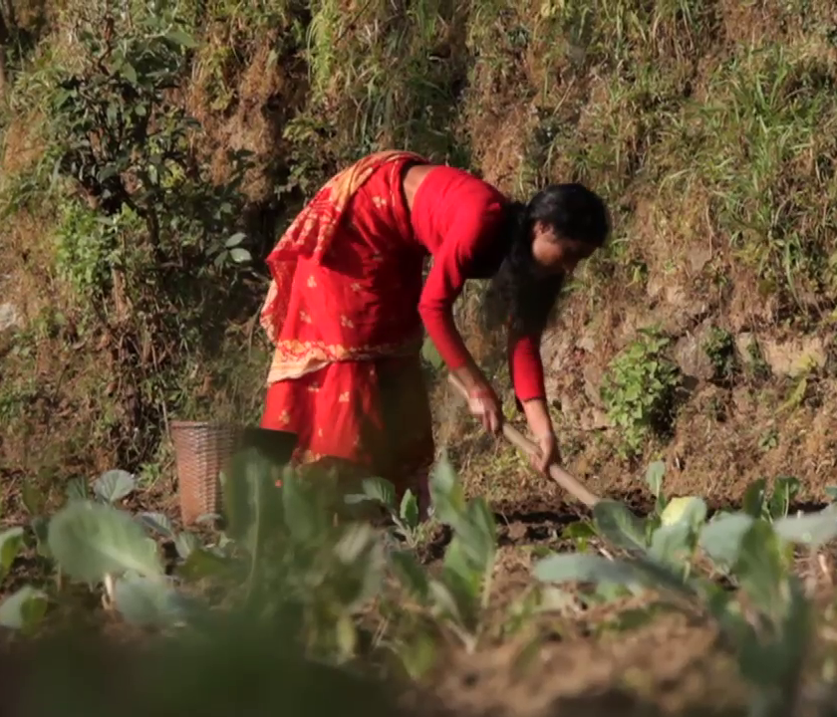
Population Projections – Opportunity Not Destiny
PROJECTED WORLD POPULATION GROWTH, 2010 – 2050

Slide 4
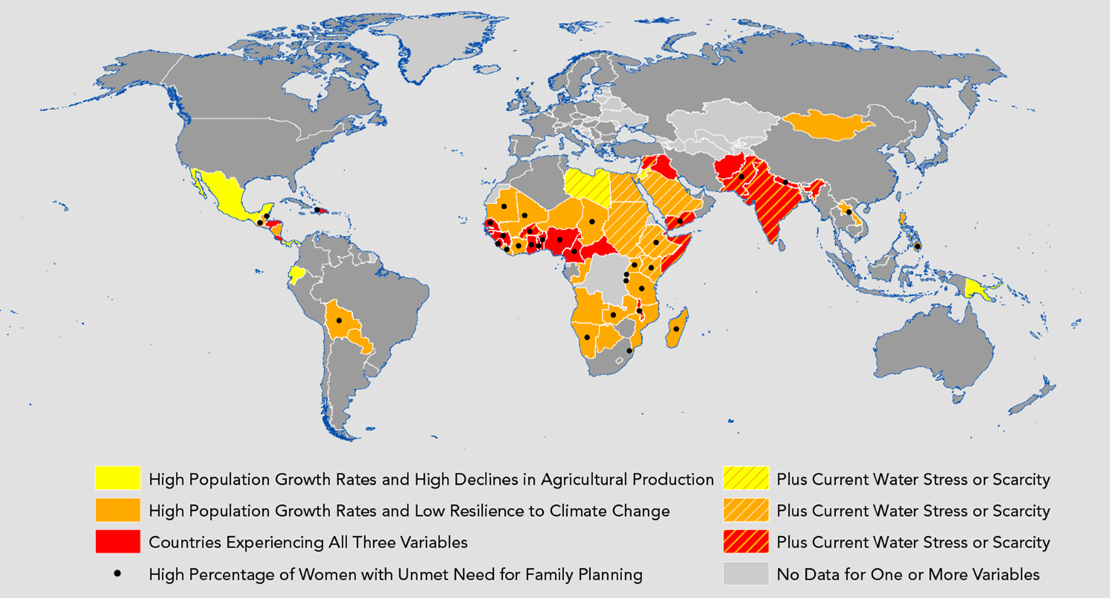
Population and Climate Change Hotspots

Slide 5
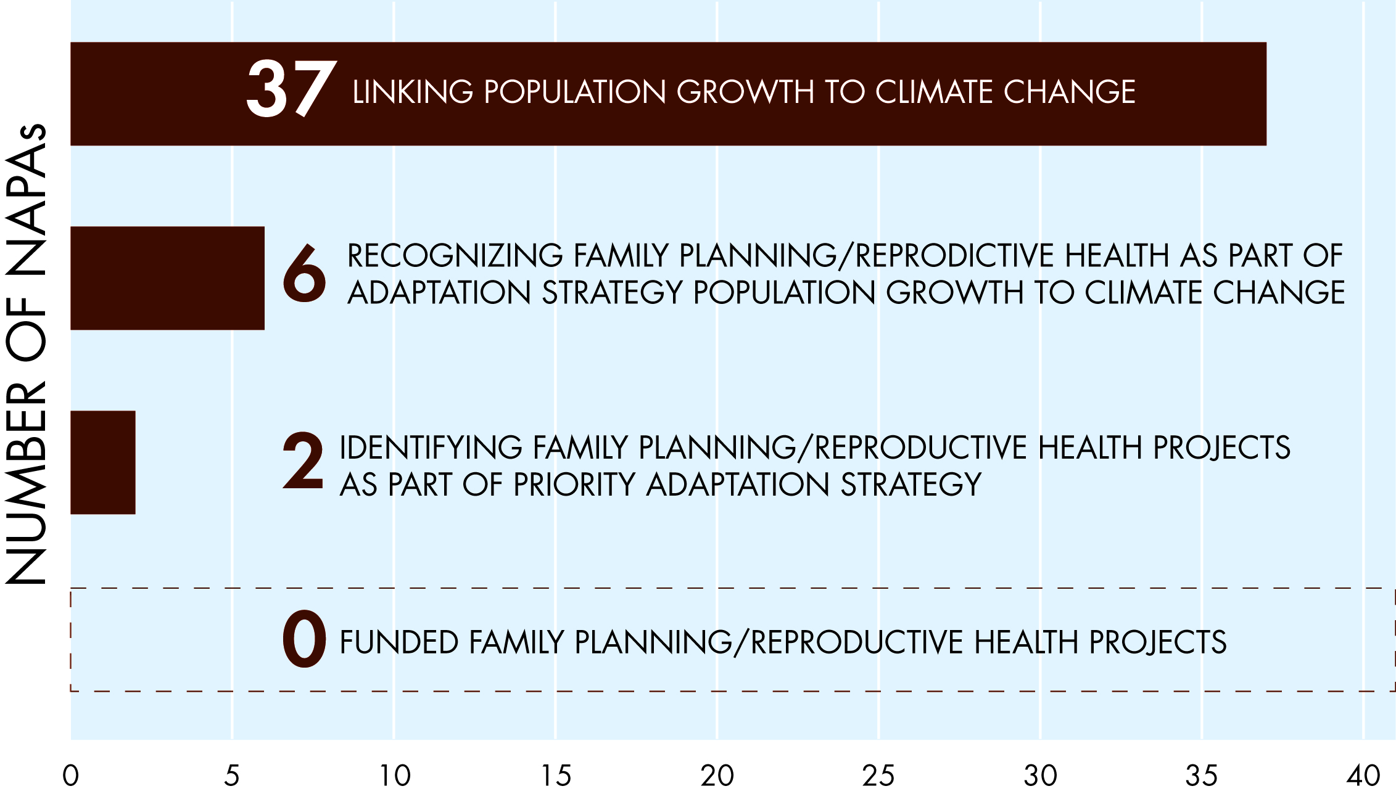
Learning from Missed Opportunities:
The Case of NAPAs

Slide 6
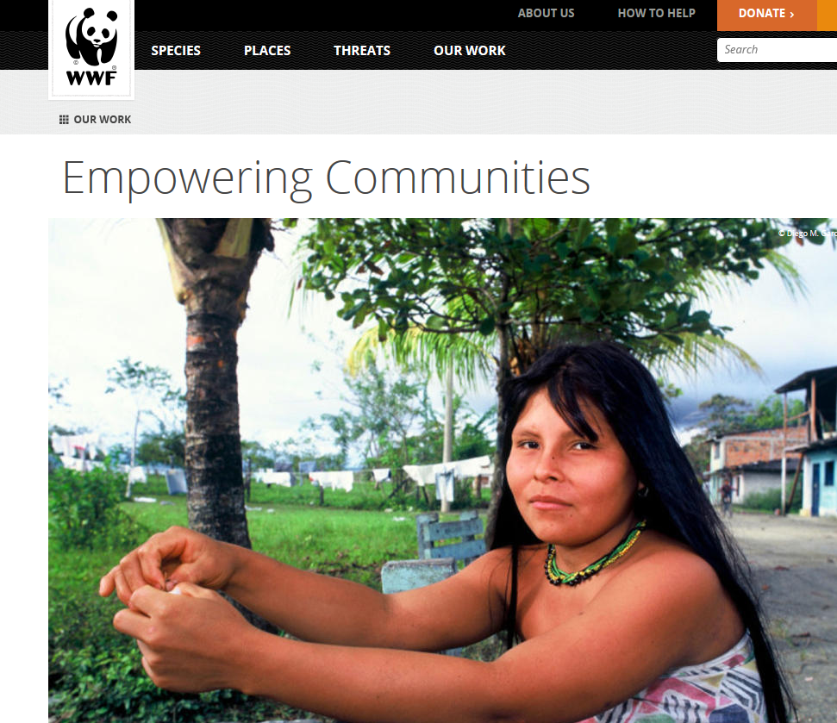
Seeking Integrated Solutions: Case of PHE Programs
PHE Statutory Language
Family planning funds
“should be made available…including in areas where population growth threatens biodiversity or endangered species.”

Slide 7
Recent Achievements:
Policy Research, Program, Advocacy
In the United States, USAID’s climate policy includes population
In Europe, Population and Climate Change Alliance informing E.U. policy; Danish Family Planning Association part of Danish delegation to Rio+20
Asia-Pacific Forum for Parliamentarians on Population and Development is including climate as part of its 5-year plan
PAI leading population track at International Community Based Adaptation conference
Engagement with WWF/ CARE, Chemonics, IUCN and many others on sustainability and gender policies and programs

Slide 8
Make Women the Heroines of the Story
Lead with population and the environment:
Protagonist is human population.
Mission becomes population reduction.
Frame: problematic, coercive, control, mitigation.
Lead with woman who wants to determine her future through spacing, timing and number of children:
Protagonist is a woman.
Mission is addressing individual rights and needs.
Frame: autonomy, solutions, women’s empowerment, adaptation.
Credit to Resource Media’s Sustainability and Family Planning

Slide 9
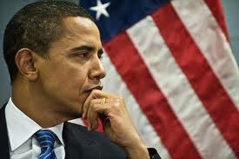
Why the Time is Right… Now
In the recent election:
Voters rejected extreme views
Voters also rejected attacks on contraception
Large gender gap in presidential race
Global engagement wins
Bipartisan support (always) needs shoring up
Power of Smart Power agenda: defense, diplomacy and development
Not to mention FP2020!

Slide 10
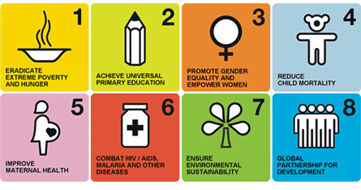
Near-Term Opportunities for Policy & Advocacy
Incorporate population, reproductive health and family planning into global and national frameworks, policies and programs for sustainable development.
Feed the Future
A Promise Renewed
Millennium Development Goals
Sustainable Development Goals
International Conference on Population and Development
Notes:
Clive fill in more on content

Slide 11
The Future We Are Building: Towards 2015
Policy research: Policymakers understand how demographic variables and access to reproductive health/family planning increase climate resilience, improve SD efforts
Advocacy: Global and national discussions, and policies and programs include the links between population, FP/RH, and sustainable development
Program interventions: Vulnerable communities become more resilient through field-based programs that incorporate population dynamics into climate adaptation, water security efforts, biodiversity protection

