Slide 1
Global
Food Safety Capacity Building
Partnership
(GFSP)
Brian G. Bedard
The World Bank
Notes:
Describe World Bank

Slide 2

Global Problem
Local Solutions

Slide 3
Food Food Control System Level
Policies, laws, regulations, dynamics and relationships between stakeholders, etc.
a
Policies, laws, regulations, dynamics and relationships between stakeholders, etc.
Organization (GOVT and FBO) Level
Staff, budgets, information resources, infrastructure, procedures, culture,
, infrastructure, procedures, culture, etc.
Individual Level
Knowledge, skills, work ethics, competency, HRD Individual Level
.
Notes:
The modules assess capacity building needs at different levels of the food safety system as illustrated on the slide.
Considering these different levels of food safety capacity is important because the causes of weak capacity may be found at different levels.
For instance, the capacity of a food inspectorate may be shaped as much by the state of laws and regulations as by the agency’s own internal resources (such as the skills and qualifications of inspectors, financial resources, equipment and vehicles, etc.).

Slide 4
Global Food Safety Partnership
APEC PTIN
WB Secretariat Roadmap – 5 Years
Partners
International Agencies
National
Governments
Industry
Consumer groups
Universities
NGOs
Other
Stakeholders
GFSP DGF
GFSP Multi Donor Trust Fund

Slide 5
#1
Training Program Implementation
#2
Global Scaling up
#3
Program Facilitation
Learning Platform
Open Education Resources
Curriculum Development
Food safety regulatory system
Value chain Support
Risk analysis
Laboratory competency
Incident management
Regional/County
Needs Assessments
On-farm
GAP
Food Safety Incident Network (INFOSAN/EURASFF)
Communication
Monitoring and Evaluation
Facilitation of GFSP
SAR
LAC
ECA
AFR
MENA
Responsive activities
EAP
Notes:
PulseNet

Slide 6
Approach
Country selection by regions
National food safety needs assessments
Country action plan
  National food safety control system
  Agribusiness and value chains
  On-farm food safety – GAP
  Auditing and certification training

Slide 7
The Capacity Building Process
Capacity Building Needs Assessment
Negotiate resources (external/internal)resources (external/internal)
Consultation and dialogue with stakeholders
(internal and external)
on and dialogue with stakeholders
(internal and external)
Analyse existing food safety capacity
Define the desired future of the food safety system
food safety
capacity building strategy
apacity buFood safety capacity building strategy
ilding strategy
Food safety training activities
(incl M&E)d evaluation)
Consultation and dialogue with stakeholders
IaIdentify capacity gaps and needs for food safety
safety
External support
(advice and/or resources)
Notes:
System approach
Without a clear understanding of current capabilities and gaps in abilities, efforts to strengthen capacity will be less than optimal.
A capacity building needs assessment is therefore an essential initial step in the process of developing diverse types of food safety capacities. This process should be open and participatory. Consultation and dialogue with relevant external stakeholders is vital – both during the needs assessment and subsequent capacity building activities.

Slide 9










The MoGlobal Markets Program - Industry
del
GFSI
Recognized Schemes
100%
12 Months
GFSI
Guidance
Document
Requirements
(6th Edition)
70%
Manufacturing
60%
Primary Production
Matching Level
12 Months
Global
Markets
Basic Level
+
Intermediate Level
40%
Primary Production
Global
Markets
Basic Level
30%
Manufacturing
Notes:
Welcome to everyone
New people to WGs raise hand
I know that there is a lot of experience in the room but there are also people first meeting and observers

Slide 10
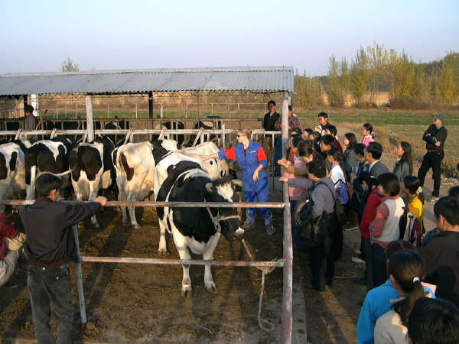
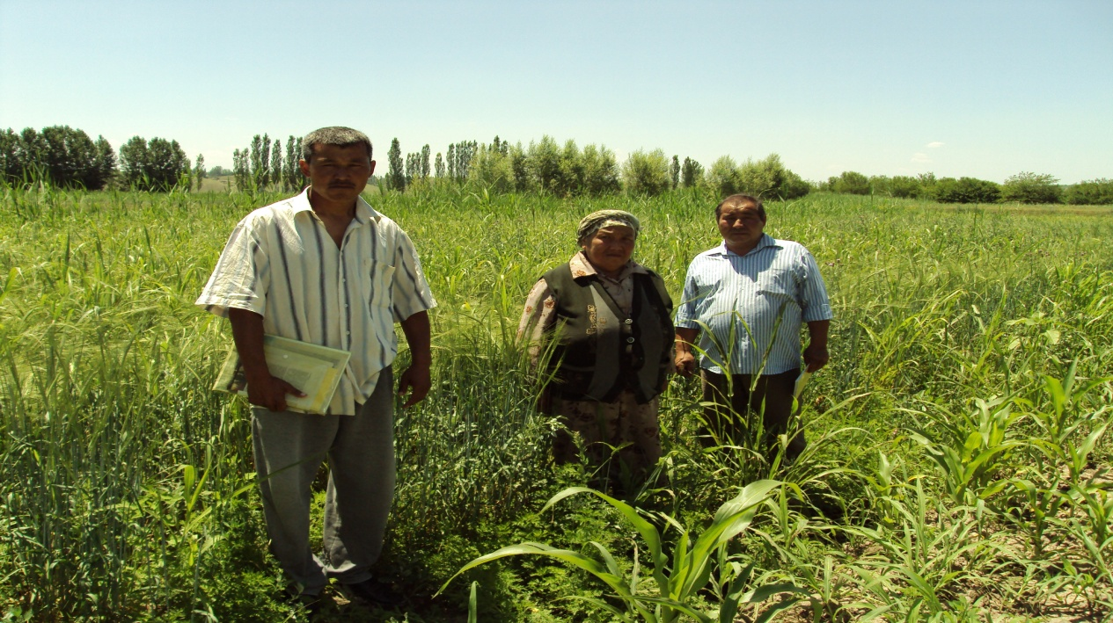
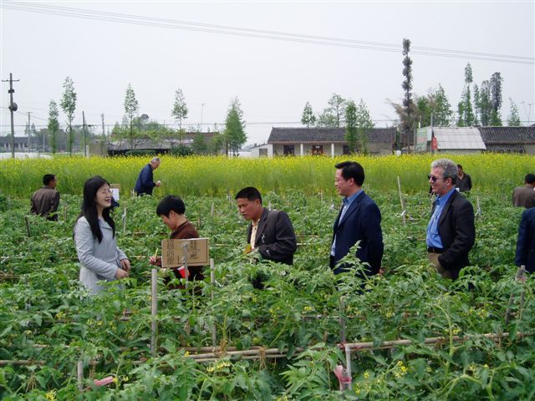
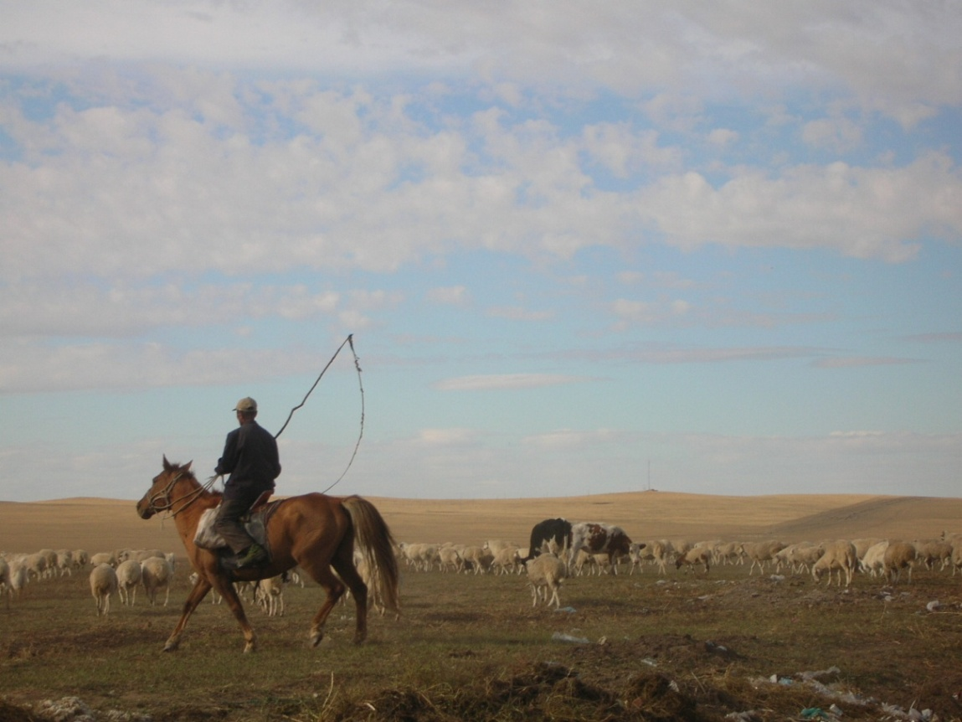


Slide 11
Understanding, Knowledge and Motivation
Capacity Building
Training - Technical Assistance - Education
    Public sector – inspectors, regulators, managers
    Private sector – enterprises, food business operators
    On-farm quality assurance: raw material supply
    Experts – consultants, auditors, trainers
    Consumers and public awareness

Slide 12
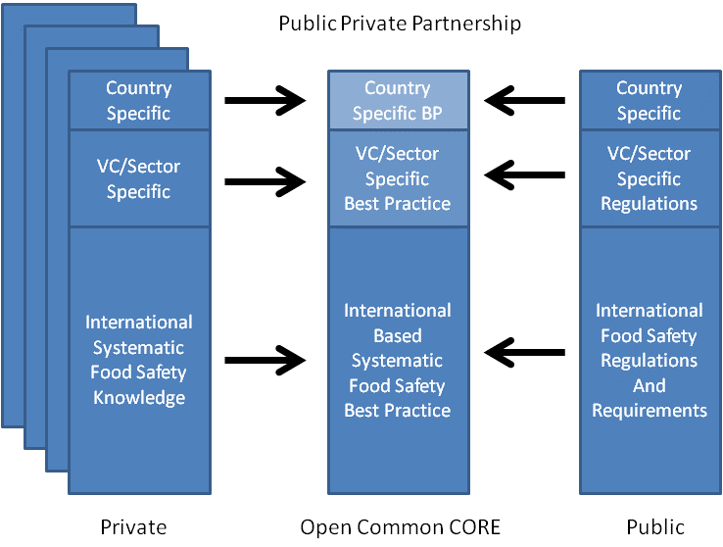
Content design
Notes:
Open source IT knowledge platform
Training ➔ Competency – based
Behavioral change
Linked to existing resources
Needs based training and education
In-service, vocational, continuing education, professional development

Slide 13
APEC Regional Food Safety Capacity Priorities
HACCP
China
E-Learning (1 month) + Residential (10 days) Certificate Program
Government, Companies, Academia
Scale up in China & Globally
Replicate

Slide 14
Why the GFSP?
Awareness raising
Scaling up: local ➔ regional ➔ global
Donor collaboration on food safety
Advocacy: mycotoxins a major hazard class
Cross-sectoral, coordinated approach
Assimilating into ongoing programs
Public good, private sector, civil society ➔ PPP

Slide 15
Local and Global Solutions
Systemic improvement and behavior change
Challenges common across cultures, languages and political boundaries
Global learning and information sharing
Spillover effects GAP, SPS infrastructure and compliance, health and nutrition
Measurable results – aflatoxins, public health indicators?

Slide 16
Good Agricultural Practices
Changing behavior
Aflatoxin-resistant planting materials
Aflasafe and related technologies
Irrigation, fungicides, herbicides and insecticides for healthier plants
Ammoniation and commercial techniques
Moisture-control measures: solar drying and hermetic storage
Promote safe disposal and alternative use of unsafe commodities
Aflatoxins in animal feeds

Slide 17
Communication
Awareness raising and advocacy
Promote aflatoxin safe value chains
Agro-dealer education
Educate retailers and consumers
Train traders, processors, manufacturers
Livestock producers
Feed industry

Slide 18
Mainstreaming Aflatoxins
Government and donor programming
Public health, nutrition, agriculture
Value chain development and competitiveness
Food safety control system upgrading
Enhanced food safety laboratory capacity
Import and export controls

Slide 19
Food Safety - A Global Public Good
public health
food security
poverty alleviation
shared prosperity
economic development
social well-being
market access / global trade
innovation
Notes:
Global public good
Linked to other development issues
Key driver in agri-food sector

