Slide 1
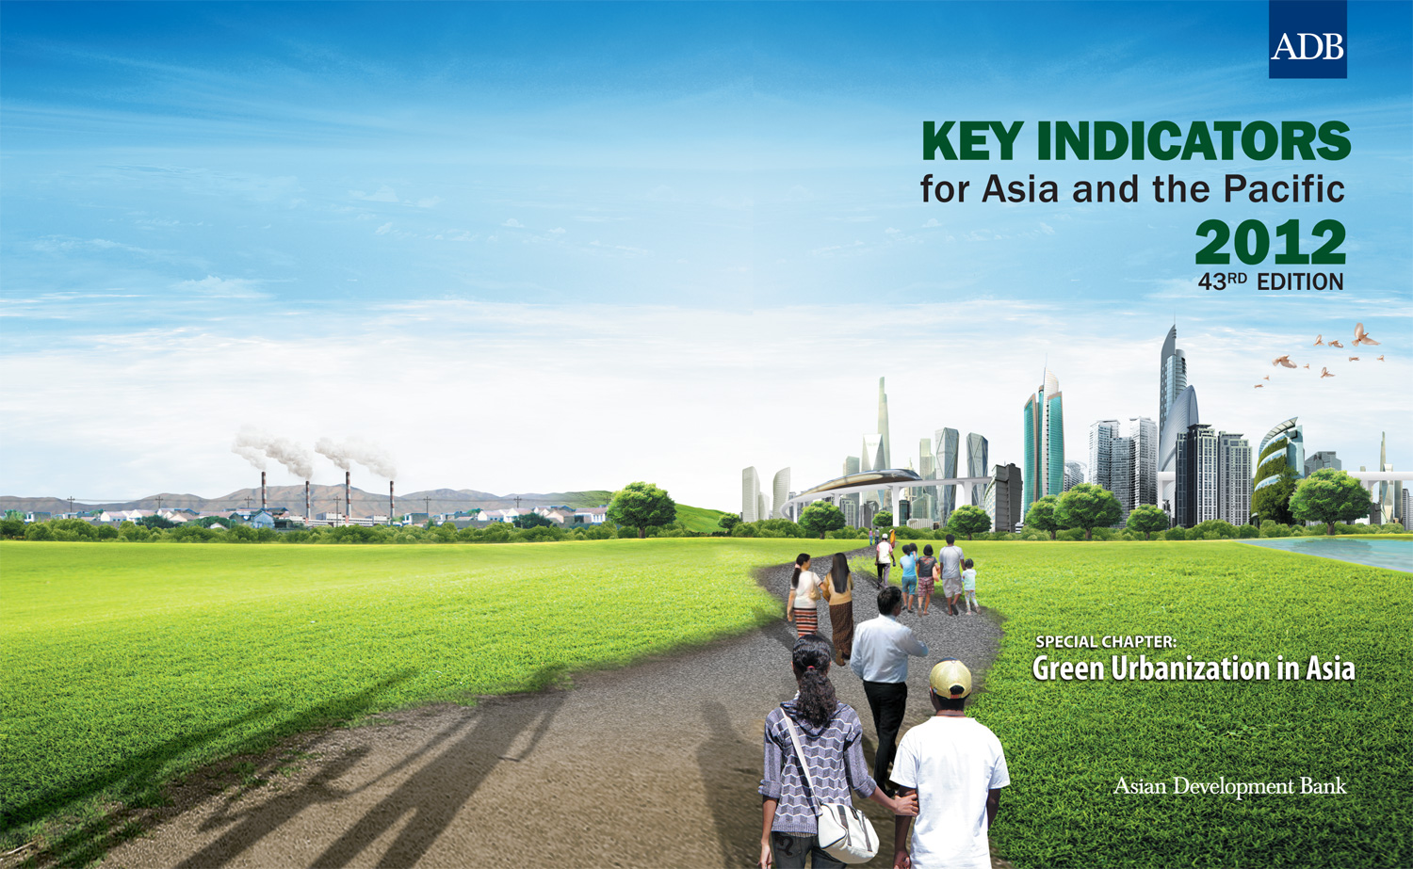
Guanghua Wan Principal Economist

Slide 2
Main Messages
Asia’s urbanization is unprecedented & unique in several aspects
… leading to enormous challenges possibly including environmental degradation
But urbanization can help!
To ensure a win-win scenario, green urbanization policies shall exploit unique features of Asia’s urbanization and late comer’s advantage

Slide 3
Asia’s urbanization is unprecedented
1 billion
Source: ADB estimates using UN(2012).
Notes:
From 1980 to 2010, Asia added more than a billion people to its cities -- more than all other regions combined -- with a further billion set to be city dwellers by 2040. This massive scale of urbanization is taking place most notably in the PRC, India, Pakistan, Indonesia and Bangladesh. By the latest estimates, Asia is now home to almost half of all urbanites on earth and its urban population is more than three times that of Europe – the region with the second largest urban population.

Slide 4
Unique feature 1: very fast speed
10%
210 years
49%
9%
105 years
51%
12%
150 years
51%
95 years
51%
11%
12%
90 years
50%
12%
65 years
54%
10%
60 years
52%
10%
55 years
51%
11%
61 years
51%
Source: ADB estimates using Bairoch (2008) and UN(2012).
Notes:
Asia’s urbanization is rapid, with the PRC transitioning from 10% of its population in urban areas to 50% urban in just 60 years, versus 210 years in Latin America and the Caribbean, 150 years in Europe, and 105 years in North America. And Asia’s urban population is projected to continue growing faster than that of any other region.

Slide 5
Unique feature 2: highest densities in the world…
Asia & the Pacific (17/25)
Africa
Europe
Latin America & Caribbean
Middle East & North Africa
Source: www.citymayors.com
Notes:
In total, 17 of the 25 densest cities are in Asia. The three densest cities are in South Asia and 8 of the top 10 are in Asia.

Slide 6
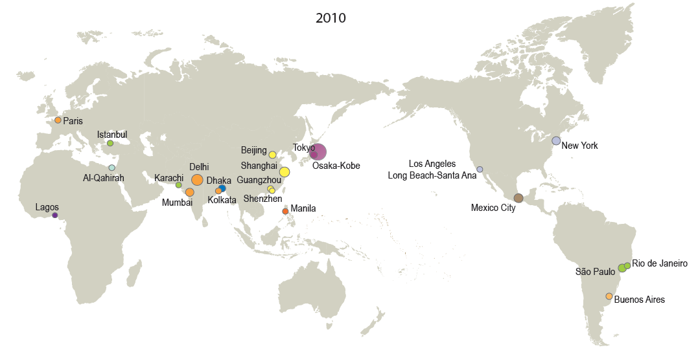
Unique feature 3: many megacities
Megacities, 2010
ASIA: 12/23
Note: The circles indicate population sizes ranging from (10 million) to (39 million). The circles do not reflect the physical extents of the cities and any overlap between them merely reflects their relative population sizes and not any official acceptance or endorsement of any geographical sovereignty.
Source: UN (2012).
Notes:
In 2010, 12 out of 23 of world’s megacities were in Asia …
Note: the sizes of circles reflect their population, not their geographical extent (those shown do not actually overlap).

Slide 7
Unique feature 4: low starting base
Northern America
67%
Europe
63%
52%
WORLD
Latin America & Caribbean
43%
ASIA & PACIFIC
Africa
Source: ADB estimates using Bairoch (2008) and UN(2012).
Notes:
In 2010, the urban share of Asia’s population was still only 43%, compared to 52% worldwide. By 2050, the urban share in Asia is projected to reach 63%, gaining on but still below the 67% global average. Thus Asian cities will likely grow bigger and have even higher density.

Slide 8
Unique feature 5: the largest cities are likely to grow bigger
Ratio of Population in Largest Cities over Urban Population (%)
Source: ADB estimates using UN(2012).

Slide 9
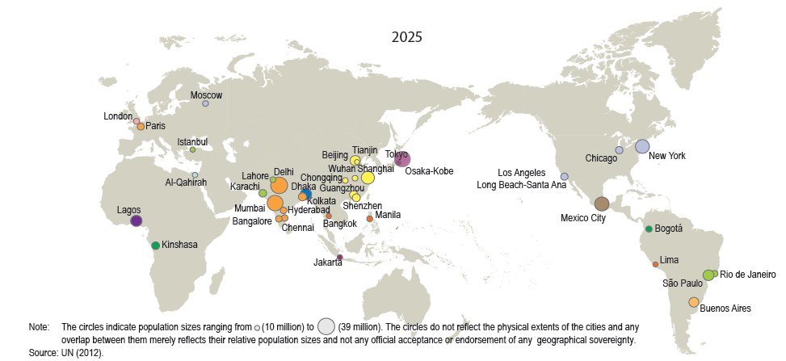
… thus more and bigger megacities are emerging
Megacities, 2025
ASIA: 21/37
Note: The circles indicate population sizes ranging from (10 million) to (39 million). The circles do not reflect the physical extents of the cities and any overlap between them merely reflects their relative population sizes and not any official acceptance or endorsement of any geographical sovereignty.
Source: UN (2012).
Notes:
By 2025, the number of megacities in Asia is expected to increase to 21 out of a global total of 37. The additional Asian cities include: Chongqing, Tianjin, and Wuhan in PRC; Bangalore, Chennai, and Hyderabad in India; Jakarta in Indonesia, Bangkok in Thailand, and Lahore in Pakistan.
Note: the sizes of circles reflect their population, not their geographical extent (those shown do not actually overlap).

Slide 10
Unprecedented urbanization poses enormous challenges already serious
Growing inequalities
Rising urban crimes
Expansion of slums
Above all, environmental degradation
  Pollution
  Vulnerability to flooding

Slide 11
67% of Asian (vs. 11% Non-Asian) cities fail to meet EU air quality standard
EU standard
Source: WHO (2012).
Notes:
34/57 = 60% cities with PM10 above 100ug/m³ are in Asia, while air pollution contributes to half a million deaths a year in the region. Air pollution in Asian cities is higher than in other regions and a staggering 67% of Asian cities (vs 11% of non-Asia cities) fail to meet the EU’s air quality standard of 40 μg/m³ for PM₁₀.

Slide 12
CO₂ emissions grow fast in Asia
Source: ADB estimates using World Bank (2012).
Notes:
Between 2000 and 2008 average per capita greenhouse gas emissions grew by 97% in Asia compared to 18% in the rest of the world, and most emissions are coming from urban areas.

Slide 13
… and three of the top five CO₂ emitting economies are in Asia.

Slide 14
Environment may degrade further with growth
Asia’s Environmental Kuznets Curve
2010=$6,107
Peak=$40,971
Source: ADB estimates using World Bank (2012).

Slide 15
CO₂ emissions may triple under the business-as-usual scenario
Source: ADB estimates using World Bank (2012).

Slide 16
Asia is more vulnerable to coastal flooding
Risk of Coastal Flooding by Region, 2000
 | Urban population at Risk (million) | Share of Population at Risk (%) | Urban Area at Risk ('000 km²) | Share of Area at Risk (%)
Africa | 32 | 11 | 18 | 6
Asia and Pacific | 251 | 18 | 129 | 11
Latin America | 24 | 8 | 42 | 6
Europe | 40 | 7 | 56 | 7
Source: ADB estimates based on McGranahan et al. 2007.
Notes:
In 2000, 18% of Asian urbanites were at risk of coastal flooding, versus 11% for Africa, 8% for Latin America, and 7% for Europe. In terms of total urban population, 251 million Asians were exposed to this risk, compared with 40 million Europeans, 32 million Africans, and 24 million Latin Americans.

Slide 17
Coastal flooding is clustered in PRC, South & Southeast Asia: Top 15 cities, 2000
Country | City | Population at risk (%) | Population at risk ('000) | City Area at risk (km²) | Area at risk (%)
PRC | Tianjin | 100.0 | 5,500 | 2081 | 100.0
PRC | Panjin | 100.0 | 1,000 | 690 | 100.0
Bangladesh | Khulna | 99.9 | 1,100 | 394 | 99.8
PRC | Nantong | 99.8 | 1,000 | 286 | 99.9
PRC | Changzhou | 99.0 | 2,000 | 362 | 99.0
PRC | Jiangyin | 96.8 | 1,200 | 492 | 96.8
PRC | Suzhou | 95.8 | 1,300 | 368 | 91.2
Indonesia | Palembang | 94.2 | 1,300 | 473 | 89.5
Thailand | Bangkok | 93.3 | 8,800 | 4805 | 80.2
PRC | Wuxi | 91.1 | 1,300 | 397 | 91.0
PRC | Shanghai | 90.8 | 14,000 | 2416 | 98.2
India | Kolkata | 89.0 | 14,000 | 1441 | 62.9
PRC | Ningbo | 85.6 | 1,700 | 779 | 85.6
Indonesia | Ujung Pandang | 85.4 | 1,200 | 295 | 68.7
Viet Nam | Ho Chi Minh | 79.3 | 4,400 | 890 | 72.6
Source: Balk and Montgomery (2012).
Notes:
Asia has more than 750 urban settlements (of at least 5,000 people, most much larger), the population of which is fully in low-lying zones with 100% vulnerability to coastal flooding. Coastal flooding is concentrated in PRC, South and Southeast Asia.

Slide 18
Inland flooding is also serious: Top 15 cities, 2000
Country | City | Population at risk (%) | Population at risk ('000) | City Area at risk (km²) | Area at risk (%)
Cambodia | Phnom Penh | 99.0 | 988 | 204 | 99.0
PRC | Wuhan | 82.0 | 5300 | 956 | 82.0
Indonesia | Palembang | 80.0 | 1100 | 257 | 49.0
India | Patna | 72.0 | 1100 | 436 | 72.0
Bangladesh | Dhaka | 60.0 | 5400 | 680 | 48.0
PRC | Nanjing | 56.0 | 2200 | 749 | 56.0
Vietnam | Ho Chi Minh | 50.0 | 2800 | 306 | 25.0
PRC | Tianjin | 50.0 | 2800 | 795 | 38.0
PRC | Huangshi | 50.0 | 624 | 170 | 45.0
PRC | Huainan | 50.0 | 614 | 277 | 49.0
PRC | Wuhu | 47.0 | 552 | 140 | 48.0
Thailand | Bangkok | 46.0 | 4400 | 2165 | 36.0
PRC | Bangbu | 44.0 | 510 | 198 | 44.0
India | Guwahati | 44.0 | 507 | 159 | 35.0
India | Allahabad | 42.0 | 665 | 230 | 43.0
Source: Balk and Montgomery (2012).
Notes:
and more than 300 settlements are 100% vulnerable to inland flooding. Inland flooding is concentrated in Southeast, East and South Asia

Slide 19
Vulnerability will rise with urbanization
Source: Balk and Montgomery (2012).
Notes:
With a projected 410 million urban Asians at risk of coastal flooding by 2025. Over 300 million were already at risk of coastal flooding in 2010, and about 250 million at risk of inland flooding such as struck Bangkok last year. The latter number will also rise, to roughly 350 million by 2025. More than half the population in large cities like Dhaka, Ho Chi Minh City and Tianjin are at risk from both inland and coastal flooding.

Slide 20
Unique features of Asian urbanization make challenges more serious...
Low level = a long way to go
Fast speed = little time to adjust or learn
More & bigger megacities = hard to manage
More slums = higher vulnerability

Slide 21
But, urban agglomeration can help
Service sector pollutes less
Manufacturers relocate
Efficient provision of infrastructure and services
Better quality of life
Innovation and higher labor productivity
Nurture property owners and middle clss
And ...

Slide 22
Urbanization leads to lower fertility
Notes:
Based on our estimation, a total reduction of 169.28 million in the population increase that might have happened without urbanization during 2010–2050, more or less evenly distributed over different decades (Figure 27). Under the “business as usual” scenario of slide 16, this amounts to an additional 1,727 million tons of CO2 in 2050, 65 .million tons more than the combined emissions of India and Viet Nam in 2009

Slide 23
… and more human capital

Slide 24
… better health as well
Source: UN (2011) and (2012).
Notes:
Infant mortality decreases with increasing urbanization.

Slide 25
The growth/composition/technical impacts of urbanization on environment
The growth impact may be negative
The composition effect is positive
Technical effect is also positive
Most importantly, Asia as a late comer can leapfrog R&D and technology
… and for adopting regulations timely

Slide 26
Environment-Urbanization relation has improved over time
Environment-Urbanization Curves
PM₁₀
1990s
CO₂
1990s
2000s
2000s
Source: ADB estimates.
Notes:
Shift left ➔ peak will be reached (and passed) sooner
Shift down ➔ problem will be less (in aggregate or per capita) than otherwise

Slide 27
Green urbanization can help shift the curves further
Unique patterns of urbanization lead to megacities with satellite cities: ToD, BRT, green/compact/eco- cities concepts
Exploit late comer advantage: import or R&D, smart grid, circular economy, clean energy, ….
Timely introduction of regulations, and better financing and transparency: pollution/emission pricing, carbon tax or cap & trade, reduce subsidies, increased block tariffs, …

Slide 28
Policy implementations
Fiscal transfer conditional on local performances
Enhance access of local governments to capital markets
Info disclosure such as “report cards” on greenness
National competition to ensure “race to top”
Notes:
NGOs, media and the public can monitor and report environmental hazards and any improvement or degradation. Good performers shall be awarded with national transfer.

Slide 29
Conclusions
It is counter-productive to contain urbanization, even for environmental concerns
But, urbanization must be steered into a green path that exploits own unique features
Asia can achieve green urbanization!
Notes:
NGOs, media and the public can monitor and report environmental hazards and any improvement or degradation. Good performers shall be awarded with national transfer.

Slide 30
Thank You www.adb.org

