Slide 1

Religious Leaders speak out for reproductive health, family planning and mother and child health
Yemen Experience
Jamila Ghalib Al Sharie

Slide 2
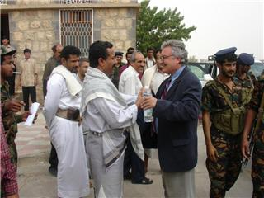
RLs Project interventions take place in some of Yemen's most isolated and underserved areas where rates of maternal and infant mortality are among the highest in the Arab world.

Slide 3
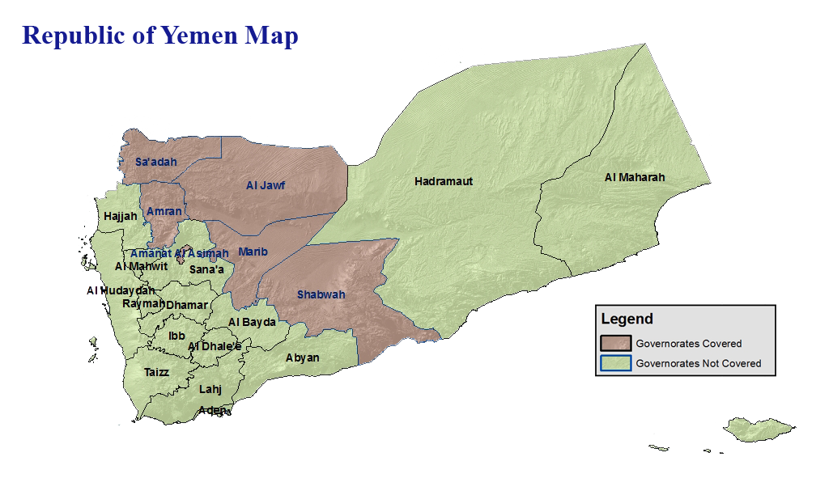

Slide 4
BHS – Pathfinder assisted the Yemeni government in improving maternal and child health and worked closely with the Yemen Ministry of Health and Population and Ministry of Endowment and Guidance to increase access to quality health care services, to promote knowledge, and raise community awareness of reproductive and child health issues.

Slide 5
The ideas of involvement
Religion is a main factor in decisions Yemeni people make about most issues in their lives.
New ideas, such as FP, RH population issues, girls’ education are always controversial .
Many problems slow down overall development (instability, conflicts, low education status, low security, women status) and religious leaders can play major role in behavior change.
Adoption of healthy behavior requires involvement of communities and opinion leaders

Slide 6
The ideas of involvement
Endorsement of population policy in Yemen required RL’s support.
Women status and rights to health and education and to participation in development need to be consistent with religion rules.

Slide 7
Investing in the training of religious leaders is an initiative based on the proven role of the individuals (RLs) who disseminate religious teachings:
In Yemen, Religious leaders are at the top of the ladder when it comes to who people seek advice from on just about any aspect of daily life .
22% of Yemeni women who reject the use of
contraception say it is because they believe it is against their religion or that fertility is the will of God .

Slide 8
Among women not using FP, 82% say that matters of FP are the husband’s decision – and who do husbands listen to?
47% of pregnant women feel that there is no need for prenatal care, and 23% of those who suffer some kind of complication (mild one) said that they did not feel there was a need for seeking care.

Slide 9
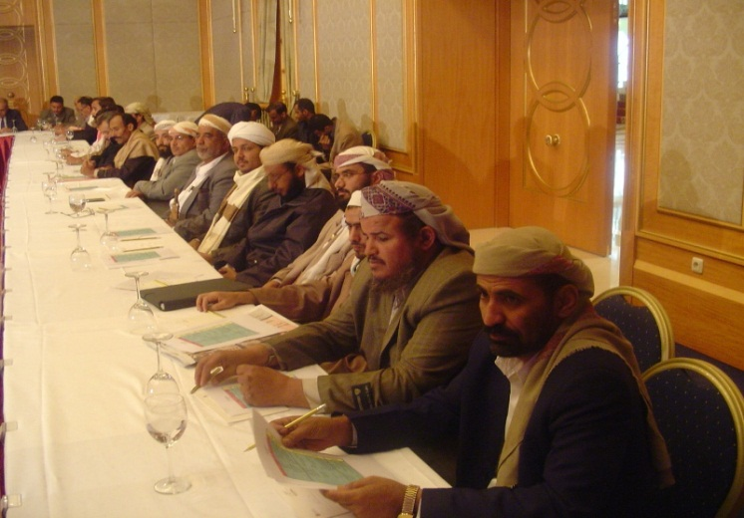
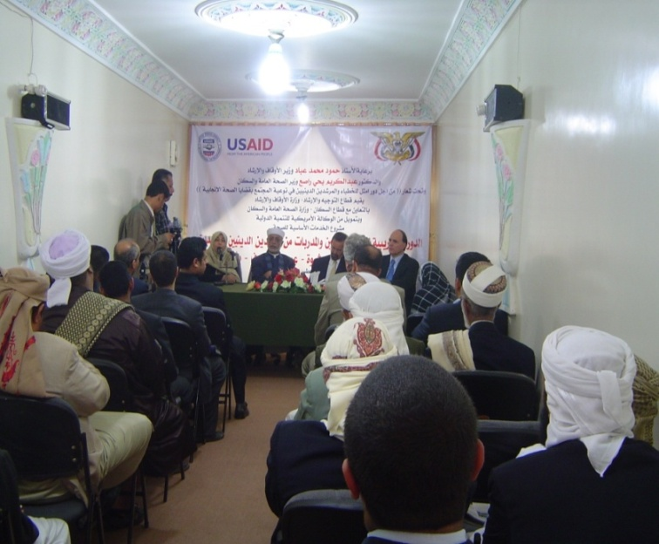
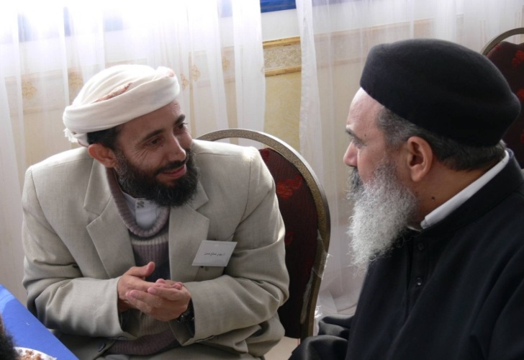
Starting the work
TOT course for senior RLs 15 males and 15 females ( 2-form each governorate in addition to some from the central ministry)
Field trip to Egypt to share experiences.
General meeting to identify scope of activities ( plans, reports system, follow up approaches)
Plan and implement local training in each governorate.

Slide 10
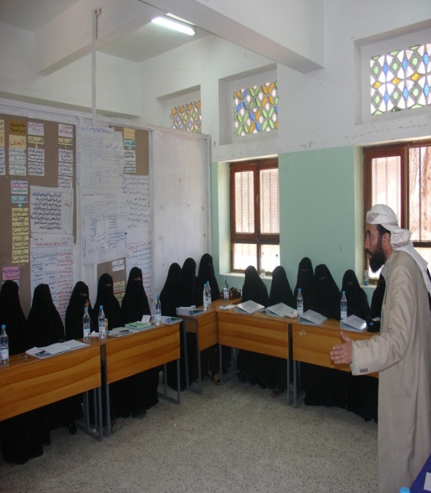
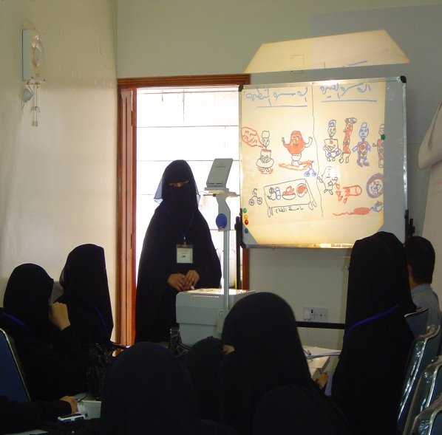
Involving Women
In some governorate female RLs have been prepared (for general religious education or as teachers of Islamic subjects in girls’ schools).
They are not available in each district.
TOT conducted for female trainers
Up to now female RLs educators trained in only in two governorates.

Slide 11
Main topics covered
FP from Islamic perspective.
Risks associated with early pregnancies.
Safe motherhood and need for prenatal care.
Immunization.
Breastfeeding and nutrition.
RH concept and life cycle.
Equity in raising children.
The importance of Girl’s education.
Health care as a human right.

Slide 12
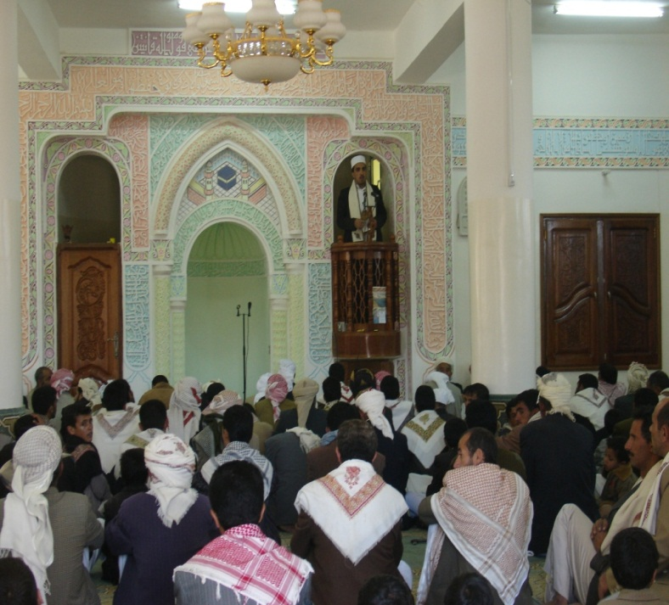
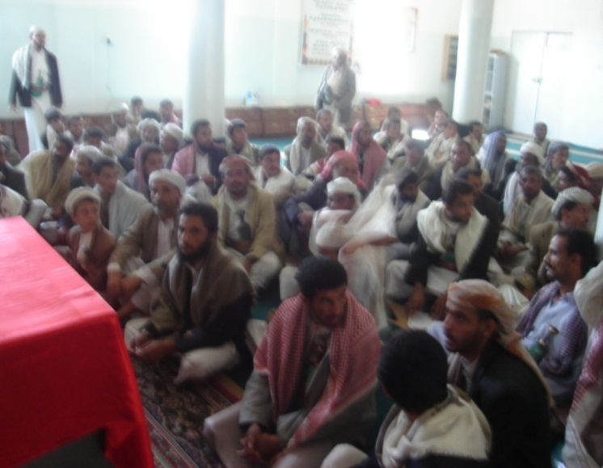
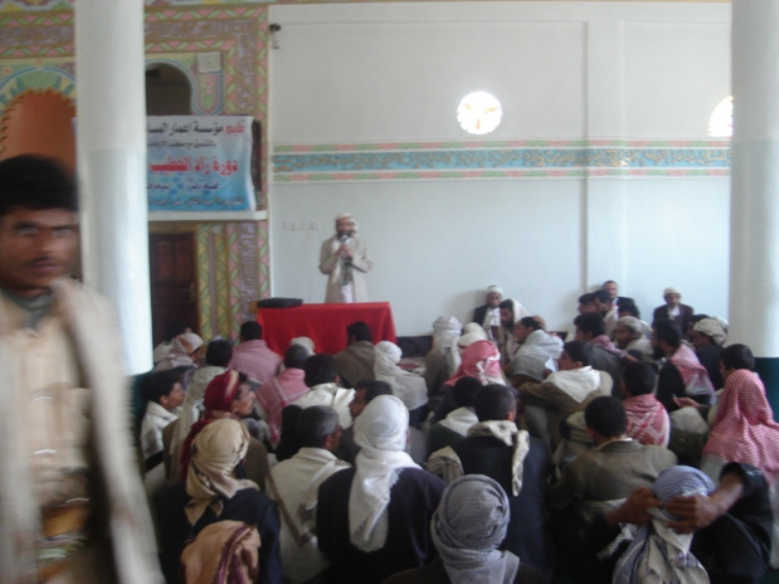
Outreach Activities
In Friday prayers speeches.
Community meetings.
Some educational sessions in mosques.

Slide 13
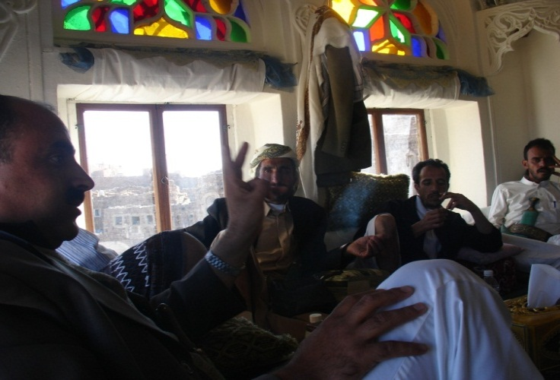
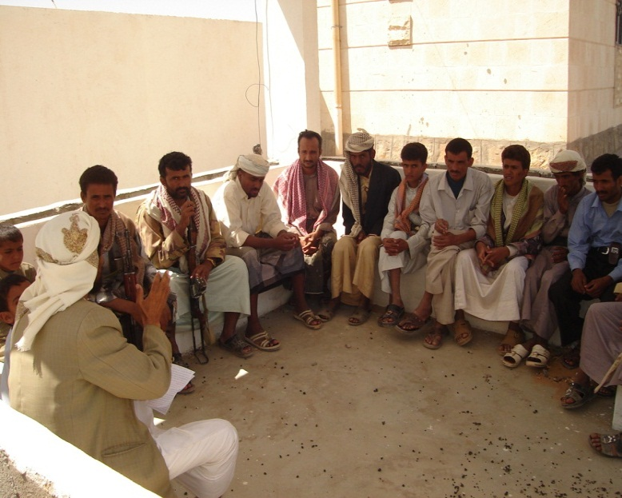
Outreach Activities
In social meetings or gathering.
In special sessions in the community
In schools and other community institutions

Slide 14
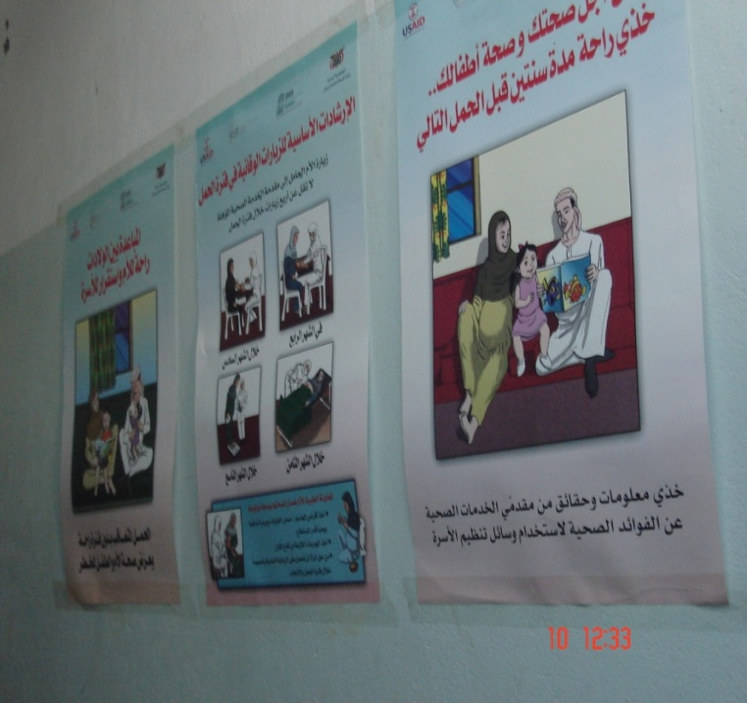
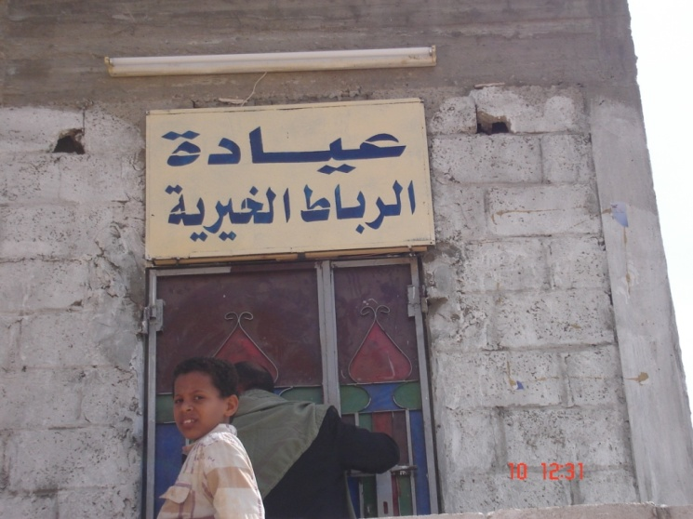
Religious Leaders and Health Services
Some religious educational centers have cooperated with health authority and opened RH/maternal clinics (2 at present)

Slide 15
What lessons were learned?
Must have supporting written materials for use by religious educators and to maintain the integrity and accuracy of the information they provide
Must be prepared to monitor quality on the ground and attend education sessions to verify that messages are not distorted or diluted.
Religious leaders among the youth may need a more youth specific program .
Coordination with other actors ( media, schools, health, youth, women) will increase impact.
11/16/2011
15
Notes:
15

Slide 16
What lessons were learned?
Religious leaders interested but unaware of health issues or health services

Slide 17
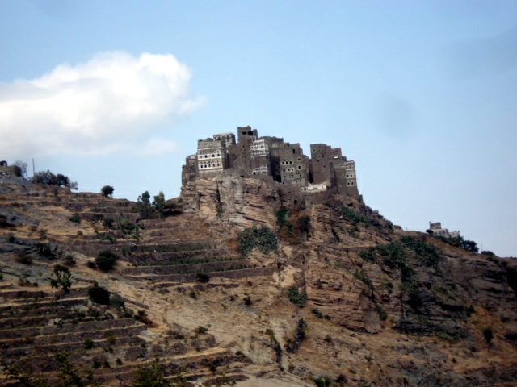
Thank you

