Slide 1
Success in Medellín: Explanations, Limits and Fragilities
Jorge Giraldo-Ramírez
EAFIT University
Medellín, Colombia
Woodrow Wilson International Center for Scholars
Washington, DC
November, 2012

Slide 2
Contents
Success: Some Explanations
Changes in Behavior
Changes in Public Policy
Limits: External Threats
Fragilities: Internal Challenges

Slide 3
Contents
Success: Some Explanations
Changes in Behavior
Changes in Public Policy
Limits: External Threats
Fragilities: Internal Challenges

Slide 4
Number of homicides and homicide rate, Medellín 1990-2011

Slide 5
Monthly number of homicides, Medellín 2004-2012 (Sept.)

Slide 6
Two decades of inflections
Tendencies leading to drastic reduction and two exceptions
2000-2002: urbanization of national internal conflict
2007-2009: fragmentation and competition among criminal organizations
Structural change in homicide rates (6 years in last decade with rates lower than 60. Only ones in 30 years)
Change in the main agents of homicidal violence (from Cartel to Militias to Paramilitaries to armed gangs)
Territorial variations

Slide 7
1998-2002
2009-
1990s
2009-2010
2009-
2004-2008

Slide 8
Contents
Success: Some Explanations
Changes in Behavior
Changes in Public Policy
Limits: External Threats
Fragilities: Internal Challenges

Slide 9
Two fundamental aspects
Construction of the local State’s centrality (stateness)
Local State-building, specially in marginal and suburban areas of the city
Certain, though contested, public force hegemony
National framework of security policies
Specific national intervention
Stronger coordination between levels of government (local-regional-national)

Slide 10
1. 1988-1994
Pre-1995 governments faced severe limits (Leyva, 2010):
Relatively low budgets
High public debt
Low investment capacity
Security was conceived as a responsibility of the national government
Local authority action focused on coexistence (“convivencia”)
Strategies: participation, alternative conflict resolution mechanisms, education and values

Slide 11
2. 1995-2000
Sergio Naranjo (1995-1997)
Qualitative turn: negotiations with armed groups
Unintended and negative consequences
Juan Gómez Martínez (1997-2000)
Continuity
New framework: violence was associated with poverty and inequality

Slide 12
3. 2001-2003
Luis Pérez Gutiérrez (2001-2003)
Break with previous policies and continuity
Oriented resources towards direct activities with affected communities
National-level interventions (2003)
“Operación Orión” (16-18 October, 2003): the State retakes Comuna 13
Diplomacy that ended with the demobilization of paramilitary organization “Bloque Cacique Nutibara” (December, 2003)

Slide 13
4. 2004-2011
Sergio Fajardo (2004-2007) and Alonso Salazar (2008-2011)
Successful national-level security policy and virtuous insertion of local government in said policy
Institutionalization of previous lessons and knowledge (“Security, Defense, and Justice Master Plan”):
Modernization of security and justice apparatus
Permanent human rights unit
Historical memory programs
SISC
Participatory budget and civilian disarmament

Slide 14
4. 2004-2011 (cont.)
Emphasis on local institution-building:
Fight against the “delegitimization” of the State, corruption and clientelism, which generate mistrust of public provision of security and justice within private armed groups
“Exercising legitimate authority”
Recovery of urban territories and heavy investment

Slide 15
Security and Coexistence as % of Local Budget

Slide 16
Contents
Success: Some Explanations
Changes in Behavior
Changes in Public Policy
Limits: External Threats
Fragilities: Internal Challenges

Slide 17
Limits: Some Factors
Persistence of comparatively high homicide rates
Regional environment
Post-Conflict issues
Youth and criminality
Police force

Slide 18
1. Persistence of Violence
Source: CCSCGP (2012)

Slide 19
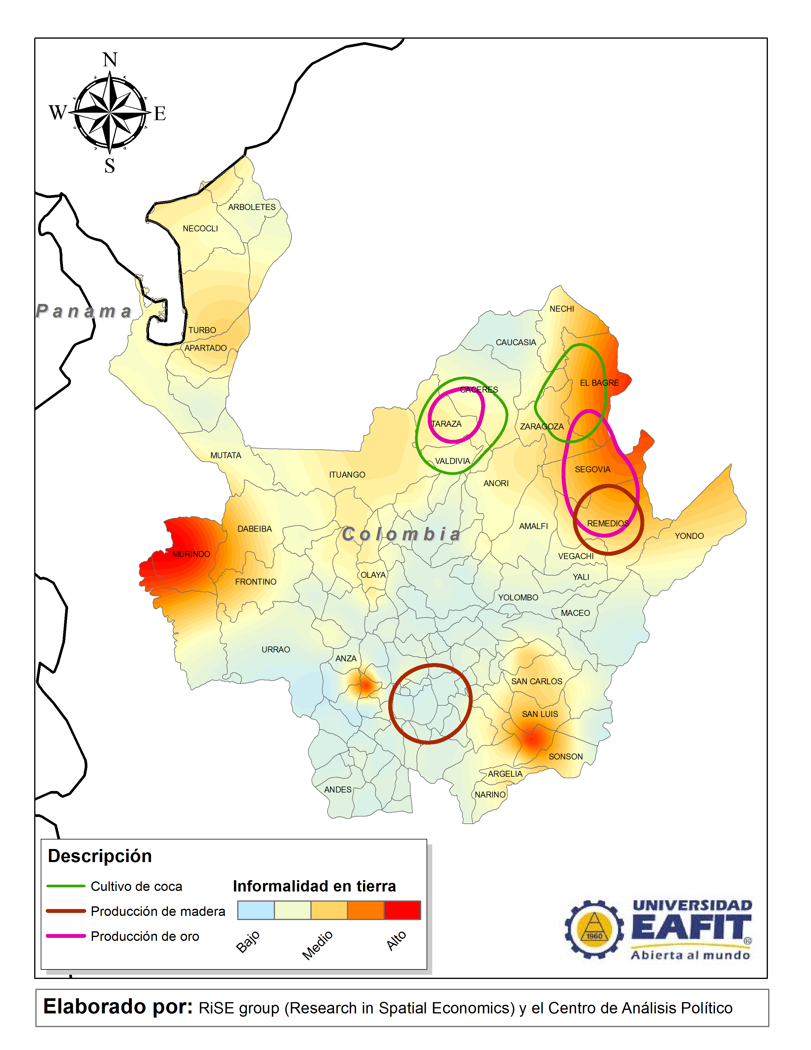
2. Regional Environment
High spatial and statistical correlations between:
Informality in land possession
Illicit crops (coca)
Informal gold mining
Illegal armed groups
Violence indexes
Low institutional capacity
Source: Giraldo & Muñoz (2012).

Slide 20
3. Post-Conflict Issues
Source: Howe & Nussio (2012)

Slide 21
4. Youth and Criminality
45,000 men aged 14-18 (22.4% of the range) captured between 2002-2010 (Medina, Posso & Tamayo, 2011)
± 60% of men aged 14-18 living in poor and/or violent neighborhoods captured in 2002-2010
Questions:
How to limit recruitment
How socially pervasive is crime

Slide 22
5. Police Force
City | Police per 1.000 inhab.
Cartagena | 3,3
Bucaramanga | 3,1
Cúcuta | 3,1
Cali | 2,9
Bogotá | 2,3
Medellín | 2,0
Barranquilla | 1,9
Despite the incidence of homicide in Medellín, the city has a comparatively low police force
Source: Acero (2012), own calculations.

Slide 23
Contents
Success: Some Explanations
Changes in Behavior
Changes in Public Policy
Limits: External Threats
Fragilities: Internal Challenges

Slide 24
Fragilities: Some Factors
Heavy displacement/migration from conflictive areas
Disputes regarding the city model
Competition between organized crime structures & changes in models of criminal protection
Urban social fragmentation

Slide 25
4. Fragmented society
Six clusters, according to six factors:
Demography
Education
labor market
Poverty
Mobility
Security
Redder: worse
Greener: better
Source: RiSE (2012).

Slide 26
Characterization
There is a cadre of organized crime, with waves of violence dependant upon variables strictly associated with drug trafficking and other illegal economies
This generates an environment that catalyzes common violence by gangs, petty criminality, and intolerant and armed citizens

Slide 27
Summary
Local governments capacity to learn from previous experiences
Citizen initiatives regarding security and peaceful coexistence
Social consensus surrounding the State
Strengthening of the State
Contested by criminal dynamics and externalities
Challenges for Medellín in the coming years…

Slide 28
Thank You
giraldoramirez.blogspot.com
jorgegiraldo@eafit.edu.co

