Slide 1
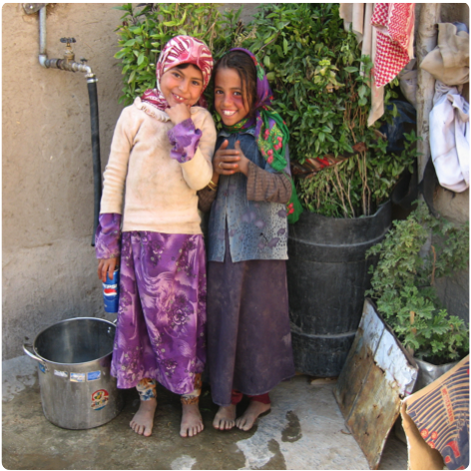
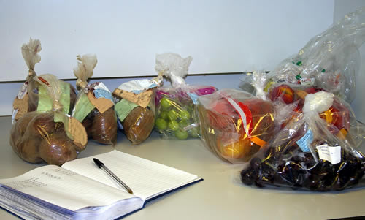
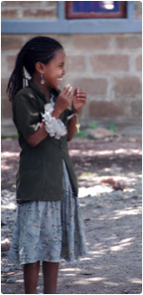
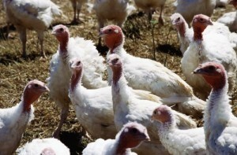
A Presentation at Mycotoxins: Triple Threat to African Development
Washington, DC
14 February 2013
The Global Challenge of Food Safety by John E. Lamb,
Abt Fellow

Slide 2
Why this event, here and now?
The evidence base for mycotoxins and aflatoxins as threats to agriculture, health, nutrition, and trade is expanding rapidly

Slide 3
Why this event, here and now?
The evidence base for mycotoxins and aflatoxins as threats to agriculture, health, nutrition, and trade is expanding rapidly
The topics at hand are extremely important to economic and social progress in Africa and all developing countries

Slide 4
Why this event, here and now?
The evidence base for mycotoxins and aflatoxins as threats to agriculture, health, nutrition, and trade is expanding rapidly
The topics at hand are extremely important to economic and social progress in Africa and all developing countries
Yet the political will, funding levels, and extent of development activity do not yet match the challenges

Slide 5
Why this event, here and now?
The evidence base for mycotoxins and aflatoxins as threats to agriculture, health, nutrition, and trade is expanding rapidly
The topics at hand are extremely important to economic and social progress in Africa and all developing countries
Yet the political will, funding levels, and extent of development activity do not yet match the challenges
On other hand, significant new global structures for food safety have emerged
1990s: WTO SPS
2000s: Private standard schemes, GFSI
2010s: APEC FSCF, GFSP

Slide 6
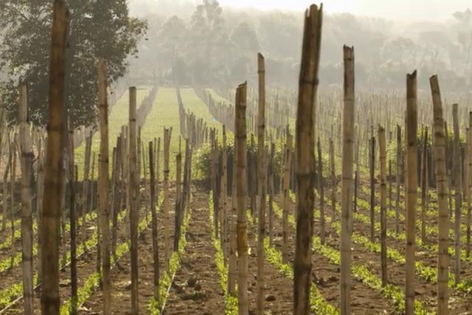
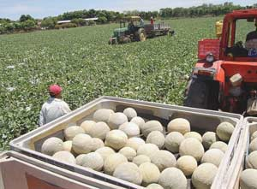
Difficult to work in international agricultural development without getting caught up
Over tolerance pesticide residues in snowpeas
Salmonella in melons
Cyclospora in red raspberries

Slide 7
What are the objectives for this event?
Raise awareness of the issues (for food safety, mycotoxins, aflatoxin control) among a cross-section of leading development policy-makers, practitioners and researchers

Slide 8
What are the objectives for this event?
Raise awareness of the issues (for food safety, mycotoxins, aflatoxin control) among a cross-section of leading development policy-makers, practitioners and researchers
Broaden and deepen understanding of the current state of knowledge

Slide 9
What are the objectives for this event?
Raise awareness of the issues (for food safety, mycotoxins, aflatoxin control) among a cross-section of leading development policy-makers, practitioners and researchers
Broaden and deepen understanding of the current state of knowledge
Point out pathways for greater institutional and personal involvement

Slide 10
What are the objectives for this event?
Raise awareness of the issues (for food safety, mycotoxins, aflatoxin control) among a cross-section of leading development policy-makers, practitioners and researchers
Broaden and deepen understanding of the current state of knowledge
Point out pathways for greater institutional and personal involvement
Facilitate greater collaboration between interested individuals, units and agencies

Slide 11
What are the objectives for this event?
Raise awareness of the issues (for food safety, mycotoxins, aflatoxin control) among a cross-section of leading development policy-makers, practitioners and researchers
Broaden and deepen understanding of the current state of knowledge
Point out pathways for greater institutional and personal involvement
Facilitate greater collaboration between interested individuals, units and agencies
Stimulate higher levels of intellectual, programmatic and financial investment

Slide 12
What are the objectives for this event?
Raise awareness of the issues (for food safety, mycotoxins, aflatoxin control) among a cross-section of leading development policy-makers, practitioners and researchers
Broaden and deepen understanding of the current state of knowledge
Point out pathways for greater institutional and personal involvement
Facilitate greater collaboration between interested individuals, units and agencies
Stimulate higher levels of intellectual, programmatic and financial investment
Share in the excitement that surrounds the emergence of a new community of practice

Slide 13
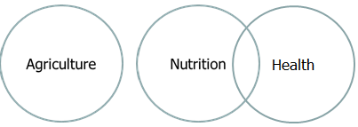
During the latter half of the last century agriculture was divorced from health & nutrition
Past

Slide 14
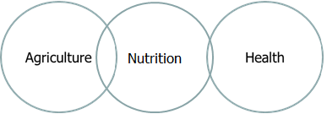
Yet in the last five years a deliberate effort began to bring these sectors together
Past
Present

Slide 15
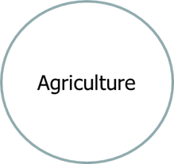
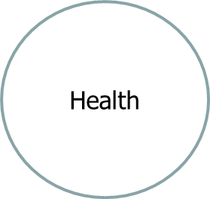
There is growing consensus that all three sectors interact with each other
Past
Present
Nutrition
Near Future

Slide 16
Development hypothesis for today
Future Perfect
Agriculture
Food Safety
Health
Nutrition

Slide 17
Development hypothesis for today
Future PluPerfect
Agriculture
Food Safety
Health
Nutrition
Mycotoxins

Slide 18
Why food safety matters to the private sector
Concern for consumers
Risk to brand
Legal liability
Costs for remediation
Disruption or loss of market access
Reduced competitiveness
Investment required for prevention and control
Impact on profitability

Slide 19
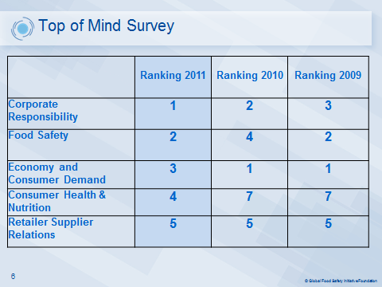
What worries food industry executives most?

Slide 20
Why food safety matters to the public sector
Concern for public health and consumer protection
Differential impacts on the vulnerable
Loss of individual productivity and aggregate output
Compliance with international agreements
Risk to country image
Disruption or loss of foreign markets
Reduced competitiveness in international trade
Investment required for compliance, prevention, and control

Slide 21
Economic loss from foodborne disease in USA
14 of the 31 major foodborne pathogens account for 95% of illness and hospitalization and 98% of deaths attributable to identifiable pathogens
These 14 are estimated to cause $14.0 billion in cost of illness and loss of 61,000 QALYs
Roughly 90% of this loss is caused by five pathogens:
nontyphoidal Salmonella enterica ($3.3 billion; 17,000 QALYs)
Campylobacter spp. ($1.7 billion; 13,300 QALYs)
Listeria monocytogenes ($2.6 billion; 9,400 QALYs),
Toxoplasma gondii ($3 billion; 11,000 QALYs), and
norovirus ($2 billion; 5,000 QALYs).

Slide 22
Why food (un)safety should matter more to the international development community
Weakens the competitive position of producers, industries and countries in which agriculturally based enterprises are significant contributors to commerce

Slide 23
Why food (un)safety should matter more to the international development community
Weakens the competitive position of producers, industries and countries in which agriculturally based enterprises are significant contributors to commerce
Causes great harm to individual health, nutritional status, and productivity, which affects entire families and especially the most vulnerable

Slide 24
Why food (un)safety should matter more to the international development community
Weakens the competitive position of producers, industries and countries in which agriculturally based enterprises are significant contributors to commerce
Causes great harm to individual health, nutritional status, and productivity, which affects entire families and especially the most vulnerable
Interferes with other crosscutting objectives such as gender empowerment, enterprise development, labor force development, human capital

Slide 25
Why food (un)safety should matter more to the international development community
Weakens the competitive position of producers, industries and countries in which agriculturally based enterprises are significant contributors to commerce
Causes great harm to individual health, nutritional status, and productivity, which affects entire families and especially the most vulnerable
Interferes with other crosscutting objectives such as gender empowerment, enterprise development, labor force development, human capital
Necessitates remedial treatment and mitigation measures that often cost much more than prevention would have cost

Slide 26
Why food (un)safety should matter more to the international development community
Weakens the competitive position of producers, industries and countries in which agriculturally based enterprises are significant contributors to commerce
Causes great harm to individual health, nutritional status, and productivity, which affects entire families and especially the most vulnerable
Interferes with other crosscutting objectives such as gender empowerment, enterprise development, labor force development, human capital
Necessitates remedial treatment and mitigation measures that often cost much more than prevention would have cost
Reduces GDP directly and indirectly

Slide 27
What is the rationale for the international development community to get more involved in food safety?
Food/water safety control systems in developing countries are often not up to best practice standards
The resulting adverse impacts on human health and welfare, as well as on economic and social progress, interfere with higher level MDG and food security objectives
Growth in trade, the natural evolution of long standing hazards, and appearance of new ones, together are outstripping the risk mitigation capacity of developing country food control systems (and even those of many developed countries)
Regulators increasingly recognize that they cannot inspect their way to a safer food supply, need to get closer to source areas, and must collaborate with a whole host of international, public and private partners to make the world of food safer for consumers

Slide 28
What is rationale for the international development community to get more involved in food safety?
Although the private sector has made tremendous progress in upgrading proprietary supply chains, there are millions of suppliers and handlers who remain outside the commercial chains
There is a great disparity between expectations, incentives, and performance between modern supply chains that aim for export markets and traditional supply chains that deliver to domestic and regional markets
Upgrading requires developmental investment, and domestic especially funding is very scarce
Host governments rarely approach this challenge pro-actively, have many other demands, and lack technical resources
Development agencies get asked, and in fact can help

Slide 29
Why food safety presents a particularly difficult development challenge
Most evident by its absence
Old approach emphasized control over prevention
Traditionally relegated to governments, and within that to regulators

Slide 30
Why food safety presents a particularly difficult development challenge
Most evident by its absence
Old approach emphasized control over prevention
Traditionally relegated to governments, and within that to regulators
Standard setting body has trouble keeping up with
Natural tension between regulators and the regulated
Inherently cross sectoral, straddling departments and agencies

Slide 31
Why food safety presents a particularly difficult development challenge
Most evident by its absence
Old approach emphasized control over prevention
Traditionally relegated to governments, and within that to regulators
Standard setting body has trouble keeping up with
Natural tension between regulators and the regulated
Inherently cross sectoral, straddling departments and agencies
Requires very specific technical expertise in a wide array of disciplines, themes, commodities, industries
Difficult to agree on priorities
Hard data is often lacking

Slide 32
The food safety field is complex
Policies and Regulations
Control Systems
Analytical Capacity
Incident Management

Slide 33
The food safety field is complex
Policies and Regulations
Control Systems
Analytical Capacity
Incident Management
These were mainly concerns of regulatory bodies, standard setting agencies and the WTO

Slide 34
The food safety field is complex
Policies and Regulations
Control Systems
Analytical Capacity
Incident Management
Risk Assessment
Risk Management
Risk Communications

Slide 35
The food safety field is complex
Policies and Regulations
Control Systems
Analytical Capacity
Incident Management
Risk Assessment
Risk Management
Risk Communications
Risk analysis involves both the regulatory community and the agrifood community

Slide 36
The food safety field is complex
Policies and Regulations
Control Systems
Analytical Capacity
Incident Management
Risk Assessment
Risk Management
Risk Communications
Industry and Supply Chain Interventions

