Slide 1
The National Climate Assessment: Overview
Glynis C. Lough, Ph.D.
National Climate Assessment
US Global Change Research Program National Coordination Office
http://assessment.globalchange.gov
December 17, 2013

Slide 2
US Global Change Research Program
Global Change Research Act (1990) Mandate:
“To provide for development and coordination of a comprehensive and integrated United States research program which will assist the Nation and the world to understand, assess, predict, and respond to human-induced and natural processes of global change.”
13 Federal Departments & Agencies + Executive Office of the President
Notes:
The Global Change Research Act, passed in 1990, established the US Global Change Research Program to coordinate global change research across the federal government

Slide 3
National Climate Assessment: GCRA (1990), Section 106
…not less frequently than every 4 years, the Council… shall prepare… an assessment which –
integrates, evaluates, and interprets the findings of the Program (USGCRP) and discusses the scientific uncertainties associated with such findings;
analyzes the effects of global change on the natural environment, agriculture, energy production and use, land and water resources, transportation, human health and welfare, human social systems, and biological diversity; and
analyzes current trends in global change, both human- induced and natural, and projects major trends for the subsequent 25 to 100 years.
Notes:
The National Climate Assessment is one of the requirements of the Global Change Research Act

Slide 4
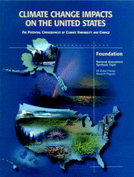
Previous National Climate Assessments
Climate Change Impacts on the United States (2000)
Climate Change Impacts in the United States (2009)
http://nca2009.globalchange.gov/

Slide 5
The “New” National Climate Assessment
Goal
Enhance the ability of the United States to anticipate, mitigate, and adapt to changes in the global environment.
Vision
Advance an inclusive, broad-based, and sustained process for assessing and communicating scientific knowledge of the impacts, risks, and vulnerabilities associated with a changing global climate in support of decision-making across the United States.
Notes:
With this next round of assessment, we will maintain a focus on synthesizing the best-available science while also looking to provide that science to users in such a way that it can support decisions about how we prepare for and respond to climate change.
In order to achieve this, we have set our sights on creating a process that reaches beyond the federal government to include state, local, and tribal governments, the business community, academic institutions, non-profit organizations, and many others that contribute to and use assessments.

Slide 6
Third NCA Report Process
Federal agencies, universities, NCAnet members, and others
January 14 – April 12, 2013
Dec – Feb 2013
Technical Input Teams
Chapter Author Teams
NCADAC
Public and Expert Review
Agency & White House Review
Technical Inputs
(March 1, 2012)
Chapters
(June 1, 2012)
Draft Report
(Fall 2012)
Multiple Revisions of Draft Report
(July – Nov 2013)
Third NCA Report
Spring 2014
Sustained
Assessment
Notes:
Inclusive, broader expertise
Over 240 authors
60 member federal advisory committee
Public engagement, e.g. “Request for Information”
Focus on a sustained process
Supporting quadrennial reports
Intermediate products to improve assessment capacity
NCAnet: 90+ organizations extend the NCA process and products beyond the federal government and are active partners in the sustained assessment process
This slide illustrates how the Third NCA Report has come together and what the steps are for it to become final. A few key steps in the process:
Technical input teams from across the country provided a variety of reports, articles, case studies, and other inputs
Chapter authors draw on technical inputs and other literature to assemble their chapters
Once receiving the chapters, the NCADAC reviewed entire report, checking for quality, consistency, and readability
Following the public comment and expert review period, review editors will check that comments have been responded to adequately
The NCADAC anticipates submitting the final report to the government in late 2013; the process of final White House review and adoption by the US Global Change Research Program as “the” National Climate Assessment report will take a few months longer

Slide 7
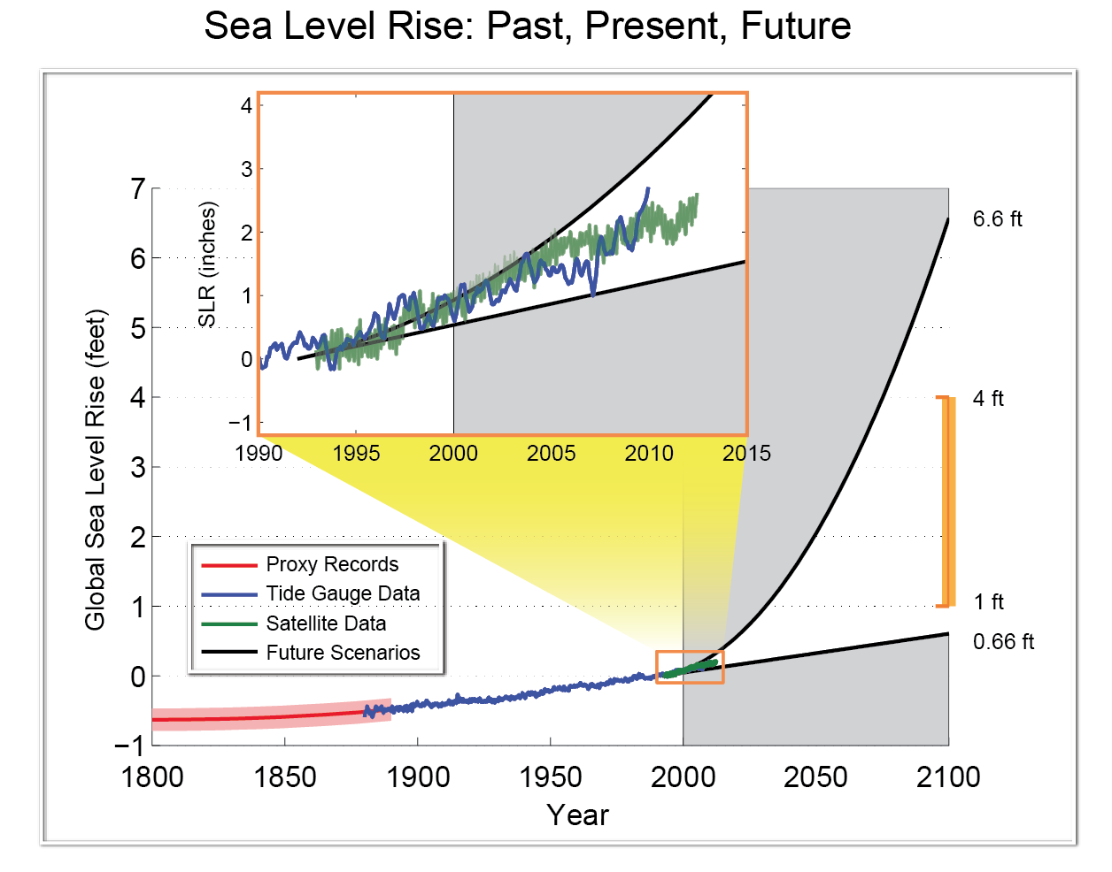
Scenarios www.scenarios.globalchange.gov
Regional climatologies and projections
Global Sea level rise scenarios

Slide 8
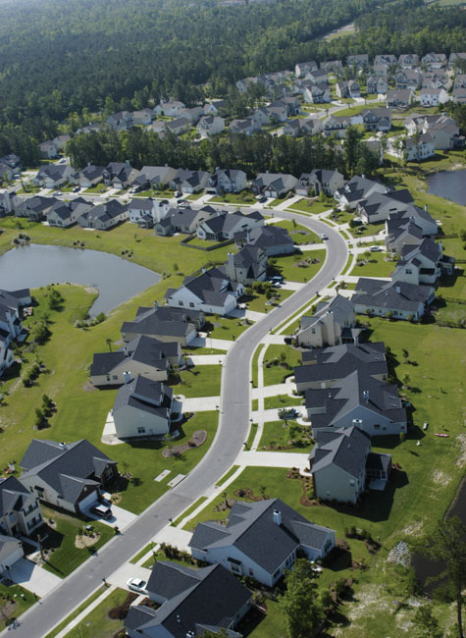
Outline for Third NCA Report
Letter to the American People
Executive Summary: Report Findings
Our Changing Climate
Sectors & Sectoral Cross-cuts
Regions & Biogeographical Cross-cuts
Responses
Decision Support
Mitigation
Adaptation
Agenda for Climate Change Science
The NCA Long-term Process
Appendices
Commonly Asked Questions
Expanded Climate Science Info
8

Slide 9
Draft Report Findings
Global climate is changing, and this is apparent across the U.S. in a wide range of observations. The climate change of the past 50 years is due primarily to human activities, predominantly the burning of fossil fuels.
Some extreme weather and climate events have increased in recent decades, and there is new and stronger evidence that many of these increases are related to human activities.
Human-induced climate change is projected to continue and accelerate significantly if emissions of heat-trapping gases continue to increase.

Slide 10
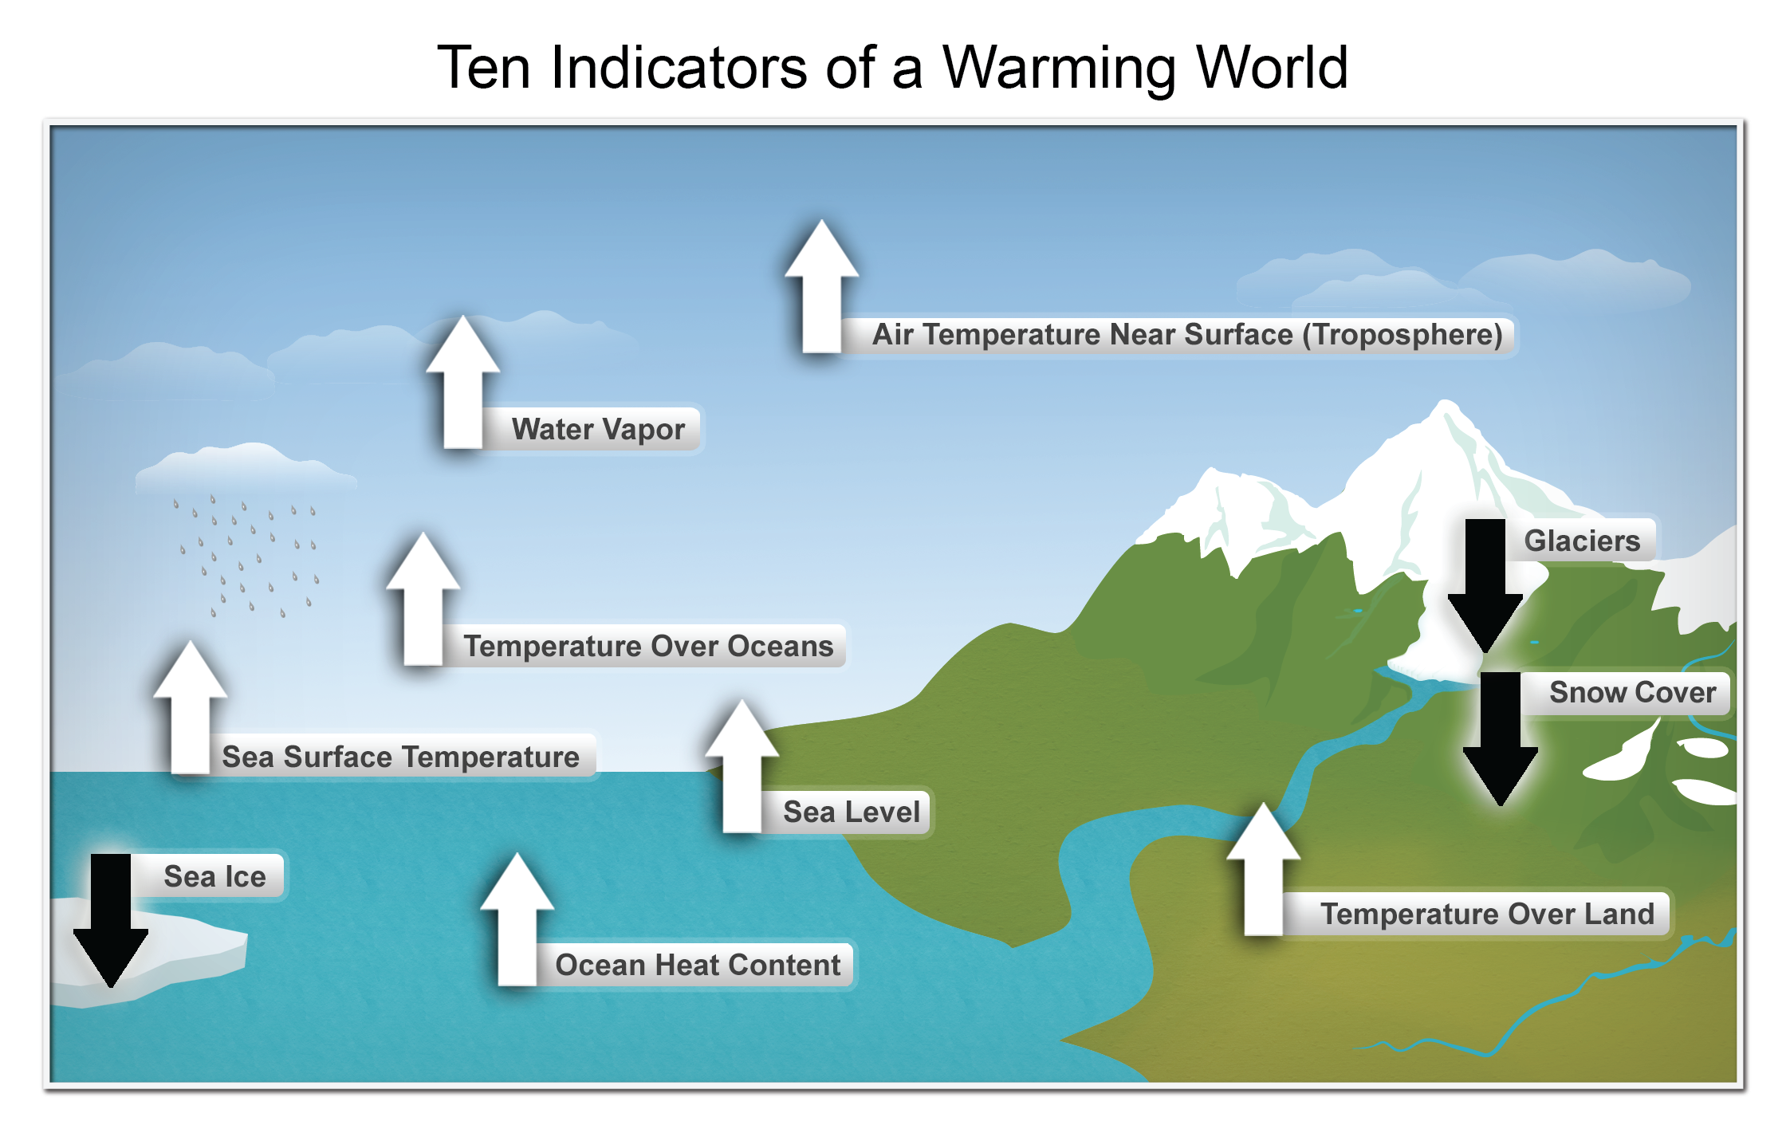
Global Climate is Changing
Notes:
These are just some of the many indicators that have been measured globally over many decades and that show that Earth’s climate is warming. White arrows indicate increasing trends, black arrows indicate decreasing trends. All the indicators expected to increase in a warming world are increasing, and all those expected to decrease in a warming world are decreasing. (Figure source: NOAA NCDC)
From Ch2: Our Changing Climate, KM #1

Slide 11
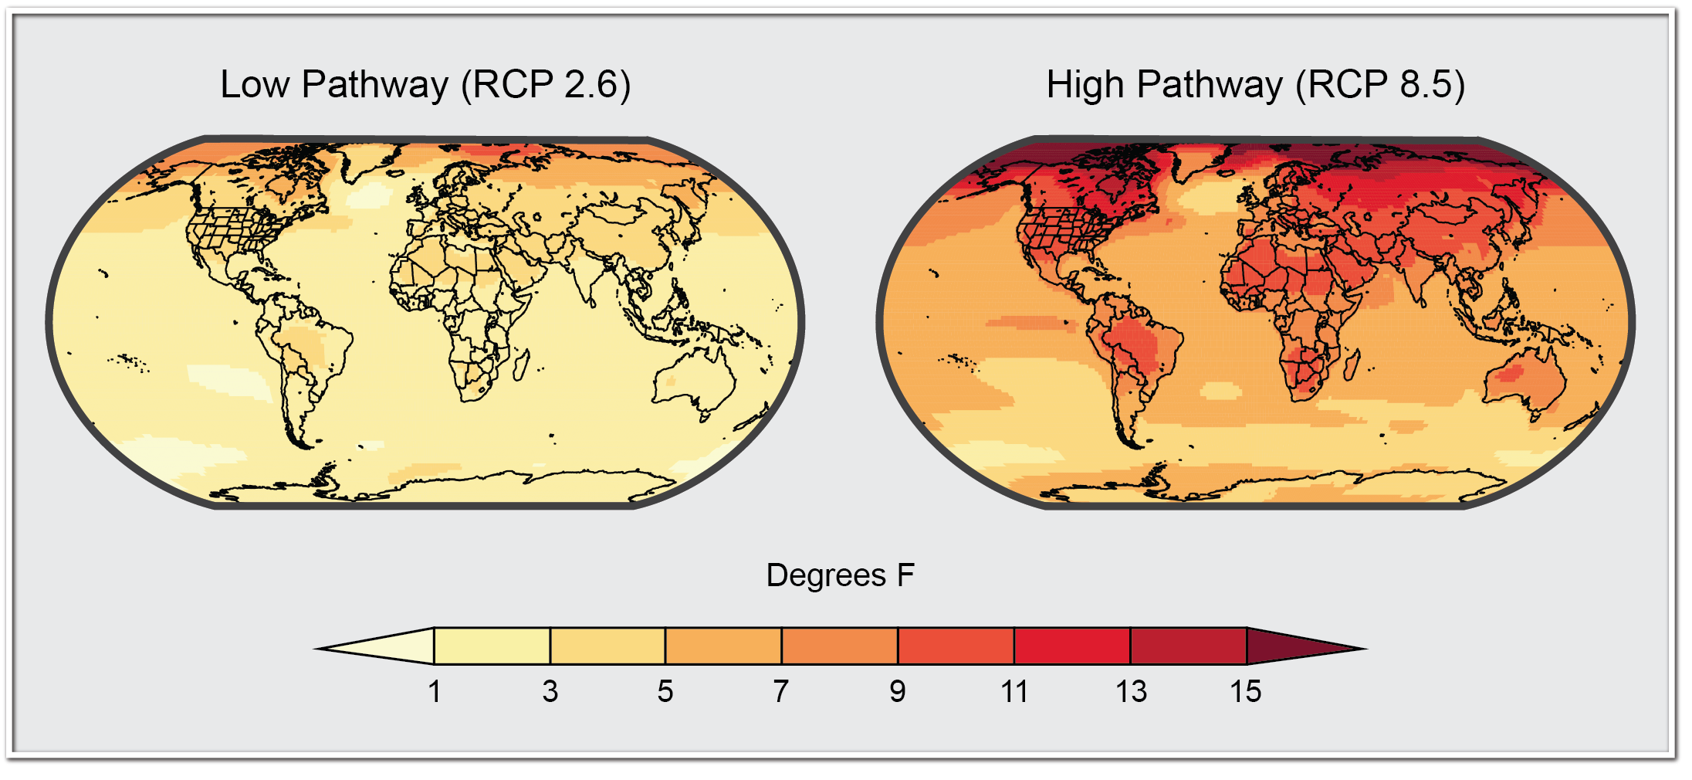
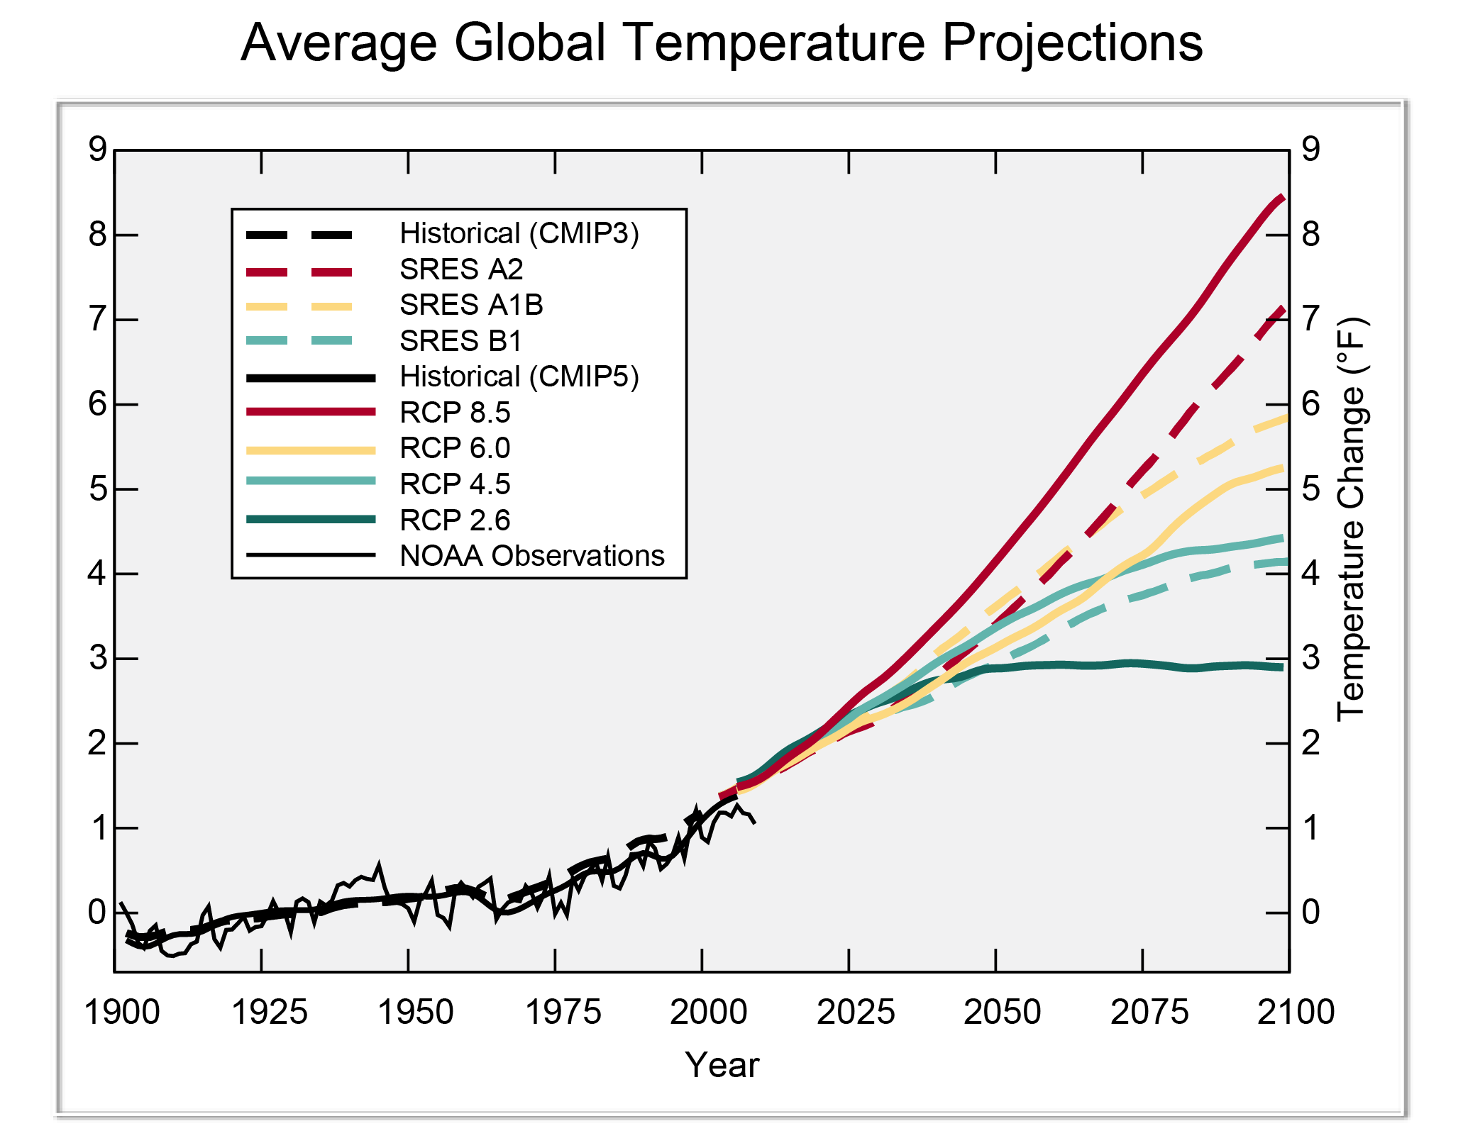
Projected temperature change under different emissions scenarios
Notes:
Projected change (°F) in annual average temperature over the period 2071-2099 (compared to the period 1971-2000) under a low emissions pathway (RCP 2.6, left graph) that assumes rapid reductions in emissions and a high pathway (RCP 8.5, right graph) that assumes continued increases in emissions. (Figure source: NOAA NCDC / CICS-NC. Data from CMIP5.). Figure 2.4 Ch2: Our Changing Climate
LOWER RIGHT: Projected global average annual temperature changes (°F) for multiple future emissions scenarios relative to the 1901-1960 average temperature. The dashed lines are results from the previous generation of climate models using the previous generation of emissions scenarios (the SRES set). The solid lines are results from the most recent generation of climate models using the most recent emissions scenarios (the RCP set), some of which consider explicit climate policies, which the older ones did not. Differences among these projections are principally a result of differences in the emissions scenarios rather than differences among the climate models. (Figure source: Michael Wehner, LBNL. Data from CMIP3, CMIP5, and NOAA, 2012.) Figure 2.3: Average Global Temperature Projections from CH2: Our Changing Climate

Slide 12
Draft Report Findings
Impacts related to climate change are already evident in many sectors and are expected to become increasingly challenging across the nation throughout this century and beyond.
Climate change threatens human health and well-being in many ways, including impacts from increased extreme weather events, wildfire, decreased air quality, diseases transmitted by insects, food, and water, and threats to mental health.
Infrastructure across the U.S. is being adversely affected by phenomena associated with climate change, including sea level rise, storm surge, heavy downpours, and extreme heat.

Slide 13
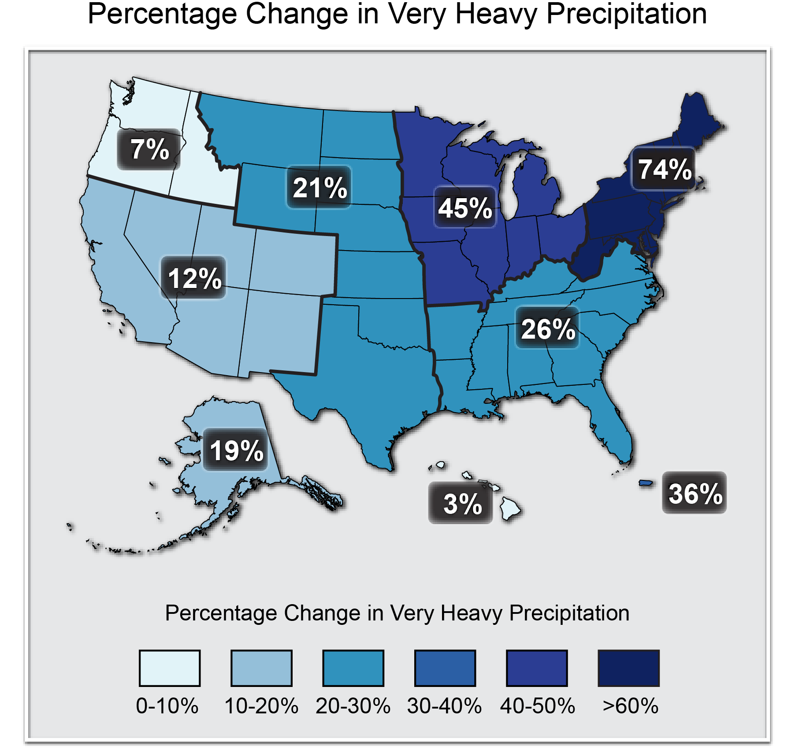
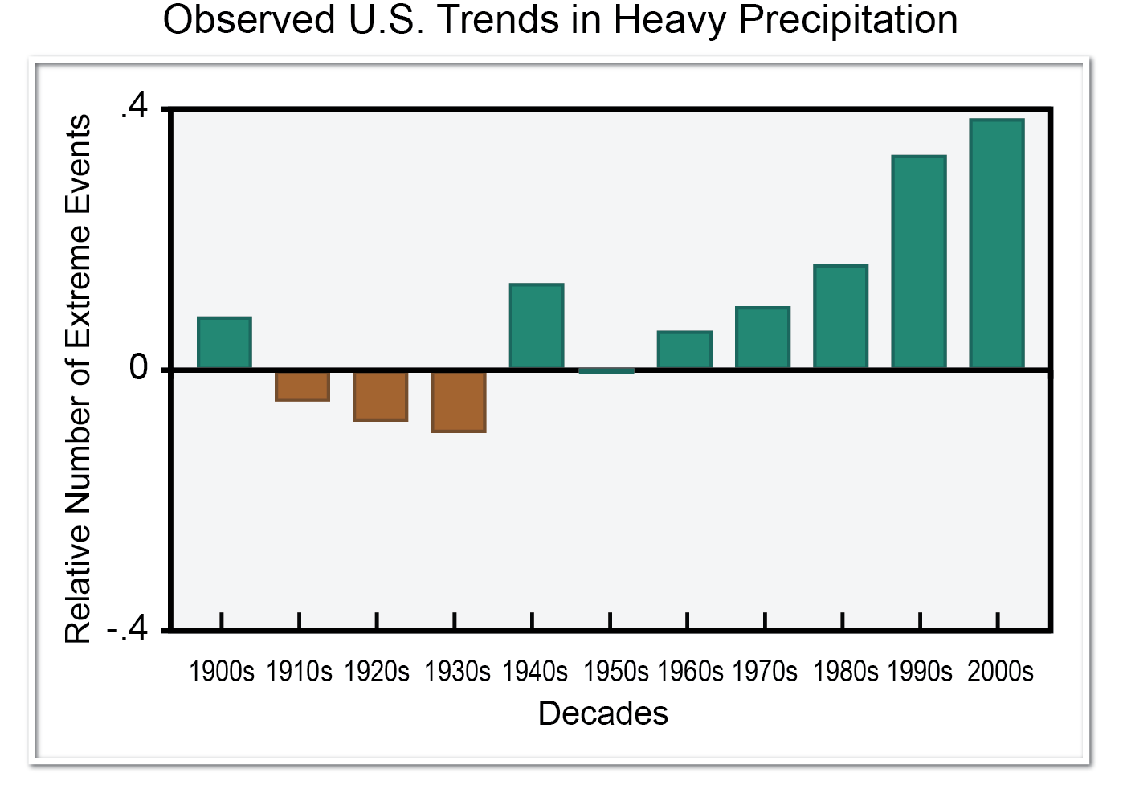
Heavy Downpours have increased
Notes:
Right: The map shows percent increases in the amount of precipitation falling in very heavy events (defined as the heaviest 1% of all daily events) from 1958 to 2011 for each region. There are clear trends toward a greater amount of very heavy precipitation for the nation as a whole, and particularly in the Northeast and Midwest. (Figure source: updated from (Karl et al. 2009) with data from NCDC). Figure 2.16 from Ch2: Our Changing Climate
Left: One measure of a heavy-precipitation event is a 2-day precipitation total that is exceeded on average only once in a five year period, also known as the once-in-five-year event. As this extreme precipitation index for 1901-2011 shows, the occurrence of such events has become much more common in recent decades. Changes are compared to the period 1901-1960 and do not include Alaska or Hawaii. The 2000s decade (far right bar) includes 2001-2011. (Figure source: adapted from (Kunkel et al. 2012). Figure 2.14 from Ch2: Our Changing Climate

Slide 14
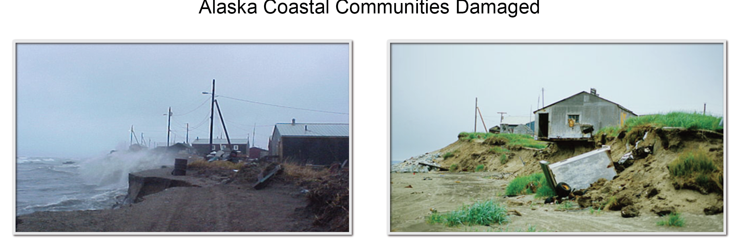
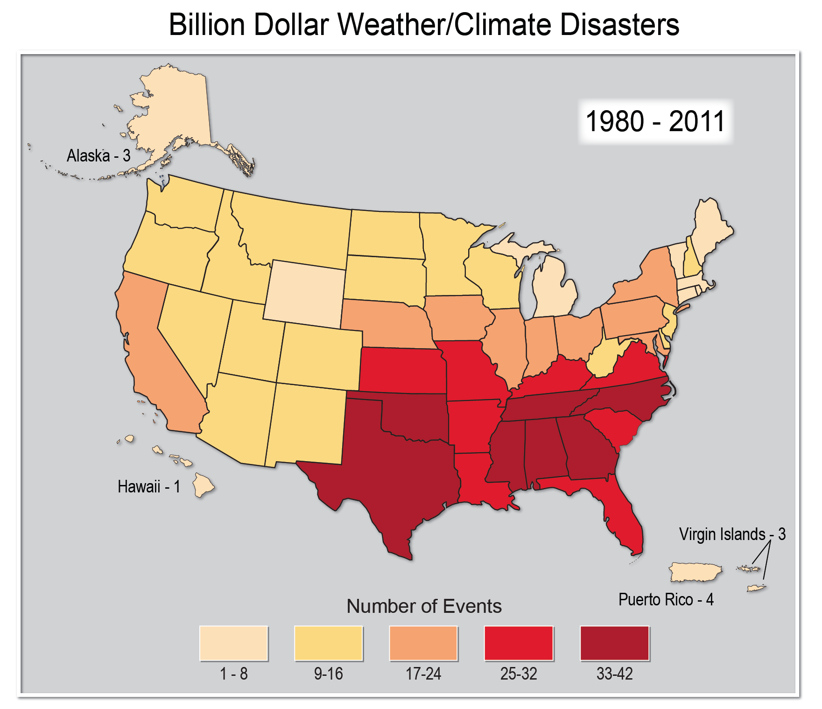
Impacts Already Evident
Notes:
Upper: This map summarizes the number of weather and climate disasters over the past 30 years that have resulted in more than a billion dollars in damages. The Southeast has experienced more billion-dollar disasters than any other region. http://www.ncdc.noaa.gov/billions/Population Distribution and Change: 2000 to 2010, summary statistics. Figure 17.1 from Ch17: Southeast
Lower: One effect of the reduction in Alaska sea ice is that storm surges that used to be buffered by the ice are now causing more shoreline damage. Photos from 2005 show infrastructure damage from coastal erosion in Shishmaref, Alaska. Photographs by Tony Weyiouanna and Gary Braasch. Fig 22.9 in Ch22: Alaska

Slide 15
Draft Report Findings
Reliability of water supplies is being reduced by climate change in a variety of ways that affect ecosystems and livelihoods in many regions.
Adverse impacts to crops and livestock over the next 100 years are expected. Over the next 25 years or so, the agriculture sector is projected to be relatively resilient, even though there will be increasing disruptions from extreme heat, drought and heavy downpours.

Slide 16
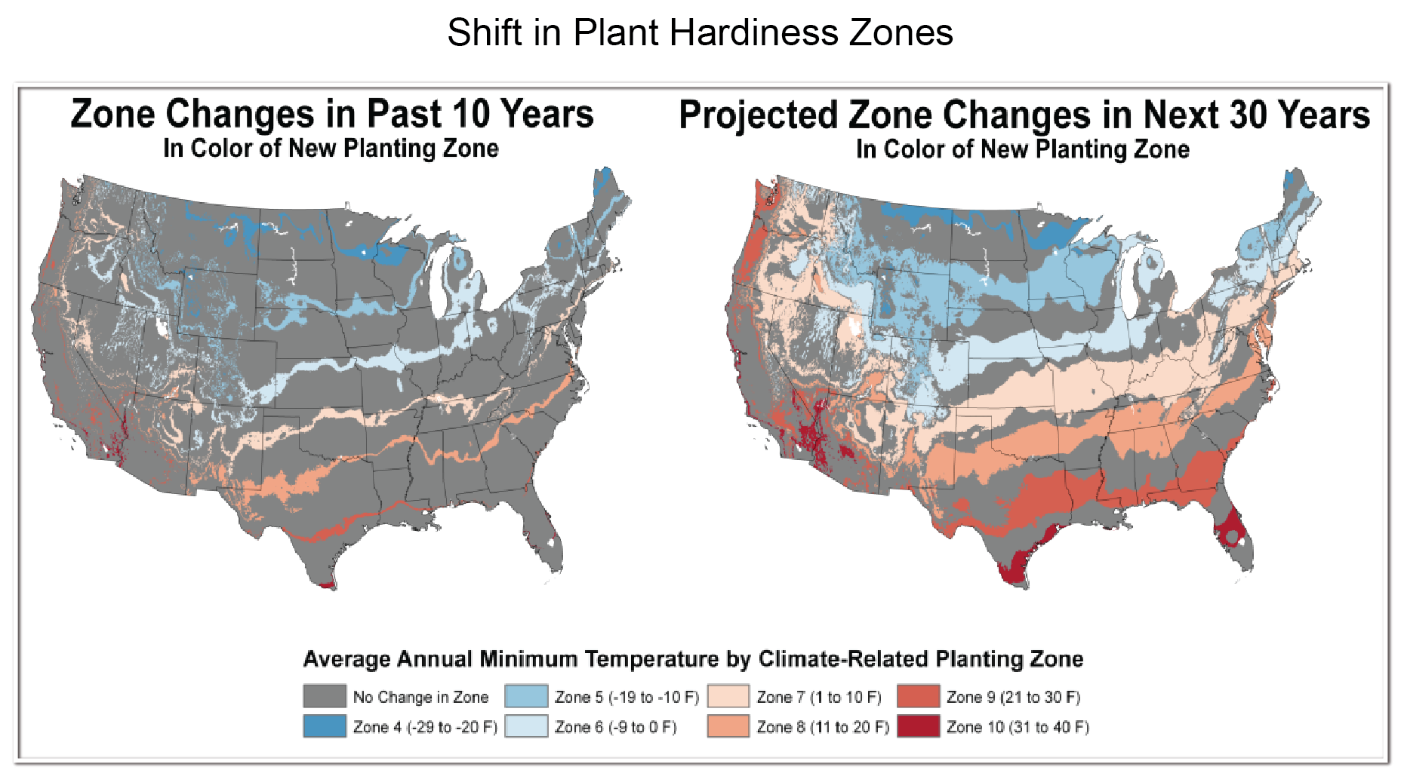
Impacts on Crops and Livestock
Notes:
The map on the left above shows the change in Plant Hardiness Zones calculated from those based on the 1971-2000 climate to those based on the 1981-2010 climate. Even greater changes are projected over the next 30 years (map on right). (Figure source: NOAA). Fig. 28 in Appendix: The Science of Climate Change

Slide 17
Natural ecosystems are being directly affected by climate change, including changes in biodiversity and location of species. As a result, the capacity of ecosystems to moderate the consequences of disturbances such as droughts, floods, and severe storms is being diminished.
Life in the oceans is changing as ocean waters become warmer and more acidic.
Planning for adaptation (to address and prepare for impacts) and mitigation (to reduce emissions) activities is increasing, but progress with implementation is limited.

Slide 18
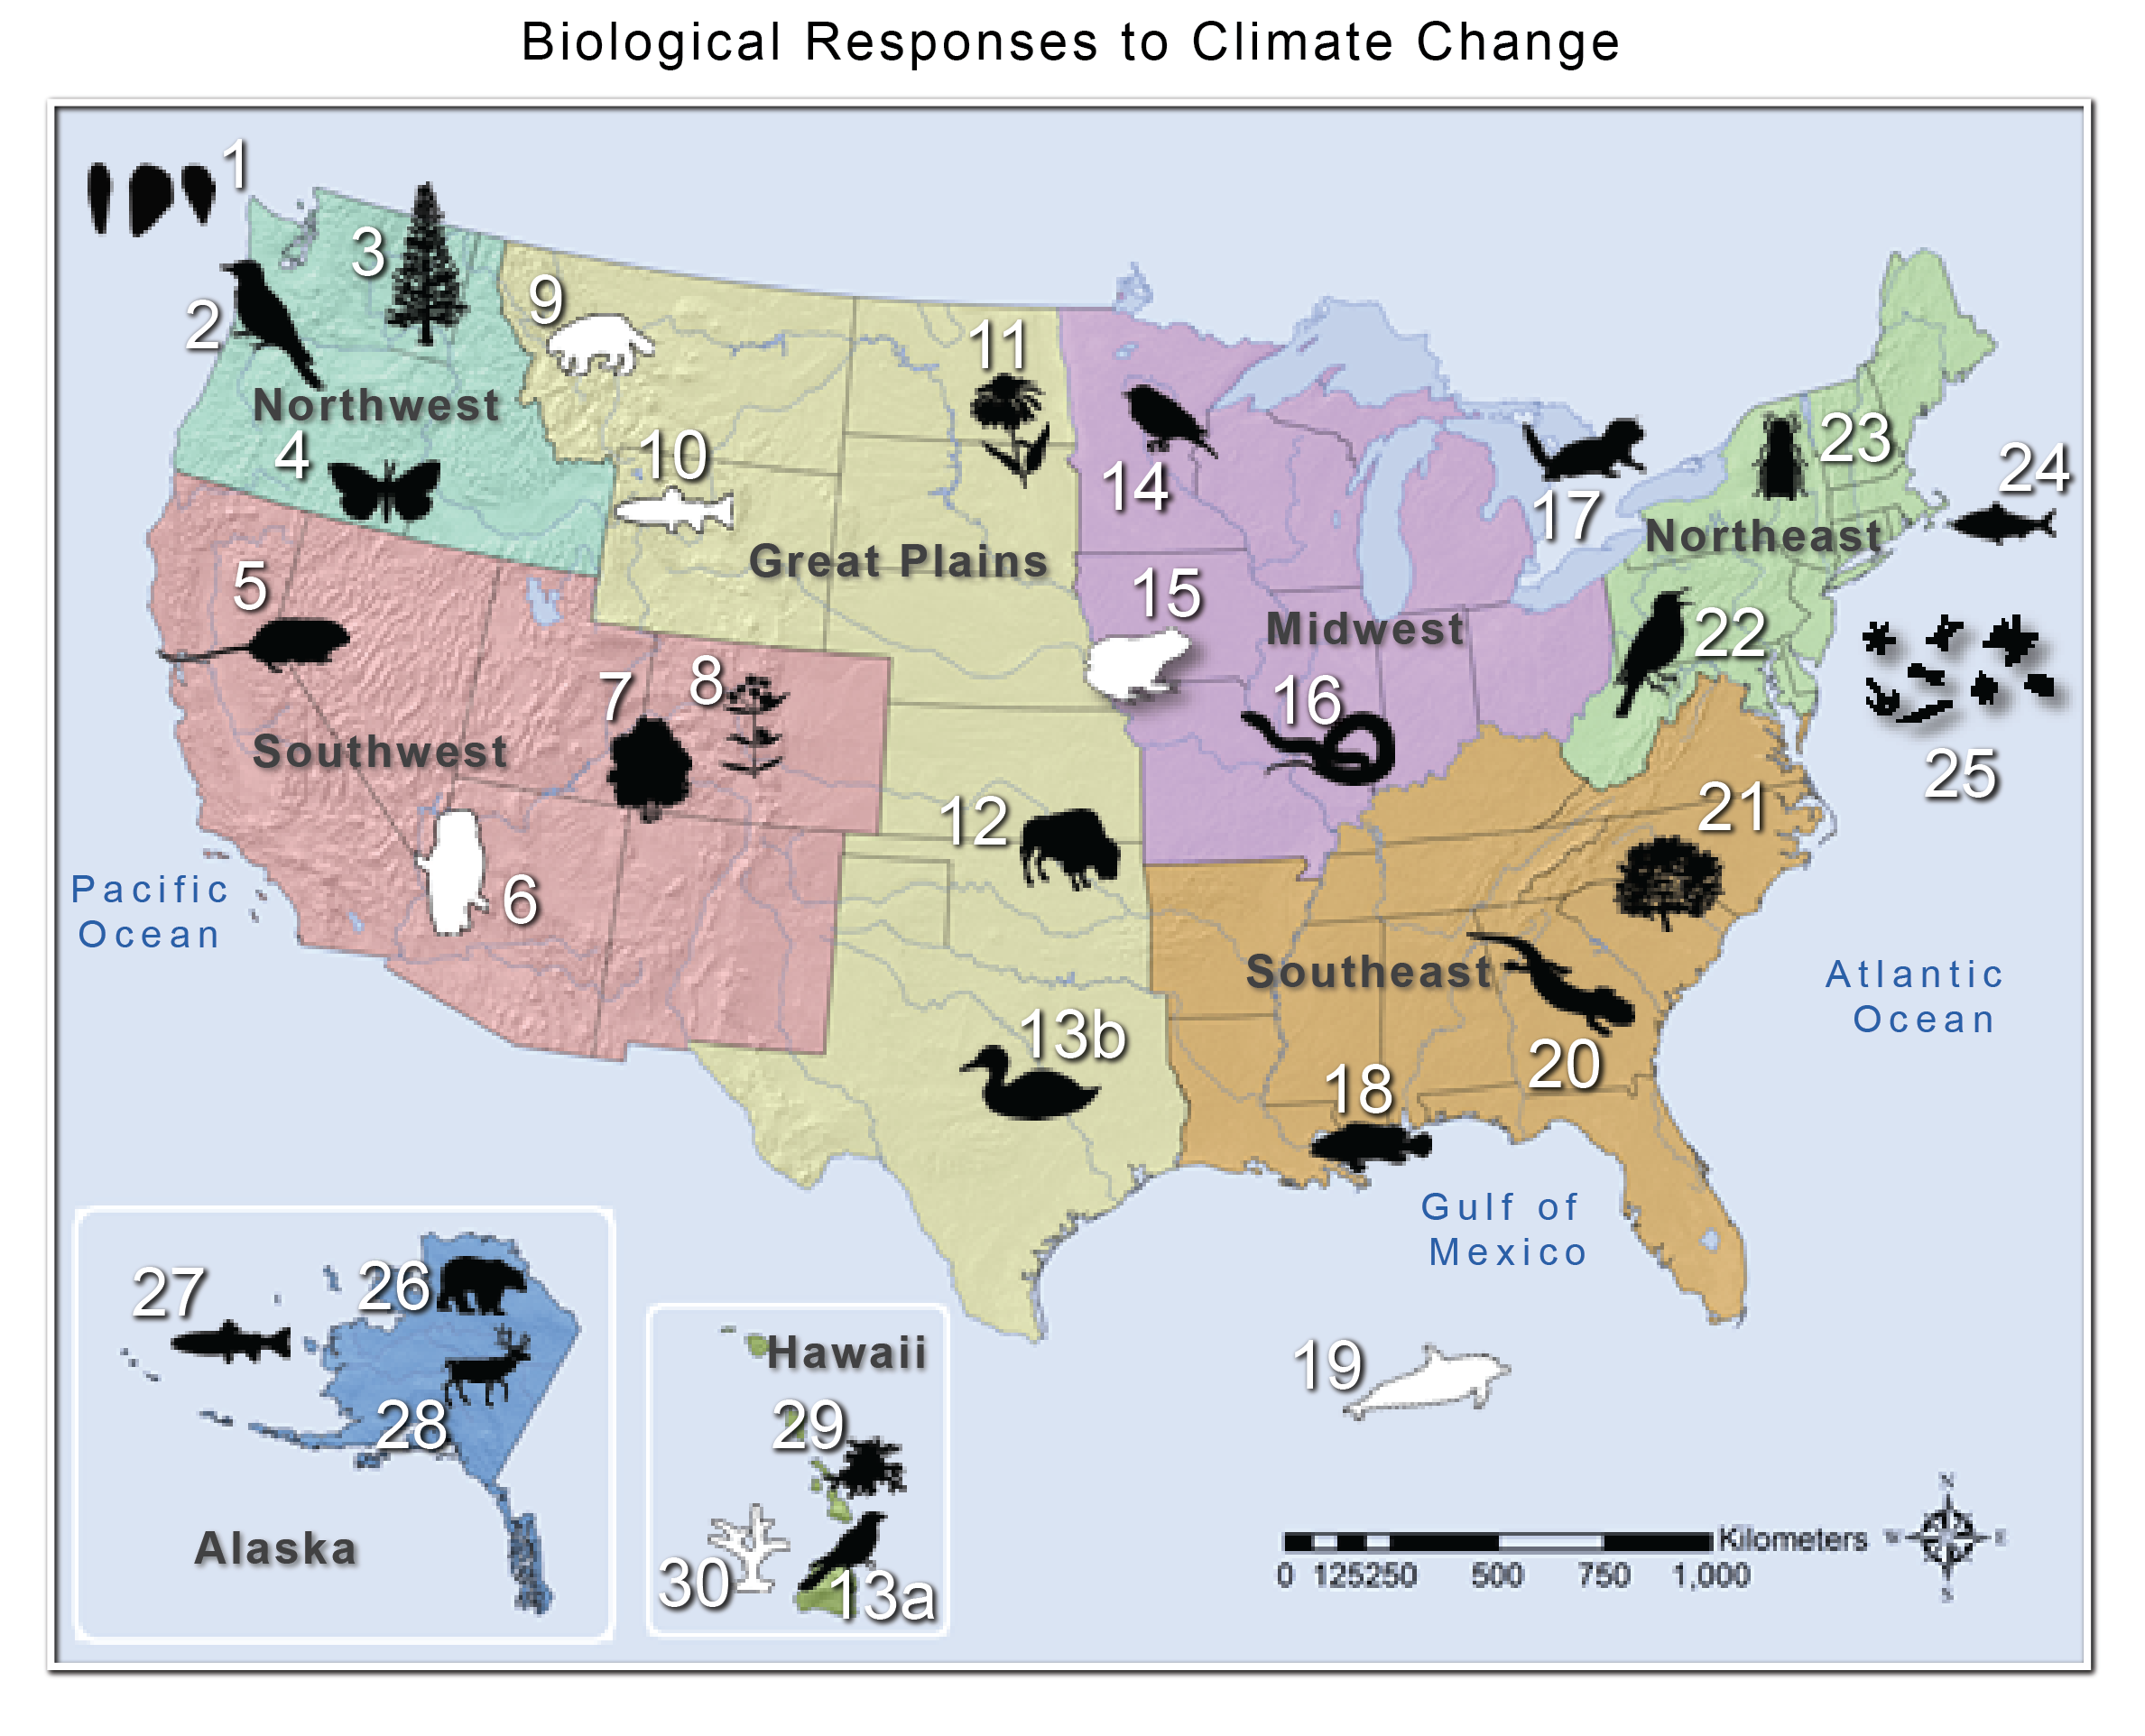
Natural Ecosystems
Biological Responses to Climate Change
Notes:
Map of observed and projected biological responses to climate change across the United States. Case studies listed in Chapter 8, Ecosystems (p. 302) correspond to observed responses (black icons on map) and projected responses (white icons on map, italicized statements). (Figure source: Adapted from Staudinger et al., 2012). Fig. 8.4 in Ecosystems

Slide 19
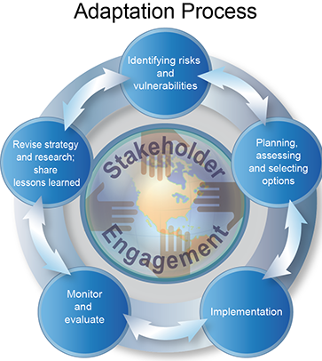
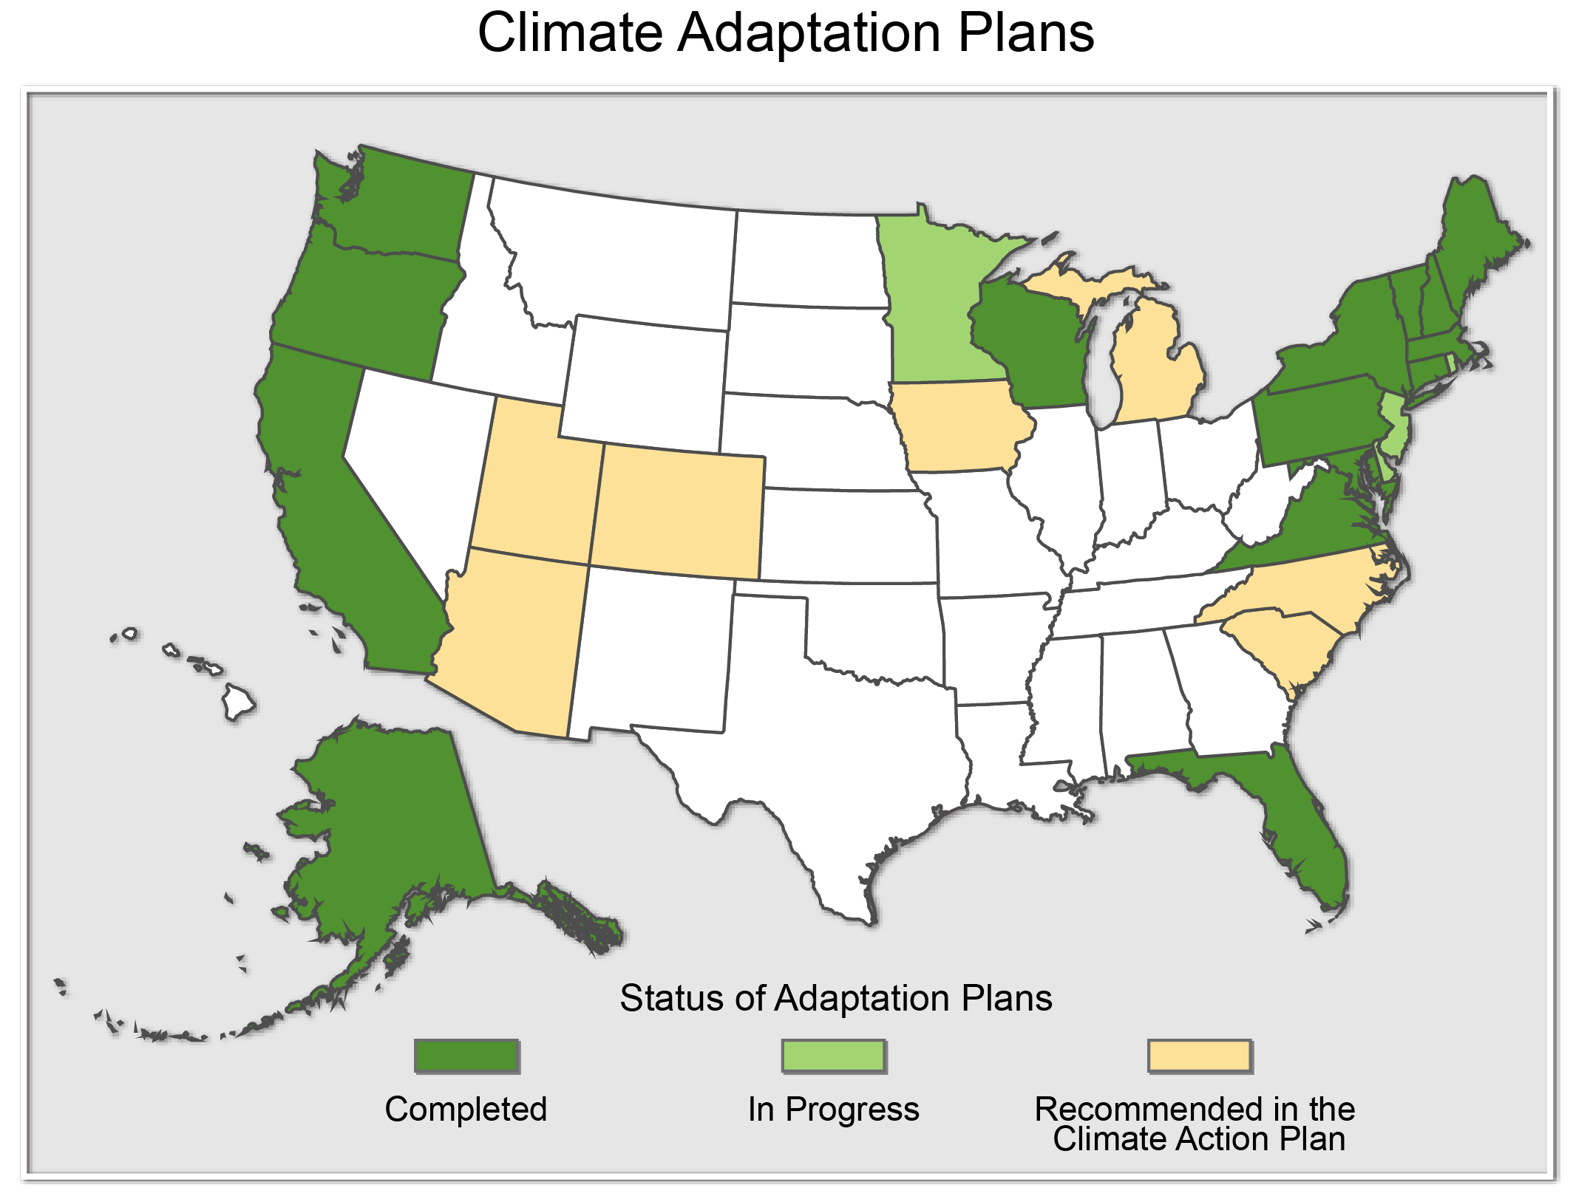
State Adaptation Plans
Adaptation
Adaptation Process
Notes:
Left:: Generalized Adaptation Process adapted from NRC’s America’s Climate Choices Reports. This is not a step-wise or linear process; various stages can be occurring simultaneously, in a different order, or be omitted completely. Figure 28.3: from Adaptation Chapter
Right: Status of State Climate Adaptation Plans. (Figure redrawn from C2ES 2 (Center for Climate and Energy Solutions) 2012a) . Figure 28.1 from Adaptation Chapter

Slide 20
More information:
National Climate Assessment Public Draft:
NCADAC.globalchange.gov
NCA information
assessment.globalchange.gov
NCANet, the NCA network of partners
ncanet.usgcrp.gov
Glynis Lough
glough@usgcrp.gov
Emily Cloyd
ecloyd@usgcrp.gov

Slide 21
EXTRA SLIDES

Slide 22
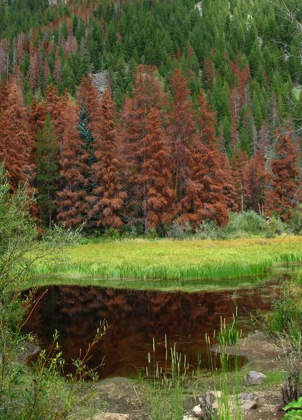
Sectors
Water Resources
Energy Supply and Use
Transportation
Agriculture
Forestry
Ecosystems and Biodiversity
Human Health

Slide 23
Sectoral Cross-Cuts
Water, Energy, and Land Use
Urban Systems, Infrastructure, and Vulnerability
Impacts of Climate Change on Tribal, Indigenous, and Native Lands and Resources
Land Use and Land Cover Change
Rural Communities
Biogeochemical Cycles

Slide 24
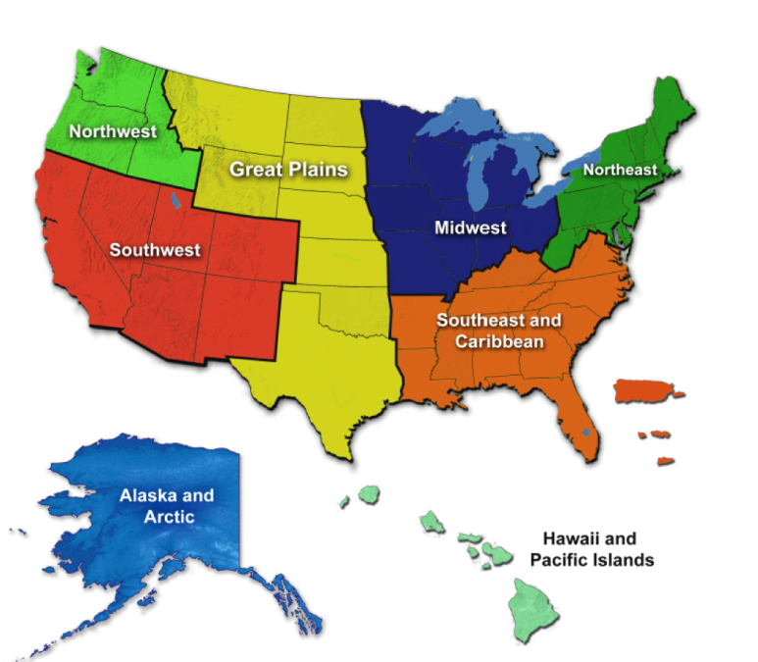
Regions & Biogeographical Cross-Cuts
Oceans and Marine Resources
Coasts,
Development,
and Ecosystems

