Slide 1
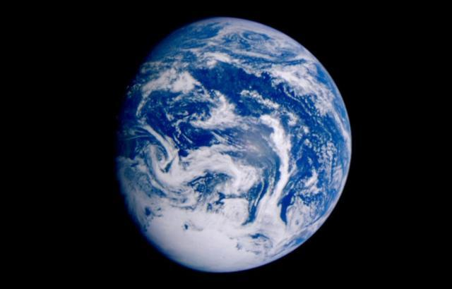
Managing
Our
Planet:
Government
Leadership
in
Sustainability
Property of the U.S. General Services Administration.

Slide 2
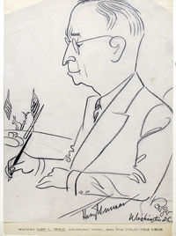

Slide 3
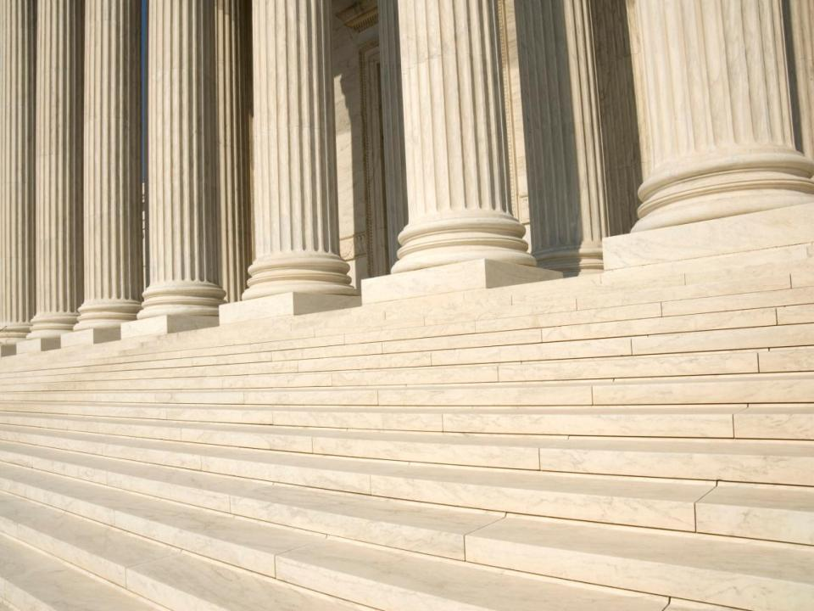
GSA Manages…
370 million square feet;
12 million products;
400,000 vehicles;
10 million trips;
$65 billion in purchases…
Property of the U.S. General Services Administration.

Slide 4
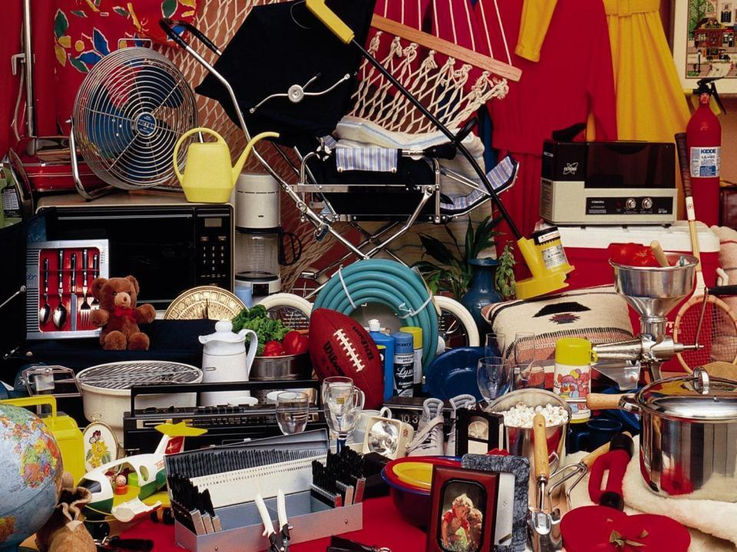
Everything…
For
Everyone…
Everywhere.
Property of the U.S. General Services Administration.

Slide 5
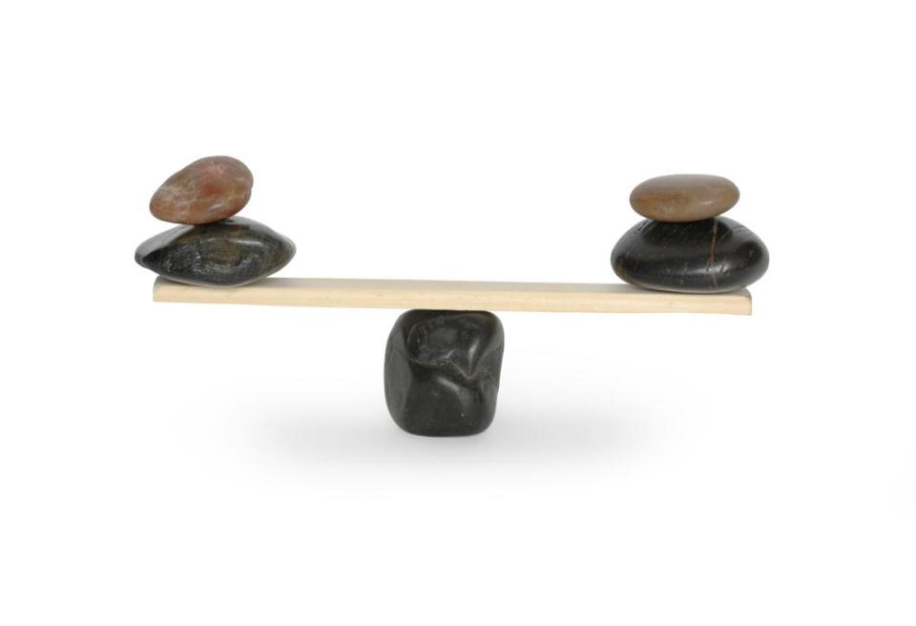
Fulcrum
of
Government.
Property of the U.S. General Services Administration.

Slide 6
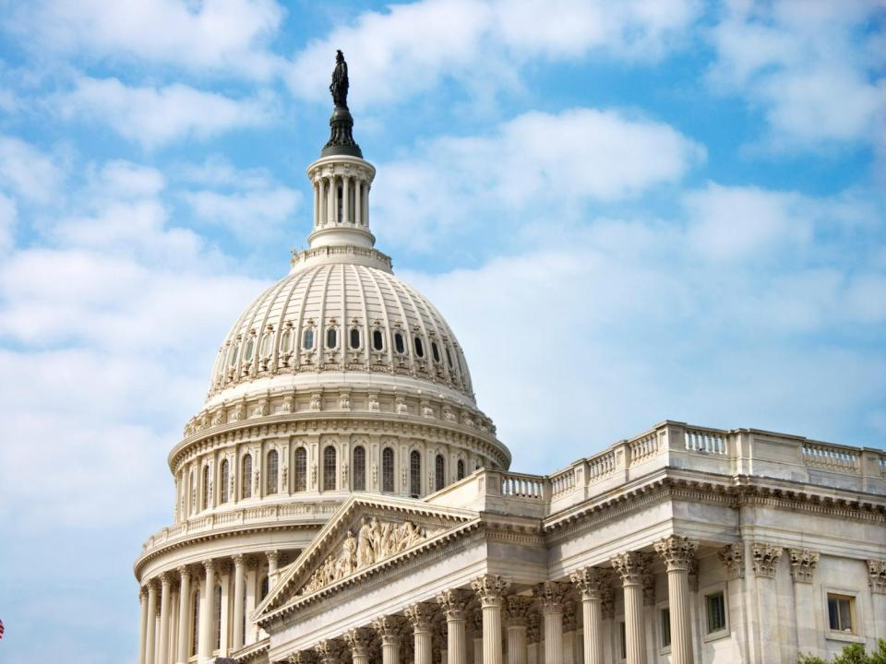
Sustainability of
Government.
Property of the U.S. General Services Administration.

Slide 7
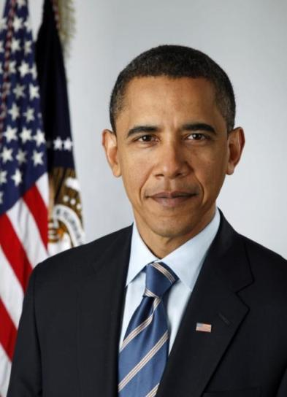
Executive Order 13514: Federal Leadership in Environmental, Energy, and Economic Performance
“…to establish an integrated strategy towards sustainability in the Federal Government and to make reduction of greenhouse gas emissions a priority for Federal agencies…”
Property of the U.S. General Services Administration.

Slide 8
Resource
Stewardship.
Property of the U.S. General Services Administration.

Slide 9
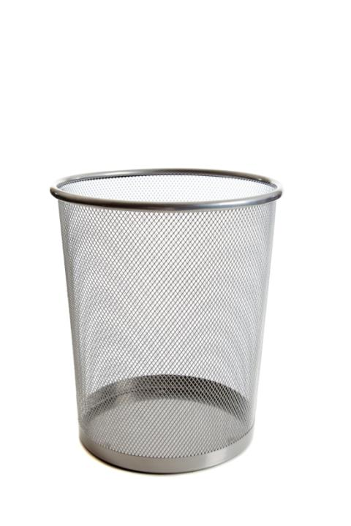
No Waste.
Property of the U.S. General Services Administration.

Slide 10
Judo (n): The modern sport derived from jujitsu, in which the object is to throw, hold to the ground, or otherwise force an opponent to submit, using the minimum of physical effort.
Property of the U.S. General Services Administration.
Notes:
.

Slide 11
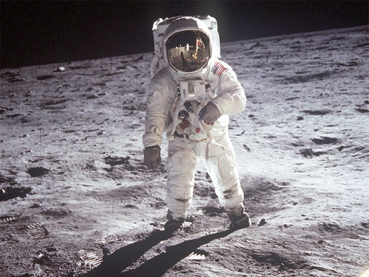
Models
of
Future
Workspaces.
Property of the U.S. General Services Administration.

Slide 12
Mobile Work.
Property of the U.S. General Services Administration.

Slide 13
The Cloud.
Property of the U.S. General Services Administration.

Slide 14
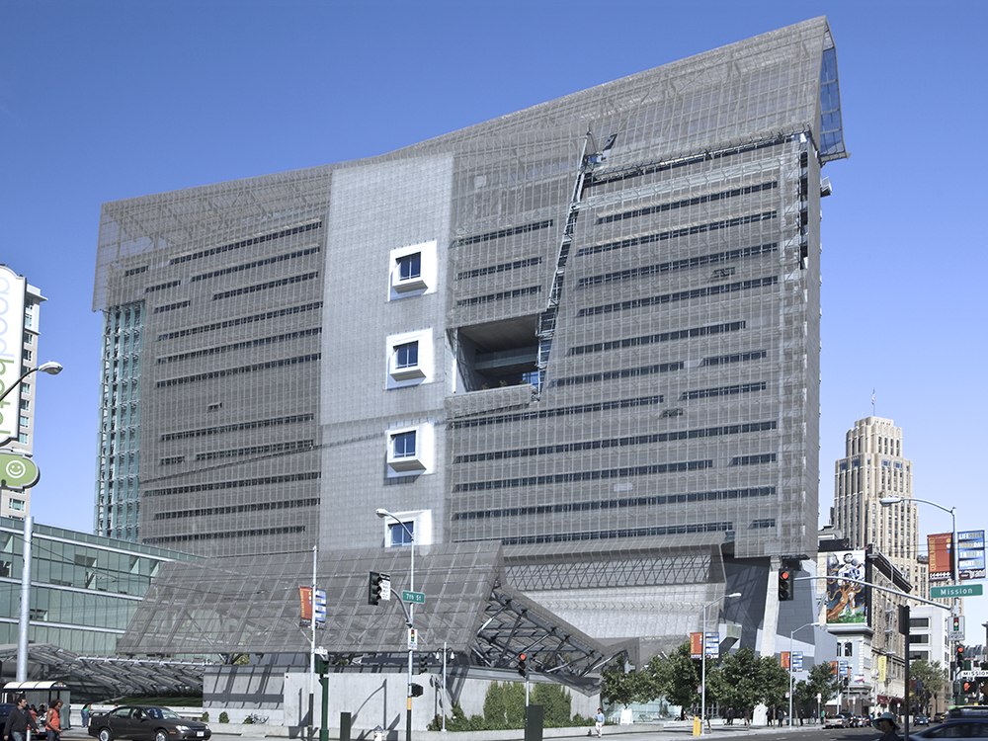
LEED Buildings.
Property of the U.S. General Services Administration.
San Francisco Federal Building San Francisco, CA

Slide 15
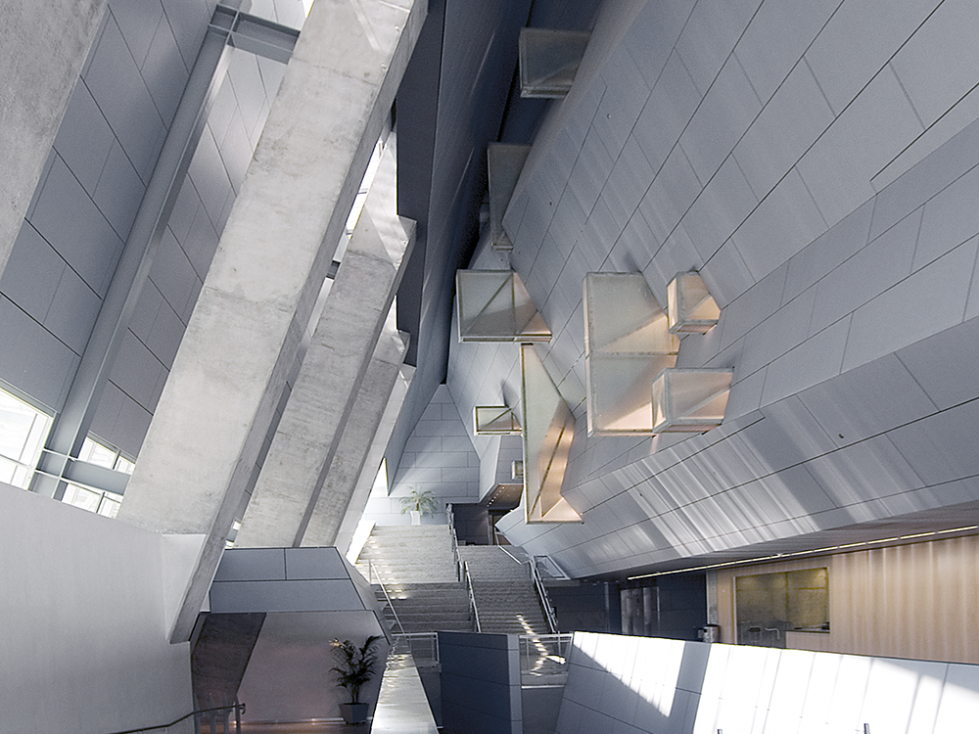
LEED Buildings.
Property of the U.S. General Services Administration.
San Francisco Federal Building San Francisco, CA

Slide 16
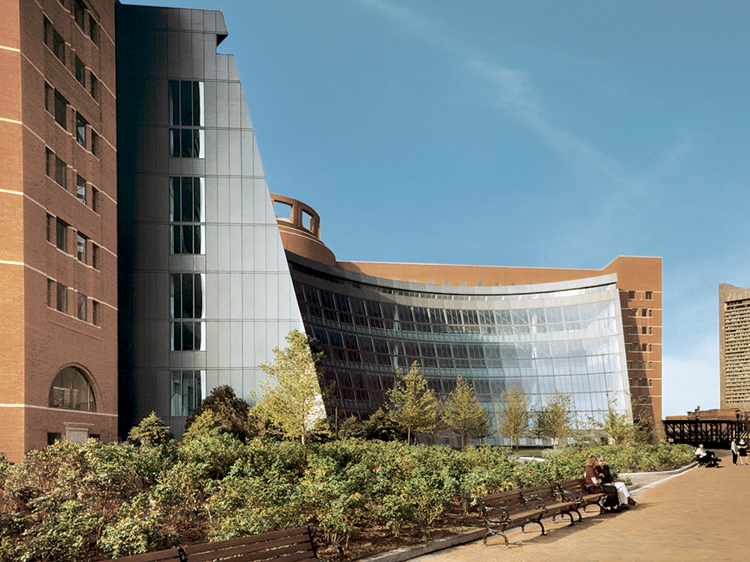
Green Proving Ground.
Property of the U.S. General Services Administration.
John Joseph Moakley U.S. Courthouse Boston, MA

Slide 17
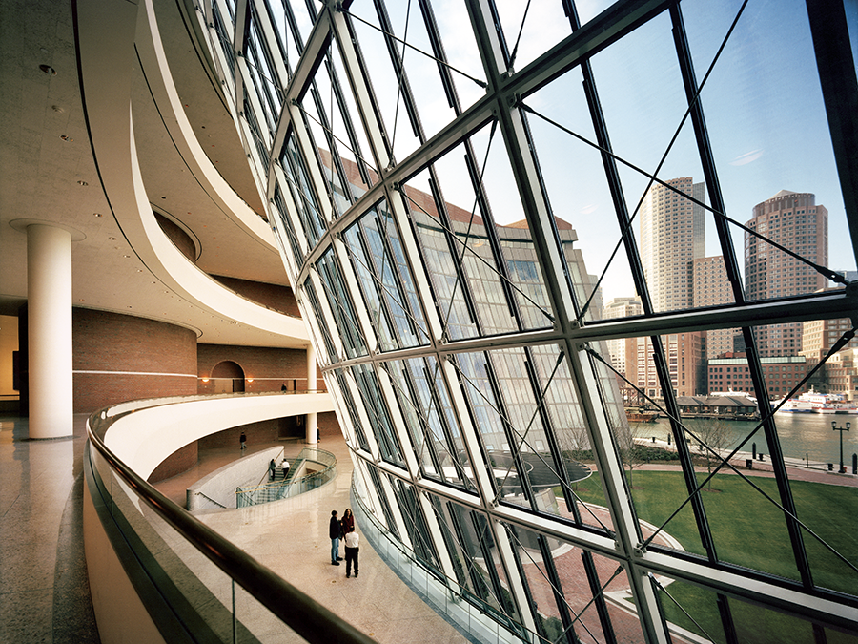
Green Proving Ground.
Property of the U.S. General Services Administration.
John Joseph Moakley U.S. Courthouse Boston, MA

Slide 18
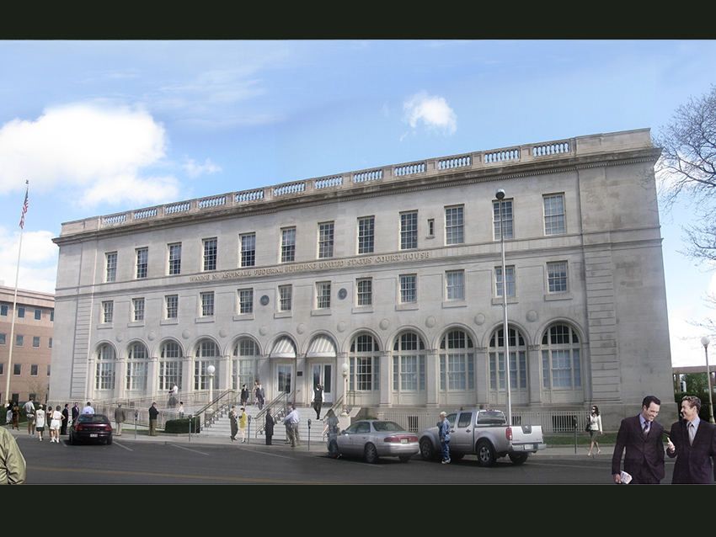
Historic Renovation.
Property of the U.S. General Services Administration.
Aspinal Federal Building Grand Junction, CO

Slide 19
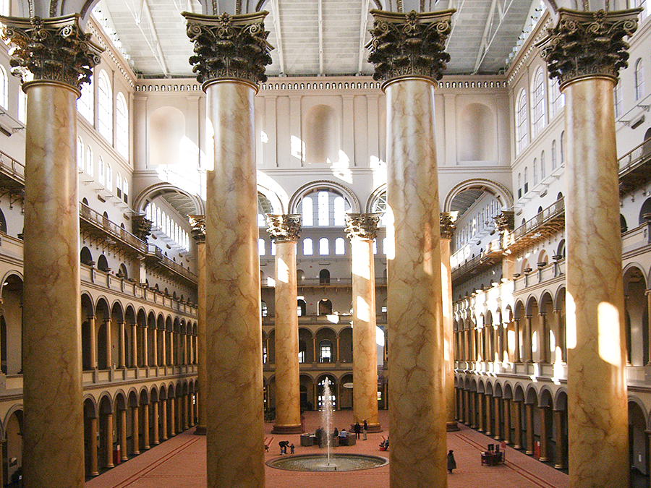
Historic Renovation.
Property of the U.S. General Services Administration.
National Building Museum Washington, DC

Slide 20
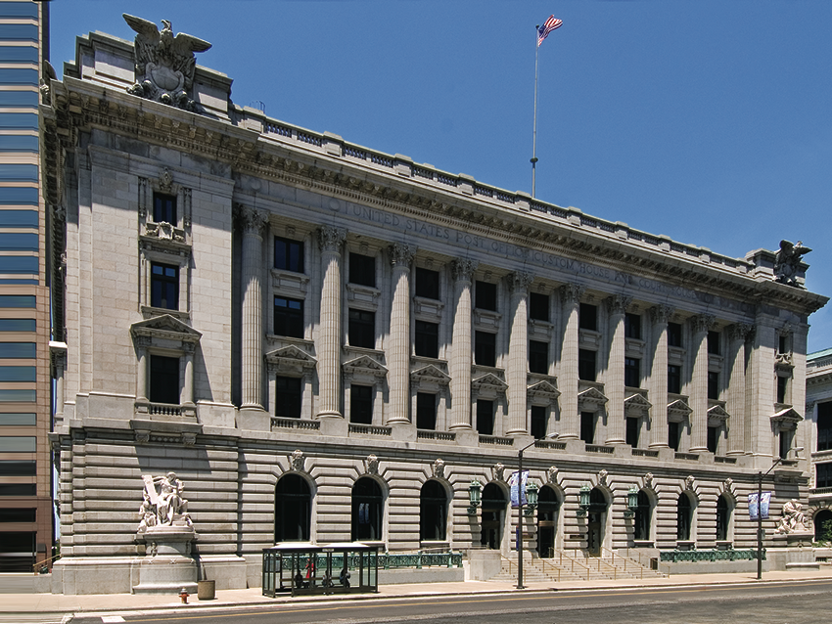
Energy Savings Performance Contracts.
Property of the U.S. General Services Administration.
Metzenbaum Courthouse Cleveland, OH

Slide 21
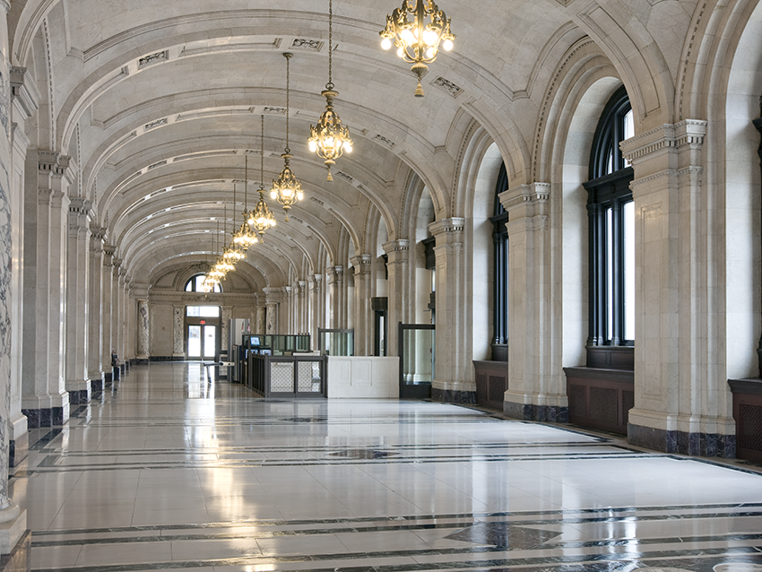
Energy Savings Performance Contracts.
Property of the U.S. General Services Administration.
Metzenbaum Courthouse Cleveland, OH

Slide 22
1800 F Street.
Property of the U.S. General Services Administration.

Slide 23
Sustainable
supply
chain.
Property of the U.S. General Services Administration.

Slide 24
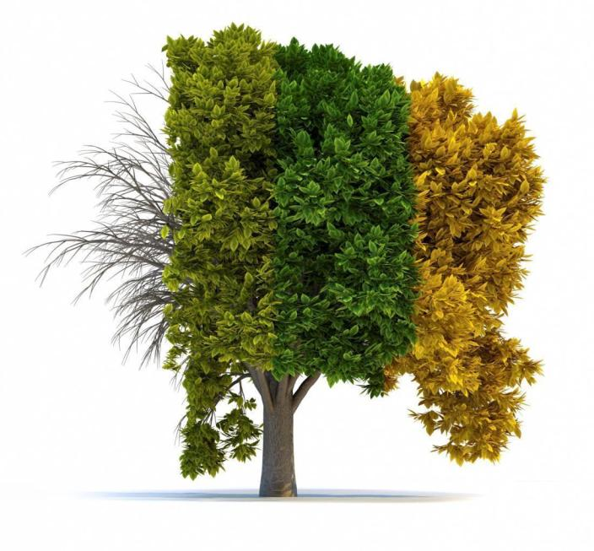
Lifecycle.
Property of the U.S. General Services Administration.

Slide 25
Return
on
Investment.
Property of the U.S. General Services Administration.

Slide 26
Risk
Mitigation.
Property of the U.S. General Services Administration.

Slide 27
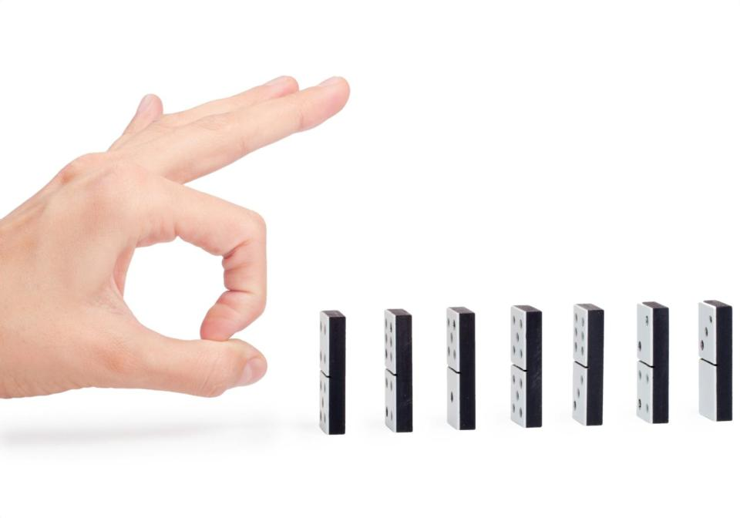
Intentionality.
Property of the U.S. General Services Administration.

Slide 28
Partnership.
Property of the U.S. General Services Administration.

Slide 29
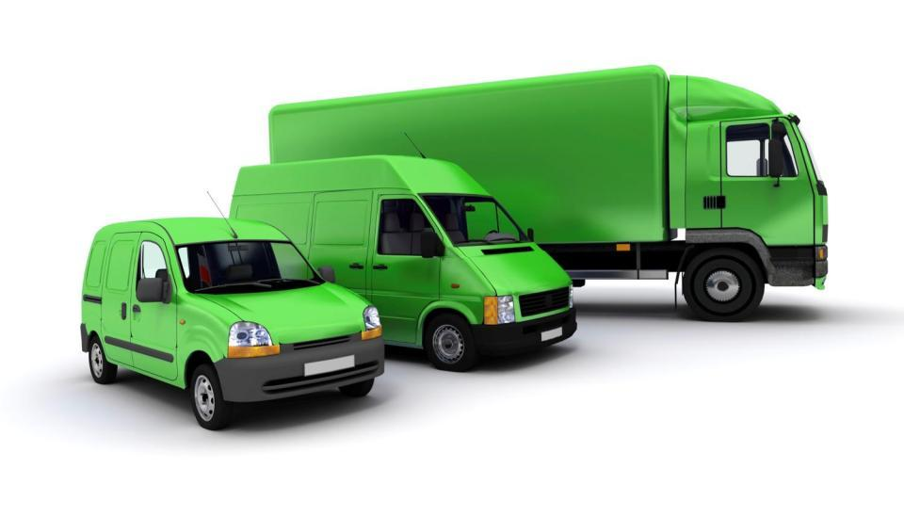
Greening
Fleet.
The
Property of the U.S. General Services Administration.

Slide 30
E-Waste.
Property of the U.S. General Services Administration.

Slide 31
Conversation.
Property of the U.S. General Services Administration.

