Slide 1
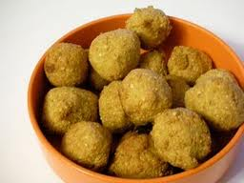
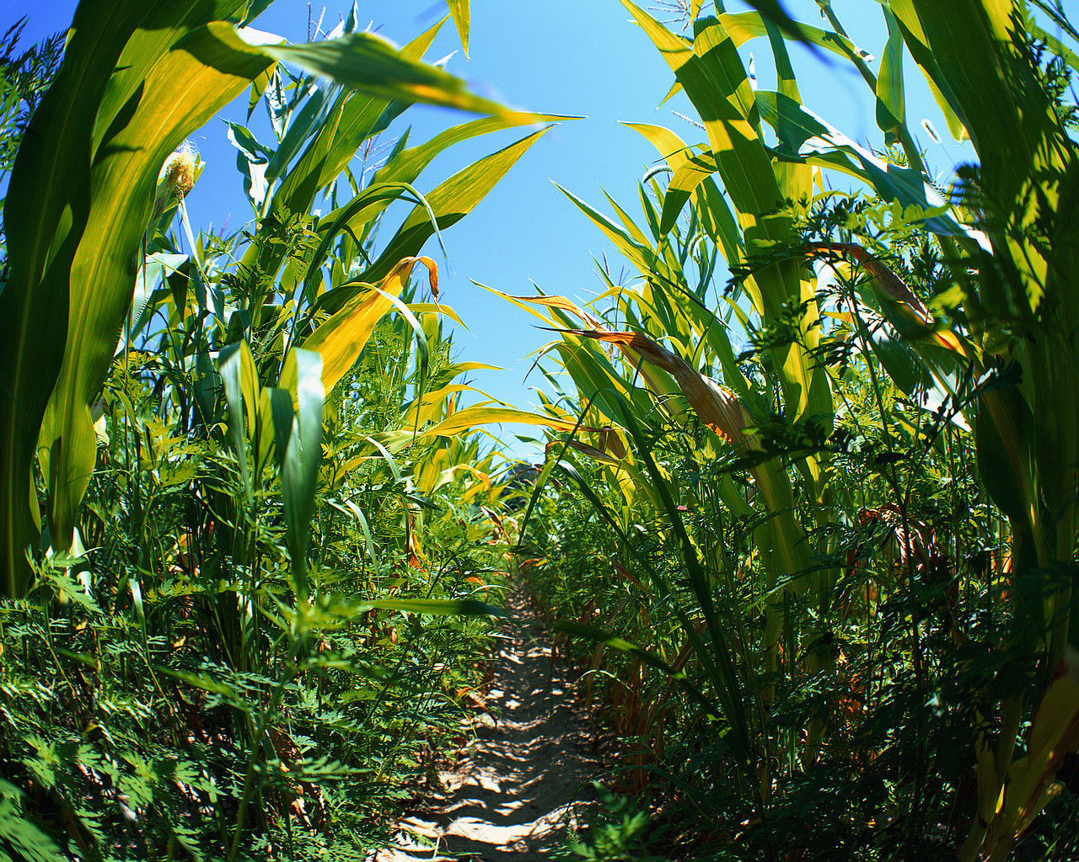
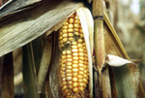
From Analysis to Action:
A Conceptual Framework for Country and Economic Assessment for Aflatoxins
Tulika Narayan and Angela Stene
Mycotoxins: Triple Threat to African Development
February 14, 2013

Slide 4
Presentation Roadmap
Objective of the country and economic assessment
Conceptual framework and research methods
Aflatoxin prevalence data for maize and groundnuts
Characterization of risk factors: method and findings
Economic impact of aflatoxin contamination
Identification and prioritization of viable control strategies through in-country workshops
Notes:
ANGIE START
The framework is replicable in any country
Even with modest resource allocations and limited prior experience.
Simple template to capture information available from existing data, documents, and resources, while
Highlighting information gaps that need to be filled.

Slide 5
Objective of the Country and Economic Assessment
Develop a replicable, low-cost method for PACA
Pilot it in Nigeria and Tanzania
Characterize the key risks and economic impacts of aflatoxin contamination…
Identify promising opportunities for control
Vet findings with policy and practitioners
Garner country-level action through cross-sectoral collaboration
Notes:
ANGIE START
The framework is replicable in any country
Even with modest resource allocations and limited prior experience.
Simple template to capture information available from existing data, documents, and resources, while
Highlighting information gaps that need to be filled.

Slide 6
Conceptual Framework
Step 1
Identify Key Crops of Concern
Step 2
Determine Prevalence of Aflatoxin
Step 3
Characterize Risks of Aflatoxin Contamination and Exposure
Step 4
Step 5
Step 6
Estimate Economic Impacts
Identify Opportunities for Aflatoxin Control
Initiate Action through Multi-Stakeholder Workshop

Slide 7
Qualitative & Quantitative Data Sources
Primary data for prevalence sampling.
Living Standard Measurement Survey - Integrated Surveys on Agriculture (LSMS-ISA).
FAOSTAT for historical trade data and food balance sheet.
Other secondary data sources on population, age structure, HBV prevalence, WHO Life tables
Qualitative primary data.
Notes:
The LSMS-ISA has nationally and zonally representative data on household consumption, anthropometry, agricultural production and sales, use of inputs and extension services, and constraints to agricultural production.
Life tables have age- and sex- specific mortality rates and life expectancies.

Slide 8
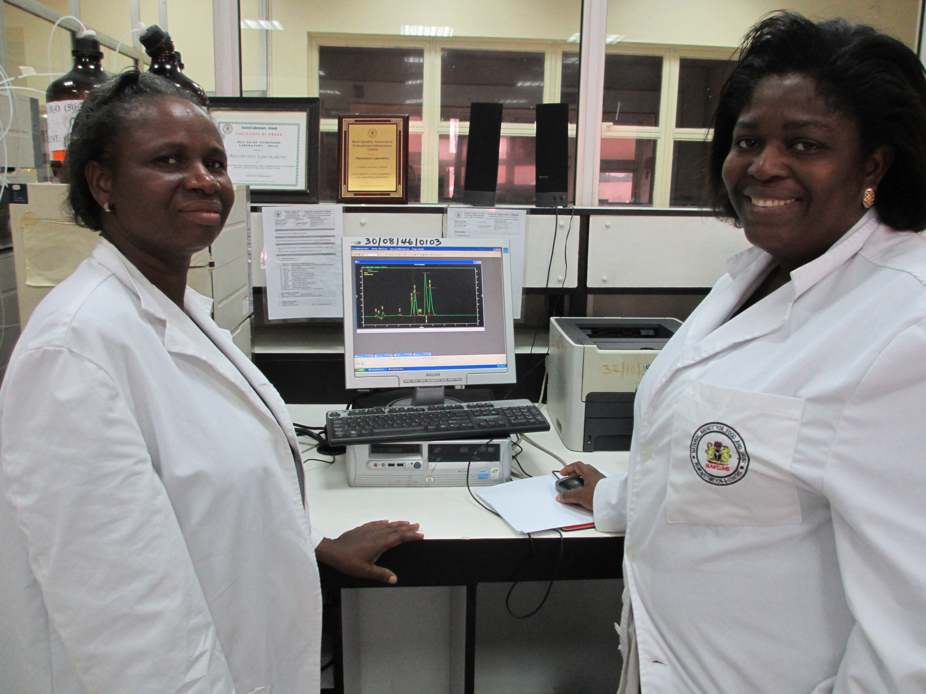
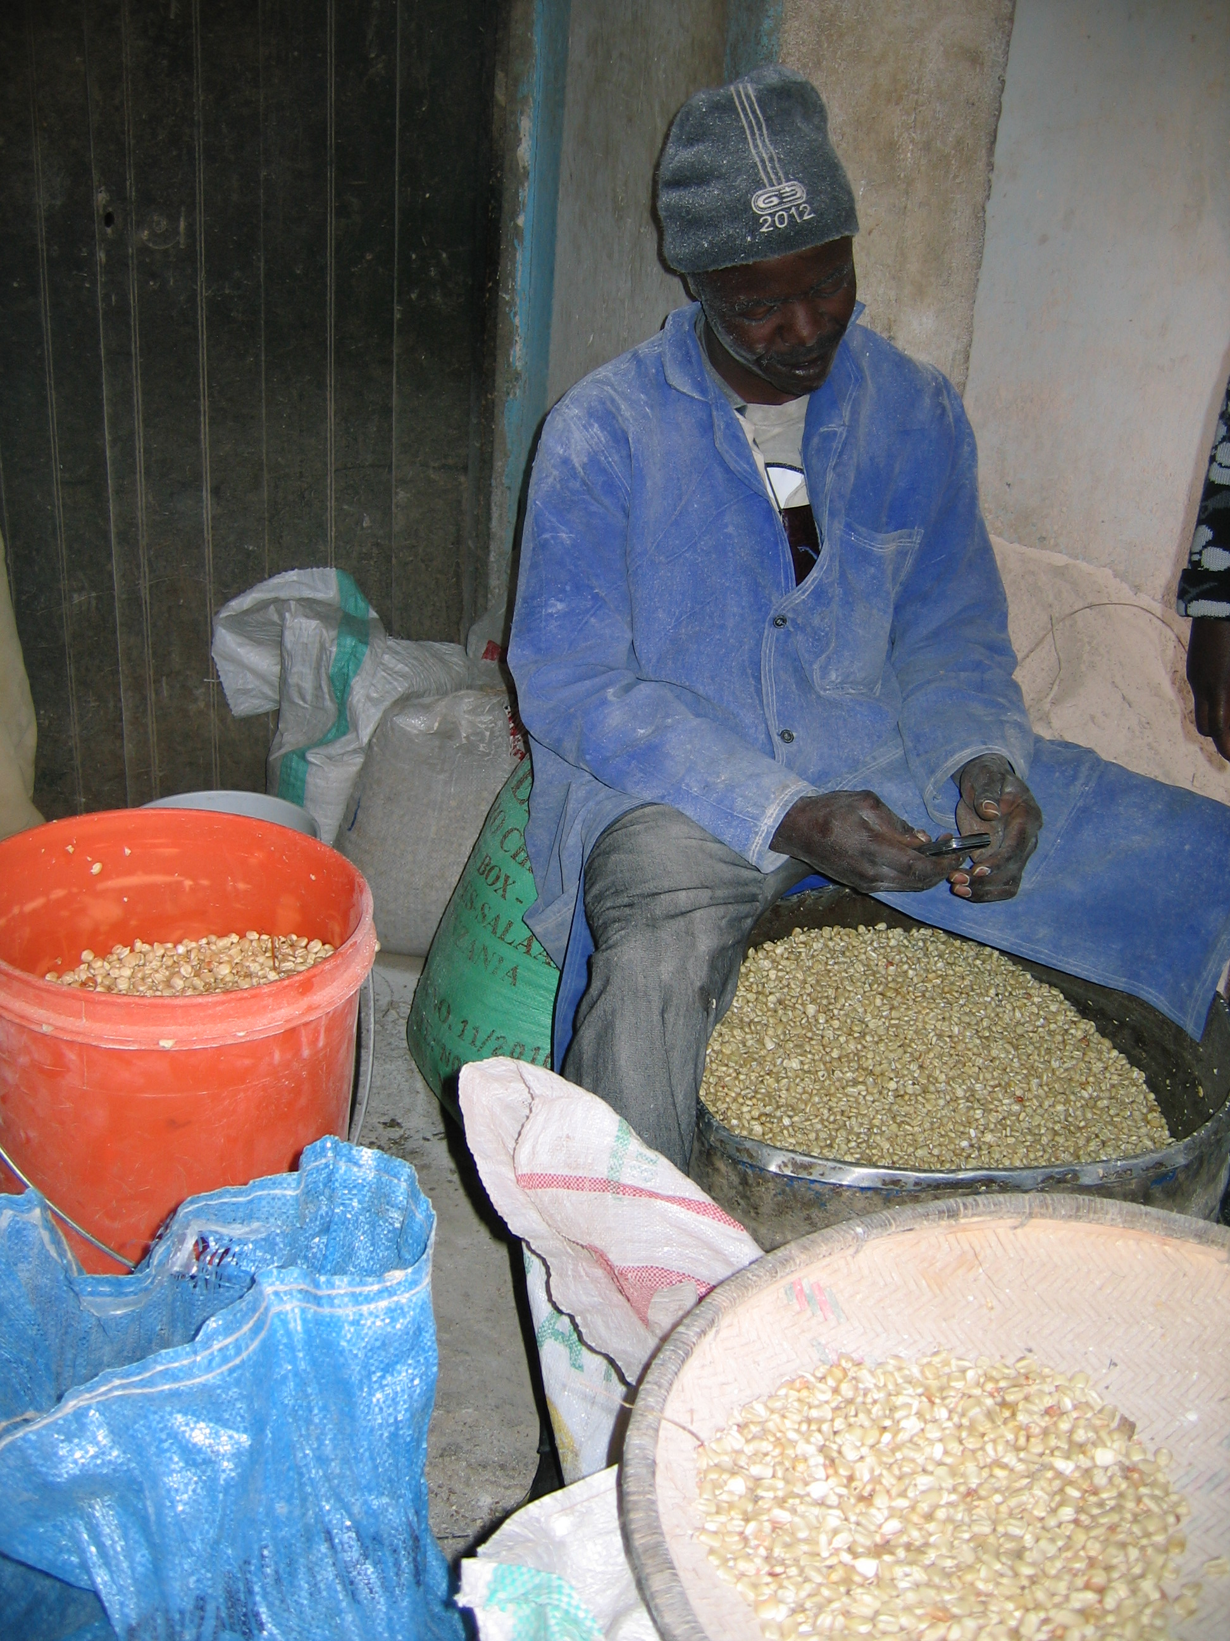
Aflatoxin Prevalence in Maize and Groundnuts
Notes:
The framework is replicable in any country
Even with modest resource allocations and limited prior experience.
Simple template to capture information available from existing data, documents, and resources, while
Highlighting information gaps that need to be filled.

Slide 9
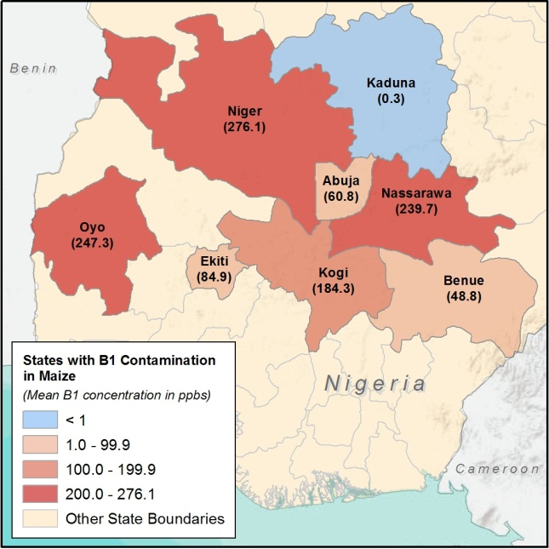
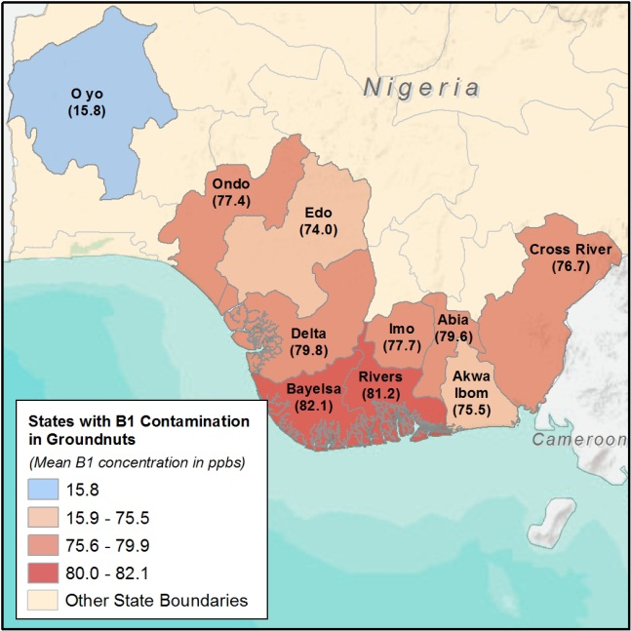
Aflatoxin B1 Prevalence in Nigeria
Notes:
Angie please point out that we could no use all the available data for our subsequent analysis. Only data with information on B1 and on groundnuts so we could tie it directly to the consumption of groundnuts.
Used specific data from studies reported in table above and took simple average by states to arrive at the state-level average.
Used only data on groundnuts (not peanut cake),
Used Aflatoxin B1 numbers only because these are input into our health impact estimates. Liver cancer dose response—relationship between aflatoxin level and liver cancer risk -- is
Map shows the data that were actually used.
Also: simple averages accounted for proportion of zeros (<LOD), not just detects. defined for aflatoxin B1 only. Remember that aflatoxin B1 is the most toxic of all aflatoxins.

Slide 10
Aflatoxin B1 Prevalence in Tanzania
Notes:
Used specific data from studies reported in table above and took simple average by states to arrive at the state-level average.
Used only data on maize (not peanut cake),
Used Aflatoxin B1 numbers only because these are input into our health impact estimates. Liver cancer dose response—relationship between aflatoxin level and liver cancer risk -- is defined for aflatoxin B1 only. Remember that aflatoxin B1 is the most toxic of all aflatoxins.
For Tz we did not calculate averages. We present data in ranges.
The shares of the samples falling into >= 5ppb range took into account maize production volumes.

Slide 11
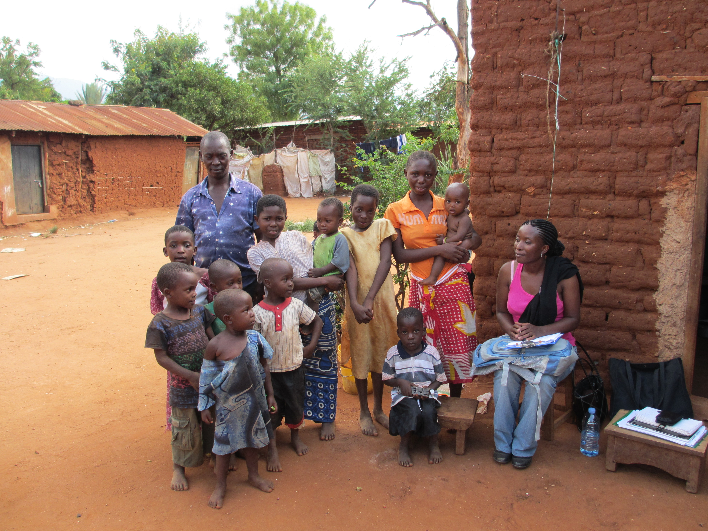
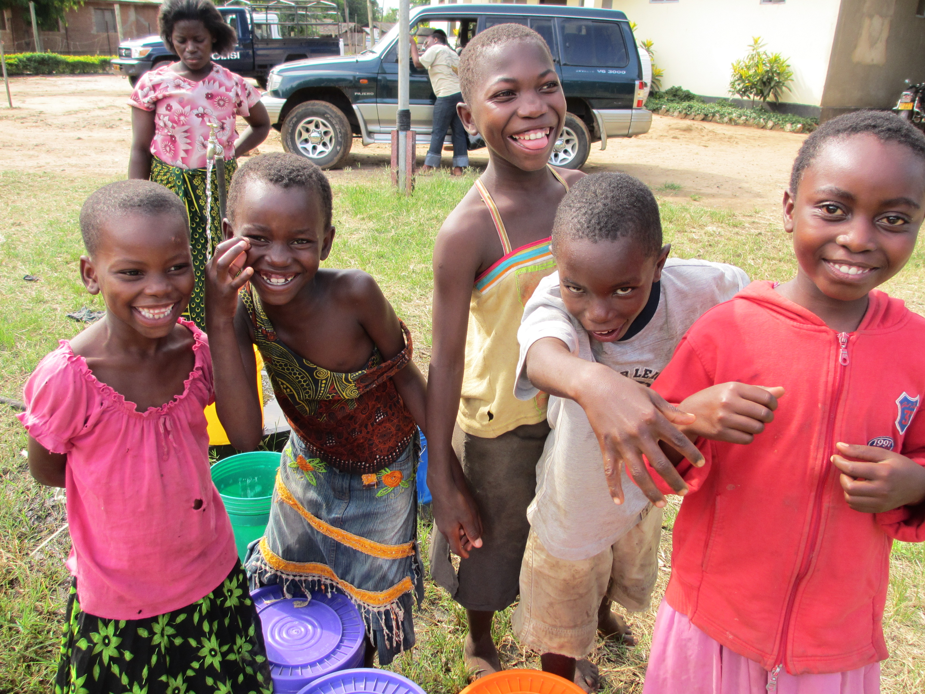
Characterization of Risk: Method and Findings
Notes:
Uses both qualitative and quantitative methods, worked with the team of consultants on the ground, Angela lead the assessment in Nigeria, I in Tanzania.
The framework is replicable in any country
Even with modest resource allocations and limited prior experience.
Simple template to capture information available from existing data, documents, and resources, while
Highlighting information gaps that need to be filled.

Slide 12
Characterization of Risks
Risks of aflatoxin on country’s agriculture and food security, trade and/or health sector are determined by:
  (1) uses of contaminated crop (domestic human consumption, international trade, or feed);
  (2) levels of awareness about aflatoxins and aflatoxin control among policy makers, farmers, traders, and consumers;
  (3) actions (of lack thereof) taken by regulators, buyers and consumers to mitigate the risk.
This step used qualitative and quantitative methods.
Notes:
Note here that in this step we consider all these three elements. Next slide considers the uses of these crops in Nigeria.
Step 3: Characterize Risks of Aflatoxin Contamination and Exposure.
Examine and quantify the core risk of aflatoxin contamination.
Examine how aflatoxin-susceptible crops are used to determine how the economic impacts are distributed (agriculture and food security, trade, health).
Assess the main uses of the commodity in the country—whether for direct consumption, domestic sale, or international trade.
Examine the core aflatoxin risks all along value chains of selected crops:
Agriculture Pre-harvest to post-harvest; and farm to plate
Domestic commerce and international trade,
Human health.
NOTE THAT IN THE FIRST STEP BOTH QUANT AND QUAL DATA WERE USED.

Slide 13
Final Use of Crops
Contaminated Products
Notes:
Losses may be incurred most heavily in human health (especially if livestock raisers have heightened awareness).
Export of maize and groundnuts is less than 1 percent of total production in Nigeria.
In Nigeria, After production, either via sale to market or through direct own consumption a large majority (78%) of the maize is consumed domestically. 2010/2011 USDA
This heightens the threat of human health impact resulting from aflatoxins. Farmers can incur losses at the point of sale to the market.
Consumption of maize by livestock can also result in human and market impact but we do not consider that sector too much in detail.
Poultry (with the largest feed market in TZ and Nigeria ) is vigilant and farmers may incur some losses in selling the produce to the feed sector, but only a small percentage of maize goes to that sector.
Majority of the maize crop in Tanzania is used for direct human consumption (FAOSTAT 2009).
68 % -human consumption,
19 % feed,
12 % other residual uses,
2% re-planting
Average agricultural households report selling 17 % of their maize produce, 2 % for feed, using 1 % for seed, and the residual 77 % for own consumption or storage (LSMS-ISA, 2008/9).
Using secondary data (eg. LSMS-ISA and FAO Stat) assess how suspected crops are used.
This determines where the economic impact lies, and where the losses are incurred (eg. agriculture and food security vs. trade vs. human health).
Awareness greatly influences economic impact. As many households and traders not aware-there are no market losses.

Slide 14
Own Consumption by Agricultural Households
Tanzania |  |  | Nigeria
Zone | Maize | Groundnuts | Zone | Maize | Groundnut
Central | 73% | 77% | North Central | 76% | 71%
East | 44% | 30% | North East | 83% | 68%
Lake | 61% | 79% | North West | 52% | 64%
North | 42% | 18% | South East | 0% | 3%
South | 82% | 80% | South South | 0% | 10%
Southern Highlands | 71% | 67% | South West | 45% | 0%
West | 61% | 75% | National | 65% | 62%
Zanzibar | 1% | 12%
National | 63% | 72%
Source: Estimated from LSMS-ISA

Slide 15
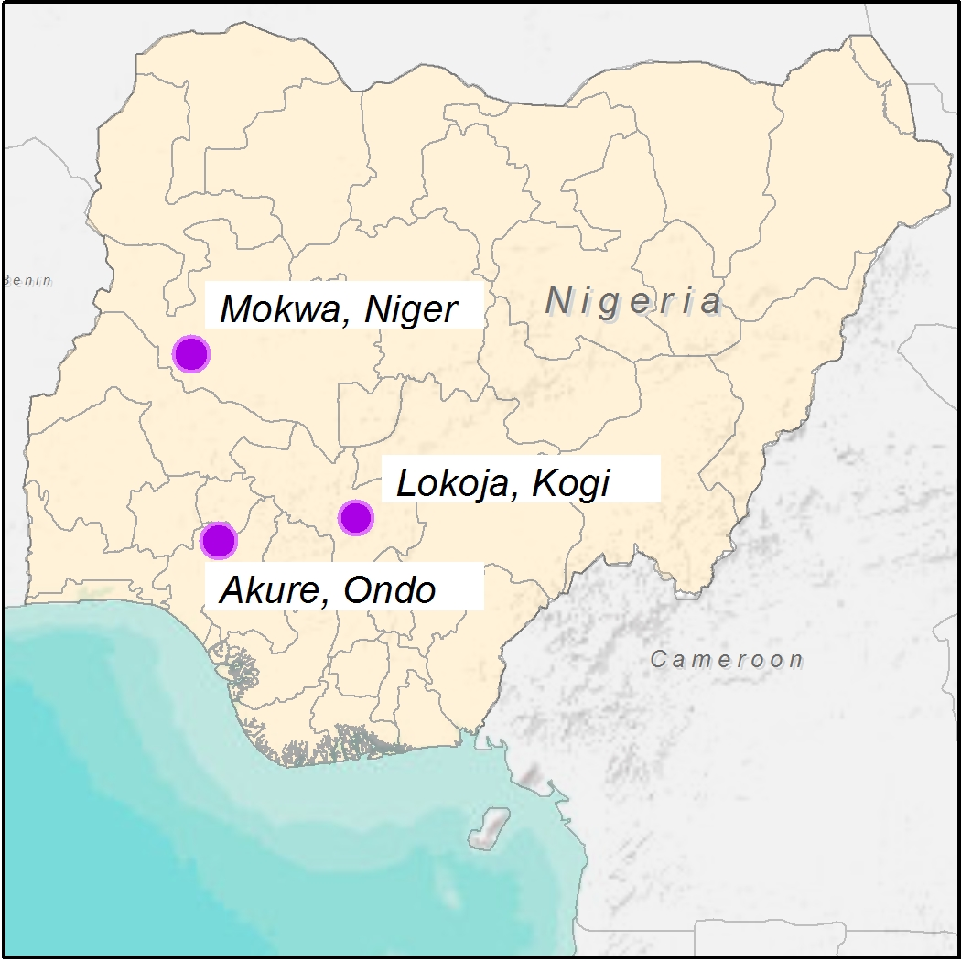
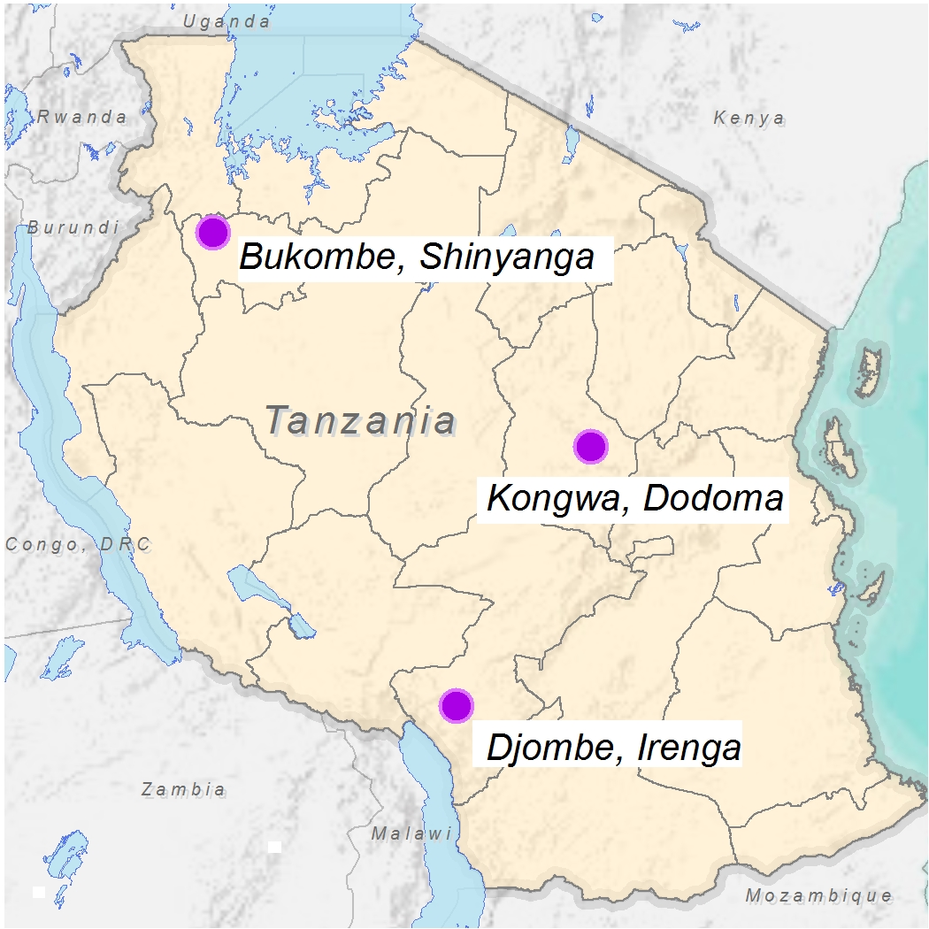
Qualitative Assessment Locations
Nigeria
Tanzania
Notes:
ANGELA START Criteria for inclusion in the qualitative assessment:
Key agro-ecological zones (three-distinct), but security a factor.
Key maize growing areas, and areas that also have peanut production.
High prevalence of aflatoxin recorded (500 ppb+).
100+ interviews, focus group discussions, and large stakeholder events with a team of three local experts assessed:
Legal and regulatory environment
District and regional implementation of regulations.
KAP assessed along the maize and groundnut value chain and among health/agriculture extension and end users .
Commercial sector stakeholders consulted for viable, available solutions.
Access to finance and willingness to pay for agricultural inputs and improved storage assessed.
Viable control and prevention strategies and technologies.

Slide 16
Stakeholders and Key Informants
Policy Makers
PACA
Regulators
Farmers
Importers
/Exporters
Agriculture
Trade
Agro-Processors
Consumers
Health
Livestock and Feed Suppliers
Practitioners in Liver Cancer, Gut Health, Nutrition
Notes:
Partnership for Aflatoxin Control in Africa started under and the Comprehensive Africa Agriculture Development Program with funding from the Gates foundation and DFID.
Ministries of Agriculture, Health and Trade
Development practitioners working to promote food security, agricultural development, economic growth (trade), livestock and human health.
Commercial sector for regional and international trade.
Commodities exchange boards (cashews, groundnut, maize and more).
Importers/exporters of susceptible crops
Animal health scientists, animal feed suppliers, livestock traders (poultry, fish, swine, dairy cattle).
Infant/complementary food processors.
Health practitioners: liver cancer, nutrition, enteric disease (gut health), child stunting, possibly HIV and malaria.

