Slide 1
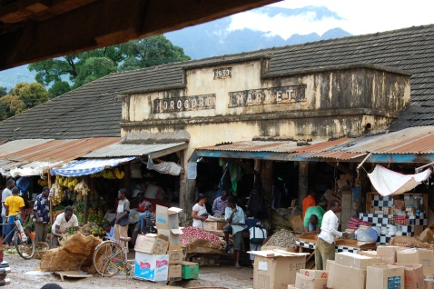
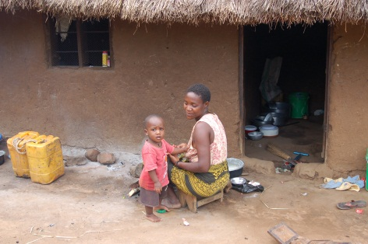
Key Issues Assessed
Regulatory and Institutional:
Presence of aflatoxin standards.
Enforcement, awareness and implementation procedures.
Agriculture:
Bio-controls
Use of agricultural inputs (insecticide/herbicide/irrigation/improved seeds).
Improved drying and storage facilities.
Trade:
Market-based incentives (consumer demand) for safer food.
Withdrawal procedures for contaminated products.
Effective grading systems.
Health:
Promotion of awareness and consumer demand for safer food.
Household sorting and processing to reduce mycotoxin contamination.
HBV vaccination.
Notes:
Prior to conducting the country assessment, we reviewed literature and came up with possible solutions to assess.
Both quantitative and qualitative assessment contributed to answering these issues. We examined nationally representative LSMS data to assess use of inputs, access to government extension systems.

Slide 2

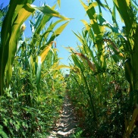
Key Questions to Assess Risk of Exposure
Agriculture
Are Good Agricultural Practices known and used?
Trade
Are there regulations on aflatoxins for commerce?
Are the regulations enforced?
Health
What is the awareness level of farmers?
Do feeding practices contribute to health risks?
Are the consumers aware about aflatoxins?
Are traders aware about aflatoxins?
Farm
to
Fork
Notes:
The country assessment asked questions to identify key risk factors across the three pillars.

Slide 3
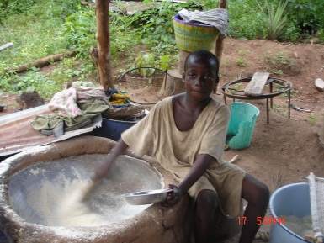
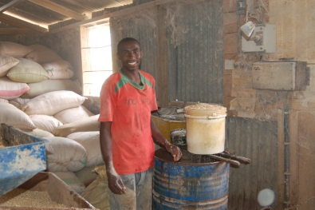
Findings: Agriculture
Low use of agricultural inputs, both due to access and inability/willingness to pay
National guidance on extension services does not include aflatoxin or promotion of GAP
Farmer awareness is low and extension messaging limited with one extension officer having 800+ households.
Rudimentary storage and no means among small farmers to measure/mitigate moisture.
Spoiled maize and groundnuts may be used for animal feed.
Notes:
Nationally, NIGERIA:
improved seeds for groundnuts (2%),
maize (10%), pesticide use
(2% to 6%), and
irrigation (0-2%)
TANZANIA:
18 percent of agricultural households use improved seeds;
3 percent use improved seeds for groundnuts.
pesticides is at 11 percent for maize and 3 percent for groundnuts
15% percent of farmers access government extension services.
25% used some type of improved storage (19% traditional).
Note that spoiled grain often ends up in human consumption. In Tanzania households reported keeping the moldy grain in case they need it.

Slide 4
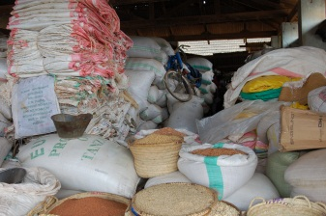
Findings: Trade
Standards for groundnuts and maize exist in both countries
No regulation of aflatoxins in raw commodities bound for the domestic market (constituting the majority food intake) in both countries.
No premium paid for aflatoxin-free commodities.
Without mandate for withdrawal and destruction of contaminated commodities, rejected commodities will likely find a market.
Some traders wash and sell contaminated grains.
No market for alternative use (yet).
Notes:
Less strict than US, more strict than EU).
Positive leadership in the animal feed market due to clear economic impacts (among larger, sophisticated firms).

Slide 5
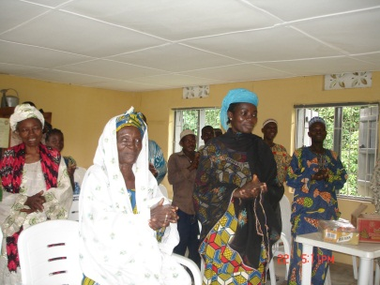
Findings: Health
Heavy reliance on maize and maize porridge during a child’s weaning stage presents large risk in early life.
Household processing and storage decisions rests with the women (enhanced sorting will increase their labor).
Consumption of kulikuli (groundnut cake) in Nigeria increases the probability of exposure in humans and animals.
The absence of collaboration between health and agriculture sectors leads to a missed opportunity to raise demand for higher quality food and nutrition.
Lack of liver cancer screening, and HBV vaccination.
Notes:
Absence of connection between food and health.
Liver cancer is seen as a threat, but causes largely unknown among farmers and rural individuals

Slide 6
Dependence on Maize for Calories
Tanzanian Households Nigerian Households
Data Source: LSMS-ISA
Notes:
Heavy dependence on Maize in Tanzania –leads to high health risk even if aflatoxin contamination is low.
Diversity exists regionally – Lake heavy on Cassava and Banana; South heavy on Cassava (26%), Eastern Zone heavy on Rice, but Maize is the most important commodity in all regions except Zanzibar.
In Nigeria much more diversity nationally but regionally there are areas that are consume a lot of maize. (in the North).

Slide 7
Key Risk and Expected Impact of Aflatoxin Contamination
Greatest risk and impact on: Health
Low awareness among farmers, traders and consumers.
Majority of maize and groundnuts is consumed domestically
Low enforcement of existing regulations on aflatoxins/mycotoxins
Notes:
This is the conclusion of our step 3 –characterizing the risk of aflatoxin exposure in Nigeria. Based on our assessment of uses, risk along the value chain (awareness among the actors in the value chain), the existence and awareness of any standards – we conclude that the health impact is likely to be the largest in Nigeria.

Slide 8
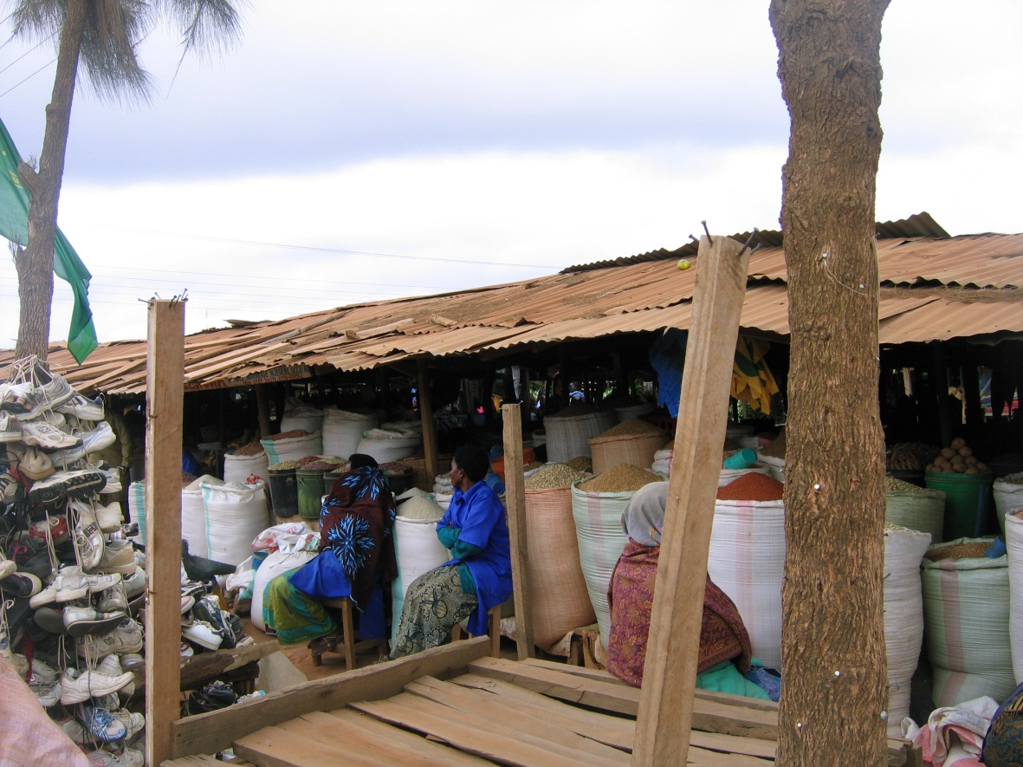
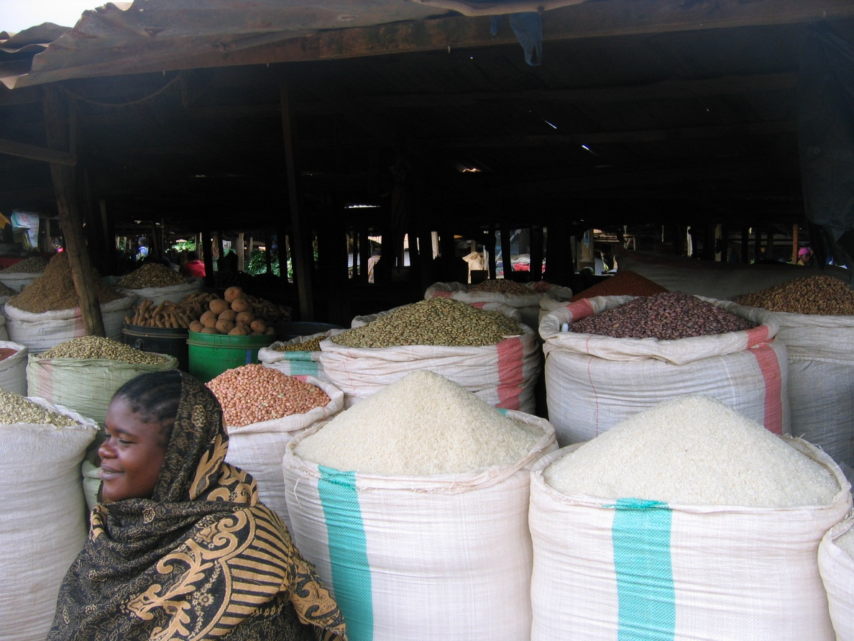
Economic Impact of Aflatoxin Contamination
Notes:
ANGIE START
The framework is replicable in any country
Even with modest resource allocations and limited prior experience.
Simple template to capture information available from existing data, documents, and resources, while
Highlighting information gaps that need to be filled.

Slide 9
Scope of the Analysis
Agriculture
Trade
Health
Economic impact resulting from aflatoxin contamination under current conditions
Focused on significant economic impact
Further extensions:
  Compare the impact to cost of interventions
  Consider alternative scenarios
  Refine estimates of trade-offs in impact across the sectors
  Distributional impacts
Notes:
TULIKA START
Very broadly note that we expect that the impact will be the greatest in Health, but we quickly consider the other sector.
Within agriculture and food security, quickly note that we consider in detail only the utilization aspect given that we concluded that is the greatest threat, and as yet there is no impact on farmer incomes (access) and the reduction in availability translates to an impact on utilization aspect –consumption of nutritious product.
That said, note that the paper shows how dependent farmers are on maize and groundnuts given us some indication of what potential impact could be should there be any price differentiation.
NOTE that agriculture no perceived threat, no impact on domestic trade either.

Slide 10
Trade Impact in Groundnuts
Groundnut export since mid 1970s has been negligible
Decline in historical share of world exports as result of oil price shock and focus away from agriculture, plus aphid infestation
Nigeria’s groundnut exports had declined significantly well before EU harmonization of standards in 1998.
Aflatoxins related challenge is only one of many reasons for loss in exports.
Notes:
Angie

Slide 11
Trade Impact in Maize
Historically maize exports have been low.
Maize exports have often been banned--as they are now-- because of this crop’s importance for food security.
Data Source: FAOSTAT, 2010
Constraints other than aflatoxin contamination is limiting export of maize from Nigeria.
Notes:
Tulika

Slide 12
Health Impact
Health is arguably the largest area of impact of aflatoxin contamination in Nigeria and Tanzania
Sufficient quantitative evidence to estimate liver cancer impacts
Evidence of relationship between stunting and aflatoxins exists but it has not been quantified

Slide 13
Estimating Health Impact
Aflatoxin Contamination
(ng/g)
Consumption
(gram/day)
Population Risk (Cancers/year/100,000
Exposure to Aflatoxins
(ng/kg-bw/day)
Body Weight
(kg)
Sum of:
Shares of HBV positive population
Cancer Potency for HBV Negative
(0.01 per 100,000)
Liver Cancer Cases
(number/year)
Population
(2010 projected)
Exposure to Aflatoxins
(ng/kg-bw/day)
Share of HBV positive population
Cancer Potency for HBV Positive
(0.3 per 100,000)
Notes:
Angie, this slide is useful to go through from policy perspective.
Knowing the elements of how the impact is estimated helps us see our policy solutions.
Note to them the things we can control –aflatoxin prevalence, shares of HBV negative populations. Note here that the cancer potency –number of cases of liver cancer is 30 times greater for those have hepatitis B. This is significant. Policy makers need to consider if they HBV vaccination can be improved more or not. If it is already at its potential then your biggest policy intervention is to reduce the extent of contamination!! This can be done in two ways, by reducing the actual prevalence in crops harvested, and then later in removing the contaminated crops from market (through enforcement) and last at the house (through preventive behaviors –sorting, diversity of diets, and increasing demand for aflatoxin-free goods) (this would happen through behavior change stratgies)
To some degree we can impact consumption but not too much. But later you do say that dietary diversity is a way to control it. So there is a marginal change we can make here through campaigns, but we can ce
We cannot impact population or individual body weights. However, we can quickly realize that areas with larger populations, or larger density of populations can be a policy target.
Please note that circles are data inputs, blue rectangle is what we calculate, and the grey rectangle is the given coefficient. You do not have to mention this but you can bring it up if a question arises.
Just as an aside, I have pointed out that the last calculation is how we get to the population risk, the number of cancers per 100,000.

Slide 14
Sensitivity Analysis of Impacts
Liver Cancer Cases Attributable to Aflatoxin Contamination in Nigeria
AFB1 Level (ppb) | Food Intake (g/person(60kg)/day)
 | 124* | 10 | 50 | 100 | 150 | 200 | 400
1 | 115 | 9 | 46 | 93 | 139 | 185 | 371
2 | 230 | 19 | 93 | 185 | 278 | 371 | 742
5 | 576 | 46 | 232 | 464 | 695 | 927 | 1,854
10 | 1,152 | 93 | 464 | 927 | 1,391 | 1,854 | 3,709
20 | 2,305 | 185 | 927 | 1,854 | 2,781 | 3,709 | 7,417
100 | 11,524 | 927 | 4,636 | 9,271 | 13,907 | 18,543 | 37,085
* Estimated Intake of Maize and Groundnuts in Nigeria (g/person(60kg)/day)
Notes:
Estimated number of liver cancer cases in Nigeria is 10,130 (derived using the 2010 Nigeria population estimate and 2004 liver cancer incidence rate -- 6.5 deaths per 100,000 population-- estimated for Nigeria by the Global Burden of Disease Project, WHO, 2008).
Note that in the first column, LSMS-ISA data says that 124 is the average intake of groundnuts and maize measured as grams per person who weight 60 kg per day.
We vary this consumption from 10 to 400 grams. One can see that as grams of any commodity, so people say we only considered maize and groundnuts, then the higher intakes can represent other commodity intakes too. Lower can be used to consider the impact in regions where the consumption of aflatoxin-contaminated foods is low.
Finally, there is a lot of uncertainty in aflatoxin contamination, and we took averages of contamination weighted by the production in each zone. There may not be that high a level of contamination everywhere. Also because studies tend to focus on high contamination areas.
The lower average levels of intake allows for this sensitivity.
Note that in our analysis, the contamination and average intakes means that—everyday in their lives the individuals have had this diet (adjusting for their body weight) and same exposure. There isnt data to help us get exposure and prevalence at different points in individuals’ life. Given this, one can argue that average exposure may be lower…and may vary spatially.

Slide 15
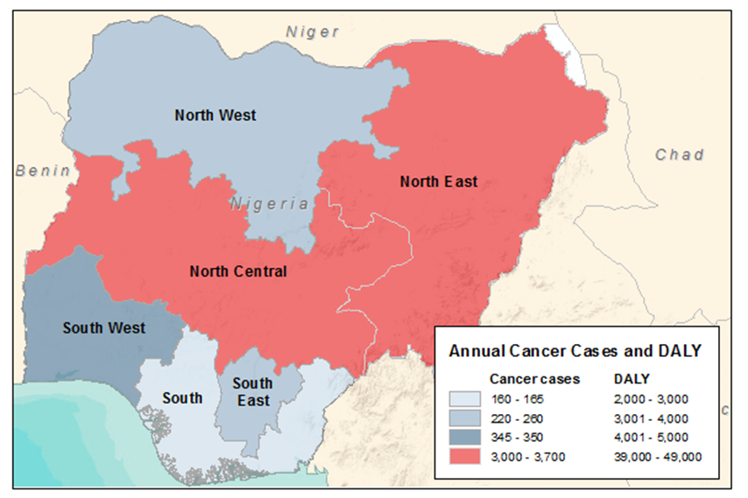
Health Impact: Nigeria
7,761 out of estimated 10,130 liver cancer cases in 2010 can be attributed to aflatoxins.
Monetized impact ranges from 0.2% to 1.6% of GDP (in 2010 Nigeria GDP was $197 billion)
Region | HCC Casesª | DALY | VSL (low) | VSL (high)
 | (cancers/ year) |  | (in millions)^{b}
North Central | 3,698 | 48,161 | $181 | $1,513
North East | 3,075 | 39,987 | $151 | $1,258
North West | 221 | 2,864 | $11 | $90
South East | 258 | 3,375 | $13 | $105
South South | 163 | 2,115 | $8 | $67
South West | 346 | 4,462 | $17 | $142
National | 7,761 | 100,965 | $380 | $3,174
Notes:
Estimated number of liver cancer cases in Nigeria is 10,130 (derived using the 2010 Nigeria population estimate and 2004 liver cancer incidence rate -- 6.5 deaths per 100,000 population-- estimated for Nigeria by the Global Burden of Disease Project, WHO, 2008). Therefore, the plausible values of HCC cases attributable to aflatoxins is bolded.

Slide 16
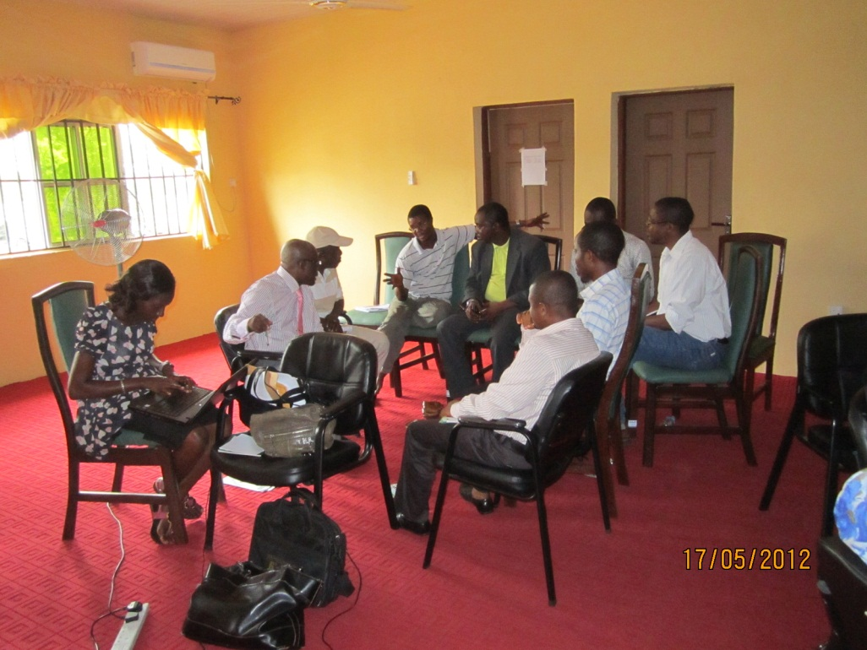
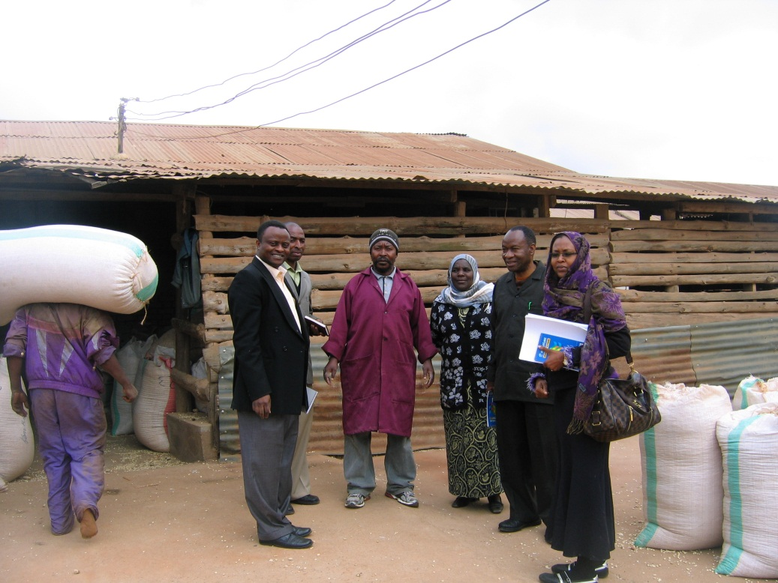
Identification and Prioritization of Viable Control Strategies

Slide 17
In-country Workshops Build Local Ownership and Prioritize Action Items
50+ stakeholders from agriculture, trade and health (commercial, non-profit and public sector).
Participatory approach allows for vetting, dissemination, revision, debate and ownership.
Local policy champions for aflatoxin control to emerge.
Locally available technologies and practices displayed and vetted.
Myths and mystery about past-approaches unveiled (Nigeria), Steering Committee formed (Tanzania)
Participatory discussions shape concrete action steps, allow duplication of mandates to be discussed.
Notes:
Note: for the Feb 14th session—we will move the ‘stakeholders’ slide down here.
Nigeria:
No regulation of raw commodities bound for domestic use, no withdrawal and no animal feed standards, no alternative use standards.
Create a centrally held, public database on research on prevalence and mitigation.
Greater tracking of liver cancer incidence.
Stratified Awareness Campaigns targeted at vulnerable populations: 1000 days issues, pregnant women and lactating mothers, immunocompromised individuals and also the general populace.
Tanzania policy recommendations: Recommend review and finalization of various policies that are important for food safety and mycotoxin control: (1) National Food Security Policy, (2) National Food Safety Policy, (3) National Nutrition Policy, and (4) Draft Regulations under the Grazing Lands and Animal Feed Resources Act.
TZ:
Support more research to fill the current gaps in aflatoxin prevalence in Tanzania—in the field and in foods—to increase information on producing and consuming aflatoxin-free foods.
Ensure that dairy legislation recognizes the official national standards for mycotoxins.
Ensure that priority strategies and action plans are included in the business plans of relevant departments and institutions within line ministries.
Develop and agree on a data collection protocol and require that results from research conducted in Tanzania be shared with the national government and entered into a centralized database, to be managed by the newly formed Secretariat of the National Forum for Mycotoxins Control.
Both:
Mainstream GAP and other food safety-friendly measures within agricultural extension efforts.
Raise awareness from the community level up to the decision makers, using a coordinated strategy with the trade and agriculture sector.
Coordinate with relevant ministries and institutions and propose mycotoxin levels for feed.

Slide 18
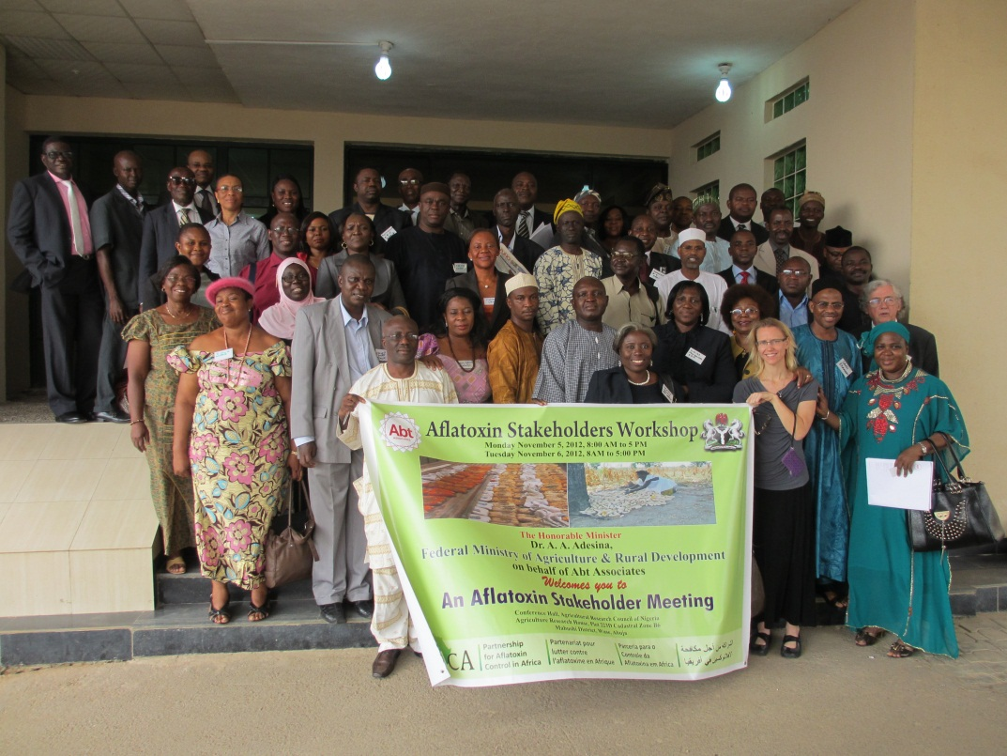
Nigeria Workshop: Key Outcomes
Minister of Agriculture publicly confirms commitment to aflatoxin mitigation strategies.
First public recognition of aflatoxin as a threat to health.
Public Commitment to a central independent body to manage cross-sectoral efforts.
Identified key-actions to initiate country-led actions with small group to finalize.
Notes:
Note: for the Feb 14th session—we will move the ‘stakeholders’ slide down here.
Nigeria:
No regulation of raw commodities bound for domestic use, no withdrawal and no animal feed standards, no alternative use standards.
Create a centrally held, public database on research on prevalence and mitigation.
Greater tracking of liver cancer incidence.
Stratified Awareness Campaigns targeted at vulnerable populations: 1000 days issues, pregnant women and lactating mothers, immunocompromised individuals and also the general populace.
Tanzania policy recommendations: Recommend review and finalization of various policies that are important for food safety and mycotoxin control: (1) National Food Security Policy, (2) National Food Safety Policy, (3) National Nutrition Policy, and (4) Draft Regulations under the Grazing Lands and Animal Feed Resources Act.
TZ:
Support more research to fill the current gaps in aflatoxin prevalence in Tanzania—in the field and in foods—to increase information on producing and consuming aflatoxin-free foods.
Ensure that dairy legislation recognizes the official national standards for mycotoxins.
Ensure that priority strategies and action plans are included in the business plans of relevant departments and institutions within line ministries.
Develop and agree on a data collection protocol and require that results from research conducted in Tanzania be shared with the national government and entered into a centralized database, to be managed by the newly formed Secretariat of the National Forum for Mycotoxins Control.
Both:
Mainstream GAP and other food safety-friendly measures within agricultural extension efforts.
Raise awareness from the community level up to the decision makers, using a coordinated strategy with the trade and agriculture sector.
Coordinate with relevant ministries and institutions and propose mycotoxin levels for feed.

Slide 19
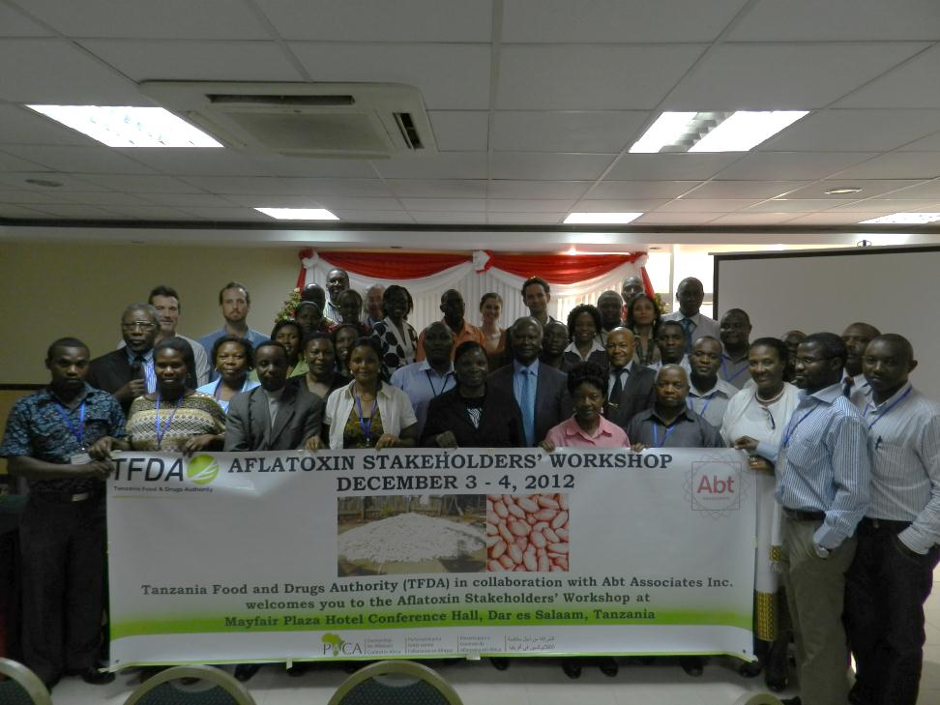
Tanzania Workshop: Key Outcomes
Formation of National Forum for Mycotoxin Control
Formation of Steering Committee for the Forum (first meeting in early 2013)
Tanzania Food and Drug Authority to serve as the secretariat for the steering committee (with funding for convening the meetings).
Health Minister supports budgetary allocation for the Forum.
Host for second Partnership for Aflatoxin Control meeting.
Identified key-actions to initiate country-led actions.
Notes:
Note: for the Feb 14th session—we will move the ‘stakeholders’ slide down here.
Nigeria:
No regulation of raw commodities bound for domestic use, no withdrawal and no animal feed standards, no alternative use standards.
Create a centrally held, public database on research on prevalence and mitigation.
Greater tracking of liver cancer incidence.
Stratified Awareness Campaigns targeted at vulnerable populations: 1000 days issues, pregnant women and lactating mothers, immunocompromised individuals and also the general populace.
Tanzania policy recommendations: Recommend review and finalization of various policies that are important for food safety and mycotoxin control: (1) National Food Security Policy, (2) National Food Safety Policy, (3) National Nutrition Policy, and (4) Draft Regulations under the Grazing Lands and Animal Feed Resources Act.
TZ:
Support more research to fill the current gaps in aflatoxin prevalence in Tanzania—in the field and in foods—to increase information on producing and consuming aflatoxin-free foods.
Ensure that dairy legislation recognizes the official national standards for mycotoxins.
Ensure that priority strategies and action plans are included in the business plans of relevant departments and institutions within line ministries.
Develop and agree on a data collection protocol and require that results from research conducted in Tanzania be shared with the national government and entered into a centralized database, to be managed by the newly formed Secretariat of the National Forum for Mycotoxins Control.
Both:
Mainstream GAP and other food safety-friendly measures within agricultural extension efforts.
Raise awareness from the community level up to the decision makers, using a coordinated strategy with the trade and agriculture sector.
Coordinate with relevant ministries and institutions and propose mycotoxin levels for feed.

Slide 20
Key Action Identified by Stakeholders
Legal and Regulatory Recommendations
Tanzania:
Incorporate aflatoxin/mycotoxin into:
National Food Security Policy
National Food Safety Policy
National Nutrition Policy
Draft Regulations under the Grazing Lands and Animal Feed Resources Act;
Dairy Legislation
Nigeria:
Regulate raw commodities bound for domestic consumption
Set standards and regulate animal feed.
Reduce overlapping functions among key enforcement and regulatory authorities.
Further investigate alternative uses for contaminated foods/feed.
Notes:
Nigeria:
No regulation of raw commodities bound for domestic use, no withdrawal and no animal feed standards, no alternative use standards.
Create a centrally held, public database on research on prevalence and mitigation.
Greater tracking of liver cancer incidence.
TZ:
Support more research to fill the current gaps in aflatoxin prevalence in Tanzania—in the field and in foods—to increase information on producing and consuming aflatoxin-free foods.
Ensure that priority strategies and action plans are included in the business plans of relevant departments and institutions within line ministries.
Both:
Mainstream GAP and other food safety-friendly measures within agricultural extension efforts.
Raise awareness from the community level up to the decision makers, using a coordinated strategy with the trade and agriculture sector.
Stratified Awareness Campaigns targeted at vulnerable populations: 1000 days issues, pregnant women and lactating mothers, immunocompromised individuals and also the general populace.
Develop and agree on a data collection protocol and require that results from research conducted be shared with the national government and entered into a centralized database, to be managed by the newly formed Secretariat of the National Forum for Mycotoxins Control (TZ) and by an independent body (perhaps the Mycotoxicology Society in Nigeria).

Slide 21
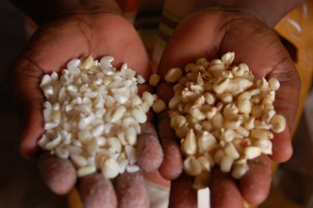
Key-actions: Agriculture
Recognize the role of agriculture sector and GAP in food safety.
Incorporate messages about aflatoxin mitigation into GAP messages
Ensure that women have access to inputs, finance and messaging.
Develop and promote affordable sale of bio-controls such as Aflasafe.™
Promote sorting and discarding crops with physical flaws and deformities (e.g., visible mold or damaged shells).
Adopt low cost, above-ground drying/storage at farm/community level.
Promote research on safe disposal and alternative use of unsafe commodities.
Notes:
Angie you may want to give them a slide about the roles of various organizations again, we already mentioned this above in the domestic impact part so I did not repeat it.

Slide 22
Key-actions: Trade
Expand food safety and aflatoxin regulations to raw commodities bound for domestic production.
Improve awareness to create market-based incentives for safer food.
Disseminate aflatoxin standards via rural trade groups and commodities associations.
Educate/persuade retailers and consumers to demand and recognize safer practices by suppliers.
Notes:
Improve policies and procedures for product withdrawal.
Provide technical support to improve capacity of medium to large traders and enforcement agencies to recognize the national enforcement agency’s “mark of quality.”
Improve suitability for commerce or trade of susceptible products by identifying and making available best practices for preventing or mitigating aflatoxin levels in priority crops (maize, groundnuts, and cassava) along the supply chains.
Collaborate with existing agriculture development projects, such as the Markets II project, to promote safe production through Aflasafe, improved seeds, and other agricultural inputs.

Slide 23
Key-actions: Health (1 of 2)
Conduct targeted behavioral change campaigns for food safety:
  Focus on first 1000 days (women/children)
  Immune-compromised individuals
  Address the mycotoxins in Infant and Young Child Nutrition guidelines
Ensure universal coverage of the hepatitis B vaccine.
Promote dietary diversity.
Monitor foods used for pregnant women and infants/children (porridge, complementary foods).
Carry out more regular testing of aflatoxin levels in major foods.
Notes:
Establish reference laboratories for mycotoxin studies in the six geopolitical zones.
For animal health: promote use of chemical toxin binders and anti-caking agent (e.g., NovaSil) in animal feed and regulate aflatoxins in animal feed. Do a better job of increasing awareness through animal science associations.
Conduct population mapping of the exposure to aflatoxins using biomarkers.
Establish the relationship between the incidence of aflatoxins, levels of biomarkers, and incidence of primary liver cancer in the Nigerian population.

Slide 24
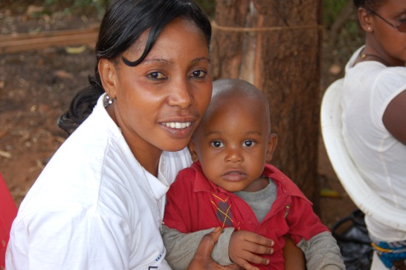
Key-actions: Health (2 of 2)
Establish the relationship between the aflatoxin prevalence, levels of biomarkers, and incidence of primary liver cancer.
Establish reference laboratories for mycotoxin studies in the six geopolitical zones (Nigeria).
For animal health: promote use of chemical toxin binders and anti-caking agent (e.g., NovaSil) in animal feed (Nigeria)
Notes:
Establish reference laboratories for mycotoxin studies in the six geopolitical zones.
For animal health: promote use of chemical toxin binders and anti-caking agent (e.g., NovaSil) in animal feed and regulate aflatoxins in animal feed. Do a better job of increasing awareness through animal science associations.
Conduct population mapping of the exposure to aflatoxins using biomarkers.
Establish the relationship between the incidence of aflatoxins, levels of biomarkers, and incidence of primary liver cancer in the Nigerian population.

Slide 25
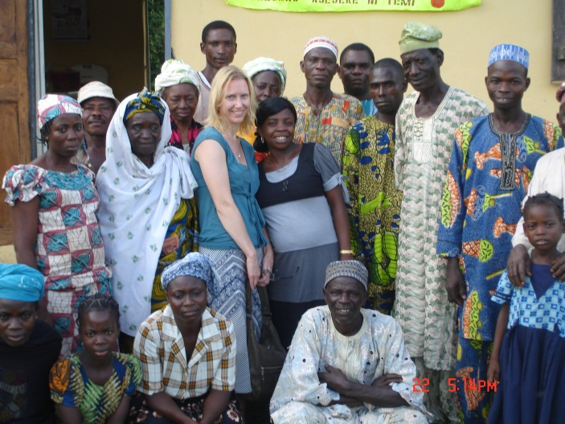
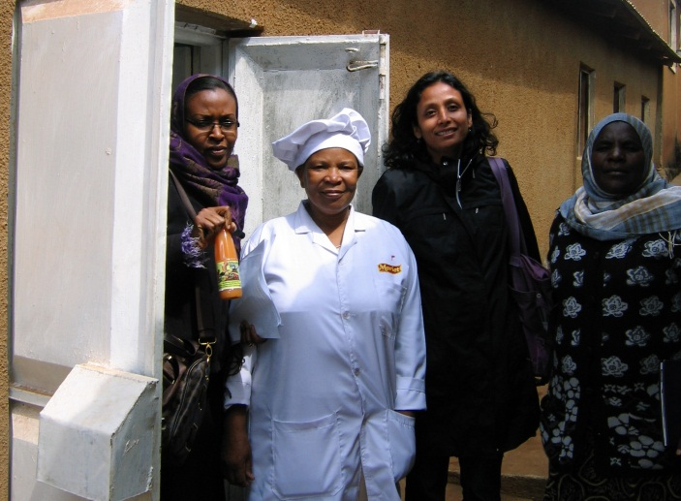
Thank you!
Nigeria Workshop (Nov 5-6th, 2012) Webpage
http://abtassociates.com/Aflatoxin-Stakeholders-Conference-Related-Materia.aspx
Tanzania Workshop (Dec 3-4th, 2012) Webpage
http://abtassociates.com/Tanzania-Aflatoxin-Stakeholders-Conference.aspx
Tulika_Narayan@abtassoc.com
Angela_Stene@abtassoc.com

