Slide 2
Outline of discussion
A. Brief overview- the discussion on women’s political participation
B. Women’s access to power and decision-making in Africa
a) Progress
b) Current outlook
c) Gender Quotas and the question of ‘what impact’?
d) Persisting challenges to women’s participation
C. Engendering political participation in Africa: Recommendations

Slide 3
Women’s inclusion in political processes:
The discourse
Underlining the discourse on women’s participation are the principles of equal rights, equal opportunities, and representative governance
Beyond this, the essence of women’s participation in decision-making has been highlighted by various reports;
“When more women are elected to office, policy-making increasingly reflects the priorities of families and women’. In Rwanda and South Africa, an increase in the number of female lawmakers led to progressive legislation on land inheritance and reproductive rights.”
-World Bank 2014
Political participation has been made an indicator of the MDG 3. This emphasizes the need to address the problem of women’s political marginalization all around the world.
However, women’s political participation is one indicator on which progress has been slow and behind target- (UN Women)

Slide 4
Women’s Political Participation in Africa
Women’s Political Participation in Africa
The right to political participation is recognized all across Africa
However, like most other parts of the world, access to power & decision-making (unlike the right to vote) is practically unequal for men and women at various levels of power
There is limited comprehensive comparative data on access to power between males and females on the continent but overall, there are far fewer women in positions of authority as compared to men
This notwithstanding, it needs to be recognized that Africa has made some impressive progress in advancing women’s access to power within its relatively short history of democratic governance

Slide 5
Current Outlook-Different levels of power
Current outlook: Different levels of power
2 Sitting Heads of State - Liberia, Central African Republic
1 President lost her seat (Malawi) and 1 Head of Government also lost her position (Senegal)
11 Speakers of Parliament (as of January 2014) - Botswana, Equatorial Guinea, Gabon, Madagascar, Mozambique, Rwanda, Uganda, Swaziland, South Africa, Tanzania, Zimbabwe
5 (out of 52) Permanent Representatives to the United Nations - Liberia, Niger, Seychelles, Sierra Leone, Zambia
There are a total of 31 women of the 193 Permanent Representatives at the UN as at June 2014 (Source: UN)

Slide 6
Women in Ministerial Positions-(As at 1ST Jan. 2014)
Women in ministerial positions (Jan 2014)
Percentage Range | No. Of Countries | Percentage of total no. of countries | Names of countries
4O% and above | 1 | 2.1% | Cape Verde
30-39% | 8 | 17.3% | Rwanda, South Africa, Burundi, Tanzania, Kenya, Uganda, Malawi, Madagascar
20-29.9% | 14 | 30.4% | Mozambique, Gambia, Swaziland, Eritrea, Nigeria, Seychelles, South Sudan, Ghana, Benin, Lesotho, Namibia, Togo, Liberia, Comoros
10-19.9% | 21 | 45.7% | Angola, Gabon, Senegal, Sudan, Cote D’Ivoire, Sao Tome and Principe, Chad, Zambia, Cameroon, Guinea, Burkina Faso, Ethiopia, Mauritania, Niger, Botswana, Algeria, Mali, Zimbabwe, DR Congo, Egypt, Sierra Leone
Below 10% | 2 | 4.3% | Equatorial Guinea, Mauritius, Somalia, Djibouti, Tunisia, Libya
Source: www.ipu.org

Slide 7
Representation in National Parliaments (lower/single house)
Representation in National Parliaments (lower/single house)
Percentage Range | Number of Countries | List of Countries | Proportion of Countries
40% and above | 4 | Rwanda, Seychelles, Senegal, South Africa | 8%
30-39% | 8 | Mozambique, Angola, Tanzania, Uganda, Algeria, Zimbabwe, Cameroon, Burundi | 16%
20-29% | 12 | Tunisia, Ethiopia, Lesotho, South Sudan, Namibia, Mauritania, Sudan, Equatorial Guinea, Madagascar, Eritrea, Guinea, Cape Verde | 24%
10-19% | 19 | Kenya, Burkina Faso, Mauritius, Sao Tome and Principe, Togo, Morocco, Malawi, Libya, Gabon, Chad, Somalia, Guinea-Bissau, Niger, Djibouti, Sierra Leone, Liberia, Ghana, Zambia, DR Congo | 38%
0-9.9% | 7 | Botswana, Mali, Cote D’Ivoire, Gambia, Benin, Congo, Nigeria, Swaziland, Comoros, | 14%
Source: www.ipu.org

Slide 8
Representation in national parliaments-chart (cont’d)
Representation in National Parliaments (continued)

Slide 9
Progress over the years(1997-June 2014)
Progress over the years (1997 – June 2014)
Electoral outcomes in SA & Malawi in the last few month/weeks saw a drop from 44.8% to 40.8% and 22.3% to 16.7% respectively

Slide 10
Sub-Saharan Africa’s performance in relation to
other regions
Outline of discussion

Slide 11
Factors contributing to progress
Factors contributing to progress
Global and regional efforts providing a framework for demanding
women’s improved access to power and decision-making
Strong Political will (‘presidential patronage’)
Efforts of strong women’s movement/civil society (South Africa, Uganda)
Adoption of gender quotas by the state and political parties

Slide 12
Adoption of Gender Quotas in Africa
Adoption of gender quotas in Africa
The nature of gender quotas adopted vary from country to country. Some have a combination of various forms of quotas.
Zimbabwe, Kenya, South Africa have both legislated candidate quota and voluntary party quotas.
Some mandated quotas are also applied either at the national or sub-national level or both (Rwanda vs South Africa)
Similarly, the impact of quotas on women’s political participation has varied from country to country
Quotas have in some cases led to impressive increases in women’s participation

Slide 13
The Different Forms of Quotas Adopted
Different forms of quotas adopted
Type of Quota | Reserved Seats | Legislated Candidate Quotas | Voluntary Political Party Quotas | No Quota adopted
List of Countries | Morocco Algeria Niger South Sudan Uganda Kenya Somalia Djibouti Tanzania Burundi Zimbabwe Swaziland Sudan Eritrea | Cape Verde Senegal Mauritania Togo Burkina Faso DR Congo Angola Rwanda Libya Tunisia Egypt Lesotho Guinea Mauritius (local level, not more than 2/3rds of the same sex, not more than 2 from same sex) | Mali Cote D’Ivoire Cameroun Malawi Namibia South Africa Botswana Mozambique | Ghana Nigeria The Gambia Guinea-Bissau Liberia *Sierra Leone *Mauritius Benin Gabon Equatorial Guinea Congo CAR Chad Ethiopia Zambia Madagascar Sao Tome and Principe Seychelles

Slide 14
Quotas in Africa-Assessing the impact
Quotas in Africa: Assessing the impact
The Outcomes
The Dangers
Overall, quotas have opened up access to power and decision-making for more women
The increased presence of women in parliament has been linked to positive legislation affecting women (e.g. the role of female MPs in Rwanda in championing the gender-based law (including courting support from male colleagues)
Impact on women’s contribution to parliamentary debates (esp. more vocal & better articulation of women’s issues, etc. {eg. Tanzania (Yoon 2011)}
Influence on a culture of acceptance of female leaders
Female leaders as role models
Quotas as glass ceiling/Limits
Implementation challenges in some countries (eg. incomprehensive modalities for implementation, e.g. Kenya)
Women being pushed away/shunning from competitive seats to quota/reserved seats only
The question of impact (descriptive vs substantive representation)

Slide 15
The discussion on IMPACT (Descriptive vs.
substantive representation)
Outline of discussion
The adoption of gender quotas as a means for expanding participation for women (quantitative descriptive rep)
But the issue of how this translates into impact is often raised
The question however is ‘what impact’ are we looking at?
Impact as in policy outcomes, overall contribution to the governance process, or which?
Are we looking only at immediate tangible outputs?
Impact on who? Women leaders assume the role of a dual representative - how about their contribution to other issues that affect other members of society?

Slide 16
The ‘impact’ question (cont’d)
The discussion on IMPACT (continued)
The question of impact is often oversimplified
There are institutional complexities and political dynamics
-legal procedures, party allegiances, etc.
Are we looking at impact of female leaders on women and women’s issues only?
OR their overall contribution to society
The question also puts female leaders under some unbalanced scrutiny (what about the leadership of male colleagues)

Slide 17
Persisting challenges to women’s participation
Outline of discussion
Progress has been made but negative socio-cultural attitudes and norms persist
“The values and norms of society are more essential to the democratic integrity of a country than the institutional barriers written in a constitution.”
-Robert Dahl on the American system
The notion and ideas of gender equality have become very popular, but attitudes are yet to change completely.
Low participation at other levels of power:
Local government structures
Political party structures
Gendered assessment of women leaders and the problem of over-generalization

Slide 18
Engendering women’s political participation in Africa:
Recommendations
Outline of discussion
National level actors
There is the need to address the socio-cultural challenge
-Intensify civic education emphasizing the equal capabilities of women to lead
-Socialize the next generation of Africans on values as equality and individual differences through schools curricula
Getting more capable women to go into the public arena
-Sensitize women on the need to come out and get involved at the various levels (there is no lack of capable or well-resourced women to run for public offices)

Slide 19
Cont’d
Engendering women’s political participation in Africa:
Recommendations (continued)
Non-Governmental organizations
Deepen engagement with political parties (this has often been a delicate issue but needs to be balanced)
Support structures such as the women’s wings to enable them identify and champion women’s issues within and beyond their parties
Promoting women’s participation in local governance (through training and capacity-building, grassroots campaigns, etc.)
2. Sustainable support to women leaders (research support, training highlighting the nature of women’s issues, etc.)
-Sensitizing males on women’s issues

Slide 20
Cont’d
Engendering women’s political participation in Africa:
Recommendations (continued)
International Actors (DPs, INGOs)
Intensify efforts at mainstreaming gender issues into development cooperation
The African Union and other sub-regional groups have shown strong leadership on gender issues but have been limited by challenges such as lack of political will at country level and inability to enforce legal instruments. These bodies should use their monitoring mechanisms to generate an index of well-performing and poor performing countries which should be released annually.

Slide 21
Outline of discussion
Thank You!

Slide 22
FOR MORE INFORMATION
Follow the Africa Program online!
https:/www.wilsoncenter.org/program/africa-program
https://Twitter.com/AfricaUPClose
https://Facebook.com/AfricaProgram
Or visit our blog for information on the Southern Voices Initiative:
https://africaupclose.wilsoncenter.org

Slide 24
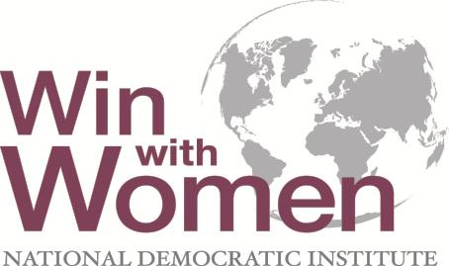
Women’s Political Participation: Strategies and Challenges for Women Post-Quota
Caroline Hubbard
Program Manager
Women’s Political Participation
National Democratic Institute
July 2014

Slide 25
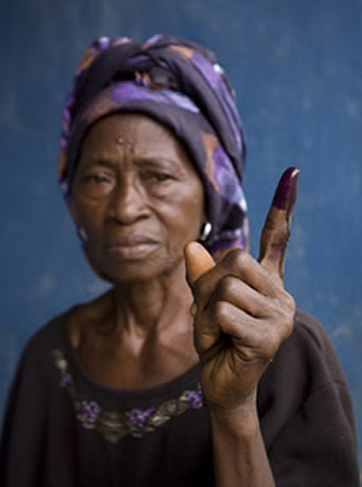
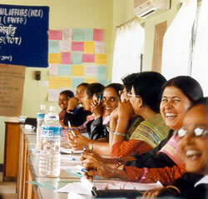
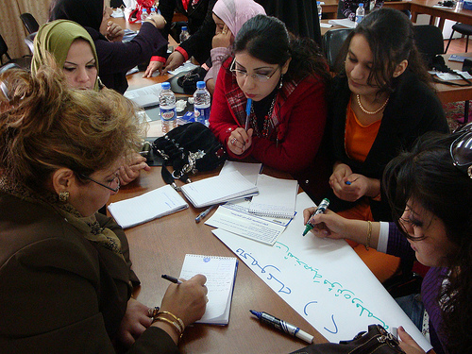
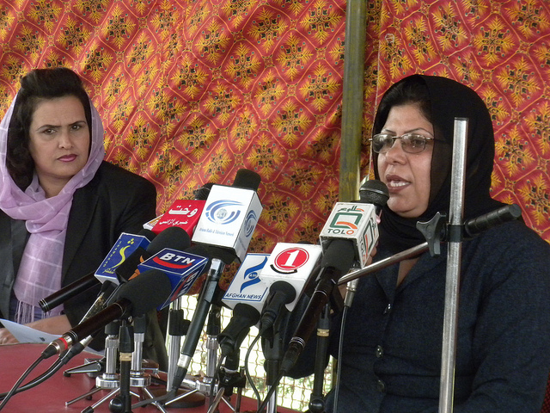

Slide 26
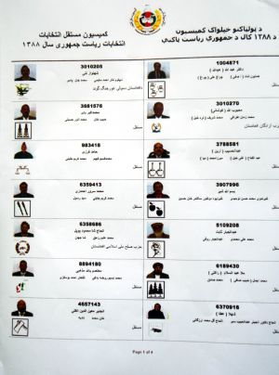
Quotas
Quotas are an important tool used to increase women’s ability to both run for office and get elected.
Face barriers to proper implementation-including how law is written, where it originates, and guidelines for implementation.
Effective design and implementation are only the first step.

Slide 27
Benefits of a Gender Quota
Ensures critical mass of women in decision-making positions & mitigates challenges of being minority.
Better able to influence policy decisions.
Female legislators are more committed to peace, invest more in community health & education & are more likely to work cooperatively across party lines than their male counterparts.

Slide 28
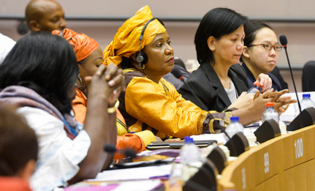
Challenges for Women MPs to Performing Legislative and Representative Function
Individual: Confidence, capacity and connections of women to perform functions.
Environment: Social-cultural norms of the parliament, parties and society.
Ecosystem: Policies and practices of the parliament-from bathrooms to committee heads.

Slide 29
Ensuring Women’s Leadership in Parliament Individual: Confidence, Capacity and Connections
MP Orientation Provide necessary knowledge to perform job/separate sessions for men & women with targeted training.
Capacity Building Provide ongoing skills building in communications, negotiations, strategic planning, constituent relations, budgets etc.
Caucus/Coalition Amplify ability of women to influence policy decisions by
creating access to power network

Slide 30
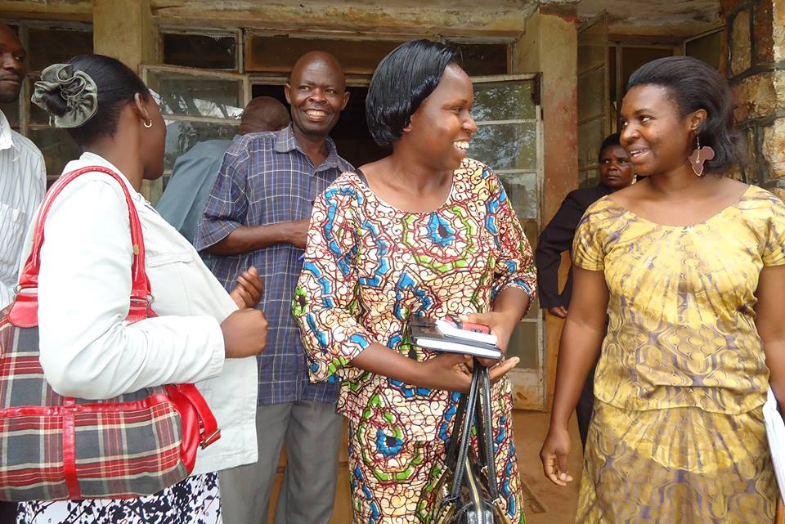
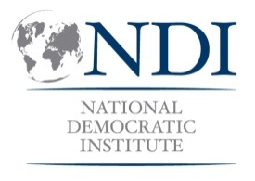
Uganda Women Parliamentarians Association (UWOPA)
Created because women were not connected to sources of power - created their own.
Provided political clout and broadened the support base for women’s issues to be included in the constitution and beyond.
Developed strategic alliances with youth, workers and disabled persons’ delegates to push constitutional agenda.
Notes:
Uganda Women’s Parliamentarians Association, UWOPA

Slide 31
NDI Support to UWOPA
NDI supported development of common legislative agenda for caucus and CSOs.
Helped UWOPA strengthen internal organizational structure.
Provided legislative capacity building and constituent outreach skills.
Notes:
From 2005 to 2007, NDI supported UWOPA to develop a Common Women’s Legislative Agenda (CWLA) in collaboration with civil society organizations (CSOs) by conducting a needs assessment and through legislative capacity-building workshops for the women MPs, roundtable discussions between UWOPA and civil society organizations, establishing an alumni MP advisory group, and widening the women’s rights network.

Slide 32
Results of UWOPA
Instrumental in lobbying for constitutional provisions for equality.
Constituency outreach efforts increased support for women MPs by increasing positive image of women in leadership role.
In part due to UWOPA’s efforts, women gradually gained greater acceptance in the Parliament and more women have been elected to parliamentary executive positions.

Slide 33
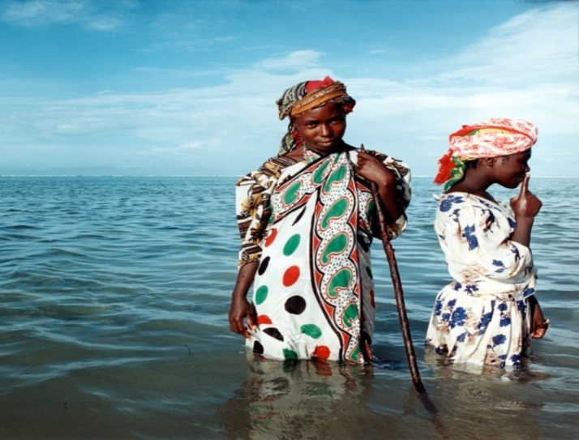
Ensuring Women’s Leadership in Parliament Environment: Social Cultural Norms
How women deputies’ interactions with communities, male MPs, and political parties impacts ability to be effective.
How social cultural norms & way society views women in political leadership impact their ability to meet the demands of the party and their constituents.

Slide 34
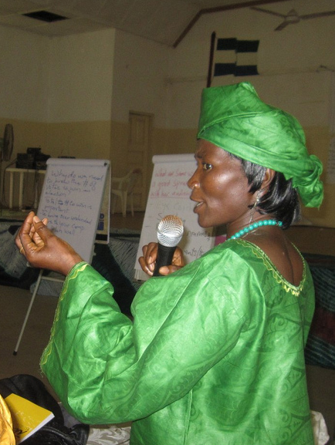
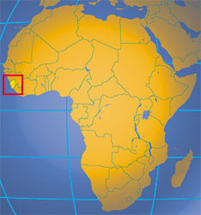
Sierra Leone
Men are more “persuasive,” “courageous,” and “better at debate.”
Women are “too emotional” for parliament’s “rough debates.”

Slide 35
Ensuring Women’s Leadership in Parliament Environment: Social Cultural Norms
Public Image Provide platforms for speaking and public debate - radio, TV, town hall meetings.
Media Training Build capacity to communicate effectively with media - on camera, in interviews etc.

Slide 36
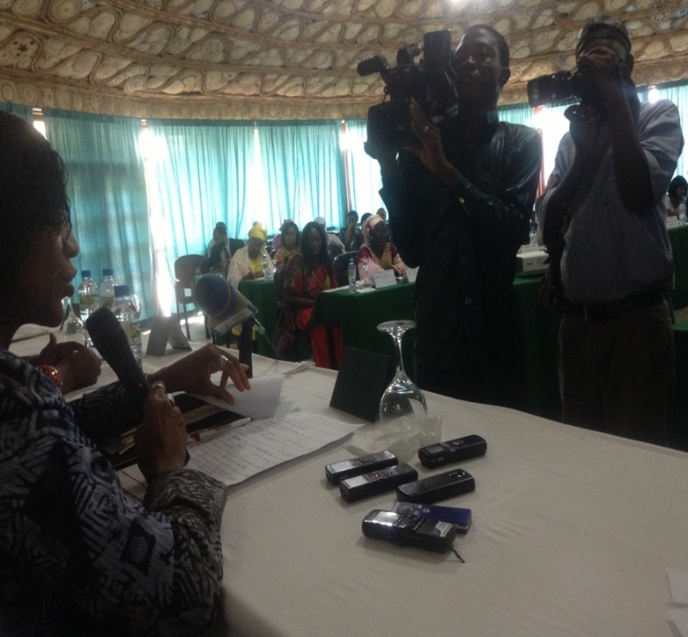
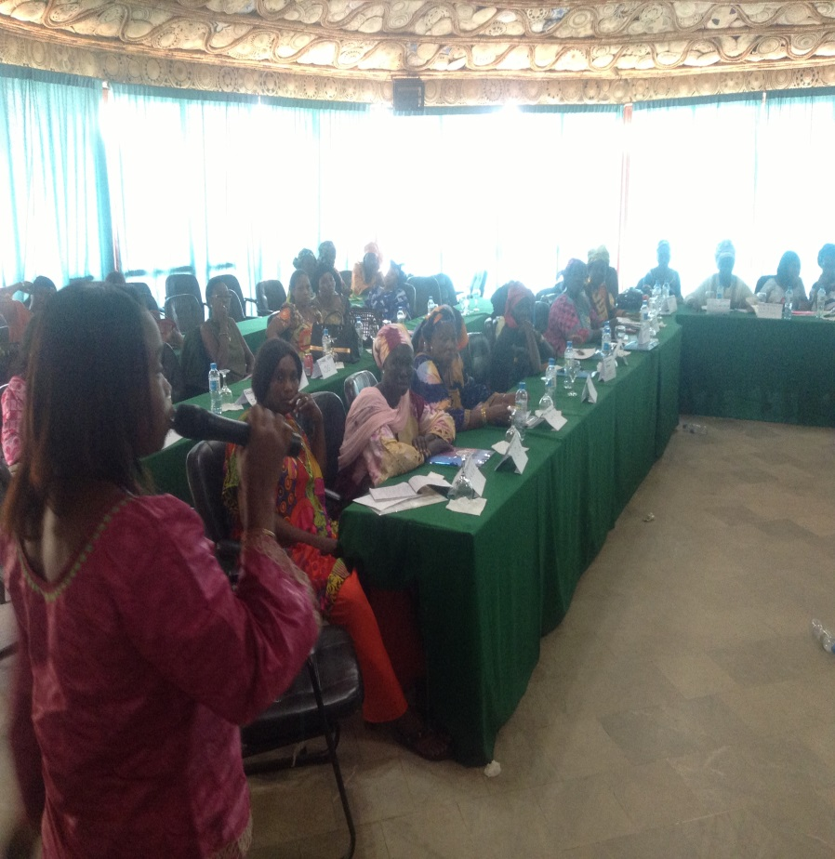
DRC

Slide 37
Ensuring Women’s Leadership in Parliament Ecosystem: Institutional barriers-Parliamentary rules, policies and practices
Rules for drafting and passing legislation-whether there is a gender focal point or gender committee.
Internal rules for choosing parliamentary leadership-such as committee chairs.
Code of conduct—include issues of sexual harassment or dress code?
Resources and infrastructure-number of bathrooms, daycare facilities, resource allocation etc.
*Political Parties

Slide 38
Strategies to Address Institutional Barriers
Support female (& male) MPs’ efforts to develop and advocate for changes to rules.
Address sexual harassment, change sitting hours, quotas for leadership positions etc.
Provide gender awareness training to male and female MPs to explain how making the parliament rules and practices more gender aware will benefit everyone (Somalia)

Slide 39
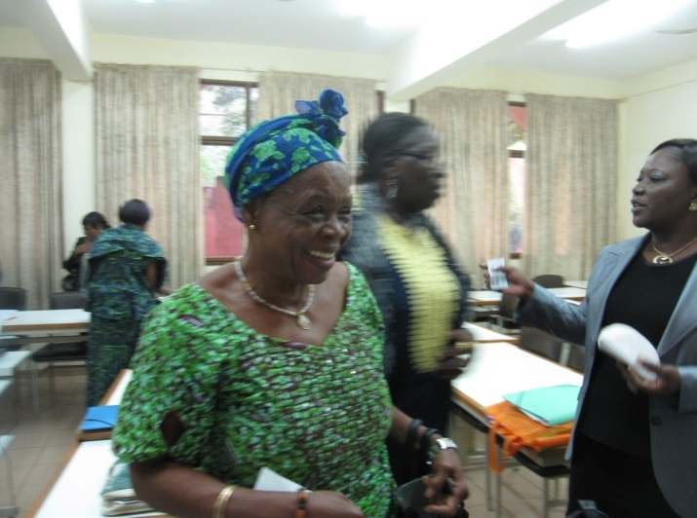
Delivering on Women’s Rights Issues
Create women and gender ministries to provide monitoring and oversight of policies.
Establish gender or women’s focal points on every parliamentary committee.
Build the capacity of MPs and their staff in gender policy analysis, including GRB.

Slide 40
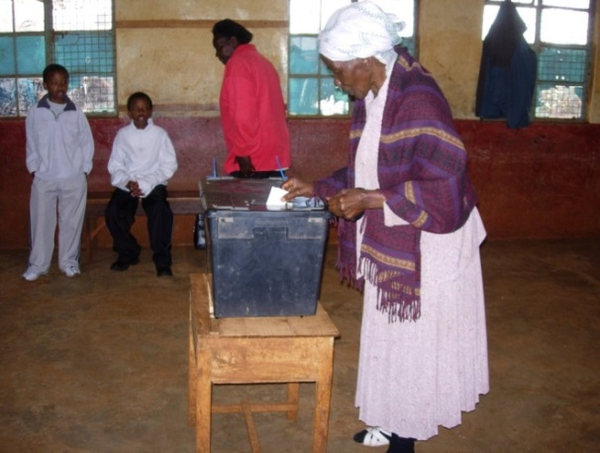
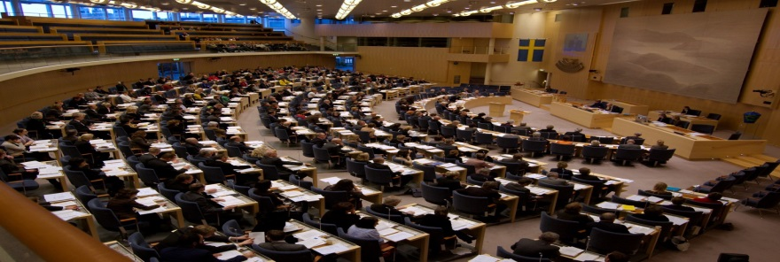
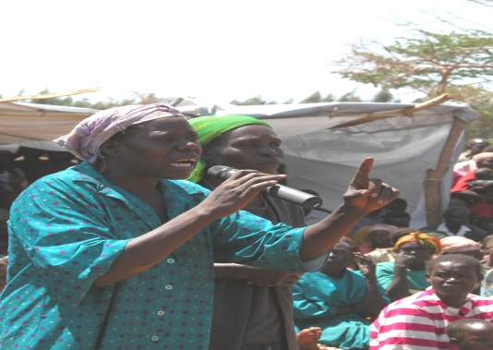
Measuring Impact of Elected Women
Impact on parliament as an institution-gender aware institution?
Impact on women’s policy issues?
Ensuring all issues are viewed through a gender lens?
Impact on perspective of women in leadership positions?
Heavy Burden

Slide 41
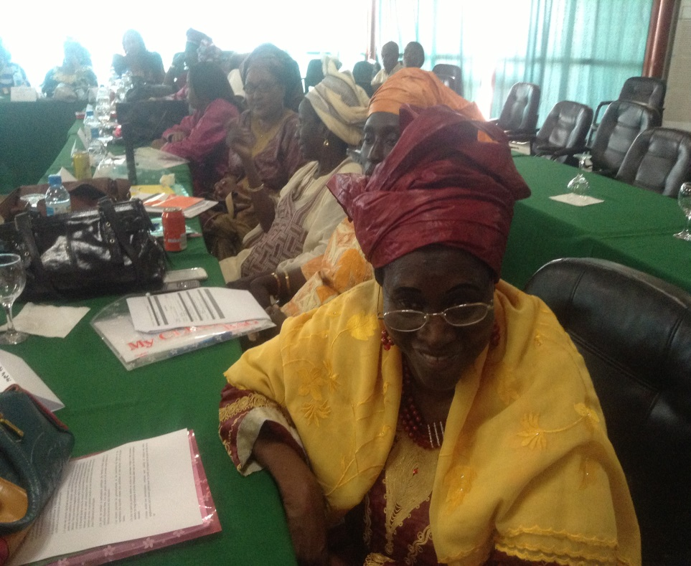
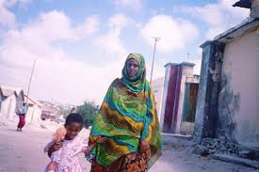
Thank You
To learn more, follow @NDIWOMEN

