Slide 1
People and Pigs in China’s
21st Century Urbanization
Fred Gale
Senior Economist

Slide 2
Traditional agrarian circular economy: hogs, crops, people intertwined
Hogs produce protein, fat, waste
Farm family consumes, sells pork
Hogs consume crop by-products, hog waste fertilizes crops
Adaptation to
a densely
populated
land mass
The number of
domestic animals
was small
75% were “work”
animals.
Pigs were the most
common
“productive”
animal

Slide 3
John Lossing Buck, 1937
“Considering the dense population of China, it is doubtful if the animal industry can be increased to any great extent for such purposes as milk, meat, or egg supply...”

Slide 4
Mao Zedong, October 31, 1959
“一头猪就是一个小型有机化肥厂”
“One pig is a small organic fertilizer factory”
“Raising pigs is the same as raising grain”
“Raising pigs can create organic fertilizer to use for ecological agriculture development”
“Pigs are in the first position”

Slide 5
Hu Yaobang, 1985
“…we must fundamentally change the whole [Chinese] race’s food structure, increasing the meat and dairy intake in our food, to improve the physique of Chinese people, so they will rank among the excellent members of humanity.”

Slide 6
Importing “modern” livestock farming modeled on factory-style production to ramp up meat output
Dedicated crop production base
Specialized feed mill
Distribution
Food company processing
Chemical byproducts
Slaughter
Hogs
A Chinese meat company’s description of the process:
Maureen Ogle, In Meat We Trust explains how the “factory” model developed
in the United States during the 20th century.

Slide 7
Separating pigs from people
Pigs
People
“Traditional”
pigs and people
cohabitation
Pigs
People
“Modern”
Pigs and people
segregated

Slide 8
Pig population growth

Slide 9
Pigs and people grow in numbers: about 3-to-4 pigs per person

Slide 10
Density of hogs increased 5-fold
Swine, people and land in 19 core provinces of China:
Item | unit | 1937 | 2006
Hog inventory | million | 59 | 353
Cultivated land | mil. ha | 74 | 86
Farm households | million | 58 | 177
Hogs per hectare | head/ha | 0.8 | 4.1
Sources: T.H. Shen, Agricultural Resources of China; 2nd Agricultural Census.

Slide 11
Vice Minister of Agriculture, 2006
“Our livestock industry has entered a new stage of development, a transformation from traditional to modern livestock industry”

Slide 12
Growth in size of hog farms

Slide 13
Problems
Pollution: Manure enters rivers, streams, lakes
  Physical proximity between people and pigs persists
Disease: Pigs are susceptible to epidemics
  “Improved” breeds in crude facilities
Food safety: Consumers don’t know what’s in their pork
  Marketing chain distance between consumers and pigs increased

Slide 14
Posting on local government web site for registering complaints
“Greetings, Honorable Secretary Wang: I live in Qianfeng Village, Tongquan Town in Wenjiang District. There are many hogs raised near us, and the waste water is discharged indiscriminately into a ditch. It stinks everywhere! At midnight there is black smoke and I don’t know what they are doing! The manure emissions from these pigs affects the drinking water of farmers in our area and we don’t drink it. At times the water has a strange smell. I hope the Secretary can help.”

Slide 15
Approaches
Olympic pork farms
Community Supported Agriculture
“Internet-thinking” pig farm
The mainstream: “Ecological pig farms”

Slide 16
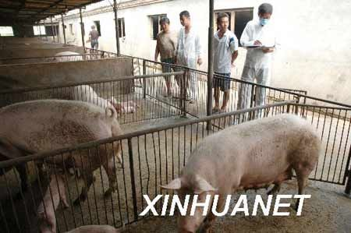
Olympic pig farms—segregation of pigs
Supplied pork for athletes in remote areas with no pollution
Only organic feed and herbal medicines
Sold in stores for 4-5 times price of standard pork

Slide 17
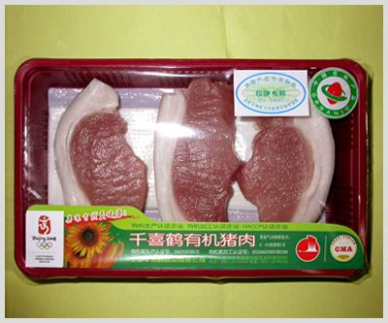
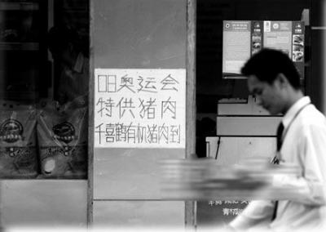
Reactions to Olympic pork from the public
“People are less important than pigs”
A “vanity project”
“We give the best to foreigners; our countrymen eat ‘problem’ food.”
“A ‘political task’…We don’t speak of the cost”

Slide 18
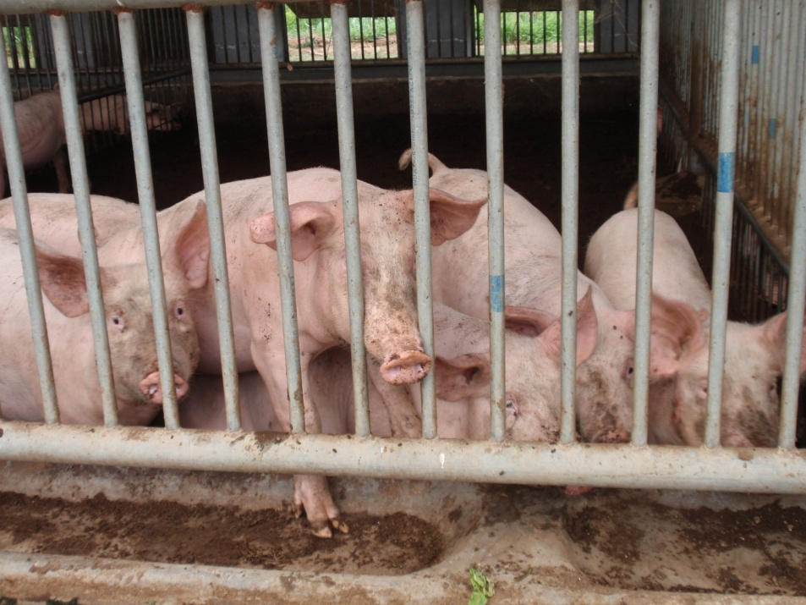
Community-Supported Agriculture—exploring new connections
Pork delivered for a subscription fee
Farm visitors can see the pigs
“Fermentation bed” absorbs waste and can be used as organic fertilizer
Issues related to feed
  No soybean meal
  Used premix feed
Slaughter issues
  Verify the carcass was theirs

Slide 19
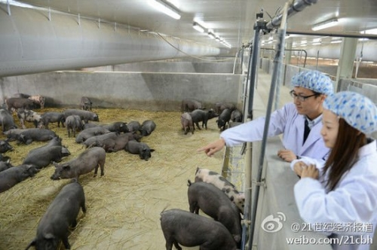
“Internet thinking”
Virtual connection between people and pigs
“An exploration of new agriculture, not a commercial venture”
Tracking process of pig-raising through the Internet
Spent years choosing breeds, working out waste disposal system, etc.

Slide 20
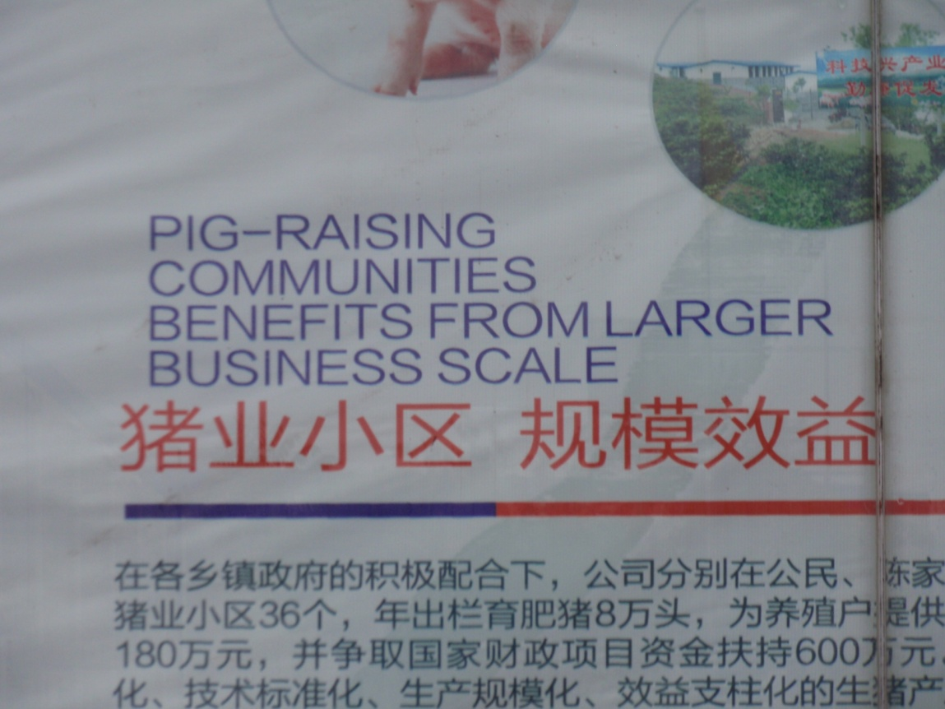
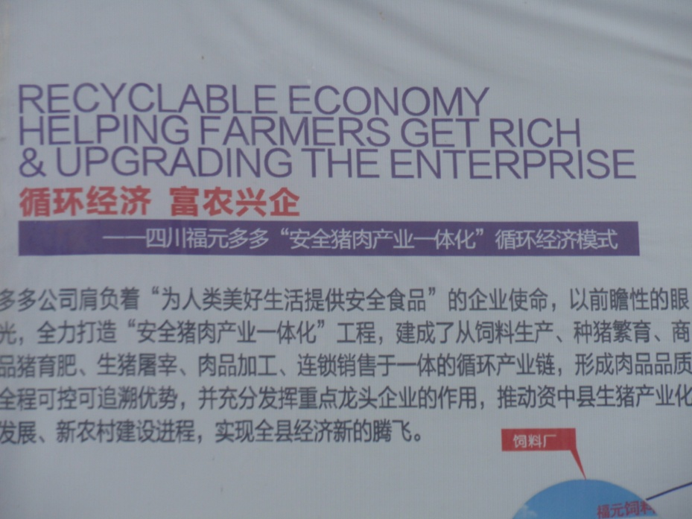
Mainstream “ecological” pig farms
Company-centered strategy
Appended “Recycling”, “Ecological” to industrial model

Slide 21
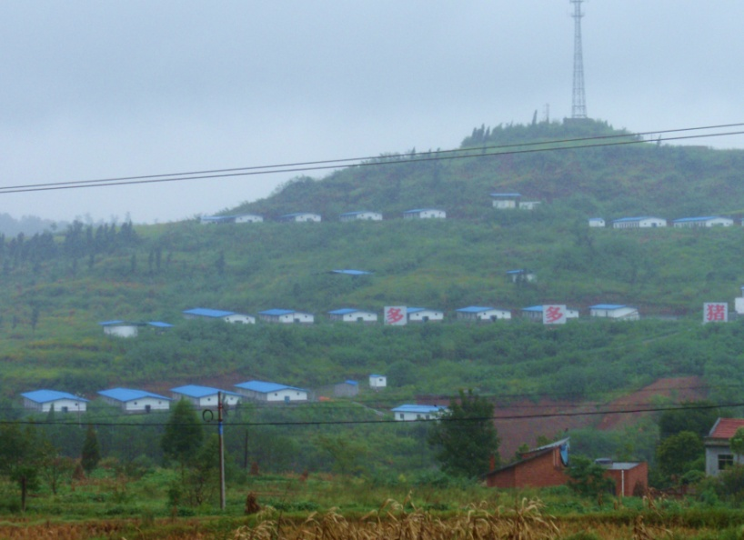
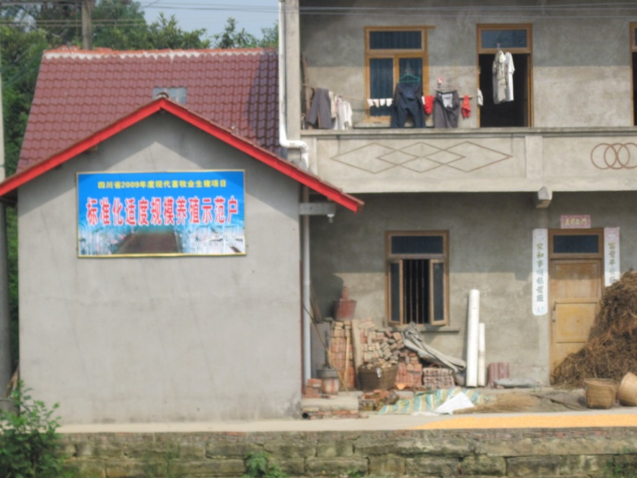
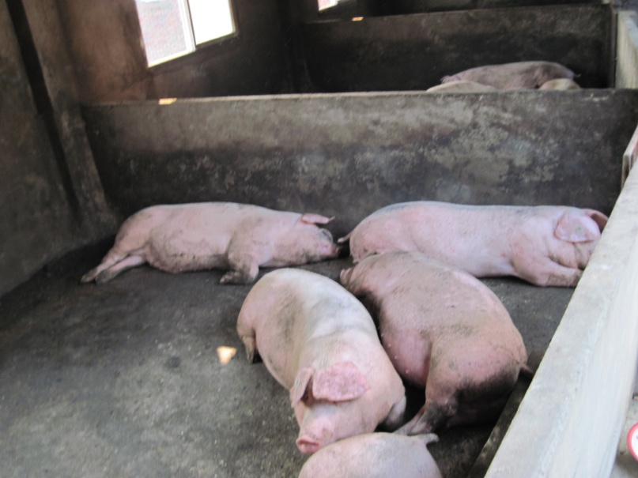
Company supplies piglets, feed to farmers
Breeding
and propagation
segregated
Fattened among
people

Slide 22
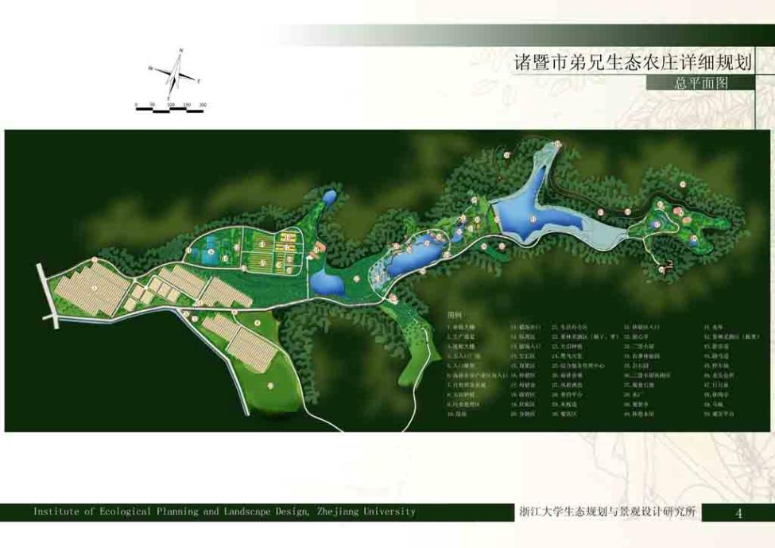
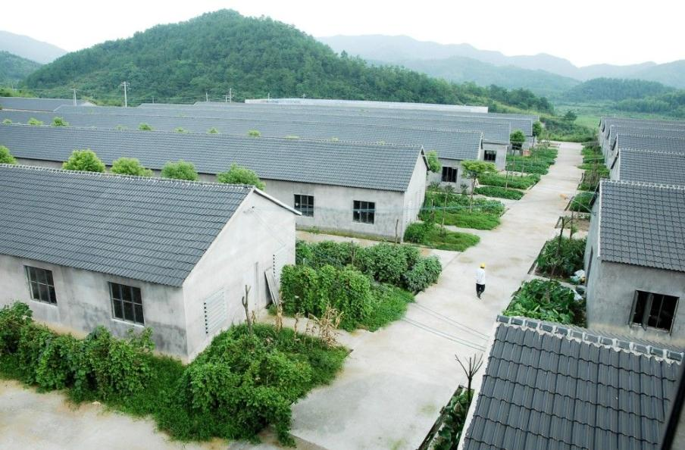
Zhejiang: Planned ecological village
A comprehensive plan integrates a large pig farm with rice,
vegetables, and fish ponds (“circular economy”).
No other pigs within 5 kilometers

Slide 23
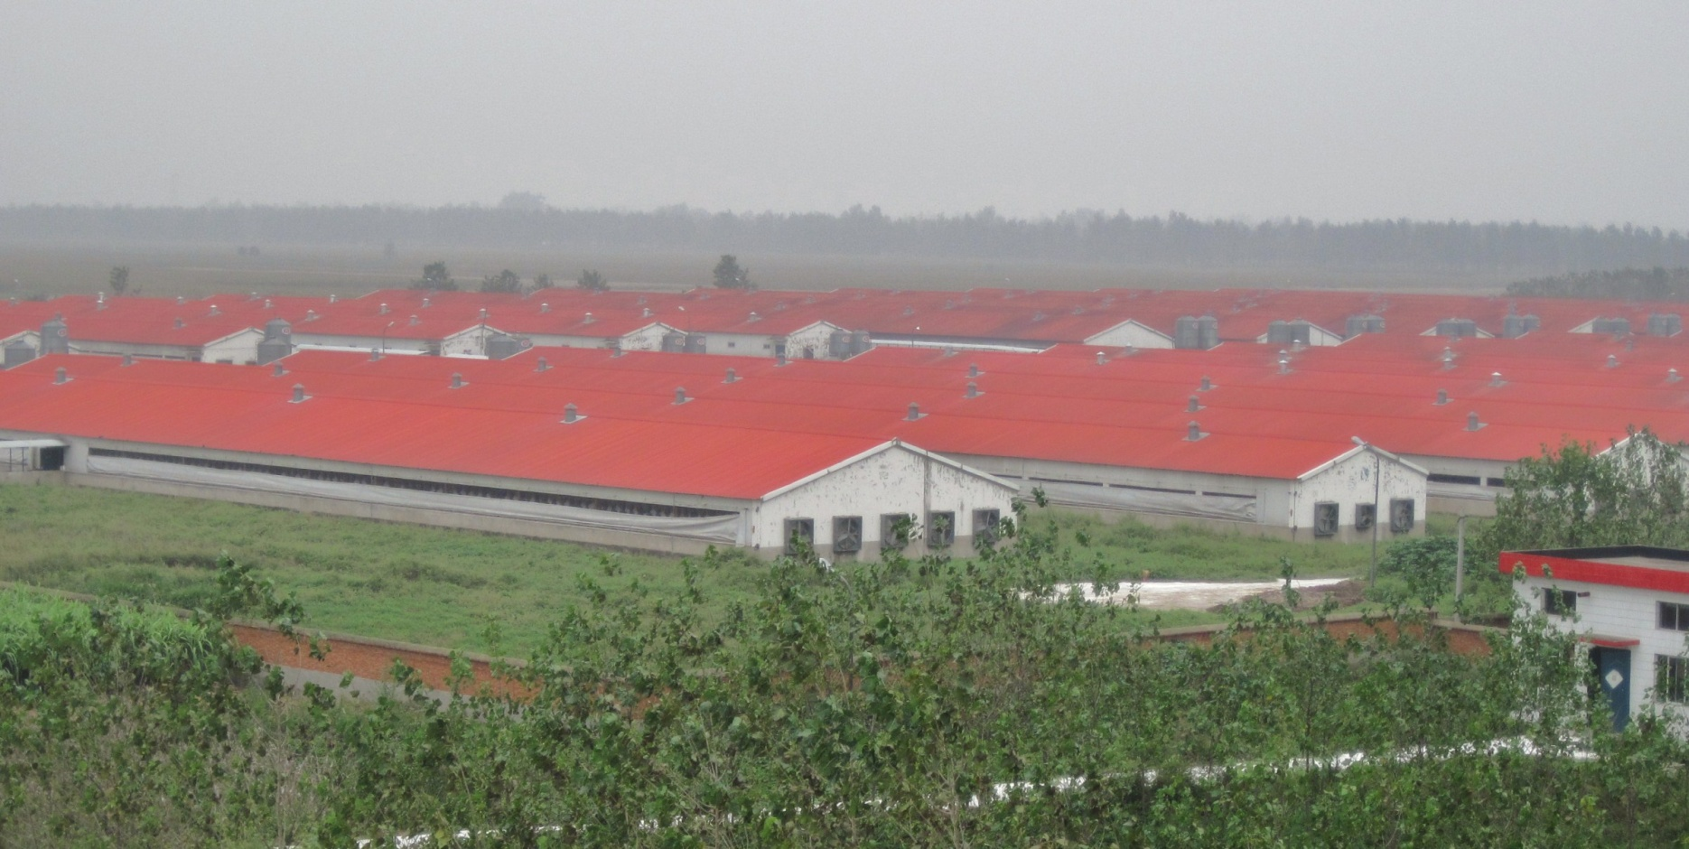
Pigs segregated in their own “cities”

Slide 24
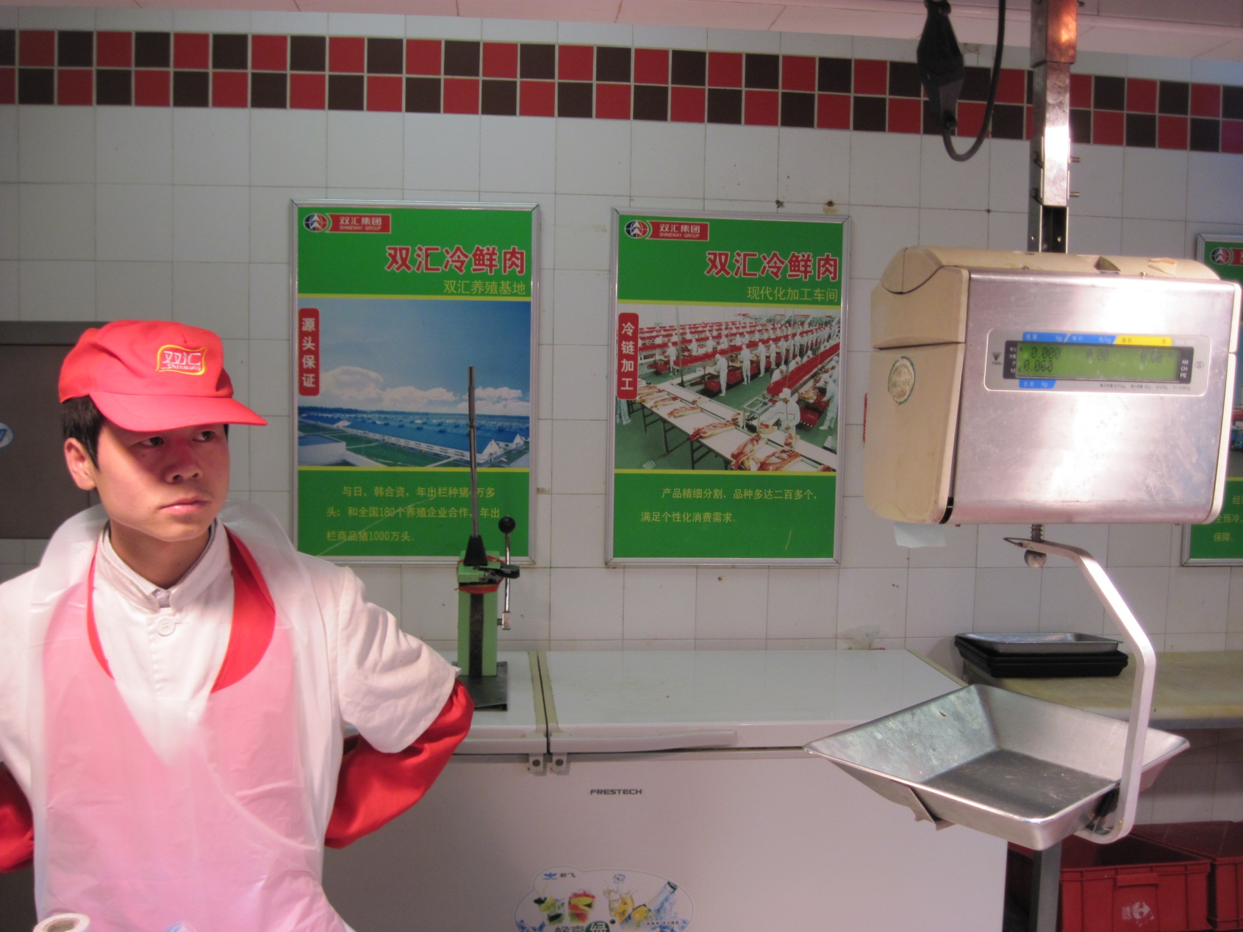
Pictures of factory farming are an assurance for consumers

Slide 25
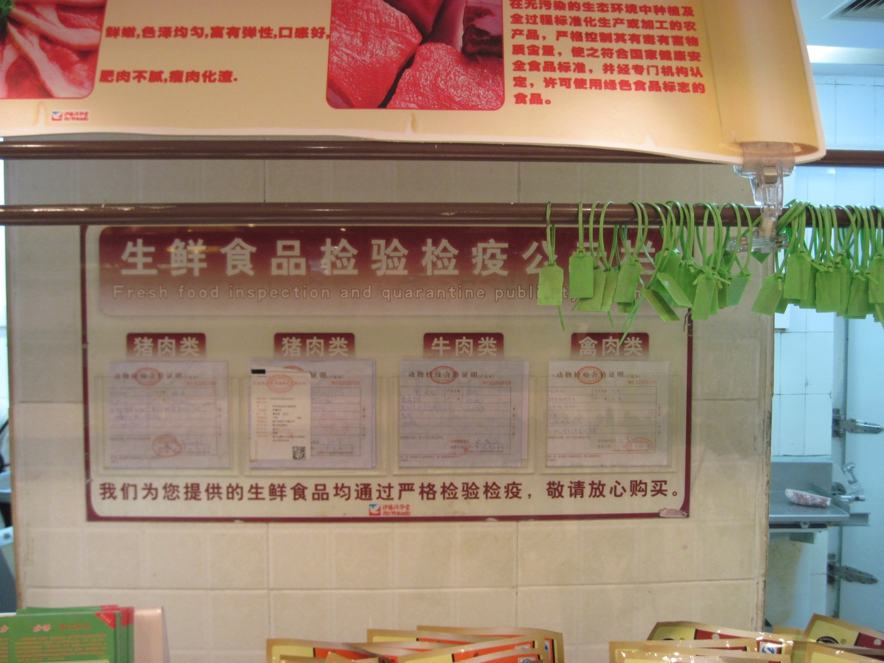
Certifications to assure consumers

Slide 26
Some thoughts
Randomly mixing imported and native modes of farming not ideal
Mainstream drifting toward pure “factory” model
New, innovative thinking outside the mainstream
Are pigs the “right” meat for modern China?
Importing meat from land-abundant countries would reduce global impact of rising Chinese meat consumption

