Slide 1
Crime and justice in revolutionary Venezuela
Rogelio Pérez Perdomo
Washington, June 30, 2012

Slide 2
The issues
Venezuela had relatively low violent crime in the 70s. Still in mid 80s homicide rate was 8 per 100k, lower than US.
In the 90s: from 8 to 20
In 2000s from 30 to 57
Kidnapping: rare in the 80s, frequent in the 90s
How to explain this significant increase?
What has been the role of law and criminal justice system?

Slide 3
The 1980s: violence and justice
Failure of an economic system (indebtedness, exchange control, devaluation, stagnation, corruption scandals, scarcity).
Rise on crimes against property: fear of crime.
Loosening on gun control regulation (an economic base for crime reduction).

Slide 4
Mano dura
More use of military police (GN)
Militarization of civil police and more discretion to policemen:
Police abuses
The police became the problem
Time of alienation from the state and the political system
Los presos sin condena (non-codemned prisoners)

Slide 5
The age of reform (1990s) 1
El gran viraje (great turn): privatization, deregulation, free markets – economic success and political failure.
Political decentralization: the creation of municipal police forces – the creation of relatively secure spaces

Slide 6
The age of reform 2
Judicial reform: managerial & technological change, investment in justice (WB)
Reform of criminal procedure: the German-American model adopted in 1998 – adversarial, oral, jury, etc.
Political change: a new constitution 1999 / Principles of criminal justice put in the constitution

Slide 7
The Código Orgánico Procesal Penal: Misfortunes of virtue
Liberal code in 1998/99: defense guarantees, principle of freedom, speed procedure. Blamed for the increase of crime in 99 and 2000
Reforms in past decade (2000, 2001, 2006, 2008, 2009). Liberal principles discarded: great discretion to prosecutors and judges to handle the procedure. Police autonomy
Inquisitorial procedure back: presos sin condena

Slide 8
Criminalization
Penal Code. Modest reform for penalization of political protest
Multiplication of crimes: more than 1000 crimes. Penalization of economic activity.
Persecution against bankers, brokers, military men, politicians and students are common.

Slide 9
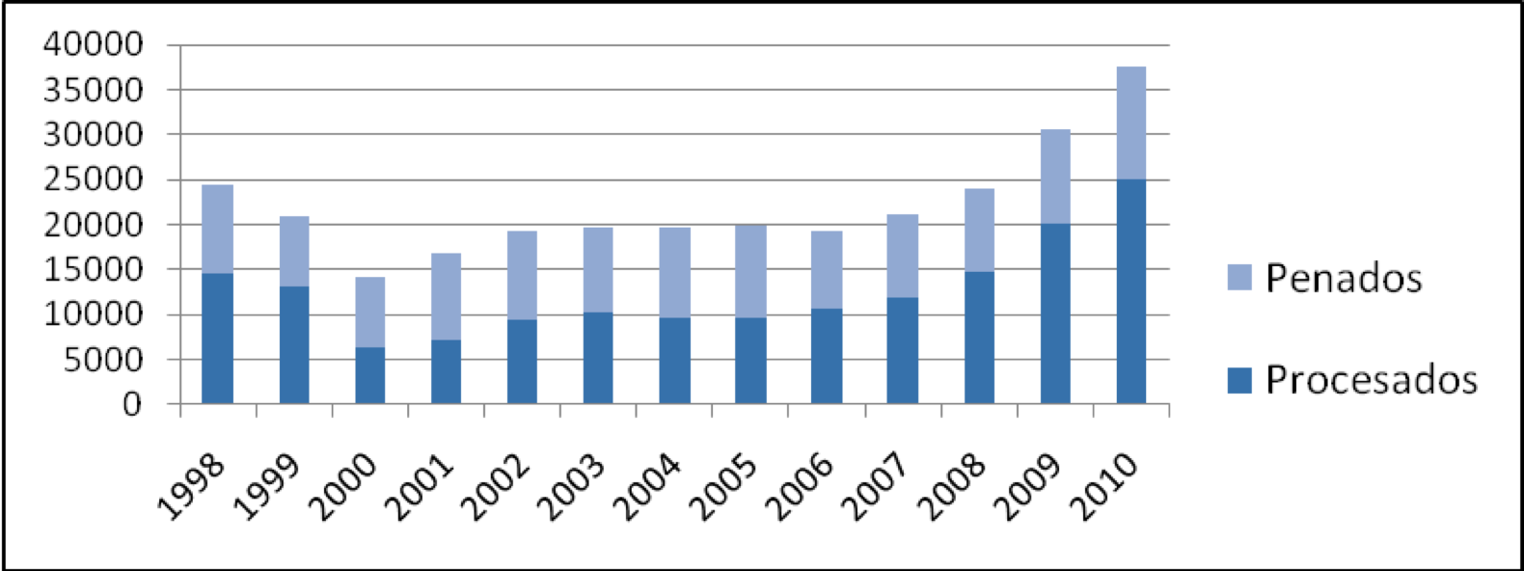
PRISON POPULATION 1998-2010

Slide 10
The control of prisons
Prisons: easy traffic of guns and drugs / Pranes are in charge / Extreme violence. El Rodeo, La Planta
Why is the government unable to control prisons?
Corruption: prisons are places for exchanges
Officials are not accountable / political loyalty is the virtue

Slide 11
The prison as a metaphor of the justice system
The case of Eladio Aponte-Aponte: Top military prosecutor converted in Supreme Court justice and head of the Criminal Chamber- the strong man in the criminal justice system.
Fell out of grace. Afraid of being killed sought DEA’s protection. Talking about the drug lords’ control of high government and the military
Chavez’s control of the judiciary explained from inside

Slide 12
The mafia-state
State as a mafia type organization.
The politicians not concerned with controlling crime, but how to use criminals for dirty political jobs.
Prosecutors, judges and policemen paralyzed. Efficiency or quality of decisions not appreciated. Obedience is awarded.
“Mistakes” punished with firing or worse.

Slide 13
Can crime be controlled? Can the state be recovered?
Political change as requisite for start the rebuilding of institutions
The institutions of the justice system are especially important: courts, National Prosecutor’s Office, police, including military police
Hard and complex task

