Slide 1
Mexican Energy Reform
Leonardo Beltran
Deputy Minister for Planning and Energy Transition of Mexico

Slide 2
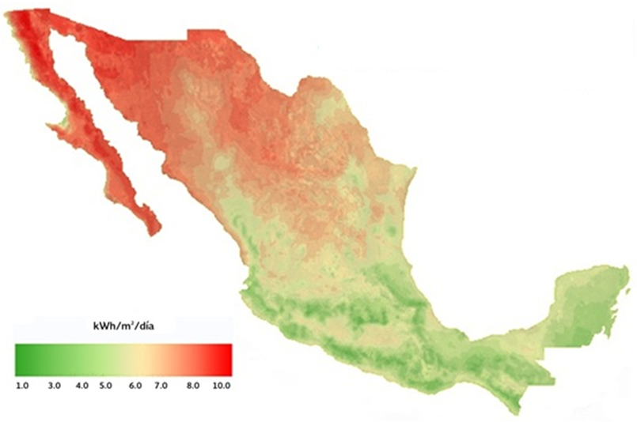
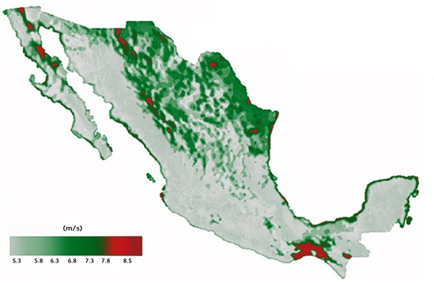
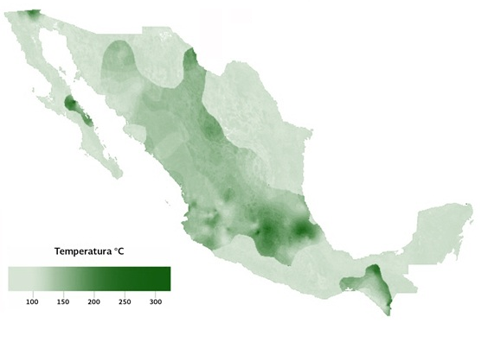
Maps of Renewable Resources
Direct irradiation During June*
Power density
80mts during Apr. (W/m²)**
Geothermal resources (°C)***
* Average daily irradiation in Mexico is about 5.5 kwh/m²/d, and can reach values higher than 8.5kwh/m².
** Studies to characterize the wind resource in regions of the Isthmus of Tehuantepec, the peninsulas of Yucatan and Baja California, and the northern region of the Gulf of Mexico.
*** geothermal potential based on the census of more than 1,300 hot spots estimated by the Federal Electricity Commission.
Source: SENER, Inventario Nacional de Energías Renovables

Slide 3
Energy Reform
key Elements
Strengthening
Legal framework and regulators
Secondary Legislation
Regulatory Bodies
(cre & cnh)
Productive State Companies (pemex & cfe)
Independent system operator (asea, cenace & cenagas)
New electricity market
New Tax Regime
New funds*
financial mechanisms
Information and transparency
national inventory of renewable energy
VUER
* funds: mexican petroleum fund, public trust for the promotion and development of national energy industry suppliers and contractors, sener-nafin fund, and universal power service fund
Notes:
Nuevo mercado eléctrico
Separación vertical
Individuals are granted the right to generate and sell electricity, with state regulation
The private sector may participate in transmission and distribution of electricity, through a system of contracts with CFE

Slide 4
Energy Reform
Power generation
2014
2015
2016
New electricity market
CENACE: Operate the electricity system and market (nov)
Interconnection criteria (dec)
Wholesale electricity market
Publication of criteria (feb)
operational Rules (jul)
Information System Testing (oct)
Development Program for the Electricity Power System (jul)
Operation of the Wholesale Market (jan)
Clean energy certificates (CLEs)
Guidelines (oct)
Requirements of clean energy by 2018 (mar)
Geothermal
Round Zero
CFE presented a request geothermal fields (Jan)
Results (jul)
bidding of geothermal fields (aug)

Slide 5
Energy Reform
Power generation
Estimated total investment, MMD
power generation
23,790
3,300 PIE’s
national transmission grid
4,450
Total
31,540

Slide 6
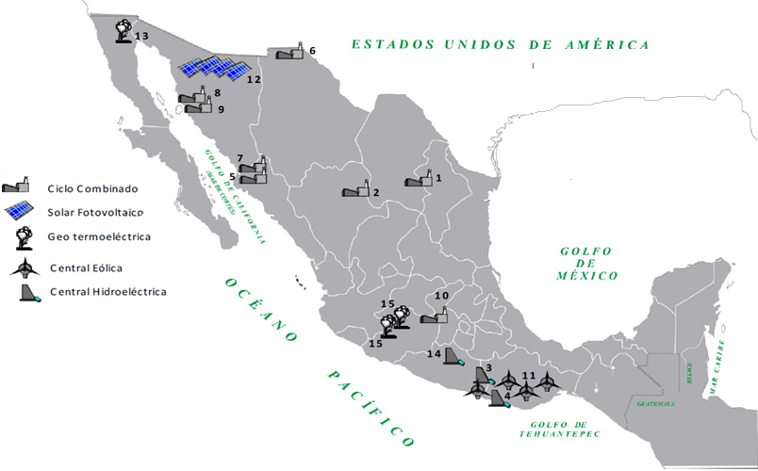
National Infraestucture Program 2014-2018
Power Generation: Investment Requirements
(Estimated Total Investment: 310.8 miles de millones de pesos)
Estimated total investment in cc projects (97,682 mdp)
1. Noreste (Escobedo)
2. Norte IV ( Lerdo)
5. Noroeste (Topolobampo II)
6. Norte III
7. Topolobampo III
8. Guaymas II
9. Guaymas III
10. Valle de México II
Estimated total investment in Renewables projects (99,669 mdp)
3. Nuevo Guerrero
4. Paso de la Reina, Oaxaca
11. Central Eólica (capacidades 296 MW y 281 MW
12. Pequeño Productor Solar (30MW)
13. Mexicali I
14. Las Cruces 240 MW
15. Azufres (Fase I y Fase II) y Cerritos Colorados (Fase I)
Central hidroeléctrica Chicoasén
Central Eólica Sureste II
Centrales Eólicas Sureste III, IV y V

Slide 7
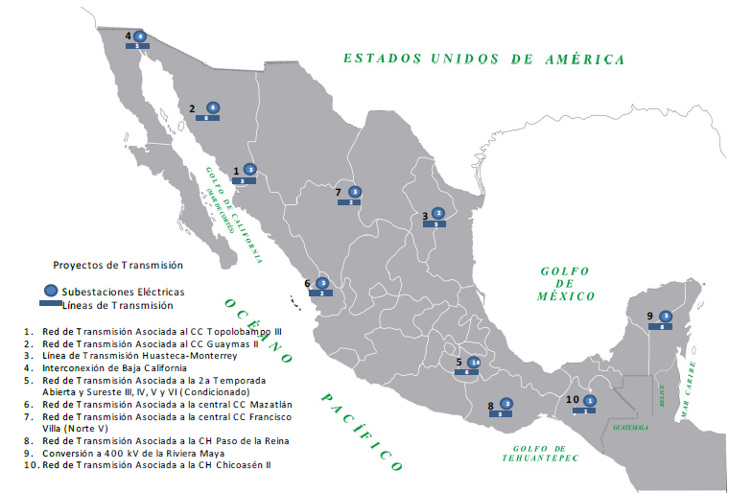
National Infraestucture Program 2014-2018
Power sector: transmission and distribution
(Estimated Total Investment: 247.2 miles de millones de pesos)
Subestaciones Eléctricas
Líneas de distribución
12
10
11
6
10
4
11. Distribución Valle de México
12. Distribución Valle de México (2ª fase)

Slide 8
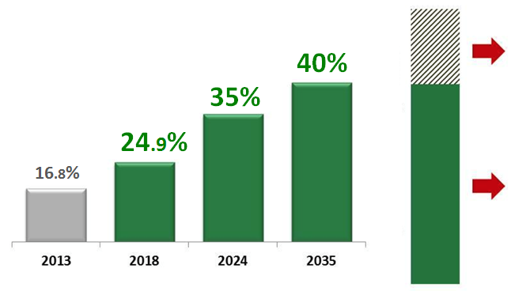
Clean power generation
National target / Certificates
Clean
energy
Certificates
energy sold
to the electric market
Source: SENER, . Prospectiva de Energía Renovables 2014-2028

Slide 9
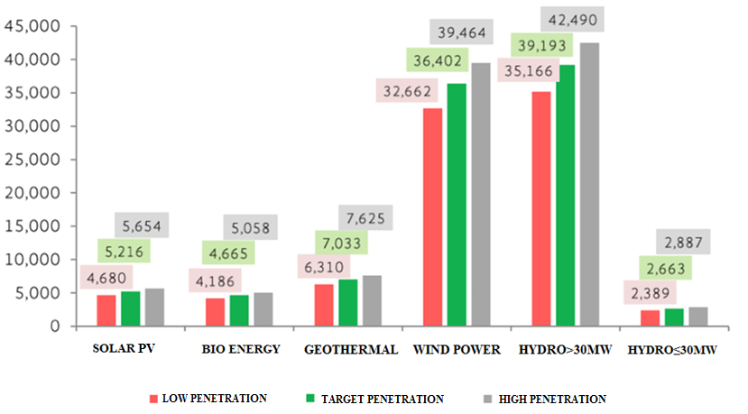
Renewable energy
Estimated power generation, 2028
+28%
+16%
GW/year
4x
2x
(+1%)
+18%
Source: SENER, . Prospectiva de Energía Renovables 2014-2028

Slide 10
National targets for low carbon economy
general climate change law
Conditional target 2020 and 2050
Estimated emissions theoretical road map
Mt CO₂e
30% REDUCTION
Versus baseline
1000
800
baseline
35%
Clean energy
From power generation
50% reduction
Versus 2000 emission
600
400
200
2010
2015
2020
2025
2030
2035
2040
2045
2050
Structural change (energy reform)

Slide 11
Structural Reforms
Energy
economic competition
telecommunications
fiscal
educational
financial
habeas corpus
electoral politics
labor
national code of criminal proceedings
transparency
objectives
increase productivity
Rule of law
democracy and freedom

