Slide 1
Preventing Mycotoxins in the Field
Peter J. Cotty
Agricultural Research Service, United States Department of Agriculture
School of Plant Sciences, University of Arizona, Tucson
Mycotoxins: Triple Threat to African Development
Woodrow Wilson International Center for Scholars
Washington, DC, 14 February, 2012

Slide 2
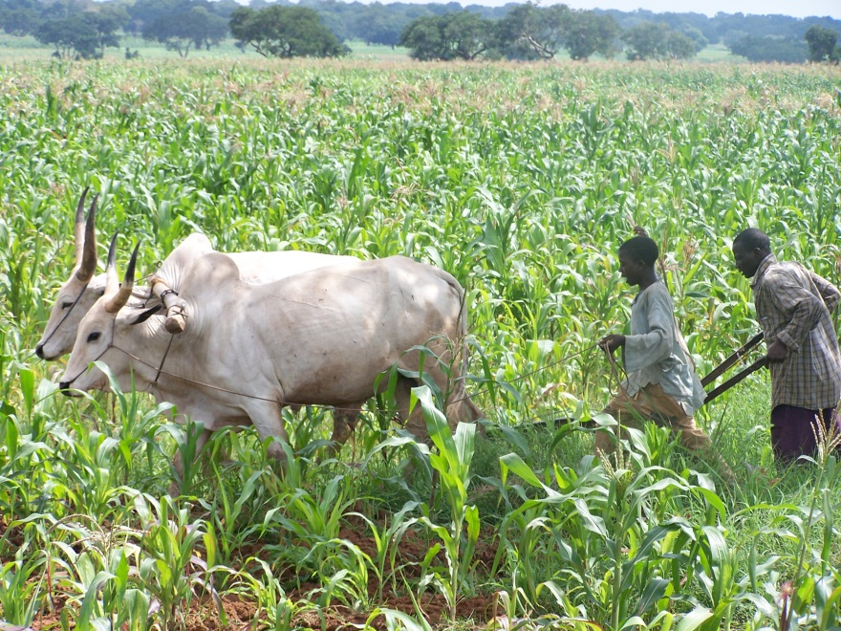
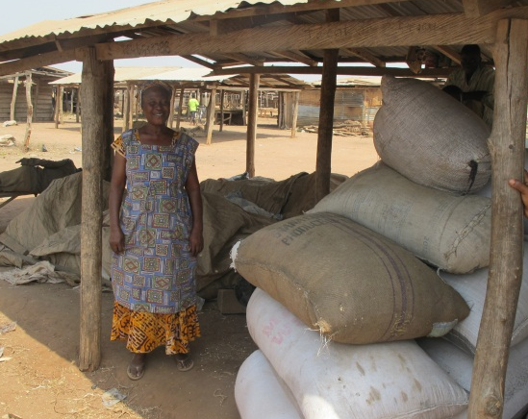
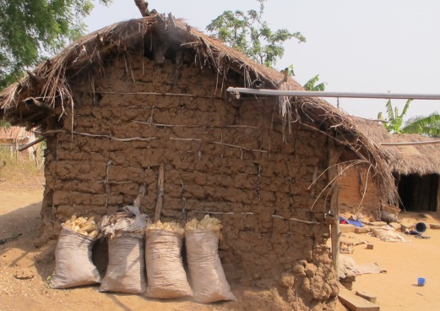
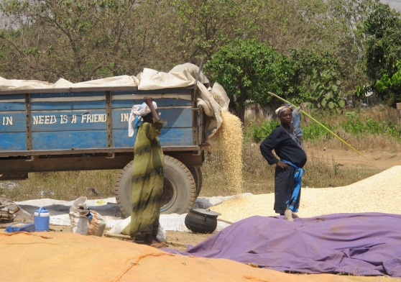
Prevent Formation of Dangerous Aflatoxin Levels
Protect Crops Until Use
During Storage
Dry, prevent moisture, cool
Prevent damage: insects, rodents
During Crop Development
Irrigation, Weed Control, Fertilize
Best cultivars, Insect Control
During Processing
Sort, Cull, Discard, Add binders.
During transport
Rapid, Dry, No Damage

Slide 3
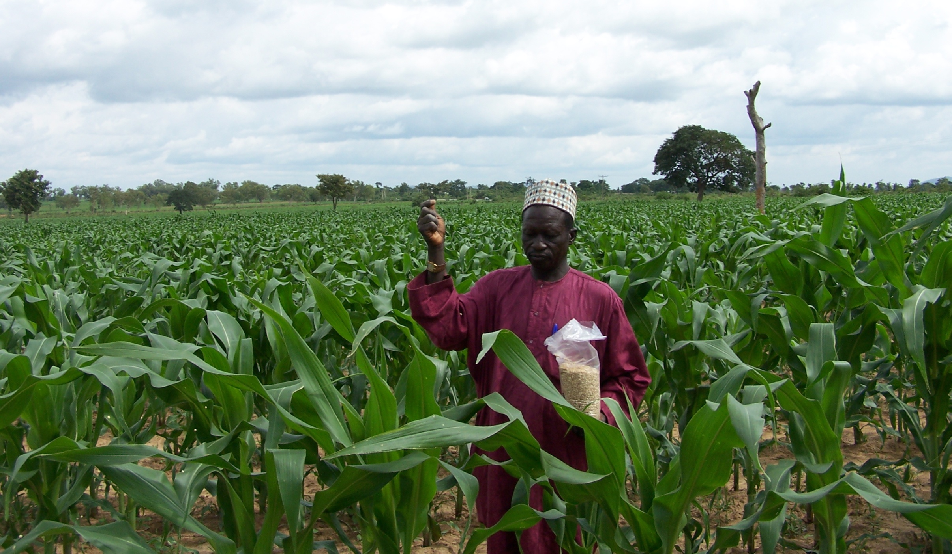
A Single application at 10 kg/hectare is enough to consistently reduce aflatoxins in maize, groundnut, and other crops.
Nigeria

Slide 4
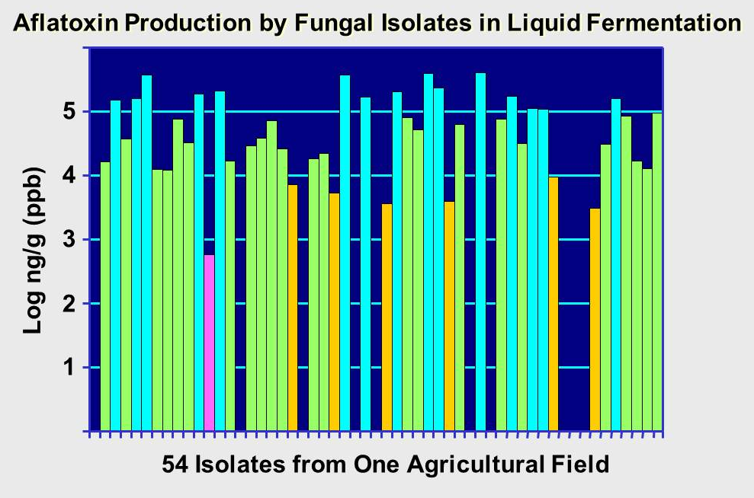
Atoxigenic Isolates Occur Naturally on Crops
Isolates useful for biocontrol are endemic in and adapted to target agroecosystems.

Slide 5
Fungi Vary Across Areas in Aflatoxin-Producing Ability
Farmers apply atoxigenic strains to reduce the average aflatoxin-producing potential of fungi on farms & thus the vulnerability of crops to aflatoxin contamination
Aflatoxin Production by A. flavus from Two Fields
Aflatoxin-Producing
Potential
Percent of A. flavus
Field 1 = Low,
3,400 ppb
Field 2 = High,
54,000 ppb
Aflatoxin Produced in Culture (log ppb)

Slide 6
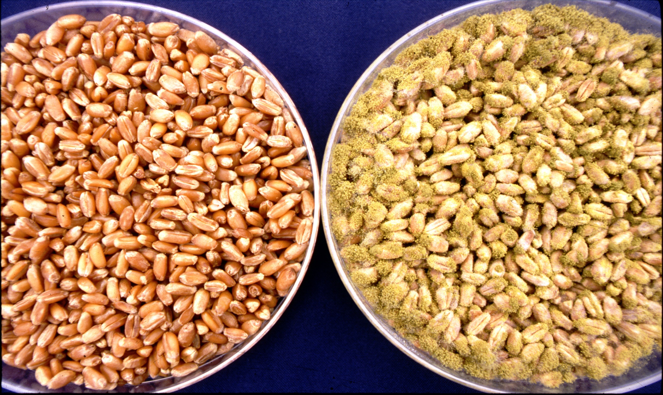
As Applied
Either Sorghum, Wheat, or Barley are used.
Sorghum is used in Africa.
The grain is killed by cooking before use.
After
Fungal Growth

Slide 7
Aflatoxin in Crop versus Atoxigenic Incidence
Dots Represent Values for Replicate Plots
Aflatoxin B₁ (ng/g X 10,000)
r = 0.71, P = 0.0001
Isolates (%) in Applied Atoxigenic Strain
Cotty, 1994. Phytopathology:1270-1277.

Slide 8
Commercial Maize: North Central Texas 2008
 |  |  |  | Aflatoxin (ppb)
Area | Samples (#) | AF36 (%) |  |  | Mean |  | Range
Grayson North | 17 | 96 | a | 12 |  | a | 0 to 48
Grayson South | 16 | 98 | a | 15 |  | a | 0 to 38
Grayson Control | 8 | 24 | b | 230 |  | b | 5 to 530
Means in the same column with different letters are significantly different by Tukey’s HSD test, P < 0.001.

Slide 9
= 1997
= 1996
=1997 & 1996 differ
Fungi Resident in the Soil
Incidence of AF36

Slide 10
Grayson County, Texas: Carry Over to the Second Year Crop
= S Strain, produces very high aflatoxins
= Atoxigenic isolate AF36
Percent of Aspergillus flavus
Crop
Treatment Year
Soil Before Treatment
Crop Year After Treatment

