Slide 1
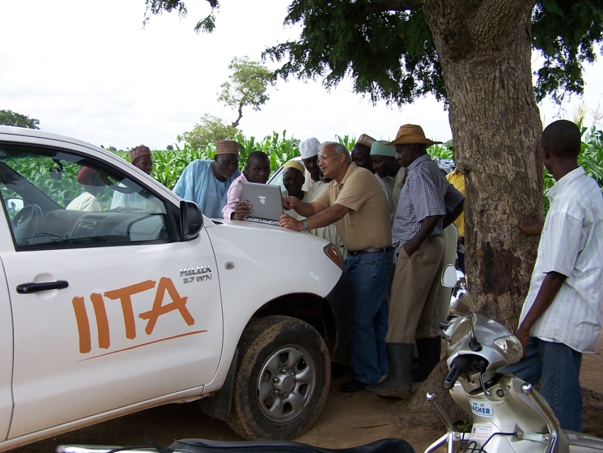
Ranajit Bandyopadhyay, Plant Pathologist
International Institute of Tropical Agriculture
Ibadan, Nigeria

Slide 2
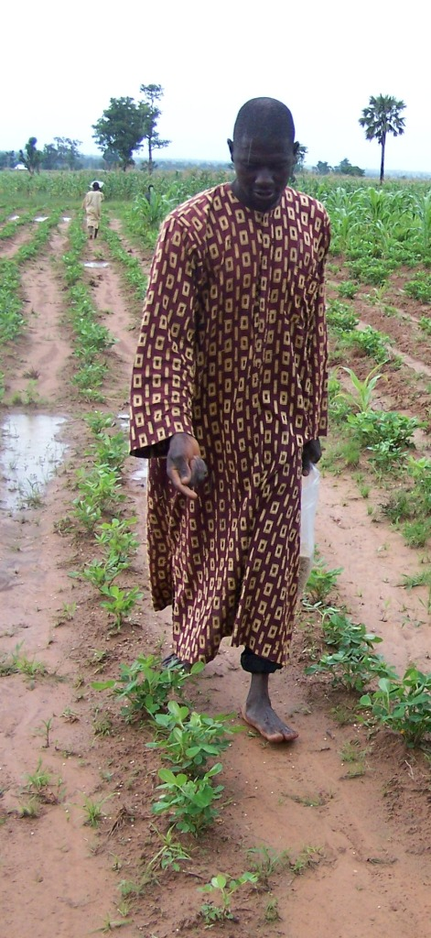
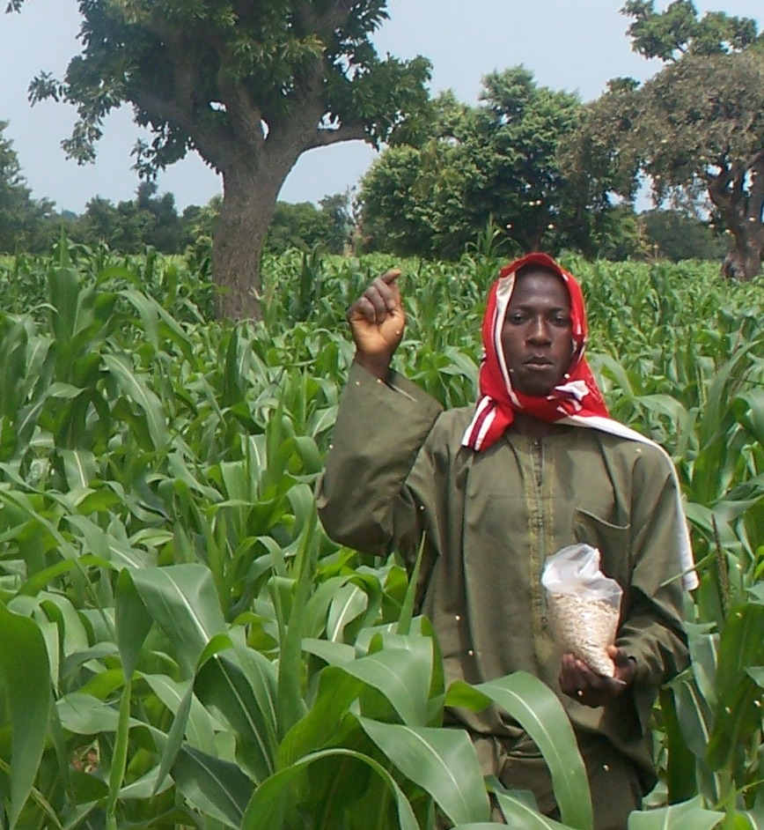
Nigeria
MAIZE: Aflatoxin reduction (%)
Stage | 2009 | 2010 | 2011
Harvest | 82 | 94 | 83
Storage | 92 | 93 | -
71% and 52% carry-over of the Atoxigenics 1 & 2 years after
PEANUT: Aflatoxin reduction (%)
Stage | 2009 | 2010 | 2011
Harvest | - | 95 | 82
Storage | 100 | 80 | -
Results from 382
on-farm trials

Slide 3
Crops are Protected in the Field and During Storage Aflatoxin reduction after 4 months poor storage (Field Treated Crops – Nigeria)
% reduction in aflatoxin content in treated fields over control
85%
82%
99%
95%
800
Control
646
600
Treated
Aflatoxin (ppb)
400
271
200
171
96
49
14
17
9
0
Birnin Gwari
Lere
Maigana
Pampaida

Slide 4
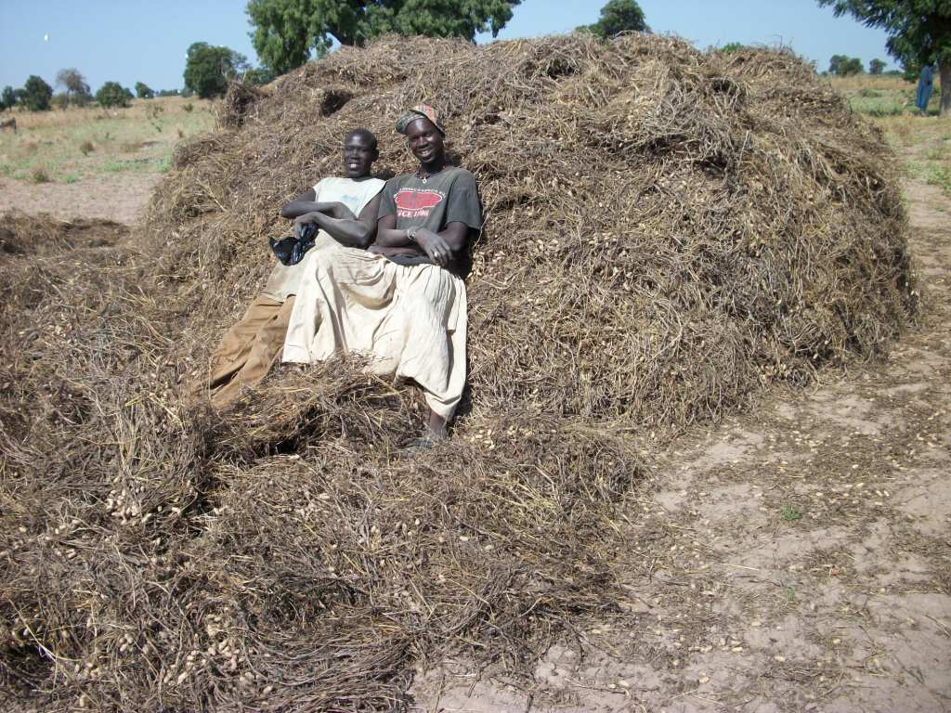
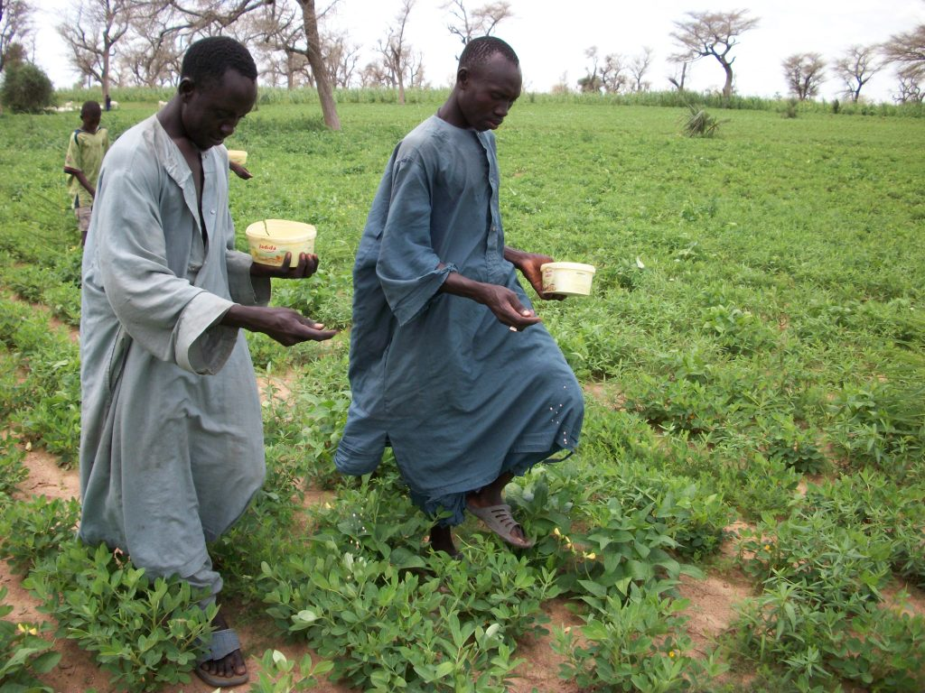
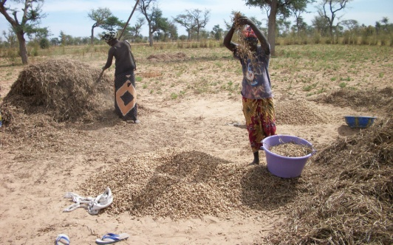
Senegal
Aflatoxin Reduction:
2010 : 87% at harvest; 89% after Storage
2011: 82% at harvest; 93% after Storage
38 Farms Treated in 2010
40 Farms Treated in 2011
196 Farms Treated in 2012
Farmers threshing groundnut
Farmers treating groundnut fields with AflaSafe

Slide 5
Mali
Senegal
Burkina Faso
Nigeria
Ghana
Rwanda
Kenya
Tanzania
Zambia
Senegal: 274 Fields Treated
Nigeria: 382 Fields Treated
Burkina Faso: 30 Fields Treated
Kenya: 388 Fields Treated
Zambia: 80 Fields Treated
Malawi
Mozambique

Slide 6
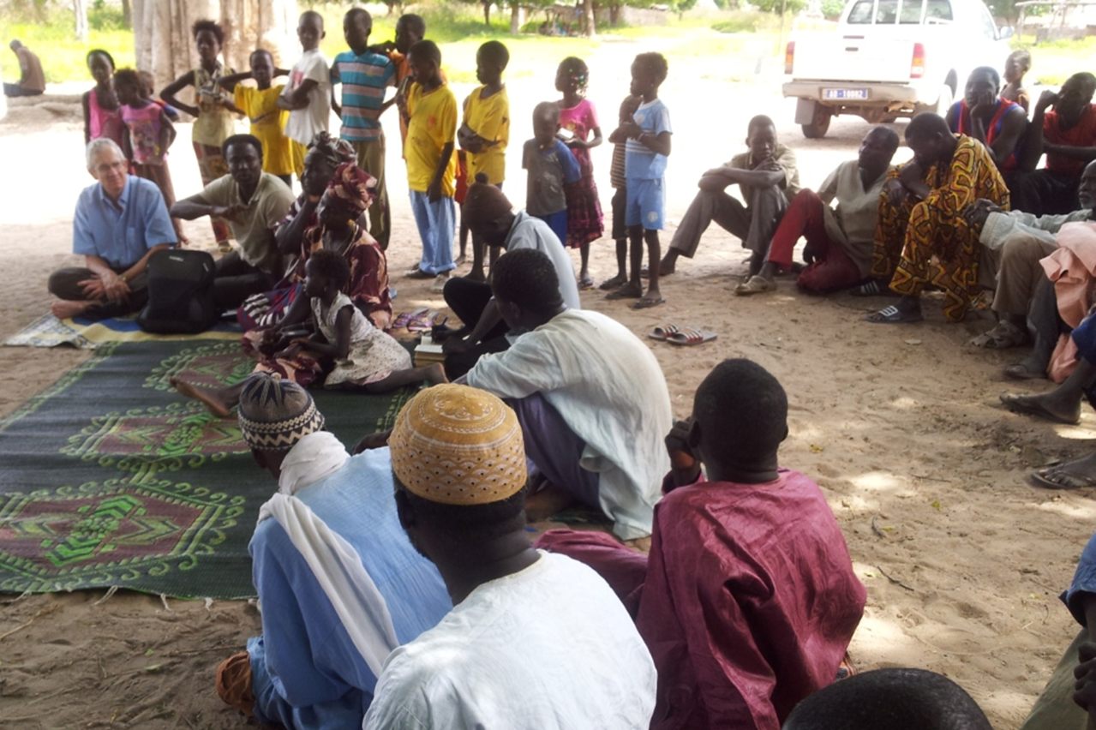

Slide 7
Crops are infected by complex communities of diverse fungi
We can influence aflatoxin-producing ability of fungal communities resident in production areas through crop rotations, agronomic practice, and by applying atoxigenic strains
There are many atoxigenic strains
Select strains best adapted to rotations, ecosystems, & climates
Atoxigenics are Already Present on the Crop
Just increasing the frequency of endemic strains & natural interference with contamination
Treatments have Long-Term Influences & Cumulative Benefits
More than One Crop May Benefit From the Same Strain
Atoxigenic Strains can be Applied Without Increasing Infection
and without increasing the overall quantity of A. flavus on the crop & throughout the environment

Slide 8
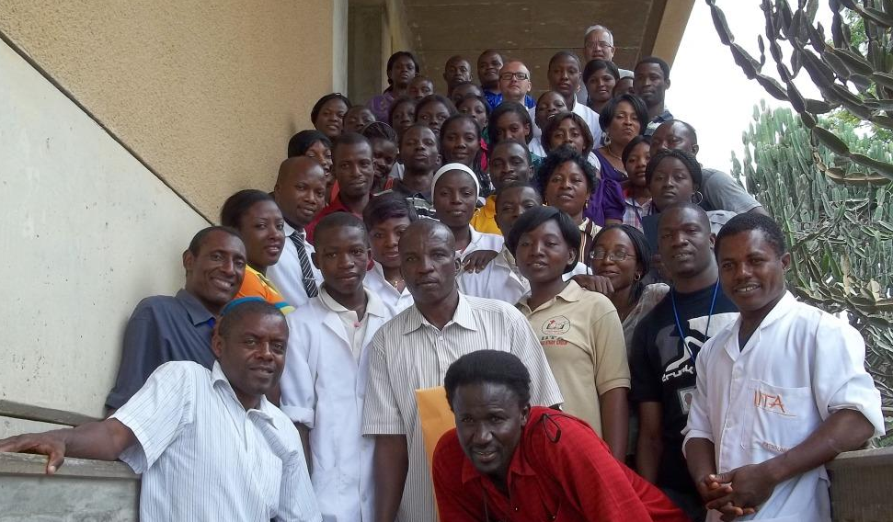
Ibadan
IITA
Nigeria
Tucson
USDA/ARS
IITA & USDA have Teamed up to Bring
Aflatoxin Prevention to Africa
Made Possible by Many National Partners in Ministries, Industry, and on the Farm
For more information about aflatoxin biocontrol for Africa, check out: www.aflasafe.com

