Slide 1
Rousseff: navigating a more challenging global outlook

Slide 2
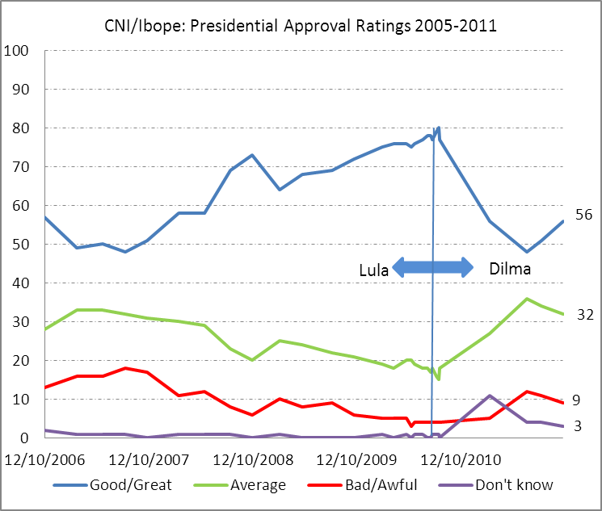
Rousseff’s resilient approval ratings

Slide 3
Legislative reform agenda
 | Approval Probability | Timing
Structural and Fiscal Reforms
Public Sector Pension Regulation | 70% | 1H 2012
Public Sector Payroll Cap | 30% | 1H 2013
ICMS Reform | 40% | 1H 2013
Import ICMS Reform | 60% | 1H 2012
Savings Account Reform | 40% | 2H 2012
Microeconomic Reforms | Probability | Timing
Government procurement reform | 40% | 1H 2013
Environmental Licensing | 60% | 1H 2012
Foreign Asset Amnesty | 30% | 1H 2012
Civil Aviation Liberalization | 70% | 2H 2012
Sector Specific Reforms | Probability | Timing
Oil Royalty Distribution | 70% | 1H 2012
Foreign Landownership Restrictions | 60% | 2H 2012
New Mining Code | 70% | 1h 2013
Utility Concession Renewal | 60% | 2H 2012
Negative Fiscal Agenda | Probability | Timing
Pension “Factor” Repeal | 20% | 2H 2012
Constitutional Amendment 300 | 20% | 2H 2012
Amendment 29 Regulation | 55% | 1H 2012

