Slide 1
Climate Change: Science, Impacts, Risks and Response
Scientific Basis for Human Induced Climate Change
Jagadish Shukla
Department of Atmospheric, Oceanic and Earth Sciences (AOES),
George Mason University (GMU)
Center for Ocean-Land-Atmosphere Studies (COLA)
Institute of Global Environment and Society (IGES)
Managing our planet, 17 December 2013, Wilson Center

Slide 2
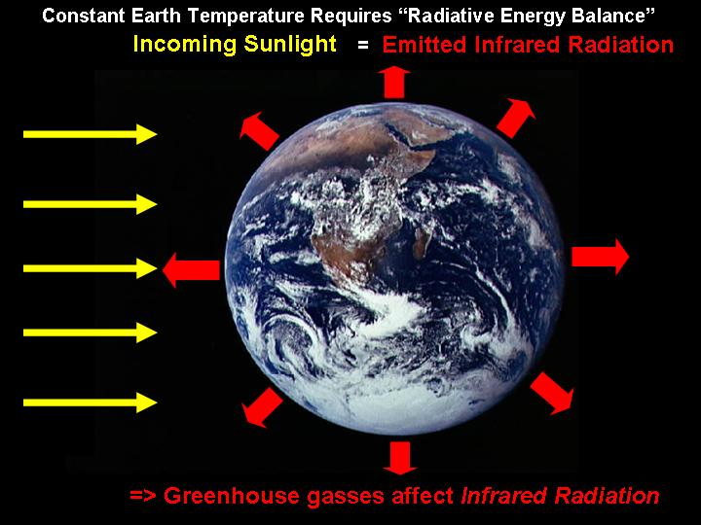
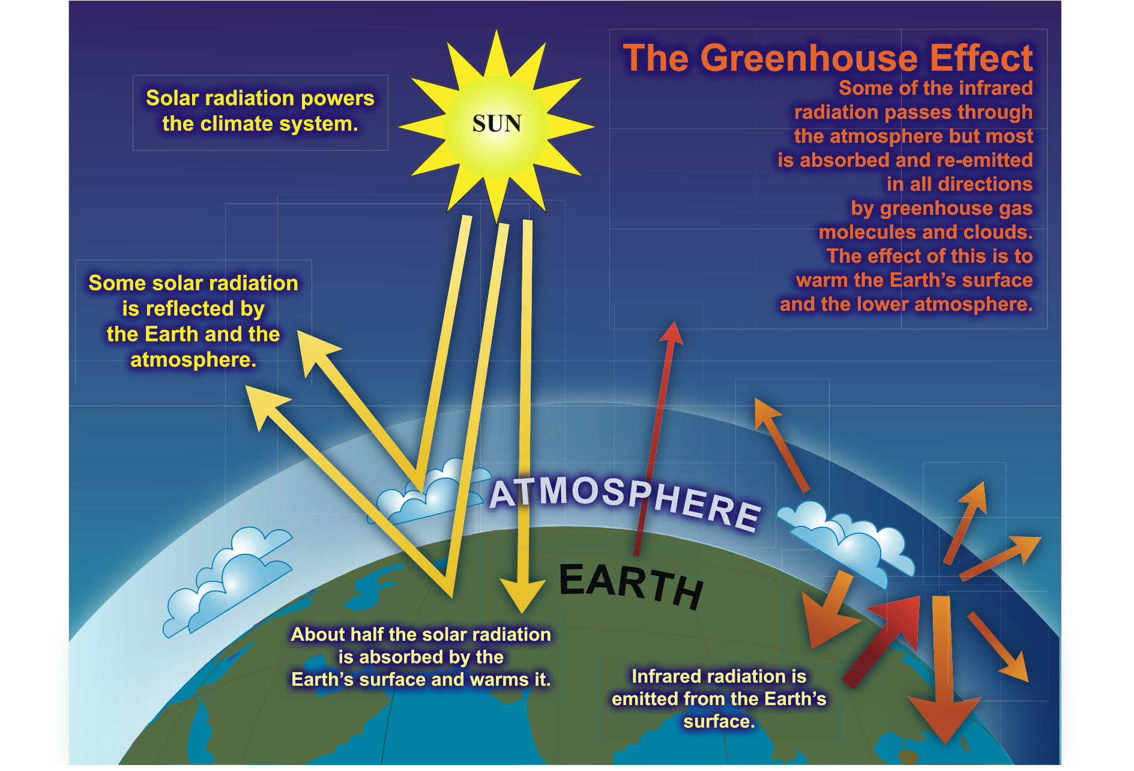
Greenhouse Effect:
Without it, the Earth would be uninhabitable.
Mean Climate:
Incoming Energy = Outgoing Energy

Slide 3
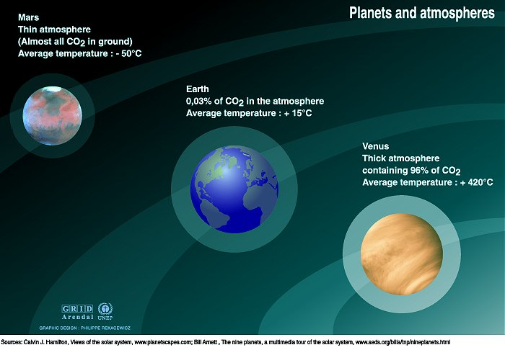
MARS
1.56 AU from Sun
F = 592 W/m²
Albedo = 17%
CO₂ = ~0%
T_{sfc} = 210 K
A Tale of Three Planets
EARTH
1.00 AU from Sun
F = 1367 W/m²
Albedo = 30%
CO₂ = ~0.03%
T_{sfc} = 288 K
VENUS
0.72 AU from Sun
F = 2639 W/m²
Albedo = 78%
CO₂ = ~96%
T_{sfc} = 737 K
Mars: −63ºC
Earth: 15ºC (59ºF)
Surface
Temperature
Venus: 464ºC

Slide 4
Outline
The observed climate change during the past 50-100 years
The causes of hiatus in global warming during the past 15 years
Projections of future global warming

Slide 5
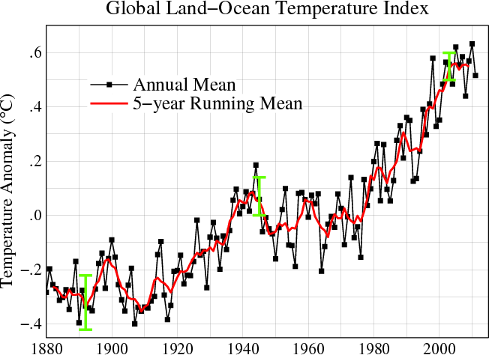
Global Warming
Global Warming is the increase in the average temperature of the Earth’s near surface air and oceans since the mid-20th century and its projected continuation. (Wikipedia)
Global Land-Ocean Temperature (1880-2011)
Annual Mean
5-year Mean
Relative to the
1951-1980 mean
(GISS, New York)

Slide 6
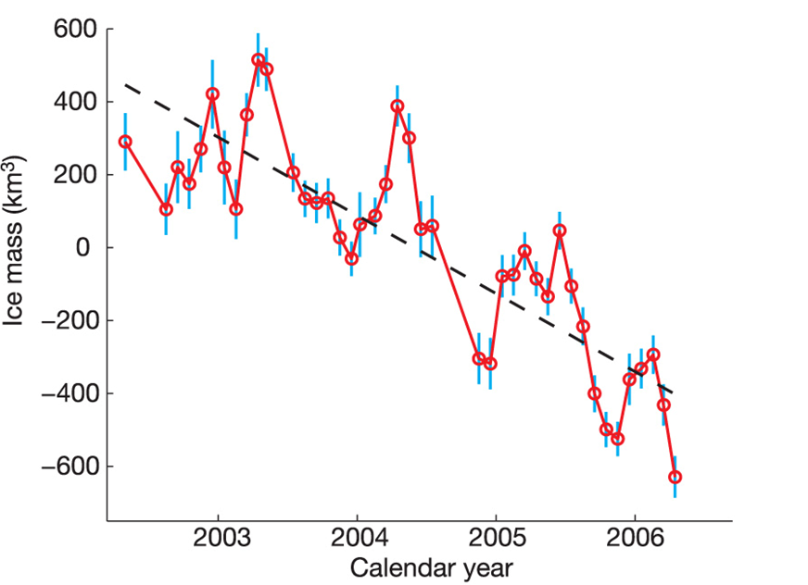
Greenland Ice Mass
The blue error bars include only the contributions from uncertainties in the GRACE gravity fields. Velicogna and Wahr (2006)

Slide 7
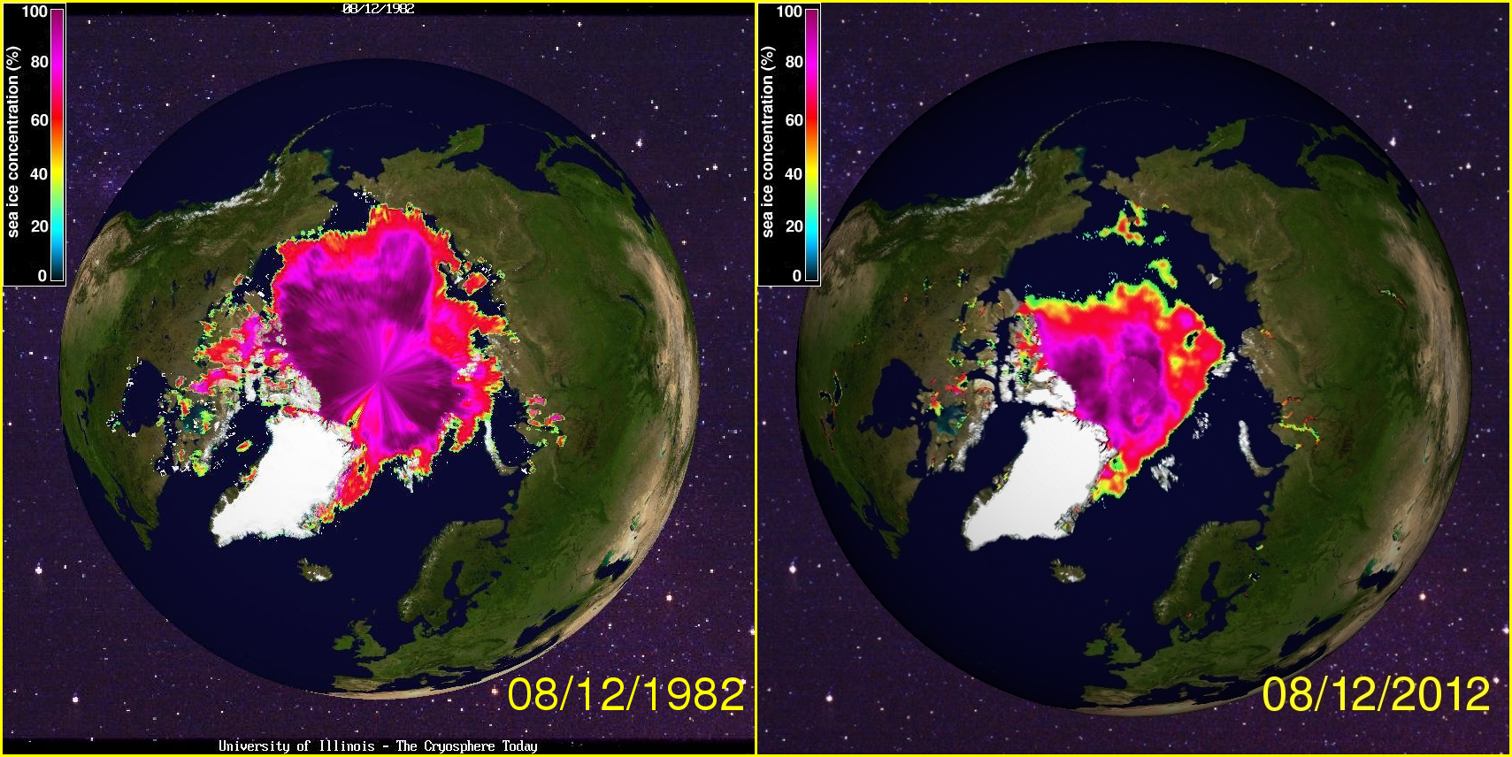
Arctic Sea Ice is Disappearing
Sea Ice Extent Aug 1982
Sea Ice Extent Aug 2012

Slide 8
Annual Cycle of NH Sea Ice Area
2012
2013
http://arctic.atmos.uiuc.edu/cryosphere/

Slide 9
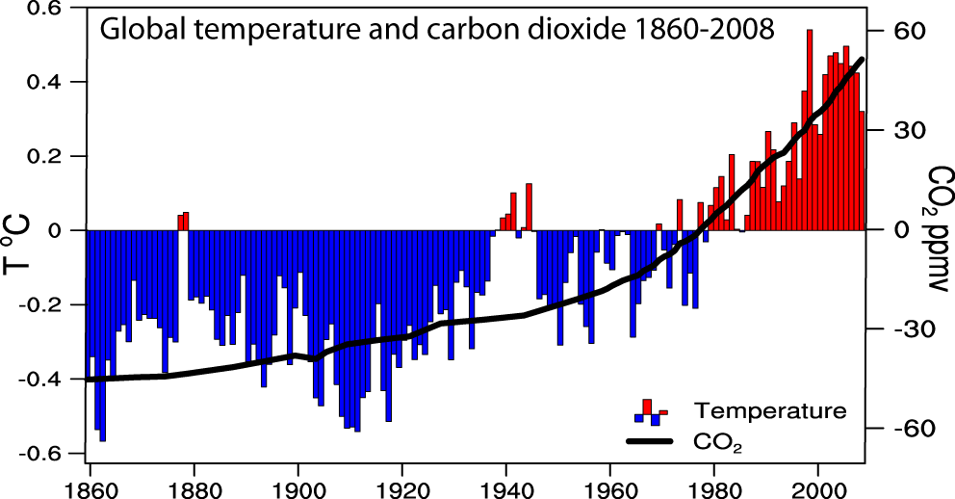
An Elegant Science Question:
Are increases in greenhouse gases responsible for increase in global mean temperature (global warming)?
14.6
Global Temperature & Carbon Dioxide 1860-2008
395
14.4
0.76°C (1.4°F) since 1900
0.55°C (1.0°F) since 1979
365
14.2
14.0
335
13.8
305
13.6
275
13.4
2012 ~ 400 ppm
Notes:
The globe is warming at a dramatic rate. Global surface temperatures today are more than 1.4˚F warmer than at the beginning of the 20th Century, and rates of temperature rise are greatest in recent decades. The ten warmest years on record have all occurred since 1997. Global temperatures for 2000-2008 now stand almost 0.4°F warmer than the average for the decade 1990–1999. This past year, 2008, was the tenth warmest year on record, in part because of the La Niña event that occurred in the tropical Pacific.
Twelve of the thirteen warmest years in the global surface temperature record have occurred since 1995, and the period 2001-2007 is 0.21°C warmer than the 1991-2000 decade.
Annual mean departures from the 1961-90 average for global temperatures, mean 14.0°C, and carbon dioxide concentrations from ice cores and Mauna Loa (1958 on), mean 333.7 ppmv.
Well known curve
Color bars: Estimated changes in global, annual mean surface temperatures since 1860 (143 years), plotted as anomalies relative to the 1961-1990 mean, obtained from thousands of surface measurements
It reveals an increase of 0.6 +/ 0.2 C since 1900, with very strong warming over the past several decades culminating in the 1990s as the warmest decade in the instrumental record.
The nine warmest years have occurred since 1990, and the 5 warmest in descending order are 1998, 2002, 2001, 1997 and 1995.
2002 was 0.58 C above the 61-80 mean
To put this in an even longer time perspective, analyses of proxy data from trees, corals, ice cores and historical records show that the 1990s are likely to be the warmest decade of the past 1000 years, with 1998 the warmest year, and the coldest probably 1601.
The consensus of the research community is that much of the recent warming can be attributed to increasing concentrations of greenhouse gases in the atmosphere, such as CO2 which is also shown here.
Direct measurements of CO2 (the solid curve) are taken from measurements in Hawaii since 1959, and prior to this are estimated from ice core records.
The CO2 anomalies are relative to a 61-90 mean of 333.7 ppmv
CO2 has increased 31% over pre-industrial values and, if current trends continue, will double during the next century, with further increases thereafter.
last century has occurred in two phases, from the 1910s to the 1940s (0.35°C or 0.63ºF), and more strongly from the 1970s to the present (0.55°C or 1.0ºF) at a rate of about 0.16ºC (0.3ºF) per decade. An increasing rate of warming has taken place over the last 25 years, and 11 of the 12 warmest years on record h

Slide 10
Are Humans Responsible for Climate Change?
Are GHG increasing? - Yes
Is global mean temperature increasing? - Yes
Does increase in GHG cause global warming? - Yes
Are increases in GHG due to human activities? – Yes
Yes to all four questions suggests (but does not prove) that human activities could be responsible for global warming.
IPCC: Assess and evaluate projections of future climate change by complex climate models developed by scientist worldwide to determine is the observed global warming is due to observed changes in GHG?

Slide 11
Intergovernmental Panel
on Climate Change (IPCC)
IPCC has been established by WMO and UNEP to assess scientific, technical and socio- economic information relevant for the understanding of climate change, its potential impacts and options for adaptation and mitigation.
Working Group I: The Physical Science Basis
Working Group II: Impacts, Adaptation and Vulnerability
Working Group III: Mitigation of Climate Change
2013: Twenty climate modeling groups from 13 countries: Australia, China(3), Canada, USA(4), Italy,France(2), Europe, UK, Korea, Russia, Japan(2), Germany, Norway submitted results from 39 climate models.

Slide 12
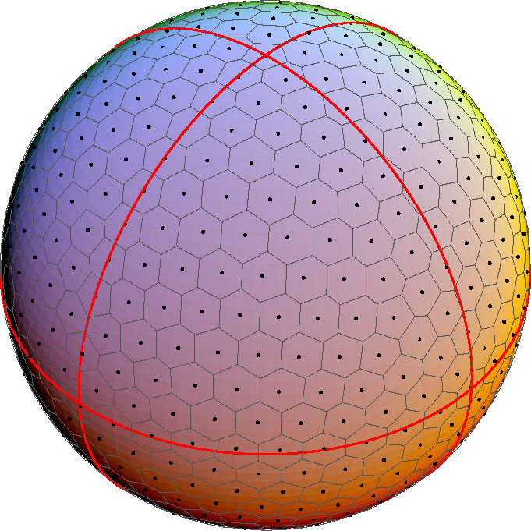
What is a Climate Model?
Equations of motions and laws of thermodynamics to predict rate of change of:
T, P, V, q, etc. (A, O, L, CO₂, etc.)
Climate
Dynamics
10 Million Equations:
100,000 Points × 100 Levels × 10 Variables
With Time Steps of: ~ 10 Minutes
Use Supercomputers
Notes:
12

Slide 13
(Net) Global Warming
Warming
1. Increasing GHG (CO₂, CH₄, N₂O)
  CO₂: Carbon Dioxide : Emission from fossil fuel
  CH₄: Methane : Agriculture (livestock)
  N₂O: Nitrous Oxide : Agriculture (soil management)
  CFC
2. Land use change
Cooling
Aerosols
  Man made/Natural
  Volcanoes
IPCC(2013): CO2 in ATM increase from 1750 – 2012: 40%
Rate of increase fastest in 22,000 years

Slide 14
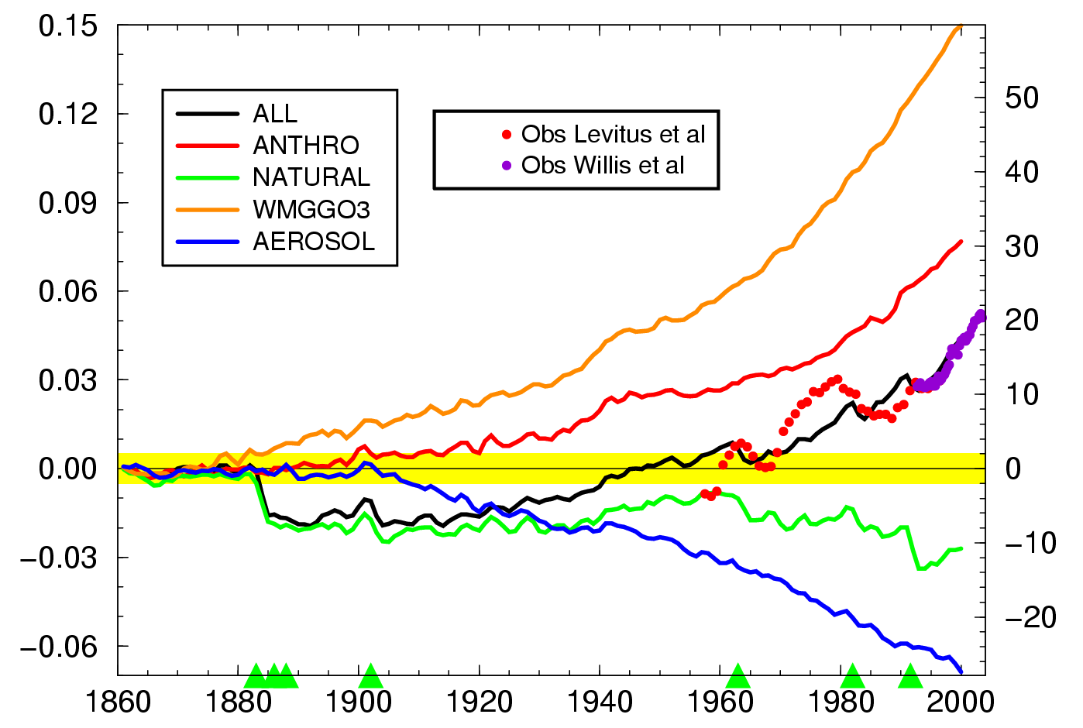


Global mean, volume mean ocean temperature
Courtesy of Tom Delworth (GFDL)
GFDL Model Simulations
Notes:
14

Slide 15
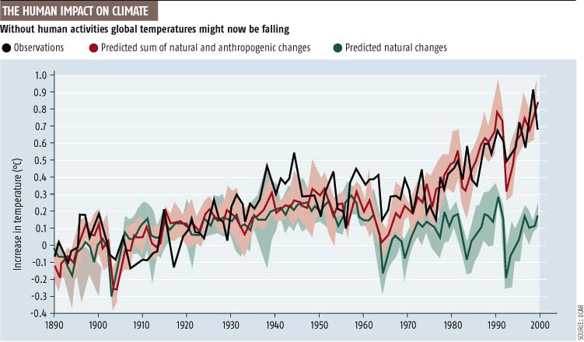

Natural Forcing cannot explain observations
Observations
Predictions with Anthropogenic/Natural forcings
Predictions with Natrual forcings
1.0º C
IPCC 2007
Center of Ocean-Land-Atmosphere studies

Slide 16
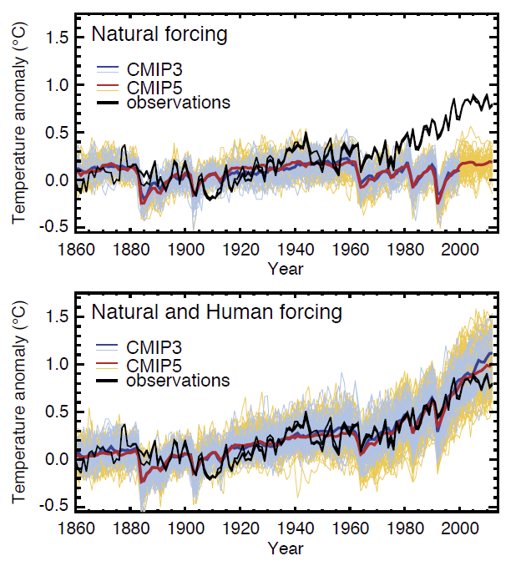
Natural Forcing cannot explain observations
IPCC 2013

Slide 17
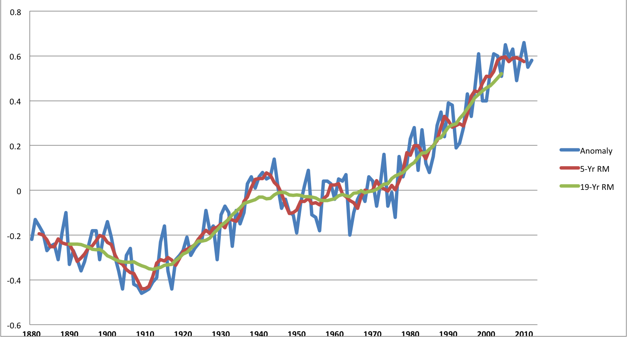
Global Warming Hiatus?
Global Land-Ocean Temperature (1880-2012)
Relative to
1951-1980 mean
(GISS, New York)
Notes:
Blue curve = 1880 – 2012 GISS estimate of global average surface air temperature with 1951-1980 mean removed
Red curve = 5-year running mean of Blue curve
Green curve = 19-year running mean of Blue curve

Slide 18
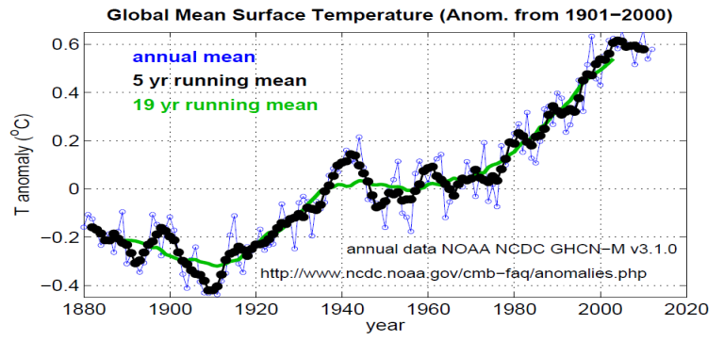
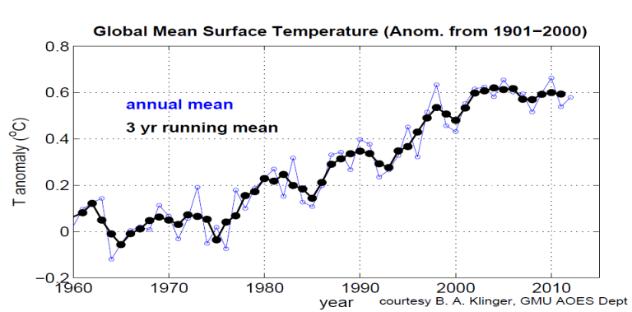
NOAA
(1880 – 2012)
NOAA
(1960 – 2012)

Slide 19
Possible Explanation of Hiatus in Warming
Increase in Aerosols: Anthropogenic (China, India) ,and small volcanoes
Enhanced heat uptake by the oceans
More La Nina (cooling) events than El Nino (warming) events
Decrease in stratospheric water vapor
Low Sun spot activity
Multi-decadal variability opposite to warming

Slide 20
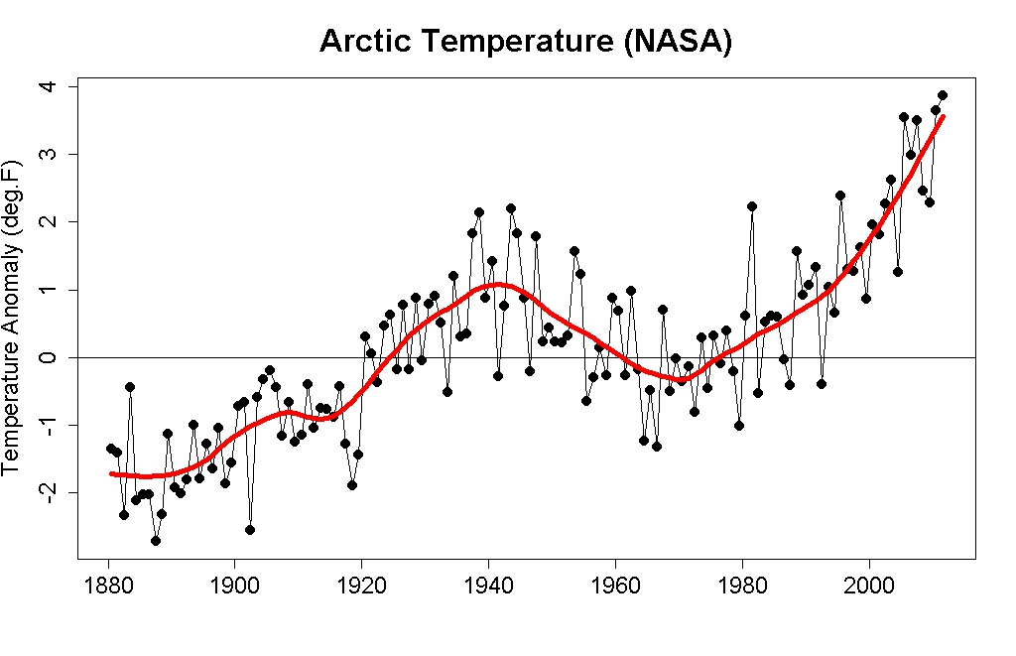
Arctic Temperature Anomaly
Global Temperature Anomaly

Slide 21
Outline
The role of human activities in the observed global warming during the past 50-100 years
The causes of hiatus in global warming during the past 15 years
Projections of future global warming

Slide 22
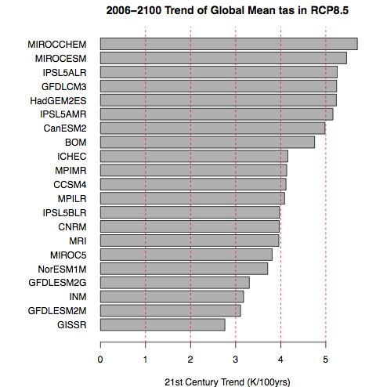
21st Century Trend (K/100yrs) for Global Mean 2m Temp (RCP8.5)

Slide 23
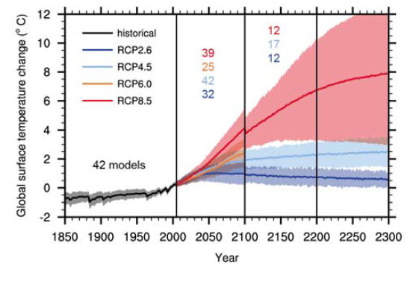
Change in Global Surface Temperature

Slide 24
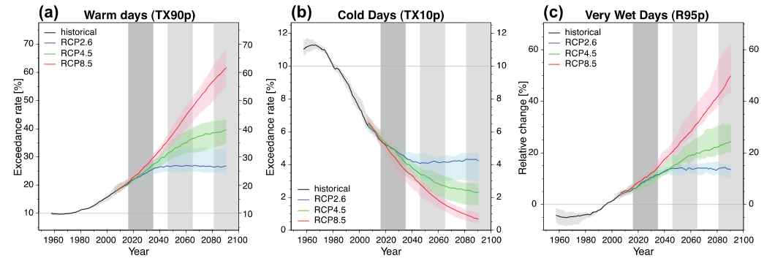
Changes in Warm Days, Cold Day and Very Wet Days

Slide 25
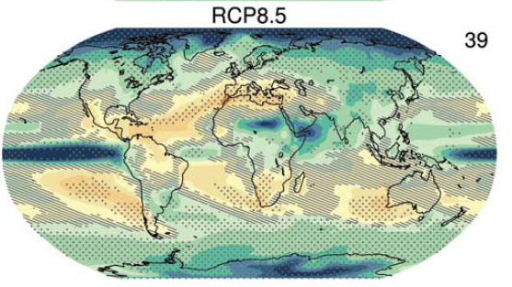

Annual mean precipitation change
(2081 to 2100 mean ) minus (1986 to 2005 mean)

Slide 26
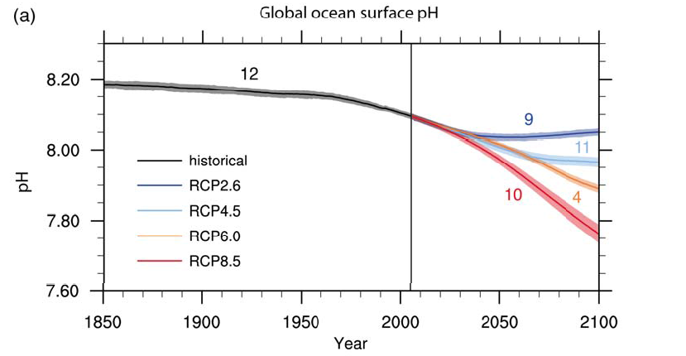
Global Ocean Surface pH

Slide 27
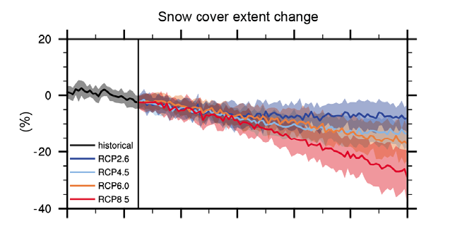

Change in Snow Cover Extent

Slide 28
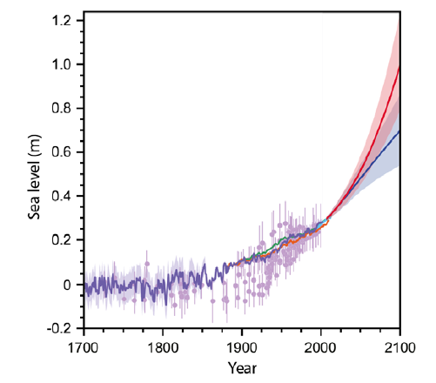
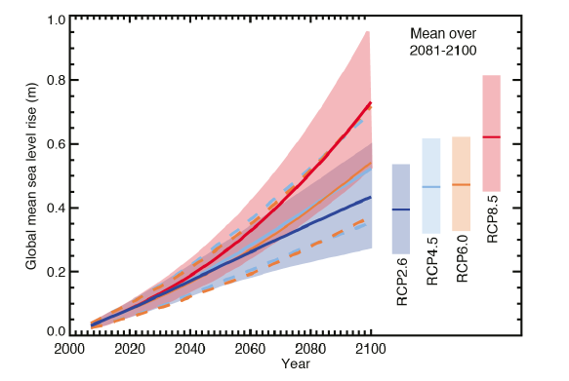
Change in Sea level
(0.8 mm/year; 1.9 mm/year; 3.2 mm/year)
1700 - 2100
2000 - 2100

Slide 29
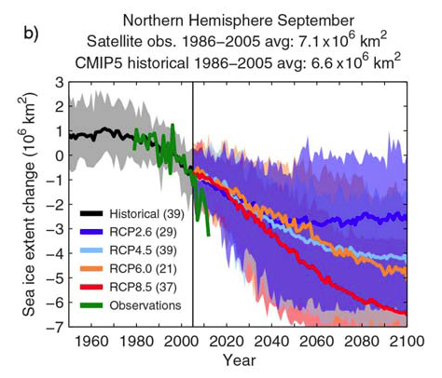
Change in Sea Ice Extend

Slide 30
Letter from More than 200 members of the U.S. National Academy of Sciences
There is compelling, comprehensive, and consistent objective evidence that humans are changing the climate in ways that threaten our societies and ecosystems on which we depend.
SCIENCE, 7 May 2010

Slide 31
IPCC AR5 Working Group I: Summary for Policy Makers
Headlines, 30 September 2013
Humans are Causing Climate Change
Global surface temperature change for the end of the 21st century is likely to exceed 2°C for RCP6.0 and RCP8.5.
Note:
  Eemian period: 114 - 130,000 years ago, ~ 2°C ; sea level 4 - 6 meters
  Pliocene period: 2.6 - 5.3 million years ago, 3-4 °C ; sea level 15 - 20 meters

Slide 32
IPCC AR5 Working Group I: Summary for Policy Makers
Headlines, 30 September 2013
Humans are Causing Climate Change
Human influence on the climate system is clear. This is evident from the increasing greenhouse gas concentrations in the atmosphere, positive radiative forcing, observed warming, and understanding of the climate system.
It is extremely likely (95%) that human influence has been the dominant cause of the observed warming since the mid-20th century.

Slide 33
THANK YOU!
ANY QUESTIONS?

