Slide 1
Is Rio’s Though Love Strategy Against Violence Working?
Mauricio Moura, December 2011

Slide 2
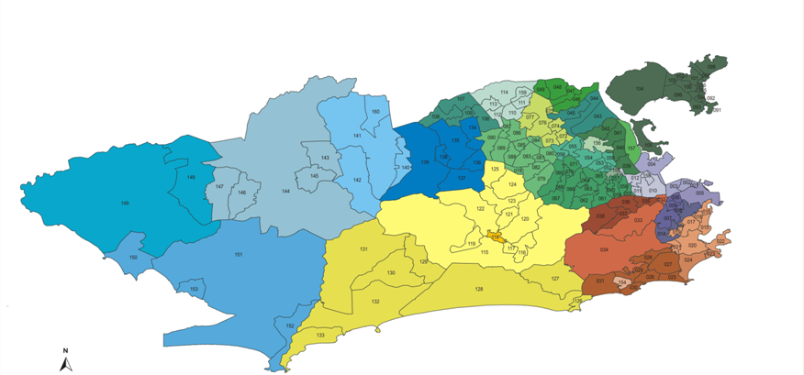
Rio de Janeiro
UPP locations
number of UPP police officers
Morro São João
200 jan/2011
6,000
Morro da Providência
179 feb/2011
7,000
number of residents
Morro do Macaco
215 nov/2010
27,000
UPP starting date
Morro do Batam
106 feb/2009
45,000
Morro São Carlos
241 may/2011
17,000
Morro do Andaraí
214 jul/2010
13,000
Morro dos Prazeres
206 feb/2011
13,000
Morro Turano
176 sep/2010 1815,000
Morro Coroa/Fallet
206 feb/2011
13,000
Cidade de Deus
344 feb/2009
45,000
Morro Babilônia / Chapéu Mangueira
96 jun/2009
10,000
Morro do Salgueiro
138 sep/2010
5,000
Morro do Borel
214 jul/2010
13,000
Morro Cantagalo / Pavão-Pavãozinho
176 dec/2009
13,000
Morro da Formiga
102 jul/2010
5,000
Morro Santa Marta
112 dec/2008
10,000
Morro Tabajaras / Cabritos
131 jan/2010
7,000
Source: Prefeitura Municipal e Secretaria de Segurança do Rio de Janeiro / Instituto Pereira Passos

Slide 3
The Sample:
Survey conducted: Aug 22nd – Sep 2nd
17 Communities: 3,816 interviews divided as follow:
(also data collected about 12,272 residents)
Morro do Andaraí:
200 interviews
Morro da Formiga:
200 interviews
Morro Santa Marta:
250 interviews
Morro do Batam:
250 interviews
Morro do Macaco:
251 interviews
Morro São Carlos:
264 interviews
Morro do Borel:
250 interviews
Morro Pavão-Pavãozinho / Cantagalo:
200 interviews
Morro São João:
200 interviews
Morro Chapéu-Mangueira/Babilônia:
200 interviews
Morro dos Prazeres/Escondidinho:
200 interviews
Morro Tabajaras/Cabrito:
201 interviews
Morro Cidade de Deus:
299 interviews
Morro da Providência:
201 interviews
Morro Turano:
200 interviews
Morro Coroa/Fallet – Fogueteiro:
200 interviews
Morro do Salgueiro:
250 interviews

Slide 4
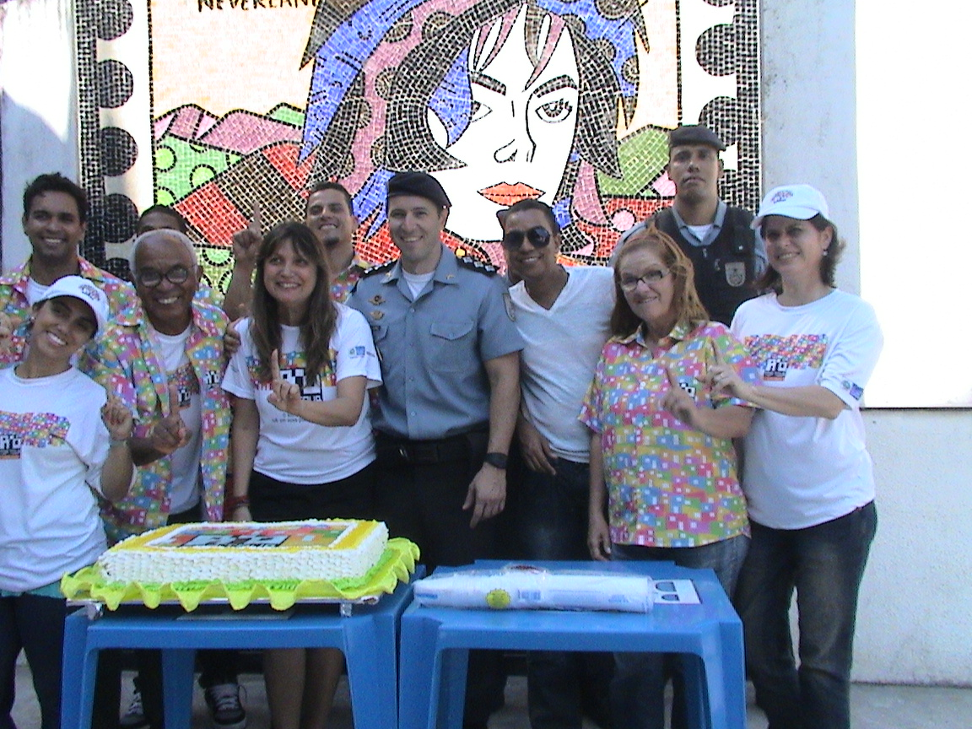
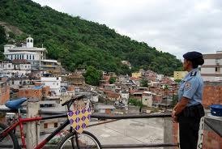
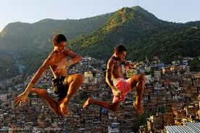
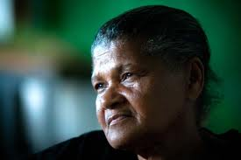
Does UPP make people
feel safer?

Slide 5
Key question:
Does UPP Make People Feel Safer?
In your opinion, regarding public security after UPP: Would you say that security in your community is...
TOTAL

Slide 6
But there are differences…
Why?
In your opinion, regarding public security after UPP: Would you say that security in your community is... (%)
DONA MARTA
CIDADE DE DEUS
CHAPÉU-MANGUEIRA BABILÔNIA
Better
Equal
Worst
BATAM
ANDARAÍ

Slide 7
Are There Enough Police Officers?
Do you consider that the number of UPP police officers in your community is...
Entirely appropriate
Appropriate
Inappropriate
Entirely inappropriate
Don’t know

Slide 8
Are the officers prepared?
73% x 7%
Do you consider that UPP police officers are…
Well prepared
Fairly prepared
Unprepared
Very unprepared
Don’t know

Slide 9
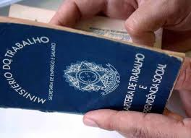
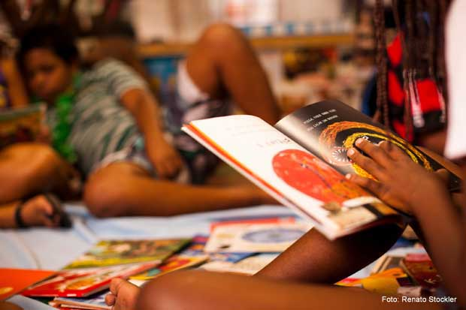
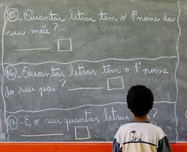
Employment & Education
Many Challenges Ahead…

Slide 10
Poverty rate
Number of households that live with less than the minimum wage monthly
Total households
Exchange rate
(dec/2011)
R$ 1.80 = US$ 1.00
Minimum wage R$ 545 = US$ 303

Slide 11
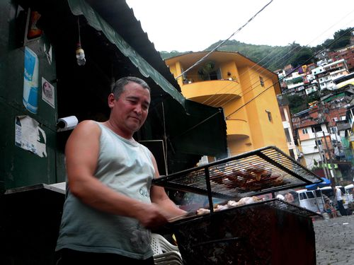
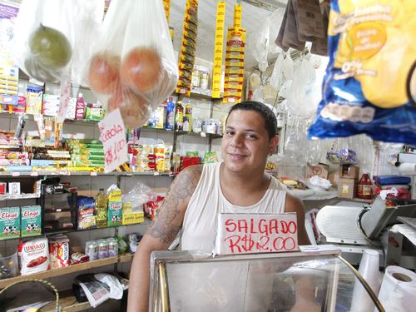
Employment rate
(occupied people/active economic population)
Source: IBGE
“Emprego é mais fácil na Zona Sul”, O Globo, 12/04/11.

Slide 12
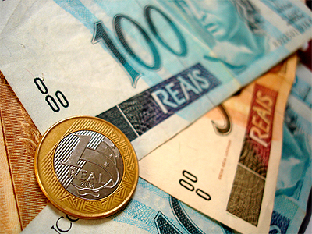
Monthly Average Income (BRL)
Individual
Source: IBGE
Exchange rate
(dec/2011)
R$ 1.80 = US$ 1.00
e.g. R$ 1,612.98 = US$ 896.10

Slide 13
Family Head
Unemployment Rate
(unemployed family head/unemployed total)

Slide 14
Family Head
Level of Illiteracy
In a country where 9,7% of its population is illiterate
(IBGE, Censo 2010)

Slide 15
Unemployment x Illiteracy: Location Puzzle

Slide 16
Do you receive or participate in any public social program? (%)

Slide 17
Bolsa Família Recipients (%)
Income Transfer From Federal Government
Average

Slide 18
Are the UPP residents interested in taking professional capacity training?
Average
Interested
Not interested

Slide 19
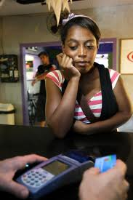
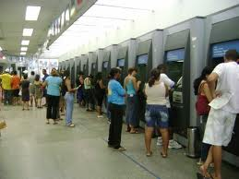
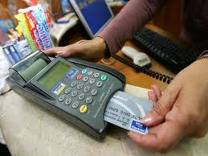
Access to Financial Services

Slide 20
Have you tried to purchase something through any source of credit?
Chosen Payment Form
53% of Brazil’s population have credit card
Source: FEBRABAN & ABECS (2011)

Slide 21
Have you tried to purchase something through any source of credit?
Yes, credit not approved
Yes
No

Slide 22
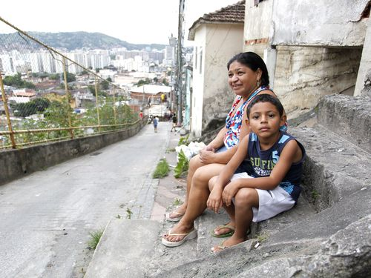
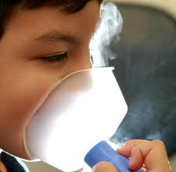
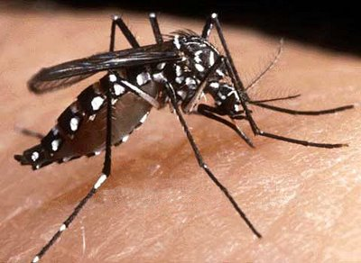
Living Conditions & Health
“Livres do tráfico armado, mais ainda com problemas de saúde”, O Globo, 12/04/11.

Slide 23
Small Properties, Big Problems…
What’s the size of your property?
Less than 20m²
Between 20m² ⁻ 40m²
Between than 40m² ⁻ 60m²
Greater than 60m²
Don’t know

Slide 24
Living Conditions and Health
Have you had any of those diseases …?
YES
14,7%
By Age
By Gender
Female: 52%
Male: 48%
NO
85,3%
By Disease
0-5 : 14%
6-15: 20%
16-24: 13%
25-39: 19%
40-59: 23%
+ 60: 11%
Dengue (during the last 12 months): 17%
Diarrhea (during the last 15 days): 28%
Respiratory Diseases(during the last 12 month): 55%

Slide 25
Common Diseases

Slide 26
What do UPP residents consider the main problems ?
Lack of public lighting
Lack of social programs
Lack of physicians and medicines in hospital
Lack of nearby hospital s
Lack of water treatment and sanitation

Slide 27
Thank you!
mjmoura@gwmail.gwu.edu

