Slide 1

Consumer Perspective on TAFTA Agenda
Lori Wallach Public Citizen’s Global Trade Watch
Washington, D.C. March 2014

Slide 2
Is Agenda of “Transatlantic Trade and Investment Partnership” Same Old TAFTA?
Many EU consumer, enviro, labor standards better than in U.S. Opportunity for new 21st Century commercial agt. model aimed at raising standards. Huge amount of trade. investment between U.S.- EU. So, rules for this relationship have enormous impact in U.S. and EU – and globally. Indeed, U.S. and EU officials say a goal is to set new global norms.
But 2/11/13 Final Report of the U.S.-EU High Level Working Group on Jobs and Growth announcing decision to launch reveals agenda similar to past U.S. FTAs, old TABD TAFTA agenda plus additional limits on domestic regulatory space.
TAFTA has been longstanding project of Trans-Atlantic Business Dialogue (TABD) now known as Transatlantic Business Council (TBC). TABD convened in 1995 by U.S. Dept. of Commerce & Euro Commission as official dialogue between U.S.-EU business leaders & U.S. cabinet secs & EU commissioners
TABD goal: elimination of “trade irritants” & “regulatory convergence”
Some TBC members: Accenture, AIG, AT&T, Audi AG, BASF, BDO, British American Tobacco, British Petroleum, BT, Cisco Systems, Deloitte, Deutsche Bank, Ernst & Young, Experian, Ford Motor Co., GE, Grant Thornton, IBM, Intel,, Johnson Controls, Johnson & Johnson, KPMG, Lilly, Merck & Co., Microsoft, Oracle, Pfizer, Philips Electronics, Phillip Morris Intl., Qualcomm, SAP, Siemens, Statoil, Texas Instruments, Thyssen Krupp, TOTAL, Verisign, Verizon, Xerox
Consumer groups question notion of homogenized standards given variances reflect different goals/values & democratic governance. But if so, floor, not ceiling (TACD)

Slide 3
Target of TAFTA Negotiations Appears to Be Best of U.S. or EU Environmental, Consumer Safeguards
U.S.-EU tariffs rates already low, so negotiation will focus on "regulatory issues and non-tariff trade barriers".
How is this agenda in consumers’ interest?
Elimination of “Trade Irritants” and “Legacy Issues” aka domestic policies that affect U.S. or EU business access to the other market.
Elements of U.S. financial reregulation, such as Volcker Rule
U.S. system of state-by-state insurance regulation
Food: EU bans on ractopamine and chlorine rinses; EU GMO labeling/segregation; EU ban on artificial beef growth hormone
EU chemical policy REACH
Aspects of EU climate directive
EU consumer privacy protections, “safe harbors” policy
“Legacy issue” Trade irritants that have not been settled, see above…
“Mutual Recognition” Accepting goods, services meeting others’ laws, not yours.
“Behind the border”- raises questions of democracy, accountability. Non-tariff policies traditionally under jurisdiction of national, state legislatures & regulators
“Regulatory convergence” At what level? Room for progress, addressing new challenges? Obviously, it’s not all the “silly differences” examples being touted

Slide 4

“Transatlantic Trade and Investment Partnership”
Not mainly about “trade” but a system of enforceable global governance promoted by large corporations and not subject to changes by those who will live with results.
Starkly different from past of int’l trade between nations that focused on tariff cutting, lifting quotas. Rather, “trade” agreement as mechanisms of “diplomatic legislating of domestic non-trade policies. Behind-the-border policies decided by trade negotiators advised by 600 official U.S. corporate “trade advisors.”
“Each Member shall ensure the conformity of its laws,
regulations and administrative procedures with its
obligations as provided in the annexed Agreements.” - Agreement Establishing the WTO
Permanence : no changes w/o consensus of all signatory nations. Limits room for progress, responses to emerging problems
Binding - unlike most labor, health, environmental treaties. Rules enforced in extra-judicial tribunals. Enforcement outside domestic court systems of matters relating directly to policies now subject to inclusive, open policymaking and adjudication.
Government-government enforcement: countries must gut their laws. Trade sanctions imposed.
Investor-state enforcement: taxpayers must compensate foreign corporations. No due process. No outside appeals.

Slide 5
TAFTA Code Word Key
“Trade Irritant” see also “non-tariff barrier”
Domestic regulatory policies that limit U.S. and EU businesses access to the other market. Some examples that will be discussed in TAFTA:
Elements of U.S. financial reregulation, such as Volcker Rule
U.S. system of state-by-state insurance regulation
Food: EU bans on ractopamine and chlorine rinses; EU GMO labeling/segregation; EU ban on artificial beef growth hormone
EU chemical policy REACH
Aspects of EU climate directive
EU consumer privacy safe harbors policy
“Legacy issue”
Trade irritants that have not been settled, see above…
“Behind the border”
Non-tariff policies that have traditionally been under the jurisdiction of nation, state legislatures and regulatory bodies - raises questions of democracy, accountability.
“Regulatory convergence”
Standardizing regulatory policies and standard-setting procedures. At what level? Room for progress, addressing new challenges? Obviously, it’s not all the “silly differences” examples being touted

Slide 6
Instruments of Regulatory Roll Back
COULD BE FOUND IN MANY OF THE CHAPTERS…
Obligations to eliminate regulatory differences:
Harmonize to a common standard/ accept int’l standards
Determine other counters’ regulatory systems as equivalent
Agree on mutual recognition (often of conformity assessment)
“Free passage” or “Exception” (approved anywhere must accept everywhere)
“Regulatory Convergence” which is code for governments using similar cost-benefit analyses of proposed regulations, conducting regular review of existing regulations. Plus Reg Convergence chapter
Notification must list non-conforming policies, advance notice to partner-govt trade agencies of prospective regs or policies or changes with right to comment. Domestically, this obligation gets written into law as a requirement to make a policy the “least trade restrictive” or to take into consideration trade compliance

Slide 7
Obligations to eliminate regulatory differences
Harmonization
Committees set up in agreement to negotiate common uniform standards that will be adopted by the countries domestically. Committee are comprised of government agency officials meeting behind closed doors. In NAFTA and WTO, most stages in this process have not been done according to APA. Alternatively, countries can agree to accept an existing int’l standard and adopt in domestically.
Equivalence
Governments are required to determine whether significantly different—and possibly less protective—regulatory systems and standards in other countries provide “equivalent” levels of protection as domestic regulatory systems. Domestic law stays the same, but imports are allowed if they meat the exporting country’s standards. Whole regulatory system is deemed equivalent, so we rely on other country’s enforcement.
Mutual Recognition (often of conformity assessment)
Agreement to allow other countries’ agencies, or private sector firms under contract determine if products meet the others’ standards.

Slide 8
International Standard-Setting Bodies
International standards developed in industry-only standard-setting institutions that are closed to government or public participation or outside scrutiny or input have the same status as standards developed by wholly governmental institutions or quasi-governmental standard-setting institutions.
Two such standard-setting institutions identified in WTO, NAFTA are the Codex Alimentarius in Rome and the ISO in Geneva.
Scores of other such bodies – see HARMONIZATION HANDBOOK
Accountable Governance in the Era of Globalization: the WTO,
NAFTA, and International Harmonization of Standards
http://www.citizen.org/documents/BCKGRNDforpdf.PDF
My personal “favorite” CHIC, which is the cosmetic industry group called Cosmetics Harmonization & International Cooperation

Slide 9
Inclusion of “Investor-State Dispute Resolution” Reiterates Pact’s Agenda is New Corporate Rights
ISDR ostensibly established to provide foreign investors venue to obtain compensation when factory/ land expropriated by a gov’t without reliable domestic court system. So, why is it in US-EU FTA? Is it US or EU property rights policies or domestic court systems that are a problem?
Individual foreign corporations elevated to level of sovereign government: empowered to skirt domestic laws/courts and privately enforce the terms of a public treaty by directly challenging gov’ts’ policies before foreign tribunals to demand taxpayer compensation.
Foreign investors given greater rights, privileges above domestic law /firms. Compensation for regulatory costs/policy changes (Vattenfall, Phillip Morris, Eli Lilly, Exxon, etc.)
US and EU countries submitted to jurisdiction of investment arbitration tribunals operating under rules of World Bank’s ICSID (Int’l Centre for Settlement of Investment Disputes) and or UN’s UNCITRAL (UN Commission on Int’l Trade Law) for investor-state enforcement.
3 private sector attorneys, unaccountable to any electorate, many of whom rotate between being “judges” & bringing cases for corps. against govts. (See Profiting from Injustice http://corporateeurope.org/publications/profiting-from-injustice) Creates inherent conflicts of interest.
Unlike domestic judges, tribunalists paid by hour . Govt’s usually ordered by tribunal to pay for share of tribunal costs, even if case dismissed. Costs chill govt action. Filing alone is serious threat: Average cost is $8M, 1 case now underway legal costs to govt $50M-plus
When investor wins, gov’t must pay amount of taxpayer money decided by the tribunal as compensation for the offending policy. ISDR challenges launched against wide array of consumer, health and safety policies, environmental and land-use laws, regulatory permits, financial regs & other public interest polices that investors allege undermine “expected future profits.”

Slide 10
Investor-State Dispute Resolution (ISDR) Tribunals–part 2
Tribunals operate behind closed doors - lack basic due process
Absolute tribunal discretion to set damages, compound interest, allocate costs
No limit to amount of money tribunals can order govts to pay corps/investors
Compound interest starting date if violation new norm ( compound interest ordered by tribunal doubles Occidental v. Ecuador $1.7B award to $3B plus
Rulings not bound by precedent. No outside appeal. Annulment for limited errors.
The number of ISDR cases has soared over last decade. Last year cumulative number of launched investor-state cases was nine times cumulative investor-state caseload in 2000, even though treaties with investor-state provisions have existed since the 1950s.
ISDR has birthed an entire industry of specialized lawyers and tribunalists (many serving both roles) and specialized equity funds that finance what is lucrative business of raiding government treasuries.
Nationality-shopping: Philip Morris International plain packaging cases eg.
PMI moved head office of Oz subsidiary to Hong Kong shortly before it ISDR attacked Oz under HK-Oz Bilateral Investment Treaty (BIT); Claimed to be Swiss-based firm to launch ISDR attack against Uruguay under Uruguay-Swiss BIT; Described itself as a US firm in 2010 USTR submission pro-ISDR in the TPP.
Under U.S. FTAs/BITs, investors have already pocketed over $3B in taxpayer money via ISDR cases, while more than $15B remains in pending claims. More info: “Table of Foreign Investor-State Cases and Claims under NAFTA and Other U.S. Trade Deals,” Public Citizen memo, June 2012. Available at: http://www.citizen.org/documents/investor-state-chart.pdf

Slide 11
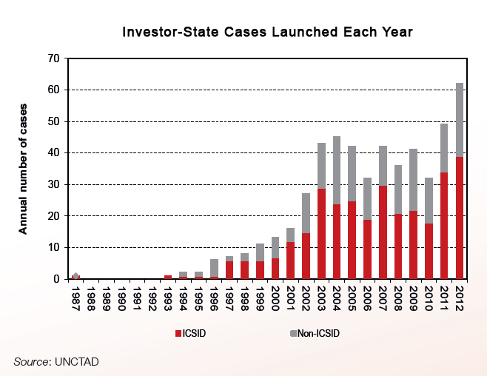
Epidemic of ISDR Attacks Raiding our Treasuries, Chilling Public Interest Initiatives
ISDR in TAFTA would mean 1000s of additional cross-registered corporations empowered to attack U.S. and EU laws and government actions deemed permissible in domestic courts.
.
Notes:
Needs a new title

Slide 12
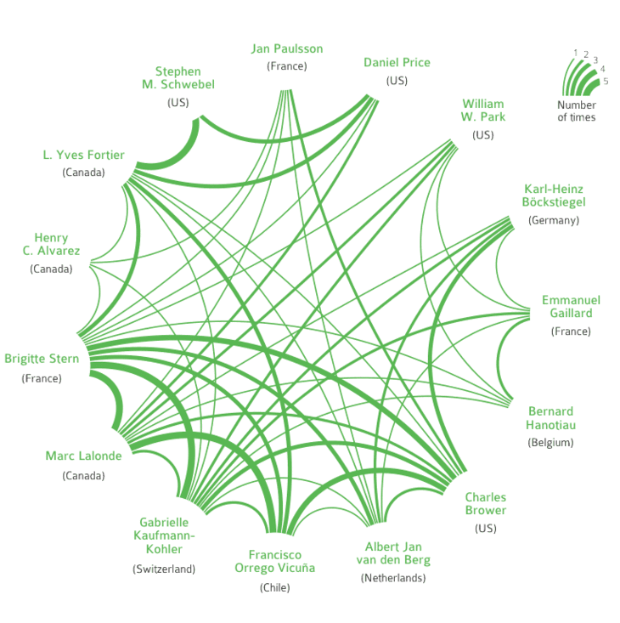
15 arbitrators alone have captured the decision-making in 55% of the total investor-state cases known today
Source: Profiting from Injustice http://corporateeurope.org/publications/profiting-from-injustice

Slide 13
New Risks for U.S. if ISDR in TAFTA: Unlike Most Past U.S. FTAs, Many Capital Exporting Nations
Already, there is expansive cross investment between the U.S. and the EU. More than 75,000 corporate affiliates are cross-established.
There are 24,249 corporate affiliates from EU countries that would obtain new rights to use ISDR against the U.S. Except for firms covered by some U.S. BITS with former Warsaw pact nations, none now have ISDR rights against U.S.
ISDR for TAFTA? Is it the US or EU Property Rights Policies or Domestic Court Systems that are the Problem…
Details, mapping of all firms at: http://www.citizen.org/TAFTA-investment-map
Number of U.S. Corporations in EU Countries & EU Nation Corps in U.S.
Austria | 67
Belgium | 1,533
Bulgaria | 241
Croatia | 181
Cyprus | 115
Czech Republic | 879
Denmark | 900
Estonia | 130
Finland | 747
France | 6,580
Germany | 6,526
Greece | 698
Hungary | 569
Italy | 3,734
Latvia | 121
Lithuania | 139
Luxembourg | 203
Malta | 57
Netherlands | 2,445
Poland | 1,386
Portugal | 772
Romania | 499
Slovakia | 300
Slovenia | 140
Spain | 3,357
Sweden | 1,976
United Kingdom | 13,413
United States | 24,249
Source: Uniworld’s foreign firms database

Slide 14
INVESTOR STATE – SOME CASES
Attack on Australian, Uruguayan Cigarette Health Laws by Phillip Morris
Attack on Canadian medicine patent policy by Eli Lilly
Attack on Canadian Fracking Ban
Lone Star v. Canada – NAFTA case filed in 2012
Attack on El Salvadoran Water, Mining Policies
Pac Rim v. El Salvador: mining- years of ISDR in very politicized case stall out passage of ban on mineral mining; tribunal voids CAFTA claim, still order govt to pay costs, continues claims based on domestic law
Attack on Reversal of Disastrous Water Privatizations
Vivendi v. Argentina; Bechtel and Suez Lyonnaise v. Bolivia etc
Attack on Financial Measures Taken During Crisis
Several Argentina cases
Attack by Chevron on Ecuador to halt court-ordered payment in Amazon pollution case

Slide 15
Some NAFTA, CAFTA Consumer, Environmental Cases
INVESTOR WINS AT TRIBUNAL, IS PAID
Exxon-Mobil/ Murphy Oil v. Canada: non-discriminatory provincial extractive industry R&D fee = performance requirement
Metalclad v. Mexico: toxic waste treatment facility, state-level zoning, permits = regulatory takings violation
S.D. Myers v, Canada: MEA enforcement. Federal-level Basel Convention enforcement/PCB toxic trade ban = discrimination, MST violation
Pope & Talbot v. Canada: timber policy – grumpy provincial gov’t official = MST violation
INVESTOR PAID IN SETTLEMENT - CHILLING
Ethyl v. Canada: Canada reverses nation-wide chemical ban, corp. paid $13 M for lost profits while ban was in effect – US states ban same chemical, MMT a gasoline additive
Abitibi-Bowater v. Canada: Water and timber rights. Firm closes, lays off employees. Canadian province withdraws timber, water concessions that were conditioned on continued operation/use. National government settles case – corp. paid $122 million
USE OF ISDR FOR LOBBYING, THREAT TO OBTAIN REGULATORY ACTION, INACTION
Renco v. Peru: REOPENING POLLUTING SMELTER - filing used to leverage new permit grant
Pac Rim v. El Salvador: MINING - years of ISDR in very politicized case stall out passage of ban on mineral mining; tribunal voids CAFTA claim, continues same claims based on domestic law
Commerce Group v. El Salv. MINING - years of ISDR stall out passage of ban on mineral mining; tribunal voids CAFTA claim, corp. allowed to file annulment year after deadline ran out
Also, Chevron Ecuador Amazon contamination case under Bilateral Investment Treaty…
U.S. LOSES ON MERITS, DODGES PAYMENT
Loewen v. U.S.: U.S. civil court judgment considered covered gov’t action in contract fight of 2 private firms. Canadian firm reorganized as US corp., loses foreign status b4 collecting

Slide 16
He who writes the rules, rules…
Secretive process, with those who will live with the results denied access to draft agreement texts.
U.S. trade advisory system empowers 600 corporate advisors to set U.S. agenda, have access to negotiating texts, negotiators.
Negotiations conducted by USTR, which sees it “constituency” as U.S. industry seeking access, rights in other countries.
“Fast Track” negotiation & approval system delegates away Congress’ constitutional authority over trade policy. Established in 1970s when agreements were mainly about traditional trade matters. Alarming mismatch between current scope and process
Current focus of TAFTA project is on facilitating U.S and EU corporate demands, not on meeting human needs for strong food or product safety or environmental protections; access to essential services and medicines; financial stability; privacy; Internet freedom. Indeed, some rules explicitly constrain governments’ policy space to meet such goals.
Sales pitch is that behind-the-border deregulation/regulatory “convergence” creates gains premised on ‘efficiencies” obtained from eliminating regulatory differences. If this is premise for why this is a good deal for us, needs to be proved that elimination of regulatory difference equals efficiency gains shared widely versus only bottom-line enhancing…

Slide 17
What is evidence for claimed “efficiency” gains?
PREMISE - REGULATORY CONVERGENCE = EFFICIENCY GAIN. Based on unproved anti-regulatory notion of economic gains from deregulation.
USTR TAFTA assessment: USITC should assume removal of all NTBs - silly
ECORYS Nederland BV study for EC, basis for jobs numbers seen, for instance, in yesterday’s New York Times: “…Unlikely that all areas of regulatory divergence identified can actually be addressed…would require constitutional changes… lack of sufficient economic benefit to support the effort; set of regulations is too broad… consumer preferences, language and geography… Political sensitivities.” …at most, 50% of all NTMs are within the realm of possibility to be “aligned or even dismantled,” while acknowledging that it would be more “realistic” to expect 25 percent of NTMs to be eliminated or “converged” under a U.S.-EU deal.
No consideration of downside costs on consumers, workers, environment. No risk-adjusted estimates of economic costs alongside estimated gains. Ie. not net impact.
Uses gravity regressions, computable general equilibrium model to project relatively small economic gains from convergence/elimination of NTMs. Approach riddled w/ assumptions that could totally skew results (UNCTAD study “Non-Tariff Barriers in Computable General Equilibrium Modeling.” Change in assumptions not only changed magnitude of effects, but changed direction of effects–from positive to negative.)
Empirical evidence on the efficiency impacts of NTM convergence/ removal? Some studies indicate regulatory convergence w/in EU has yielded little or no significant efficiency gains (eg. Barbara Casu, Philip Molyneux, “A Comparative Study of Efficiency in European Banking,” Applied Economics 11/03. www. wharton.upenn.edu/fic/papers/00/0017.pdf
So, why now? Premise that EU is so desperate for “growth” that critical regulatory policies will be traded away for “growth” ? But what real gains?

