Slide 1
Urban Space, Visual Iconography and the Moscow Metro
James T. Andrews
Professor of Modern Russian History
Iowa State University

Slide 2
Moscow May 1, 1932-Plan of Metro Displayed at Okhotnyi Riad

Slide 3
Stalin, Molotov/Dom Soiuzov 14 May 1935 Celebrating Opening of Metro

Slide 4
Kirovskaia Station Outer Pavilion 1935

Slide 5
Lenin Library and Metro Station Opened May 1935

Slide 6
November 1935 Metrostroi Workers Celebrating 1917

Slide 7
Metro Station Kurskii Vokzal November 1937

Slide 8
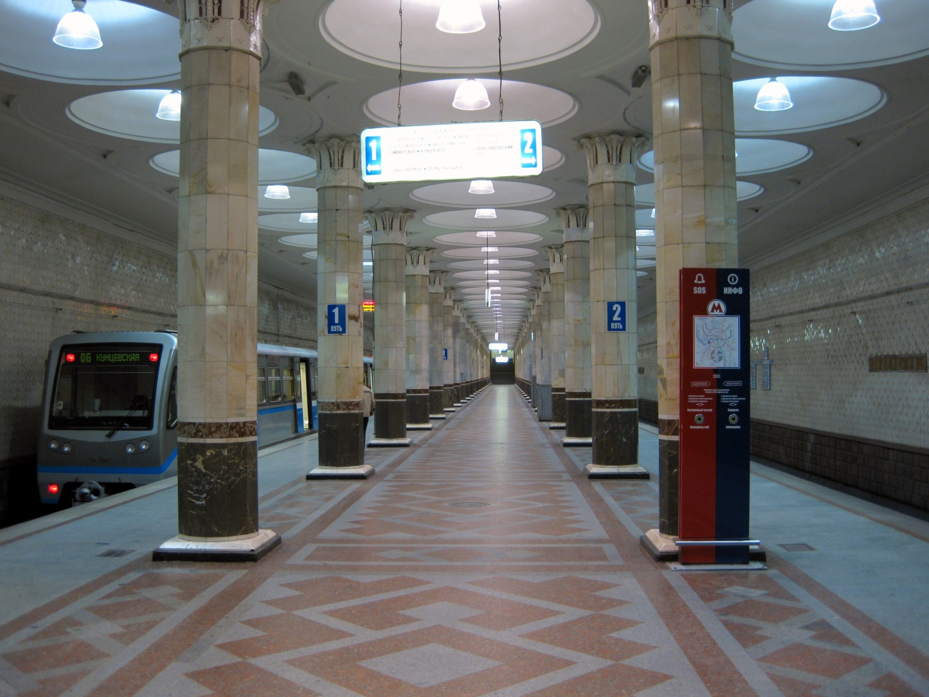
Kievskaia Metro Station Architect Chechulin, 1938

Slide 9
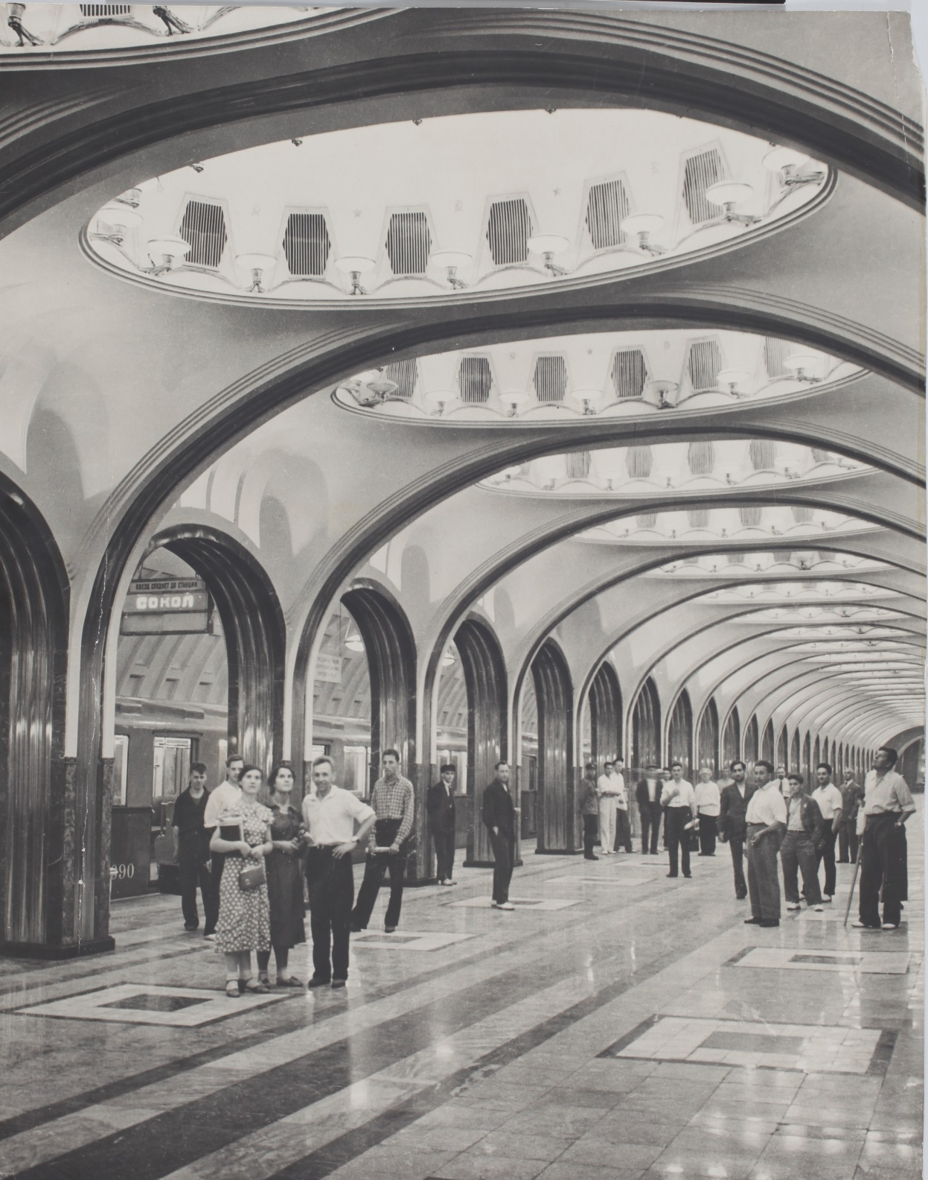
Station Mayakovskaia September 1938 Architect A. Dushkin

Slide 10
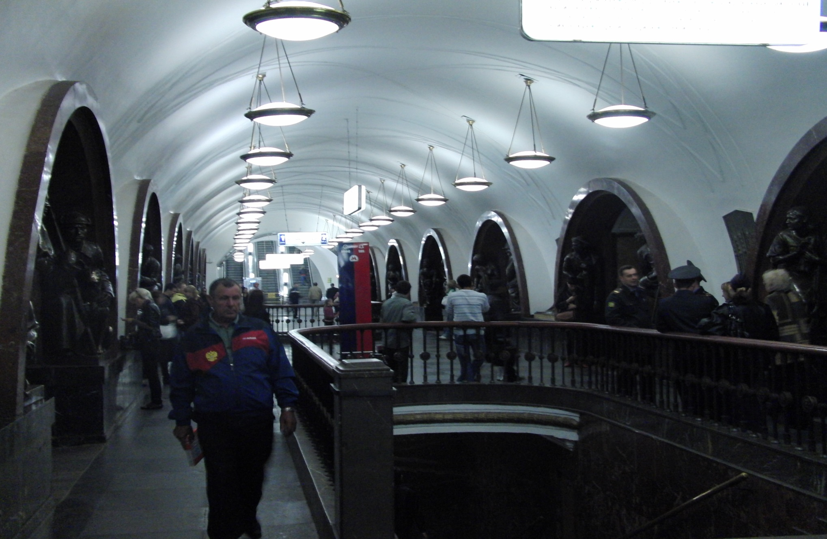
Revolutionary Square Metro A. Dushkin, Architect, 1938

Slide 11
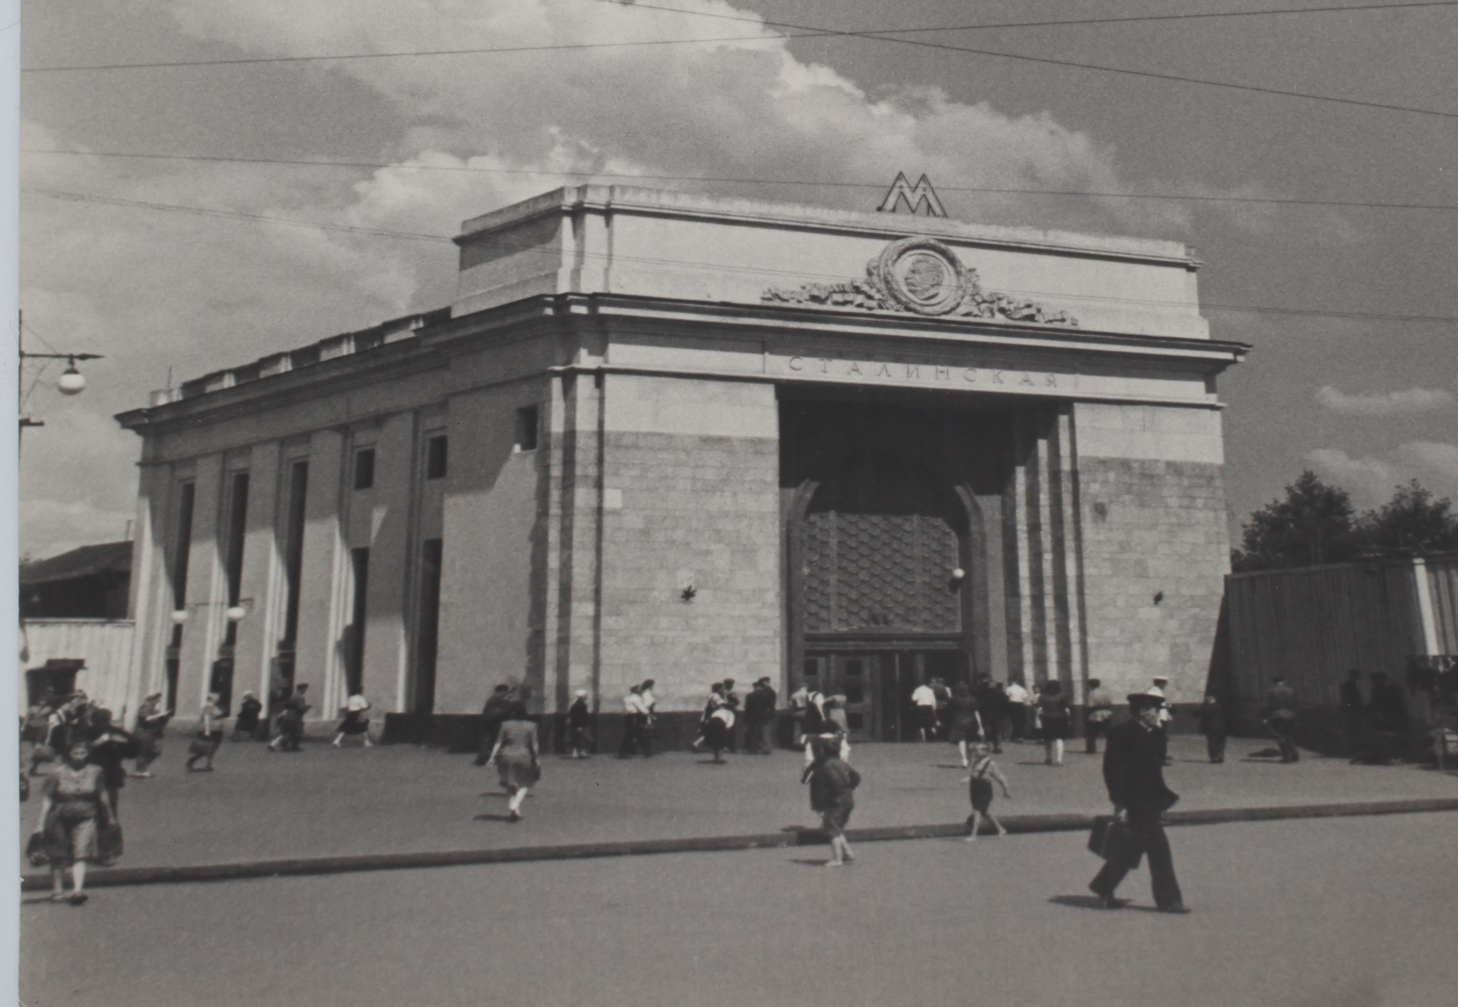
Stalinskaia Station – Opened 1944 After 1961 - Semenovskaia

Slide 12
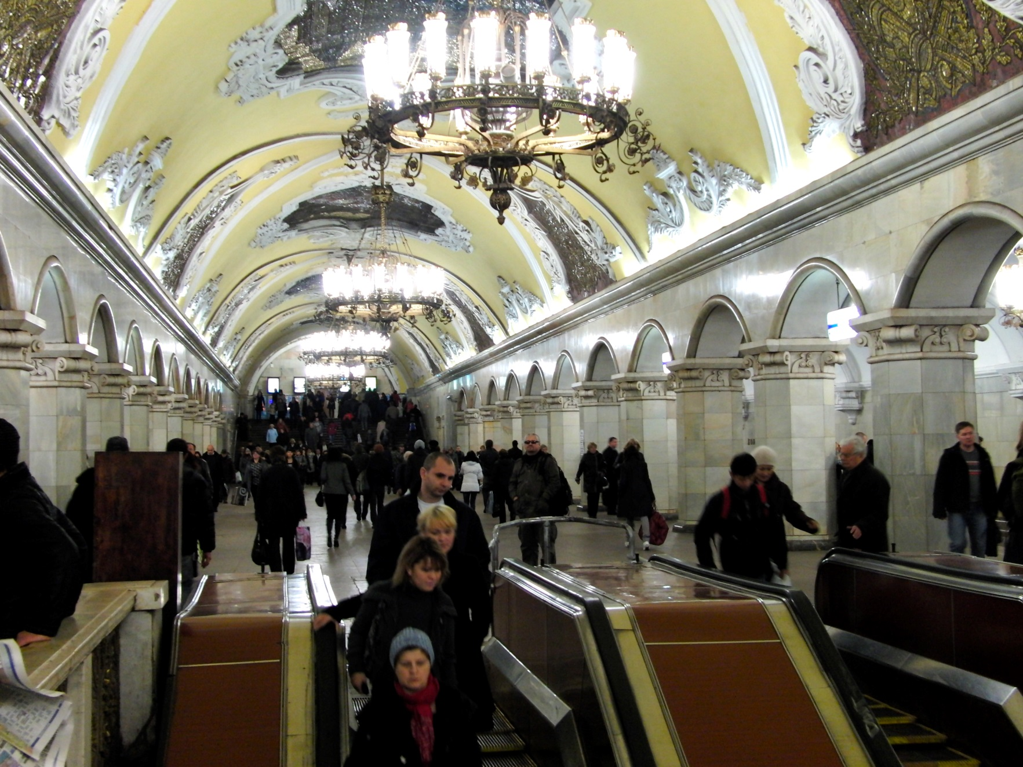
Komsomolskaia Station, 1952 Architect, A. Shchushev

Slide 13
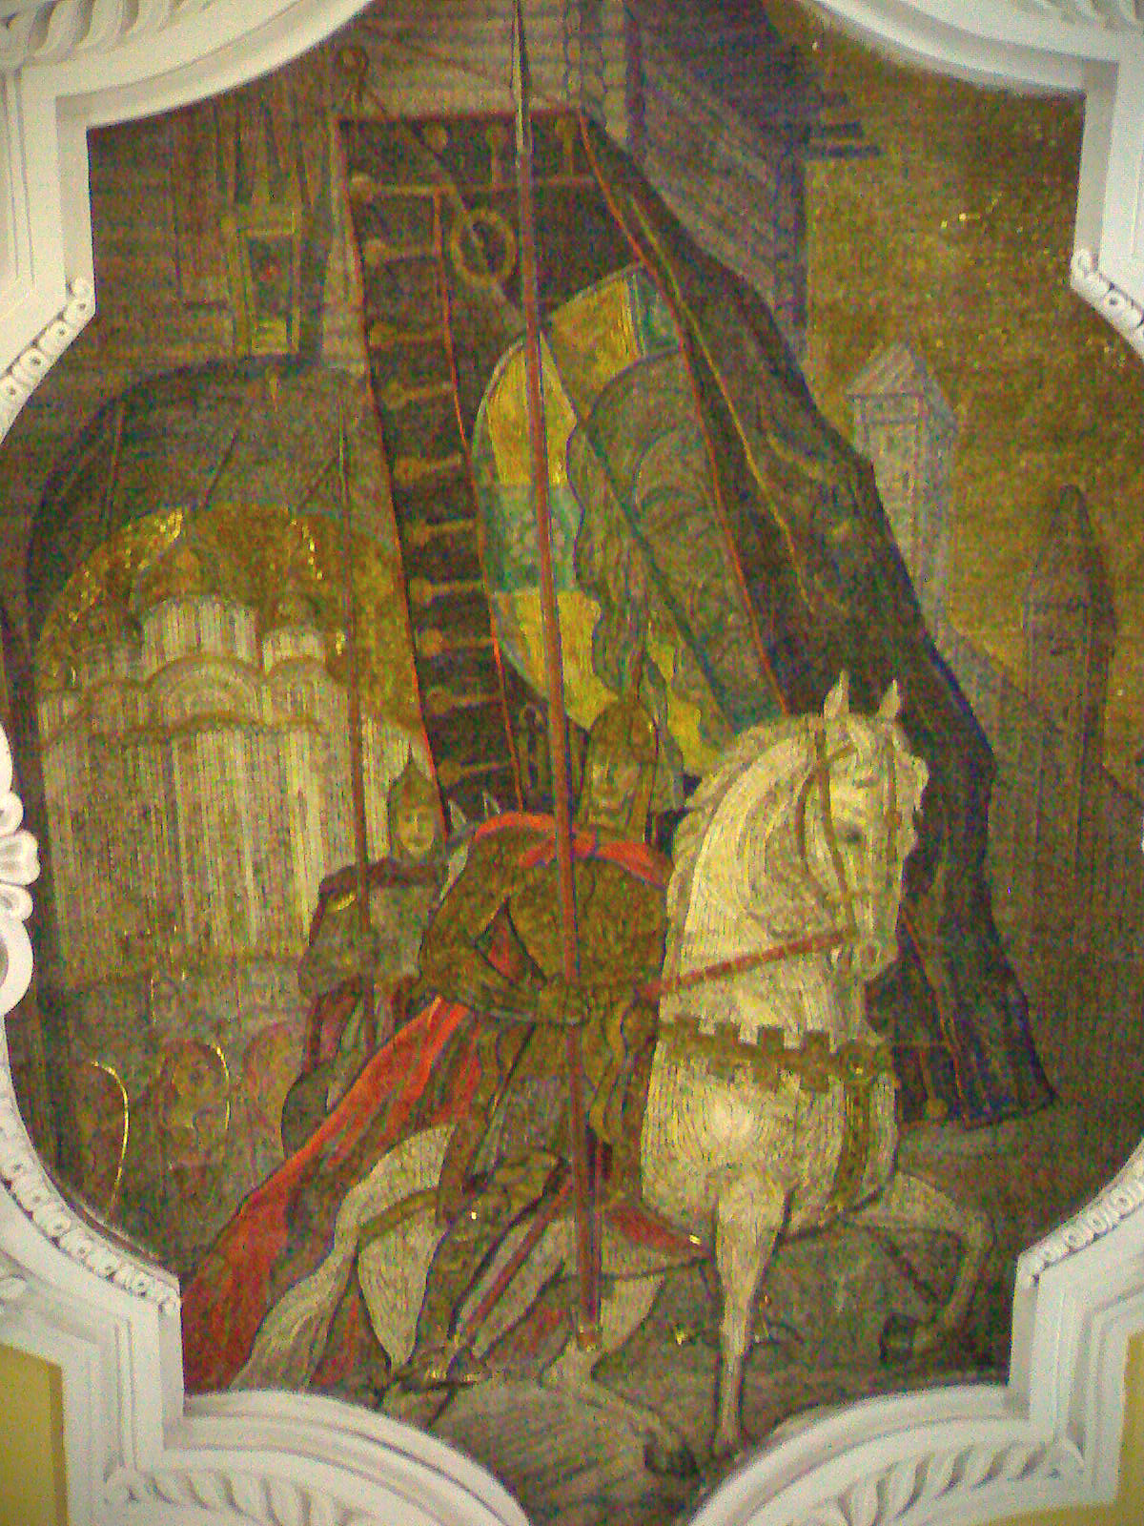
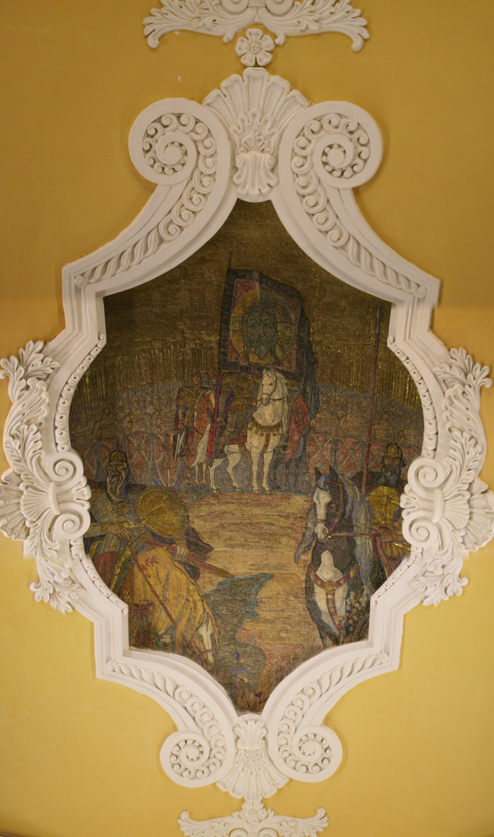

Slide 14
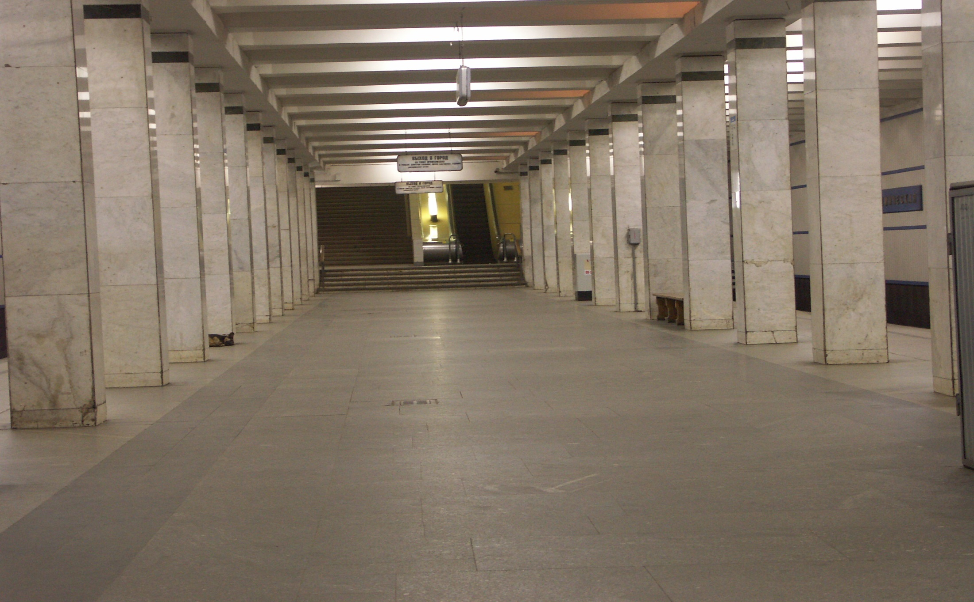
Akademicheskaya, Oct. 1962 Yuliya Kolesnikova-Sorokonozhka Style

Slide 15
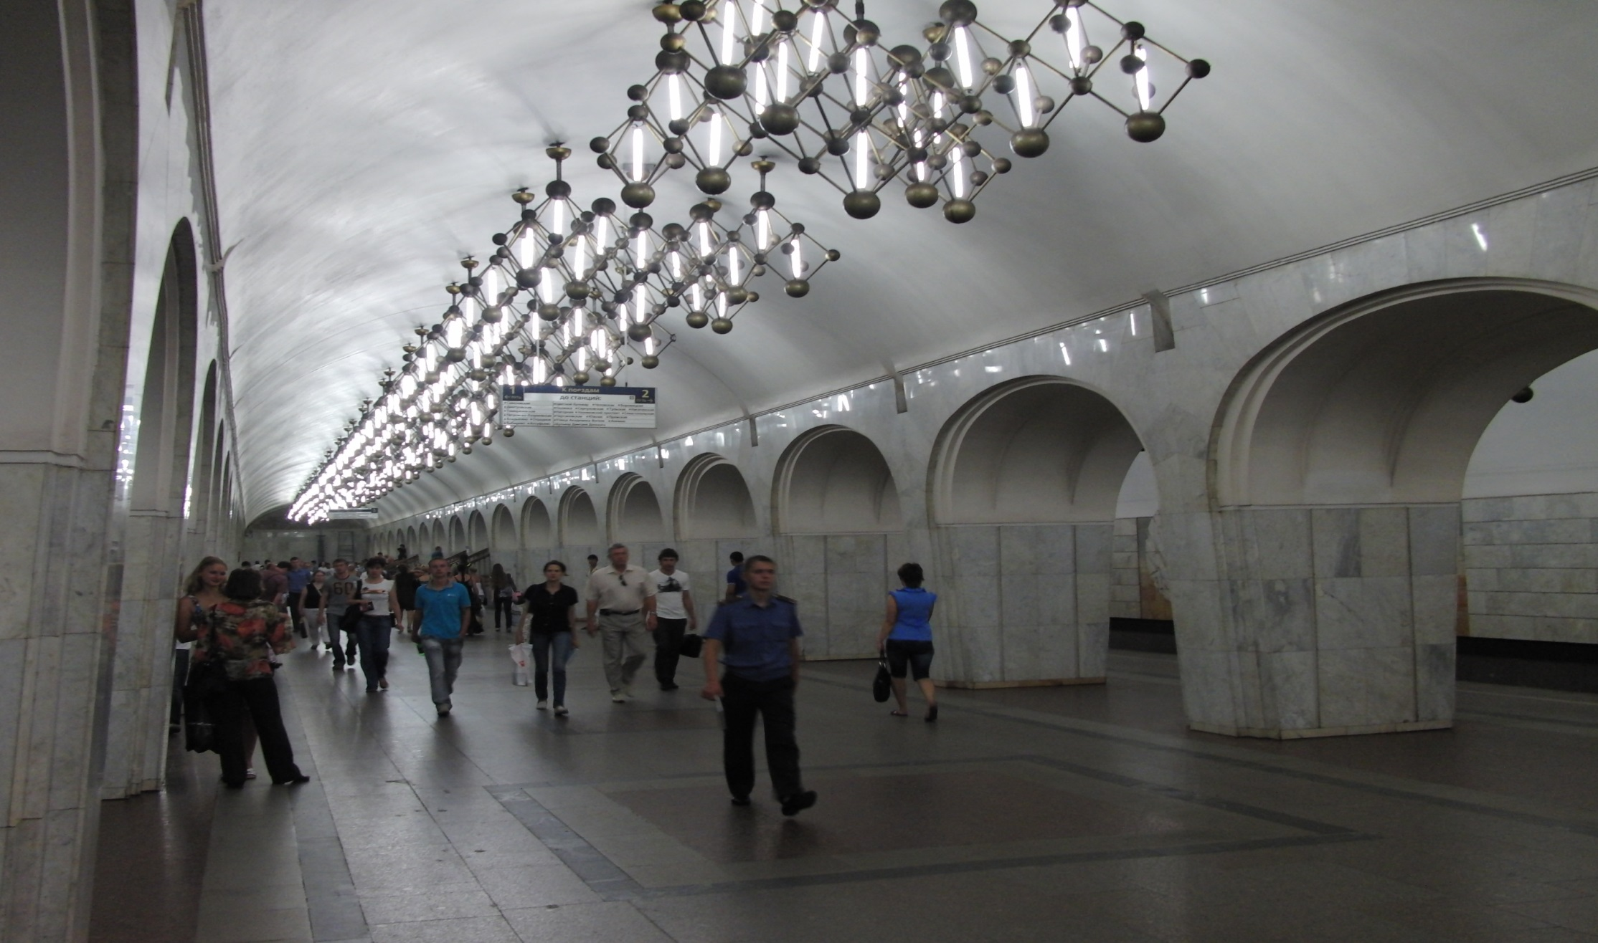
Mendelevskaya, 1988

Slide 16
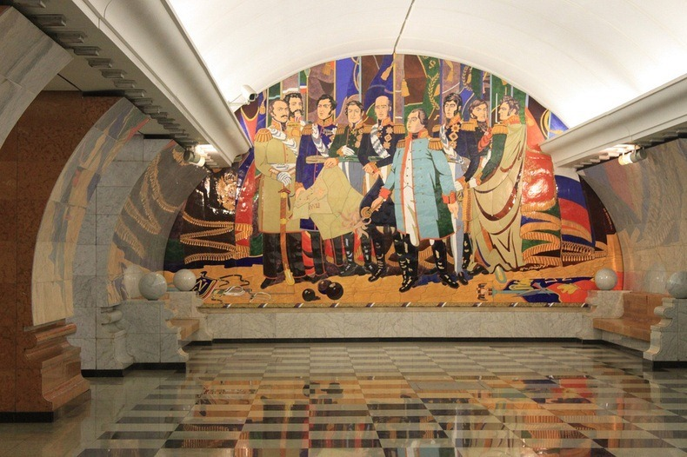
Park Pobedy Station 2003

Slide 17
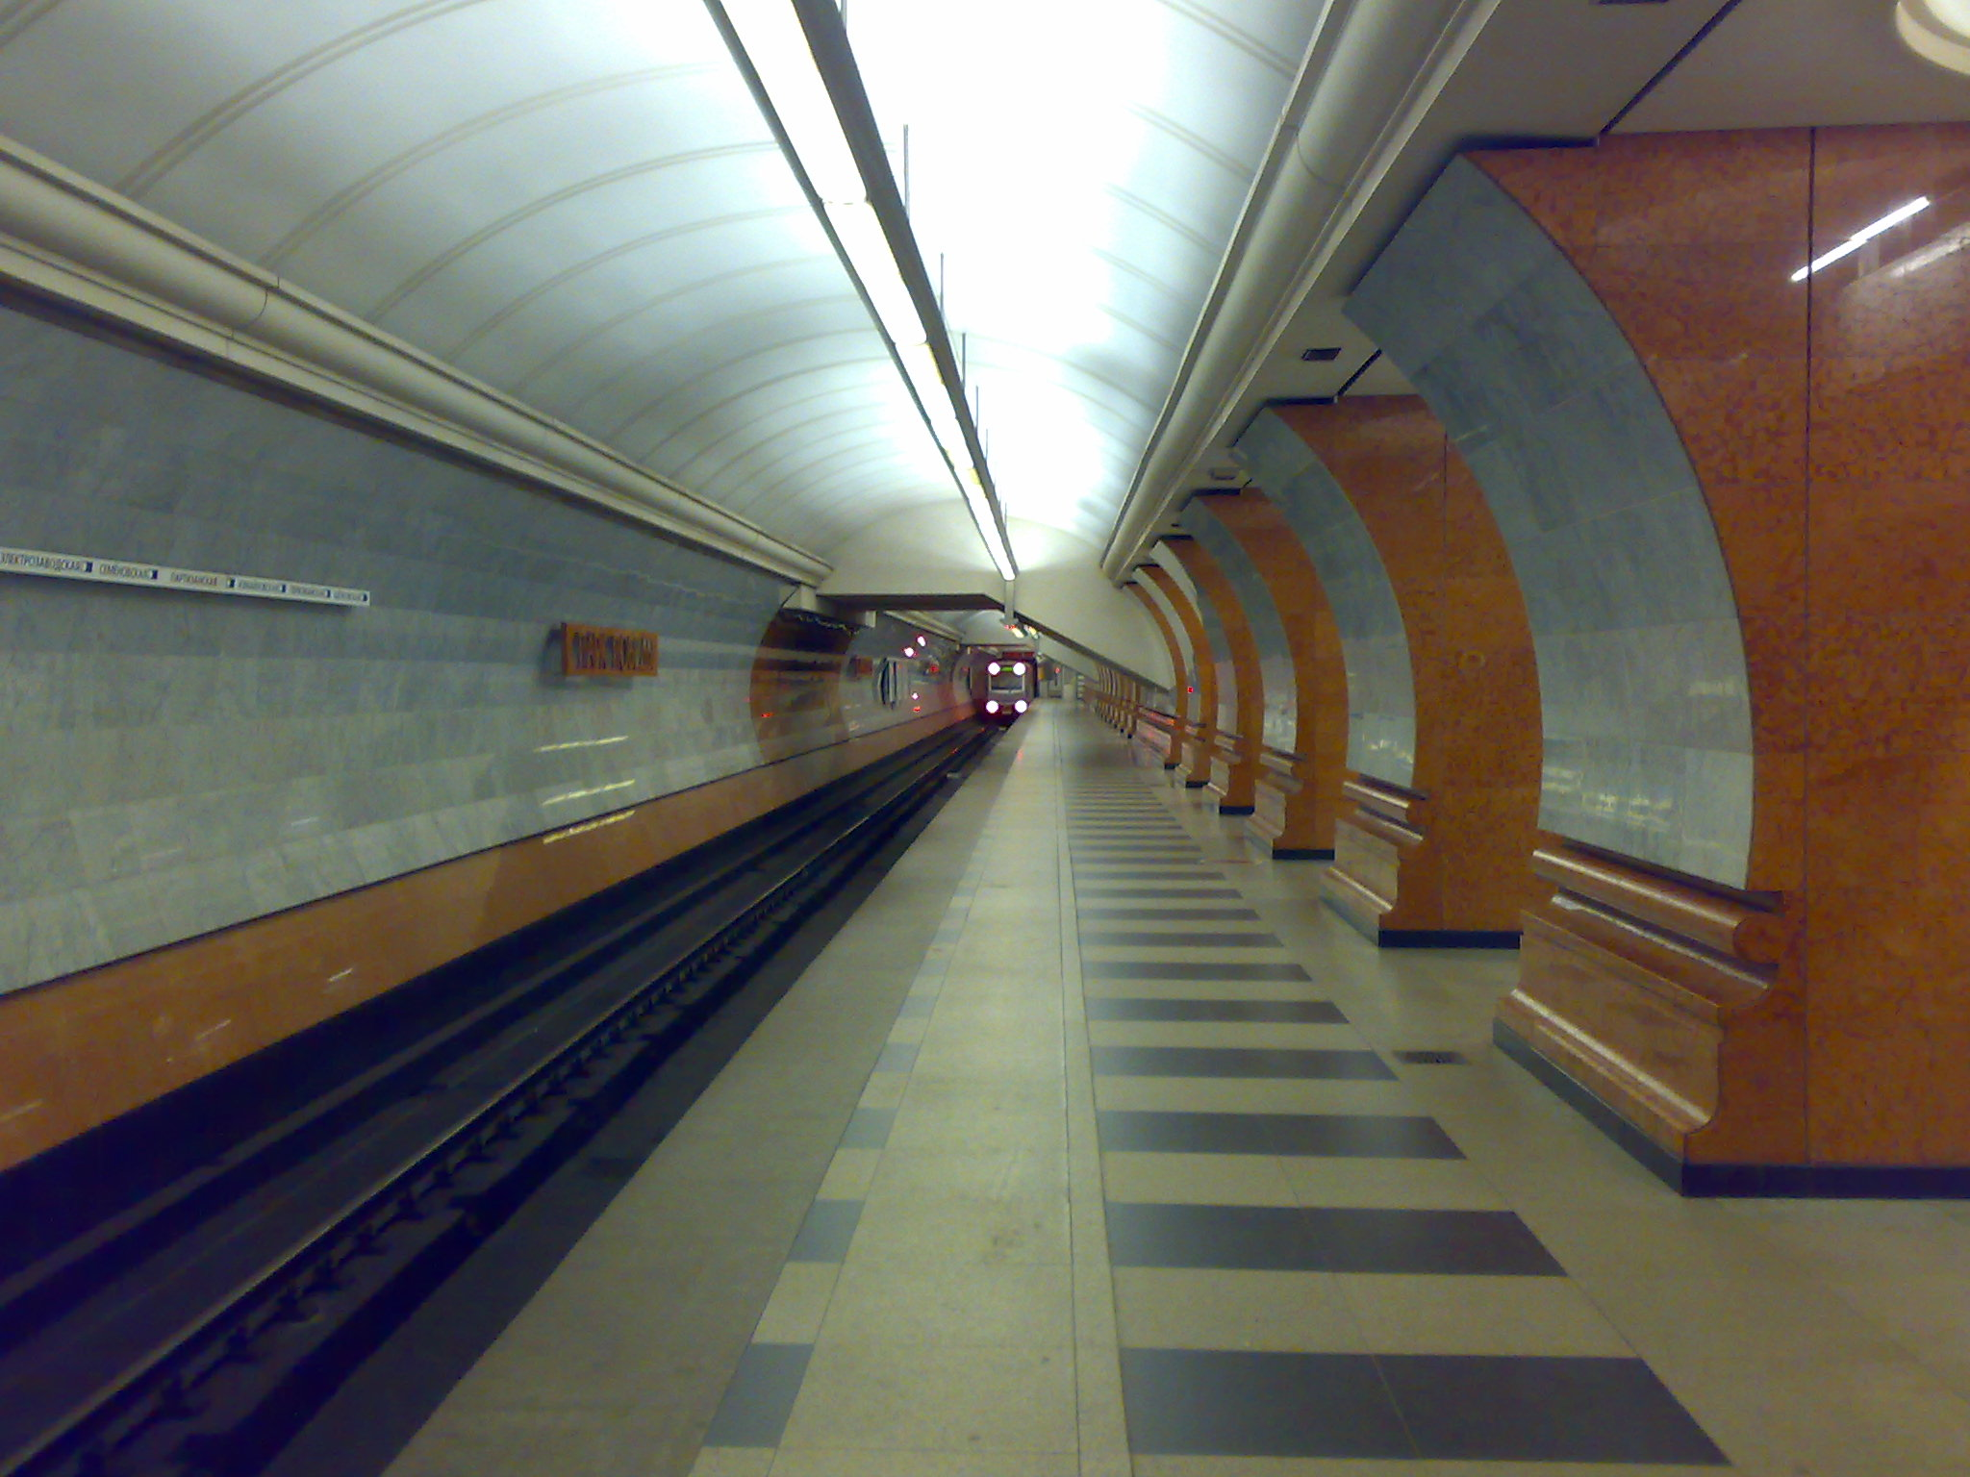

Slide 18
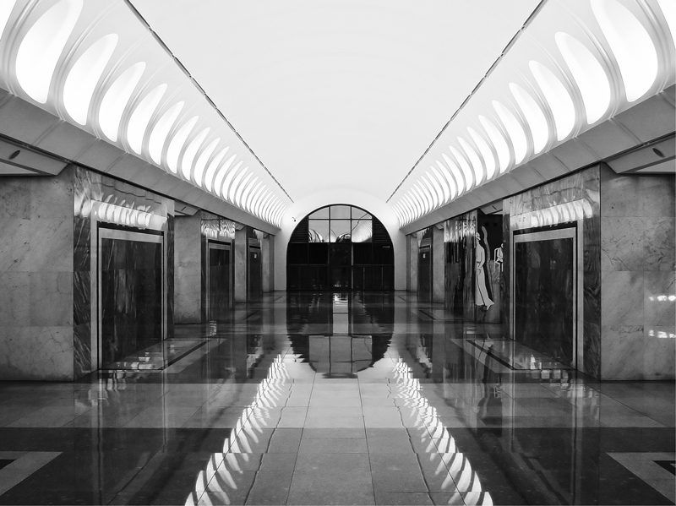
Dostoyevskaya Station, 2010

