Slide 1
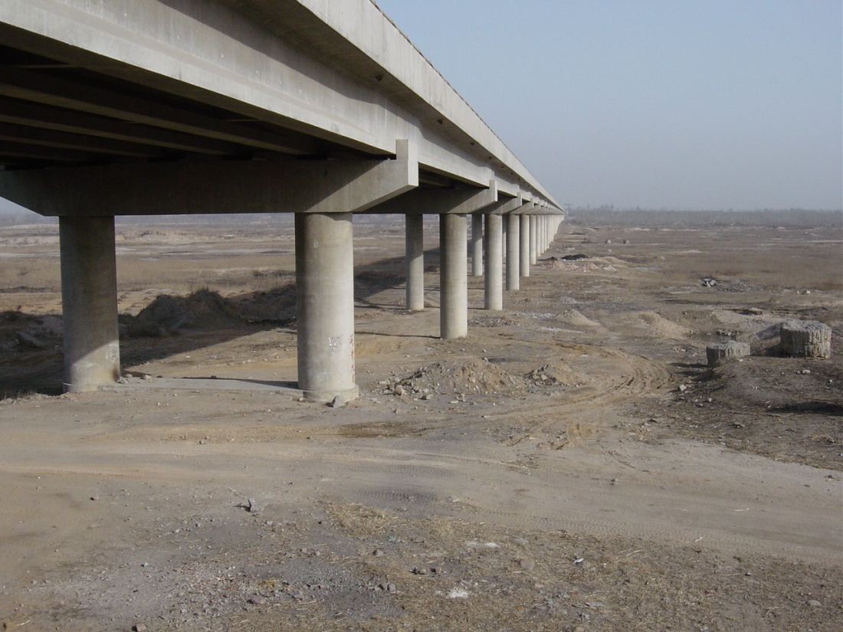
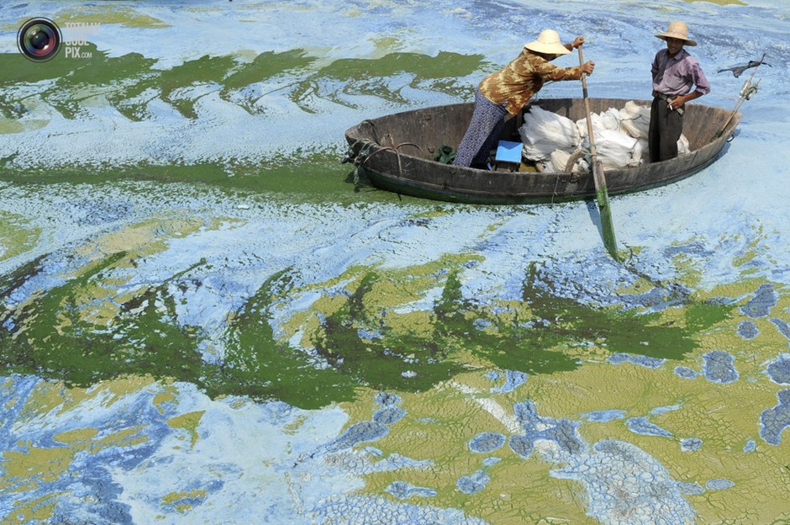
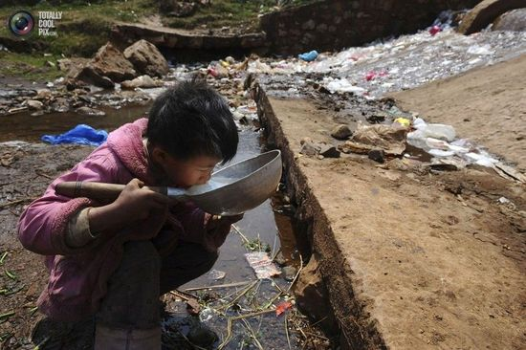
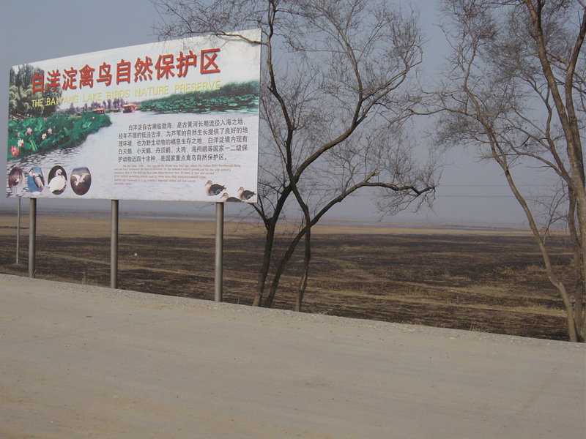
China’s War Against Water Pollution:
Filling in the Gaps
Rivers Dried Up
Rivers Polluted
Public Health Hazard
Ecosystem Damage

Slide 2

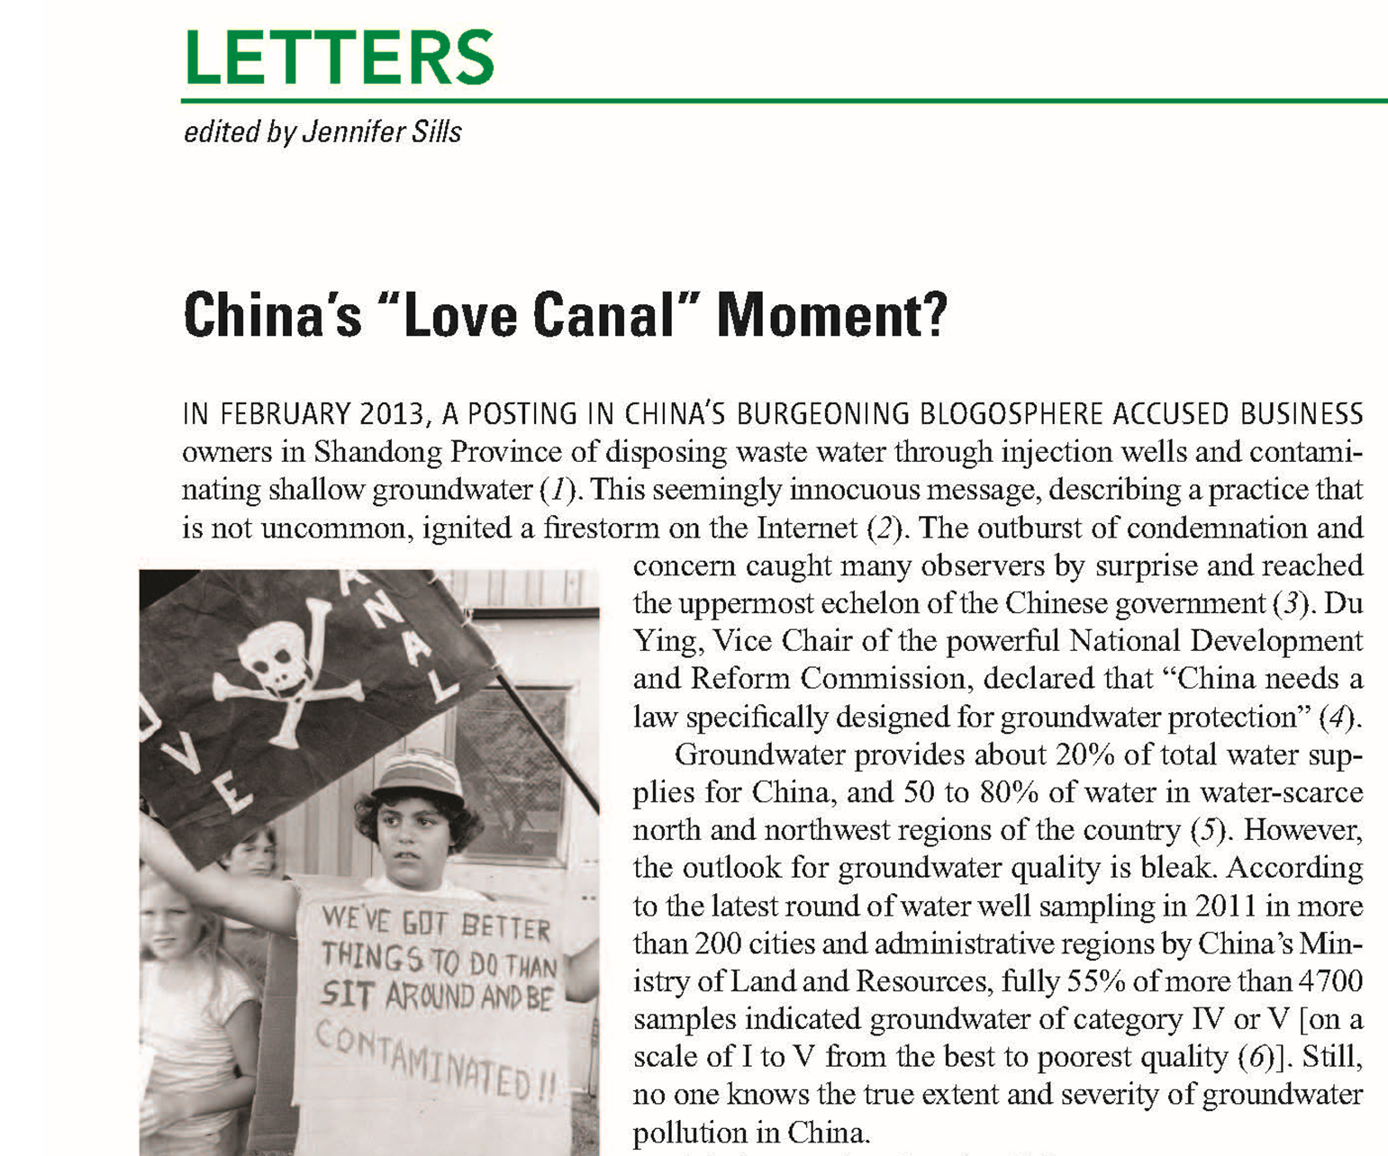
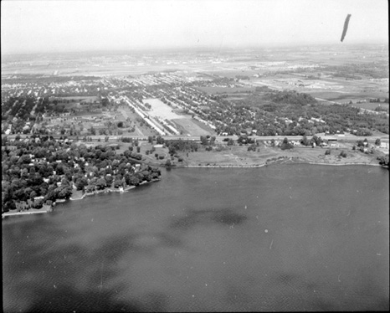
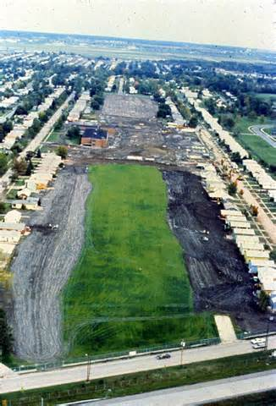
(May 17, 2013)
Chunmiao Zheng & Jie Liu
2

Slide 3
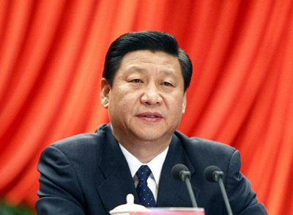
Never Greater Concerns About the Environment
from National leadership to General Public
Key Words
Clean water
Blue sky
Green mountains
Water and air pollution control
President XI Jinping on Environment

Slide 4
Putting Action Plan into Action:
SWOT
Strengths
National leadership
Public attention
New economic might
Weaknesses
Limited data
Spotty infrastructure
Lacking human resources
Opportunities
Lessons of past 30 years
International collaboration
Technological advances
Threats
Preoccupation with GDP
Inadequate enforcement
Markets at infancy

Slide 5

Filling the Gaps in the Action Plan
Enforce existing laws/regulations
Open up, stimulate and normalize environmental markets
Promote and encourage technological innovation
Invest in education and training
Support more international exchange and collaboration

Slide 6
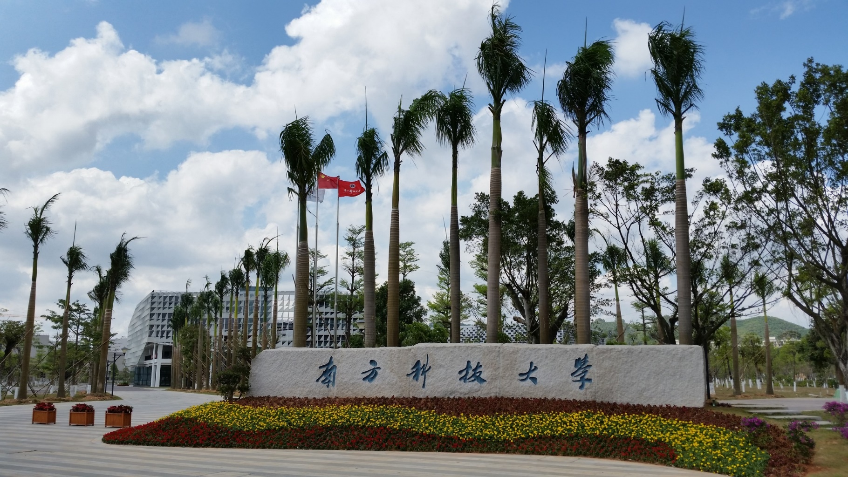
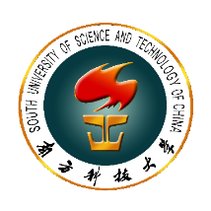


Thank you!
谢谢！
South University of Science and Technology of China
http://www.sustc.edu.cn
zhengcm@sustc.edu.cn

