Slide 1
How Can China Reform Its Power Sector and Improve Air and Water Quality?
Wilson Center
Washington, DC
Presented by Christopher James, Principal
June 12, 2017

Slide 2
Generator Capacity Utilization Has
Decreased Over 30% Since 2004
.
Notes:
Source: China Electricity Council

Slide 3
Wind Curtailment Has Slightly Improved in 2017, But Is Still High (Ditto for Solar)
Wind Curtailment Jan- March 2017
Area | Cumulative Curtailed Wind Energy (GWh) | Cumulative Wind Curtailment Rate (%) | Cumulative Operation hours
North Hebei | 800 | 10% | 583
Inner Mongolia | 3100 | 21% | 475
Liaoning | 600 | 15% | 477
Jilin | 1100 | 44% | 278
Heilongjiang | 1000 | 36% | 307
Gansu | 2200 | 36% | 305
Xinjiang | 2900 | 34% | 317

Slide 4
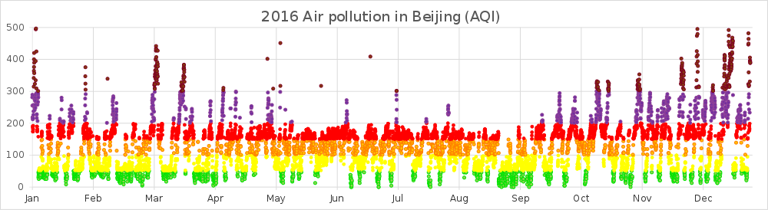
Air Pollution Has Improved, But Hazardous Episodes Continue to Occur, Especially in Fall and Winter Months
Notes:
Source: wikipedia.org

Slide 5
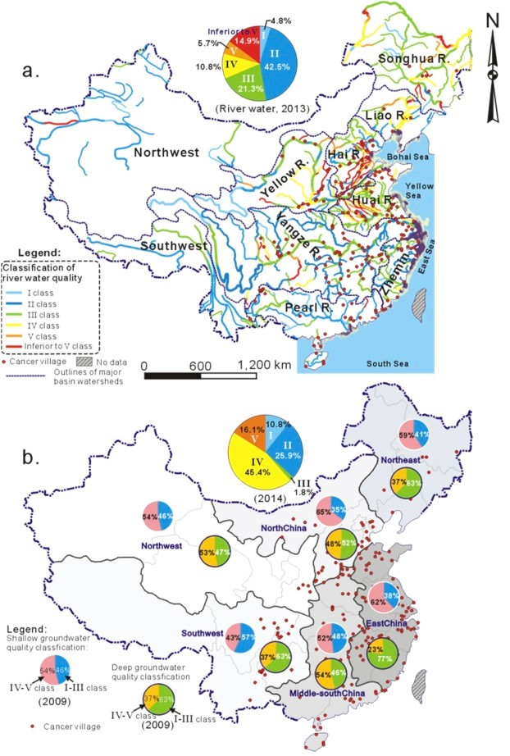
China’s Water Quality Is Poor in Many Regions
Notes:
Source: http://blogs.agu.org/waterunderground/2017/03/16/deep-challenges-chinas-war-water-pollution-must-tackle-deep-groundwater-pollution-pathways/

Slide 6
13th Five Year Plan: Improve Air and Water Quality and Restructure Energy Use
Continue cuts in SO₂, NO_{X}. Reduce VOC
Reach acceptable air quality 80% of days by 2020
Reduce water consumption 23% from 2015 levels by 2020
Reduce energy consumption 15% from 2015 levels by 2020
Cap coal consumption at 5 billion tonnes (tce)
Establish market-based electricity pilots for large consumers
Notes:
China has solid energy and environmental policy, regulations and law. NDRC Document 9, revised Air Law

Slide 7
Risks to Achieving Air and
Water Quality Goals
Coal cap is a 16% increase from current consumption levels
Market-based electricity pilots could increase use of inefficient thermal plants
Air quality plans have not yet incorporated clean energy elements

Slide 8
Recommendations
Require environmental portfolio standard as criteria to be eligible to participate in market-based electricity pilots
Reform electricity dispatch to economic based, then to priority for clean energy resources
Establish large energy balancing areas (larger than a single province)
Model environmental benefits of clean energy programs, then integrate into air and water plans

Slide 9
Mechanisms
Renew and strengthen State Council “Ten Measures”
Consistently implement and enforce the Air Law
GHG trading system offers co-control benefits
Permit system: require subject facilities to complete energy audits, and implement all cost-effective energy efficiency measures

Slide 10
For More Information
RAP China landing page: http://www.raponline.org/where-we-work/china/
May 2017 blog on power sector reform: http://www.raponline.org/blog/chinas-power-sector-reform-progress-clean-energy/
Improve air quality, reduce curtailment of renewable energy: http://www.raponline.org/blog/reducing-renewables-curtailment-china-air-quality-measure/
Regional air quality planning: energy and air quality integration: http://www.raponline.org/knowledge-center/regional-air-quality-planning-energy-and-air-quality-integration/

Slide 11
Christopher James, cjames@raponline.org
+1 617 861 7684
Skype: climatekaos

