Slide 1
The Dinosaur Survives and Wins
Joy Langston, CIDE

Slide 2
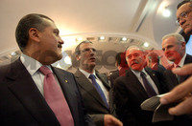
Why Did the PRI Win in 2012?
STRONG IN ALL REGIONS.
NO MAJOR INTRA-PARTY DIVISIONS.
STRONG CANDIDATE.
Tremendous power of the PRI governors.
Avoided fragmentation.
Split between two factions that lasts through 2006.
3. The coordination mechanism that is a
popular presidential hopeful.

Slide 3
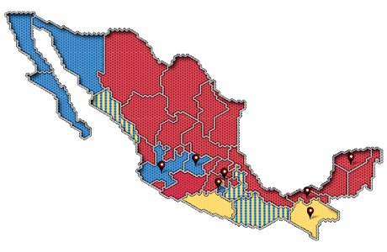
PRI Governors, 2011

Slide 4
Debilidades Regionales: Distritos de Mayoría en Distintas Regiones, 2012
 |  | PAN | PRD | PRI/PVEM
Circun. 1 | Northwest | 13 | 0 | 47
Circun 2 | Northeast | 28 | 0 | 31
Circun 3 | Southeast | 6 | 18 | 33
Circun 4 | Guerrero/DF/ Morelos | 5 | 41 | 14
Circun 5 | Edomex/Mich | 1 | 11 | 49

Slide 5
PRI: Resultados electorales estatales y locales

Slide 6
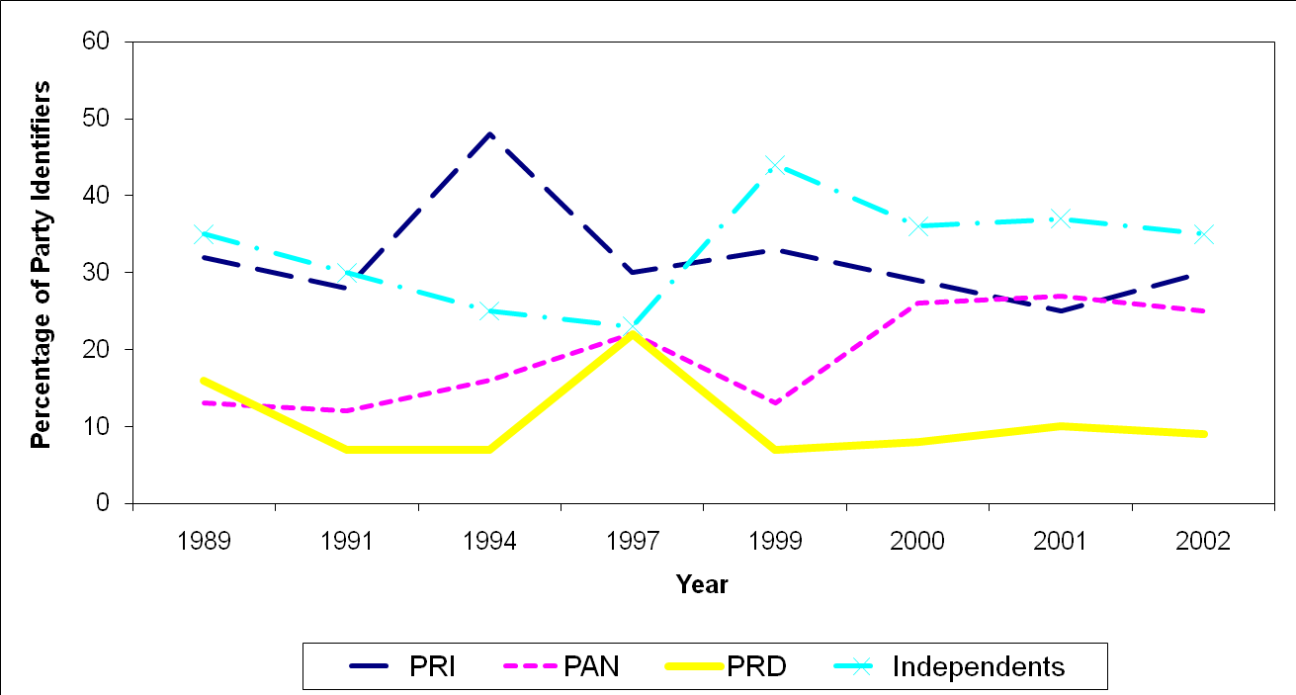
PARTY ID, 1989 TO 2002 (Moreno, 2003).

Slide 7
PARTY ID, 2006-2010, Mitofsky

