Slide 1
Public opinion in Russia under the authoritarian regime November, 2016

Slide 2
SOCIAL SENTIMENT INDEX

Slide 3
ASSESSMENT OF SITUATION IN THE COUNTRY
N=1600
3

Slide 4
 | APPROVAL OF PUTIN
N=1600

Slide 5

LEVADA ANALYTICAL CENTER
ASSESSMENT OF THE ECONOMIC STATE OF THE COUNTRY AND OWN FAMILY
5
4,5
4
3,5
3
2,5
2
1,5
1
0,5
0
Apr-94
Aug-94
Dec-94
Apr-95
Aug-95
Dec-95
Apr-96
Aug-96
Dec-96
Apr-97
Aug-97
Dec-97
Apr-98
Aug-98
Dec-98
Apr-99
Aug-99
Dec-99
Apr-00
Aug-00
Dec-00
Apr-01
Aug-01
Dec-01
Apr-02
Aug-02
Dec-02
Apr-03
Aug-03
Dec-03
Apr-04
Aug-04
Dec-04
Apr-05
Aug-05
Dec-05
Apr-06
Aug-06
Dec-06
Apr-07
Aug-07
Dec-07
Apr-08
Aug-08
Dec-08
Apr-09
Aug-09
Dec-09
Apr-10
Aug-10
Dec-10
Apr-11
Aug-11
Dec-11
Apr-12
Aug-12
Dec-12
Apr-13
Aug-13
Dec-13
Apr-14
Aug-14
Dec-14
Apr-15
Aug-15
Dec-15
Feb-16
Family economic state
Country economic state

Slide 6
Attitude towards Putin
By what words could you describe your attitude towards Vladimir Putin?
 | 2001 | 2002 | 2003 | 2004 | 2005 | 2006 | 2007 | 2008 | 2010 | 2011 | 2012 | 2013 | 2014
Admiration | 4 | 5 | 4 | 4 | 4 | 6 | 9 | 9 | 4 | 3 | 3 | 2 | 6
Sympathy | 34 | 37 | 38 | 30 | 32 | 32 | 38 | 40 | 31 | 28 | 20 | 18 | 31
Can't say anything bad about this person | 38 | 37 | 39 | 35 | 36 | 36 | 34 | 31 | 38 | 36 | 33 | 30 | 29
Neutral, indifferent | 11 | 9 | 10 | 14 | 11 | 13 | 9 | 10 | 11 | 18 | 19 | 22 | 15
Watchful | 8 | 6 | 4 | 7 | 5 | 4 | 4 | 3 | 7 | 4 | 11 | 10 | 6
Can't say anything good about this person | 3 | 3 | 3 | 7 | 8 | 5 | 2 | 3 | 6 | 5 | 8 | 8 | 7
Antipathy + aversion | 1 | 1 | 1 | 3 | 2 | 1 | 2 | 1 | 2 | 3 | 5 | 5 | 2
Nothing bad + indifference | 49 | 46 | 49 | 49 | 47 | 49 | 43 | 41 | 49 | 54 | 52 | 52 | 44
+/- | 3.2 | 4.2 | 5.2 | 2.0 | 2.4 | 3.8 | 5.9 | 7.0 | 2.4 | 2.6 | 0.9 | 0.8 | 2.5

Slide 7
ATTITUDE TOWARDS PUTIN
IN YOUR OPINION, IS PUTIN GUILTY OF ABUSE OF POWER,
AS HE IS UNDER AN ACCUSATION BY HIS OPPONENTS?
 | 2012 IV | 2012 XII | 2013 VIII | 2014 V | 2015 VII | 2016 VII
Doubtless guilty, that confirms the array of facts in the Internet and free media | 16 | 11 | 10 | 10 | 7 | 14
Probably yes as all high-ranking officials, but I don’t know a lot about that, I don’t follow that | 32 | 37 | 42 | 30 | 29 | 37
Even if that is true, it is most important of all that the country is better off | 25 | 14 | 18 | 28 | 31 | 18
Whatever they say, I don’t believe that Putin had ever abused of power | 11 | 15 | 13 | 19 | 22 | 17
Difficult to answer | 16 | 23 | 17 | 3 | 11 | 14
N=1600
10.2015
speaker: Lev gudkov
7

Slide 8
WHICH SOCIAL GROUPS DOES VLADIMIR PUTIN RELY ON?
ATTITUDE TOWARDS PUTIN

Slide 9
ОДОБРЕНИЕ ДЕЯТЕЛЬНОСТИ ДМИТРИЯ МЕДВЕДЕВА
июл.16
9

Slide 10
Одобрение деятельности Правительства
10

Slide 11
ОДОБРЕНИЕ ДЕЯТЕЛЬНОСТИ ГОСУДАРСТВЕННОЙ ДУМЫ
Нет данных
11

Slide 12
INDEX OF ATTITUDE TO THE USA AND THE EU
N=1600

Slide 13
What is your attitude towards the USA now?
N=1600

Slide 14
What is your attitude towards the EU now?
N=1600

Slide 15
What is your attitude towards Ukraine?
N=1600

Slide 16
What is your attitude towards Georgia now?
N=1600

Slide 17
DYNAMICS OF THE RUSSIAN’S ATTENTION TO THE UKRAINIAN EVENTS

Slide 18
State redistribution and planning
Private ownership and market relations
Difficult to answer

Slide 19
WHAT POLITICAL SYSTEM SEEMS BEST TO YOU:
SOVIET (THAT USED TO BE BEFORE THE 90TH ), NOWADAYS SYSTEM,
OR DEMOCRATIC SYSTEM UPON THE MODEL OF WESTERN COUNTRIES?
60
50
40
30
20
10
0
Feb-96 Sep-96 Apr-97 Nov-97 Jun-98 Jan-99 Aug-99 Mar-00 Oct-00 May-01 Dec-01 Jul-02 Feb-03 Sep-03 Apr-04 Nov-04 Jun-05 Jan-06 Aug-06 Mar-07 Oct-07 May-08 Dec-08 Jul-09 Feb-10 Sep-10 Apr-11 Nov-11 Jun-12 Jan-13 Aug-13 Mar-14 Oct-14 May-15 Dec-15
Jan-16
Soviet system
Now days system
Democrasy

Slide 20
Please name five countries that are the most unfriendly or hostile to Russia (%)
 |  | 2012 | 2013 | 2014 | 2015 | 2016
↓ | USA | 35 | 38 | 69 | 73 | 72
↑ | Ukraine | 15 | 11 | 30 | 37 | 48
↓ | Georgia | 41 | 33 | 19 | 11 | 10
↓ | Latvia | 26 | 21 | 23 | 25 | 23
↓ | Lithuania | 25 | 17 | 24 | 25 | 23
↓ | Estonia | 23 | 16 | 21 | 19 | 16
↓ | UK | 7 | 9 | 18 | 21 | 18
↑ | Poland | 8 | 8 | 12 | 22 | 24
↑ | Germany | 3 | 3 | 18 | 19 | 19

Slide 21
What countries have got friendly and hostile attitudes towards Russia? (2008)
Friendly |  | Hostile
Belorussia | 50 | Georgia | 68
Germany | 51 | The USA | 65
China | 47 | Ukraine | 50
France | 45 | Lithuania | 40
Japan | 37 | Poland | 27
Italy | 25 | Great Britain | 8
Great Britain | 24 | Israel | 5
Turkey | 23 | Belorussia | 5
Ukraine | 21 | Iran | 4
Spain | 20 | Turkey | 4
Austria | 18 | China | 4
Poland | 17 | The Czech Republic | 3

Slide 22
WHICH COUNTRIES ARE MOSTLY INTERESTED IN CONFRONTATION?
USA
NATO
EUROPE
RUSSIAN LEADERSHIP
RUSSIAN GENERALS
DO NOT KNOW
OCTOBER 2015, N = 1600
Notes:
22
22

Slide 23
Do you think that military threat from other countries towards Russia is existing now?
2000-2009 N=1600; 2010-2016 N=800

Slide 24
Do you think a military threat towards Russia from other countries exists?
2000 – 2009: N=1600; 2010 – 2016: N=800

Slide 25
DO YOU PERSONALLY AGREE OR DISAGREE WITH THE STATEMENT THAT: “RUSSIA WAS ALWAYS AROUSING HOSTILITY OF OTHER COUNTRIES, AND WE ARE NOT BEING WISHED WELL NOW BY NO ONE”
 | 2000 MARCH | 2008 FEBRUARY | 2015 OCTOBER
YES | 66 | 65 | 66
NO | 26 | 27 | 26
DIFFICULT TO ANSWER | 7 | 8 | 8

Slide 26
DOES RUSSIA HAVE ENEMIES?
Yes
No
Do not know

Slide 27
In your opinion, what’s Russian influence in international relations now?
N=1600

Slide 28
WHAT WAS DONE BY VLADIMIR PUTIN DURING HIS STAY IN POWER?
EXPECTATIONS
 | Aug 2010 | Feb 2013 | Mar 2014 | Mar 2015
 | VIII | II | III | III
Restore Russia’s superpower status | 36 | 36 | 51 | 49
Overcome separatist sentiments, keep Russia from the break-up | - | 24 | 27 | 32
Keep Russia on the reform track | 22 | 22 | 16 | 24
Continue the reforms but with a greater focus on the social security of the population | 22 | 9 | 12 | 14
Overcome the crisis in the economy, stop the decline in output | 18 | 14 | 12 | 10
Cope with the consequences of the crisis 2008 | - | 19 | 19 | 29
Raise salaries, pensions, scholarships and allowances | 43 | 28 | 25 | 29
Ensure the rule of law and order | 17 | 11 | 9 | 18
Pursue the agenda of reunification of the republics of the former Soviet Union | 20 | 16 | 13 | 16
End the war in Chechnya/ tensions in North Caucasus | 12 | 17 | 25 | 34
Ensure the fair distribution of wealth in the interest of common people | 5 | 3 | 2 | 4
Reimburse the population for the savings lost in course of reforms | 11 | 5 | 3 | 5
None of the above | 6 | 9 | 6 | 5
Difficult to answer | 5 | 8 | 10 | 6
Ranged by 2015, N=800, in percentage

Slide 29
Do you think Russia is currently a great power?
 | Mar-99 | Apr-00 | Oct-01 | Mar-04 | Nov-05 | Nov-06 | Nov-07 | Jun-09 | Nov-10 | Nov-11 | Mar-14 | Mar-15 | May-16
Definitely yes + Likely | 31 | 53 | 40 | 39 | 30 | 43 | 53 | 61 | 55 | 47 | 63 | 68 | 67
Definitely no + Unlikely | 65 | 43 | 57 | 57 | 67 | 52 | 42 | 33 | 41 | 46 | 32 | 27 | 23
Difficult to answer | 4 | 4 | 3 | 3 | 4 | 5 | 5 | 6 | 4 | 6 | 5 | 6 | 10

Slide 30
THE POTENTIAL OF PROTEST WITH ECONOMIC REQUIREMENTS (%)
Feb-16

Slide 31
THE POTENTIAL FOR PROTESTS WITH POLITICAL DEMANDS
Feb-16
Fairly possible
I would participate
31

Slide 32
HOW WOULD YOU DESCRIBE THE CURRENT GOVERNMENT?
*First 10 statements

Slide 33
HOW WOULD YOU DESCRIBE THE CURRENT GOVERNMENT?

Slide 34
Do you think Russia would aim to join EU in the future?
Yes
No
* Answers ‘do not know’ omitted

Slide 35


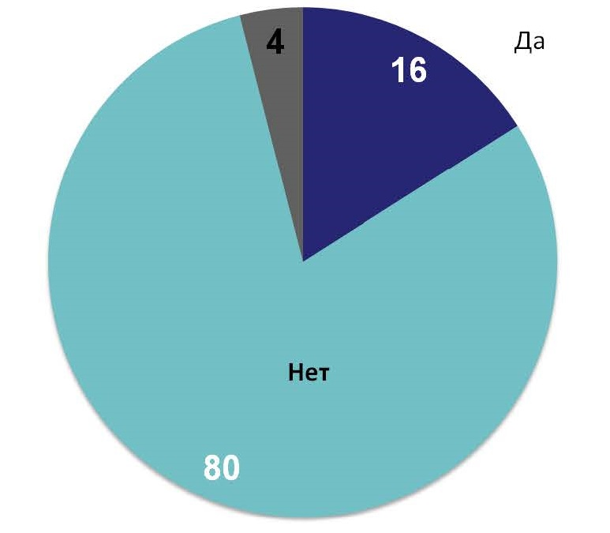


Do you personally feel hostile to the EU? (%)
Yes
No
OCTOBER 2015, N = 1600

Slide 36
What is your attitude towards Japan now?
N=1600

Slide 37
WHAT ROLE ARE THE INSTITUTIONS LIKE … PLAYING NOW IN RUSSIA?
Average value on 5 grades scale. January,2015 N=800
 | 2013 | 2014 | 2015
SUPER IMPORTANT (TWO POSITIONS FROM 55% TO 89%)
THE PRESIDENT | 4.17 | 4.5 | 4.57
THE ARMY | 3.49 | 3.91 | 4.09
THE FEDERAL SECURITY SERVICE | 3.68 | 3.93 | 4.03
THE PRESIDENT ADMINISTRATION | 3.71 | 3.8 | 3.93
THE OLIGARCHY | 3.84 | 3.62 | 3.72
THE GOVERNMENT | 3.65 | 3.71 | 3.71
IMPORTANT (TWO POSITIONS FROM 48 % TO 37%)
THE PUBLIC PROSECUTOR’S OFFICE | 3.48 | 3.48 | 3.52
MASS MEDIA | 3.46 | 3.54 | 3.47
THE COUNCIL OF FEDERATION | 3.32 | 3.49 | 3.45
GOVERNORS, REGIONAL AUTHORITIES | 3.3 | 3.44 | 3.36
THE STATE DUMA | 3.29 | 3.38 | 3.31
THE COURT | 3.31 | 3.3 | 3.33
THE POLICE | 3.21 | 3.22 | 3.26
THE RUSIAN ORTHODOX CHURCH | 3.09 | 3.08 | 3.26
DIRECTORS OF MAJOR NATIONAL ENTERPRISES | 3.23 | 3.07 | 3.19
LESS IMPORTANT (TWO POSITIONS 20% AND LESS)
POLITICAL PARTIES | 2.87 | 2.96 | 2.93
THE INTELLECTUALS | 2.58 | 2.6 | 2.61
THE PROFESSIONAL UNIONS | 1.96 | 2.07 | 2.1

Slide 38
FEARS (SUM OF THE ANSWERS “CONSTANTLY IN FEAR” AND “IN FEAR”
 | 1994 | 1999 | 2003 | 2008 | 2013 | 2014 | 2015
DO YOU FEAR NATURAL DISASTER? | 33 | 33 | 34 | 27 | 38 | 43 | 25
DO YOU FEAR AUTHORITY TYRANNY, LAWLESSNESS? | 51 | 55 | 44 | 30 | 41 | 33 | 29
DO YOU FEAR CRIMINAL ATTACKS? | 62 | 52 | 49 | 33 | 39 | 33 | 30
DO YOU FEAR LOSING THE SAVINGS | - | - | - | - | 29 | 32 | 27
DO YOU FEAR UNEMPLOYMENT? | 49 | 66 | - | 30 | 38 | 30 | 31
DO YOU FEAR PUBLIC HUMILIATION, INSULTS? | 37 | 32 | 24 | 26 | 32 | 30 | 22
DO YOU FEAR THE WORLD WAR? | 21 | 22 | 33 | 44 | 29 | 26 | 43
DO YOU FEAR TIGHTENING OF THE POLITICAL REGIME? | - | - | - | - | 38 | 24 | 17
DO YOU FEAR RETURNING THE MASS REPRESSIONS? | 20 | 23 | 10 | 19 | 10 | 4 | 20
NUMBER OF RESPONDENTS: | 3000 | 2000 | 2000 | 1500 | 1600 | 1600 | 1600

Slide 39
In your opinion, what should be a reaction of Russian people upon the problems, they are meeting nowadays?
N=1600

