Slide 1
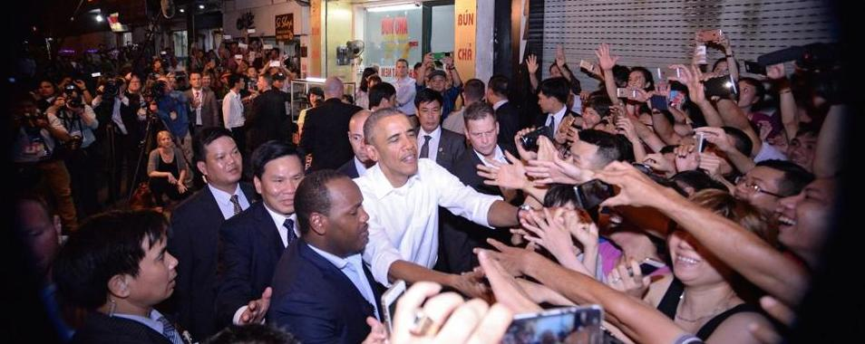
VIETNAM BETWEEN THE AMERICAN PIVOT AND CHINESE ASSERTIVENESS: IMPLICATIONS OF PRESIDENT OBAMA’S VISIT TO VIETNAM

Slide 2
Presentation on “President Obama in Hanoi: Vietnam-U.S.-China Relations in Transition” Kissinger Institute--Woodrow Wilson Center June 1, 2016 Nguyen Manh Hung Nonresident Senior Associate Center for Strategic and International Studies

Slide 3
ISSUES TO BE DISCUSSED
Factors affecting Vietnam’s relations with the big powers
Vietnam’s adjustment to the changing relations between the big powers
Chinese assertiveness and the development of Vietnam-U.S. partnership
President Obama’s visit to Vietnam and its implications

Slide 4
INFLUENCING FACTORS IN VIETNAM’S RELATIONS WITH CHINA AND THE U.S.
Vietnam and China:
Vietnam-China relations are influenced by three key factors: geographical proximity and power asymmetry; a complex history of love-hate relationship and Vietnam’s perception of the Greater Han concept; and ideological affinity and the need for regime stability.
A combination of factors –geographical proximity, ideological affinity, and the need of regime survival—tends to make Vietnamese leaders more comfortable with China than with the U.S. Only the perception of China as a bullying neighbor would force Vietnam to opt for a different orientation and adopt an antagonistic policy toward China.

Slide 5
INFLUENCING FACTORS IN VIETNAM’S RELATIONS WITH CHINA AND THE U.S.
Vietnam and the United States:
Vietnam-United States relations are affected by a twin concerns: sensitivity to China and mistrust of U.S. intention.
The U.S. may be a destabilizing factor in Vietnamese domestic politics but it can also be a stabilizing factor from Vietnam’s foreign policy perspective.
Chinese assertive behavior in the South China Sea led to a convergence of strategic interests between Vietnam and the U.S.
Vietnam’s need of the U.S. for economic development and as a counterweight to China.
As Vietnam moves closer to the U.S., it remains concerned about being a pawn on the chessboard of big-power politics.

Slide 6
TIPPING POINTS IN VIETNAM’S BALANCING ACT
End of the Cold War and the Need of Foreign Policy Realignment, 1991
A “multidirectional foreign policy” to end diplomatic and economic isolation as a result of the Cambodian War, and the need of economic reform.
Attempt to form a “socialist alliance” with China against Western plots of “peaceful evolution.”
Seeking regional integration and support through the promotion of ASEAN unity and centrality.

Slide 7
TIPPING POINTS IN VIETNAM’S BALANCING ACT
Chinese Assertive Behavior and the Failure of Accommodation/Appeasement, 2009
Publication of China’s nine-dash line in 2009 and Vietnam’s emphasis on “peaceful diplomacy.”
The Scarborough Shoal crisis and the failure of the Phnom Penh ASEAN Summit in 2012.
The need to find a credible counterweight.
The American pivot toward Asia and requirements of a peaceful and equitable solution to the South China Sea dispute
Chinese restraint in its claims
ASEAN unity to strengthen collective bargaining power and serve as a buffer zone
American engagement must be credible

Slide 8
CHINESE INCREASING BELLICOSITY AND THE DEVELOPMENT OF VIETNAM-U.S. PARTNERSHIP
President Truong Tan Sang’s visit to the U.S. and the signing of the “Vietnam-U.S. Comprehensive Partnership” agreement, 2013.
The oil rig crisis of 2014 and China’s massive land reclamation and militarization of the man-made islands in 2014-2015, radically changing the strategic balance in favor of China.
Conclusion of a Vietnam-U.S. Joint Vision on Defense calling for defense trade between the two countries, “potentially including cooperation in the production of new technologies and equipment,” June 2015.

Slide 9
CHINESE INCREASING BELLICOSITY AND THE DEVELOPMENT OF VIETNAM-U.S. PARTNERSHIP
Vietnam’s commitment to “do everything possible” to join the TPP, a major instrument of U.S. rebalance.
CPV General Secretary Nguyen Phu Trong made a historic visit to the U.S., July 2015, signed a joint declaration to pursue “deepened, sustained, and substantive relationship” with the U.S., and declared the U.S. the “utmost important area of operation of Vietnam’s foreign policy.” A Vietnam’s foreign policy pivot.
The Xi-Jinping Summit, September 2015, and the hardening of Chinese position on the South China Sea.
Continued militarization of man-made islands and the beginning of U.S. FONOPS.

Slide 10
RESULTS OF PRESIDENT OBAMA’S VISIT TO VIETNAM
Full lifting of the ban on military sale to Vietnam
U.S. commitment to help Vietnam prepare for the TPP and get market economy status
U.S. commitment to help Vietnam have access to military equipment to protect its security
U.S. commitment to continue offer training and equipment to Vietnamese Coast Guards
Major commercial deals to buy Boeing aircraft and Pratt & Whitney engines
Vietnam’s approval of the Fulbright University Vietnam the presence of the U.S. Peace Corps

Slide 11
PRELIMINARY ASSESSMENT OF PRESIDENT OBAMA’S VISIT TO VIETNAM
A history and legacy-making visit on a par with the normalization of relations with Cuba and the Iranian nuclear deal.
The May 23, 2016 op-ed in the New York Times by John Kerry, John McCain, and Bob Kerrey, three highly-decorated veterans of the Vietnam War, represents some sort of bipartisan support for President Obama’s decision to fully lift the ban on arms sale to Vietnam.
Obama continues the tradition of “pragmatic neo-Wilsonianism” in American foreign policy practiced by George H. W. Bush when he sent envoys to China after the Tiananmen incident in 1989, and Bill Clinton’s decision to grant China MFN status in 1994 despite the lack of “significant progress” on human rights.
Triumph of strategic and economic interests over human rights considerations

Slide 12
PRELIMINARY ASSESSMENT OF PRESIDENT OBAMA’S VISIT TO VIETNAM
Clear manifestation of Vietnamese people’s love and admiration for the U.S. This stands in contrast to Chinese President Xi Jinping’s visit to Vietnam in November 2015 where he was reminded by his host of the “erosion of trust” between the two parties and countries.
Potential of increased U.S. cultural and political influence through the Fulbright University Vietnam and the Peace Corps.
Additional proof of Vietnam’s potential to play a significant role in the construction of a multipolar regional security structure in the Asia Pacific region.
President Obama is more popular abroad than at home; he represents a better face of America to the world.

Slide 13
VIETNAM’S CHANGE OF HEART
“In the next ten years Vietnam and the United States must be allies.”
(Hong Ha, former Party Secretary and architect of the attempted Sino-Vietnamese “socialist alliance,” at a symposium on “U.S.-Vietnam Relations: Toward a Brighter Future, Hanoi, July 8-9, 2010).
“Among our strategic and comprehensive partners, the United States is the only country that can effectively help us to develop our economy and protect our security. Russia is only interested in selling us weapons . . . and China is always trying to find ways to encroach upon our territorial integrity.”
(Le Van Bang, first Vietnamese Ambassador to the United States in an interview with VietTimes, May 14, 2016)

Slide 14
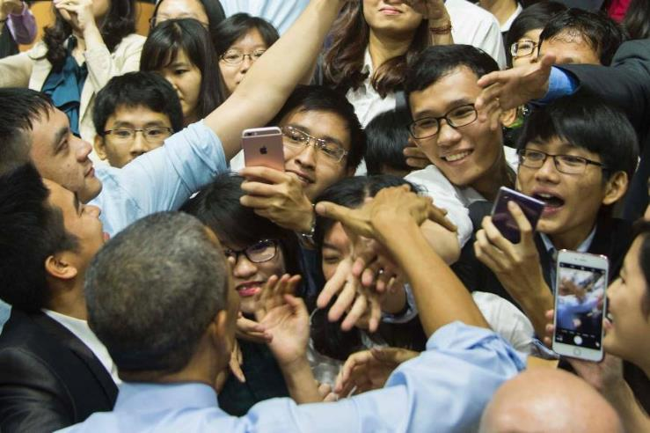
U.S. President Barack Obama greets members of the audience after speaking at the Young Southeast Asian Leaders Initiative town hall event in Ho Chi Minh City on Wednesday. | AFP-JIJI
U.S. President Barack Obama greets members of the audience after speaking at the Young Southeast Asian Leaders Initiative town hall event in Ho Chi Minh City on May 25, 2016. | AFP-JIJI

Slide 15
Thank You

