Slide 1
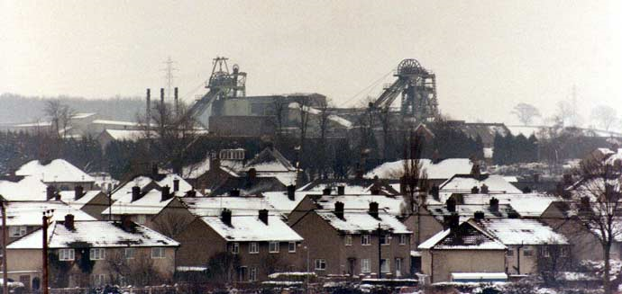
Sample Cover Page
The Importance of a Plan…
Presented by
April 2015
Hongxia Duan & Lucy Kitson
12 July 2017
Notes:
Thank you Jennifer for the welcome and the introduction, and good afternoon everyone. Hongxia and I are delighted to be here and have the opportunity to share our work with you.
I’m going to jump right in and talk a bit about global transitions.
This photo is of a coal mine right in the middle of England, about 5 miles away from where I grew up.

Slide 2
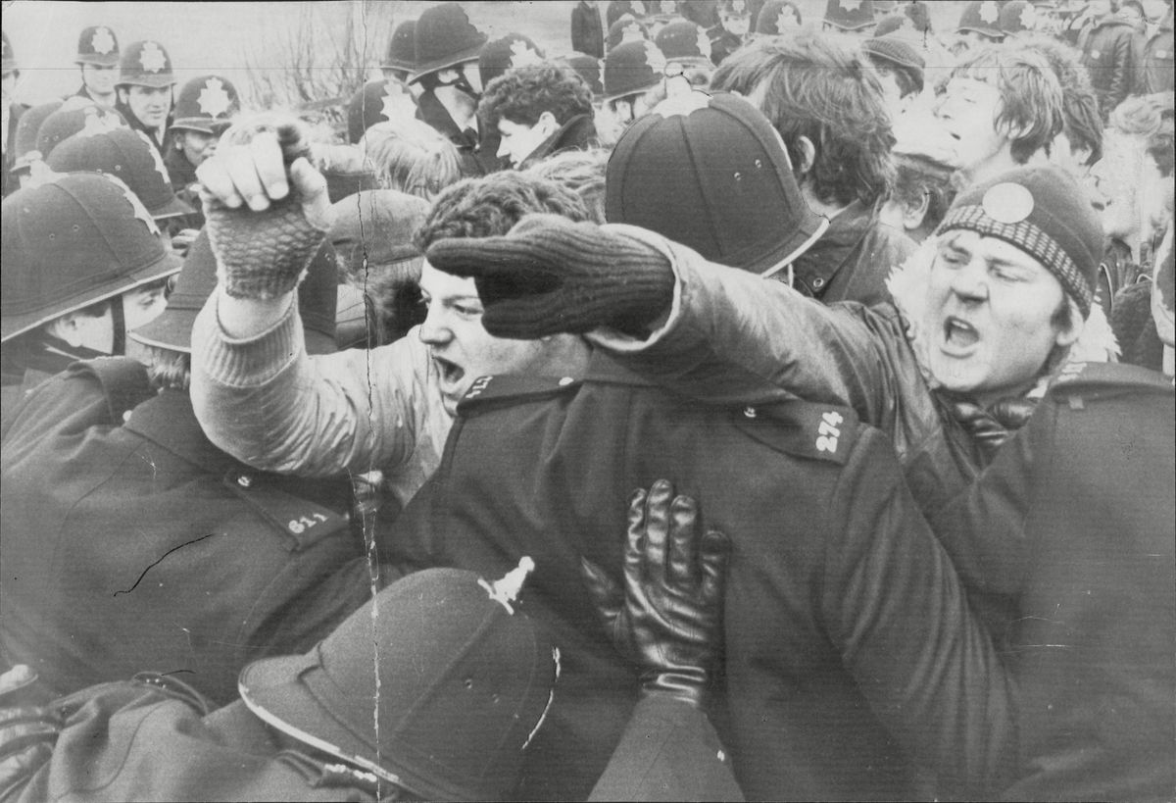
…and a managed transition
Notes:
When I was about 6 years old, the government announced the closure of not only this pit, but many others across the country. This process was extremely politically difficult, and resulted in quite severe economic and social dislocation which - to some extent - endures today.
It is partly my experience of this transition and its aftermath that has prompted my interest in how to make transitions better.

Slide 3
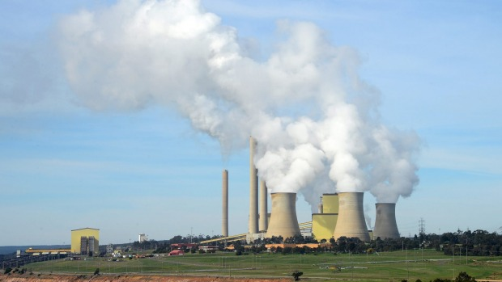
“We’ve looked ahead, read the writing on the wall and developed an orderly plan to get out of coal.”
AGL Energy (Australian Utility)
Sub-title
text
Notes:
And why does this matter? Because the world is facing an inevitable shift away from coal, and if we are to make this shift as successful as possible, we need to plan for it. Experience tells us that if coal mines and coal fired power stations close down without plans already in place, then it is the workers and their communities who are left behind without the skills and opportunities that they need in the new world.
----------------------------------------------------
This is from AGL energy, one of Australia’s largest utilities and its most polluting, has promised to ramp up investment in renewable energy capacity and to shut down all of its existing coal plants over the next 35 years, as part of a new plan to decarbonise its generation portfolio by 2050.

Slide 4
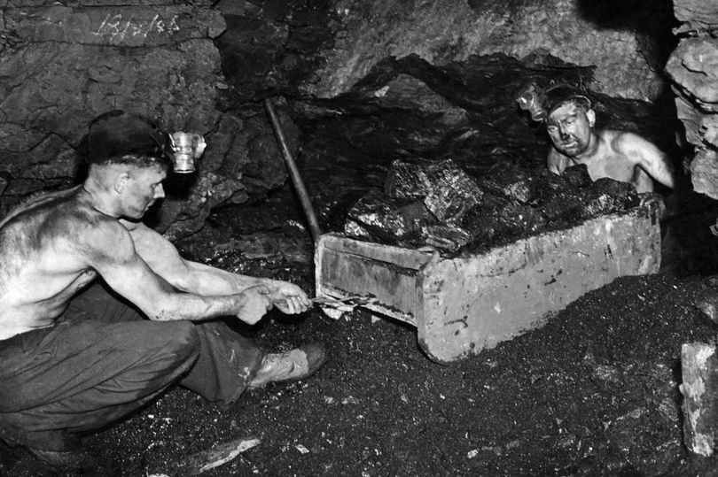
The writing on the wall
Notes:
Why is transition is inevitable? Three reasons.
The first is this. By and large, mining like this is disappearing:

Slide 5
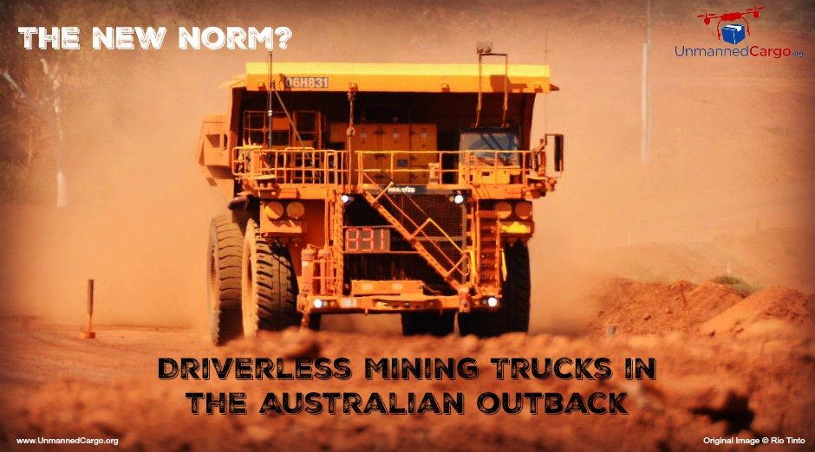
The writing on the wall
Sub-title
text
Notes:
and its being replaced with mining that looks more like this.
Basically, even if we continued to mine at the same rate as we are doing today, we would still face job losses due to mechanization and automation.

Slide 6
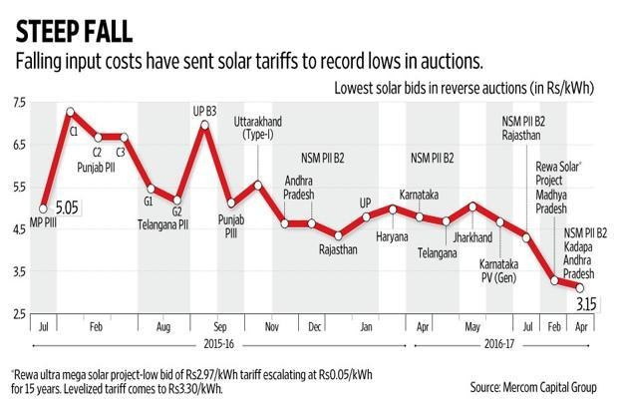
The writing on the wall
Notes:
Reason two for the inevitable transition: Coal is not the only energy source, and increasingly nor is it the cheapest or most convenient. The big story here is renewable energy and how in some places costs have fallen to the same level as coal. Recent auctions for solar capacity in India have yielded prices as low as 4 US cents per kwh (2.66 rupees); by comparison, the price charged by the largest coal company is 5 US cents per kwh (3.2 rupees)

Slide 7
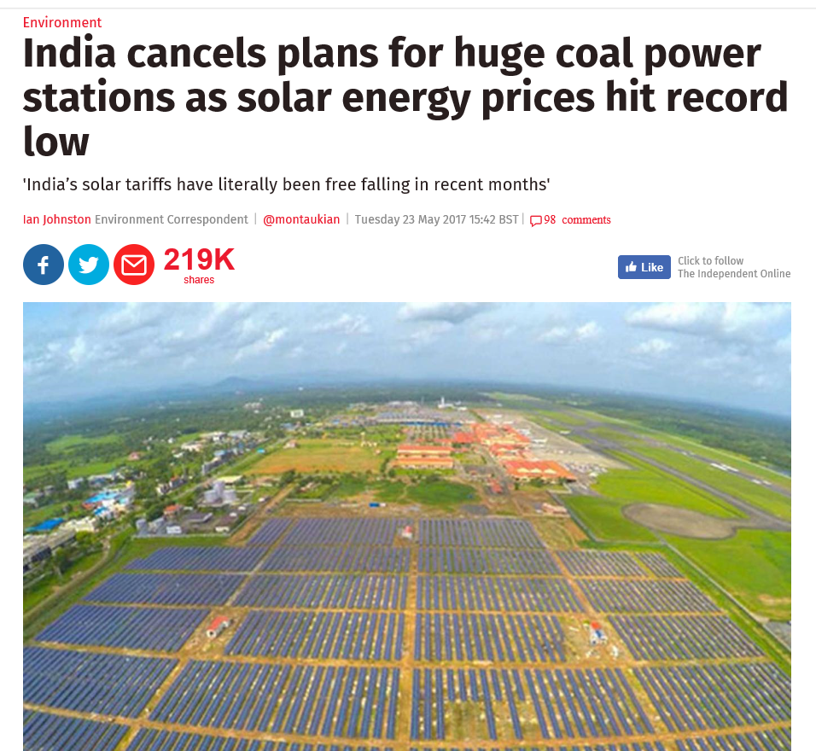
The writing on the wall
Notes:
And where does this lead? In May 2017, almost 14 GW of coal fired power was cancelled across India.
---------------------------------------------
(The government also admitted that 8.6 GW of operating import-coal-fired power plants were no longer viable.)

Slide 8
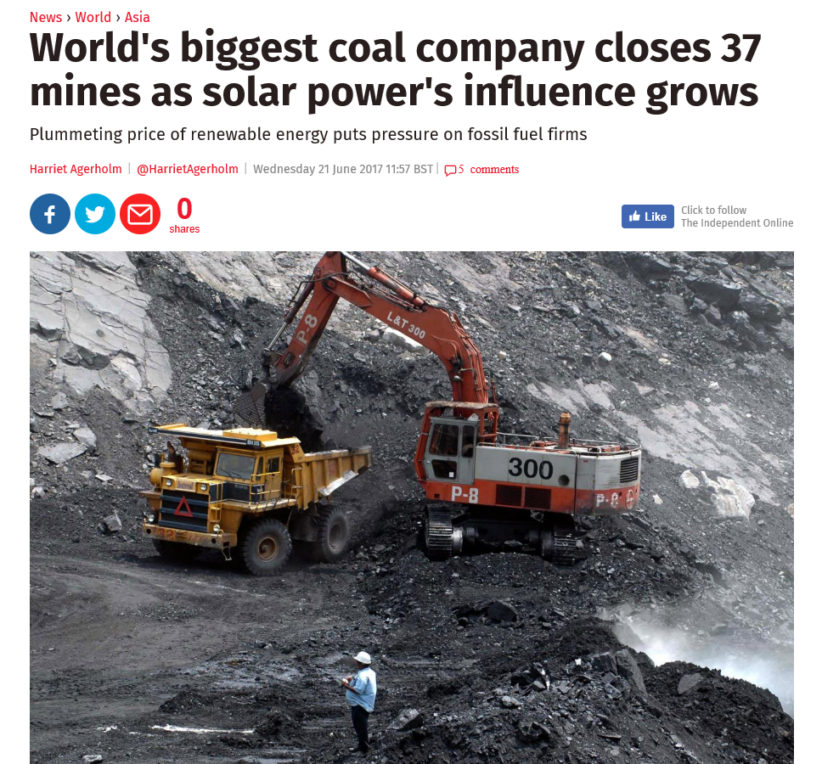
The writing on the wall
Notes:
In June, the largest coal mining company in the world announced it will close 37 mines because they are no longer economically viable.
-------------------------------------------------
Coal India, which produces around 82 per cent of India's coal, said the mines would be decommissioned by March 2018.

Slide 9
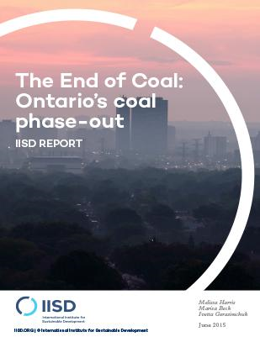
The writing on the wall
Notes:
And reason 3. Emissions from burning coal. The effects of particulates on human health is also becoming ever more important in discussions on the energy mix. In fact, this was the major factor driving phase out of coal in the Ontario power sector in 2014.
--------------------------------

Slide 10
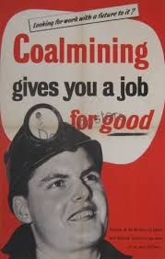
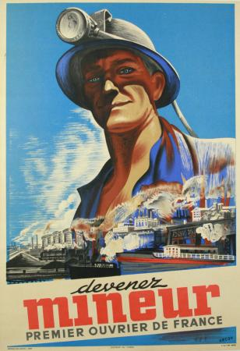
But at what cost?
Notes:
So if transition is inevitable, how do we best mitigate the negative impacts?
The foremost concern is obviously the economic consequence of job losses, both for the miner and his family, and teh local economy. If not managed, these effects can last through generations. (Today in the UK, coal mining areas have – on average – only 50 jobs per 100 working age adults compared to a national average of 67 jobs. In some more remote areas, this number is as low as 41). It’s not just the miner who has lost his job – it’s his son and his grandson as well.
And it is more than numbers – it is also about the type of job. Although manual labour, jobs in coal mining were secure, often well-paid and highly-regarded. (Traditionally, mining has been tied to economic progress). Replacing these type of jobs with equivalent positions is not easy and takes considerable planning (the UK saw more women entering the labour force).
----------------------------------
One in seven adults is on out-of-work benefits compared to the national average of 9.

Slide 11
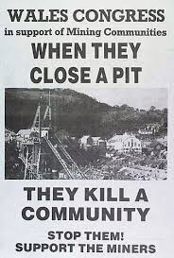
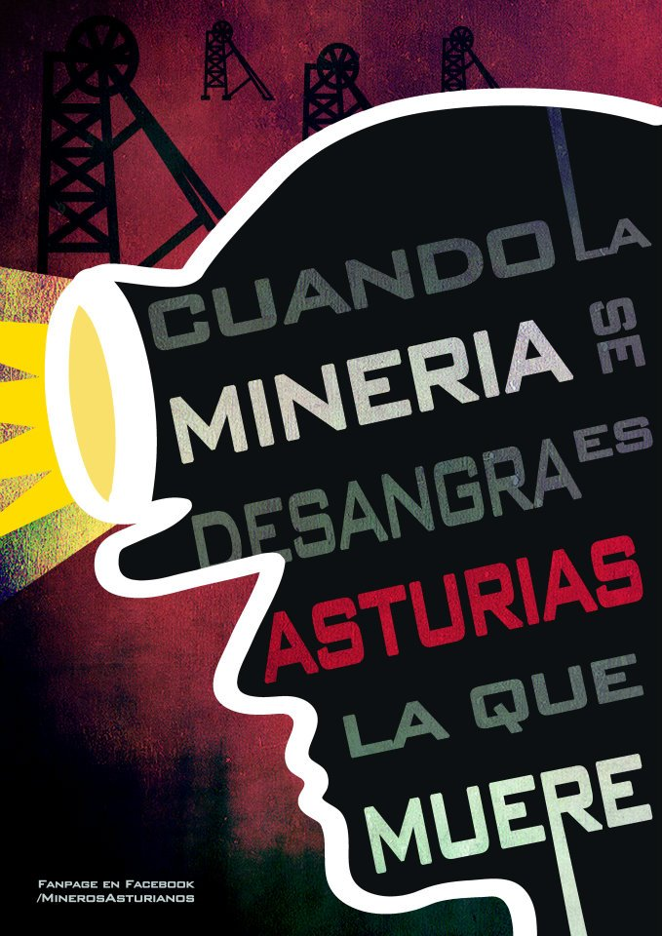
But at what cost?
Notes:
But of course, it’s not just about the economic impacts of job losses – it’s also about the broader social impacts.
When the mine goes, the community and social structures that were in place around mine go as well (add in examples). And this is even more the case when lack of alternative employment means that workers move outside the region, leaving behind those who do not have the resources to move – the elderly, poor, ill, less well educated. And this can basically be the start of a downward spiral for communities, a spiral that is compounded by fiscal pressures as tax revenues decrease and tax expenditure increases.
----------------------------------------------------
When mining is bleeding it is Asturias that dies

Slide 12
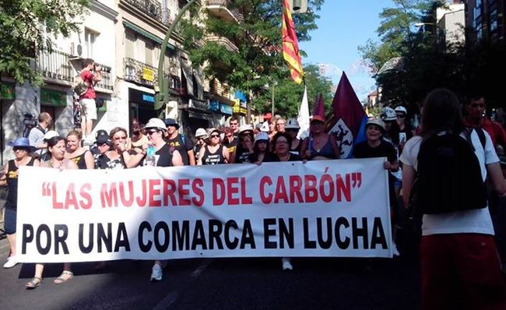
An orderly plan
Notes:
So, what to do?
Well, first, I want to make the point that transitions to date have rarely been planned in a comprehensive fashion, but this has meant that the costs – political, economic or social – have been higher than they needed to be. Nevertheless, these transitions can yield some useful lessons – positive and negative. I’m just going to talk about three main areas.
First – the design stage – in many cases the process of transition has been politically difficult. I mentioned the UK, this has also been the case at various time in Poland, Germany, Spain. But there are examples where the process has been based on consensus and dialogue and as a result the transisiton has been more easily obtained and less disruptive – this was the case in Poland in the late 1990s and in the Netherlands in the 1960s.
----------------------------
BUT, 2012 in Spain. Violent clashes had already broken out between miners and police in weeks of protests in northern mining towns over Madrid’s decision to slash coal industry subsidies this year to 111 million euros ($US136 million) from 301 million euros last year. Unions say the cuts will destroy coal mining, which relies on state aid to compete with cheaper imports, and threaten the jobs of some 30,000 people directly and indirectly employed by the sector, including 8,000 coal miners.

Slide 13
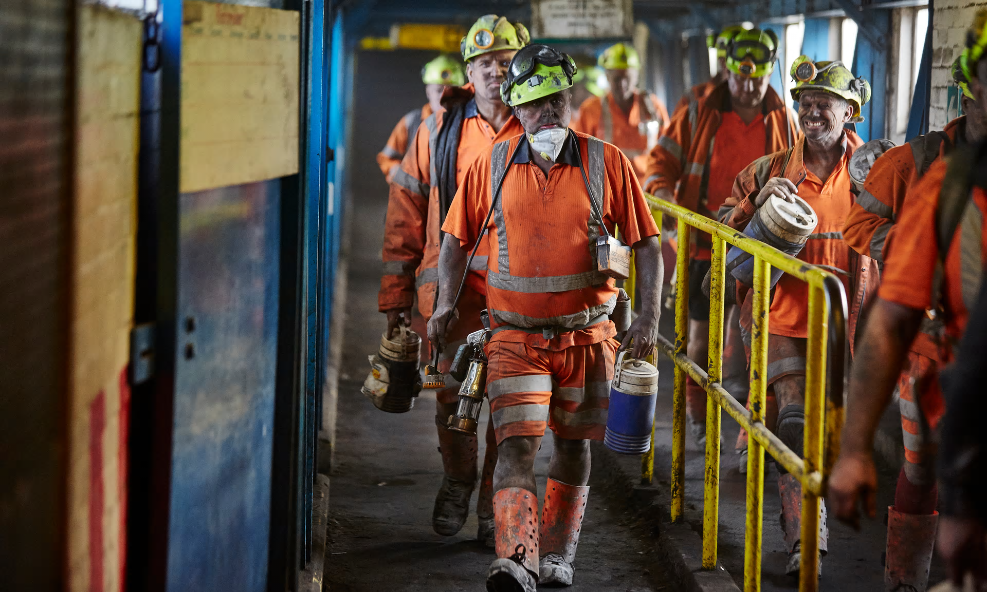
An orderly plan
Notes:
Second set of policies is around preventing short term economic hardship for miners - there are lots of policy options that have been used here, not only from mining.
First, voluntary relocation gives miners the opportunity to move to pits that are still in operation – this can be a way of smoothing the transition and ensuring that those miners who are most at risk stay in employment for as long as possible.
Second, early retirement packages can be used to protect older miners who stand little chance of finding alternative employment.
For younger miners, redundancy packages can protect income in the shorter term, while looking for new work.
Finally, social safety nets provide some level of protection, assuming that these exist.
One thing that comes out of previous experiences is that there is a lot of debate over what is an appropriate package for miners. In France, redundancy packges were extremely generous (Under the 1994 redundancy agreement, men as young as 35 can draw almost full salaries for life). On the one hand, this meant that there was little protest regarding closure and miners felt fairly compensated. On the other hand the policy was expensive and some commentators argue that it led to social problems such as domestic violence, alcoholism, and community breakdown.

Slide 14
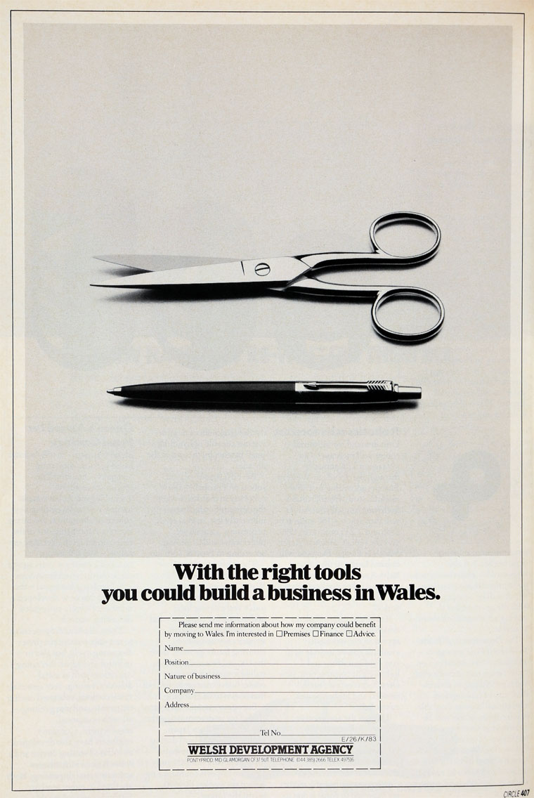





An orderly plan
Notes:
A second thing worth noting is that these short term mitigation measures need to be part of an integrated approach that ensures that miners and their dependents can secure alternative jobs.
This brings me to my third set of measures– building resilient economies and communities over the longer term. If mining is just a part of a diverse and healthy local economy, then focus can be more on retraining miners so that they participate in this economy. There are some good examples from the Netherlands where retraining was matched with the needs of the local economy and where policies focused on education for the next generation to ensure that children form mining families were able to find employment.
Where the local economy is focused on mining, it becomes more difficult, but there are some examples of at least partial success. For example, the Welsh government launched a program focusing on attracting inward investment through provision of facilities and financial incentives. On the one hand, this attracted around USD 6 billion into the country over 7 years and created jobs in new industries and improved infrastructure. On the other hand, the jobs weren’t necessarily right for miners or near the mines, and as the incentives dried up some of the investment has left.
(There are many more policies that I haven’t raised. In particular I haven’t mentioned much on the role of community organisations in maintaining and regenerating the social fabric – typically this has taken second place to economic impacts and measures, but increasingly recognised as important.)
The transitions that I have talked about were tiny in scale compared to the transition we are facing now. But even for these tiny transitions, there were benefits from preparing and planning in advance, and costs of not doing so; for large transitions the potential costs are much higher. I’m going to hand over to Hongxia who will tell us about the importance of plans in Shanxi.
------------------------------------------------
Between 1983 and 1991 it secured investment totalling over £4 billion. But, as the financial incentives dried up, some of the investment left other regions with lower labour costs, and continued low educational levels in the region meant that Wales was less successful in attracting more hi-tech industry. Questions also regarding both the location of the jobs created (typically away from the mining areas) and the suitability of jobs for miners (women and younger men). Nethertheless, inward investment was certainly helpful in the transition.

Slide 15
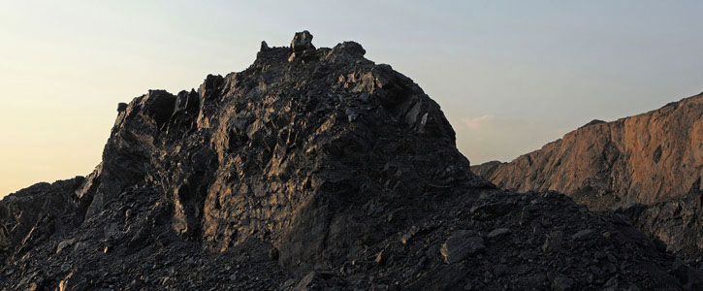
De-Capacity of Coal and Employment: A Case of Shanxi, China
Dr Hongxia Duan

Slide 16
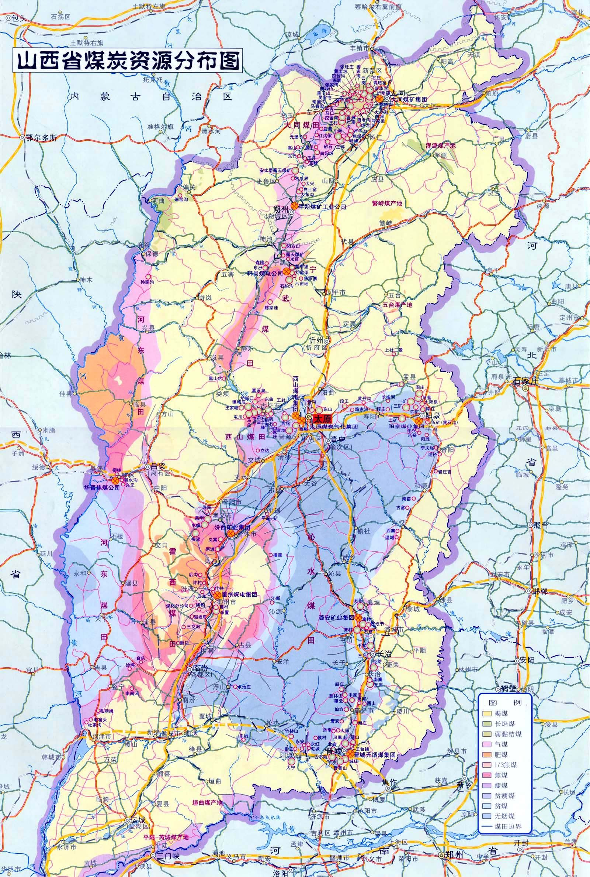
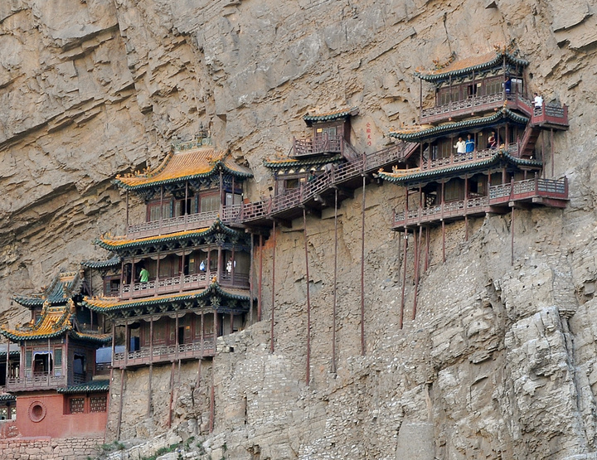
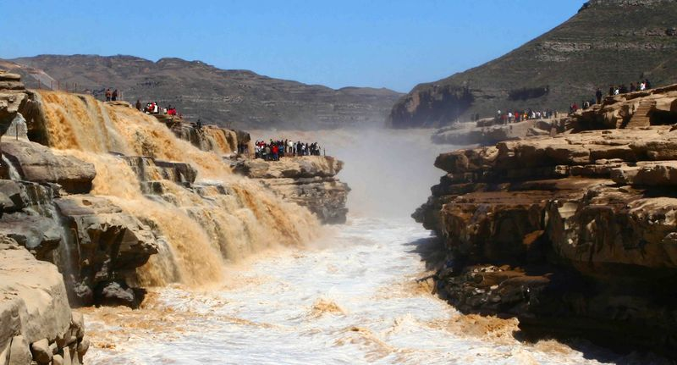
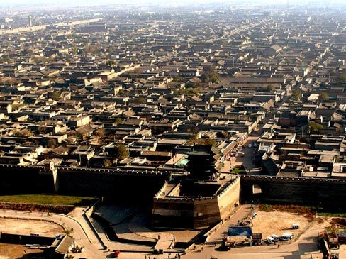

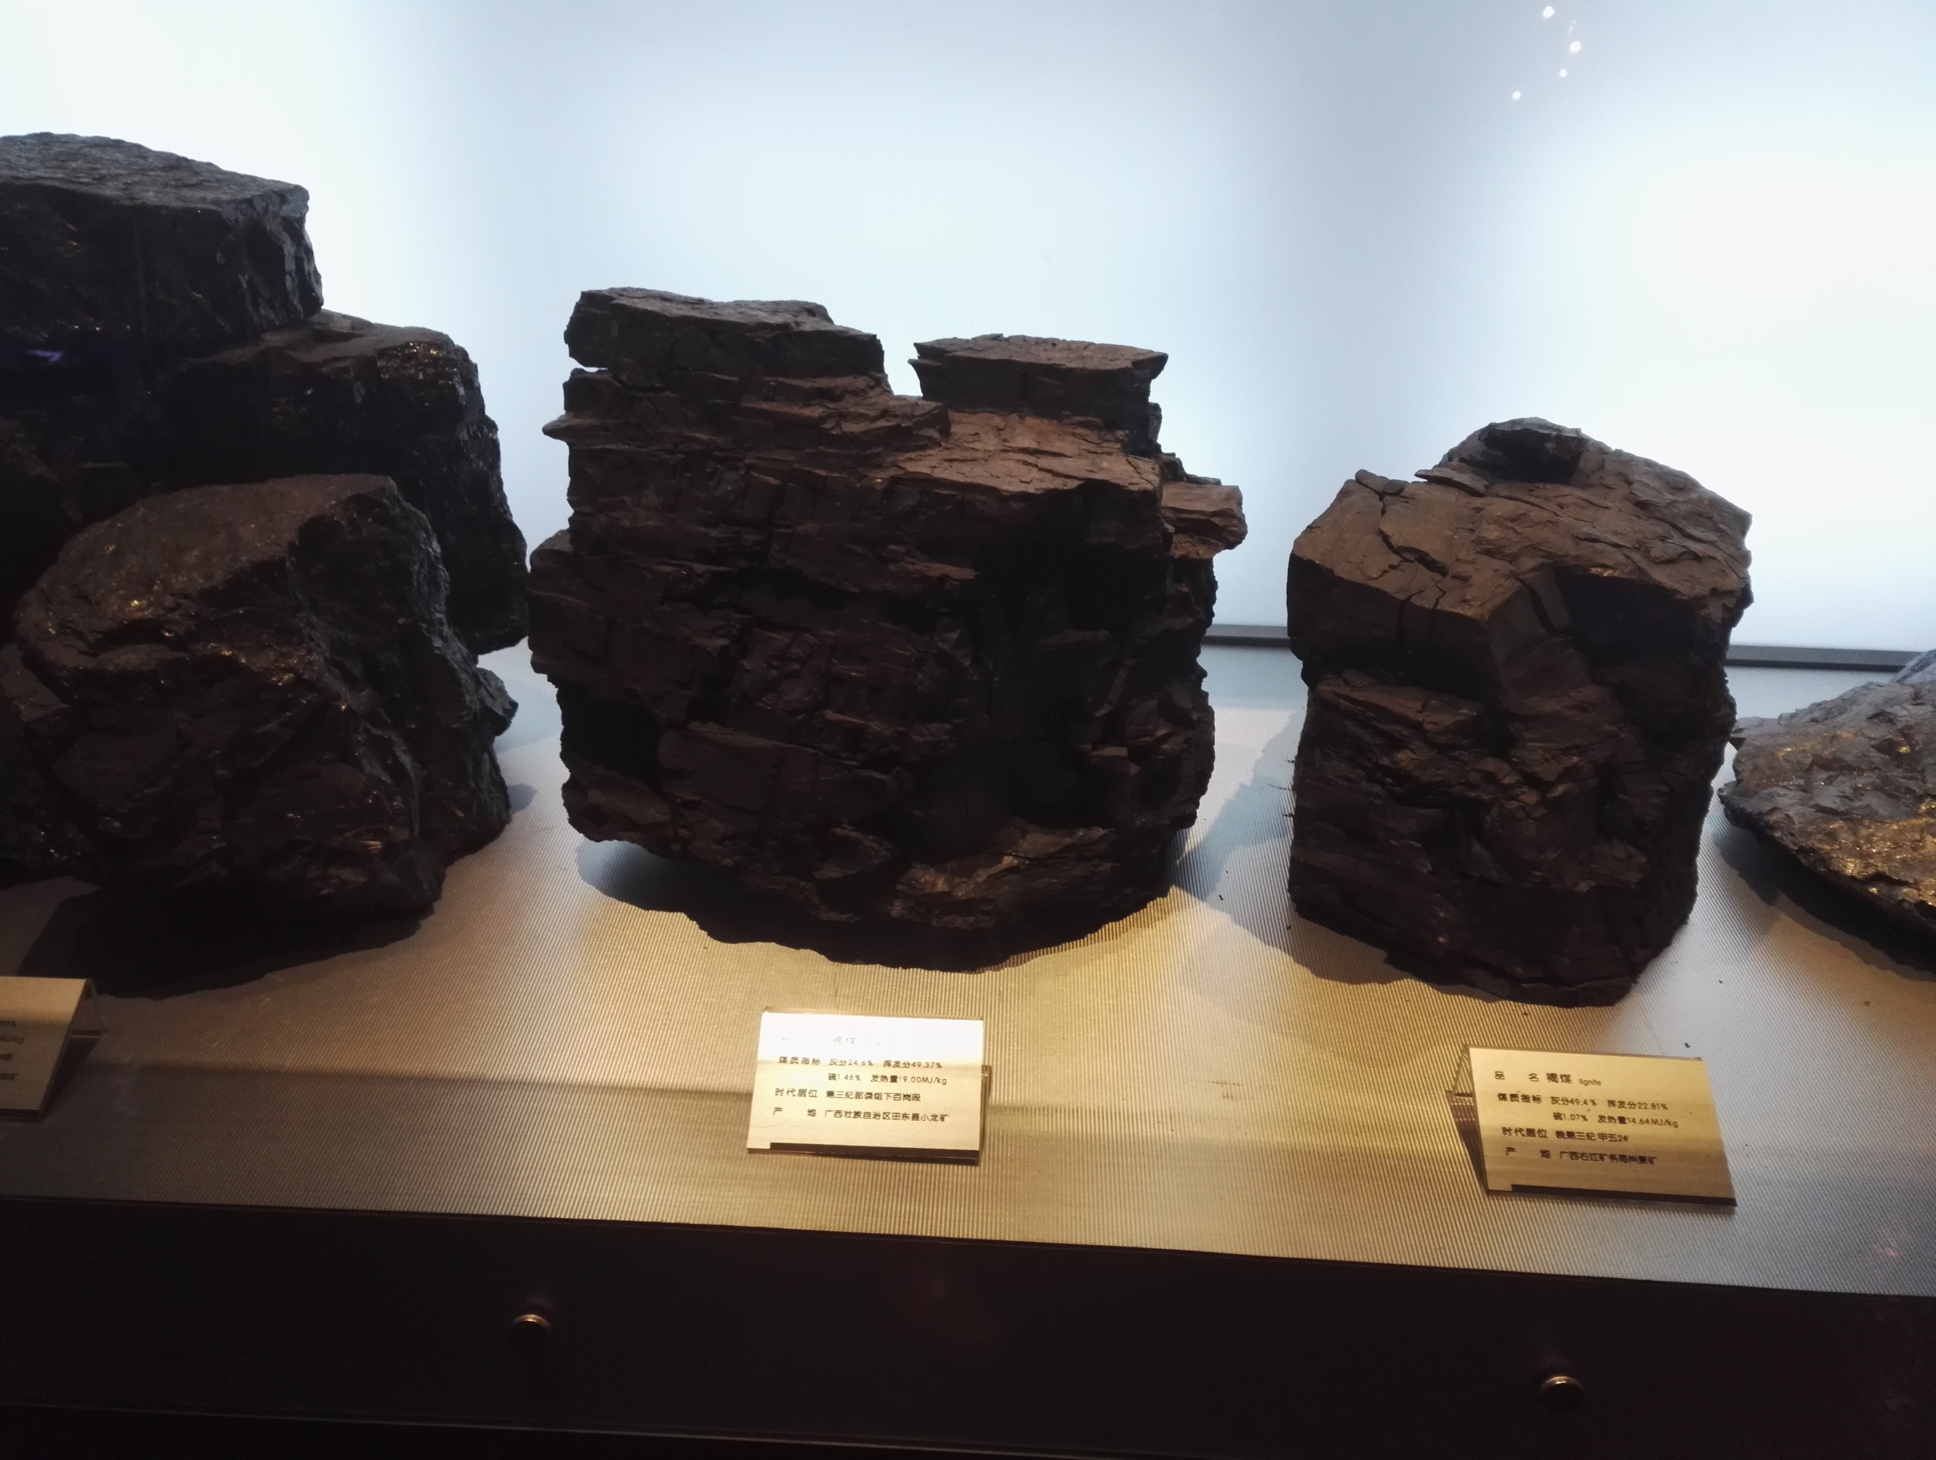
Shanxi and Coal
Population: 36.8 million (2016)
Total area: 156,807 km², of which 40% covered by coal resources
Proved coal reserves: 267.4 billion tonnes (estimated), about 1/4 of the national total
Cumulative coal production (end 2015): 16.6 billion tonnes; 11 billion tonnes transported to 28 provinces across the nation
Coal bed methane (CBM): over 1/3 of total national reserves

Slide 17
Transition in Shanxi
Closure of small illegal coal mines (1998-1999):
February 2016: the State Council issued de-capacity policy to address overcapacity in the coal/steel sectors over the next 5 years: phasing out 500 mn tonnes of coal capacity and 500 mn tonnes of production
  Closed: 3018 illegal, polluting, low quality and inefficient coal mines;
  Phase out: 70.78 Mt of coal capacity
The 13th Five Year Plan (2016-2020) for the Coal Industry in Shanxi
  reduce number of mines to 900
  suspend approval of new projects
  phase out mines with capacity less than 600,000 tonnes/year
  reduce 1 billion tonnes of coal capacity
10th Five Year Plan (2001-2005):
Over 4100 small coal mines shut down;
11th Five Year Plan (2006-2010):
planned reduction to 10,000 coal mines nationwide; 1,188 in Shanxi
Coal Industry consolidation and reconstruction (2008-2012):
Number of mines decreased to 1,053 and coal ownerships cut to 130 (from 2,200);
diversified structure of coal ownership emerged: SOEs (20%), private (30%), and mixed ownership (50%)
In 2015, Shanxi has 1,078 coal mines, with capacity of 1.46 billion tonnes, but its coal consumption and transported outside was 0.95 billion tonnes; cutting overcapacity is urgent

Slide 18
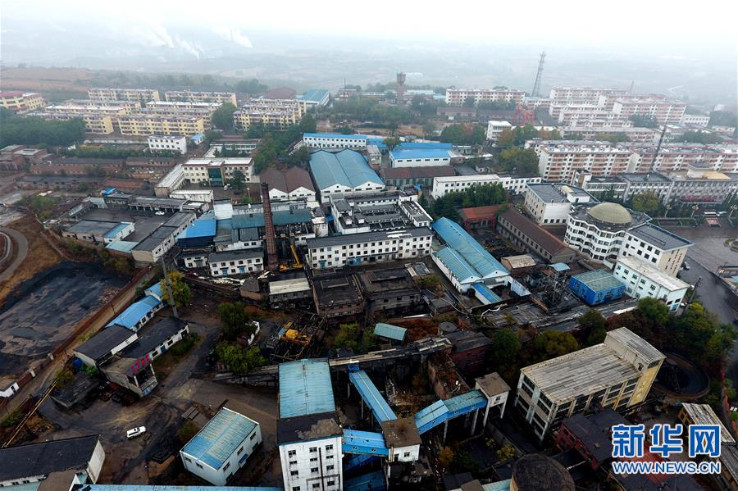
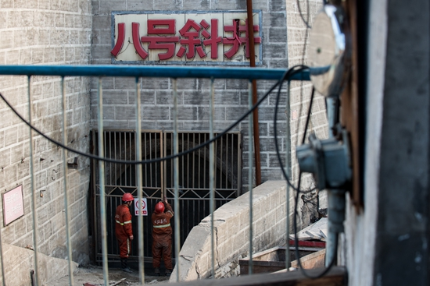
De-capacity of Coal
In 2016, the coal and steel sectors resettled more than 726,000 workers
Nationally, coal capacity was reduced by 290 million tonnes (planned 250 Mt) and managed 530,000 laid-off coal workers
Oct.13, 2016: LUAN group phased out depleted mine - SHIJIEGE - after 90 years of operation
By Oct. 2016, Shanxi had closed 25 mines, phased out 23.25 mn tonnes of capacity, and reduced coal production by 140 mn tonnes
Oct. 19, 2016: Tongjialiang pit in Datong closed:
78 years of mining;
the largest coal capacity (3 mn tonnes/year)
four generations of miners and a coal city,
4000 workers and more than 10,000 family members affected

Slide 19
Support for De-capacity in Shanxi Coal & Steel Sectors (2016-18)
Measures | Subsidies to job creation
Internal job transfer | Internally transferring employment (CNY1000-3000/person) Helping workers resettle (CNY1000-3000/person)
Job security | Keeping affected people employed (each person gets 50%-70% of last year’s total unemployment insurances)
Job transfer | Transferring employees to different sectors and regions (CNY1000-3000/person) Career service for job hunting and recommendation, differing on job locations (CNY 300, 600 or 800/person) Export of labor services (CNY 500-800/person)
Job training | Re-training unemployed workers (CNY 1200/person) Training self-employed workers (CNY1800/person)
Business Support | Incubator services to start-ups (CNY 10,000/household) Industrial parks for constructions (CNY 5000/household)
Self-Empmt | Self-employed workers 3 years social security fees Owners of small/micro companies: CNY 2000/yr for 3 yrs
Retirement | Shanxi urban citizens: early retirees receive 60-80% pension
Career service | Career centers to host job affairs for unemployed workers
Public sector | Public service positions for laid-off workers (bottom-line)
2016: Central goverment set up an Industrial Transition Fund with CNY 100 bn for transition arrangements in the coal (CNY 72.2 billion) and steel sectors
In 2016 Shanxi assisted more than 20,166 coal workers in making a transition
Shanxi received CNY1.2 billion of funds in 2016 and raised an additional CNY 0.365 billion to subsidize relocating coal employees: on average, each person received more than CNY 50,000 for job transfer and resettlement

Slide 20
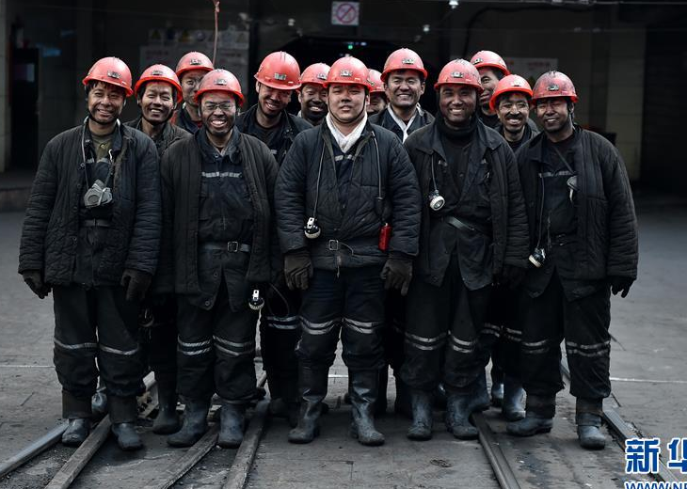

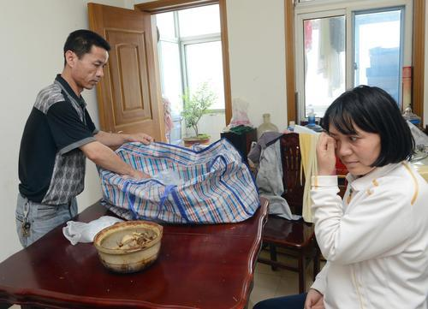


Where to go
Shanxi’s employment in the coal industry (2015): total 1.2 mn, on position 1.1 mn.
Employment at coal mines: 782,000, on position 745,200.
Ways to manage laid-off coal workers
  Internal job transfer
  Transfer to positions out of coal
  Self-employment/start-ups
  Training for new skills
  Early/internal retirement
  Public service jobs

Slide 21
Way Ahead – Challenges
Shanxi continues to shut down 18 coal mines and phase out 17.40 million tonnes of coal capacity by 2017
During the 13th Five Year Plan (2016-2020), Shanxi will assist more than 118,000 laid-off workers in the coal industry
Workers in 40s and 50s with extensive experience in coal
Limited education and skills
People in mining cities do not want to leave and change, they grew up and lived with coal over several generations
  Hoping for revitalization of the coal industry
  Expecting government to take care of them

Slide 22
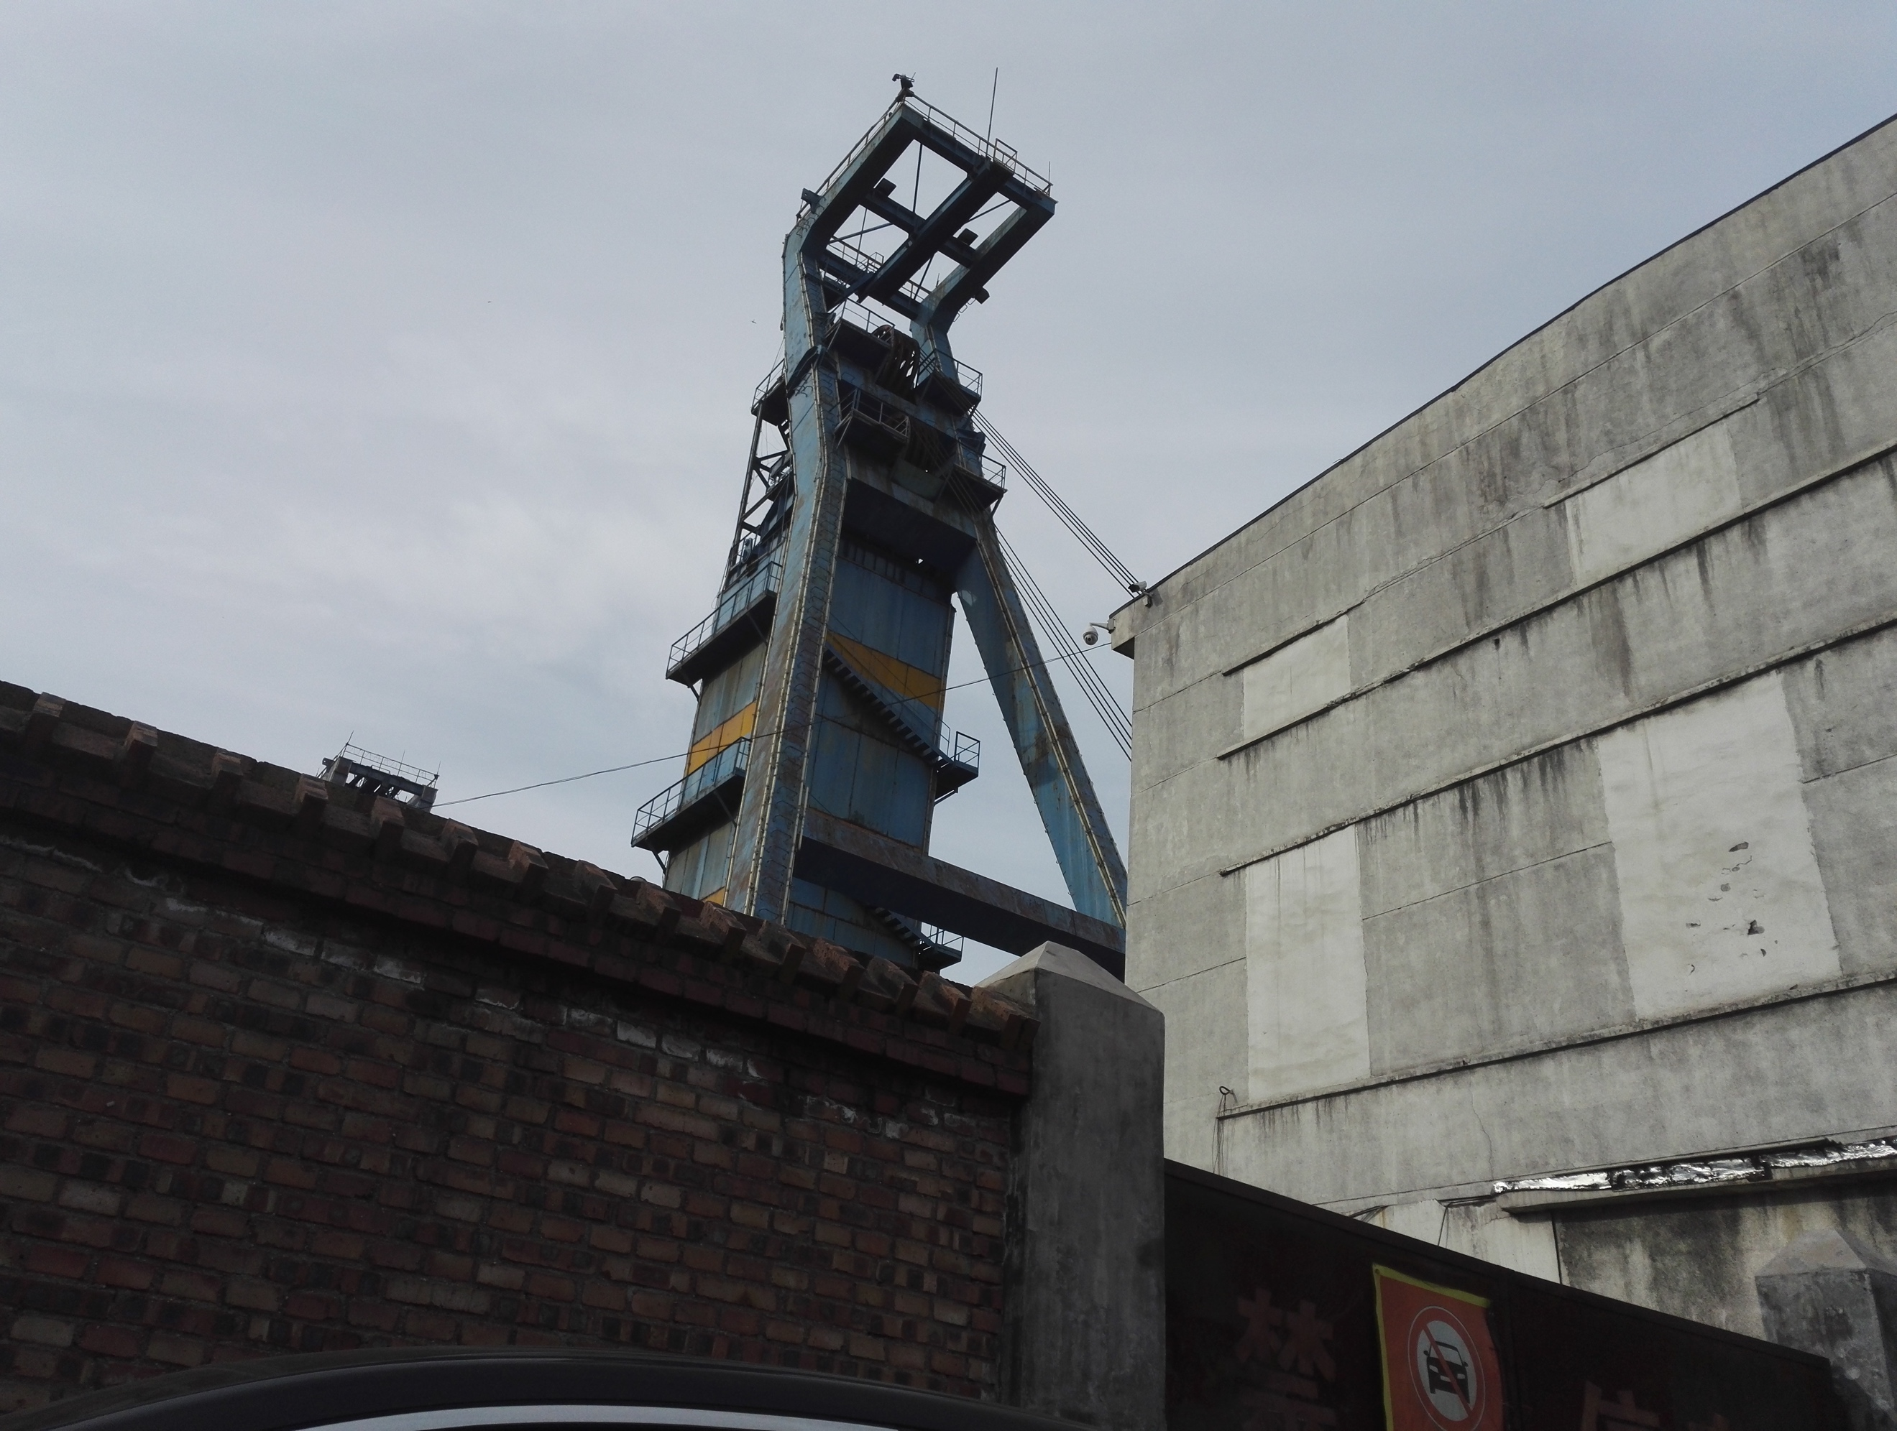
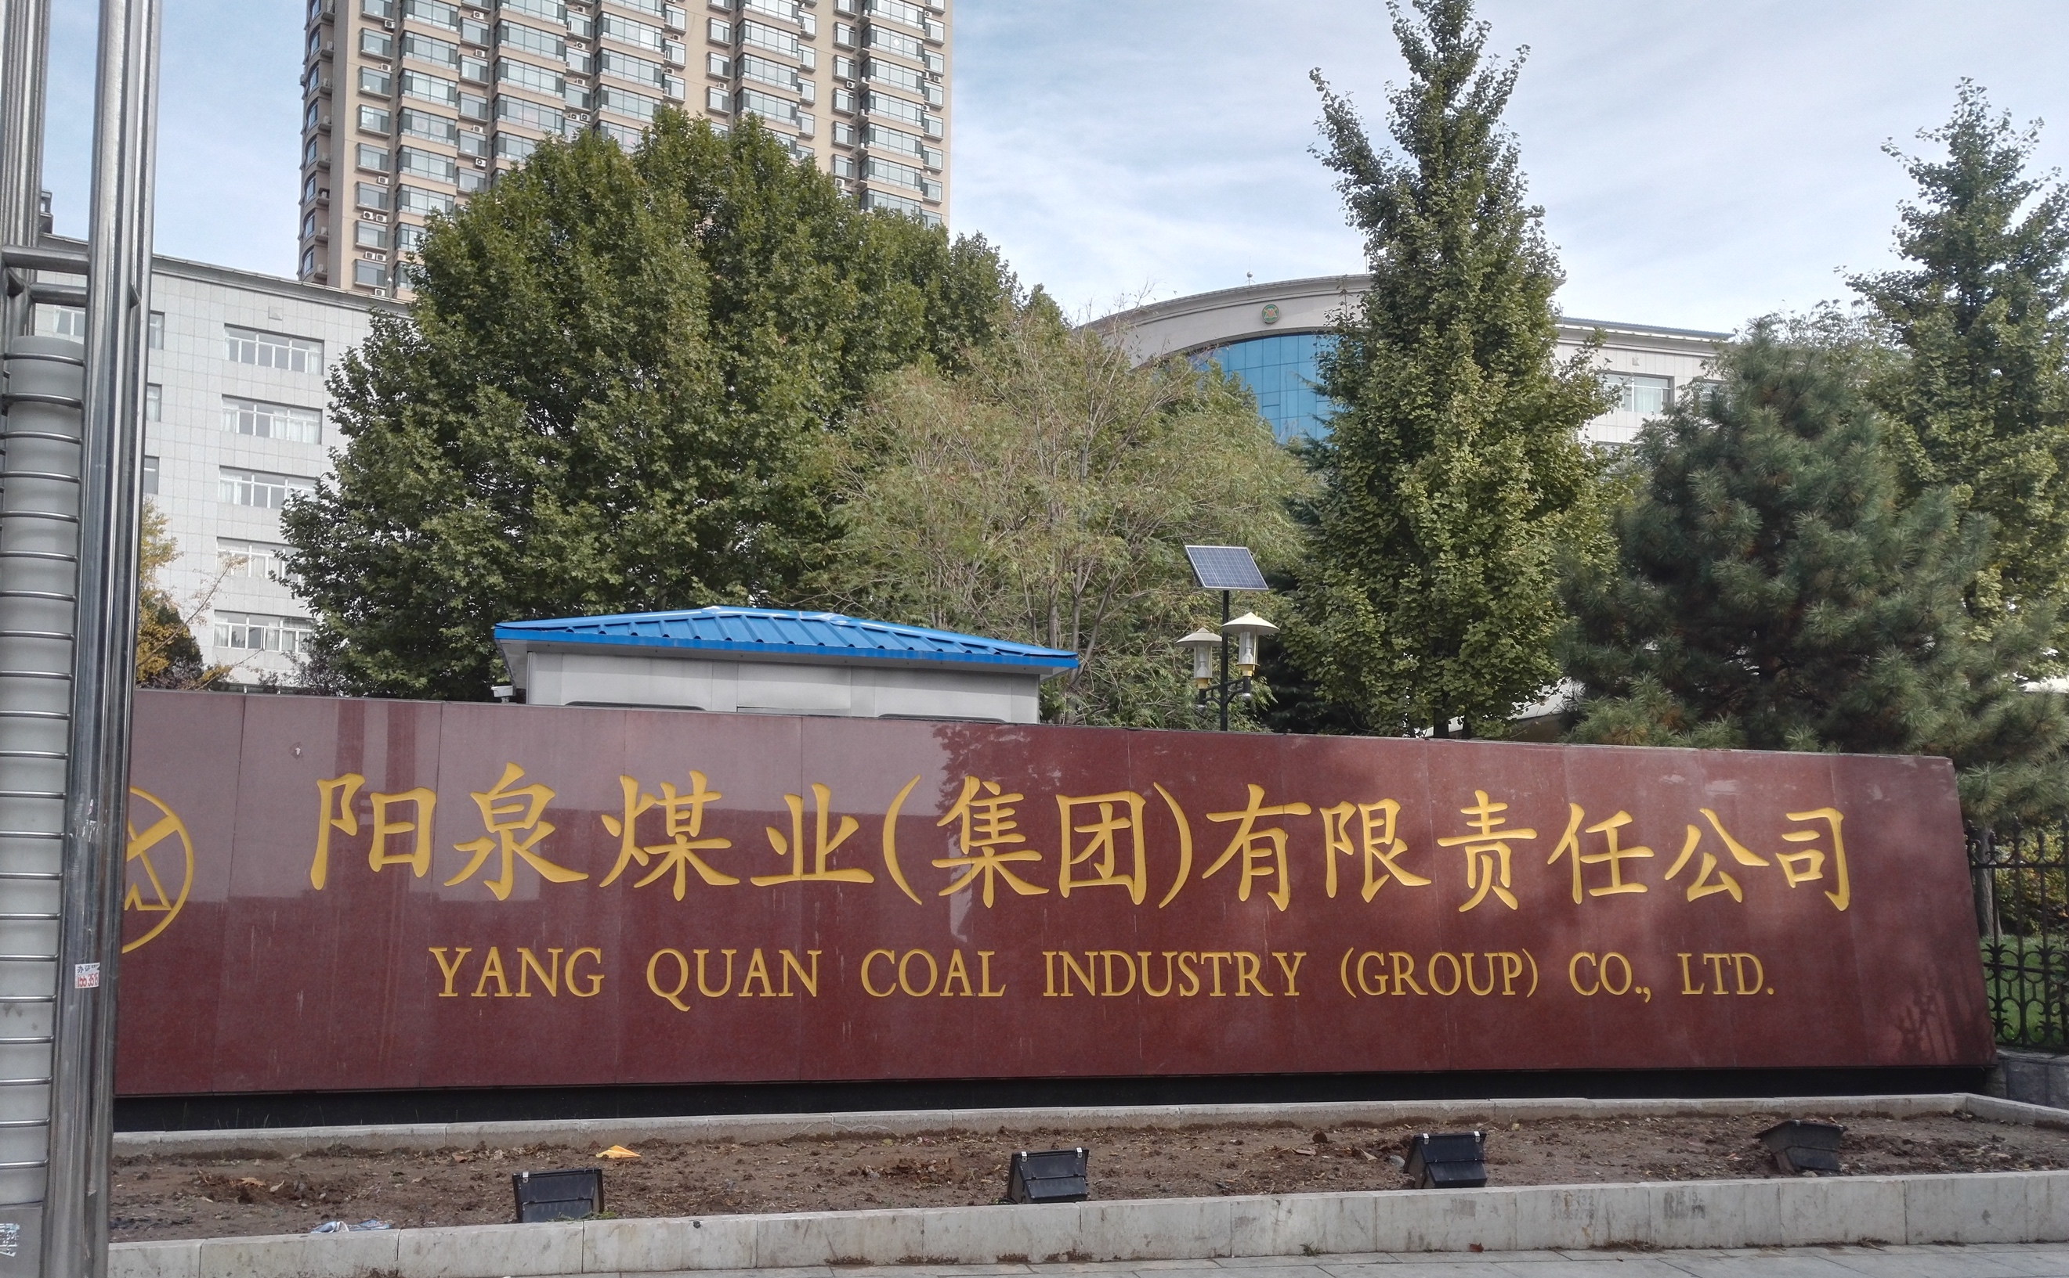
Potential Social Risks
Economic meltdown in Shanxi
Debt and financial crisis in major coal groups
Increasing cost of unemployment provisions
Far enough subsidizes from the reward funds
No funding sources for private coal mines
Some unemployment issues unsolved and new layoffs from coal closures and de-capacity
More layoffs from coal fired power plants and other heavy industries
Decreased employment in the coal industry
Industries replacing coal not mature, most likely not labor intensive
Limited internal positions for new workers
No more positions created by governments
Similar difficulties in heavy industries

Slide 23
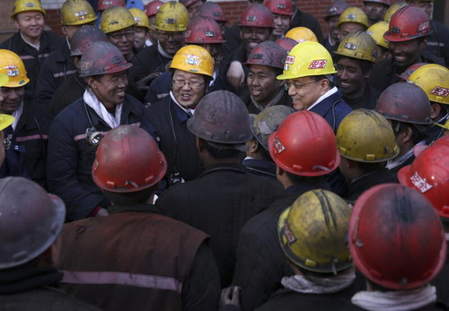
Support from Central Government
De-capacity is a must and there will be no hold back; affected workers reassigned to new posts rather than laid-off
If needed, financial support will be given, assuring the legal rights of workers and providing them with basic life insurance
Looking for a strategy to balance de-capacity, economic development, and employment
Structural change needs to focus on new growth and developments rather than old industries,
Exploring new job opportunities to reduce redundant labor

Slide 24
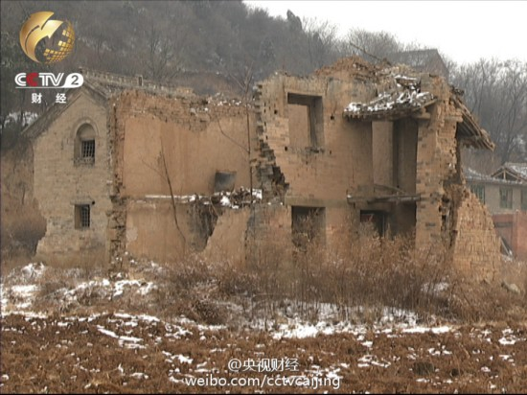
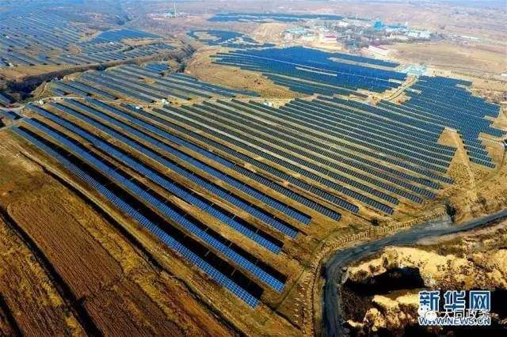
Solutions
Integrating ancient villages protection with coal mine recovery
Remediating abandoned coal mines, with investment of CNY 30 billion over the next 3 years
  Ecological/environmental recovery of 59 mines
  Soil remediation for 40 key recovery areas
National Solar Leading Program in Shanxi
  Solar bases built up in coal mining subsidence regions for poverty relief
National Tourism Initiatives for Poverty Relief

Slide 25
Innovation & Efficiency
  Technology: developing new business and industry
  Ideology: turning risks caused by coal into opportunities
  Use resources wisely and put people with skills in right place
  Improve coal services and explore potentials from corporate level
Establishing a complete social security system
Setting up a special fund for coal transition
  new business development, innovation, technology
Enhancing vocational education system
  Changing the way of thinking: coal vs beyond
    openness and cooperation
  Speeding up state-owned enterprisers reform

Slide 26


Thanks to our funders:

Slide 27
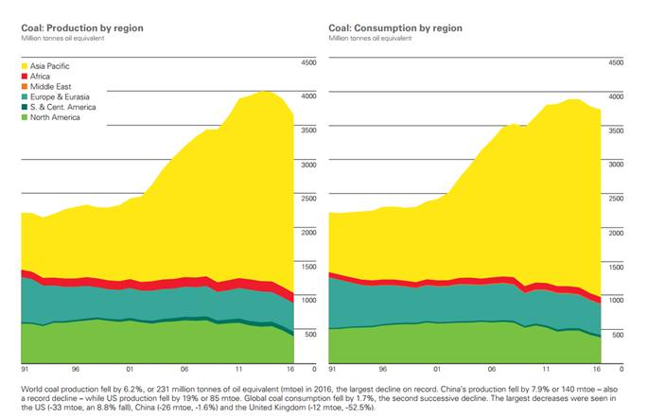
Coal transition: a global trend?
Notes:
BP Statistical Review of Energy

Slide 28
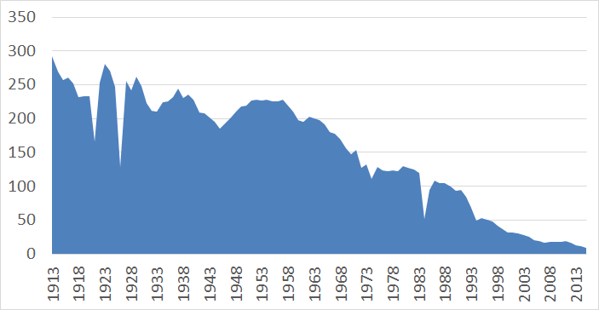
What does transition look like?
Presentation Title Presentation Date
Notes:
So what could transition look like? Well, the transition has already taken place (to varying degrees) in a number of countries: France, Netherlands, Spain, Poland, Germany, Japan. This is coal production in the UK from the beginning of the 20th centrury. Peak in production was in 1913, when 1.1 million miners produced 292 million tonnes of coal. Declined through the twentieth centur, and today there is no production
Why? First, deposits became more difficult to access, labour costs rose meaning that mining became increasingly unprofitable (and subsidised). Incresaing, users turned to foreign coal. Second, North sea oil and gas and later nuclear came on line. Third, increasing concern about smog from burning coal.

Slide 29
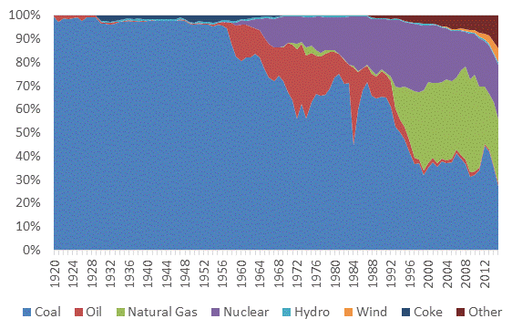
What does transition look like?
Notes:
This was the result

Slide 30
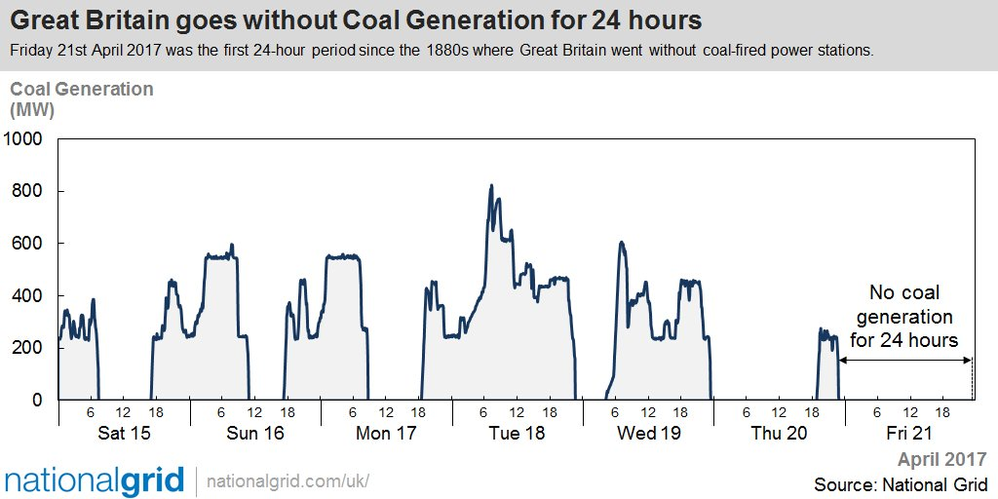
What does a transition look like?
Presentation Title Presentation Date
Notes:
More recently: April 2017, the UK had its first coal free day since the 1880s. The UK is not yet a coal free economy, but is moving rapidly in that direction.

Slide 31
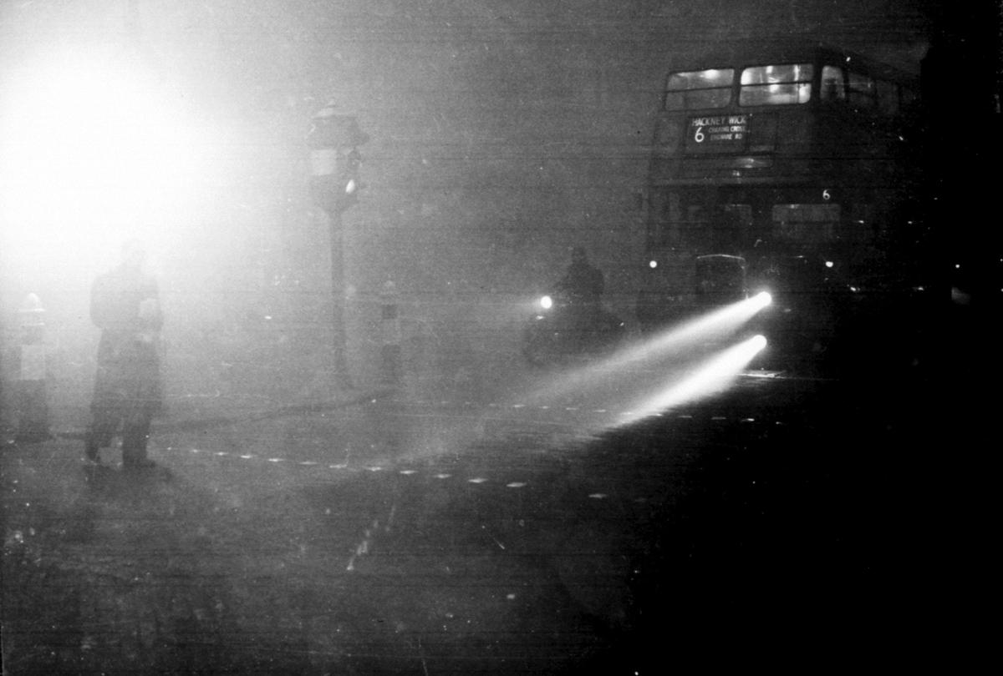
The writing on the wall
Notes:
London 1952 Smog- caused by cold weather, lack odf wind, lots of cola fired power generation. Lasted 4 days
In later weeks, the government would estimate that 4,000 lives were brought to an early end by the smog. The real number of fatalities is now believed to be closer to 10,000.
Result was the clean air act of 1956

Slide 32
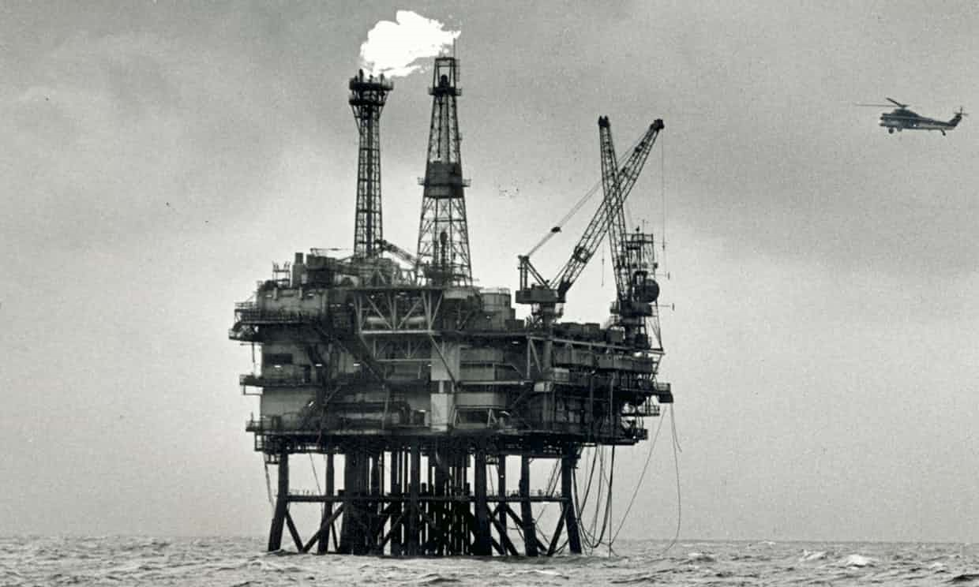
The writing on the wall
Notes:
But it has not always been about RE. In the UK and the Netherlands, coal was pushed out by North Sea oil and gas. In France and Japan, it was nuclear power.

