Slide 1
Another Great Leap Forward ? The Next Phase in Chinese Investment in Latin America

Slide 2
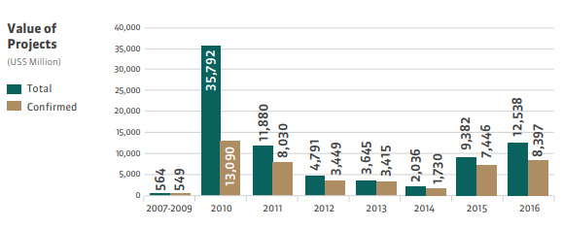
Figure 1: Evolution of Chinese investment projects in Brazil – 2007-2016

Slide 3
Figure 2: Estimated FDI inflows from China, by country of destination – 2005-October 2017 (Billions of dollars) Source: Economic Commission for Latin America and the Carribbean (ECLAC), on the basis of Financial Times, fDi Markets, and Bloomberg

Slide 4
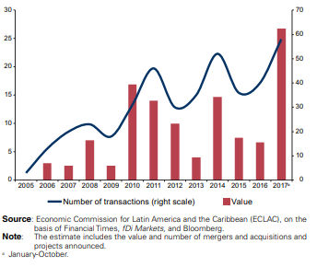
Figure 3: Estimated FDI inflows from China to Latin America and the Caribbean – 2005-October 2017 (Billions of dollars and number of transactions)

Slide 5
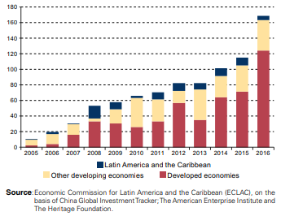
Figure 4: FDI outflows by groups of destination economies 2005-2016 (Billions of dollars)

Slide 6
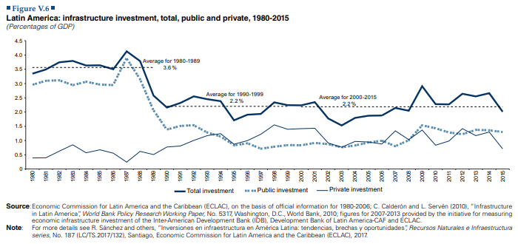
Figure 5: Infrastructure investment in Latin America (total, public, and private) – 1980-2015

Slide 7
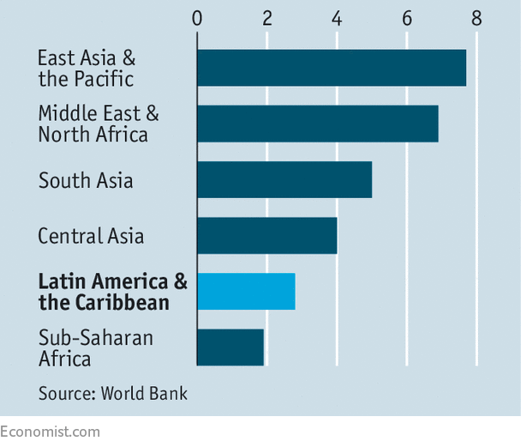
Figure 6:
Public and private infrastructure investment 2017
(% of GDP)

