Slide 1
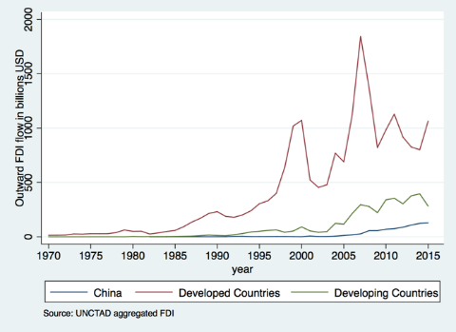
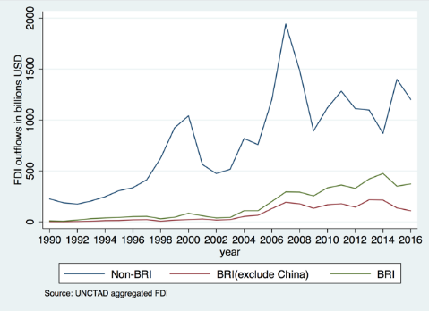
Global FDI
Figure 2: Trends of outward FDI
Stylized Fact 1: Developed countries are the main sources of FDI around the world, but FDI from developing countries, in particular, China is rising.

Slide 2
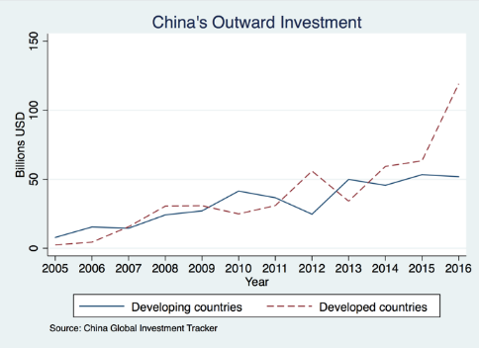
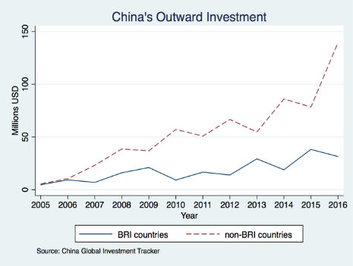
China’s Outward FDI
Figure 7: Trends of China’s outward investment
Stylized fact 2: China’s ODI growth is led by its investment towards developed and non-BRI countries while the majority of China’s construction contracts are in developing and BRI countries.

Slide 3
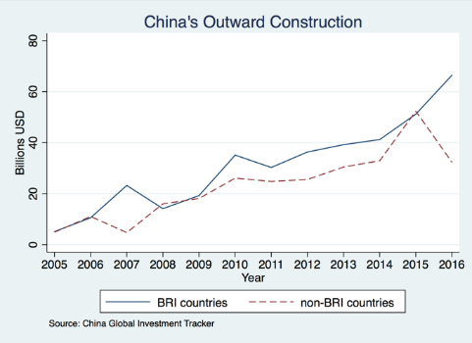
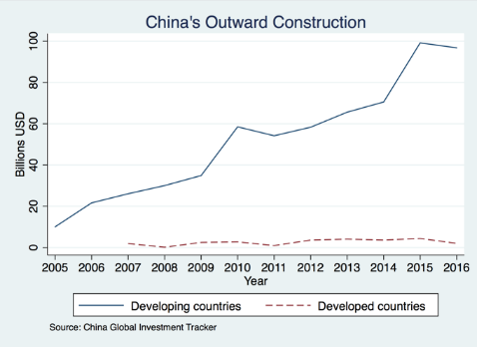
China’s Outward Infrastructure Projects
Figure 8: Trends of China’s foreign construction contracts
Stylized fact 2: China’s ODI growth is led by its investment towards developed and non-BRI countries while the majority of China’s construction contracts are in developing and BRI countries.

Slide 4
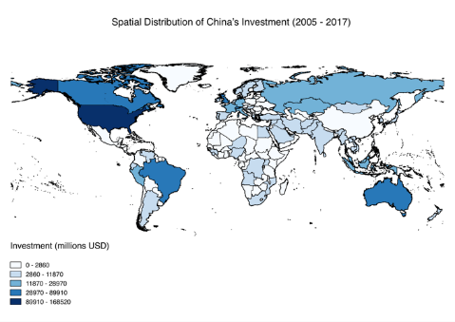
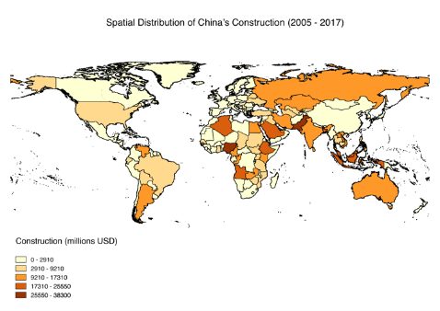
The Spatial Distribution of China’s ODI
Figure 9: The spatial distribution of China’s general outward and construction investment
Stylized fact 2: China’s ODI growth is led by its investment towards developed and non-BRI countries while the majority of China’s construction contracts are in developing and BRI countries.

Slide 5
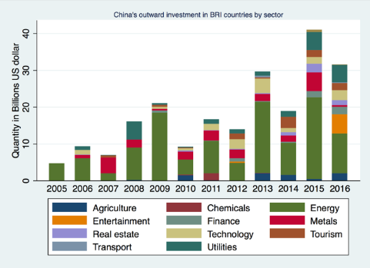
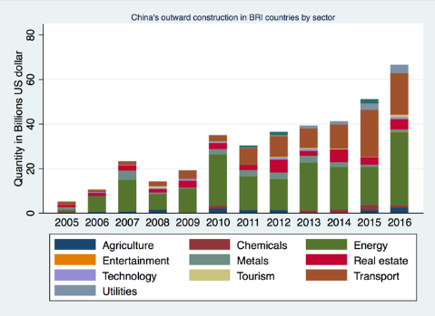
The Sector Composition of China’s ODI
Figure 11: Trends of China’s general outward and construction investments in BRI countries by sector
Stylized fact 3: Energy is the leading sector in both China’s ODI and construction contracts in BRI.

Slide 6
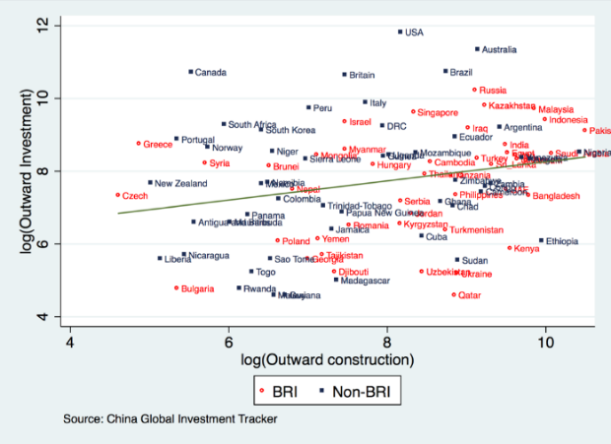
Figure 19: The correlation between China’s general outward investment and construction investment (based on aggregate values from 2005-2016)
Stylized Fact 4: China’s infrastructure activities serve as a catalyst for FDI in manufacturing and service sectors. A 10-percent increase in construction contracts is associated with an increase in FDI by 7 percent in the same year, 11 percent the next year, and 16 percent in two years.

Slide 7
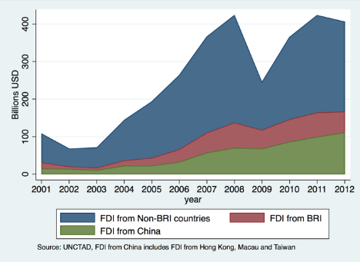
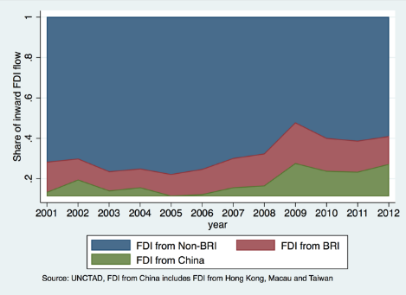
FDI in B&R
Figure 4: The decomposition of BRI’s inward FDI
Stylized Fact 5: The majority of BRI’s FDI comes from non-BRI countries but the share of intra-BRI FDI, in particular, China’s FDI in BRI, is growing.

Slide 8
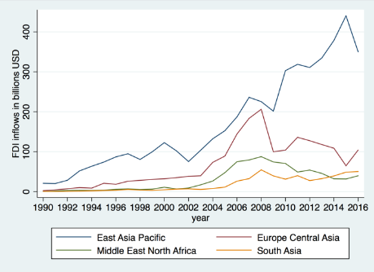
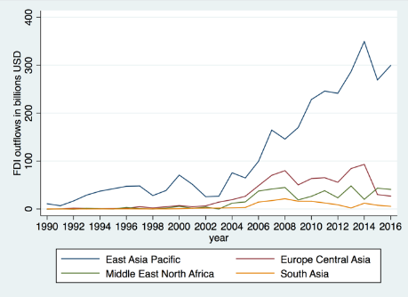
FDI in B&R
Figure 5: FDI patterns within BRI by Region
Stylized Fact 5: The majority of BRI’s FDI comes from non-BRI countries but the share of intra-BRI FDI, in particular, China’s FDI in BRI, is growing.

Slide 9
FDI and Economic Growth
Stylized Fact 6: Increased FDI inflow is associated with faster GDP, export and import growth and the effects are found stronger for lower-income countries.

Slide 10
FDI and Economic Growth
Stylized Fact 6: Increased FDI inflow is associated with faster GDP, export and import growth and the effects are found stronger for lower-income countries.

