Slide 1
tracking China’s coal transition
Melanie Hart
Center for American Progress

Slide 2
Key takeaways
China’s new coal-fired power plants are more efficient than anything operating in the United States.
China’s emission standards for conventional air pollutants from coal-fired power plants are stricter than the comparable U.S. standards.
Demand for coal-fired power is falling so quickly in China that the nation cannot support its existing fleet.
Many of the coal-fired power plants that skeptics point to as evidence against a Chinese energy transformation are actually white elephants that Chinese leaders are already targeting in a wave of forced plant closures.
If current U.S. regulatory trends continue, by 2020, every coal plant operating in the United States would be illegal to operate in China.

Slide 3
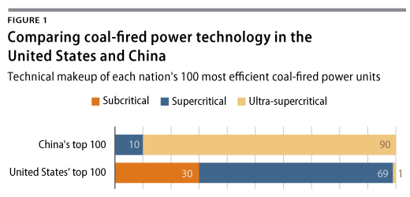
top 100: technology type

Slide 4
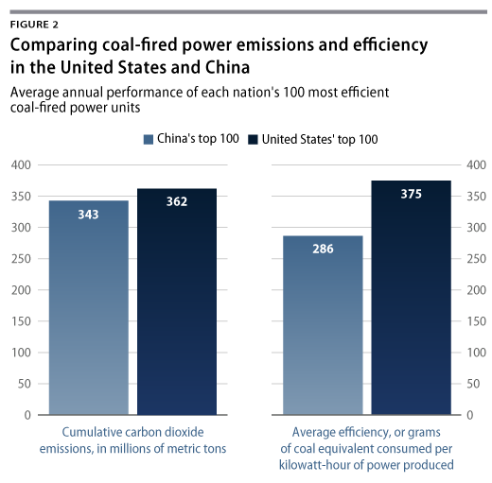
Top 100: Emissions and efficiency

Slide 5
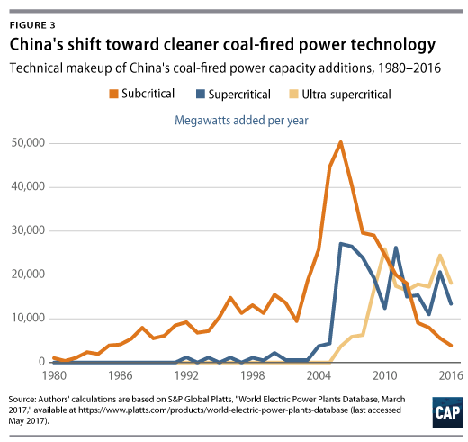
Capacity additions in operation as of 2017

Slide 6
Coal power standards

Slide 7
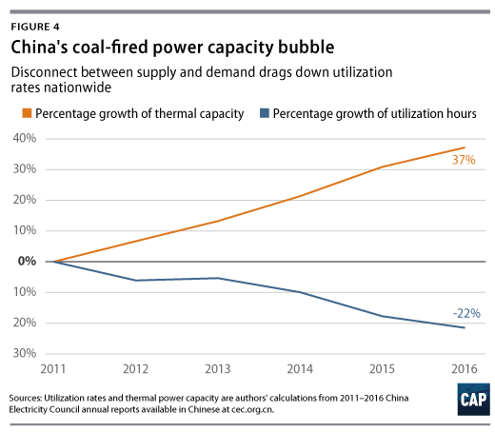
overcapacity → declining utilization

Slide 8
China regulatory timeline: Beijing aims to rein in the coal-fired power bubble
October 2014 -- “Government Approvals for Investment Projects Catalogue 2014 Version” (State Council)
November 2015 -- “Notice on the Appropriate Use of Project Approvals for Electric Power Plants Under Decentralized Authority” (National Development and Reform Commission and National Energy Administration)
March 2016 -- “Notice on Promoting the Orderly Development of Coal Power” (National Development and Reform Commission and National Energy Administration)
March 2016 -- “Notice on Establishing a Coal Power Planning and Construction Risk Early Warning Mechanism” (National Energy Administration)
April 2016 -- “Notice on Moving Forward to Phase Out Outdated Production Capacity in the Coal Power Industry” (National Development and Reform Commission and National Energy Administration)
September 2016 -- “Notice Canceling Multiple Coal Power Projects Lacking Approved Construction Conditions” (National Energy Administration)
November 2016 -- “13th Five-Year Development Plan for the Electricity Sector (2016-2020)”
January 2017 -- Letter Regarding Scale of Coal Production Being Put into Operation Across Multiple Provinces in 13th Five-Year Plan Period (National Energy Administration)

Slide 11
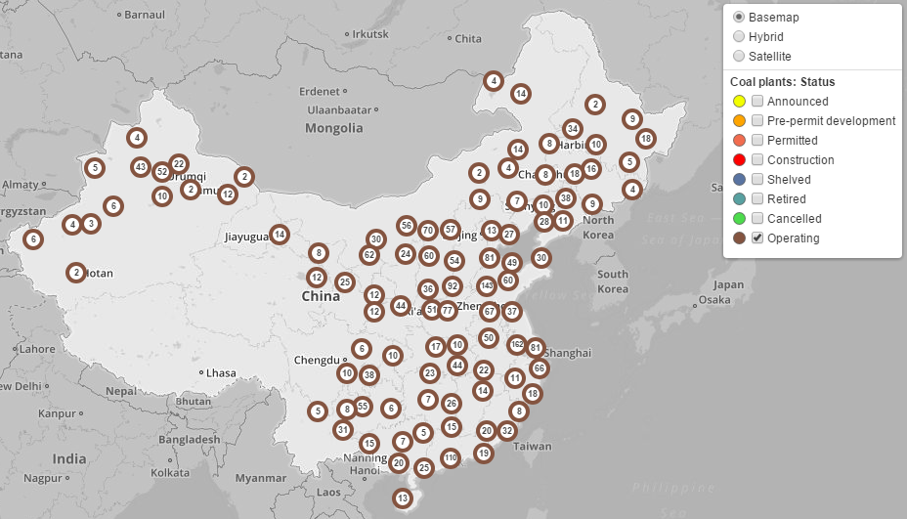
Operating units

Slide 12
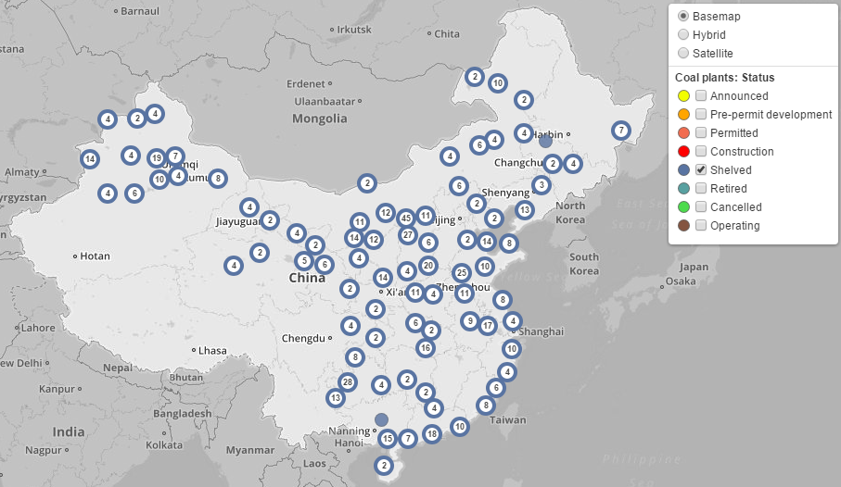
shelved units (PROGRESS HALTED FOR 2+ YEARS)

Slide 13
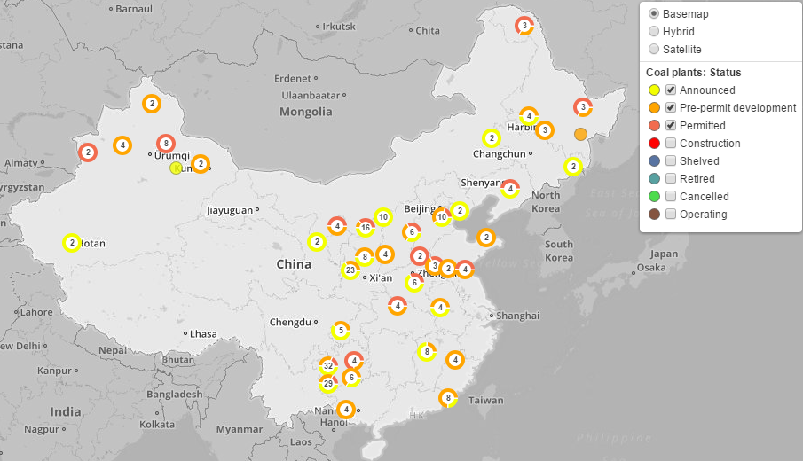
Pre-construction

Slide 14
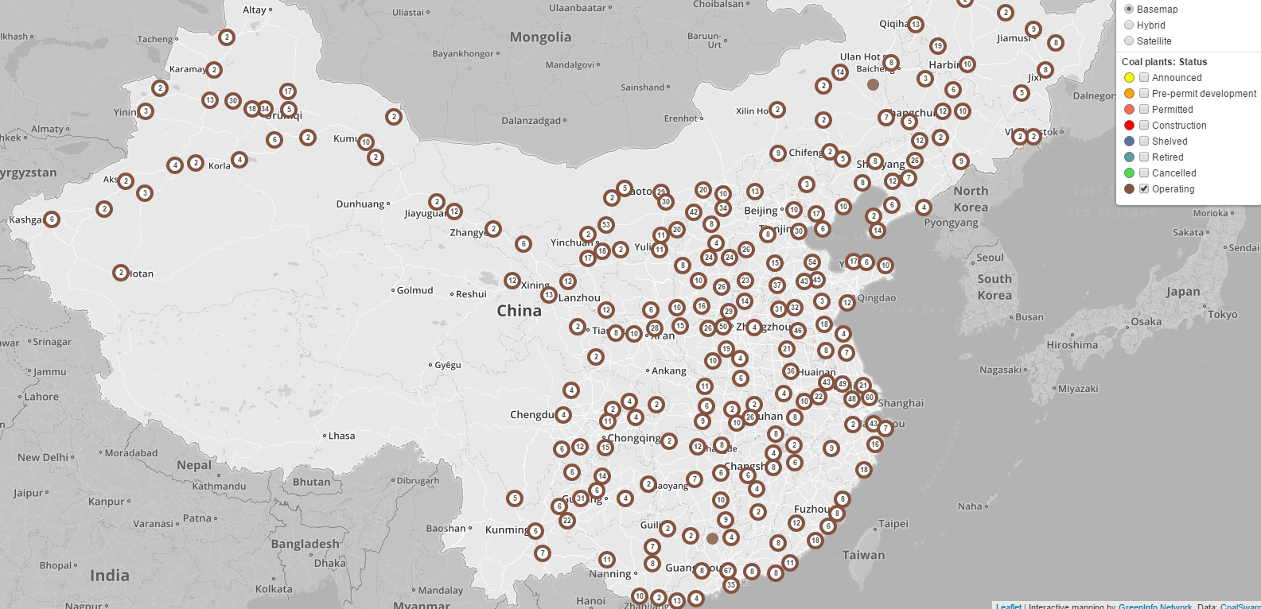
COALSWARM Coal plant tracker

Slide 15
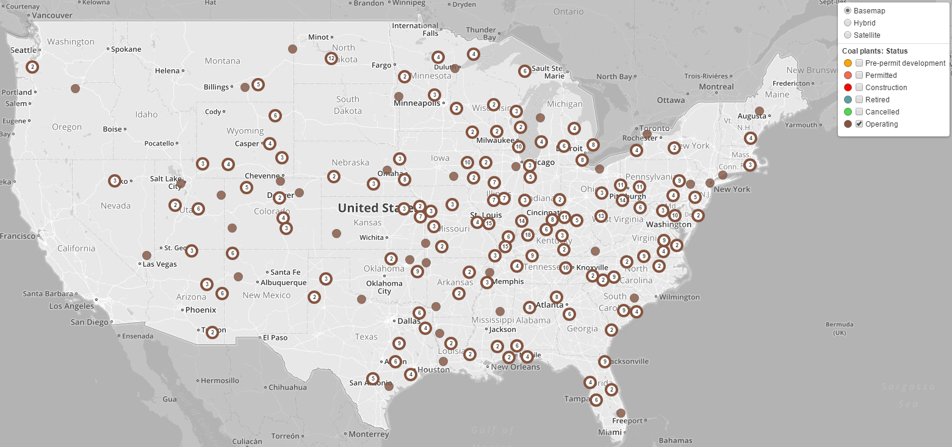
COALSWARM Coal plant tracker

Slide 16
Sources
Melanie Hart, Luke Bassett, and Blaine Johnson, “Everything You Think You Know About Coal in China Is Wrong,” May 15, 2017, available at https://www.americanprogress.org/issues/green/reports/2017/05/15/432141/everything-think-know-coal-china-wrong/.
Melanie Hart, Luke Bassett, and Blaine Johnson, “Research Note on U.S. and Chinese Coal-Fired Power Data,” May 15, 2017, available at https://www.americanprogress.org/issues/green/reports/2017/05/15/432136/research-note-u-s-chinese-coal-fired-power-data/.
CoalSwarm, “Global Coal Plant Tracker” (2017), available at http://endcoal.org/tracker/.

