Slide 1
China Electricity Reform:
Lessons from challenges to earlier reforms
Mun Ho
Resources for the Future &
Harvard China Project on Energy, Economy and Environment
Wilson Center, China Environment Forum
China’s Great Green Grid?
Capturing Wasted Wind and Solar Power
June 12, 2017

Slide 2
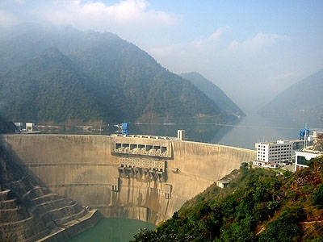
Ertan Hydropower Plant, Sichuan—3.5GW
Completed 2000

Slide 3
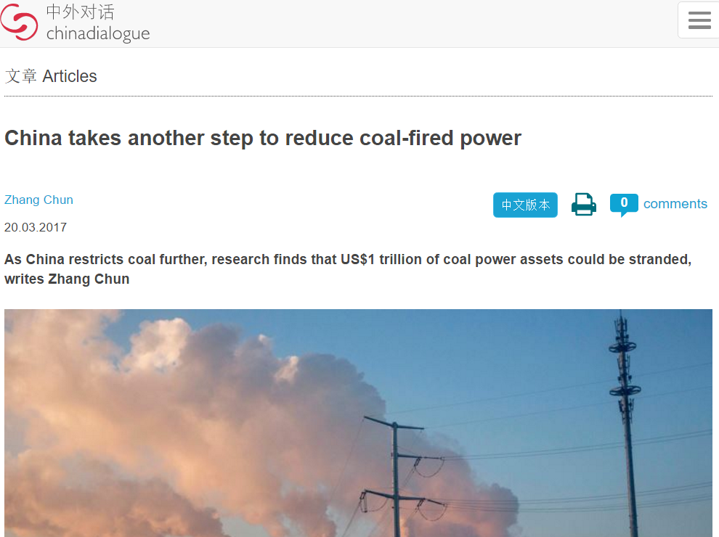

Slide 4
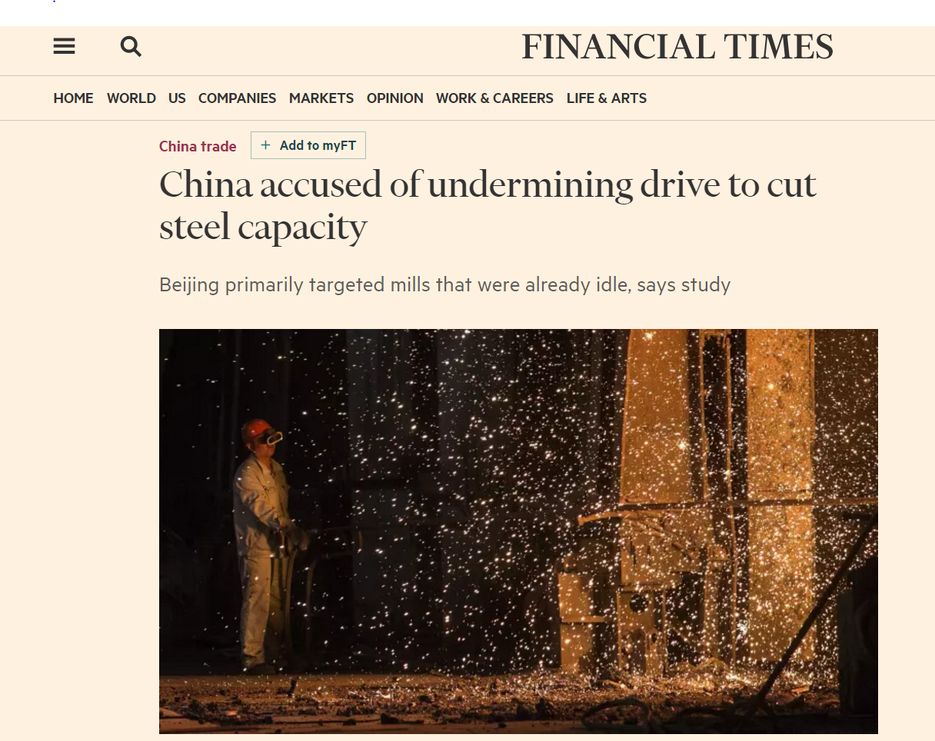

Slide 5
Year | Event
1985 | Independent Power Producers allowed; Power Purchase guarantees; Fair dispatch
1997/8 | State Power Company established; Ministry of Power abolished
1998 | Breaking power generation off from the State Power Company; end of severe power shortages
1999 | Ertan incident; curtail hydropower
2002 | "Power Sector Reform Scheme" (Document No. 5) SPC broken into 2 grid Co. and 5 gen. Co.
2003 | Inter-provincial/regional contracting introduced
2004 | The "Transparent, Fair and Impartial" rule for dispatch (“san gong” or 3-public principles)

Slide 6
Year | Event
2004 | Direct contracting between generators and consumers allowed
2006-2010 | 11th FYP targets: shutdown of small plants and SO₂ targets
2007 | "Energy Conservation Dispatch" Rules
2008 | Generation Rights Trading started
2011 | NDRC reasserted control over prices for interprovincial contracts made by grid Company after seeing abusive pratices
2015 | Decree no. 9 “Deepening Reform”
2016/7 | Huge excess capacity; investment decision-making returned to central government

Slide 7
Direct Contracts 2004
2004 SERC introduced Direct Contracting between Power Producers and major consumers; with a negotiated price to generator.
RESULTS:
lower prices for the major consumers.
But generators had little incentive to participate
(guaranteed prices and “fair dispatch”)
Confusion over whether contracted hours are part of base hours. SERC decided in 2009 to excluded these hours from the base.

Slide 8
Composition of energy contracts, 2010
Form of contract | Energy (TWh) | (%)
Base-hour allocation | 2740 | 81.06
Direct contracting | 8.04 | 0.24
Inter-provincial/regional contracting | 592.5 | 17.53
Generation right trading | 149.3 | 4.42
Total national electricity production (excl self-gen) | 3380 | 100

Slide 9
Energy Conservation Era
2006+ era of greater consciousness of efficiency and pollution. In 11th Five-year plan 2006-2010 two major innovations:
Shutdowns and “generation rights trading”
Energy conservation dispatch

Slide 10
Generation rights trading 2008
Small plants required to shut down.
As compensation, they can sell their generation quotas for 3 years; thus starting “generation rights trading.” Resulted in some efficiency improvements but limited success due to:
Emission control costs not fully compensated (dirty plants not willing to sell their quotas)
Trading subject to intervention by provincial govt.
Unreasonable transmission charges by grid co.

Slide 11
Energy Conservation Dispatch 2007
Provincial governments produce a “priority order” for their generators:
Renewables, hydro, nuclear, CHP, gas, & coal
Among coal units: 1st by heat rates, 2nd by pollutants
8 pilots: Jiangsu, Henan, Sichuan, Guangdong, Guizhou, Guangzi, Yunnan, Hainan

Slide 12
Provincial Dispatch Pilot Difficulties
Some got fewer hours than guaranteed
Uncertain compensation
Overturning “fair dispatch” upset many
Strongly opposed by powerful coal generators
Jiangsu, Henan, Sichuan gave up, returned to old system

Slide 13
Readings
“The Real Reasons China is Struggling to Control its Air Pollution Problems” Nielsen and Ho, Fortune 1/10/2017
http://www.fortunechina.com/business/c/2017-01/15/content_277037.htm
Ho, Wang and Yu (2017). China’s Power Generation Dispatch, Resources for the Future Report, April.
http://www.rff.org/research/publications/china-s-power-generation-dispatch
Harvard China Project page:
https://chinaproject.harvard.edu/people/mun-s-ho

Slide 14
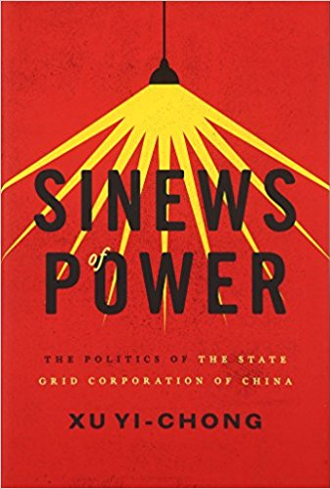

Slide 15
Extra slides

Slide 16
“Fair Dispatch”
1985. Independent Power Producers (IPP) allowed to meet shortages. Power Purchase Agreements (PPA) – guarantee of payback period.
Start of “Fair Dispatch” system where all generators, regardless of efficiency and pollution control, are allocated equal generation hours.

Slide 17
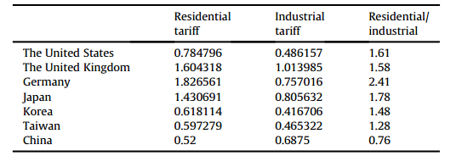
Unlike most other countries, prices in China
discriminate against large industrial users

Slide 18
Direct Contracts, cont.
Provincial govt. happy to have discretion to bypass the prices set by the central govt. – favor local enterprises with cheaper electricity under direct contracting.
Provincial govt. pressure generators to enter into these contracts. To compensate the generators somewhat, they were allocated more hours (i.e. violating fair dispatch)
Use of direct contracts shrank during 2009-11 with increased enforcement of energy efficiency regulations (only 0.2% of all electricity in 2010).
But expanded by 2013 as a decentralized mechanism to deal with excess capacity. The provincial govts. were delegated the authority for final approval of contracts.

Slide 19
Inter-provincial, inter-regional contracts
2 forms of inter-provincial contracts:
1. Agreements to share reserves and ancillary services
2. Forward contracts to trade electricity
Compared to direct contracting, inter-provincial contracts are both market innovation and technical innovation.
It requires a high level of coordination between provincial power grids. Hence national and regional grid companies are responsible for these contracts with NDRC having ultimate authority.
Eligible participants are generators > 200MW and big consumers or grid companies.

Slide 20
Inter-provincial contracts, cont.
Inter-provincial/regional contracts were successful in that they covered a good share of total kWh. The expansion was mostly due to the implementation of central and provincial govts. energy strategies/plans. Only 1/5 is due to market negotiations.
However, the grid companies abused their authority to advance their own agenda, e.g. pushing the UHV transmission grid; charging inappropriate transmission fees for these contracts; colluding to bully generation companies.
Hence, in 2011, stipulated that these contracts use prices set by the NDRC.

Slide 21
Energy Conservation Dispatch (ECD)
2007 State Council, NDRC, MEP & NEA jointly issued ECD pilot measures. A proposal to supersede the planned generation scheduling. ECD provides a merit order based on efficiency and emission rates:
Intermittent Renewables (wind, solar, tidal)
Renewables that can perform grid services (hydro, biomass, etc.)
Nuclear
CHP cogeneration; Integrated coal units
Natural gas; Coal-gasification plants
Coal units
Oil units

Slide 22
Reform proposals of 2015-16.
Decree No. 9
5 main tasks:
1. Expand transmission and distr. pricing reform nationally
(to be based on “reasonable return on investment”)
2. Deregulate long-term markets in provincial systems
3. Short-term markets in pilot provinces
4. Establish retail electricity markets
5. Establish national, regional, provincial trading centers
(non-profit under NEA supervision, operate trading
system, release day-ahead trading sche., provide
settlement services)

Slide 23
2015 Reform:Long-term and spot markets
Long-term markets
Direct contracts on prices between generators and consumers (bypassing grid co.)
Prioritized dispatch contracts. Priority consumers are households and get retail prices fixed by govt. Priority baseload get prices fixed by govt.
Contracts for ancillary services
Spot markets
Supply and demand curves offered to trading centers in 1-hour time steps. Zonal or nodal prices determined by centers.

Slide 24
Reform of 2015; Non-pilot provinces
Organization of markets with the following order:
1. Inter-regional, inter-provincial contracts settled by grid cos. Prioritized contract quantity determined by provincial NEAs
2. Bilateral annual contracts between qualified units settled
3. Monthly wholesale markets cleared

