Slide 1
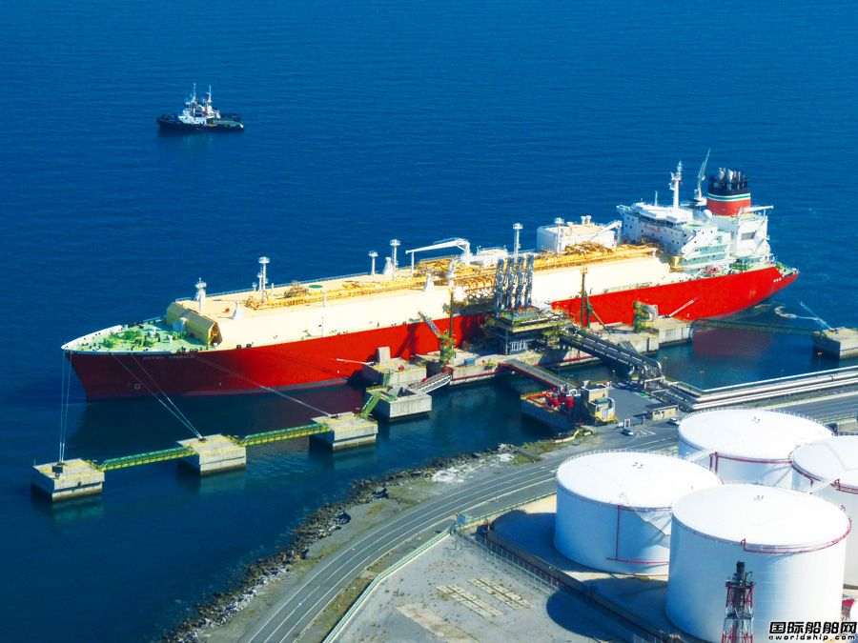
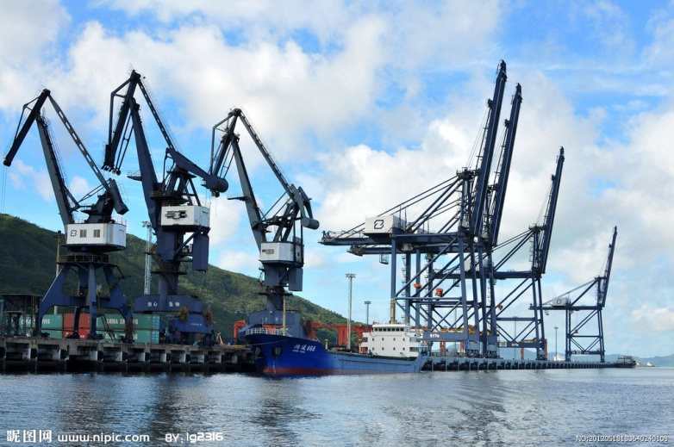
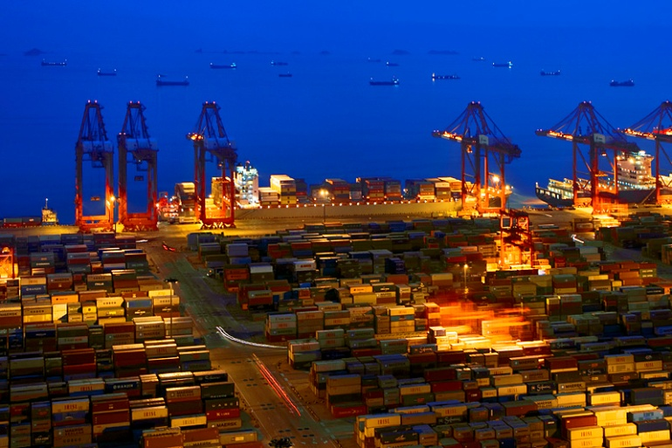
Ideas Aided Decision-Making for Controlling Air Emission from Shipping in China
Prof. Peng Chuansheng
China Waterborne Transport Research Institute
26 July 2016 Washington DC UNITED STATES

Slide 2
Peng Chuansheng
He engaged in waterborne transport research and consulting work from 1991. His work covers port machinery research and development, port and terminal planning, terminal operation system development, energy conservation and environment protection.
In past years, he aided the Ministry of Transport to formulate standards such as Limits and Verification Methods of Fuel Consumption for Commercial Ships, Limits and Verification Methods of CO2 Emission for Commercial Ships and Green Port Grand Evaluation Standard，Technical Specification for Terminal Energy Efficiency Management, and make policies or regulations such as Water Transportation Energy Conservation and Emissions Reduction Implementation Plan During the National 12th 5-Year Plan, Action Plan on Shipping and Ports Pollution Control and Marine Emission Control Area Plan for Pearl River Delta, Yangtze River Delta and Circum-Bohai-Sea (Beijing-Tianjin-Hebei Region) Ship Emission Control Zones and so on.
He had won a National Prize for Progress in Science and Technology and published more than 400 papers
China Waterborne Transport Research Institute

Slide 3
China Waterborne Transport Research Institute
Waterborne Economic
Environment Protection
Safety and Emergency
WTI
Modern Logistics
Intelligent Transport
China Waterborne Transport Research Institute

Slide 4
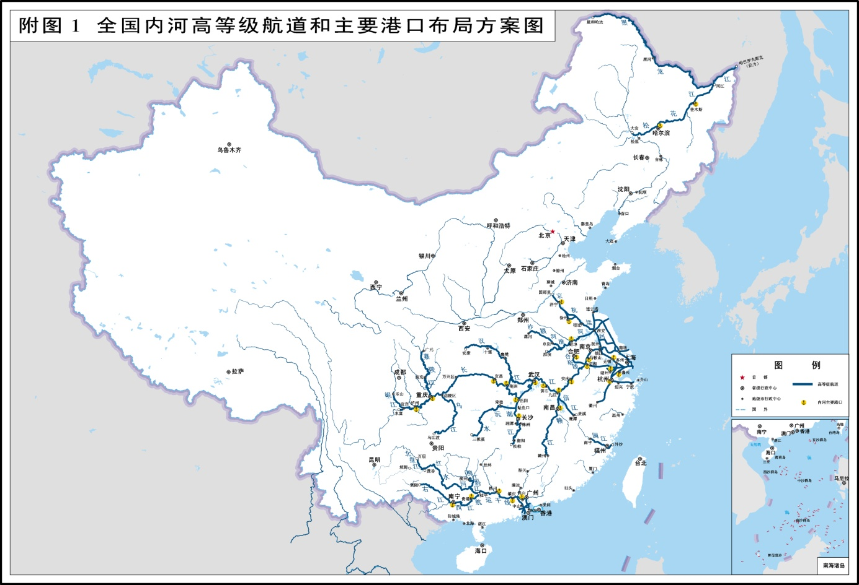
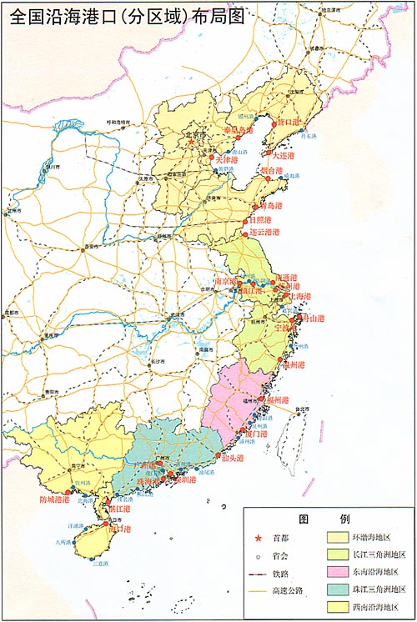
Port and Ocean Going & Inland River Shipping = Waterborne Transport
Port: Stationary source monitored by local government.
Shipping: Mobile source, different to control by a single local government, especially for foreign flag ships.
China Waterborne Transport Research Institute

Slide 5
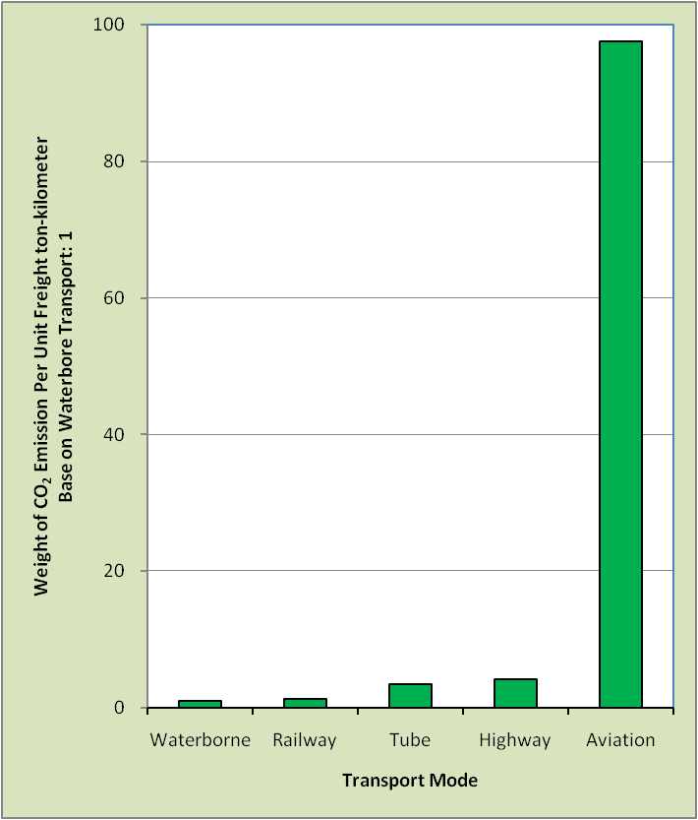
Port and Ocean Going & Inland River Shipping = Waterborne Transport
China Waterborne Transport Research Institute

Slide 6
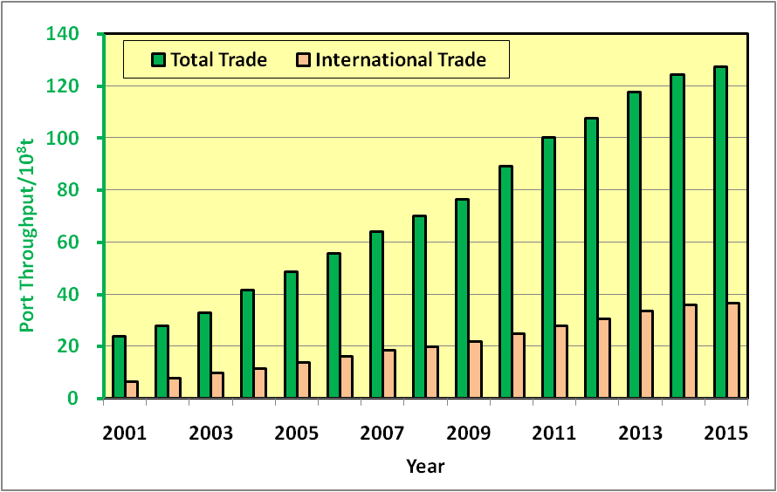
Green Ports: New Front for China’s War on Pollution and Climate Mitigation
Port throughput increased rapidly in past years
China Waterborne Transport Research Institute

Slide 7
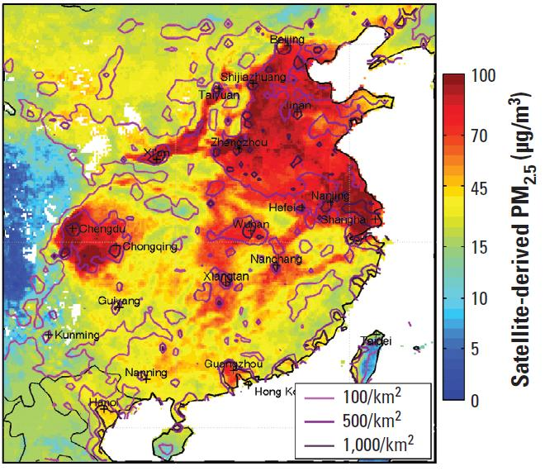
Green Ports: New Front for China’s War on Pollution and Climate Mitigation
Emission from ship increased sharply and comes to public attention
Annual Average Concentration of PM_{2.5} in Main Port Areas in 2014
Beijing,Tianjin & Hebei京津冀93μg/m³
Yangtze River Delta长三角
60μg/m³
Pearl River Delta珠三角
42μg/m³
The 6 cities' annual average concentration of PM_{2.5} is less than 35μg/m³ and all inland river port cities can not meet the Chinese Ambient Air Quality Standards。
China Waterborne Transport Research Institute

Slide 8
Green Ports: New Front for China’s War on Pollution and Climate Mitigation
Emission from ship increased sharply and comes to public attention
Port of Shanghai in 2010 Industry city, Data from City Environment Monitoring Centre
Pollutant | Share
SO₂ | 12.0%
NO_{x} | 9.0%
PM_{2.5} | 5.3%
Port of Shenzhen in 2013 Trade city, Data from City Environment Protection Bureau
Pollutant | Emission | Share
SO₂ | 16300t | 66.10%
NO_{x} | 19254t | 14.10%
PM_{2.5} | 1635t | 5.80%
China Waterborne Transport Research Institute

Slide 9
Green Ports: New Front for China’s War on Pollution and Climate Mitigation
Necessity
Timing
Benefit
China Waterborne Transport Research Institute

Slide 10
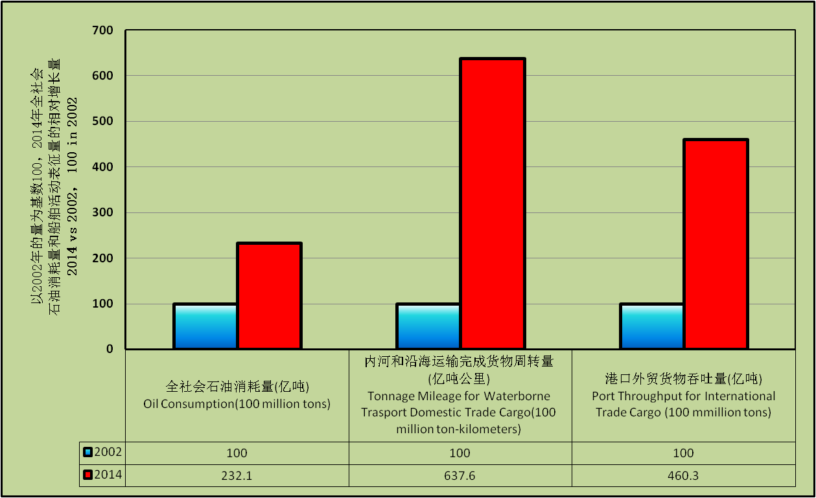
Green Ports: New Front for China’s War on Pollution and Climate Mitigation
China Waterborne Transport Research Institute

Slide 11
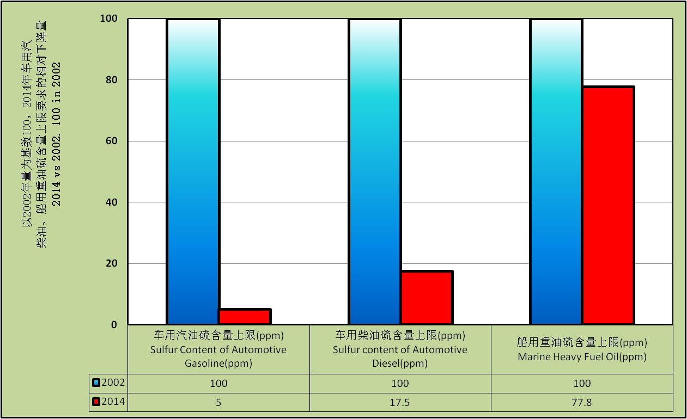
Green Ports: New Front for China’s War on Pollution and Climate Mitigation
China Waterborne Transport Research Institute

Slide 12
Green Ports: New Front for China’s War on Pollution and Climate Mitigation
Necessity
Timing
Benefit
China Waterborne Transport Research Institute

Slide 13
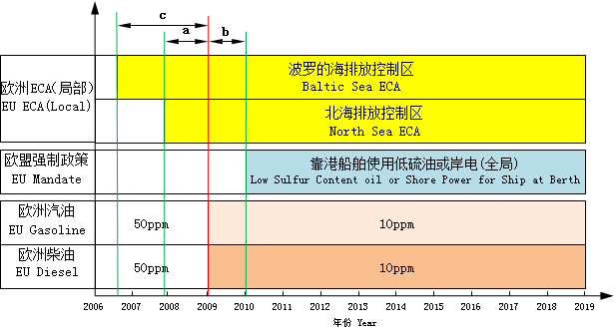
Green Ports: New Front for China’s War on Pollution and Climate Mitigation
China Waterborne Transport Research Institute

Slide 14
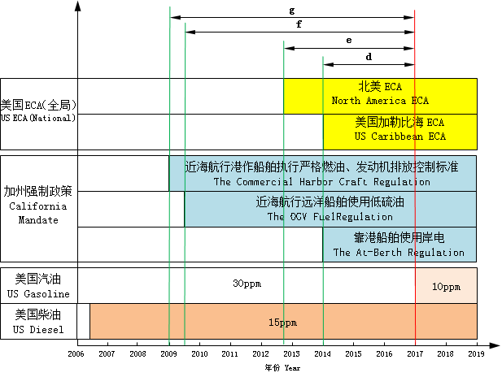
Green Ports: New Front for China’s War on Pollution and Climate Mitigation
China Waterborne Transport Research Institute

Slide 15
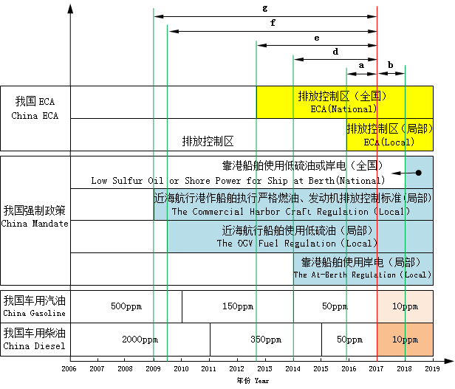
Green Ports: New Front for China’s War on Pollution and Climate Mitigation
China Waterborne Transport Research Institute

Slide 16
Green Ports: New Front for China’s War on Pollution and Climate Mitigation
Necessity
Timing
Benefit
China Waterborne Transport Research Institute

Slide 17
Green Ports: New Front for China’s War on Pollution and Climate Mitigation
Designation of North American Emission Control Area to Reduce Emissions from Ships
(Office of Transportation and Air Quality of EPA, EPA-420-F-10-015, March 2010)
The total costs of improving the emissions of ships operating in the ECA from current performance to ECA standards will be approximately $3.2 billion in 2020.
EPA estimates that the annual benefits in 2020 will include preventing between 5,500 and 14,000 premature deaths, 3,800 emergency room visits, and 4,900,000 cases of acute respiratory symptoms in 2020.
The monetized health benefits in 2020 in the U.S. are projected to range from $47 to $110 billion in 2006 U.S. dollars.
China Waterborne Transport Research Institute

Slide 18
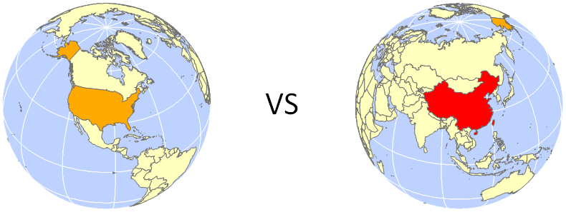
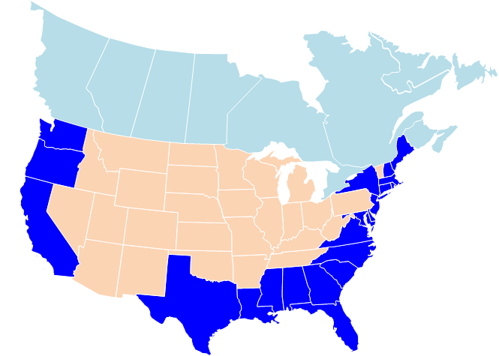
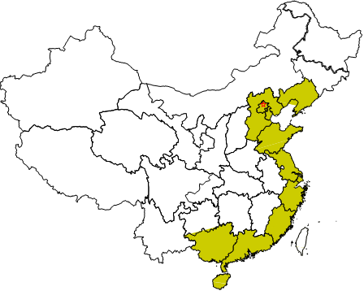
Green Ports: New Front for China’s War on Pollution and Climate Mitigation
China Waterborne Transport Research Institute

Slide 19
Influencing Intensity of Air Emission from Ship
船舶大气污染物排放对公众身体健康的影响强度
Using Port Cargo Throughput for International Trade Per Unit Coastline to indicate Average Emission of International Navigation Ships
用单位岸线（km）沿海省（州）港口外贸货物吞吐量（t）表示“国际航行船舶的平均排放强度”
Using Product of Population Per Unit Area in Coastal States or Provinces and Average Emission of International Navigation Ships to indicate Influencing Intensity of Air Emission from Ship.
用沿海省（州）平均单位面积人口数量（人/km²）与“国际航行船舶的平均排放强度”乘积衡量“船舶大气污染物排放对公众身体健康的影响强度”
China Waterborne Transport Research Institute

Slide 20
Country | Population Per Area of Coastal States or Provinces (persons per square kilometer) | Cargo Throughput Per Unit Coastline (tons per kilometer) | Influencing Intensity of Air Emission from Ship
US | 68.7 | 12707 | 872935
China | 449.6 | 90195.9 | 40553140
China vs US |  |  | 46.5
China Waterborne Transport Research Institute

Slide 21
Green Ports: New Front for China’s War on Pollution and Climate Mitigation
Conclusion
Cost：32*2785530000/1133458880=78.6×10⁸USD）
Profit： Min：470*46.5=21855×10⁸USD）
Max：1100*46.5=51150×10⁸USD）
Assuming that value produced by a person in China is 1/50 of value produced by a person in US, the profit is equal to cost about minimum (21855/50)/78.6=5.6 times and maximum (51150/50)/78.6=13 times.
China Waterborne Transport Research Institute

Slide 22
Green Ports: New Front for China’s War on Pollution and Climate Mitigation
Conclusion
Control emission from shipping:
It is necessary to do.
It is time to do.
It is worth to do.
That means it is feasible.
Whether we do and when we do depend on government’s decision.
China Waterborne Transport Research Institute

Slide 23
Green Ports: New Front for China’s War on Pollution and Climate Mitigation
Prof. Peng Chuansheng
China Waterborne Transport Research Institute
Add：8 Xitucheng Road，Beijing, 100088，China
Tel: 86-10-65290315
Email: pengcs@wti.ac.cn
China Waterborne Transport Research Institute

