Slide 1
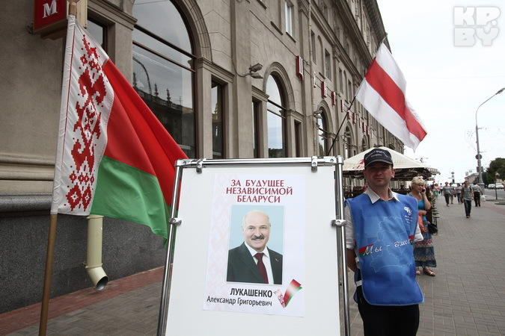
Belarus Elections: before and after
Yauheni Preiherman
Discussion and Analytical Society Liberal Club

Slide 2
Key Trends
Political prisoners released
Presidential elections: the usual and the unusual
Economy: oil, Russia, Ukraine and own deficiencies
Foreign policy: in light of the geopolitical crisis
Lessons learned

Slide 3
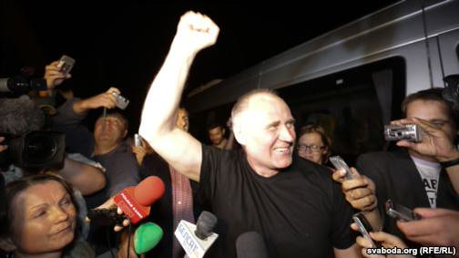
August 22: political prisoners released
WHY: negotiation process with the West + geopolitical and economic factors
WHY NOW: elections factor
IMPLICATIONS: before and after the elections

Slide 4
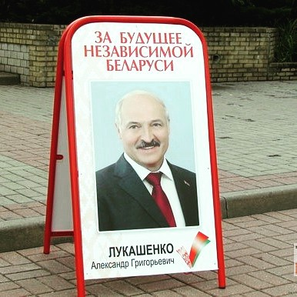
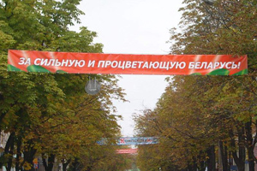
Elections: 11 October 2015
2010 Elections: “Bland filling in spicy pastry”.
2015 Elections: “Bland filling with no pastry in front of an overheated oven”.
Not a word about the All-Belarusian People’s Assembly: how to explain the failures or where to head after the elections?
Narratives of security, stability and sovereignty dominate over economic agenda.

Slide 5
Elections: October 11 2015
Oppositional chaos: weak and fragmented as never before.
The authorities have allowed a comparatively free campaigning regime while keeping in mind the lessons of the 2010 elections
The ultimate goal – to pass the elections period without much internal and external turbulence and break the vicious circle in the relations with the West

Slide 6
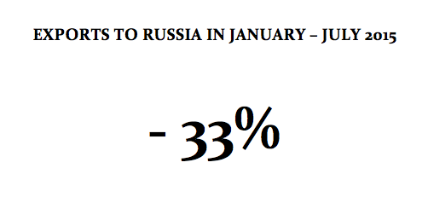
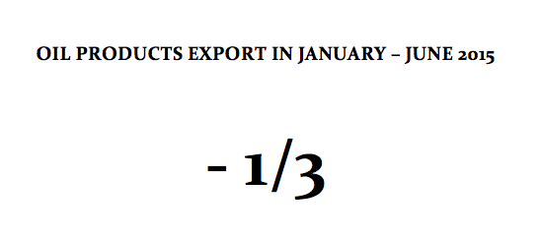
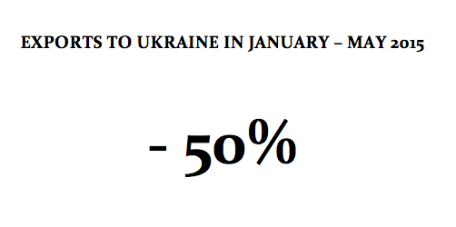
Economy: weaknesses and external context
Russia’s economic decline.
Oil prices.
Ukraine crisis.
Internal imbalances building up.

Slide 7
Economy: weaknesses and external context
Russia’s economic decline
Oil prices
Ukraine crisis
Internal imbalances building up
Russian assistance now?

Slide 8
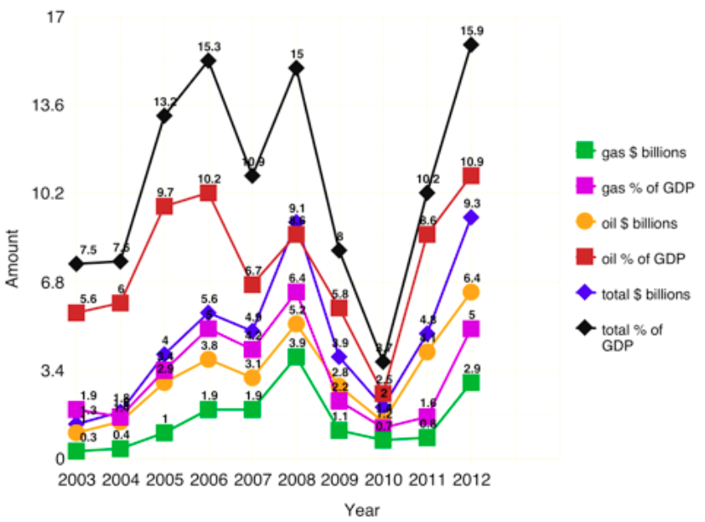
Russian oil and gas subsidies
Source: Non-paper, Belarus Reality Check 2012

Slide 9
Foreign Policy: geopolitical escalation
Classical balancing/bandwagoning dilemma.
Mediation efforts (Minsk accords, OSCE Ukraine Contact group): primarily, hedging against the risk of being involved.
In search of other themes and platforms: EU-EEU or an intermediary niche in China’s Silk Road Economic Belt.
Emphasis on updated vocabulary: ‘national interests’, ‘sovereignty’, etc.

Slide 10
Belarus – Russia relations
Absolutely central but becoming less comfortable
Russia’s economic decline
Dwindling benefits of the EEU
Russia’s line on Ukraine

Slide 11
Eurasian Economic Union
‘Integration race’ (quick passage of integration stages) is over.
Fundamental integration exemptions undermine the EEU’s functionality.
Lack of integration resources on all sides.
Fear of political and monetary integration in Minsk.

Slide 13
Belarus-EU relations
Cautious attempts to de-freeze the relations began at the end of 2012.
Minsk’s position on the Ukraine crisis gave an additional impetus.
Release of political prisoners – election waiting mode.
The Eastern Partnership framework and the overhaul of the European Neighborhood Policy.

Slide 14
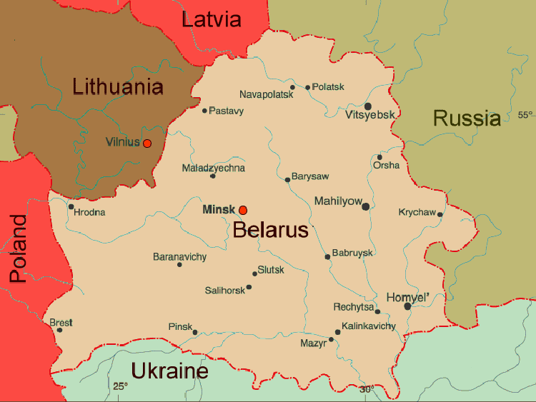
What does Minsk expect from the West?
No further political and military escalation in eastern Europe.

Slide 15
What does Minsk expect from the West?
No further political and military escalation in eastern Europe.
Lifting of sanctions.
Access to credits / eurobond opportunities.
Pragmatic cooperation.
Regional infrastructure and logistics projects.

Slide 16
Conclusions and lessons learned
Post-elections developments are the biggest concern.
Unprecedented role of regional factors: Belarus becoming more strategic.
New trends are emerging but are too vulnerable.
Reforms: unwanted but unavoidable.
The West: what lessons should be learned?

