Slide 1
VIDEO

Slide 3
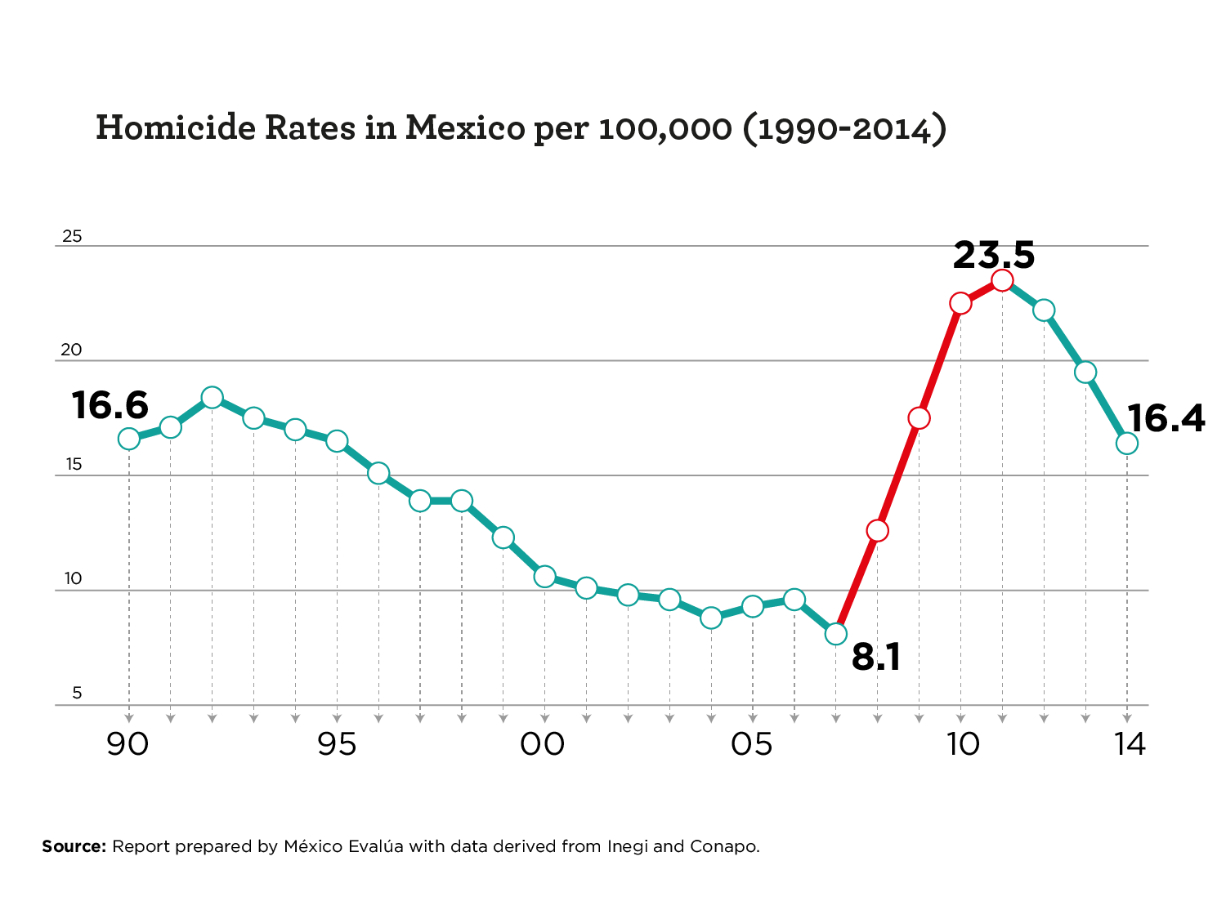
HOMICIDE RATES

Slide 5
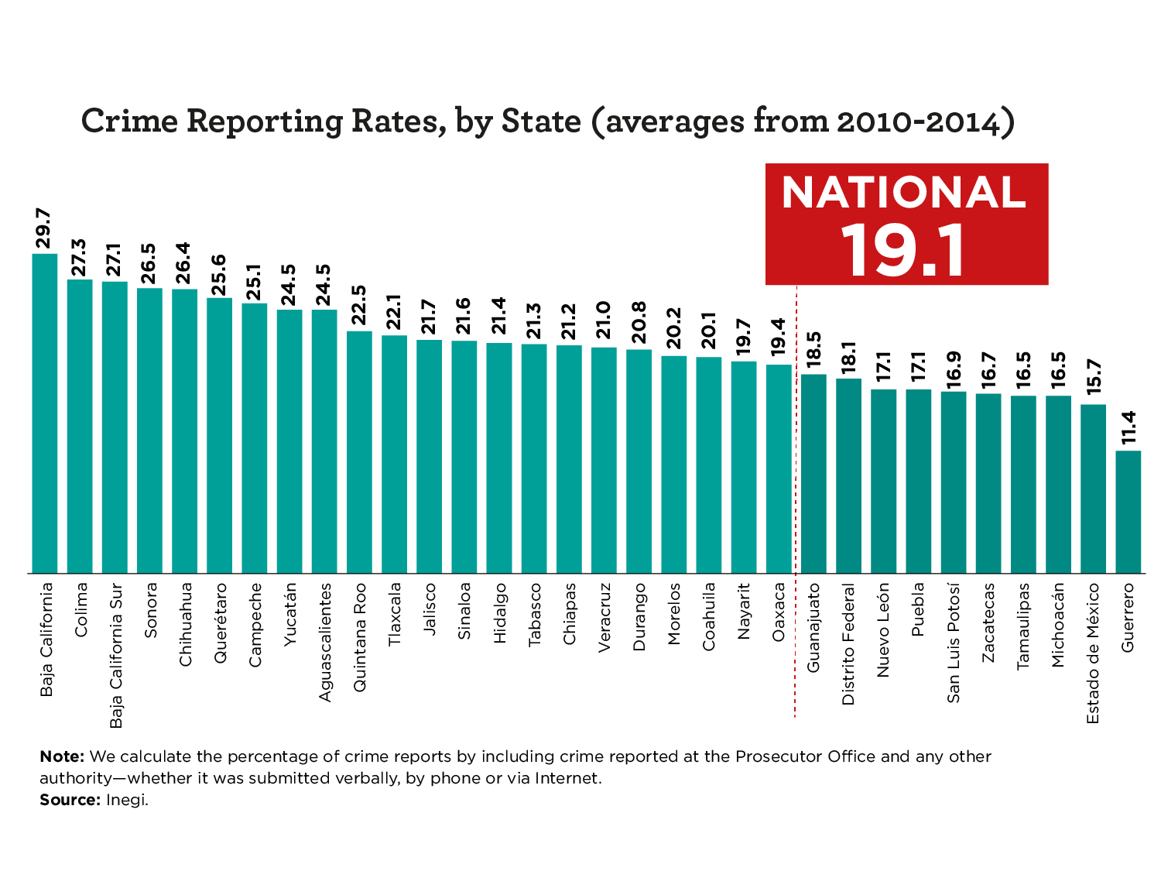
PERCENTAGE OF CRIMES REPORTED

Slide 7
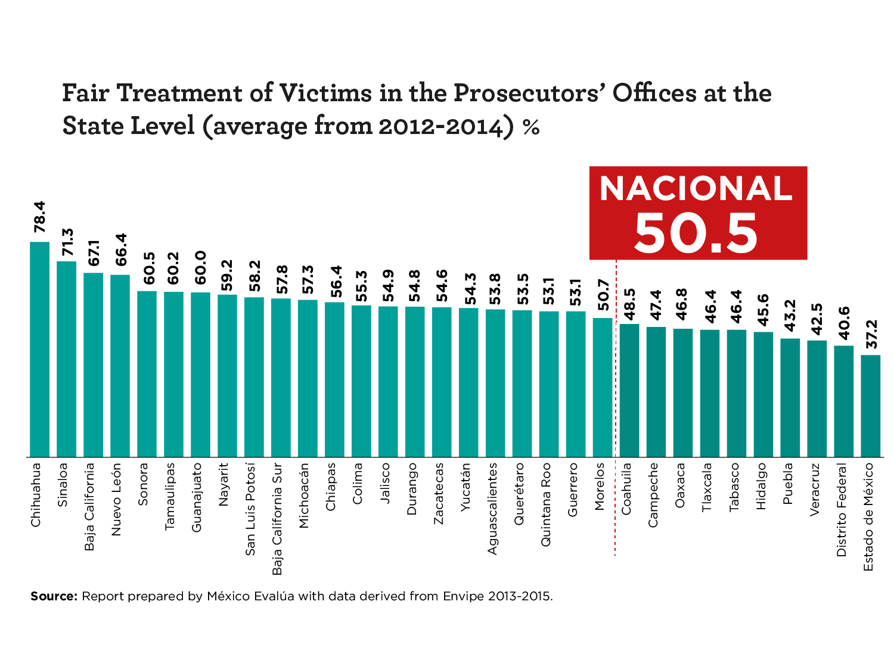
FAIR TREATMENT OF VICTIMS

Slide 10
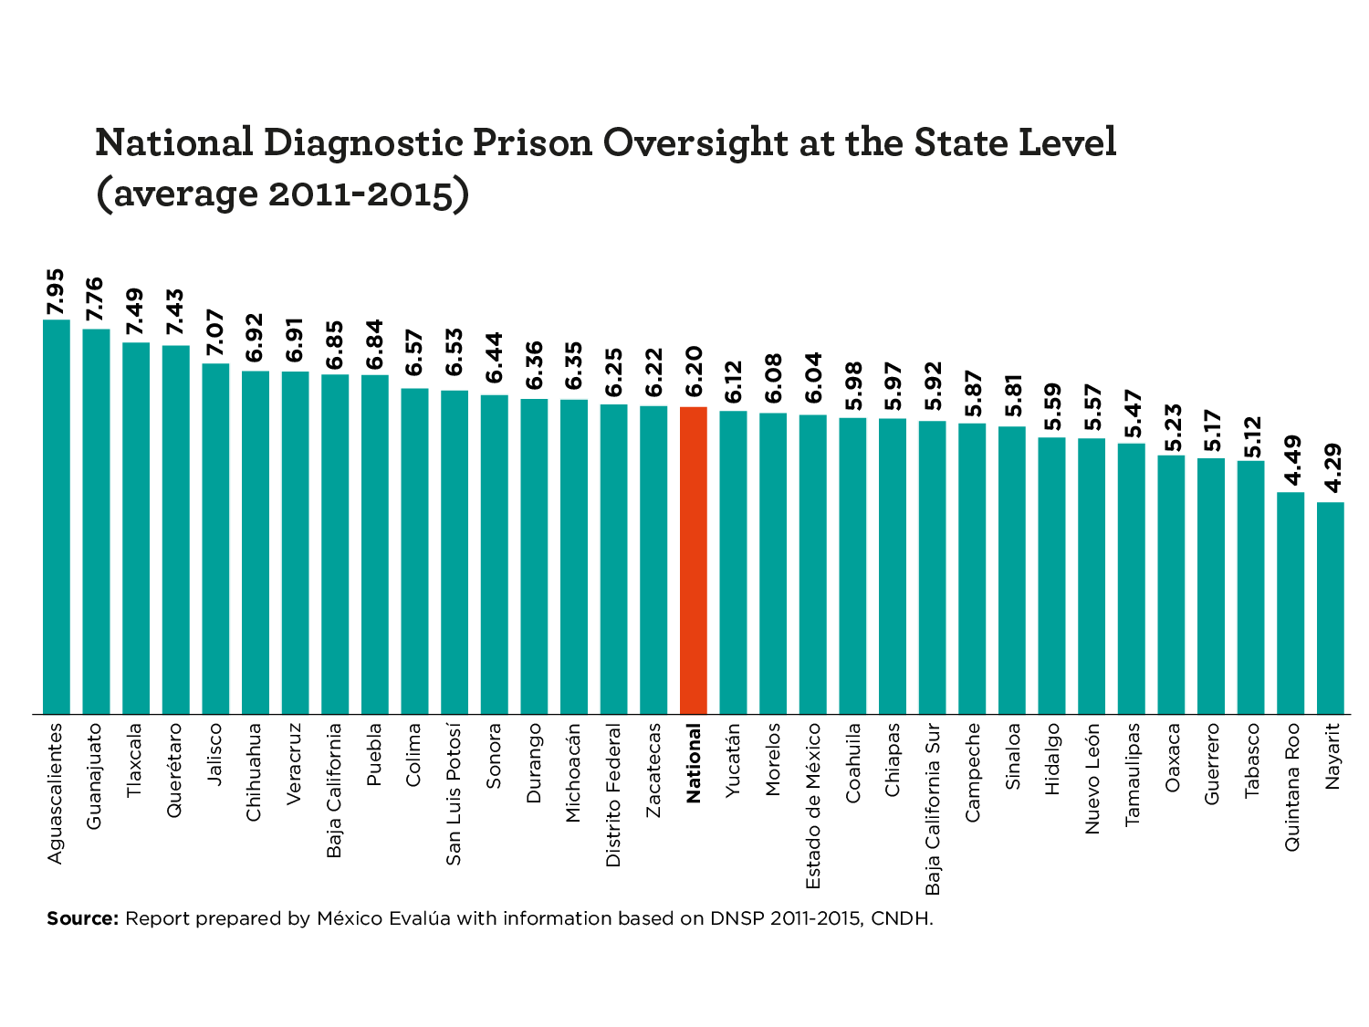
DECENT AND SAFE PRISONS

Slide 12
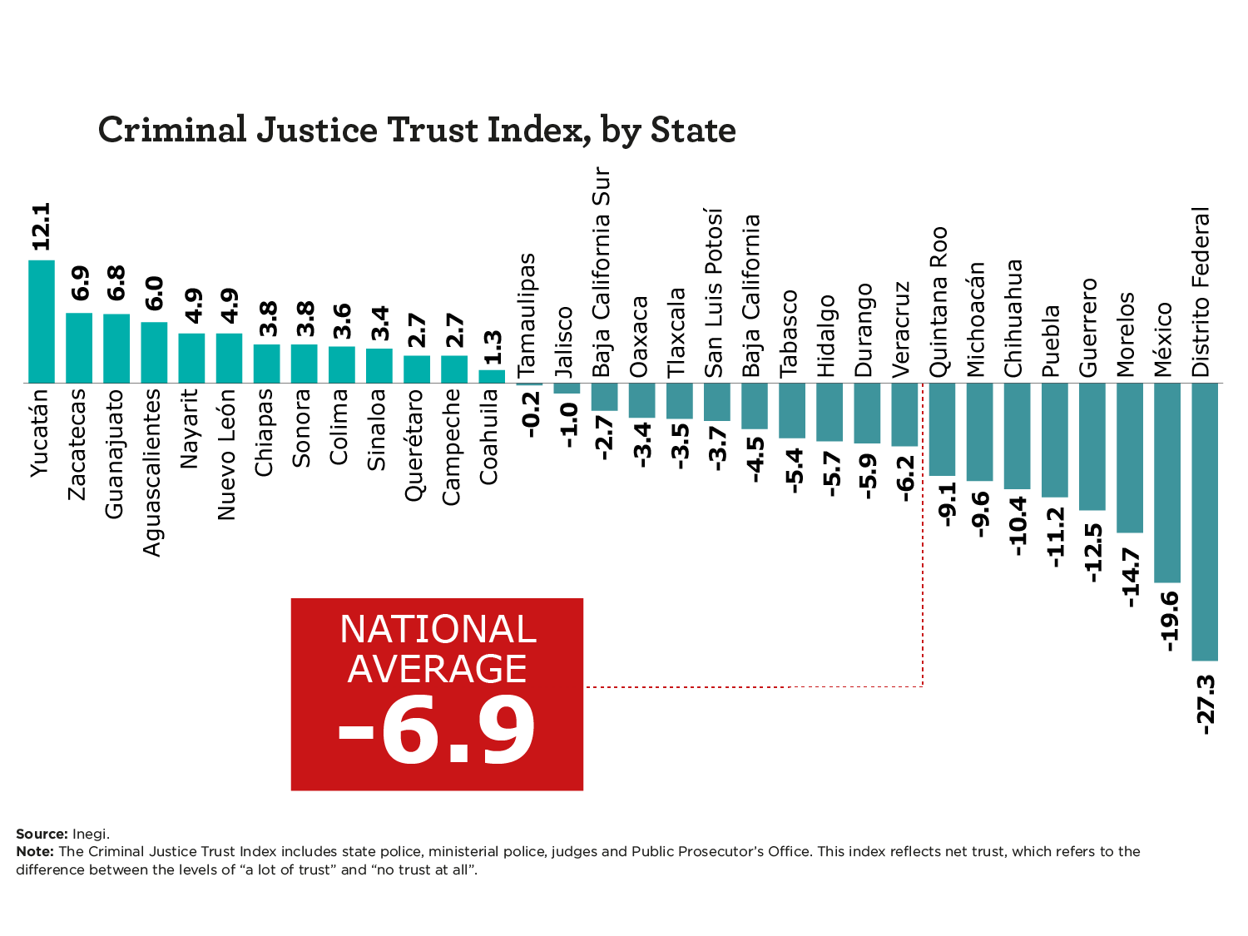
TRUST

