Slide 1
Parliamentary Election in Belarus Special Co-ordinator Kent Härstedt
Kent Härstedt

Slide 2
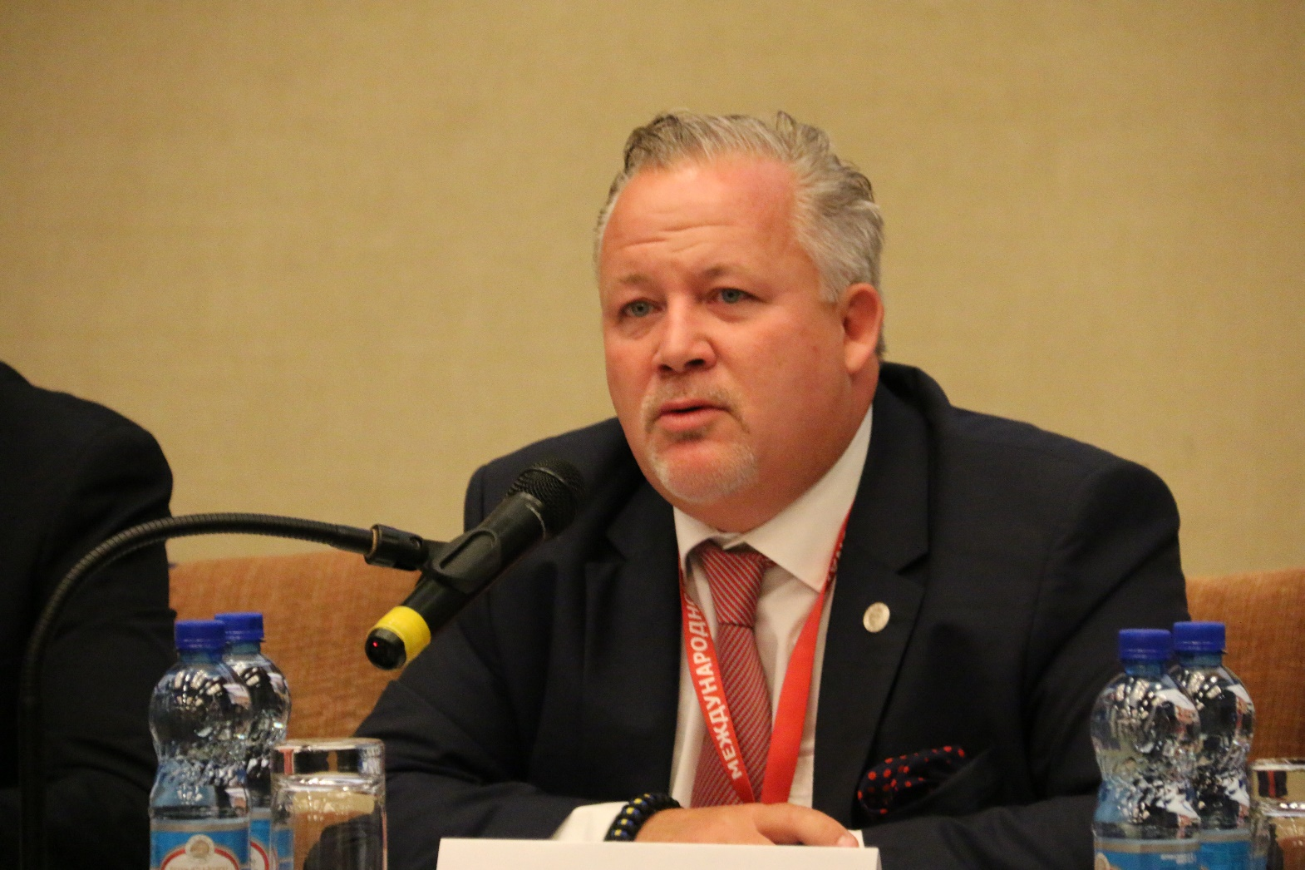
Kent Härstedt

Slide 3
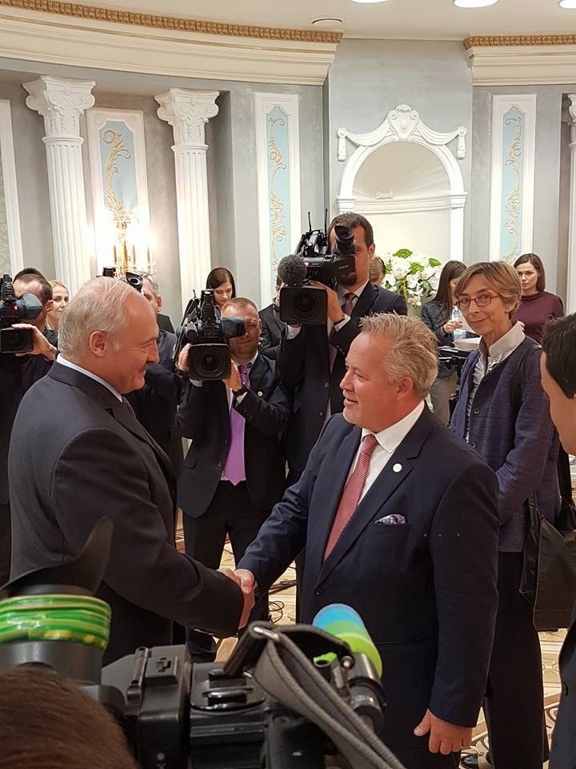
Kent Härstedt

Slide 4
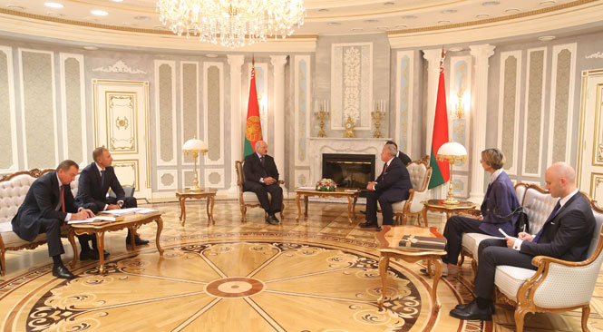
Kent Härstedt

Slide 5
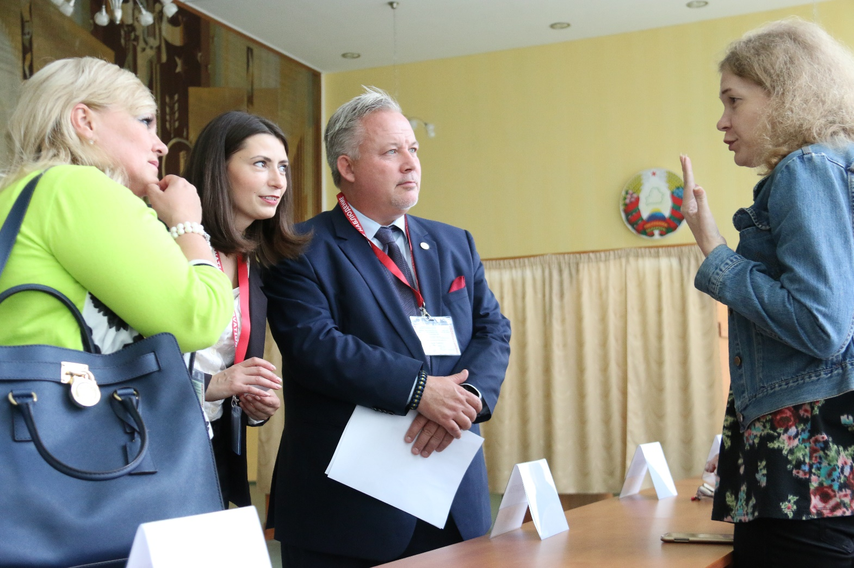
Kent Härstedt

Slide 6
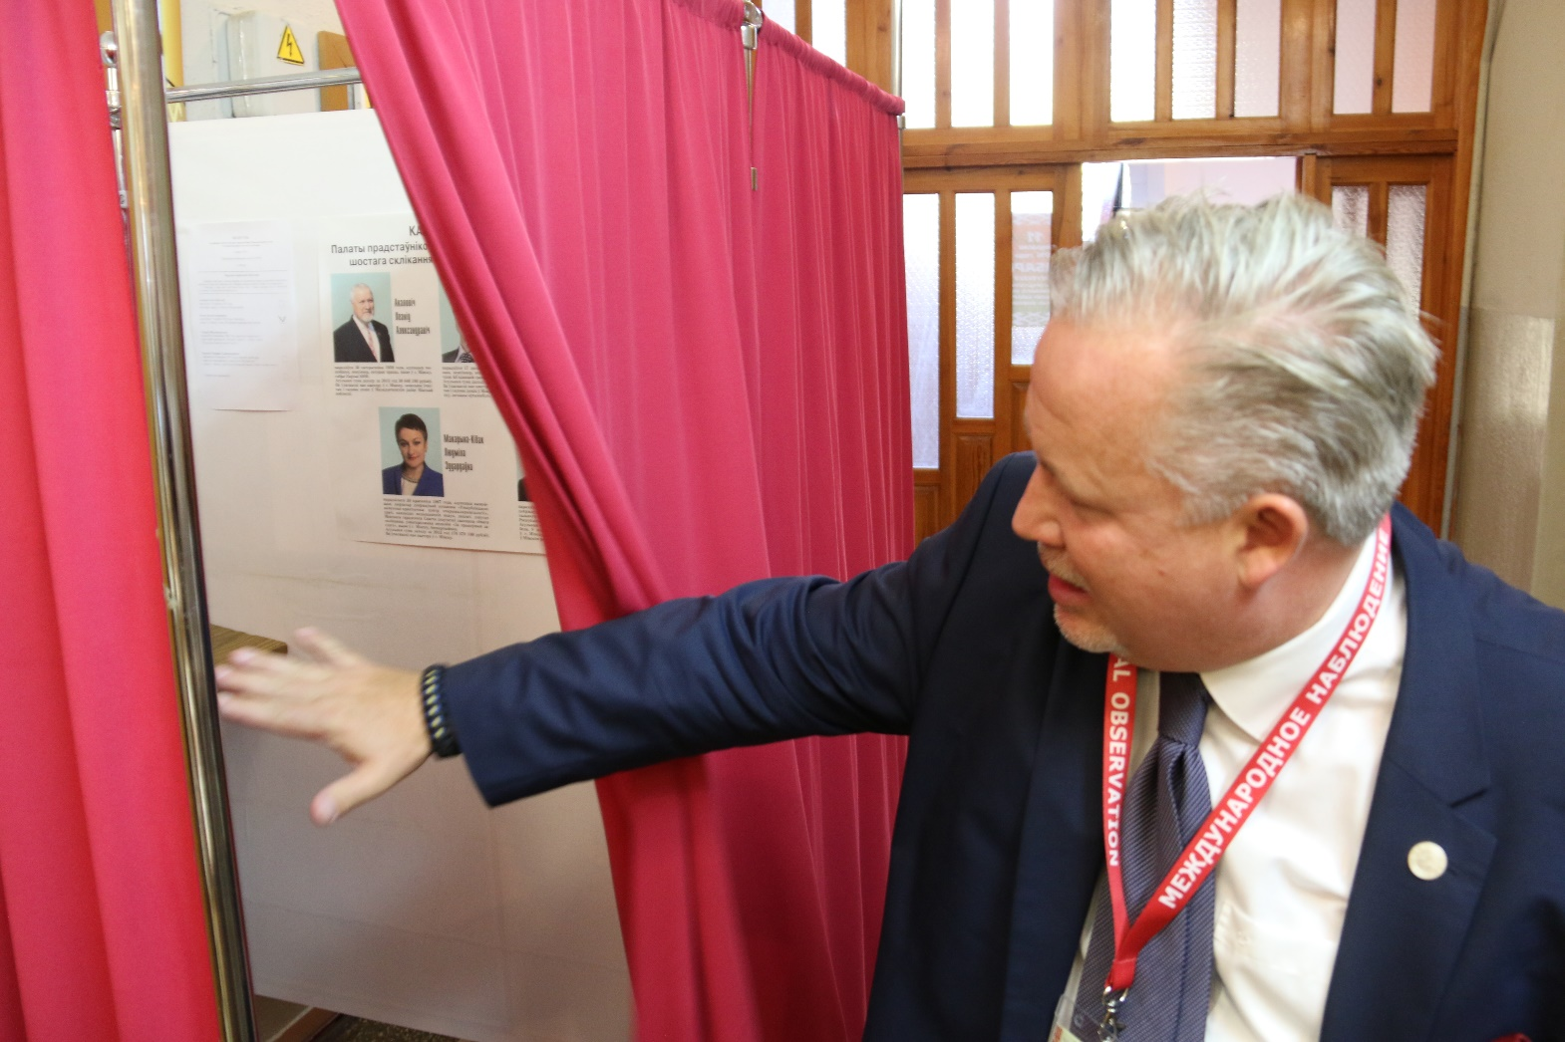
Kent Härstedt

Slide 7
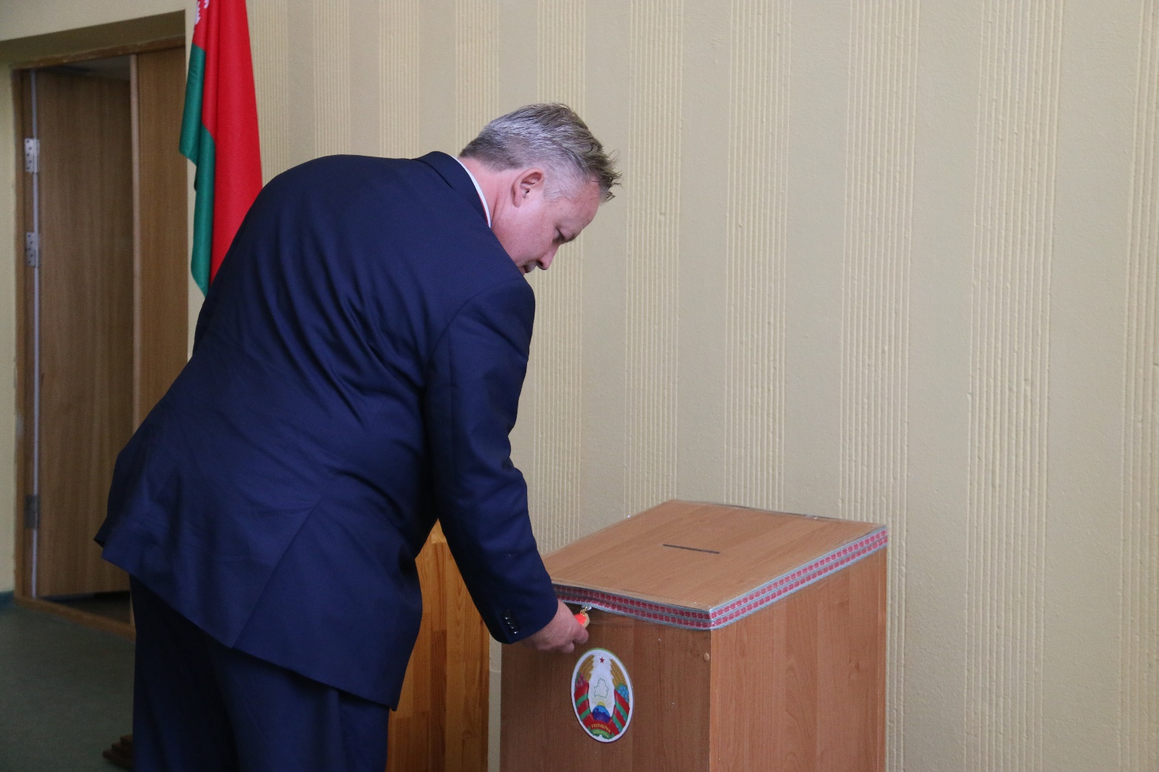
Kent Härstedt

Slide 8
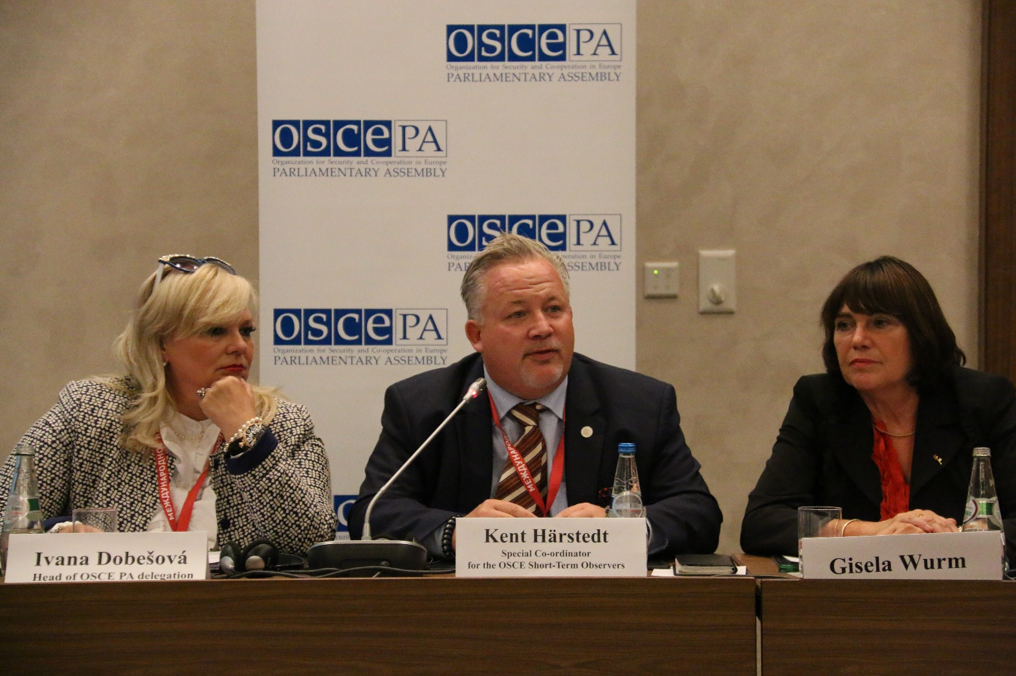
Kent Härstedt

Slide 9
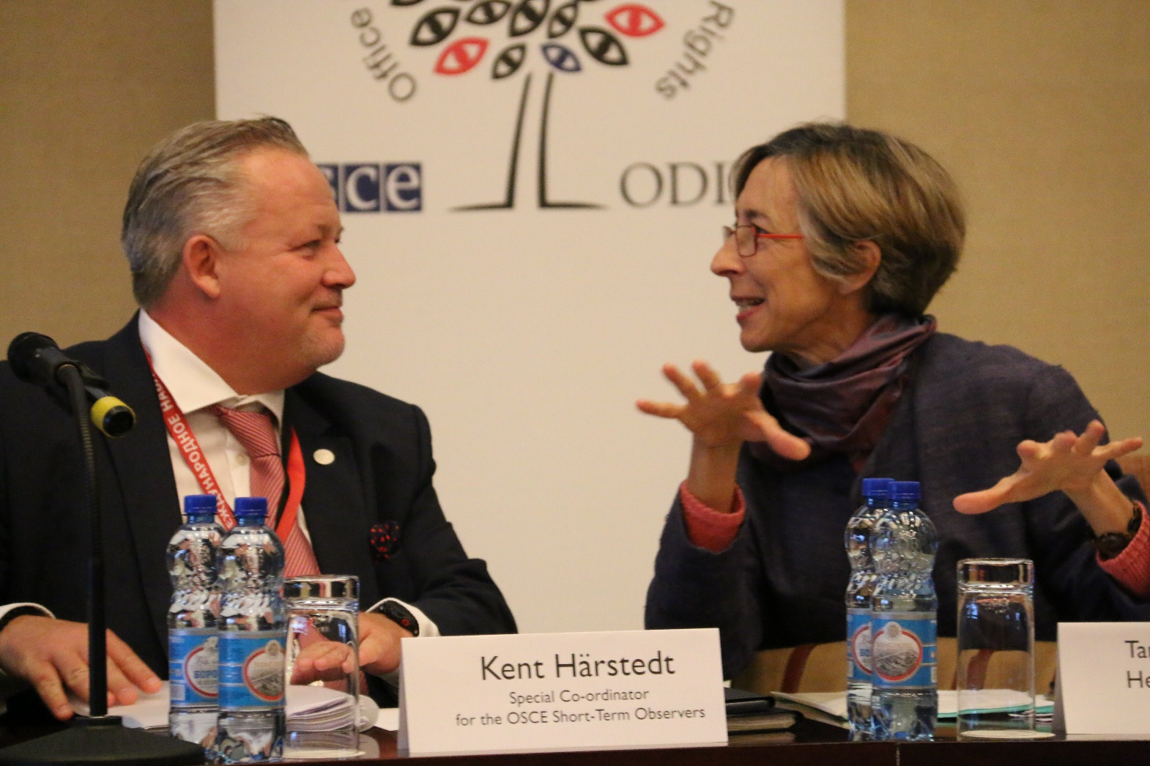
Kent Härstedt

Slide 10


Election Observation Mission
Parliamentary Elections
11 September 2016
Republic of Belarus

Slide 11
Basic Information
389 observers from 38 countries were deployed
OSCE/ODIHR Election Observation Mission included 11 experts in Minsk and 38 long-term observers throughout the country, 32 members from the OSCE Parliamentary Assembly and 17 members from the Parliamentary Assembly of the Council of Europe
Statement of preliminary findings and conclusions was issued on 12 October and endorsed by all three institutions
Notes:
ODIHR presentation
11

Slide 12
Basic Information
The assessment was made against:
OSCE commitments
Council of Europe standards
other international obligations for democratic elections
national legislation
Observation of:
Opening in 169 polling stations
Voting in 1539 out of 5971 polling stations
Counting in 166 polling stations
Tabulation in 101 District Election Commissions
Notes:
ODIHR presentation
12

Slide 13
Findings and Conclusions
The legislation does not guarantee democratic conduct of elections
number of OSCE/ODIHR recommendations remain unaddressed
Restrictions on fundamental freedoms negatively affected the campaign
Although candidates were able to campaign freely the unequal access to public resources skewed the playing field
The composition of election commissions was not pluralistic
a negligible number of members were appointed from opposition nominees
strong influence of the executive and criteria of membership

Slide 14
Findings and Conclusions (count.)
Despite restrictive legal provisions for candidate registration, the number of candidates increased, including from the opposition
480 candidates run for 110 seats of the House of Representatives
Media environment is restricted, the media coverage and visibility of the campaign did not enable voters to make an informed choice and resulted in public disinterest
Criminal offences for defamation exist and during the campaign media focused largely on the activities of the President and other state officials
Dispute resolution process lacks transparency and efficiency
Most of the 767 complaints submitted were not reviewed in public sessions and very few decisions were published

Slide 15
Findings and Conclusions (count.)
Observers were accredited in an inclusive manner but legal limitations for observation persist
more than 32,000 citizen observers were accredited, but mostly from state-subsidized public associations
observers were not allowed to observe all activities of election commissions, to inspect voter lists, or to receive certified copies of result protocols
Election day generally proceeded orderly however, serious irregularities were observed during counting and tabulation
a significant number of seemingly identical signatures and indications of ballot stuffing were observed and
no centralized voter register allowed to cross-check registrations

Slide 16
Recommendations (selection)
ODIHR will soon publish the Final Report which will include recommendations for improvement of the election process
Some previous key long-standing recommendations include:
comprehensive and inclusive legal reform on the basis of previous ODIHR recommendations to ensure respect for fundamental freedoms
Amendments to the Electoral Code to include safeguards that ensure integrity and transparency of the electoral process
Guarantees for genuinely pluralistic composition of election commissions
Unrestricted access of observers to observe all aspects of the electoral process
Clear and transparent procedures for counting and tabulation
Polling results to be published and disaggregated by polling station

