Slide 1
WHAT CONSTITUTES A SUCCESSFUL
ECOSYSTEM OF INNOVATION?
Jerry Haar
Professor, Florida International University
Global Fellow, Woodrow Wilson International Center for Scholars
Research Fellow and Adjunct Professor, Georgetown University
Fostering Innovation Ecosystems in Latin America
Latin American Program, Woodrow Wilson Center
June 2, 2016
Notes:
What defines an“Ecosystem of innovation”? Same basic characteristics of ecosystem of entrepreneurship--except with innovation greater technology content and more extensive creativity.

Slide 2
WHAT ARE THE KEY INGREDIENTS FOR A
SUCCESSFUL ECOSYSTEM OF INNOVATION?
Large pool of skilled talent
An installed and diffuse technological base (e.g., broadband networks)
Dedicated infrastructure of research universities, labs and entrepreneurship instruction
Ample funding (angel investment, venture capital, convertible debt, microfinance, crowdfunding
Networks and collaboration among financiers, entrepreneurs, scientists, technologists, designers
An environment that nurtures, supports and sustains creativity
Mechanisms for the fast transfer of knowledge
Strong intellectual property laws and surety of enforcement
Pro-market economic, tax and regulatory policies
Well-functioning administrative, legal and judicial systems
Federal, state and local industrial policies—especially those targeted at “clusters”
Notes:
What are the key ingredients of a successful ecosystem of innovation? (SLIDE 2)

Slide 3
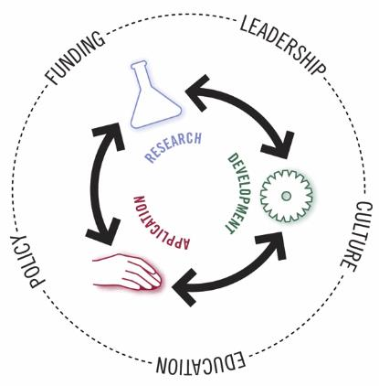
COMMUNITIES OF INNOVATION
BUSINESS
Source: Center for Ethics and Entrepreneurship
ACADEME
GOVERNMENT
Notes:
Two classifications of ecosystems: (1) national level and subnational levels (Chile, Uruguay, Costa Rica); and (2) ecosystems within clusters (aerospace, Querétaro; IT, Campinas; sugar cane, Valle de Cauca, Colombia)
Who are the prime actors in the ecosystem: the triad of government, business and academic...a community (SLIDE 3)

Slide 4
THE CREATION OF BETTER OF OR MORE EFFECTIVE PRODUCTS, PROCESSES, SERVICES, TECHNOLOGIES OR IDEAS THAT ARE READILY AVAILABLE TO MARKETS
INNOVATION
PRODUCT INNOVATION
PROCESS INNOVATION
SERVICE INNOVATION
BUSINESS MODEL INNOVATION
Packaging/price innovation
Social media innovation
Distribution innovation
Advertising innovation
Sustainable innovation
Digital innovation
Disruptive innovation
…AND STILL OTHERS
Notes:
Book Innovation in Emerging Markets highlights the ecosystem's drivers of innovation: national policies, facilitating institutions (e.g., Colciencias in Colombia), and firm-level innovation.
Facilitating institutions can have far greater impact than government or the firms themselves. Some great examples are: Techstars, 500 Startups, Endeavor, Founder Institute, Zfunction University, Wayra, NXTP Labs
We look at innovation in terms of products, processes, services and business models (SLIDE 4)

Slide 5
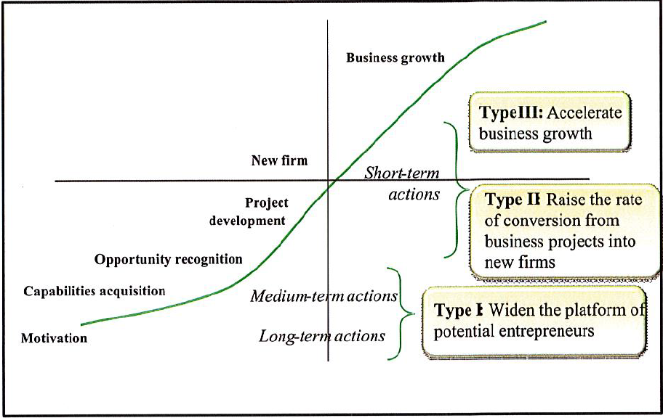
The Entrepreneurship & Innovation Policy Map
Source: H. Kantis, Aportes para el diseño de políticas integrales de desarrollo emprendedor en América Latina, Washington, D.C.: Banco Interamericano de Desarrollo, 2010.
Notes:
Whether for an entrepreneurial project or an innovative one, the trajectory is the same (SLIDE 5)
The diagnoses of what constitutes a successful ecosystem of innovation have long been known. The perennial challenge is to implement, monitor, evaluate and make adjustments in the system when necessary.
For as Edison concluded: “Vision without execution is hallucination”

