Slide 1
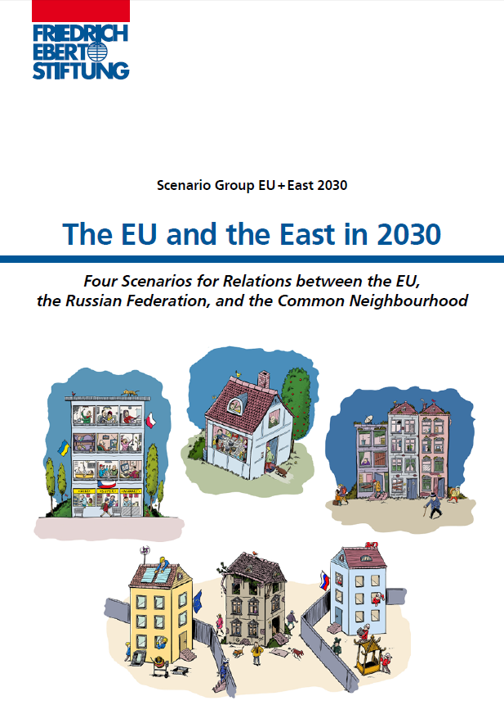

Slide 2
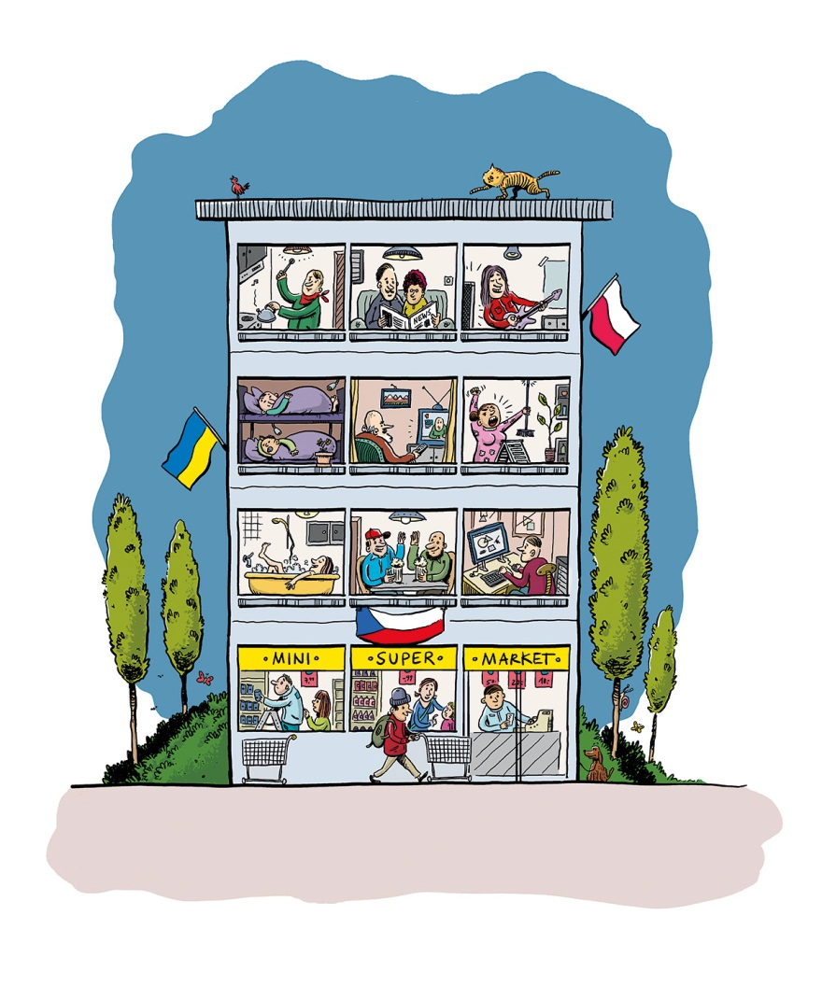
Scenario 1: Shared Home
Stagnation First: No breakthrough in mutual relations in either the EU or Russia until the mid-2020s
Realism Returns: After a lost decade, Russian elites initiate reforms, whilst the EU is happy to re-engage with Moscow
Pragmatism Prevails: By 2030, the EU and Russia focus on shared interests. EaP countries are no longer forced to take a decision for or against either side.

Slide 3
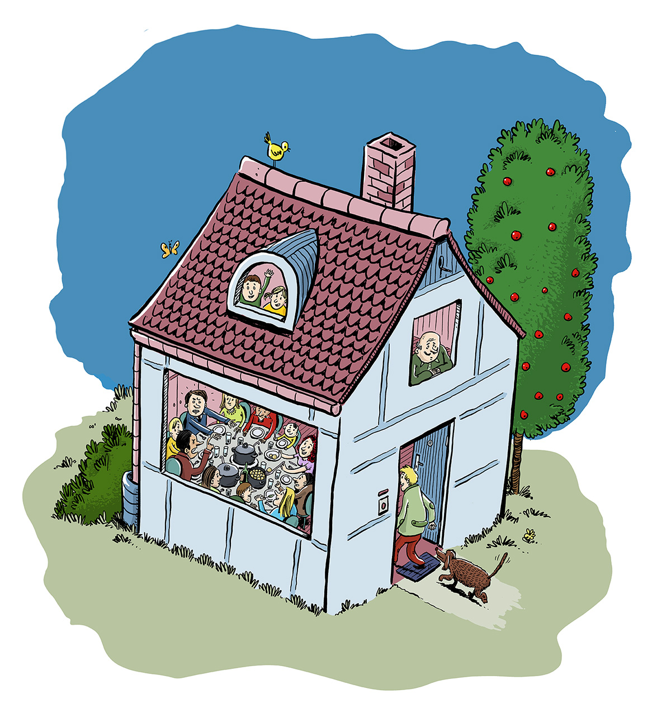
Scenario 2: Common Home
Transformed Russia: Economic downturn leads to reforms and improved EU-Russia relations
Depoliticised Energy: Decreasing importance of oil and gas reduces conflict in the energy field
Common Interests: As new global powers rise, Russia and the EU join forces

Slide 4
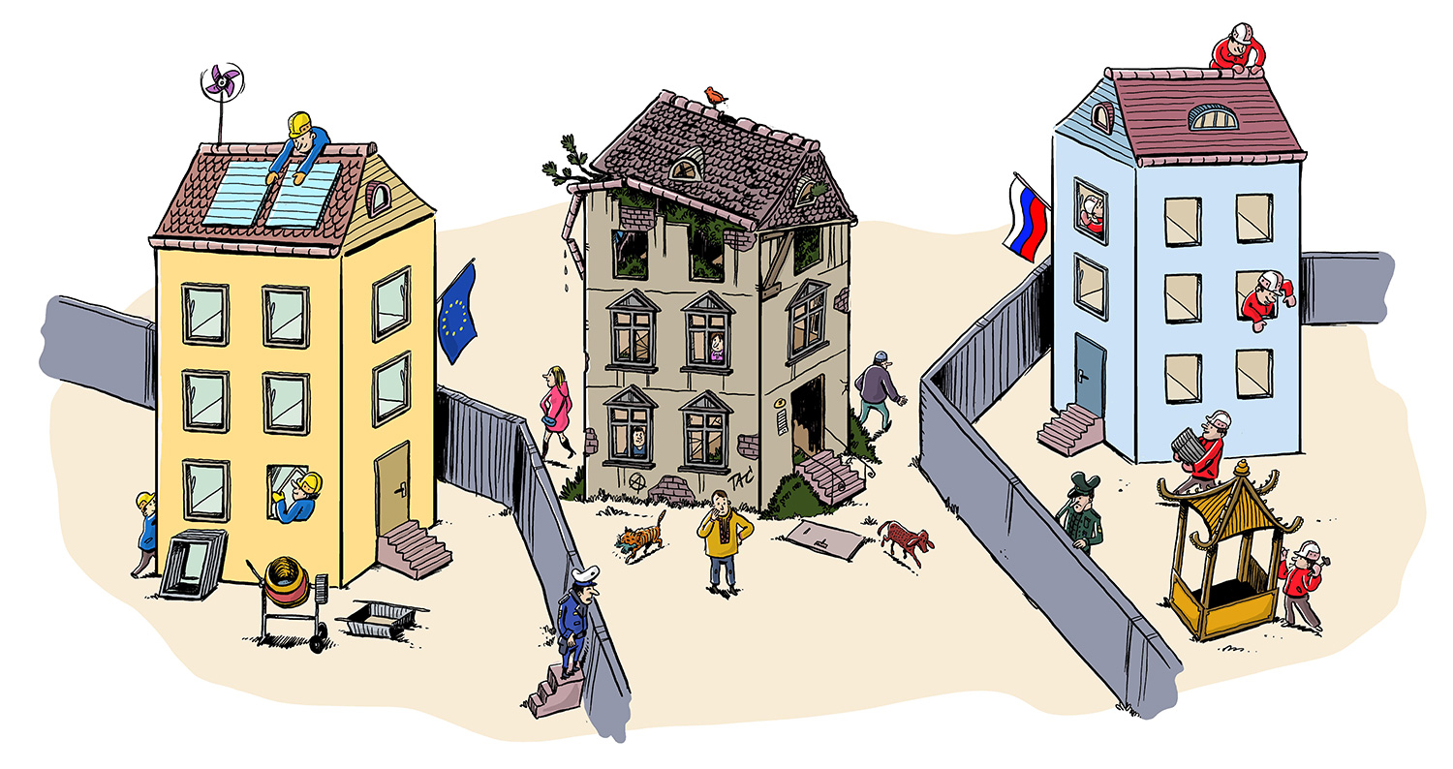
Scenario 3: Broken Home
Protracted Conflict: No solution to the Ukraine crisis, conflict lasts to 2030
Interdependance Unwound: Relative success of authoritarian modernisation in Russia and the energy transition in the EU: both sides can act independently
Unstable Neighbourhood: The EaP countries remain objects of competition: A zone of instability in Europe.

Slide 5
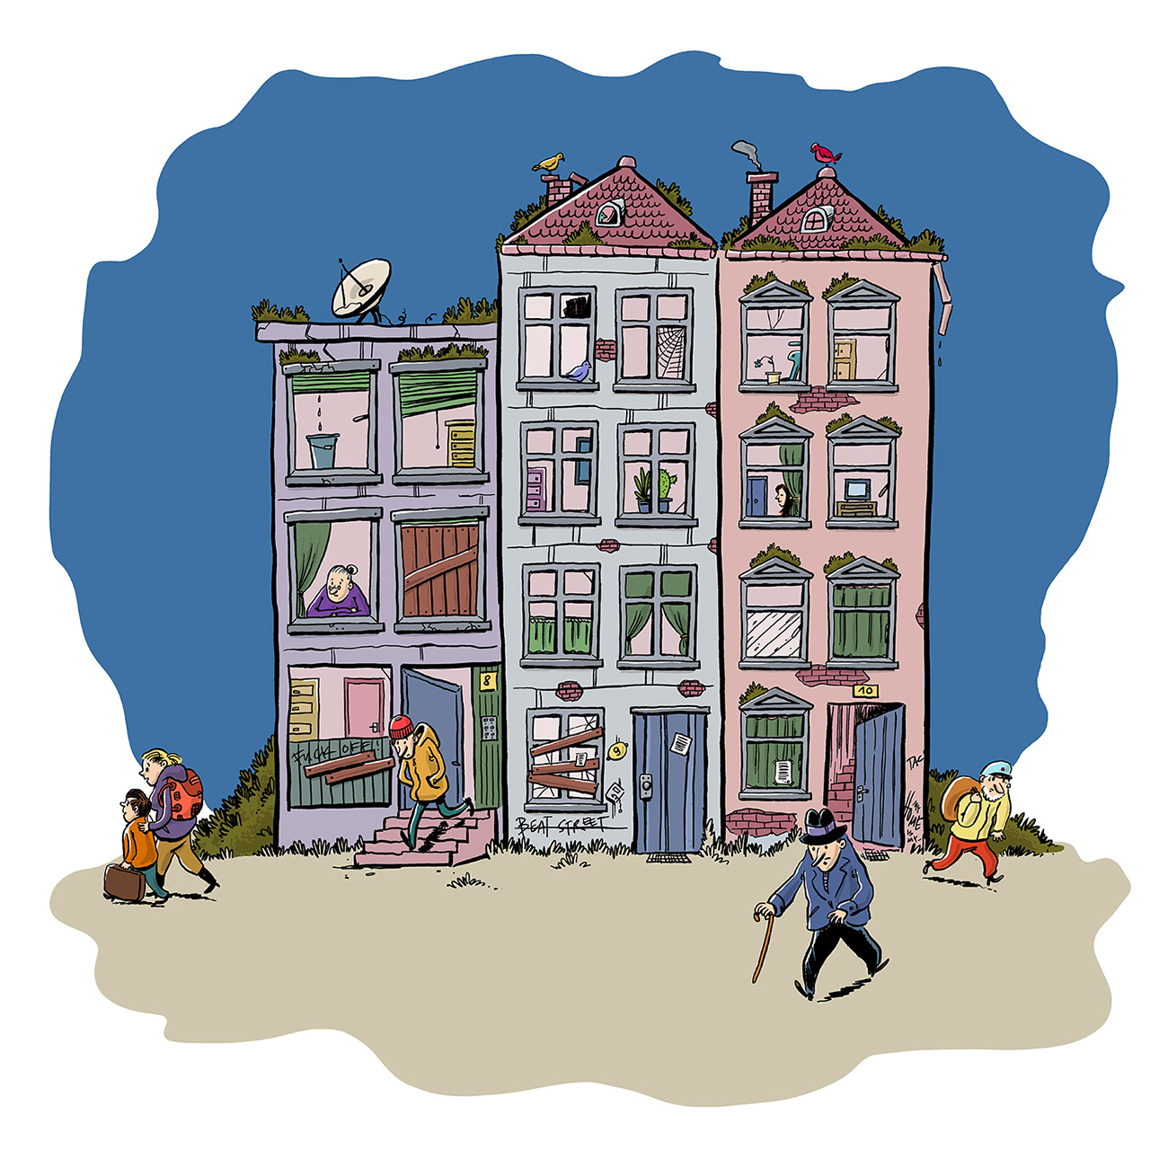
Scenario 4: Divided Home
Cold Peace: EU and Russia locked in stalemate: Interdependance hinders further deterioration, but improvements seem impossible due to value divide.
Contested Neighbourhood: EaP countries falter between East and West.
Lacking Transformation: Europe as a whole loses touch with the global power centres.

