Slide 1

Giving Value to Our Society Gabriel Rozman

Slide 2
SOME DEMOGRAPHIC DATA Latin America and the Caribbean
Population 60+
1950 | 1975 | 2000 | 2025 | 2050
9.305.994 | 20.986.036 | 42.920.967 | 100.452.132 | 183.688.194
Percentage
5.6 | 6.5 | 9.0 | 14.8 | 24.3
Source: CELADE – Latin American and Caribbean Demographic Center. Population Division of CEPAL. Impact in population 1950 – 2050.

Slide 3
URUGUAY
Population 60+
1950 | 1975 | 2000 | 2025 | 2050
263.992 | 399.476 | 569.632 | 746.032 | 988.086
Percentage
11.8 | 14.1 | 17.1 | 21.0 | 26.5
Source: CELADE – Latin American and Caribbean Demographic Center. Population Division of CEPAL. Impact in population 1950 – 2050.

Slide 4
THE VISION HAS TO CHANGE
FROM THE PERSON:
Providing new alternatives for this stage of life
Building a new perception of YOU as a person
Understanding your own value to society
Working to make your dreams come true
FROM SOCIETY
Recognizing and valuing this age group as an active resource for our society
Generating training programs, support, job opportunities and mentoring
Providing tools and technology to support senior entrepreneurs
Accepting the experience and advice senior people can offer

Slide 5
IS LATAM DIFFERENT? Other societies (India, Japan) value and cherish the wisdom which older people can provide, especially to younger people

Slide 6
XENIORS is an NGO, Non-profit entity, which supports people who are 50 plus years, and who want to continue contributing to society.
Promotes the creation of new ideas which can be converted into Business projects, through a series of seminars over an 8 month period.
Supports people who want to enter the job market.
Teaches Technology to fill the voids in the Digital Age.
Its focus is on people 50 plus who are retired or lost their previous employment, who want to supplement their incomes or simply want to feel that they are contributing to society.
Focuses on ideas that produce new jobs and are financially sustainable.

Slide 7
CREATED IN 2011, OUR ROLE IS…
To fight discrimination in the workplace against senior aged workers
To promote that organizations hire 5% seniors in their labor forcé
To break the age divide between young and old, eliminating prejudices
To change laws that discriminate against seniors
To provide an institution who is totally devoted to this age group
To create senior entrepreneurs, many times creating work groups with similar ideas
To develop a group of mentors who understand how to support and teach people in this age group

Slide 8
WHY DID WE CREATE XENIORS?
Uruguay population getting older (in the 2011 Census, 30% of the population was 50 and older)
Programs to help retired people who need to supplement their retirement allowances, which are low
The impact of technology over our lives in this decade and ther predictions for the future
A place to lobby society and Government to accept the contributions this age group could make and change present legislation
Breaking down cultural barriers

Slide 9
PROGRAMS XENIORS ENTREPRENEURS
Promote an entrepreurship culture
Annual contests in 2 categories
Ideas which convert to projects
Small businesses which scale
Create a staff of mentors
Hire and train instructors
Training sessions
Limited financial support
A network of contacts
Connect with prospective investors

Slide 10
PROGRAMS
XENIORS EMPRENDE
JOBS:
Labor Insertion 50+
INFOXENIORS: Computer Science & Technology 50+
CALLS 2016:
Ideas
Ongoing Projects
SUPPORT TO SENIOR ENTREPRENEURS:
Follow up
Workshops
WORKSHOPS & TRAININGS:
International programs
Internship in Israel
Video conferences, etc
NETWORKING:
JCI Event
Annual Event, etc.
SUPPORT TO JOB SEARCH:
Workshops
Companies network
Coaching
Interviews
JOB FAIR FOR SENIORS:
Face-to-face
Virtual Platform
ACTIVITIES WITH OTHER INSTITUTIONS:
Chamber of Industry Workshops
INEFOP Workshops (MTSS)
Labor Competencies 50+
COURSES:
Basic, advanced
Internet
Blogging
Apps usage
Linkedin
Mobile phones (Android, Iphone)
Movie Maker
WORKSHOPS:
ORT University: Security
Companies and social network
eCommerce
Digital Marketing

Slide 11
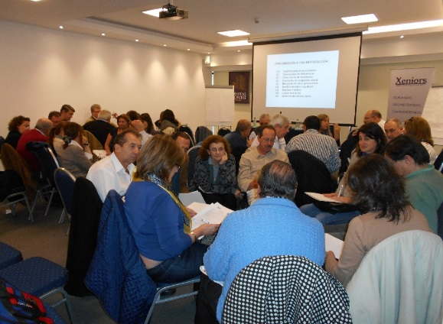
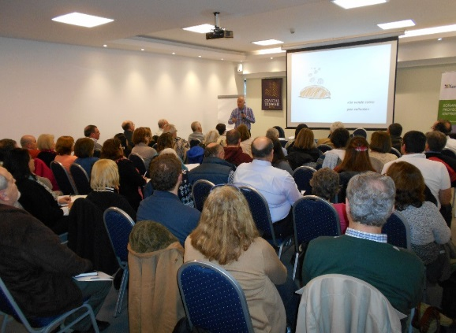
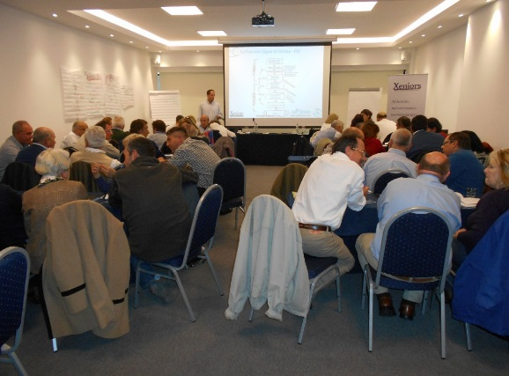
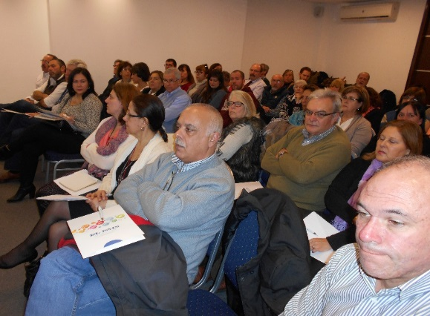
WORKSHOPS AT XENIORS EMPRENDE
Innovation Techniques
Strategies for entrepreneural success
Business Model
Marketing & Sales
Financial Planning
Technology Tools: positioning your business in the web
eCommerce
Digital Marketing

Slide 12
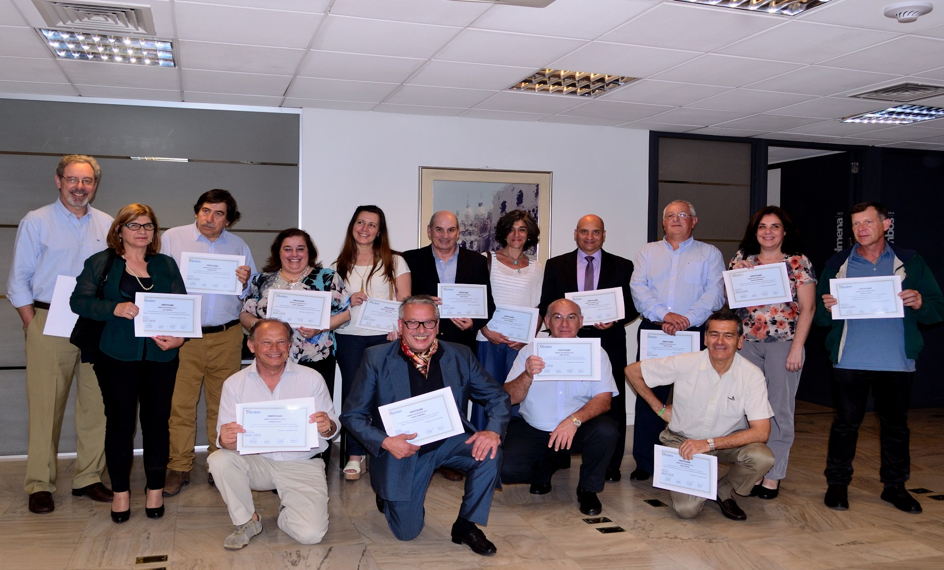
COMPETITION “SENIORS WITH INITIATIVE” - 2015
Jury: Gabriel Rozman, Maria Julia Pou, Alberto Brause, Nelly Morganti,
Ricardo Alarcón, Andrés Pasquet y Martín Sánchez Bazán
More than 40 initiatives - 16 Senior Entrepreneurs selected

Slide 13
XENIORS JOBS – Labor Insertion 50+
Visibility and Public Agenda access (removal of age limits to employment; reconciling work-retirement; right to life employment)
Social Awareness about exclusion among the 50+ (invisible & excluded)
Trainings through workshops and seminars to support job search
Social Network through XENIORS Jobs Group (Linkedin)
Company Awareness on job opportunities for over 50s and/or new roles (consulting, etc)

Slide 14
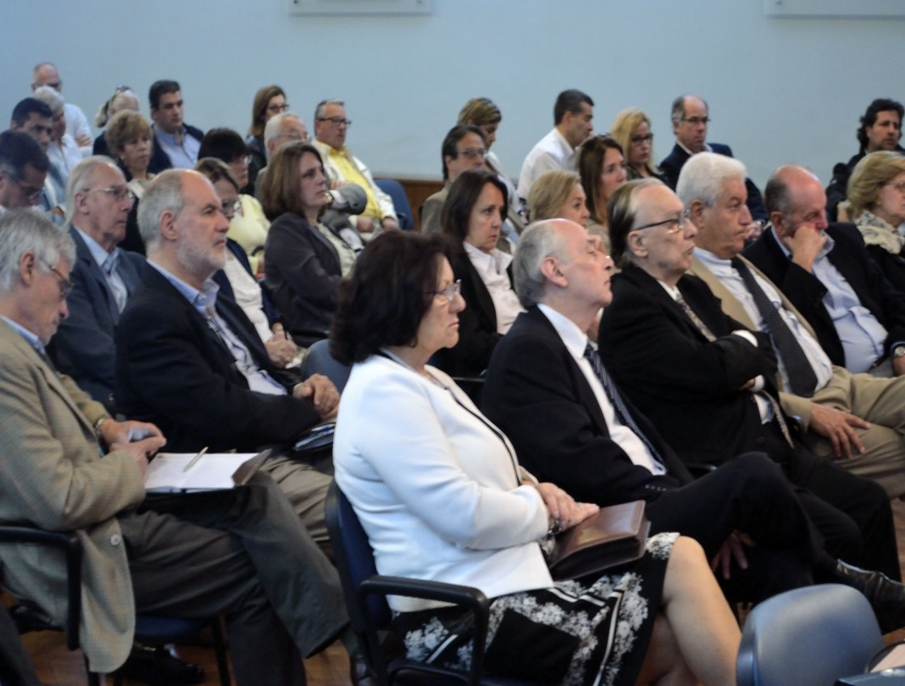
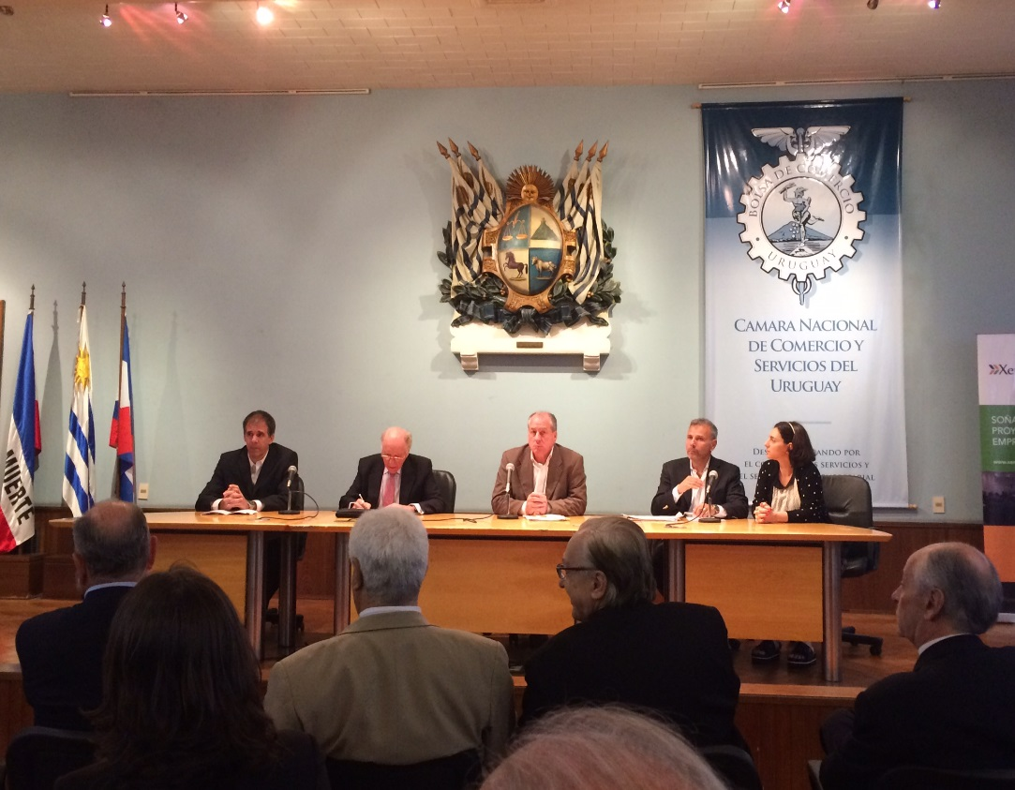
XENIORS Jobs PROGRAM - Labor Insertion 50+
Event, Labor Inclusion. It is worth the experience
Ernesto Murro (Minister, Ministry of Labor and Social Security)
Jorge Cappellini (President, DIAGONAL - Argentina)
Brenda Pruczanski (Executive Director, DIAGONAL – Argentina)
Federico Muttoni (Director, ADVICE)
Gabriel Rozman (President, XENIORS)

Slide 15
INFO XENIORS
Breaking the Digital Divide
Understanding how technology can help projects
Basic and Intermediate courses in Internet; Social Networks; Blogging; Tablet; Smartphone, etc.
Technology tools for entrepreneurs:
Electronic Commerce
Digital Marketing

Slide 16
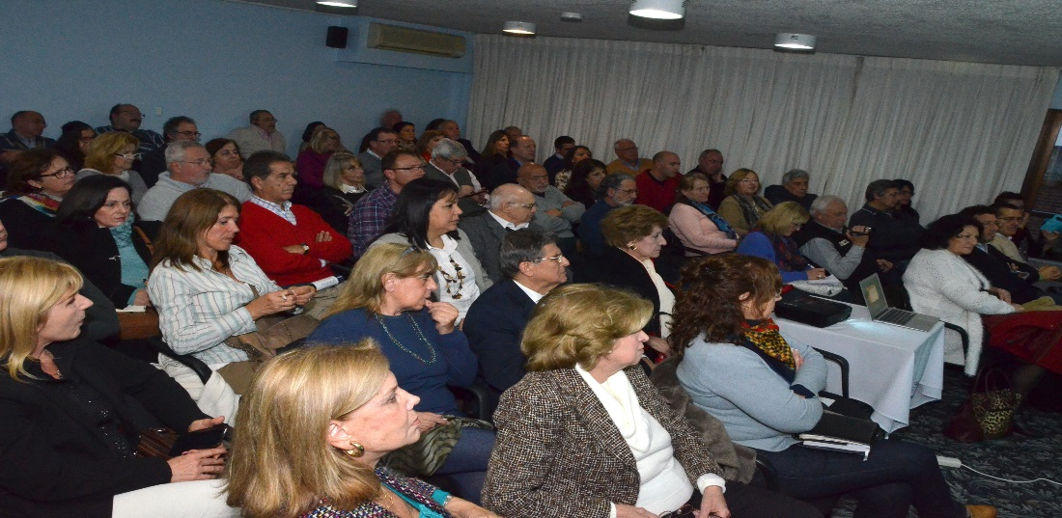
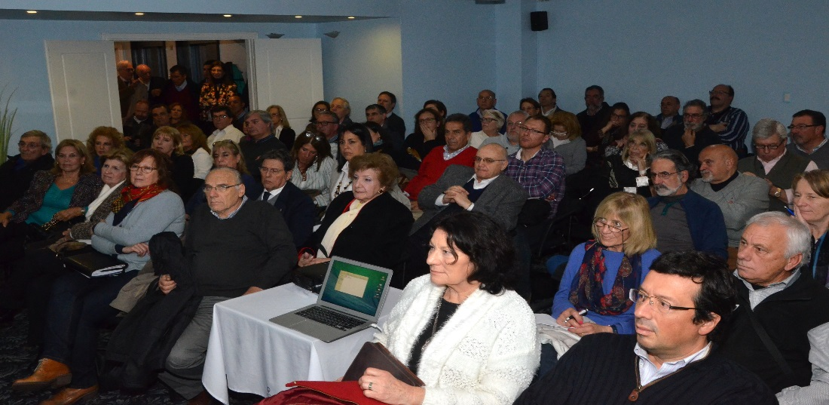
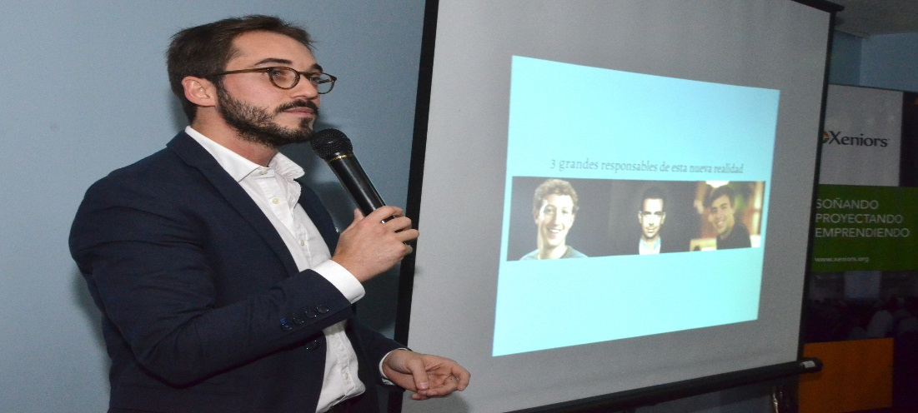
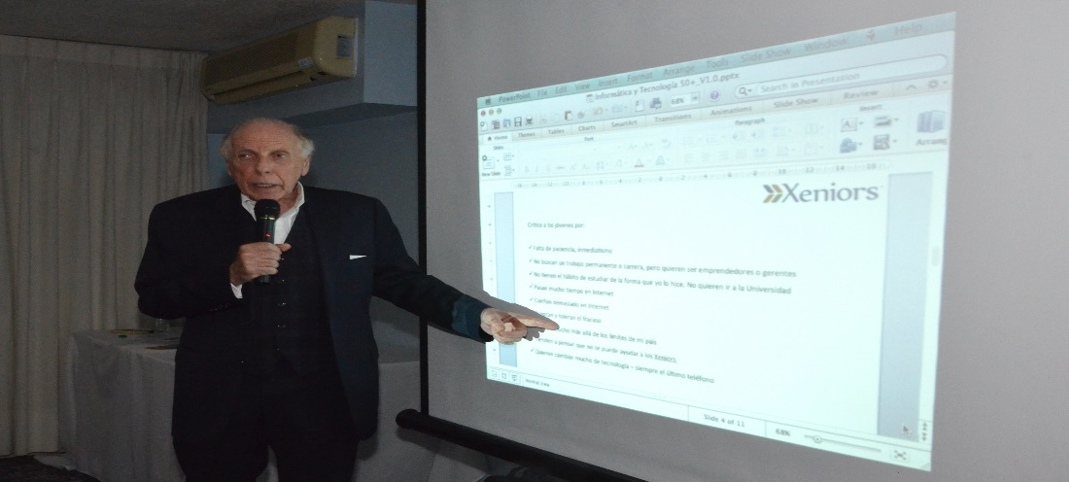
INFO XENIORS PROGRAM Computer Science and Technology 50+
Conference, New Technologies in the XXI Century:
Challenges and opportunities for people 50+
Gabriel Rozman – Pablo Buela

Slide 17
BUSINESS ORGANIZATIONS CREATED AND SUPPORTED SINCE 2012
Pilot Flight school, basic and advanced training for national and foreign pilots
“El Descanso”. Agri-tourism entrepreneurship (Maldonado)
“Caprino Alto”. Production of goat products: goat milk, cheese, etc
Mental Gym. Exercises for all ages and trainers education
Computer Science Education Institute for Adults and people with disabilities
“Ecobus”. Ecological bus for passengers (Florida)
“Goldencars”. Tourism and events with cars of the early Twentieth Century
“Centro de Golf Bajo Techo”. Golf simulator training
“Clínica Masters”. Care & Treatment on sexual dysfunction
Stimulation Services for disabled adults. Focused on people with Dementia and Alzheimer
“Oroverdeorgánico”. Frozen organic products
“Nuevo Ambiente”. Organic Products (Colonia)
Neighbourhood Magazine. Communication Media for companies
Virtual Closing Sale. Virtual platform commercialization (Durazno)
Virtual Assistant. Secretarial services through the web

Slide 18
CANDIDATES DATA
DESCRIPTION | FIGURES
Database | 3.000
Workshop atendees | 1.200
Nominated & Assessed | 170
Selected | 54
Operating | 32
Left after 2 years | 2
Giving support | 16

Slide 19
People who have worked a lifetime, might have dreams that they couldn’t achieve. We are still active and we have the essential: experience and confidence in ourselves.

