Slide 1
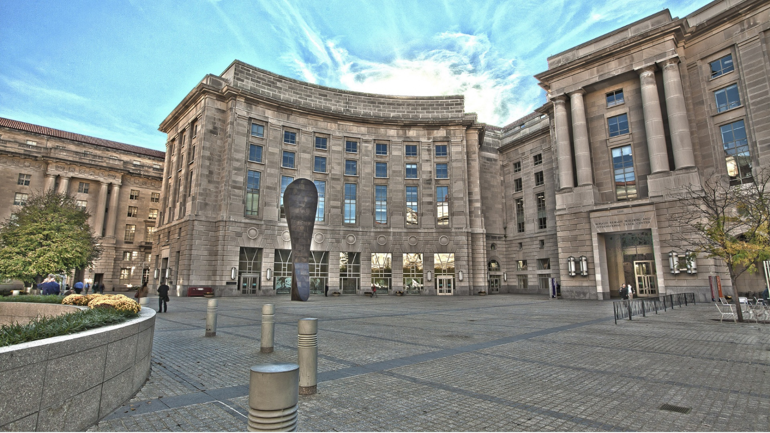
Yuri Shafranik
Версия 6.0
US-Russia Relations: from confrontation to compelled co-operation
Existential Incompatibility ?
Do we need each other in the global world ? Confrontation or compelled co-operation ?

Slide 2
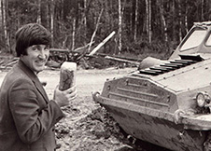
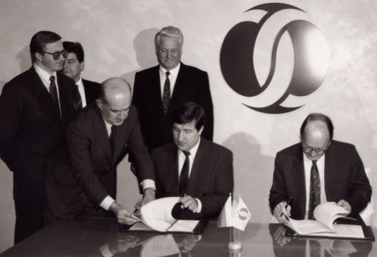
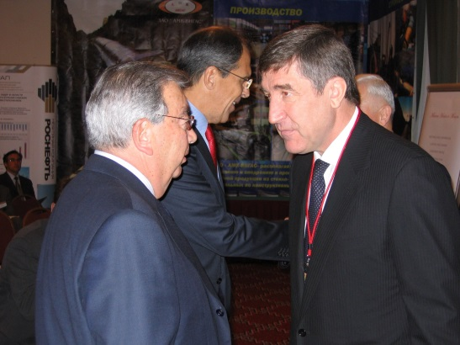
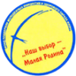
About the speaker
President of the Fund “World Politics and Resources”
President of the Institute for Russian Energy Strategy
Special Advisor to Foreign Affairs Ministry on foreign energy strategy
Former Minister Fuel and Energy of the Russian Federation
Editorial Board member of the “International Life” magazine published by the Ministry of Foreign Affairs of Russia
First post-Soviet Governor of the largest hydrocarbon producing region in Russia – Tyumen Oblast
43 years in the oil, gas and energy sector of the USSR and Russia
26 years of political and public high level activities
20 years of investments in international projects
Founder and head of a number of public establishments and professional societies for Russian energy sector
Member of several centers for political science and international politics in the Russian Federation

Slide 3
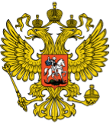
Systemic causes of the conflict
RF points:
Russia does not consider itself the loser in the the Cold War:
USSR internal forces caused the disintegration of the country
US took advantage of the weakness of the state and supported disintegration-oriented nationalistic elites in the Soviet republics
US support of Perestroyka was aimed at undermining military capabilities of Russia
US continues actions to undertake to weaken international status of the RF (“regional state with authority within the national borders”)
Status of a junior partner of US can not be supported internally
US makes efforts to interfere in the internal affairs and foreign policy of Russia
US is projecting its norms and values directly on the Russian society neglecting its long history and traditional national identity
US points:
US is the winner in the Cold War – the prevailing thesis, which assumes:
Regarding Russia as a “defeated enemy”
Behaving as the supreme military and political mentor
Military and political agenda towards Russia requires complete neutralization of the Russian military capabilities that balance the US nuclear
US should exert political and economic pressure on Russia in order to change the existing regime
US can violate or even withdraw from the existing treaties with Russia
US should impose sanctions on Russian elites and persecute Russian citizens abroad if need be

Slide 4
USA – the “winner” theses
Global power with prevailing agenda in military, political and economic affairs world wide due to the exclusive values of the American national model and the unipolar world system
“Leading from the back seat” by authorizing military activity of NATO allies under US control
Ultimate responsibility to protect “Greater Europe” through the control of NATO
Cultivation of disagreements between Western Europe and Russia to prevent political and economic rapprochement
Unilateral withdrawal from the Anti-Ballistic Missile Treaty (ABM Treaty) and construction of the Global anti-missile defence system close to Russian borders
Measures to liquidate nuclear parity between US and Russia
Demand for continuous reduction of the conventional armament by Russia along
Blocking sovereign Russian foreign policy
Pressuring CIS members interested in Collective Security Treaty Organization (CSTO) and Eurasian Economic Community (EAEC or EurAsEC) led by Russian Federation
Undermining Russian energy policy in Europe and Asia-Pacific

Slide 5
The policy of the “winner”
Actions by the US and NATO that violate International law concerning issues of war and peace; military operations abroad without serious and adequate justification
Presentation to global community of faked threats as a pretext for use of force to change governments and dismantle legitimate state institutions
Regarding Russia:
Making alliances with CIS countries in order to implement anti-Russian projects
Pressuring European partners on energy cooperation with Russia
Avoiding cooperation with Russia on its strategic interests in the Middle East and Asia-Pacific
Economic sanctions against Russian elite, citizens and companies and demonization of the leader
Public statements of government officials supporting regime change in Russia

Slide 6
Russian position
Russia does not contest US global leadership that falls within the International law
Russia is an equal player in the global agenda of the multipolar world, where in various spheres there are different leading countries such as USA, China, possibly India
Russia will not tolerate and will act against attempts to weaken its independent foreign policy and threats to its national security
Limitation of national interests of Russia can not be part of any international treaty or cooperation objectives
Primary threat to the Russian national security is identified as the purposeful weakening of Russian nuclear capabilities. Russia is ready to undertake asymmetric measures, but aims to avoid new arms race
Russian military doctrine includes among national defense measures certain preventive military actions not excluding use of its nuclear arsenal

Slide 7
Russian position (cont’d)
Russia is interested and has the right to strengthen the CIS security system
Russia is seeking a unified European security system where it can participate also through the Collective Security Treaty Organization (CSTO)
Russia’s geopolitical interest in the Middle East developments is caused by:
Continuously rising threats of terrorism in the regions of Russia and its partners in regional security cooperation
Risks to its security arising from the military conflicts and humanitarian crises
China is a strategic partner in the Far East region and in “The New Silk Road” project targeting Western European markets and Central Asian infrastructure projects
Strengthening of Russia’s presence in traditional markets and the development of co-operation with South East Asia including energy remains priority of foreign policy
New military and political alliances with states, who pursue an independent foreign policy and require improved defensive potential

Slide 8
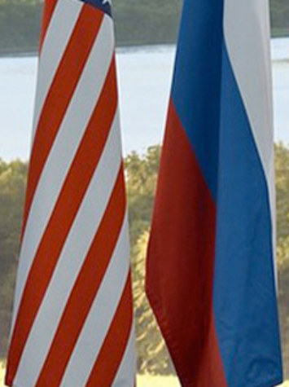
Current State of Relations
The relations between US and Russia are at the stage of imbalance and require solid grounds for laying down the basis for future co-operation on all levels
Disintegration of the USSR has not brought up a long-term stability of global affairs and permanent peace. On the contrary the world has become poorly governed, less secure and more turbulent. Russia discontinued to represent the global antagonistic Soviet ideology to the West, while the number of threats to the international security system has only increased
Russian-American mutual destruction is still an issue in the most negative scenario, which is unique in the system of the US international relations. Each party still maintain doctrine of preventive strike
For objective reasons US failed to liquidate Russian nuclear threat

Slide 9
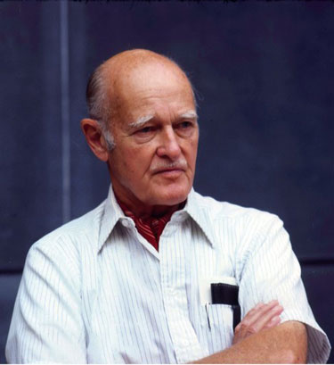
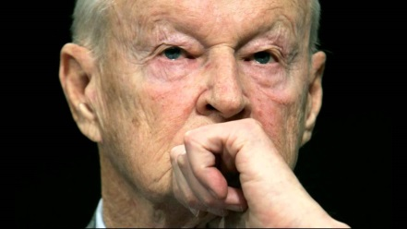
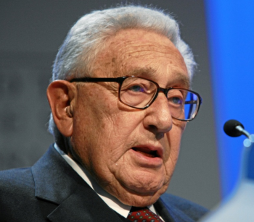
Russia should be perceived as an essential element of any new global equilibrium.
I am here to argue for the possibility of a dialogue that seeks to merge our futures rather than elaborate our conflicts. This requires respect by both sides of the vital values and interest of the other. These goals cannot be completed in what remains of the current administration. But neither should their pursuits be postponed for American domestic politics. It will only come with a willingness in both Washington and Moscow, in the White House and the Kremlin, to move beyond the grievances and sense of victimization to confront the larger challenges that face both of our countries in the years ahead.
Henry A. Kissinger
“The extraordinary violence that was perpetrated against Poland did affect my perception of the world, and made me much more sensitive to the fact that a great deal of world politics is a fundamental struggle. But it is also a struggle that has to be waged intelligently.”
February 2016. http://nationalinterest.org/feature/kissingers-vision-us-russia-relations-15111
“…use of force is unreliable and unpredictable in its consequences.”
“I think it is the beginning of a new cold war. I think the Russians will gradually react quite adversely and it will affect their policies. I think it is a tragic mistake. There was no reason for this whatsoever. No one was threatening anybody else. This expansion would make the Founding Fathers of this country turn over in their graves. We have signed up to protect a whole series of countries, even though we have neither the resources nor the intention to do so in any serious way. [NATO expansion] was simply a light-hearted action by a Senate that has no real interest in foreign affairs.”
George Kennan
“We have been nationally very secure over the decades, in fact – several centuries, we are unaccustomed to real dangers, and I think we have a tendency of dramatically overreact to them.”
Zbigniew Brzezinski
December 2010. Al Jazeera interview. Video source: https://www.youtube.com/watch?v=03ApSE6mgHE
May 1998. Thomas L. Friedman: “Foreign Affairs; Now a Word From X” http://www.nytimes.com/1998/05/02/opinion/foreign-affairs-now-a-word-from-x.html

Slide 10
Asymmetry of relations
The US has the acquired status of the global leader
Dynamic US hegemony in 1990-s was accompanied by:
Examples of political dictate instead of agreements
Primacy of the American laws over international regulation
“Movement without resistance” from 1991 to 2001 caused some parallel processes:
Political weakening of independent states of the unified Europe
Formation on new consolidating policy in Russia
Accumulation of the economic puissance by China
Strengthening or creation of new destructive forces and rogue elements, who act violently and without control from the world civilized community (terrorism)
Since 2002 the world goes through major reorganization of the global political system with gradual restoration of multipolarity
Long term asymmetry in relationship between the US and Russia created conditions for Georgian military aggression (in 2008), which Russia had to react to with adequate steps
In 2010 Russia adopted the principle of preventive use of weapons for protection against threats to national security

Slide 11
New Russian elite
Modern elite of Russia, generally, is free from Soviet ideology-exporting complex , much more pragmatic and realistic, and the most “deal-credible” compared to the past
Establishment of social institutes is not complete (ownership rights, social contract, government regulation and guarantees), that creates an impression of a vulnerability of the Russian elite, but also makes it to act in a more brutal in defending the national interests
In the last 15 years the elite of Russia split-up in two groups:
Economically independent but politically non-influential groups and
A consolidated political system acting as a unified political, military and economic block with one leader
The consolidation of the political elite is practically completed and the support of the population is guaranteed for the medium term
Scenarios of “colored revolutions” or of a military coup (similar to Turkish coup) are unrealizable because of long term social and political conditions

Slide 12
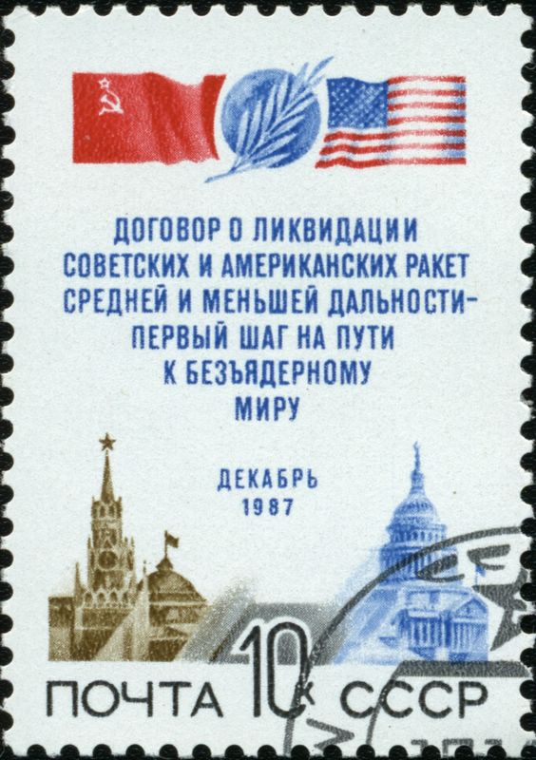
Degradation of treaties
The Intermediate-Range Nuclear Forces Treaty (INF Treaty), 1987
The Treaty on Conventional Armed Forces in Europe (CFE), 1990
Reduction and Limitation of Strategic Offensive Arms (START), 1991
The Missile Technology Control Regime (MTCR), Russia joined in 1995
Convention on Prohibition of Chemical Weapons (CPCW), 1997
The Anti-Ballistic Missile Treaty (ABM Treaty), 1972
International Code of Conduct against Ballistic Missile Proliferation (HCOC), 2002

Slide 13
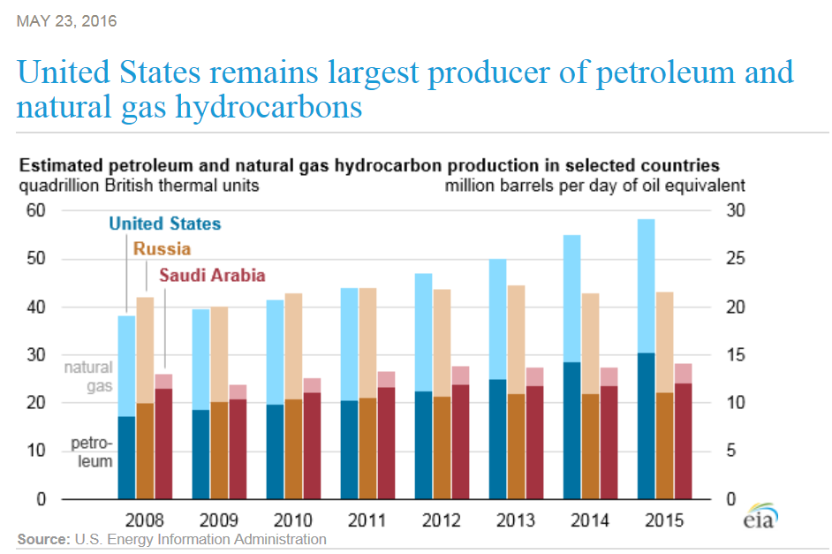
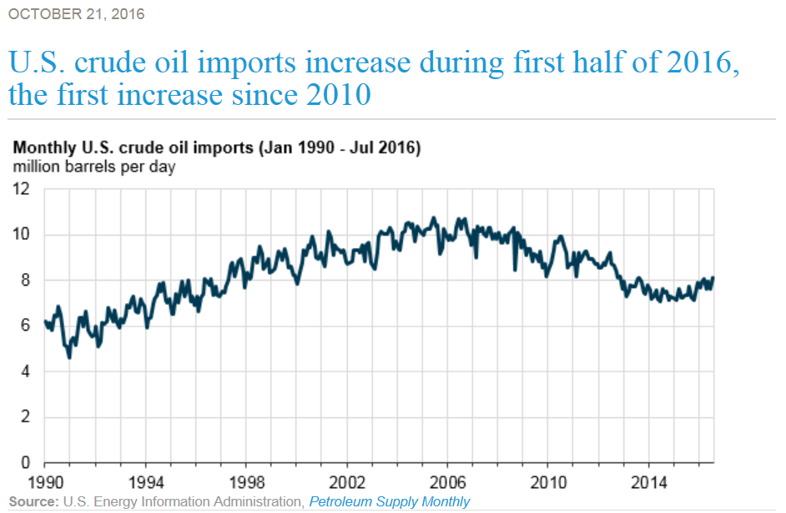
Market maker of global oil ?
USA demonstrated the record growth of production in 2013 – 2015
Oil import volumes dropped to 7 Mbd (some increase in mid 2016)
US renewable energy sources here and there proved competitiveness with conventional hydrocarbon ones
«Shale spurt» in USA drastically influenced industry both in the US and worldwide
Does this make United States a sole market maker of the global energy markets?
Nevertheless the technological and economic success has resulted in changes of US foreign policy and relations with traditional partners

Slide 14
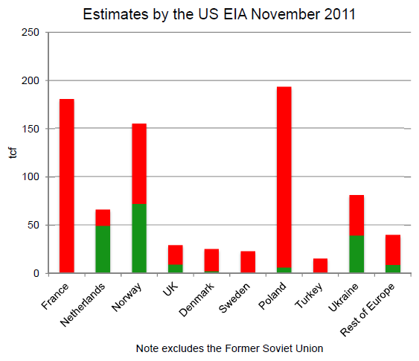
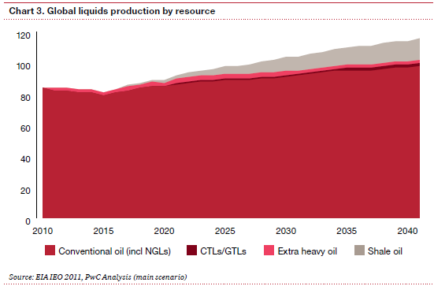
Technological revolution ?
Qualitative technological spurt:
New exploration and production technologies for unconventional oil and gas
Lowering costs and government support of production of renewable energy
Broadening of production and transport geography of LNG
Growth of electric car manufacturing
Improvement of energy saving technology
Japan intentions to exploit hydrates
Quantitative growth in USA:
In production of shale oil and gas
In reducing costs of renewable energy
Shale oil and gas resources in Europe (ex. UK) and China are not so rapidly developed
Shale oil will constitute 10-15% of the world liquid hydrocarbon production by 2040
Russia accumulates significant unconventional resources also in East Siberian province
China has developed unconventional technologies but yet lacks professional expertise

Slide 15
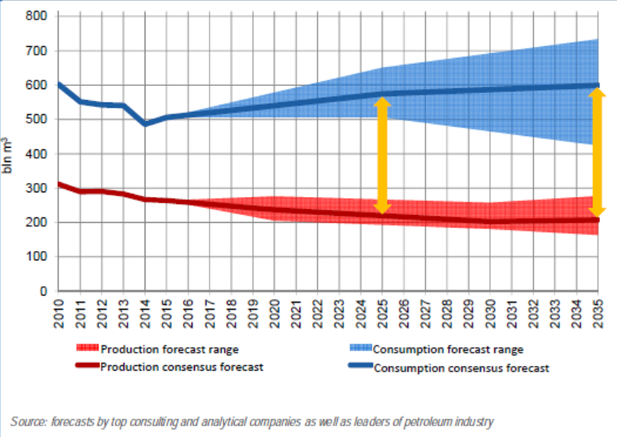
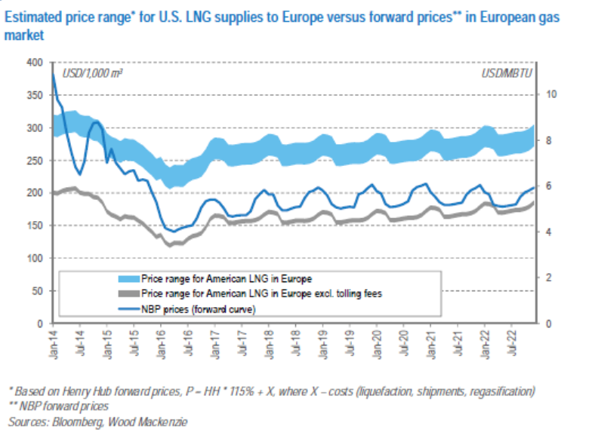
European gas market player ?
The consensus forecast of total natural gas requirement for Europe by 2035 is 400 bln. m3 per year (60% up from the current deficit)
Current Henry Hub gas price is comparable with current price in European market, but LNG delivery will cost around $2,5 for MBtu (approx. $12 / boe)
The cost structure of US gas supplies will be comparable with Qatar LNG, not Russian pipeline gas
To reduce strategic share of the Russian gas in Europe by US gas supplies it will require to strengthen political ties between USA and Europe through the transatlantic integration
Discrepancies between political priorities and the energy-economic rational cause dissociative effects for EU

Slide 16
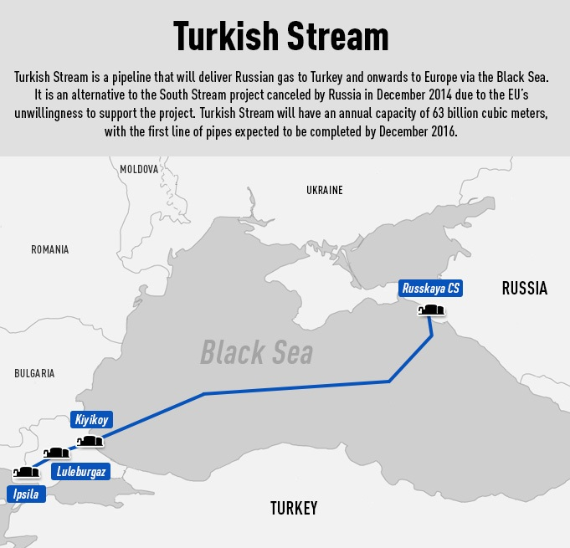
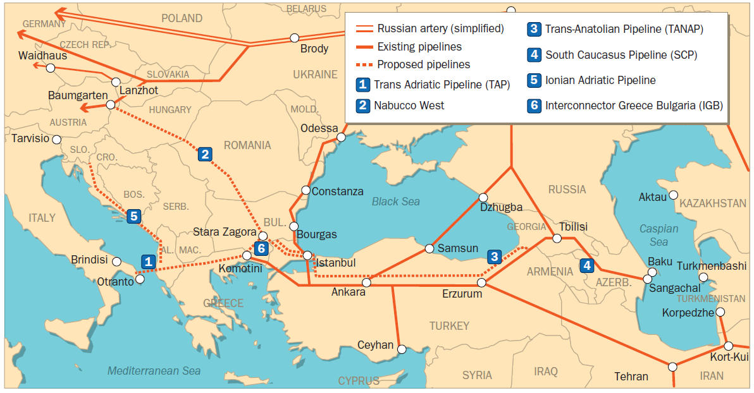
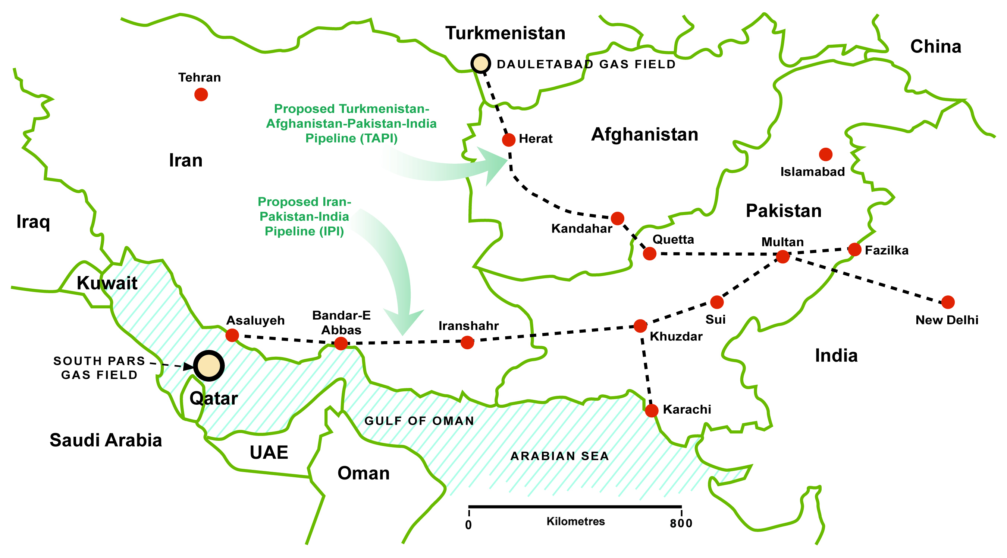
Iranian gas potential
For 15 years Europe and US are actively pursuing the so called “Southern gas corridor”
Cost-wise Iranian gas is the most attractive source of new gas supplies to Europe
Development of infrastructure is held back by political and now military factors
US political landscape in the Middle East has gradually become much more complicated and requires new policy
National interests of Russia are directly influenced by the events in the Middle East, which includes the energy policy and strategic matters

Slide 17
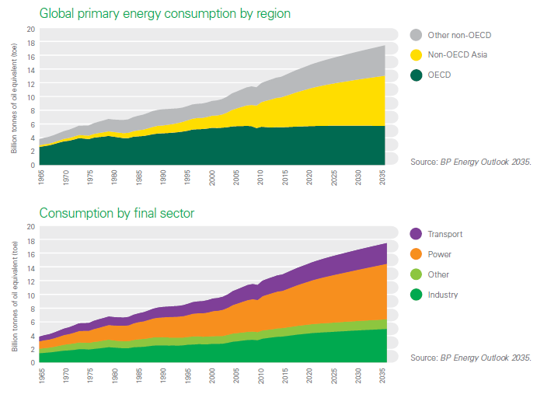
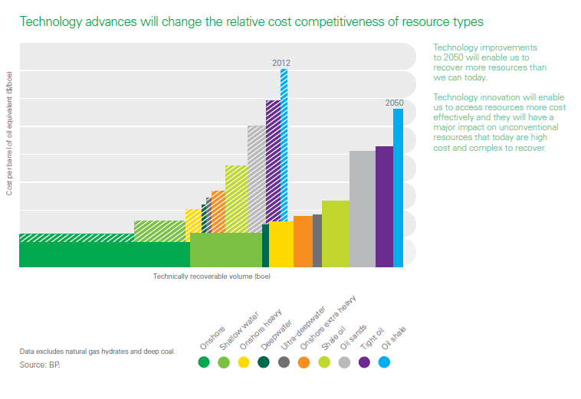
Energy consumption vs. Cost structure
Long-term global demand for energy will grow steadily
Recent technology development demonstrates that accessible sources of energy are much larger that originally estimated
The key question – will the cost reduction be sufficient and fast enough to access new energy without high impact on prices?

Slide 18
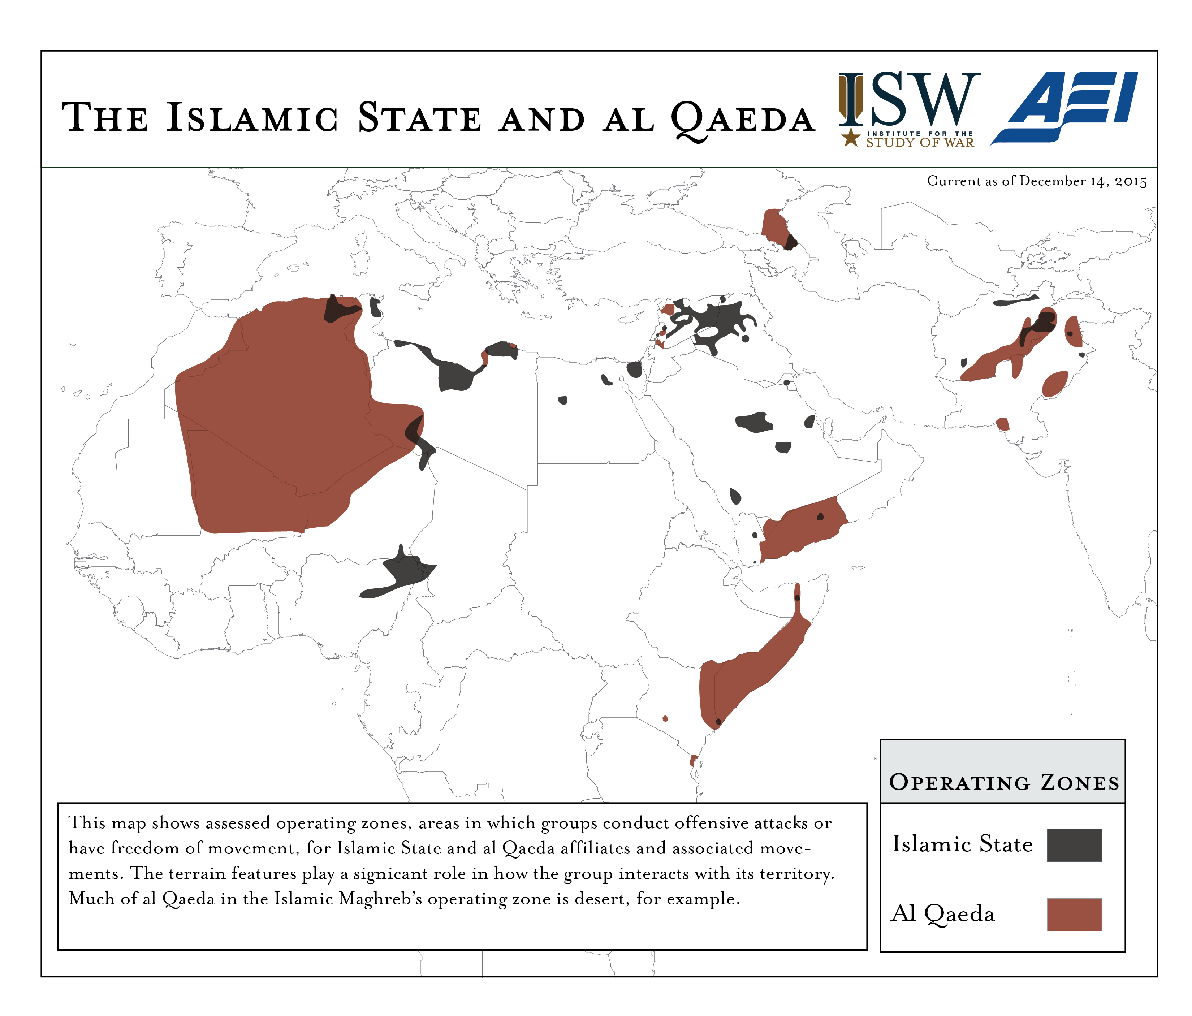
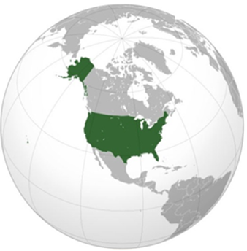
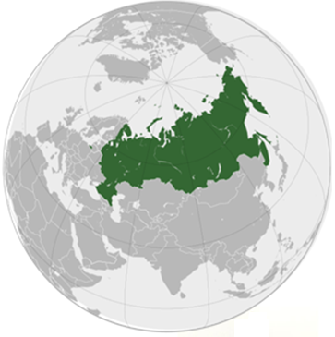
Basis for compelled co-operation
Existential incompatibility of USA and Russia does not exist
Nuclear arms parity is the corner stone of global security for nearly 70 years and shall be maintained
Cold War makes no sense in the XXI century, and to overcome its legacy is common responsibility USA and Russia
USA are not interested in expanding of the list of existing external threats
In the last 15 years Russia involuntarily was involved in a number of severe world issues and is much more useful as a partner to US, rather than a rival
US engagement in the European and Middle East energy development will force them to take into account the interests of Russia and seek compromises
The size of RF territory defines its role in the global ecology and climate issues

Slide 19
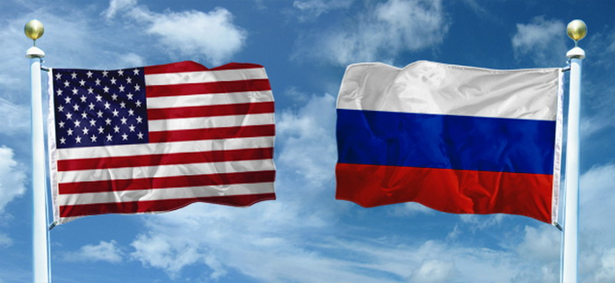
Possible architecture of global co-operation
In military sphere: prevention of use of nuclear weapons; prevention of nuclear terrorism; nonproliferation of WMD; reduction of conventional weapons
In politics: Russia is an active participant in global agenda; US recognizes and respects Russian national interests in the CIS and in the Middle East (Iran, Iraq, Syria and Afghanistan)
In energy: several joint large projects in Russia, Europe, Middle East and Arctic
In humanitarian sphere: co-ordinated efforts to eliminate causes of poverty and population radicalization; prevention of terrorism; joint actions in fight against existing terrorist organizations and their ideologies
In ecology: an action plan to address rapid global warming and its possible consequences

